Slide 1
This work is licensed under CC BY 4.0
Medical Image Analysis ​
NBE-E4010
Koen Van Leemput
Fall 2025

Slide 2
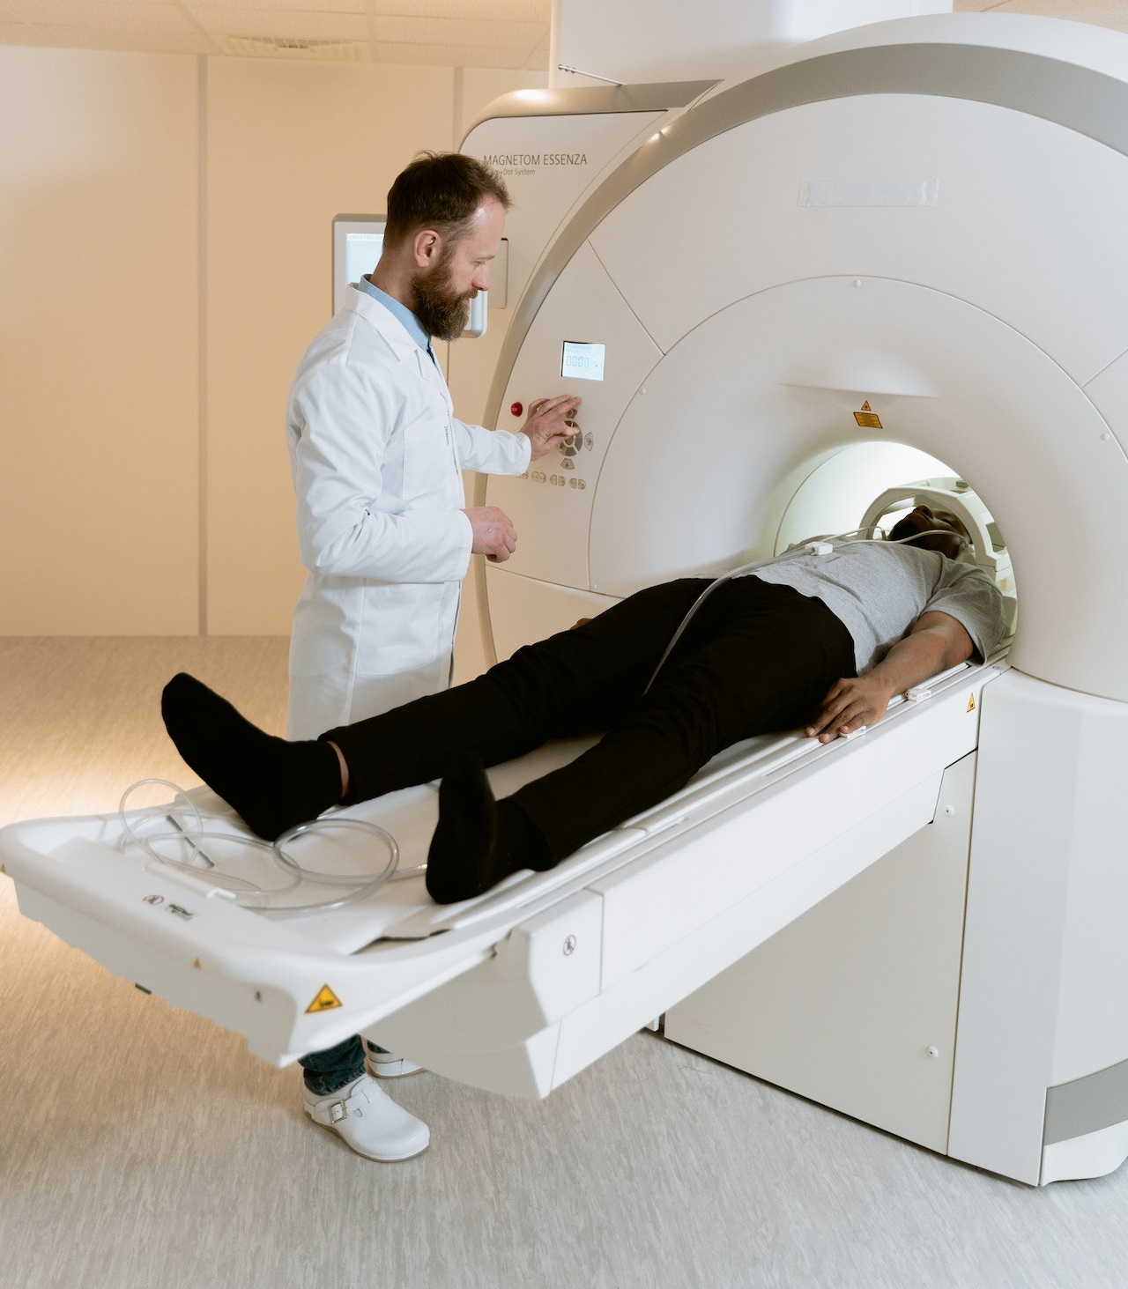
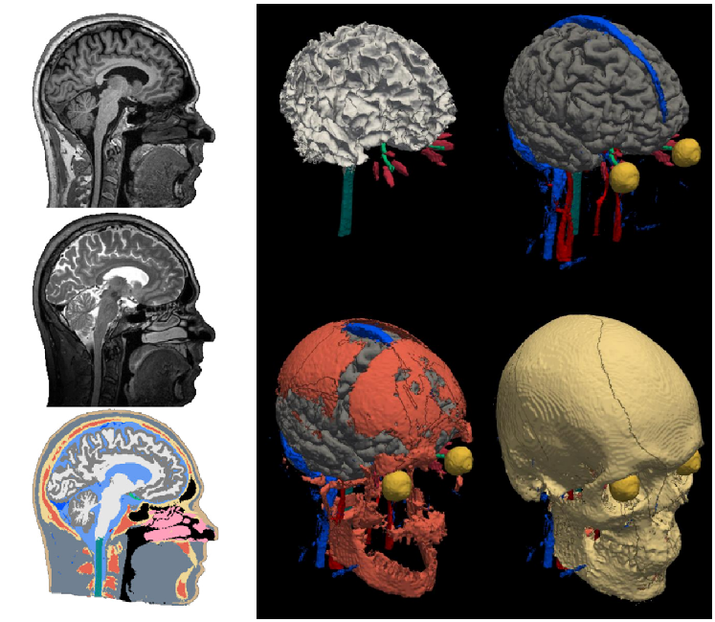
AI in medical imaging
images
scanner
- acquire images faster
- visualize more details

Slide 3
AI in medical imaging
images
scanner
- expose the “unseeable”
- measure more consistently
- analyze images faster
information

Slide 4
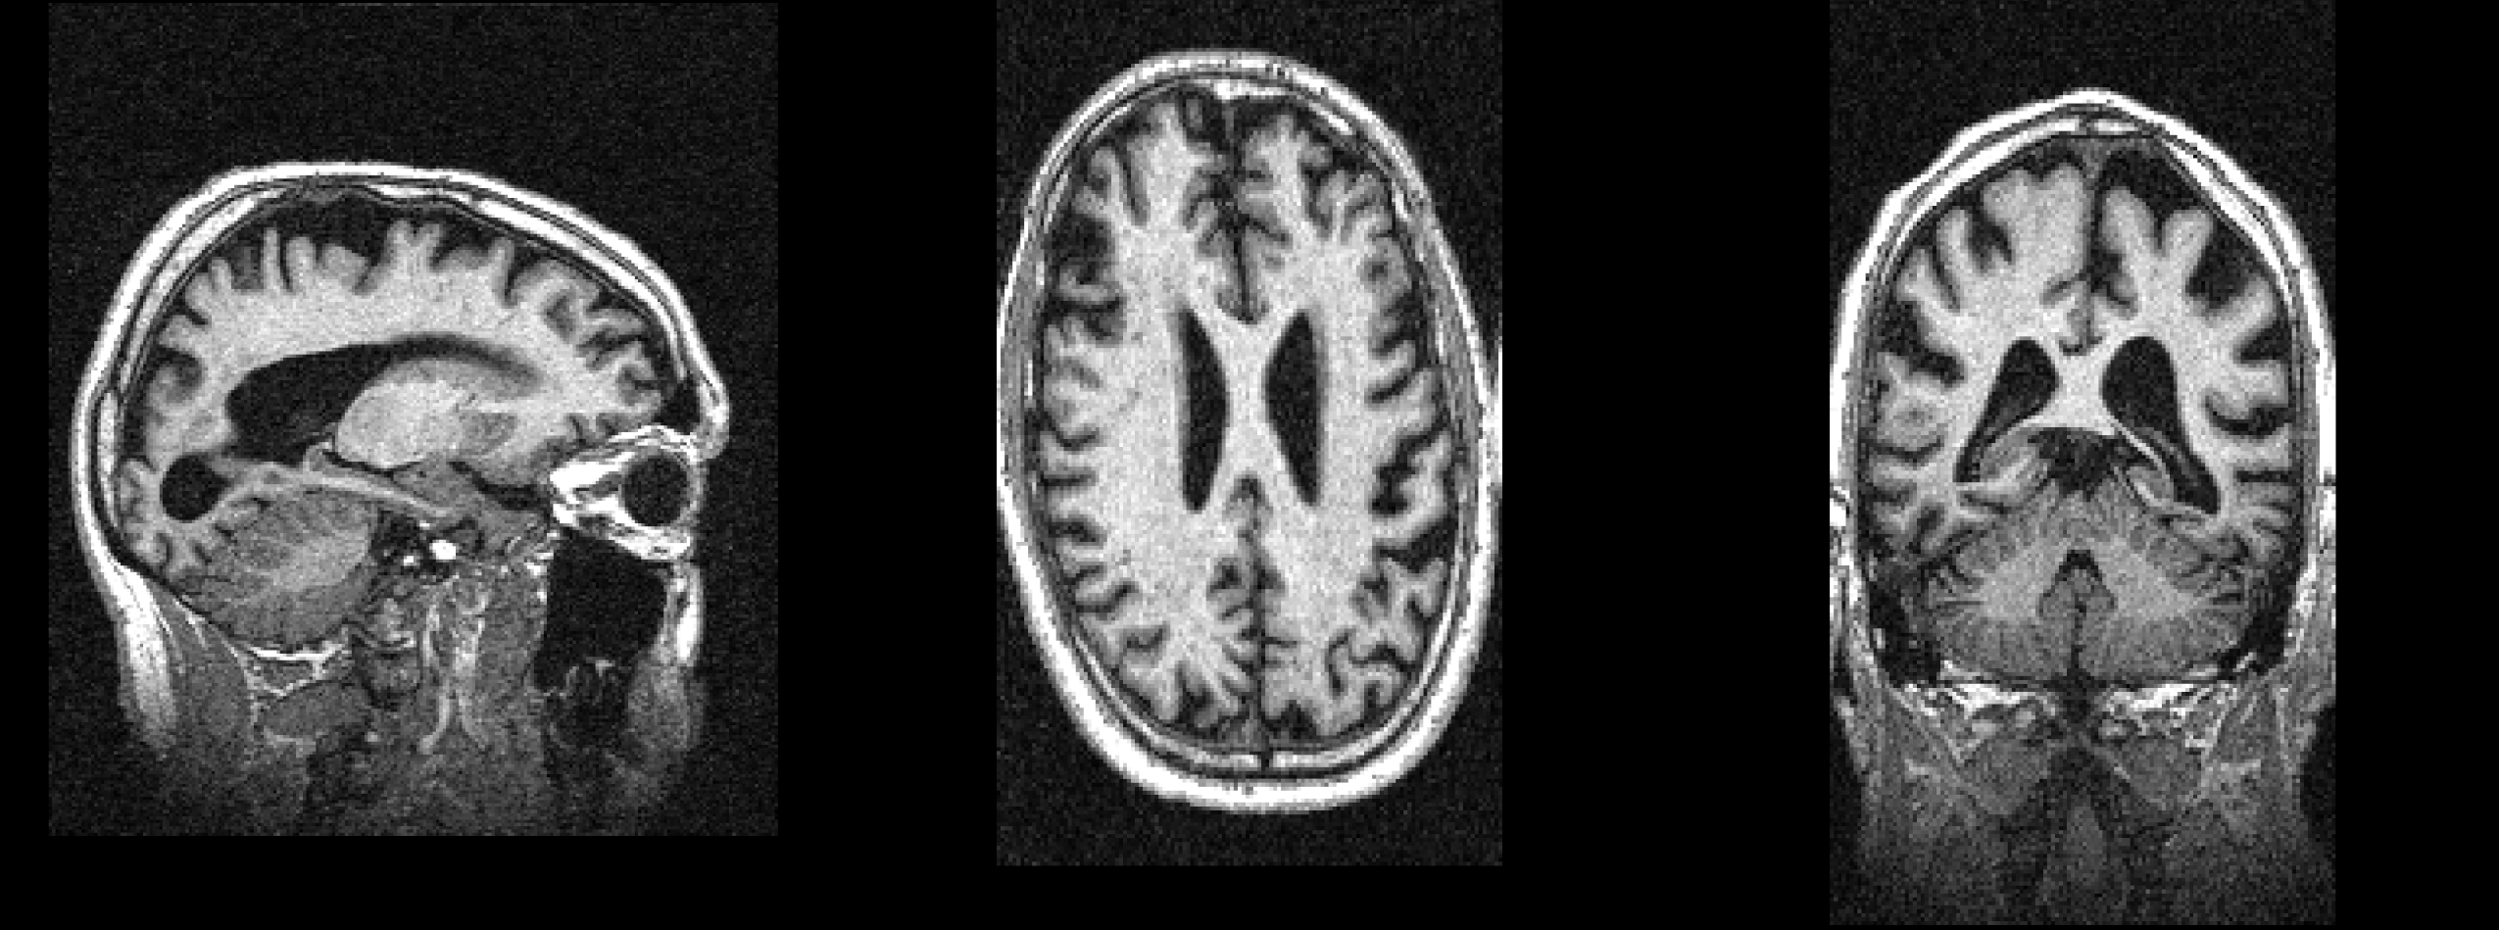
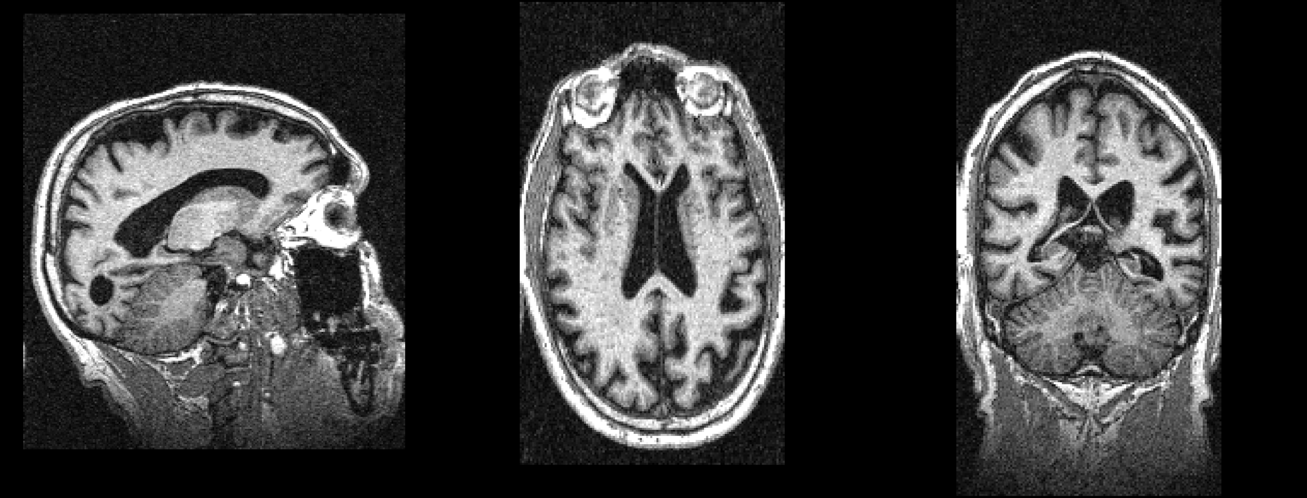
Exposing the “unseeable”
today
8 months ago

Slide 5
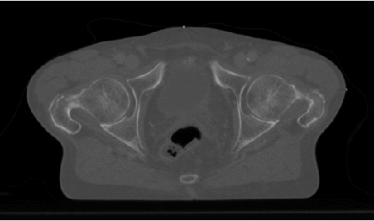
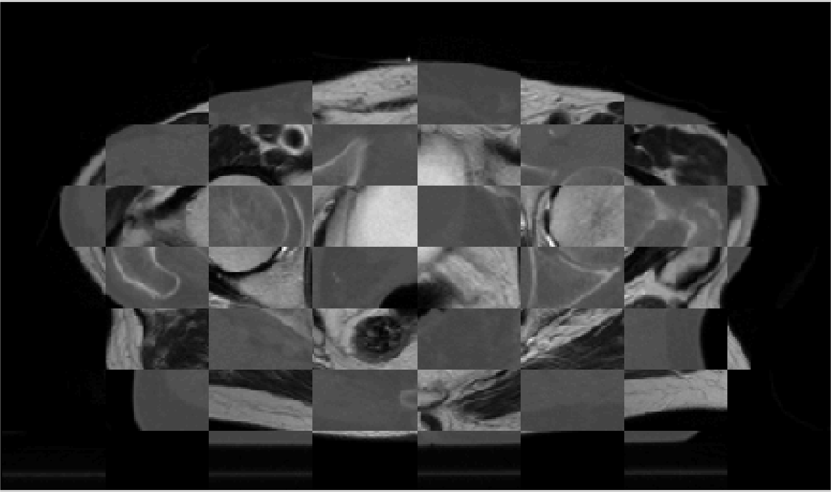
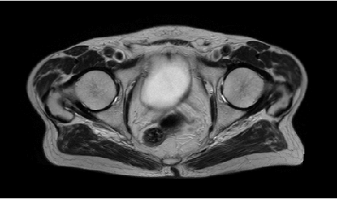
Exposing the “unseeable”
CT
today
mosaic CT/MRI
MRI
8 months ago

Slide 6
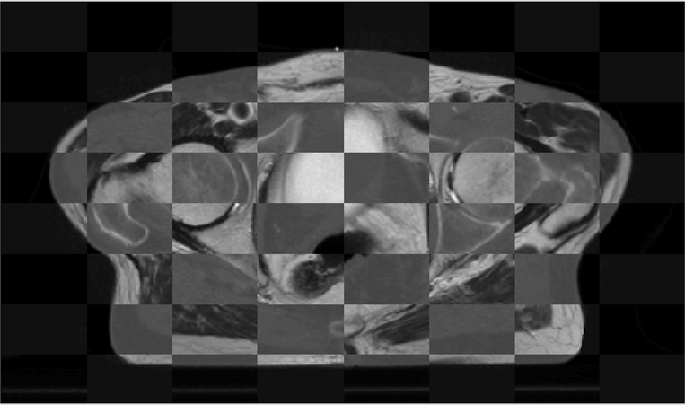
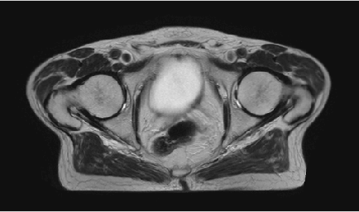
Exposing the “unseeable”
CT
today
mosaic CT/MRI
MRI
8 months ago

Slide 7
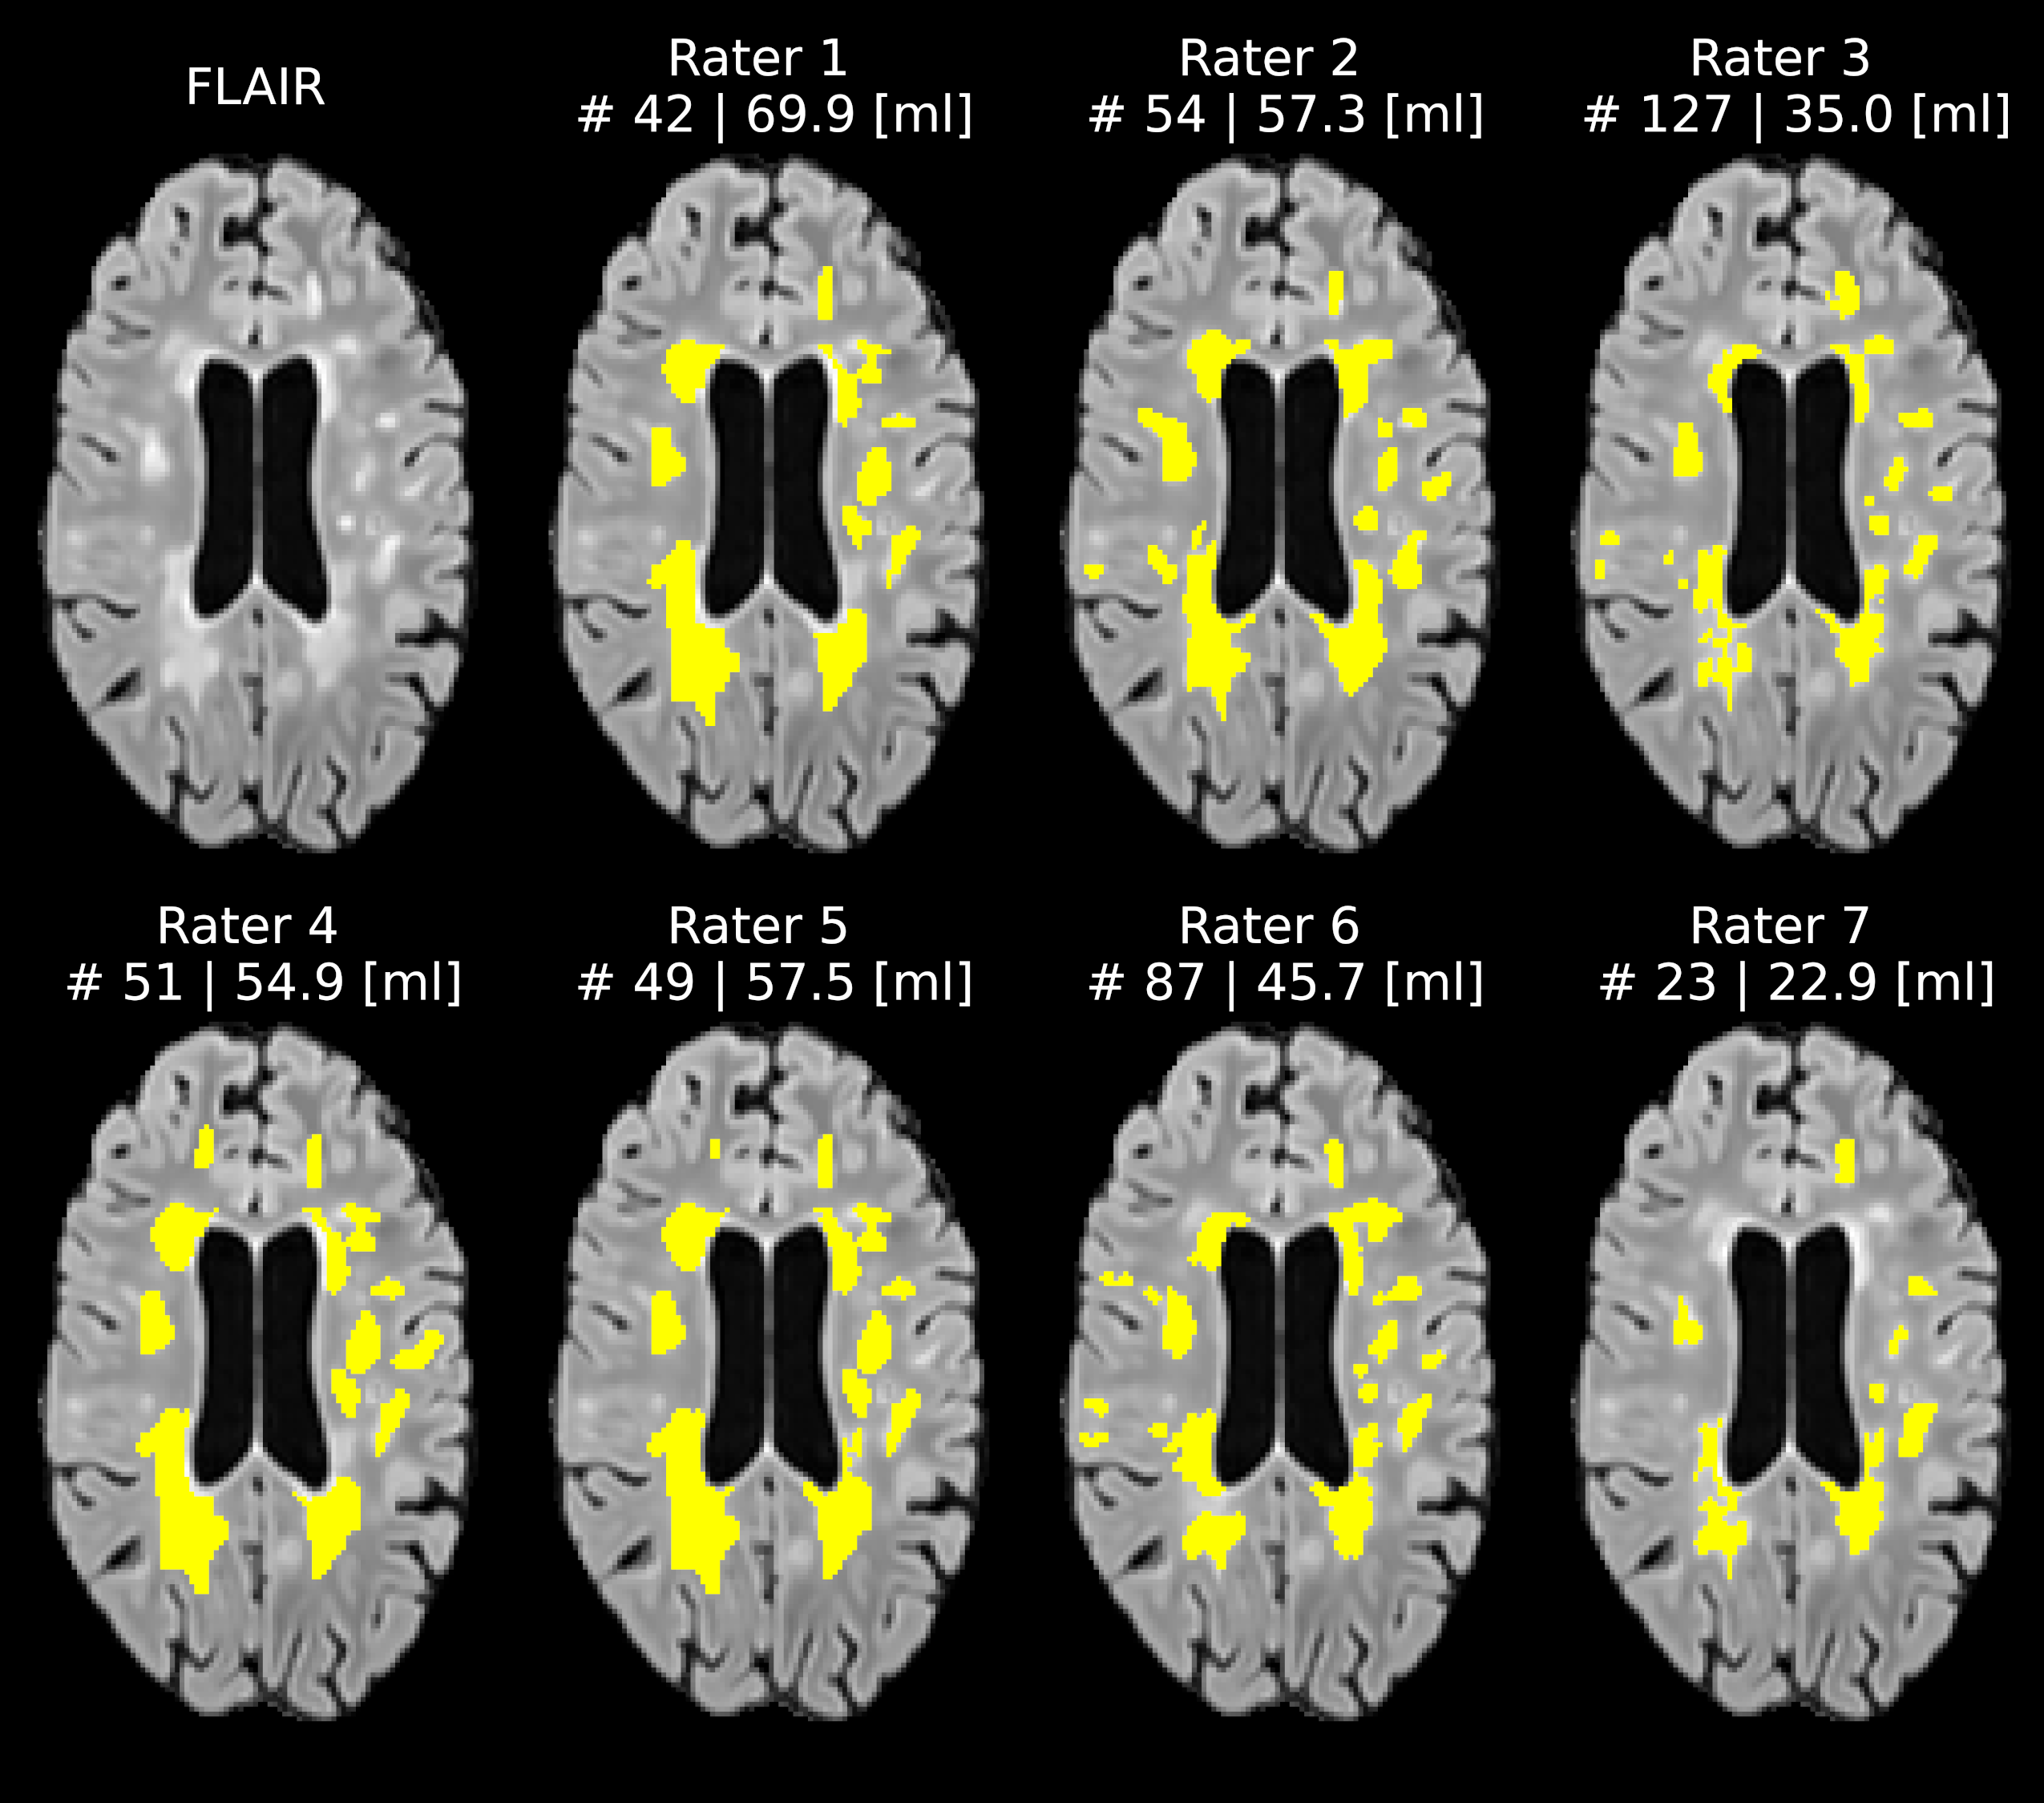
Measuring more consistently
Quantifying lesions in multiple sclerosis (MS):
- number (#)
- volume (ml)

Slide 8
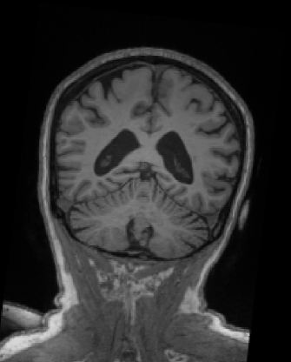
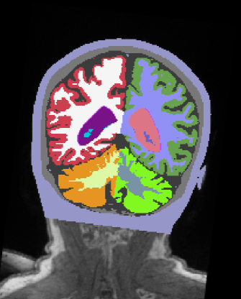
Analyzing images faster
MRI
segmentation

Slide 9
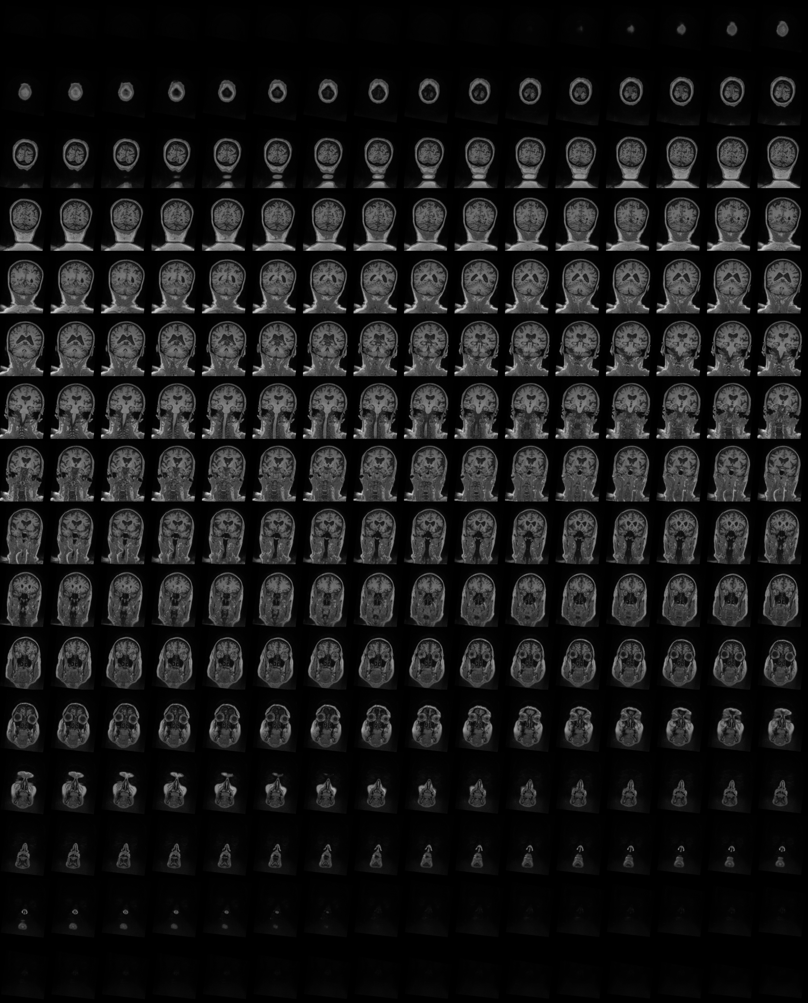
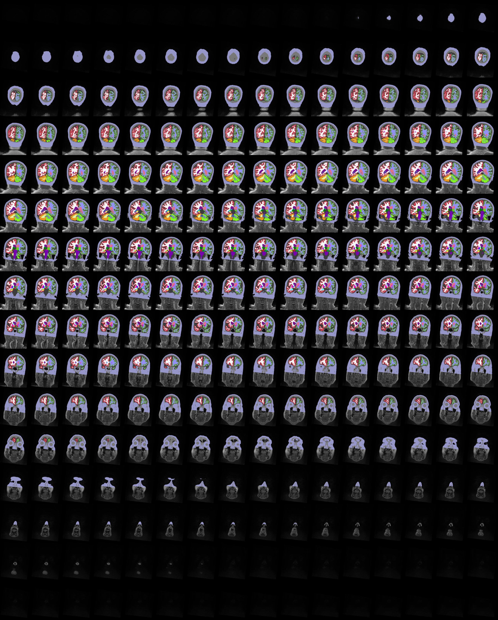
MRI
segmentation

Slide 10
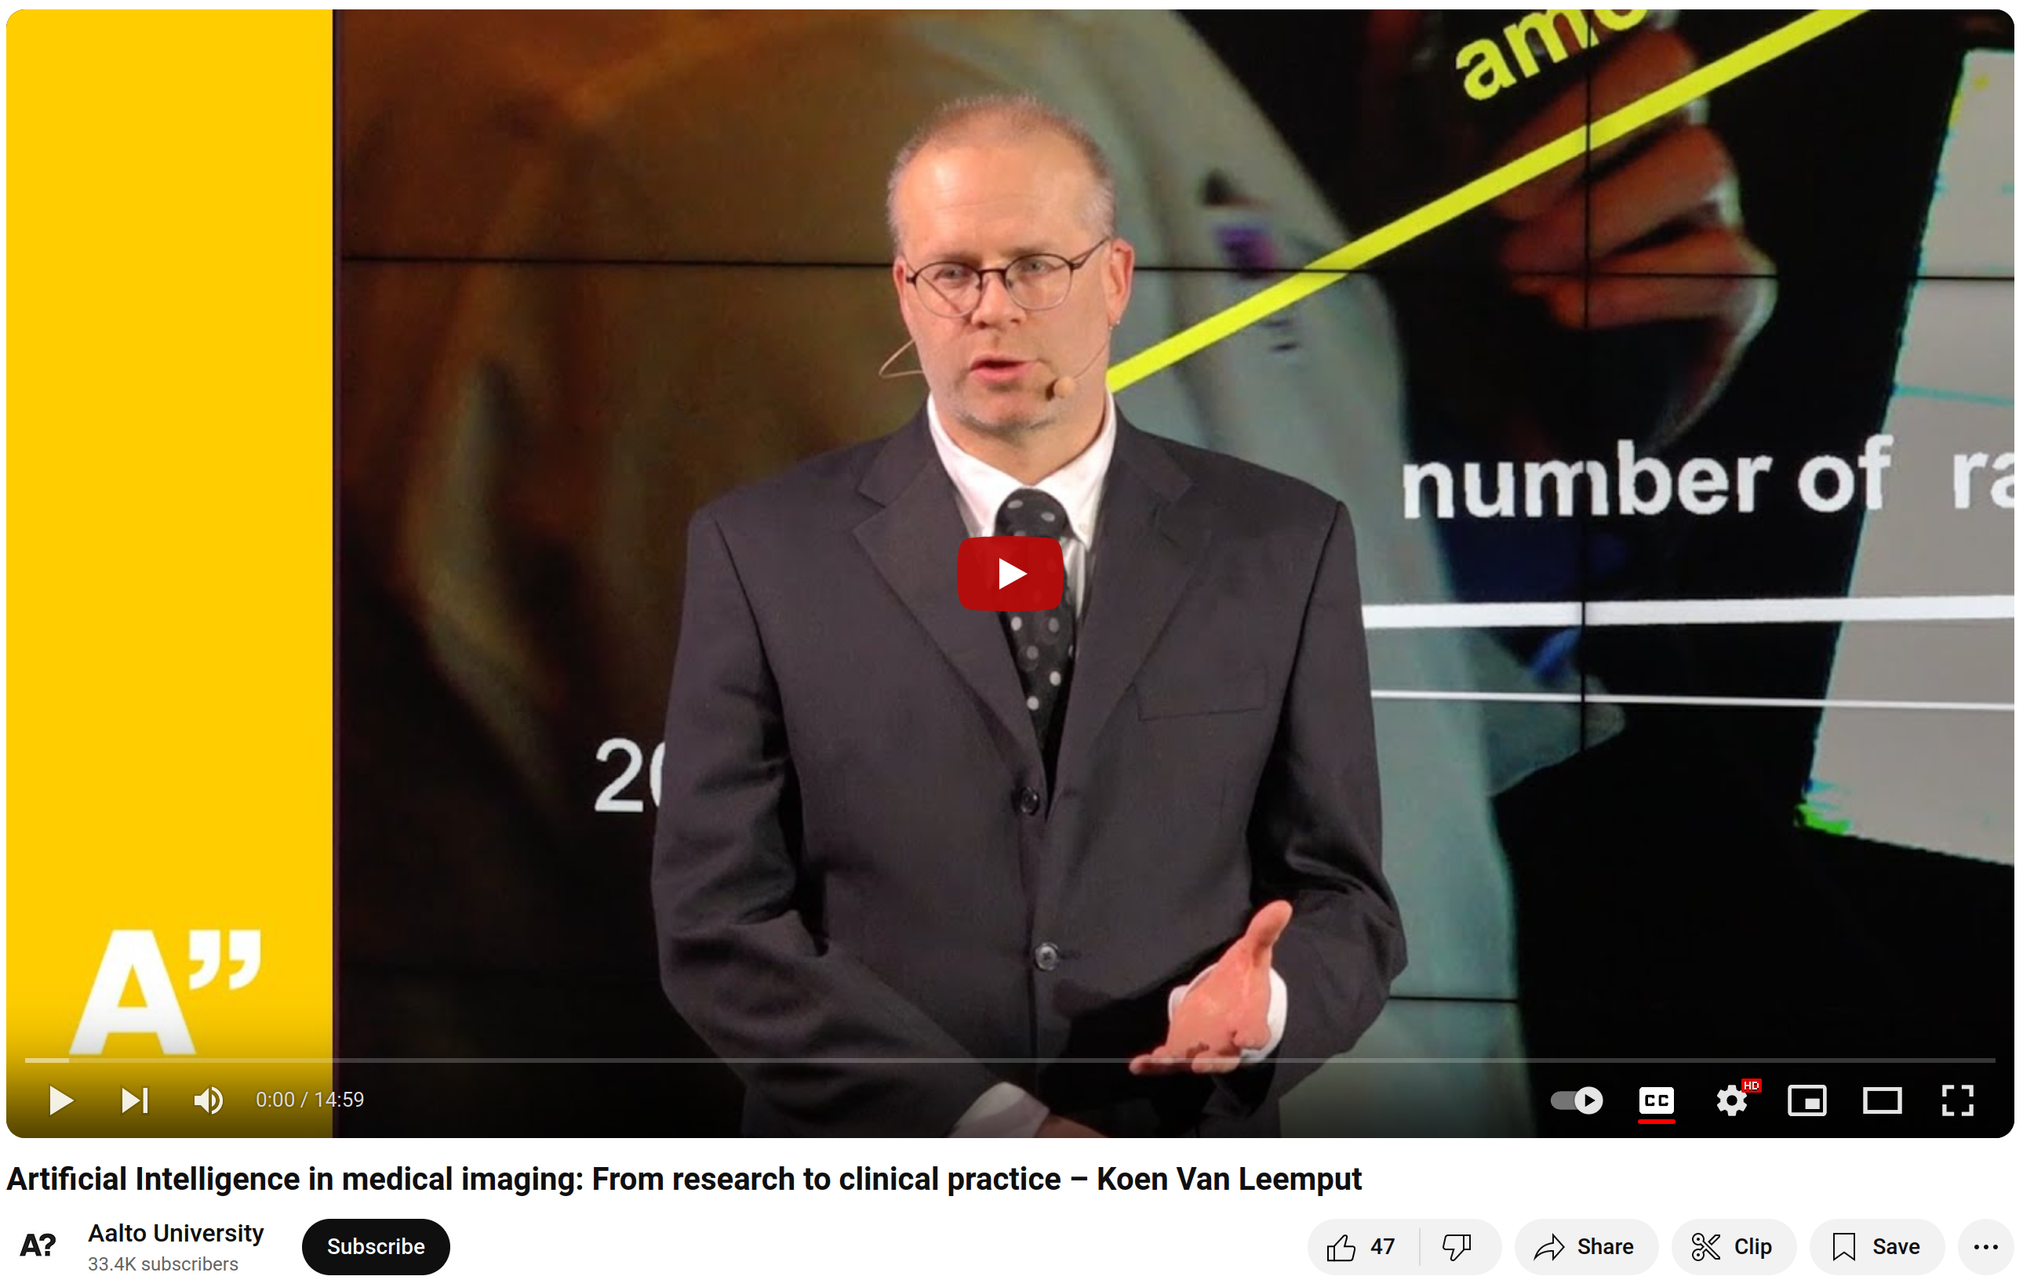
Want to know more?
https://youtu.be/iiw4j-Frljo

Slide 11
Learning objectives
After this course you should be able to:
Implement image smoothing and interpolation techniques
Use spatial coordinate systems in medical images
Perform landmark-based and intensity-based image registration
Select the most appropriate similarity measure for specific image registration problems
Implement rigid, affine and nonlinear spatial transformation models
Solve segmentation problems using generative models
Perform image segmentation using discriminative methods (neural nets)
Weigh the advantages and limitations of generative vs. discriminative techniques in medical image analysis
A “do” course

Slide 12

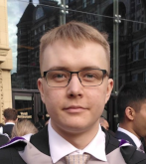


Who are we?
Koen Van Leemput, teacher (Professor, Neuroscience and Biomedical Engineering)
Matias Vuokko, TA (Doctoral Researcher, Neuroscience and Biomedical Engineering)
Amir Hassankhani, TA (Doctoral Researcher, Neuroscience and Biomedical Engineering)
Alessandro De Florio, TA (Doctoral Researcher, Neuroscience and Biomedical Engineering)

Slide 13
Who are you?
Master's Programme in Life Science Technologies 29
Exchange studies (SCI + ELEC): 11
Master's Programme in Computer, Communication and Information Sciences 6
Bachelor's Programme in Electrical Engineering 5
Bachelor's Programme in Science and Technology 3
Aalto Bachelor's Programme in Science and Technology 3
Bachelor's Programme in Chemical Engineering 2
JOO Studies (Engineering, manufacturing and construction), SCI 2
Master's Programme in ICT Innovation 2
Master's Programme in Engineering Physics 2
Master's Programme in Health Technology Engineering 1
Aalto Doctoral Programme in Science 1

Slide 14
Who are you?
Master's Programme in Life Science Technologies 29
Exchange studies (SCI + ELEC): 11
Master's Programme in Computer, Communication and Information Sciences 6
Bachelor's Programme in Electrical Engineering 5
Bachelor's Programme in Science and Technology 3
Aalto Bachelor's Programme in Science and Technology 3
Bachelor's Programme in Chemical Engineering 2
JOO Studies (Engineering, manufacturing and construction), SCI 2
Master's Programme in ICT Innovation 2
Master's Programme in Engineering Physics 2
Master's Programme in Health Technology Engineering 1
Aalto Doctoral Programme in Science 1
Physical attendance:
- is expected in the lectures and the exercise sessions
- your primary way to ask questions and get feedback
- (it’s possible to follow online, but not designed that way)

Slide 15
Teaching form
Lectures:
Thursdays 12.15-14.00 (F239a)
Lecture recordings are available
One guest lecture (typically from industry)
Exercises:
Thursdays 14.15-16.00 (Nanotalo 228)
Python/NumPy + Jupyter notebooks
Group-work (2 students per group)
Five exercises in total, each split into an initial “easy” and a subsequent “difficult” part
Student participation:
Students peer grade + present their fellow students’ “difficult” exercise reports
go to MyCourses and select a group:
- otherwise you can’t submit!
- exceptionally OK to have a 1-person “group” this week
simple grading by TAs
peer review by fellow students
+
feedback and final grading by TAs

Slide 16
Teaching form
Lectures:
Thursdays 12.15-14.00 (F239a)
Lecture recordings are available
One guest lecture (typically from industry)
Exercises:
Thursdays 14.15-16.00 (Nanotalo 228)
Python/NumPy + Jupyter notebooks
Group-work (2 students per group)
Five exercises in total, each split into an initial “easy” and a subsequent “difficult” part
Student participation:
Students peer grade + present their fellow students’ “difficult” exercise reports
go to MyCourses and select a group:
- otherwise you can’t submit!
- exceptionally OK to have a 1-person “group” this week
simple grading by TAs
peer review by fellow students
+
feedback and final grading by TAs
today’s exercise should be very easy for you
(if not, carefully reconsider taking this course!)

Slide 17
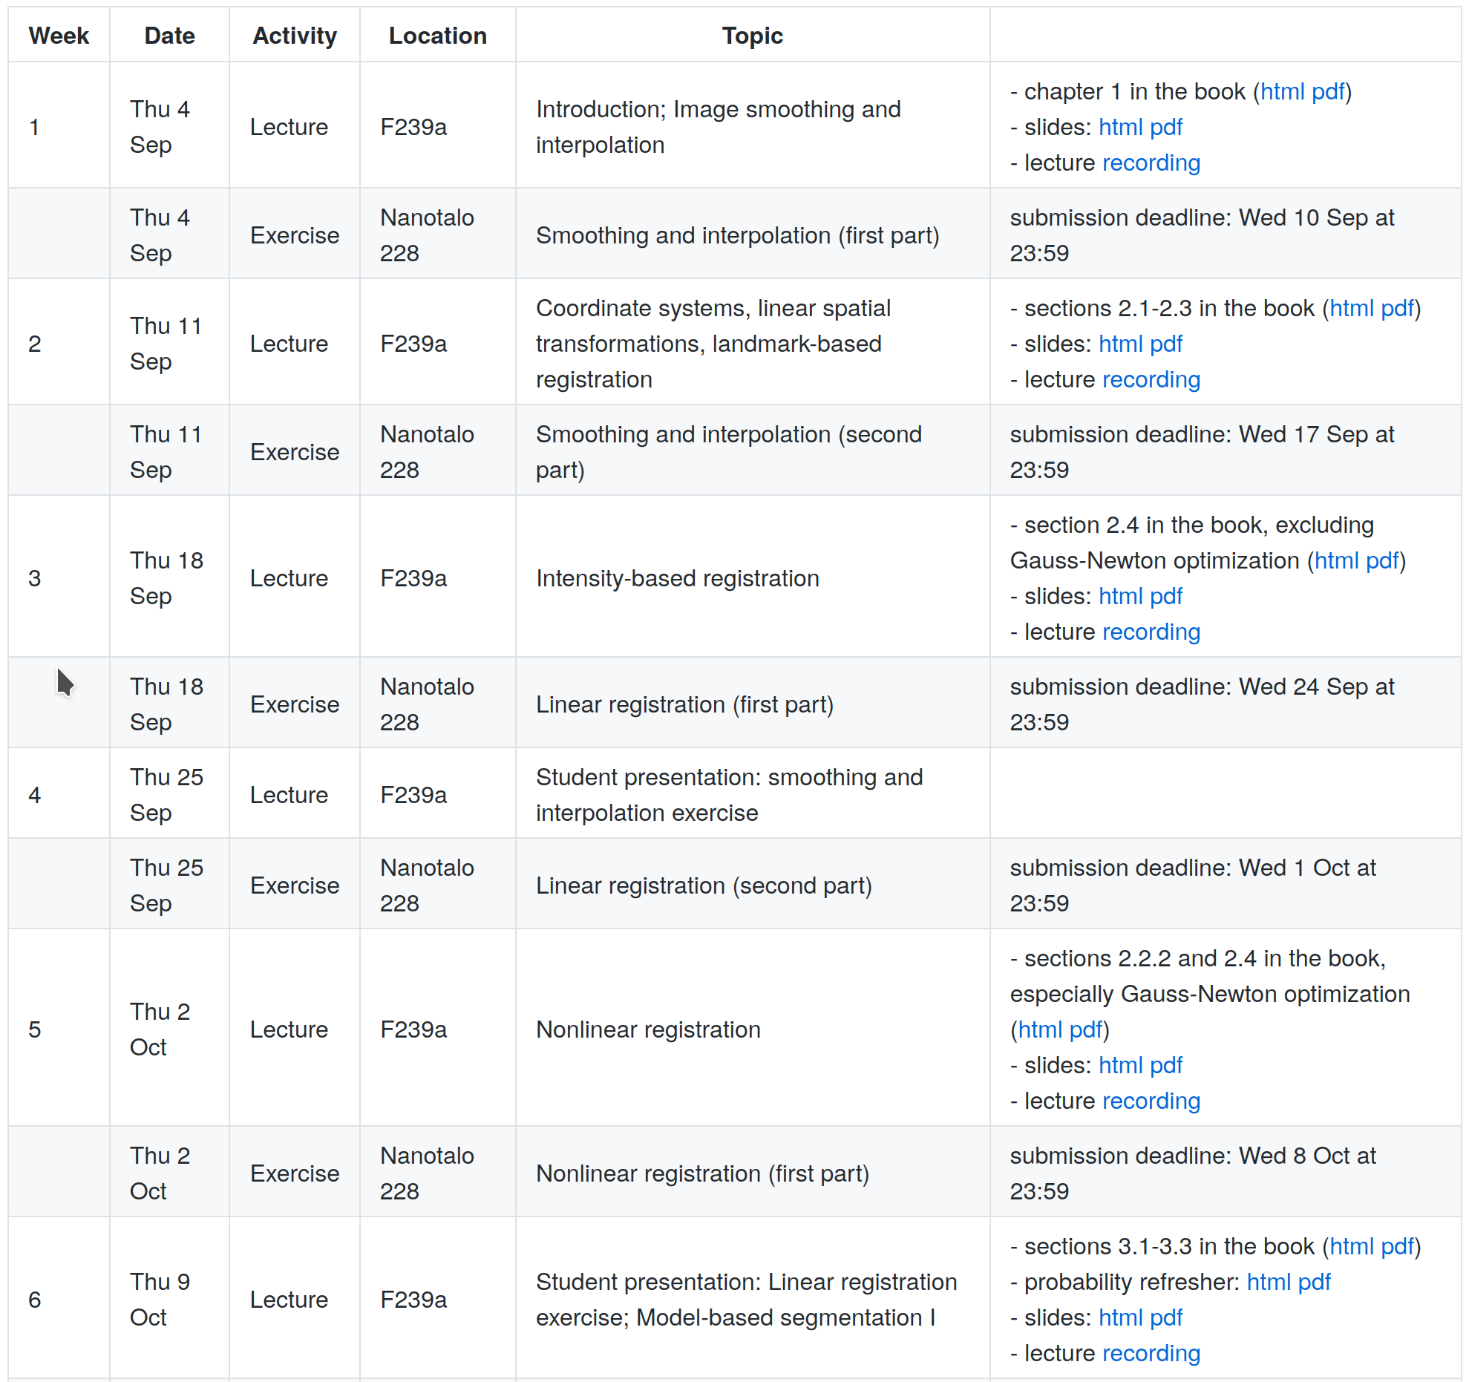
Logistics
https://leempko.github.io/mia/
Course material (book, slides)
Schedule
https://mycourses.aalto.fi/
Group selections
Exercises (input data, report submissions, peer grading)
Zulip course chat
Link in MyCourses
Important announcements
Secondary place to ask questions

Slide 18
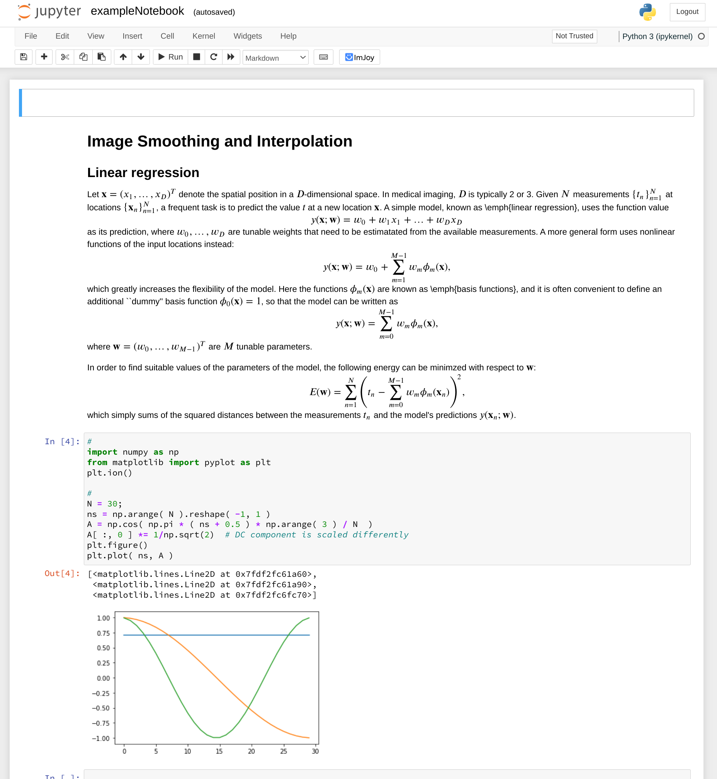
Python/NumPy,
Jupyter Notebooks
Python: https://lectures.scientific-python.org/
Jupyiter Notebooks:
https://www.dataquest.io/blog/jupyter-notebook-tutorial/
https://jupyter.cs.aalto.fi/

Slide 19
Copyrights
"Accurate and robust whole-head segmentation from magnetic resonance images for individualized head modeling“ by Puonti et al. NeuroImage (2020), licensed under CC-BY-NC-ND

