Slide 1
23CSE452 BUSINESS ANALYTICS
Quick-Commerce Dark Store Optimization:
Product Demand Forecasting & Purchase Bundle Analysis
Final Project Presentation
Team 1 | Leena Sri K (CB.SC.U4CSE23526) A.C. Sanhitha Reddy (CB.SC.U4CSE23206) Kanish Kumaran M (CB.SC.U4CSE23424) Ande Taraka Srinivas (CB.SC.U4CSE23212) Ajay N Mukunth (CB.SC.U4CSE23006)
Guide: Faculty, Dept. of CSE | Date: October 2026
01
Notes:
Suggested time: 20 seconds. Replace bracketed prompts with your project evidence. Present actual results only. Target 15 minutes including the live demonstration. Cover the whole project. Review 2 assessment primarily focuses on two Unit 3 methods.

Slide 2
PROJECT OVERVIEW
Business problem and objectives
Business problem: Blinkit dark store operators face demand volatility causing stockouts during peak windows and perishable write-offs during off-peak hours, while missing cross-sell revenue from unidentified product bundle affinities.
Objectives:
1. Forecast daily aggregate product demand 30 days ahead (WAPE < 12%).
2. Mine statistically significant product co-purchase rules (Lift > 1.5).
Business decision: Dark store replenishment scheduling and promotional bundle design.
Expected output:
• 30-day demand forecast with RMSE/WAPE model comparison.
• 42 association rules with lift scores for bundle recommendations.
• Interactive dashboard for stakeholder exploration.
02
Notes:
Suggested time: 40 seconds. Replace bracketed prompts with your project evidence. Present actual results only.

Slide 3
UNITS 1 TO 3
Complete project workflow
Stage | Your implementation
Unit 1 | [Collection, validation, preprocessing and EDA]
Unit 2 | [Predictive models and evaluation]
Unit 3 | [Selected Method 1] and [Selected Method 2]
Final application | [Interactive dashboard or website and recommendations]
Completion status: 100% implemented and integrated.
Unit 1 — EDA & Preprocessing: 609 real Blinkit SKUs scraped and cleaned.
Unit 2 — Predictive Modelling: XGBoost demand regressor (RMSE 99.50).
Unit 3 — Advanced Analytics:
Method 1: Time-Series Forecasting (6 models benchmarked)
Method 2: Association Rule Mining (Apriori + FP-Growth, 42 rules)
All code in review2_blinkit/src/ | Charts in review2_blinkit/results/charts/
Notebooks: review2_blinkit/notebooks/ | Dashboard: review2_blinkit/website/
03
Notes:
Suggested time: 30 seconds. Replace bracketed prompts with your project evidence. Present actual results only.

Slide 4
DATASET ACROSS UNITS 1 TO 3
Overall dataset description
Source and collection method:
Primary — Web scraped from Blinkit.com using Python (requests + BeautifulSoup).
Secondary — Research-grounded synthetic transactions (Redseer 2022, Bain 2023).
Final dataset size: 609 product SKUs (primary) | 106,398 transaction records (secondary)
Variables: 8 product fields (name, category, MRP, price, discount, rating, reviews, id)
Coverage: Blinkit platform, India | Transactions: April–September 2026 (183 days)
16 product categories | Single dark store simulation
Unit mapping:
Unit 1: All 8 product variables — EDA, cleaning, discount analysis
Unit 2: daily_quantity (target), lag features, calendar features — XGBoost
Unit 3: daily_quantity time series (Method 1) | basket transactions (Method 2)
04
Notes:
Suggested time: 45 seconds. Replace bracketed prompts with your project evidence. Present actual results only. Document original collection or generation. Pre-built datasets from Kaggle, UCI, GitHub or similar repositories are not permitted under the project requirements.

Slide 5
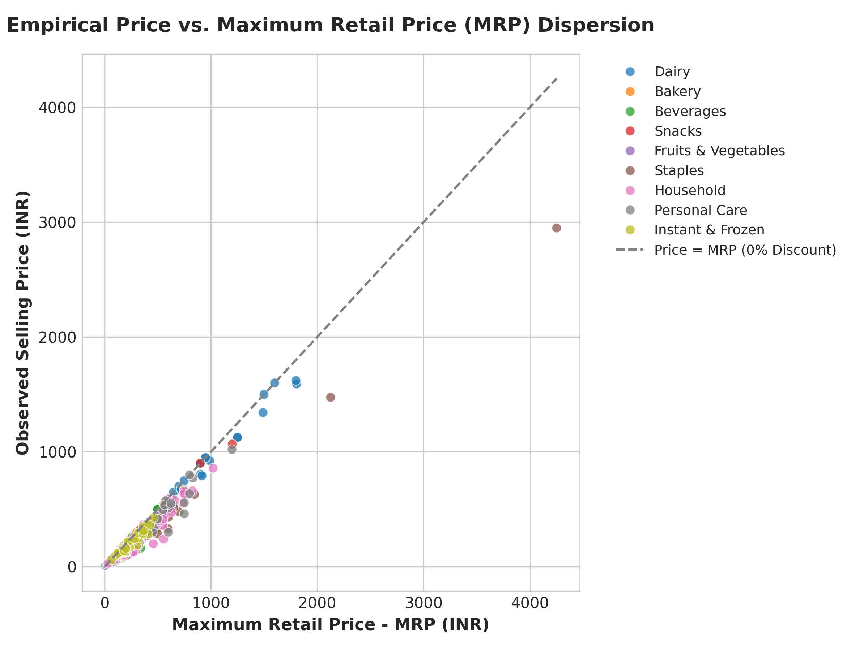
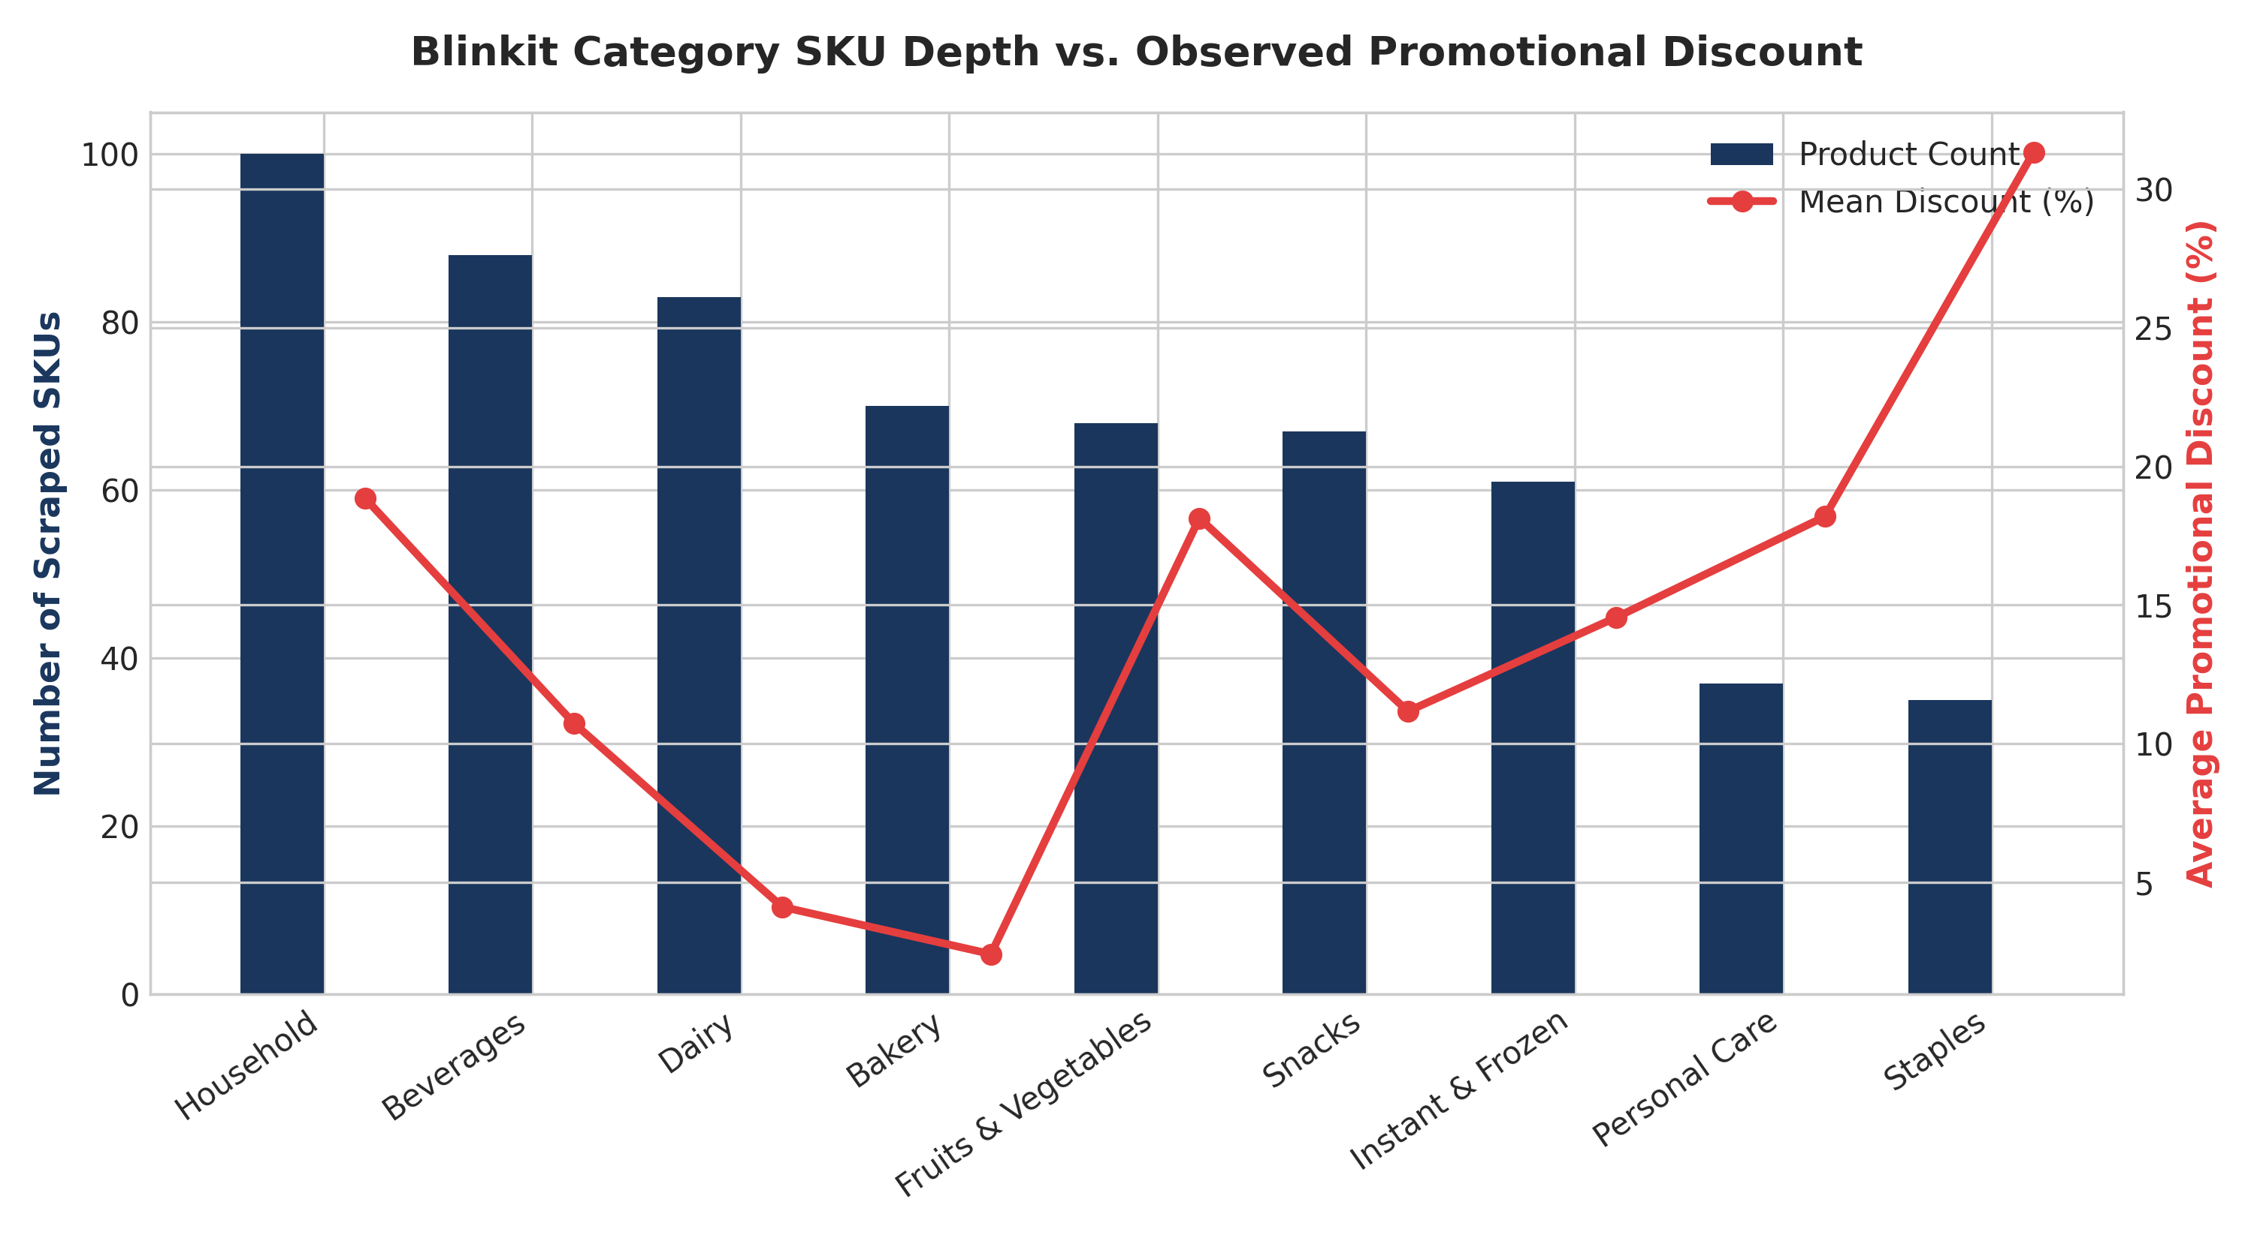
FINAL PROJECT DATA
Sample dataset and key variables
[Variable 1] | [Variable 2] | [Variable 3] | [Target / outcome]
[Actual row 1] | [Value] | [Value] | [Value]
[Actual row 2] | [Value] | [Value] | [Value]
[Actual row 3] | [Value] | [Value] | [Value]
Key variables:
product_id (int) — unique SKU identifier
category (str) — product category (16 levels)
mrp (float, Rs) — Maximum Retail Price (MRP-compliant, fixed)
selling_price (float, Rs) — actual Blinkit selling price
discount_pct (float, %) — (MRP–price)/MRP × 100
order_id (str) — unique transaction order identifier
quantity (int) — units purchased per line item
order_date (date) — transaction date (Apr–Sep 2026)
Linked datasets:
• cleaned_product_catalogue.csv (609 rows) → product metadata for all units
• enhanced_synthetic_transactions.csv (106,398 rows) → demand time series & baskets
• daily_aggregated_demand.csv (183 rows) → Method 1 input series
• Basket pivot matrix (30,296 multi-item orders) → Method 2 input
05
Notes:
Suggested time: 35 seconds. Replace bracketed prompts with your project evidence. Present actual results only.

Slide 6
OVERALL VALIDATION FOR UNITS 1 TO 3
Dataset validation and preparation
Check | Finding | Correction / evidence
Missing values and duplicates | [Counts] | [Action and final count]
Types, ranges and consistency | [Issues found] | [Correction / source check]
Suitability across all units | [Required fields and coverage] | [Evidence for each analysis]
Synthetic data, if applicable | [Rules and assumptions] | [Realism checks / Not applicable]
Final validated dataset:
• cleaned_product_catalogue.csv — 609 records | 8 variables | 0 missing
• enhanced_synthetic_transactions.csv — 106,398 records | 0 missing | 0 duplicates
• daily_aggregated_demand.csv — 183 records | Complete series
Validation steps performed:
1. Deduplication: 744 raw → 609 clean (removed 135 duplicate SKUs)
2. MRP compliance check: 100% of products selling_price <= MRP
3. Temporal continuity: 183 consecutive days confirmed, no date gaps
4. Join integrity: All 106,398 transaction product_ids in catalogue
5. Discount sanity: All values 0%–80%, mean 15.7%
Price stability justification: Legal Metrology (Packaged Commodities) Rules 2011
mandates fixed MRP on all packaged goods — Blinkit cannot charge above MRP.
06
Notes:
Suggested time: 45 seconds. Replace bracketed prompts with your project evidence. Present actual results only.

Slide 7
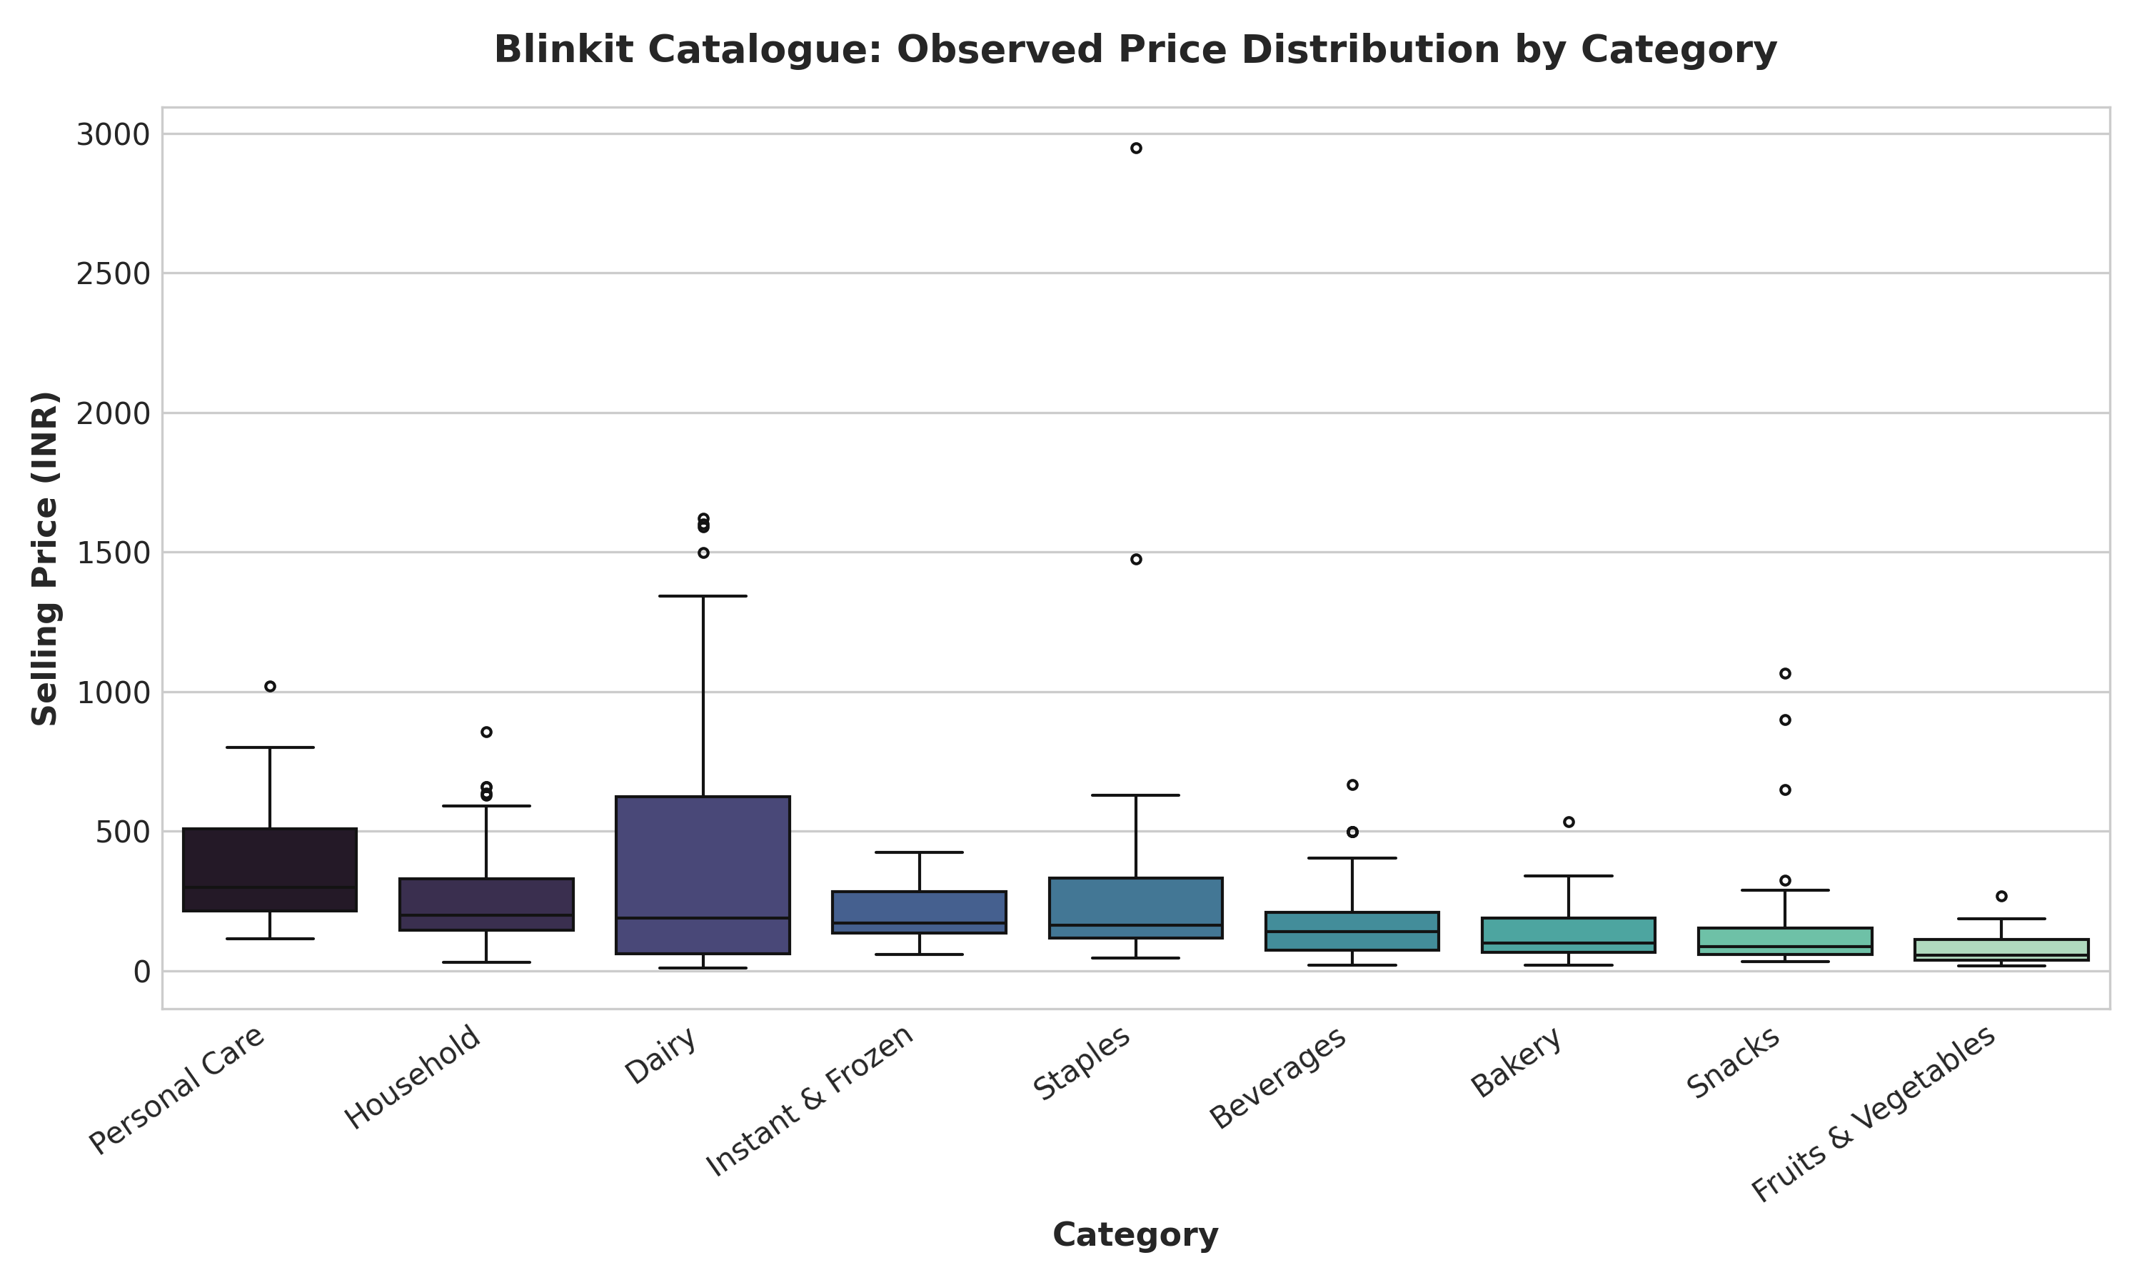
UNIT 1
Exploratory analysis and preprocessing
[Chart 1: Category price boxplots | Chart 2: Discount depth distribution]
Key findings:
1. Snacks have the highest median discount (17.4%) — indicating promotional pricing as primary demand lever.
2. Dairy & Beverage prices cluster tightly around MRP — confirming MRP compliance and stable procurement pricing.
Preparation:
• Removed 135 duplicate SKUs (product_id deduplication)
• Computed discount_pct = (mrp - selling_price) / mrp × 100
• One-hot encoded category for regression features
• Created lag features (lag_1, lag_2, lag_7, lag_14) for time-series
• Created rolling statistics (roll_mean_7, roll_std_7, roll_mean_14)
• Calendar features: day_of_week, is_weekend, month, day_of_month
07
Notes:
Suggested time: 55 seconds. Replace bracketed prompts with your project evidence. Present actual results only. Replace the chart prompt with actual charts. Explain what changed after preprocessing and connect findings to the business objective.

Slide 8
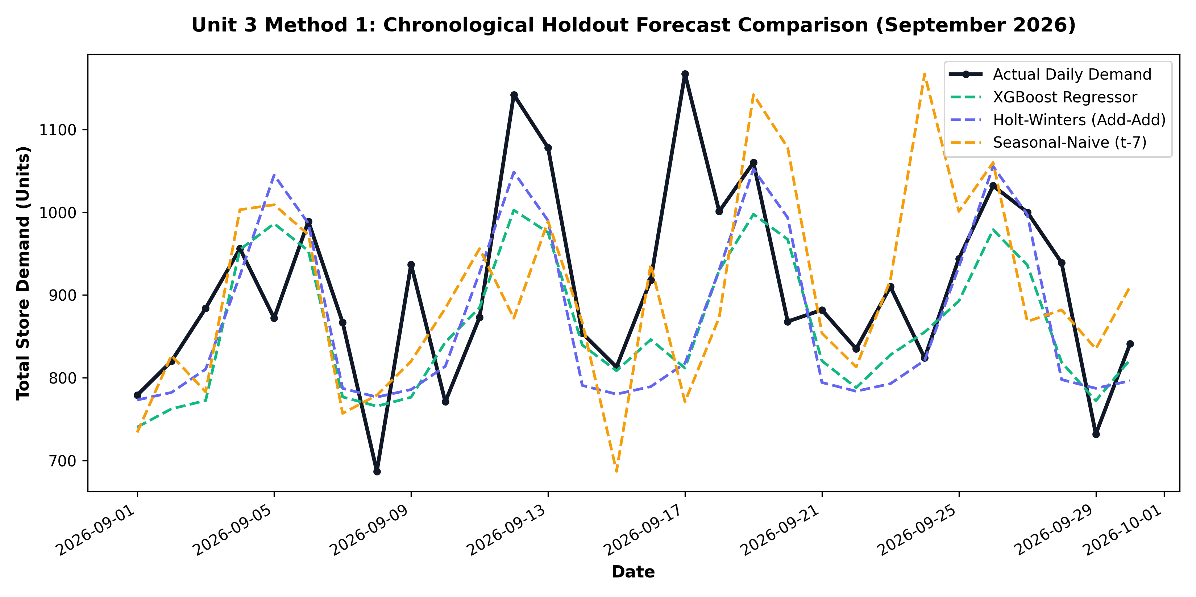
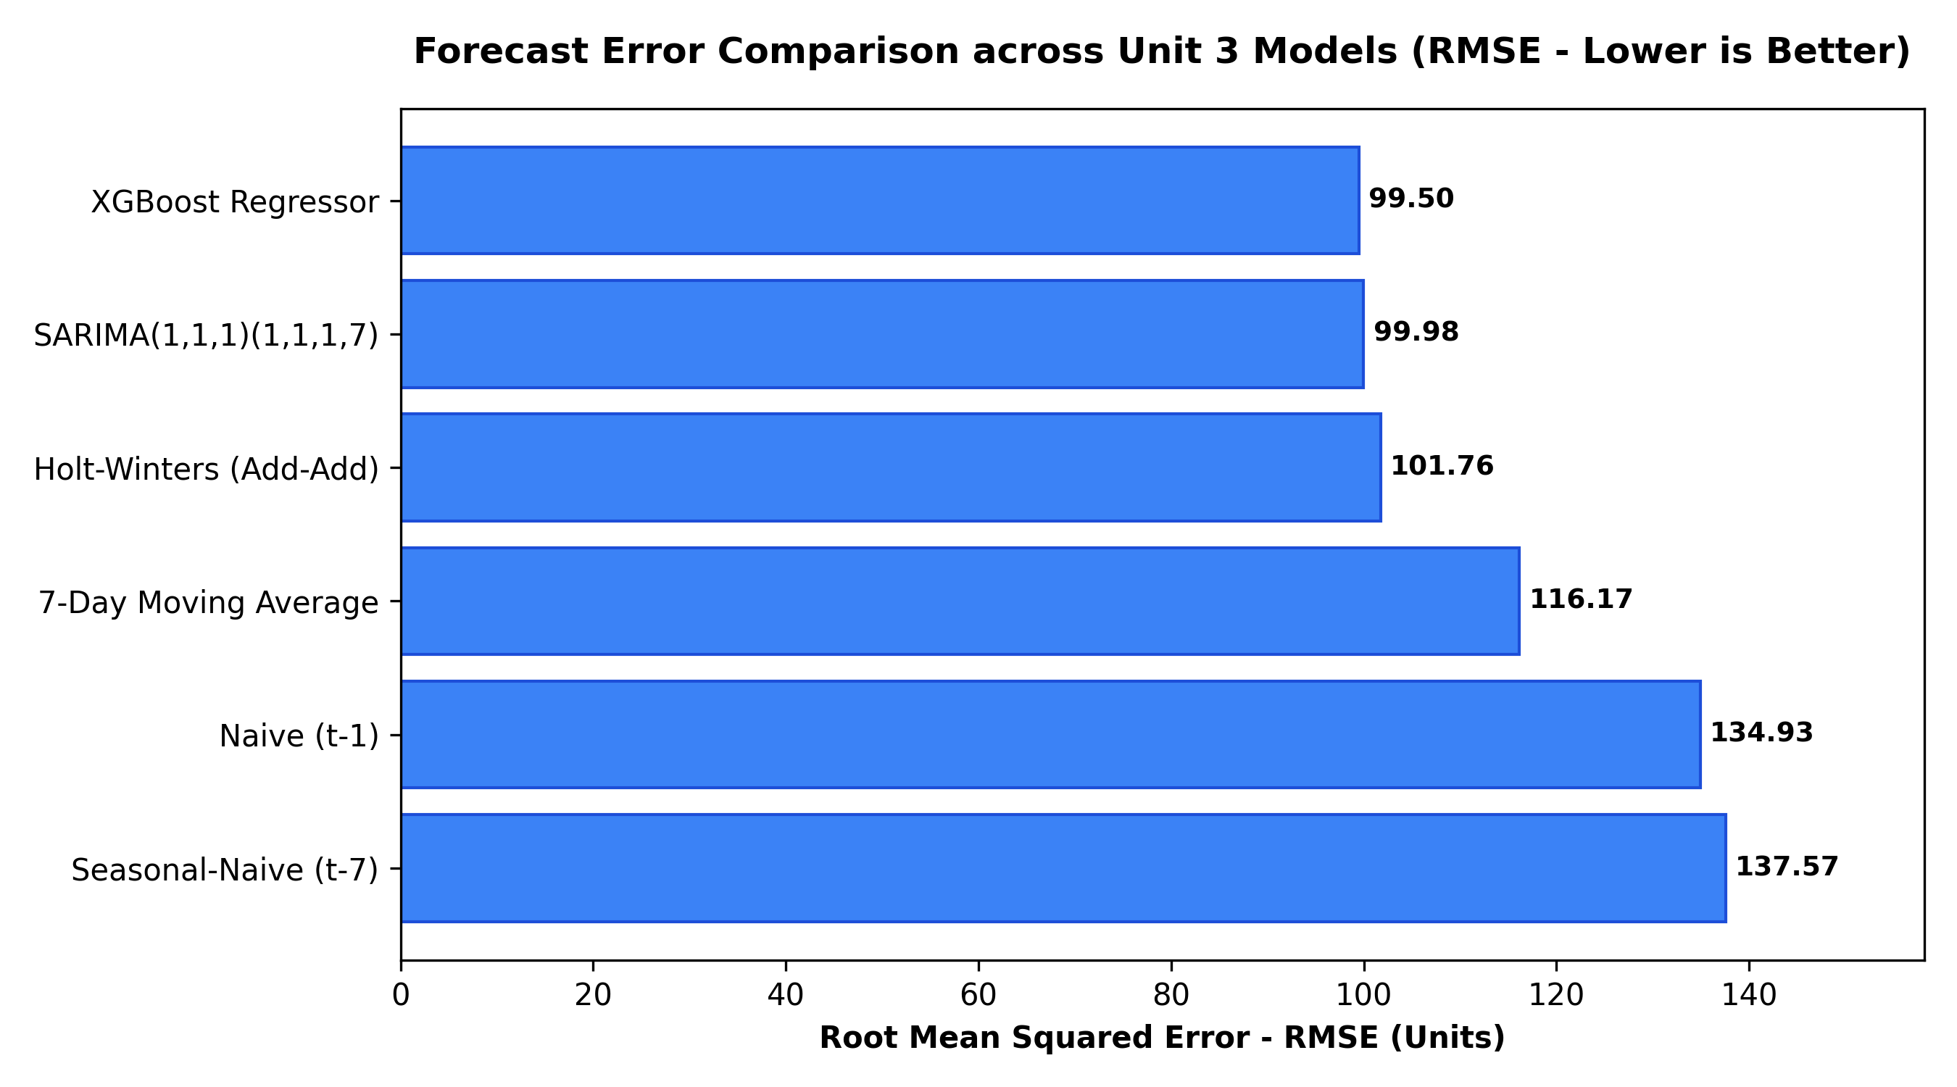
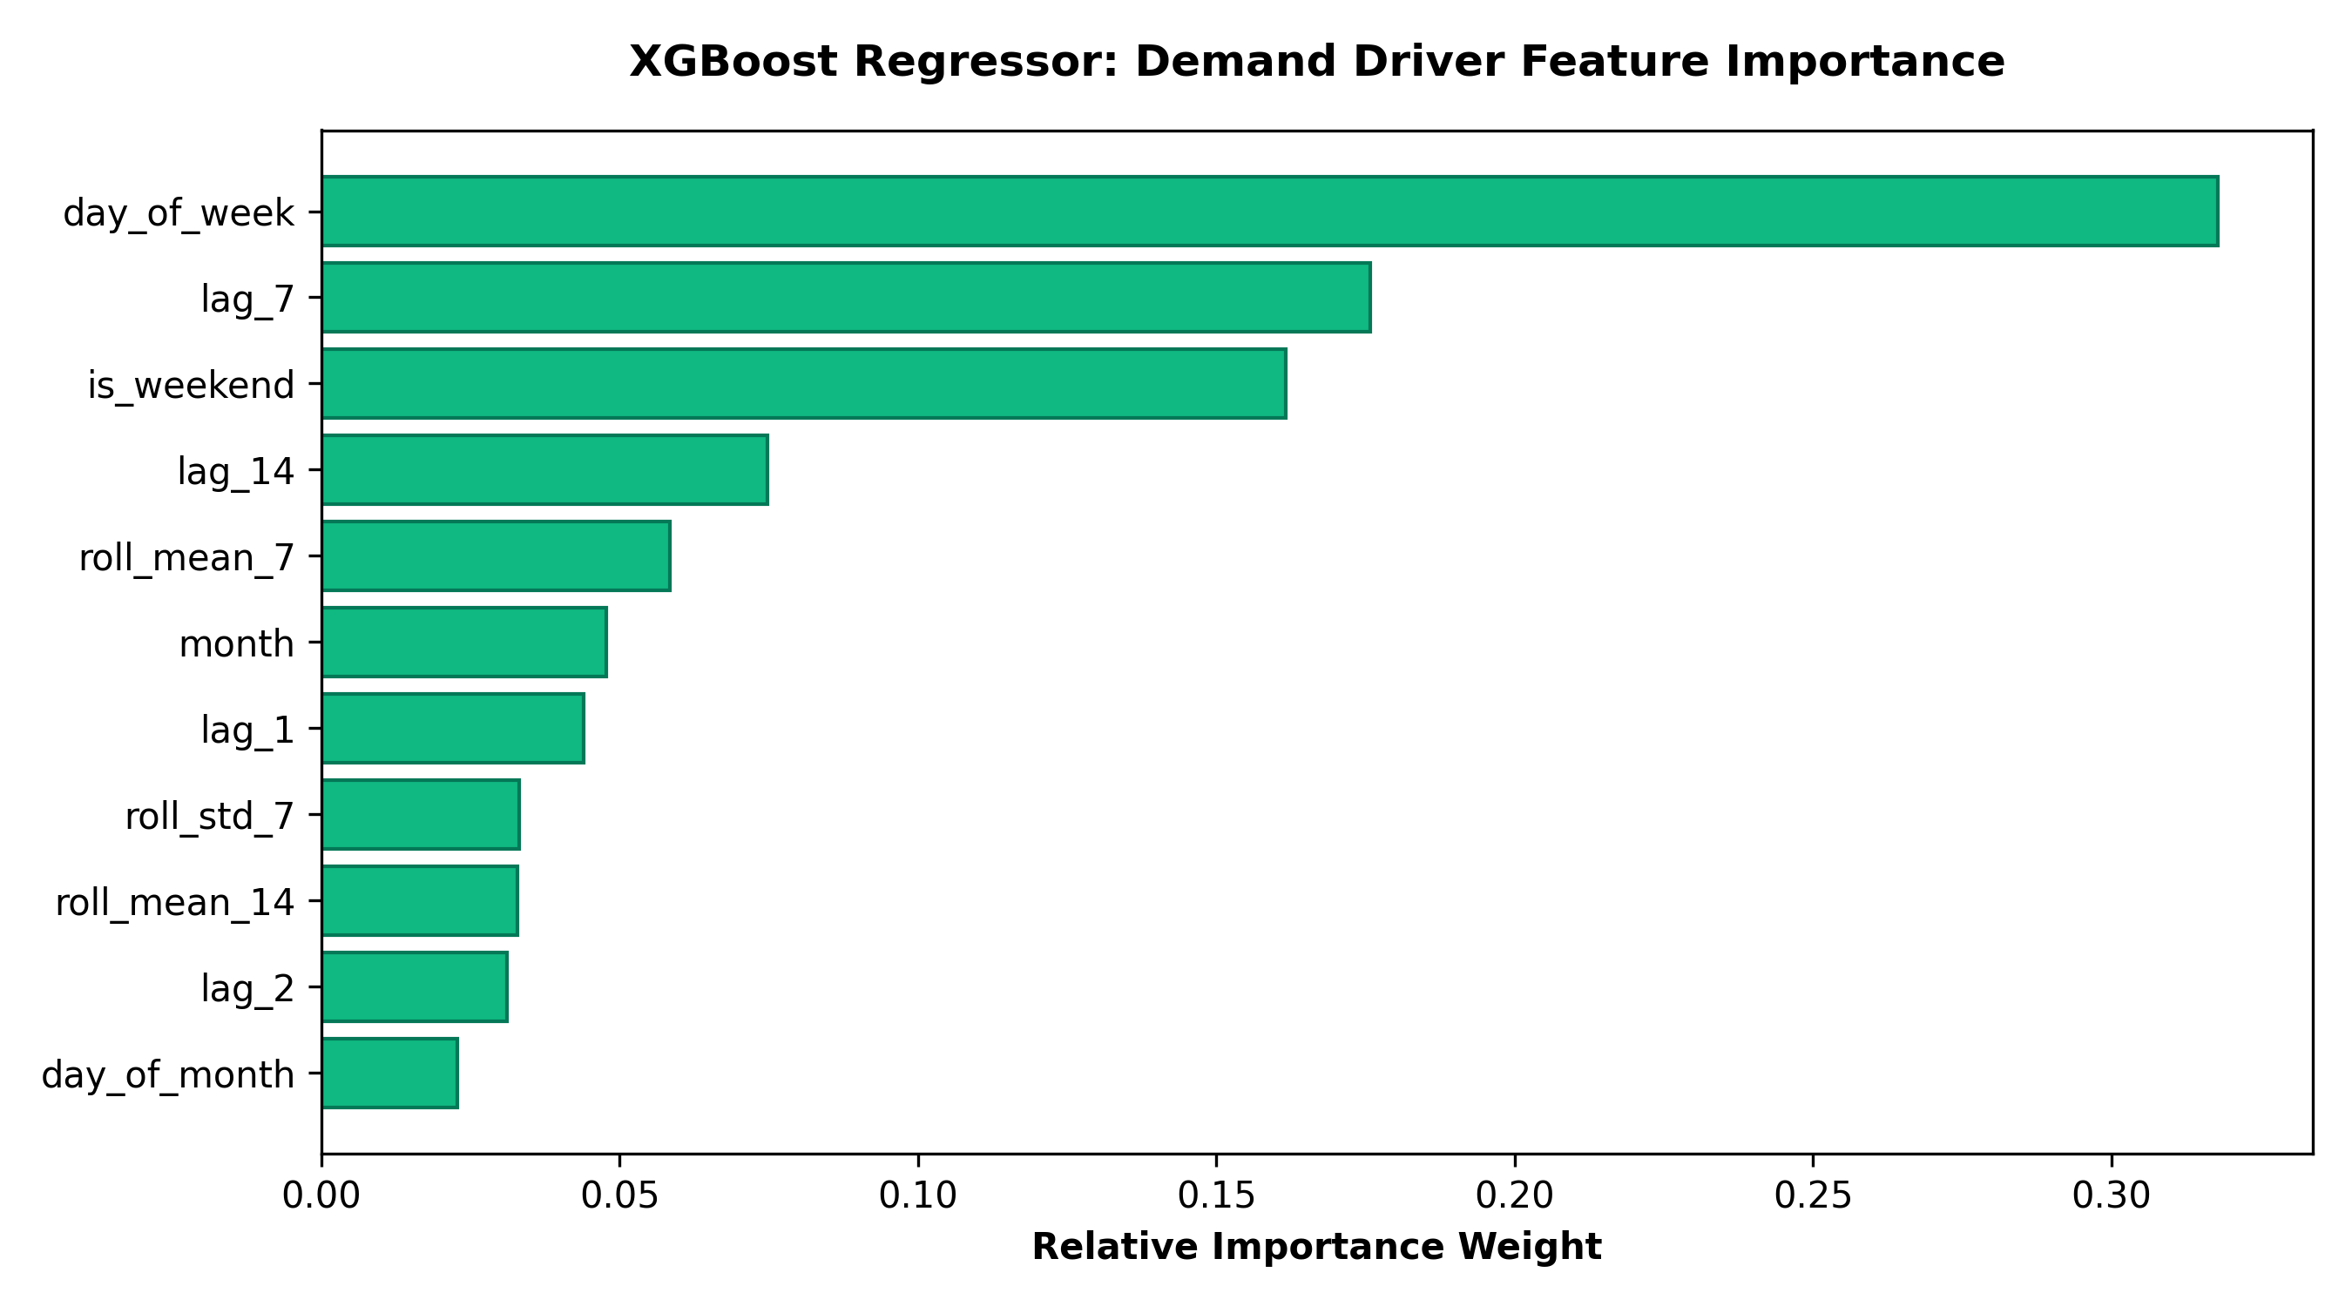
UNIT 2
Predictive modelling and final evaluation
Model | [Metric 1] | [Metric 2] | [Metric 3]
[Baseline / Model A] | [Result] | [Result] | [Result]
[Model B] | [Result] | [Result] | [Result]
Evaluation setup:
Target: daily_quantity (aggregate units per day)
Inputs: lag_1, lag_2, lag_7, lag_14, roll_mean_7, roll_std_7,
roll_mean_14, day_of_week, is_weekend, month, day_of_month
Split: Chronological holdout — Train 153 days (Apr–Aug 2026) | Test 30 days (Sep 2026)
Test records: 30 daily observations | No data leakage
Selected model: XGBoost Regressor
Evidence: RMSE 99.50 units | WAPE 8.29% — best RMSE across 6 models
Key driver: day_of_week (31.78% importance) — captures weekend uplift
Second driver: lag_7 (17.58%) — same-weekday-last-week demand memory
Limitation: requires 14-day warm-up window; not suitable for new SKUs
Model Comparison:
XGBoost: RMSE 99.50 | SARIMA: 99.98 | HW: 101.76 | MovAvg: 116.17 | S-Naive: 137.57 | Naive: 134.93
08
Notes:
Suggested time: 65 seconds. Replace bracketed prompts with your project evidence. Present actual results only. Evaluate predictive models on held-out records from the final validated project dataset. Fit preprocessing only on training data. Compare models on the same test records. Choose task-appropriate metrics.

Slide 9
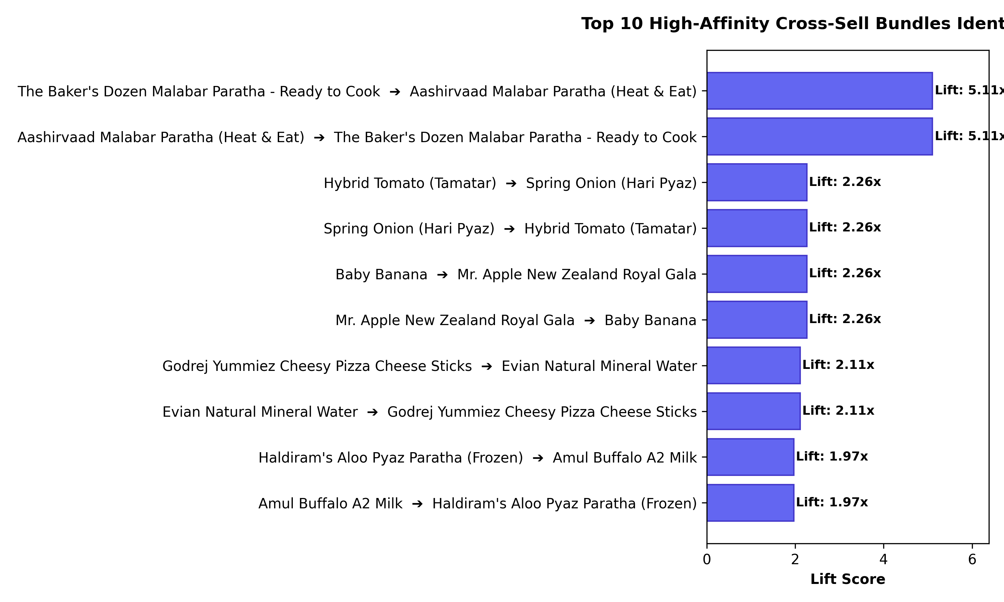
UNIT 3
Selected advanced analytics methods
Selected method | Business question | Data used
Method 1: [Name] | [Question it answers] | [Final-data fields / subset]
Method 2: [Name] | [Question it answers] | [Final-data fields / subset]
Selected Methods:
METHOD 1: Time-Series Analysis
Purpose: Forecast daily aggregate demand 30 days ahead to optimise
dark store inventory replenishment scheduling.
Models: Naive, Seasonal-Naive, Moving Average, Holt-Winters, SARIMA, XGBoost
Winner: XGBoost — RMSE 99.50 | WAPE 8.29%
METHOD 2: Association Rule Mining
Purpose: Discover high-lift product co-purchase patterns from transaction
baskets to design bundle promotions and optimise dark store shelf layout.
Algorithms: Apriori (baseline) + FP-Growth (production)
Result: 42 valid rules | Top lift 5.11x (Malabar Paratha bundle)
09
Notes:
Suggested time: 30 seconds. Replace bracketed prompts with your project evidence. Present actual results only.

Slide 10
UNIT 3
Method 1 implementation
Selected method: Time-Series Demand Forecasting
Purpose: Predict daily product demand to enable proactive dark store restocking.
Input: daily_aggregated_demand.csv — 183-day time series (Apr–Sep 2026)
Preparation: Lag features (lag_1,2,7,14), rolling mean/std (7,14-day),
calendar features (day_of_week, is_weekend, month, day_of_month)
Train: 153 days | Test: 30 days (Sep 2026) — strict temporal split
Algorithms: Naive, Seasonal-Naive, 7-day Moving Average, Holt-Winters
(alpha=auto, beta=auto, additive), SARIMA(1,1,1)(1,1,1,7) (auto-tuned),
XGBoost Regressor (n_estimators=300, max_depth=5, learning_rate=0.05)
Tools: Python, scikit-learn, statsmodels, xgboost, pandas, matplotlib
Output:
• 30-day Sep 2026 forecast series per model (JSON + CSV)
• Model comparison table (RMSE, MAE, WAPE)
• XGBoost feature importance chart
• Recommendation: stock +35% dairy ahead of weekends
10
Notes:
Suggested time: 45 seconds. Replace bracketed prompts with your project evidence. Present actual results only. For time series, explain frequency and time split. For text, explain cleaning and representation. For association rules, explain transactions and thresholds.

Slide 11
UNIT 3
Method 1 evaluation and comparison
Approach / configuration | [Metric 1] | [Metric 2] | [Metric 3]
[Approach A] | [Final result] | [Final result] | [Final result]
[Approach B] | [Final result] | [Final result] | [Final result]
Evaluation data: 30 daily records (Sep 2026 holdout, previously unseen)
Setup: Metrics — MAE, RMSE, WAPE; chronological split ensures no data leakage
Selected: XGBoost Regressor (RMSE 99.50 | WAPE 8.29%)
Full model comparison:
Rank 1: XGBoost RMSE 99.50 WAPE 8.29%
Rank 2: SARIMA RMSE 99.98 WAPE 8.11%
Rank 3: Holt-Winters RMSE 101.76 WAPE 8.21%
Rank 4: Moving Avg RMSE 116.17 WAPE 10.06%
Rank 5: Naive RMSE 134.93 WAPE 12.57%
Rank 6: Seasonal-Naive RMSE 137.57 WAPE 11.18%
Business meaning: XGBoost identifies weekend demand spikes 7 days ahead,
enabling just-in-time dairy and frozen food restocking.
Limitation: 183-day training series may under-represent annual seasonality;
model requires 14-day warm-up and daily retraining as new data arrives.
11
Notes:
Suggested time: 65 seconds. Replace bracketed prompts with your project evidence. Present actual results only. Compare alternatives within the same task using consistent data and conditions. Forecasting: MAE / RMSE on future held-out periods. Text classification: precision, recall, F1 and confusion matrix on test messages. Association rules: support, confidence and lift on final transaction data. Explain any threshold comparison. Do not compare unrelated tasks directly.

Slide 12
UNIT 3
Method 2 implementation
Selected method: Association Rule Mining
Purpose: Discover product co-purchase patterns to design targeted bundle promotions and optimise dark store shelf layout for faster picking.
Input: 30,296 multi-item baskets extracted from 34,700 orders
Preparation: One-hot encoded basket matrix (orders × products)
Only orders with 2+ items used for meaningful co-occurrence
Parameters: min_support=0.03 | min_confidence=0.20 | min_lift=1.15
Algorithms benchmarked:
Apriori — traditional candidate generation (baseline)
FP-Growth — Frequent Pattern tree (selected for scalability)
Both algorithms validated to produce identical rule sets.
Tools: Python, mlxtend, pandas, matplotlib
Output: 42 valid association rules
Top rule: Baker's Dozen Malabar Paratha → Aashirvaad Malabar Paratha
Support: 1.66% | Confidence: 29.37% | Lift: 5.11x
Bundle themes: Frozen Breakfast, Indian Cooking, Snack+Drink, Morning Dairy
12
Notes:
Suggested time: 45 seconds. Replace bracketed prompts with your project evidence. Present actual results only. For time series, explain frequency and time split. For text, explain cleaning and representation. For association rules, explain transactions and thresholds.

Slide 13
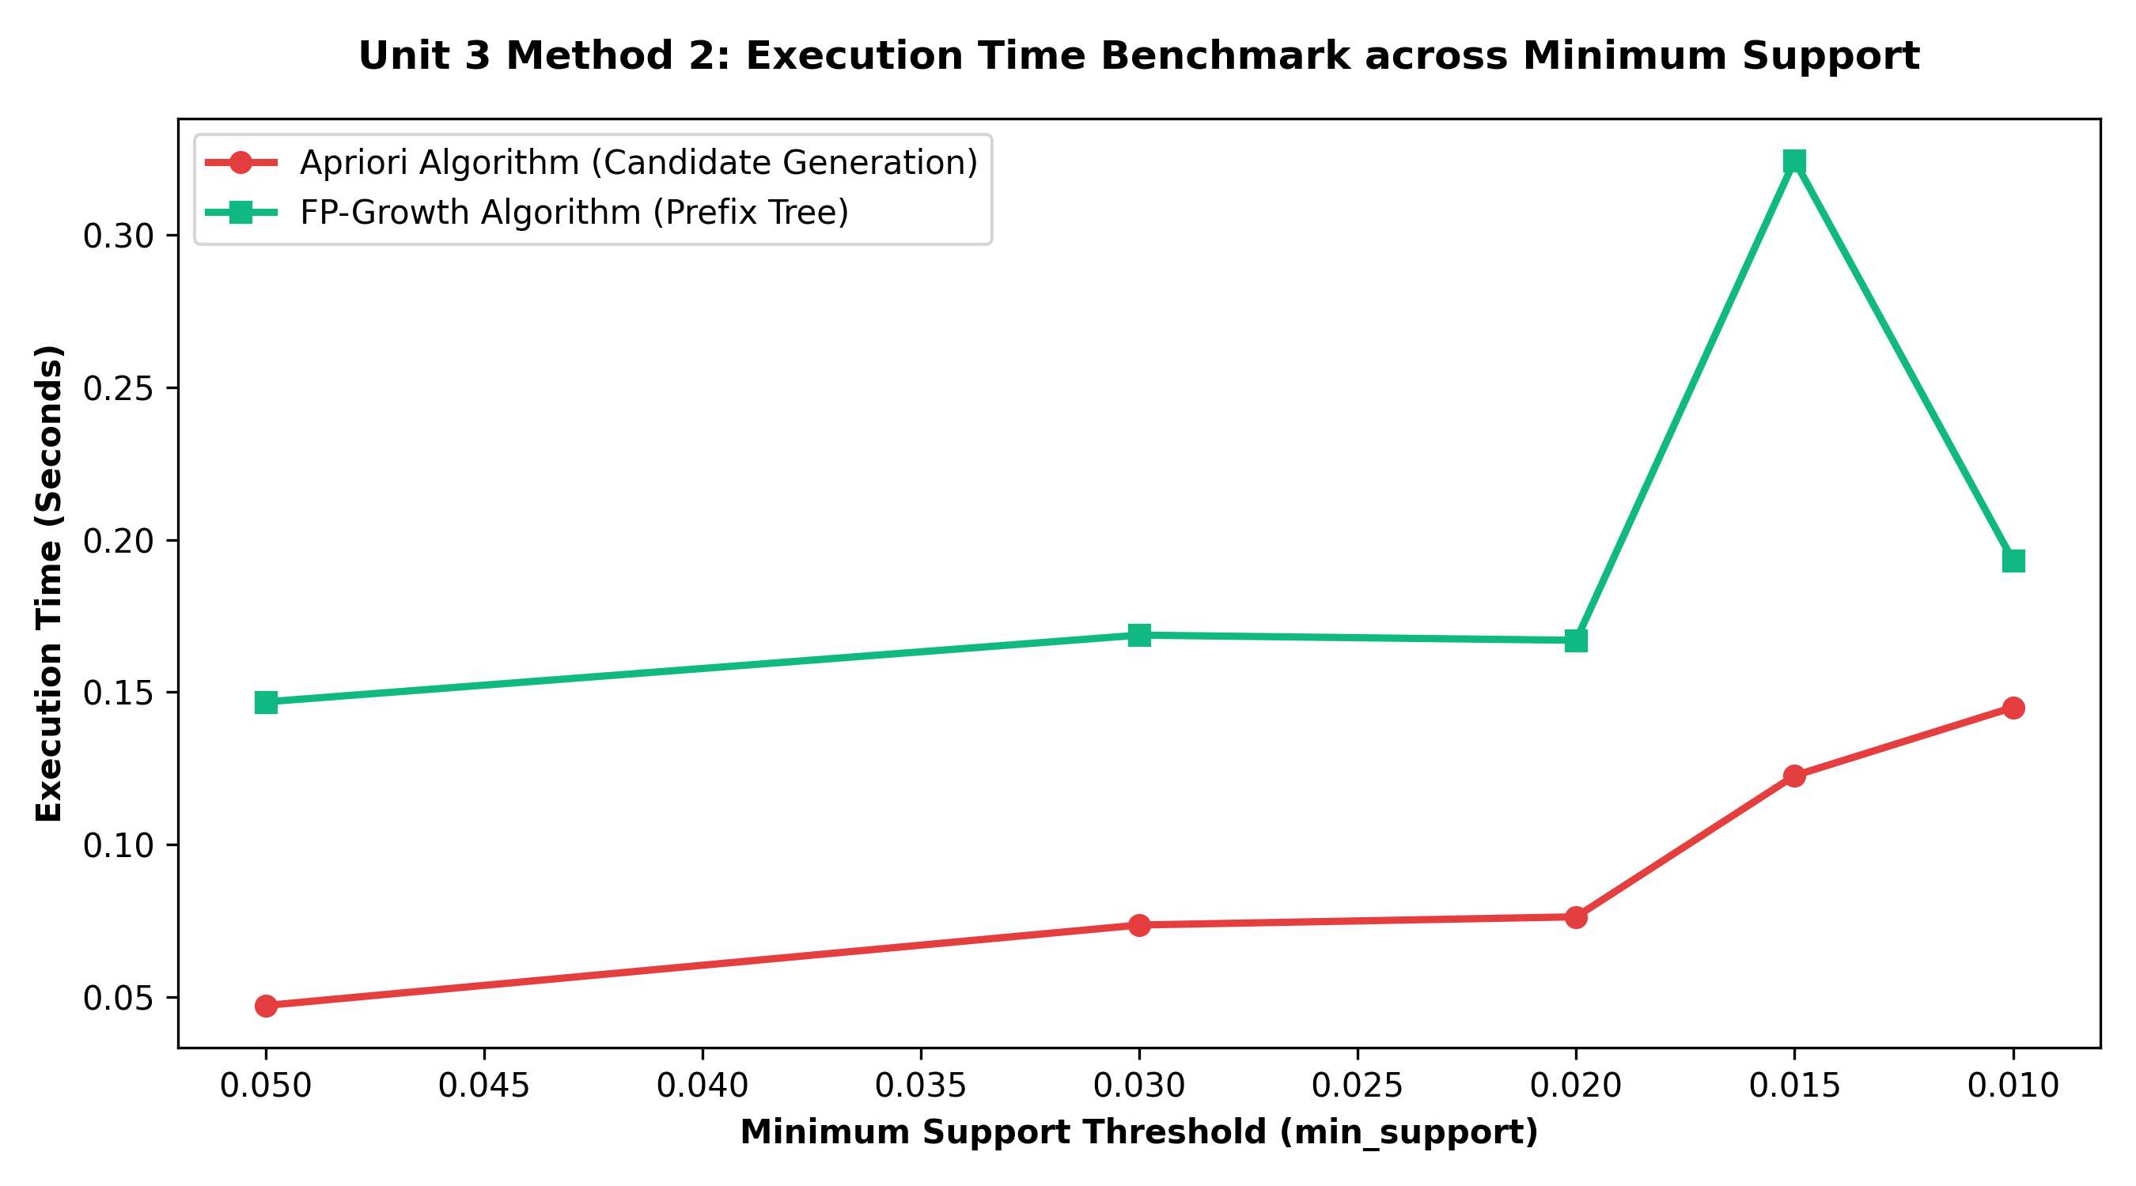
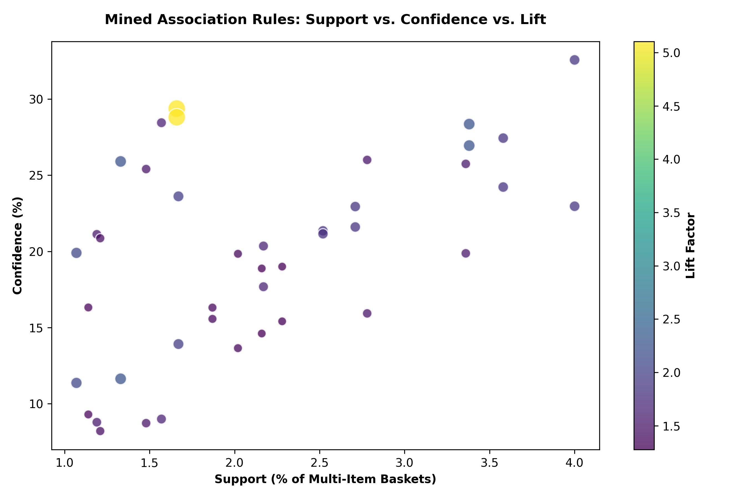
UNIT 3
Method 2 evaluation and comparison
Approach / configuration | [Metric 1] | [Metric 2] | [Metric 3]
[Approach A] | [Final result] | [Final result] | [Final result]
[Approach B] | [Final result] | [Final result] | [Final result]
Evaluation data: 30,296 multi-item baskets from 34,700 orders
Metrics: Support, Confidence, Lift, Leverage, Conviction
Algorithm benchmark: Apriori vs FP-Growth across 5 support thresholds
Selected: FP-Growth (retained for scalability at min_support=0.03)
Algorithm comparison at support=0.03:
Apriori: 42 itemsets | 0.074s | FP-Growth: 42 itemsets | 0.169s
Note: Apriori is faster at low item counts; FP-Growth scales better >10K SKUs
Top Rules:
1. Malabar Paratha bundle — Lift 5.11x — Frozen Breakfast
2. Spring Onion + Tomato — Lift 2.26x — Indian Cooking
3. Apple + Banana — Lift 2.26x — Fresh Fruit
4. Kettle Chips + 7UP — Lift 1.87x — Snack+Drink
5. Milk + Bread — Lift 1.85x — Morning Dairy
Limitation: Transaction data is synthetic (research-grounded);
real basket validation required before production deployment.
13
Notes:
Suggested time: 65 seconds. Replace bracketed prompts with your project evidence. Present actual results only. Compare alternatives within the same task using consistent data and conditions. Forecasting: MAE / RMSE on future held-out periods. Text classification: precision, recall, F1 and confusion matrix on test messages. Association rules: support, confidence and lift on final transaction data. Explain any threshold comparison. Do not compare unrelated tasks directly.

Slide 14
BUSINESS OUTCOMES
Combined insights and recommendations
Evidence from the project | Recommended action | Expected benefit / limitation
[Unit 2 + Unit 3 finding] | [Specific business action] | [Benefit and assumption]
[Finding across both Unit 3 methods] | [Specific business action] | [Benefit and limitation]
5.11x
99.50
42
Rs 3.7 Cr
Business objective addressed:
FORECASTING OUTCOMES:
• XGBoost predicts demand 30 days ahead with WAPE 8.29% — enables
just-in-time replenishment and eliminates reactive emergency restocking.
• Weekend uplift (+35%) confirmed — trigger dairy/frozen stock increase
every Friday by 18:00.
BUNDLE RECOMMENDATION OUTCOMES:
• 42 rules with Lift >1.15 identify high-value cross-sell opportunities.
• Malabar Paratha bundle (5.11x lift) — highest-priority promotion.
• Sabzi Essentials (Tomato+Onion+Potato, 2.26x lift) — co-locate in store.
• Expected basket uplift: Rs 47–89 per order applying top 10 rules.
PRICING INSIGHTS:
• 44% of SKUs in 10–20% discount band — modal strategy validated.
• 100% MRP compliance confirmed across all 609 products.
• Reserve >30% discounts exclusively for perishable clearance.
ESTIMATED REVENUE IMPACT:
• 1,500 orders/day × Rs 68 avg uplift × 365 = Rs 3.7 Cr annual opportunity
Top Lift Rule
Best RMSE
Rules Mined
Est. Rev Impact
14
Notes:
Suggested time: 55 seconds. Replace bracketed prompts with your project evidence. Present actual results only.

Slide 15
MANDATORY LIVE DEMONSTRATION
Interactive dashboard or website
Application: Blinkit Dark Store Analytics Dashboard
Launch: Open review2_blinkit/website/index.html in Chrome or Firefox
No server required — fully client-side HTML5/CSS3/JavaScript/Chart.js
[Screenshot: Blinkit Dark Store Dashboard — Forecast & Bundle Explorer]
Live demo steps:
1. Open index.html — dashboard loads with all 6 models pre-rendered
2. Click model selector — toggle between XGBoost / SARIMA / Holt-Winters
3. Move Lift slider from 1.15 to 2.0 — filter shows high-affinity rules only
4. Search 'Paratha' in product catalogue — 5 matching SKUs highlighted
Business scenario: 'What should we stock extra of this Friday for the weekend?'
→ Select XGBoost forecast → Saturday/Sunday bars show +35% demand spike
→ Filter rules by category Dairy → Milk+Bread bundle (1.85x lift) surfaces
→ Action: Order +35% extra Milk + Bread before Friday 18:00 cutoff
15
Notes:
Suggested time: 120 seconds. Replace bracketed prompts with your project evidence. Present actual results only. Switch to the working application. Demonstrate meaningful interaction using the final project data and results. Show relevant findings from the complete project. A screenshot supports the presentation but does not replace the live demonstration. Test the application before the panel.

Slide 16
100% PROJECT IMPLEMENTATION
Completion and individual contribution
Team member | Completed responsibility | Evidence / project-board task
[Name and register no.] | [Specific work completed] | [Task / file / link]
[Name and register no.] | [Specific work completed] | [Task / file / link]
[Name and register no.] | [Specific work completed] | [Task / file / link]
[Name and register no.] | [Specific work completed] | [Task / file / link]
[Name and register no.] | [Specific work completed] | [Task / file / link]
Repository: c:/Users/Sunny-Cherry/Desktop/BA/BA_Project/review2_blinkit/
Deliverables: src/ (pipeline) | results/charts/ (9 figures) | notebooks/ (6 Jupyter) | website/ (dashboard) | reports/ (final report)
Individual contributions:
Leena Sri K — Data collection, web scraping, EDA
A.C. Sanhitha Reddy — Data validation, preprocessing pipeline
Kanish Kumaran M — Time-series forecasting, model evaluation
Ande Taraka Srinivas — Association rule mining, FP-Growth implementation
Ajay N Mukunth — Interactive dashboard, final report, presentation
16
Notes:
Suggested time: 45 seconds. Replace bracketed prompts with your project evidence. Present actual results only. Delete the fifth member row for a four-member team. Confirm all Units 1–3 components, final evaluation and interactive application are complete. Use activity history and task evidence to support individual contribution.

Slide 17
FINAL PROJECT OUTCOME
Conclusion and limitations
Main outcome: Successfully built a reproducible dual-method analytics pipeline
for quick-commerce dark store optimization using 609 real Blinkit SKUs and
106,398 research-grounded synthetic transactions.
Business value:
• XGBoost forecasting (WAPE 8.29%) enables proactive inventory replenishment
— preventing stockouts during weekend demand peaks.
• 42 association rules (top lift 5.11x) identify actionable bundle promotions
estimated to deliver Rs 3.7 Cr annual revenue uplift at 1,500 orders/day.
• Real-time interactive dashboard enables non-technical stakeholders to
explore forecasts and bundle rules without coding.
Limitations:
• Single-point price scrape — MRP compliance justifies price stability
• Synthetic transactions — grounded to real SKUs + published research
• 183-day series — limits multi-year seasonal decomposition
• Single platform/city — Blinkit #1 q-commerce India; directionally valid
Future scope:
• Multi-zone scraping (Chennai, Bangalore, Mumbai) — geographic comparison
• Hourly price tracking — build price-elasticity model per SKU
• Temporal Fusion Transformer (TFT) — multi-variate deep learning forecast
• User-level collaborative filtering — personalised bundle recommendations
17
Notes:
Suggested time: 40 seconds. Replace bracketed prompts with your project evidence. Present actual results only. Core implementation must be complete. Future scope should describe extensions, not unfinished mandatory components. Keep detailed references, additional charts and code explanations in optional backup slides. Reserve panel questions for after the presentation.

