Slide 1
Predictive Analysis of Teen Mental Health Using Machine Learning
LEENA PATEL
12-01-2026

Slide 2
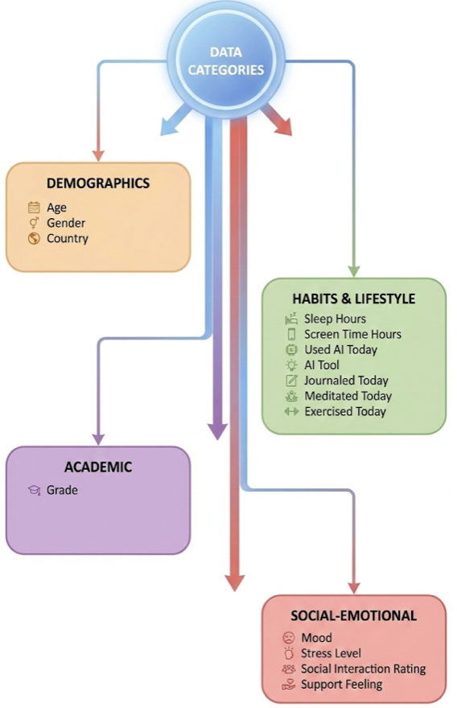
Problem & Data
Dataset: ~1000 students × 30 days (~30,000 rows)
Features:
  Mood
  Sleep & screen time
  Social interaction & support
  Demographic/contextual variables
Target: Stress Level → Low / Medium / High
Goal:
  Predict daily stress
  Prioritise high-stress detection
Problem Type: Multi-class classification

Slide 3
Models, Metrics & Key Results
Models Evaluated
Logistic Regression (baseline)
Random Forest
XGBoost
Support Vector Machine (final model)
Evaluation Metrics
Recall high-stress ≈ 84% (primary)
Macro F1 (secondary)
Confusion matrix for error analysis
Final SVM Results (with mood)
High-stress recall ≈ 84%
Macro F1 ≈ 0.81
Accuracy ≈ 80%
Ablation Insight
Removing mood → performance collapses to near random
WITH mood → 0.81 Macro F1
WITHOUT mood → ~0.33 (random)

Slide 4
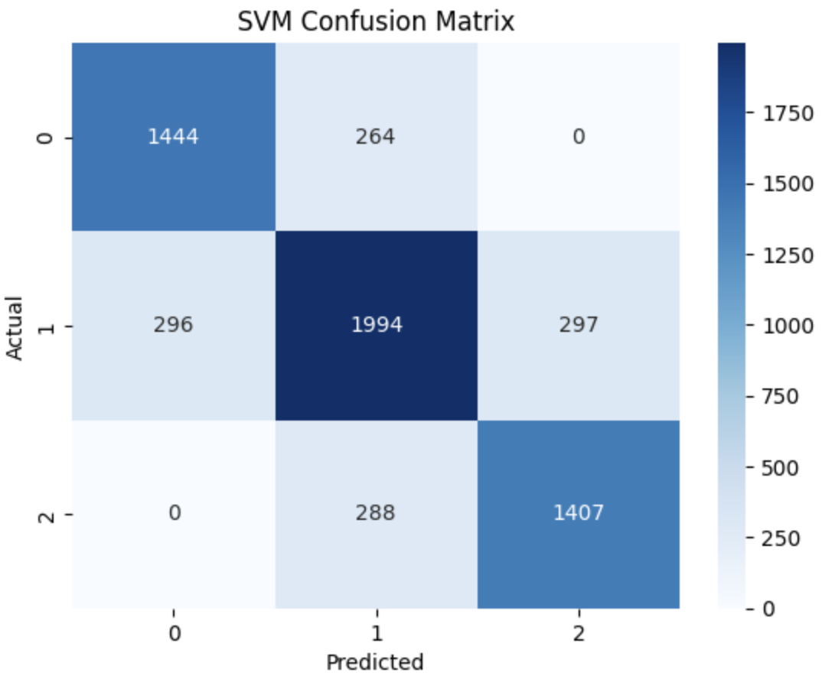
Interpretation, Feature Importance & Conclusion
Feature Importance (Permutation)
Mood overwhelmingly dominant
Sleep & screen time → minimal influence
Confusion Matrix Insight
No Low ↔ High misclassifications
Errors mainly between adjacent classes
Conclusion
Mood is a proximal predictor of stress and behavioural features act mainly as indirect signals
Among all models, the SVM was chosen because it consistently identified high-stress cases and made safer, more realistic errors.

Slide 5
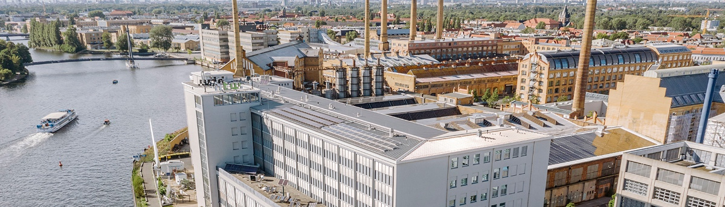
Thank you.

