Slide 1
Amex AI/ML Hackathon
Geek Goddess 2019
Credit Card issuance
Leena Bhandari

Slide 2


Brief Solution
Solution-
Data is studied so as to use only the relevant features (feature engineering). Various classification algorithms are tried to figure out which performs well. Ensemble learning is incorporated to improve the score. Finally, hyperparameter optimisation is performed on the model. Metric used for evaluation is f1_score.
The problem- Given the attributes of a person and some historic data, whether a credit card is to be issued or not?
The idea- Build a classification model to predict whether credit card is to be issued or not keeping into account its effectiveness and simplicity. Trial and Error method is used to see what works.

Slide 3
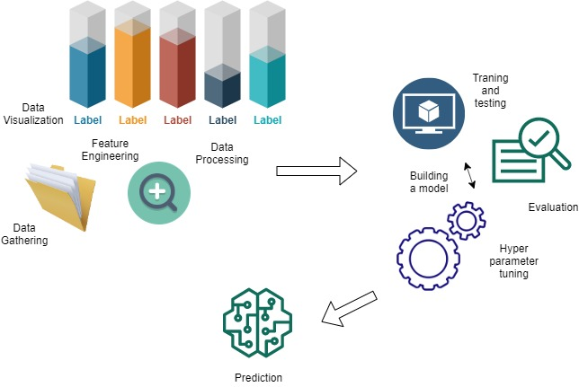

Technical architecture/
POC
We have used the following steps to build a model-
1. Prepare training and testing datasets.
2. Choose a model.
3. Training.
4. Evaluation.
5. Hyperparameter tuning
6. Prediction

Slide 4





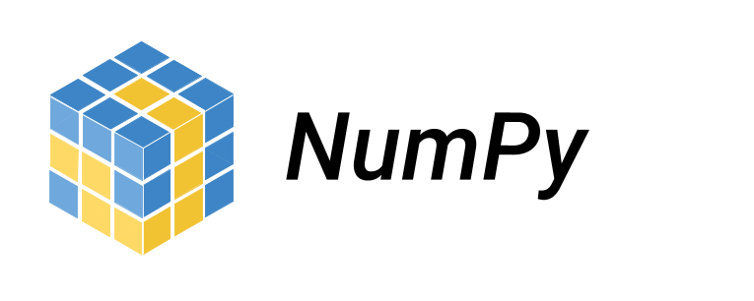



Technology/
Tool Stack/
Libraries
Tools-
Anaconda, Jupyter Notebook
Language- Python
Libraries-
ScikitLearn - algorithms
Pandas- data structures
Numpy- array processing
Matplotlib- data visualization
Seaborn- plotting data

Slide 5

CG_TEAM_NP
Prototype
The link below give the details about how the model has been implemented. It describes the process in detail.
https://drive.google.com/file/d/12X1iQU1YPr2-zKt79cs7ILwnP9wgSfOm/view?usp=sharing

Slide 6

Impact of Usage
It brings advanced data analytics to combat fraudulent transactions and improve compliance. It brings the following to the table-
Effective decision-making
Prediction of future outcomes and trends
Enhanced customer experience
Impact of usage
kn

Slide 7




Possible Improvement
Data:
More amount of training data would lead to a stronger model. However that’s not the only factor. The data collected could have more features apart from the given attributes. The following features can give a better insight-
Criminal records
Health information.
Assets owned
Spending patterns
Process:
More methods can be tested if data available is sufficiently large. Also, this would mean better computation power. Trial and error method would help to find the right model. The following could help in this field-
Cloud platforms
Sophisticated 3D visualization
Domain Expertise

Slide 8

Challenges faced
Domain Knowledge
Data availability was limited
Computation power limited to local machine
Time for research

Slide 9


