Slide 1
Better time

Slide 2
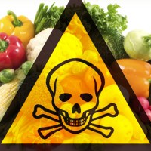
A picture is worth a thousand words
Food is the consumed to provide nutritional support. What if it is doing the opposite?

Slide 3
3,51,000
Whoa! That’s a big number.
This is the number of people who die every year due to food adulteration according to WHO.

Slide 4
"Adulteration" is a legal term meaning that a food product fails to meet federal or state standards.

Slide 5
ADULTERATION
ADULTERATION IN EVERYDAY FOOD
Food adulteration has been greatly increased during last couple of years. Along with basic food grains like rice and wheat, and spices like ‘chillies’, ‘black pepper’, ‘turmeric’ etc. packaged water and bottled soft drinks are also in the area of adulteration.
RECENT ANALYSIS
In a recent report, the Public Health Foundation of India attributed 80 percent of all premature deaths to contaminated food and water.
"Food adulteration in India starts from the field itself where fertilizers and pesticides are overused. Therefore one kind of contaminant that is present across all range of food is very high level of pesticide residues,"
More info at http://www.dw.com/en/food-adulteration-a-rising-problem-in-india/a-5958444
This is one of the articles and there are many more..

Slide 6
CONCEPT
Our idea is to use technology to fight with this social ill namely Food Adulteration.

Slide 7

Want big impact
But it starts from
small steps

Slide 8
Implementation
Signup on the webapp
Login
Here if you have any news related to the topic you may post it or you can review what others have to say.
This will help in spreading awareness about the topic and people will automatically stop buying products which are adulterated.

Slide 9
FEATURES
Open for everyone
This portal will be available for everyone. This means anyone can sign up and post whatever they have to say. More the number of people more will be the impact and more will be its accuracy.
Genuinity Meter
This is a small algorithm which calculates how genuine the news is. It uses the feedback of other users to calculate
Comments to support
If one agrees with one post but has more to say on that topic he/ she can add his own references in the comment section after every post. Similarly, he/she can also add why they disagree.

Slide 10
Our process is easy
Login/Signup
Post
Review

Slide 11
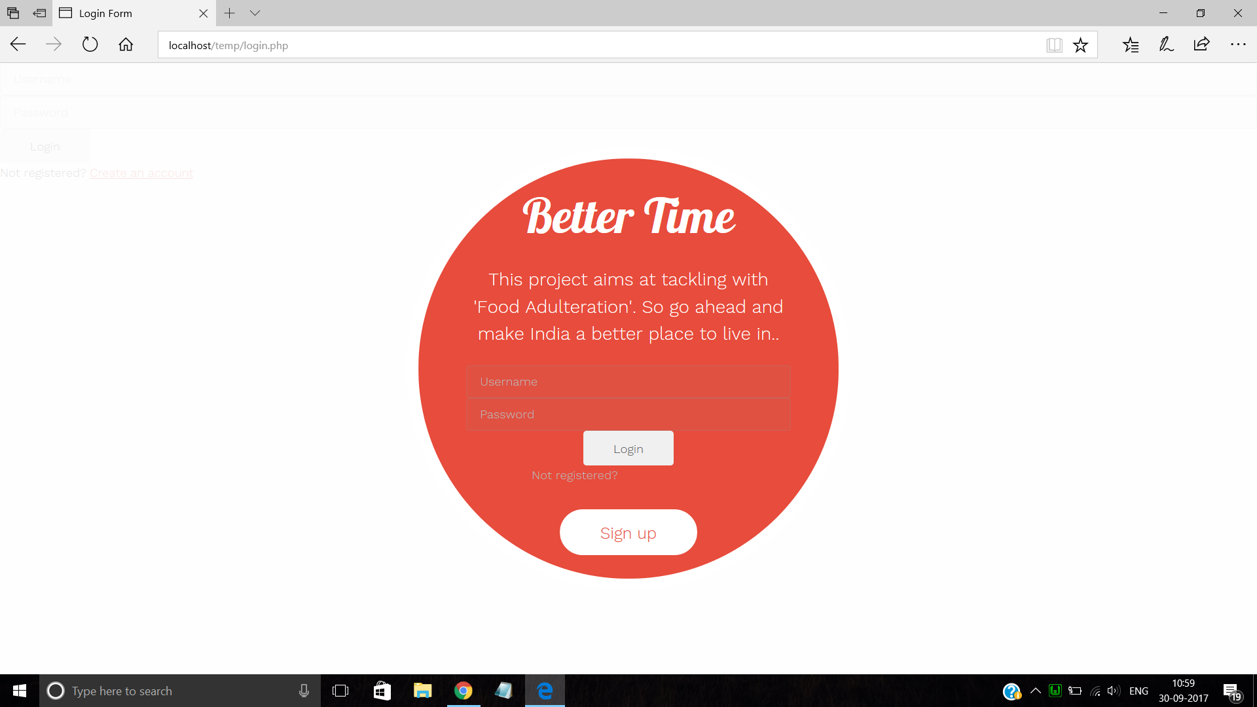
Place your screenshot here
Desktop project

Slide 12
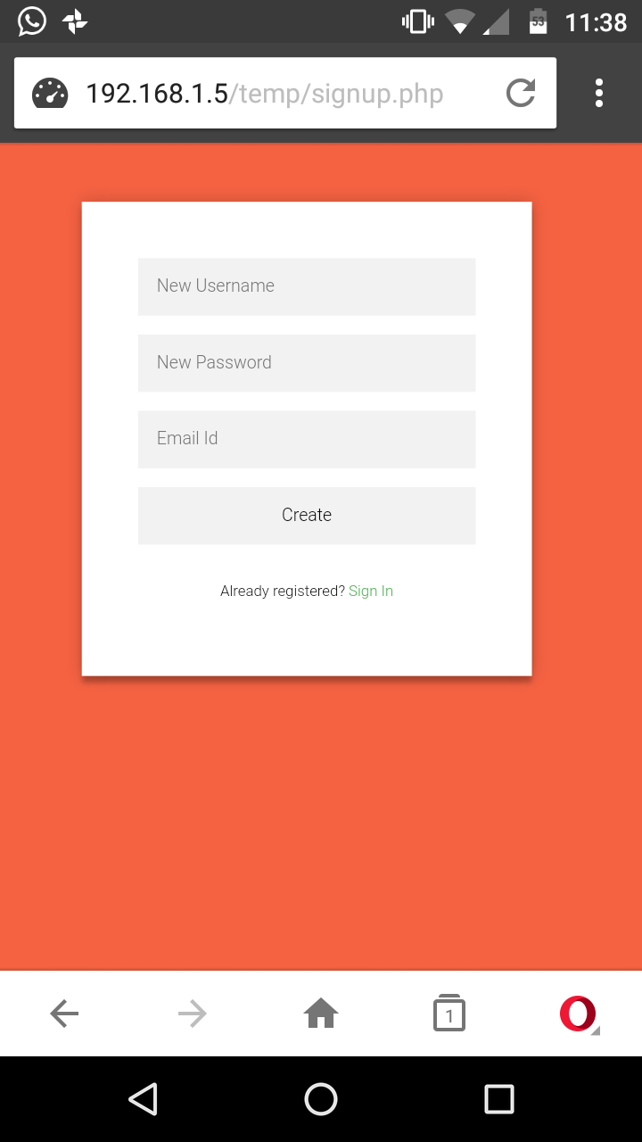
Place your screenshot here
Mobile Accessible

Slide 13
About this project and further scope
We chose this topic for the theme ‘SOCIETY’. We planned to create a webpage as even today it is the most used type of application and accessible to all those devices having a browser. Which is pretty much every smart device,
Php is used for the basic coding of the project. All the functions are created using PHP. Also MySQL runs on the backend. It is the database system used to take care of the data created and used. Also, HTML is used to make it user friendly.
This project is basic but has a scope. It runs on a local server currently, but can be hosted on the internet. More features can be added such as filters, security constraints, robo checks, etc.

Slide 14
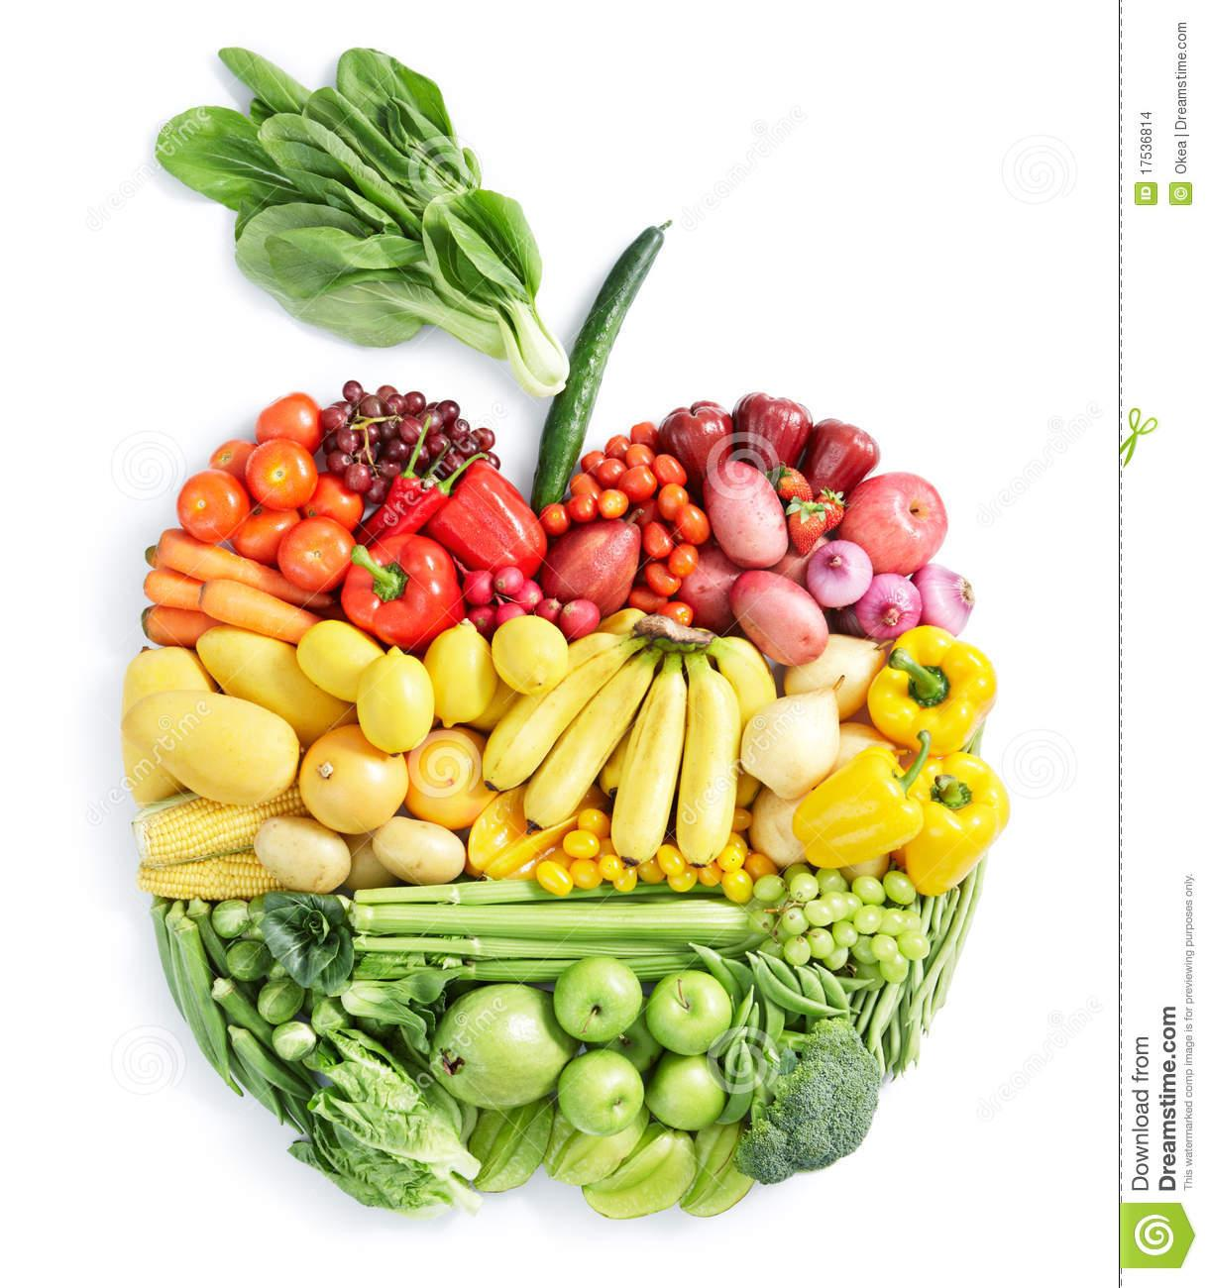
Hello!
This was a small demo of our project.
Hope you liked it..

Slide 15
Thanks!
Any questions?
Team:
Leena Bhandari
Atharva Vaidya

