Slide 1
CAR PROJECT

Slide 2
Presented by
Leena chatterjee

Slide 3
Contents:
Introduction
Problem Statement And Understanding
EDA Steps
Visualizations
Steps And Assumptions
Finalized Model
Conclusion

Slide 4
Introduction
CARS24 is an online used car marketplace that is headquartered in Gurugram, Haryana, IndiaThe company sells more than 1,50,000 cars annually.The company is considered among the four major organised players in the used car segment in India.
Cars24 was founded in 2015 by Vikram Chopra, Mehul Agrawal, Gajendra Jangid and Ruchit Agarwal as a platform to buy and sell used cars.^{[3]} In 2021, the company expanded operations internationally in several countries, including the United Arab Emirates and Australia.
Here we have fetched used car data for buying a car and trying to predicting the price based on car history(accidental or non-accidental), monthly Emi ,fuel type

Slide 5
EDA Steps
Variable Identification: Identification of target variable. The feature “Price” is the target variable. As the problem statement explains the predict the price of the car, we can say that “Price” is the target variable.
Missing values treatment:There are many missing values in the dataset.
Outlier treatment: As al the columns are categorical so we did not remove
Encoder: Encoding the categorical data using Label Encoder.
Scaling: Scaling all the values to a single scale using standard scalar

Slide 6
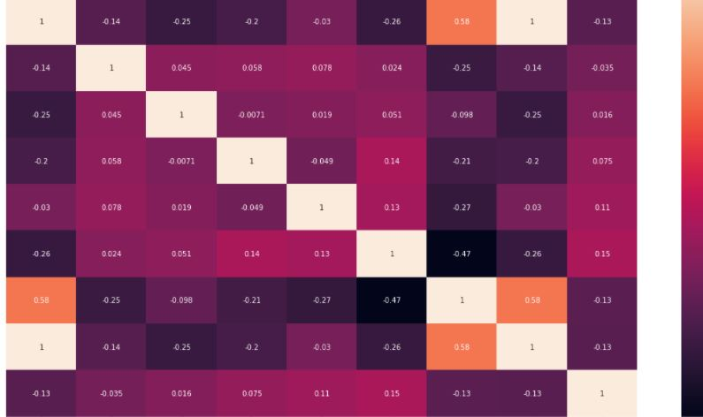
Visualizations
To know the relationship between the variables we used heatmap with correlation.
Used various plots to know the relationship among feature variables against target column.

Slide 7
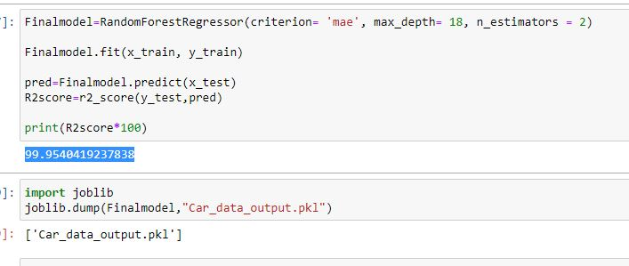
finalized model
Random forest Regressor has the best performance metrics with a good R2 score. So, we chose this as the finalized model.

Slide 8
conclusion
The goal is to achieve the system which will reduce the human effort to find a car having reasonable price. The proposed system car Price Prediction model approximately tries to achieve the same one. We have managed out how to prepare a model that gives users for a best approach with future lodging value predictions.

