Slide 1
Flight Fare Prediction
Fare Prediction

Slide 2
Presented by
Leena chatterjee

Slide 3
Contents:
Introduction
Problem Statement And Understanding
EDA Steps
Visualizations
Steps And Assumptions
Finalized Model
Conclusion

Slide 4
Introduction
Airline companies use complex algorithms to calculate flight prices given various conditions present at that particular time. These methods take financial, marketing, and various social factors into account to predict flight prices.
Nowadays, the number of people using flights has increased significantly. It is difficult for airlines to maintain prices since prices change dynamically due to different conditions. That’s why we will try to use machine learning to solve this problem. This can help airlines by predicting what prices they can maintain. It can also help customers to predict future flight prices and plan their journey accordingly.

Slide 5
EDA Steps
Variable Identification: Identification of target variable. The feature “Fare” is the target variable. As the problem statement explains the predict the Fare of the Flight ticket, we can say that “Fare” is the target variable.
Missing values treatment: There are many missing values in the dataset.
Outlier treatment: As al the columns are categorical so we did not remove any
Encoder: Encoding the categorical data using Label Encoder.
Scaling: Scaling all the values to a single scale using standard scalar

Slide 6
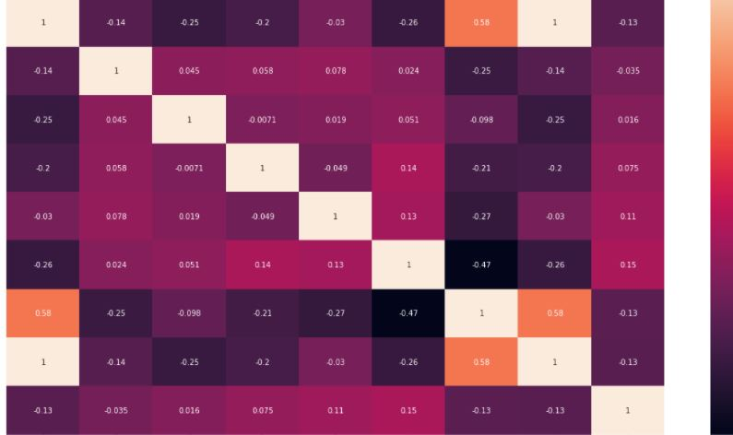
Visualizations
To know the relationship between the variables we used heatmap with correlation.
Used various plots to know the relationship among feature variables against target column.

Slide 7
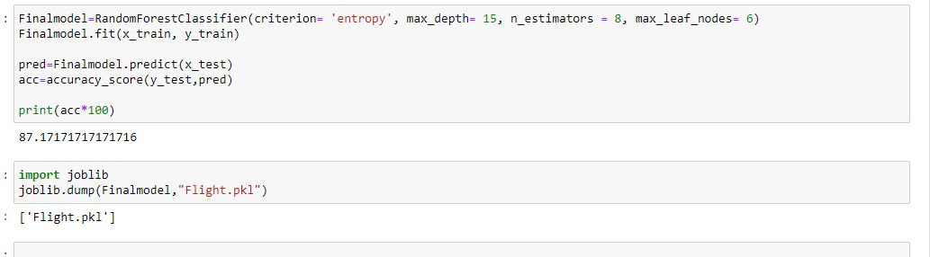
finalized model
Random forest Classifier has the best performance metrics with a good Accuracy score. So, we chose this as the finalized model.

Slide 8
conclusion
The goal is to achieve the system which will reduce the human effort to get flight at reasonable price. The proposed system Fare Prediction model approximately tries to achieve the same one. We have managed out how to prepare a model that gives users for a best approach to buy flight ticket with value predictions.

