Slide 1


Presented by Leena chatterjee

Slide 2
Agenda of discussion
What is MI
Type of machine learning
Project topic
Data types
Data visualization though univariate , bivariate and mulvariate graph plotting
Model Analysis
Best model selection
Hyper tuning
Calculate Final model and save final model
Summery
Challenges

Slide 3
What is MI ?
Machine learning is the study of computer algorithms that improve automatically through experience and by the use of data. It is seen as a part of artificial intelligence.

Slide 4
A study of machine learning
Machine Learning
Supervised
learning
Regression
Classification
Unsupervised
Learning

Slide 5
Machine learning of “ Micro-Credit Defaulter Model” to help client selection of customers for the credit loan of mobile balance
Dataset is categorial data ,In this dataset target variable is label which will represent value as 0 and 1. Label ‘1’ indicates that the loan has been payed i.e. Non- defaulter, while, Label ‘0’ indicates that the loan has not been payed i.e. defaulter.

Slide 6
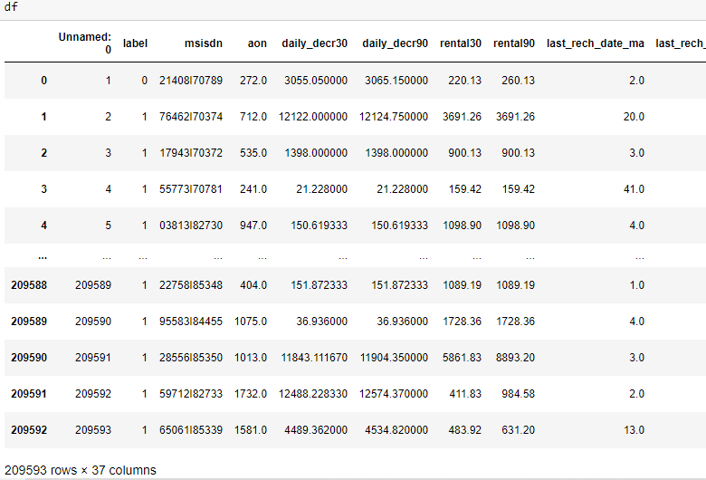
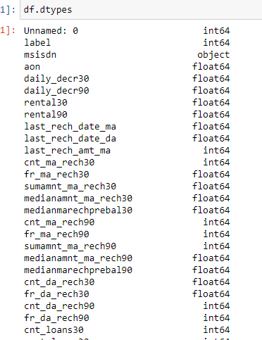
Data and datatypes:

Slide 7
Univariate analysis
Kde plot --- x axis represent value of column and y axis represent kernel density we understand data distribution
Box plot-- In descriptive statistics, a box plot or box plot is a method for graphically depicting groups of numerical data through their quartiles. Box plots may also have lines extending from the boxes indicating variability outside the upper and lower quartiles, hence the terms box-and-whisker plot and box-and-whisker diagram.
Count plot- A countplot is kind of like a histogram or a bar graph for some categorical area. It simply shows the number of occurrences of an item based on a certain type of category

Slide 8
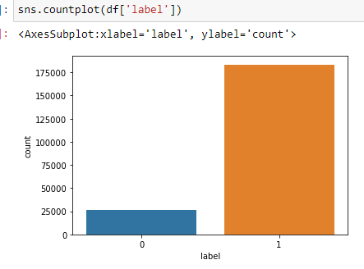
Countplot
sns.countplot(df['label'])
Observation -- we do see here class is imbalanced

Slide 9
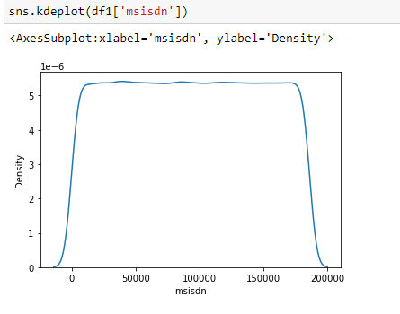
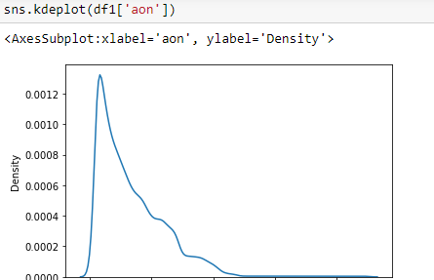
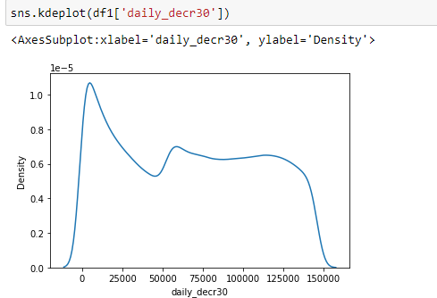
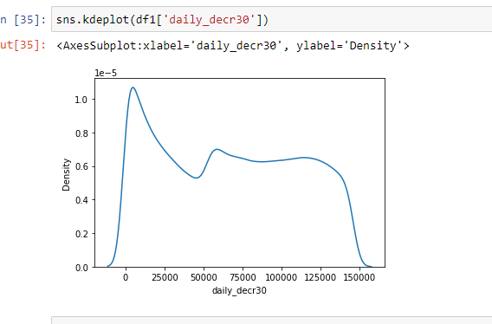
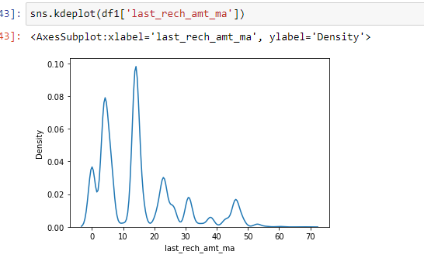
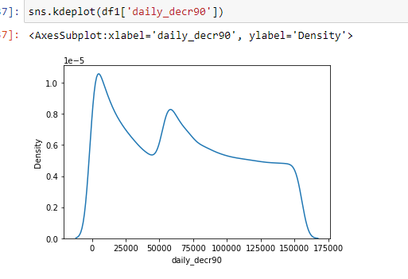
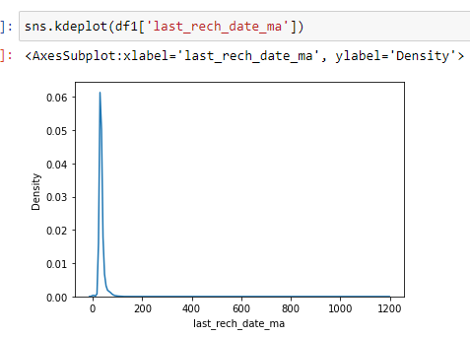
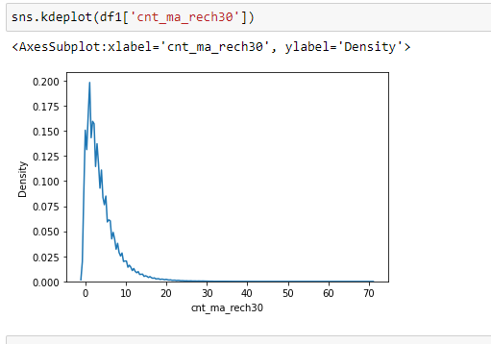
KDEplot:

Slide 10
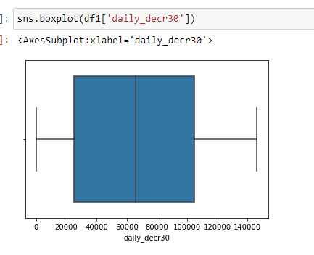
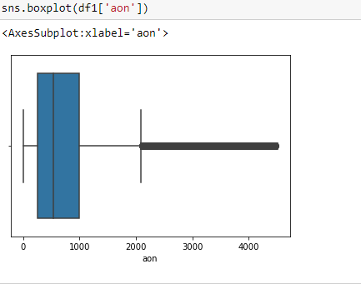
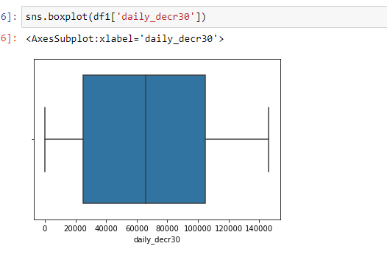
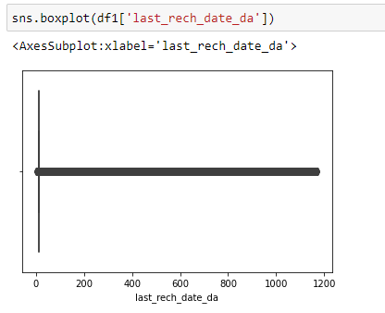
Boxplot:

Slide 11
Bivariate analysis
A scatter plot is a type of plot or mathematical diagram using Cartesian coordinates to display values for typically two variables for a set of data. If the points are coded, one additional variable can be displayed

Slide 12
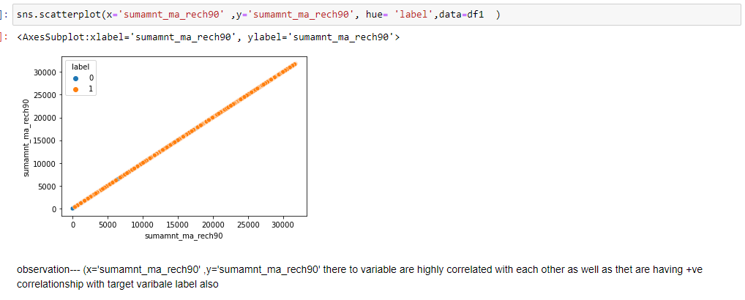
Scatterplot

Slide 13
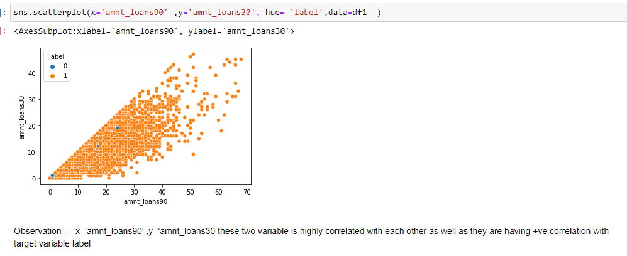
Scatterplot

Slide 14
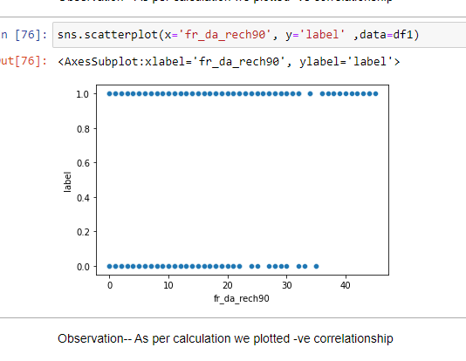
Scatterplot

Slide 15
Multivariate Analysis
Heatmap
This visualization style came a long way from simple color-coded tables, it became widely used with data, and its commonly applied for describing density or intensity of variables, visualize patterns, variance.
Pairplot: A pair plot plot a pair wise relationships in a dataset. The pairplot function creates a grid of Axes such that each variable in data will by shared in the y-axis across a single row and in the x-axis across a single column

Slide 16
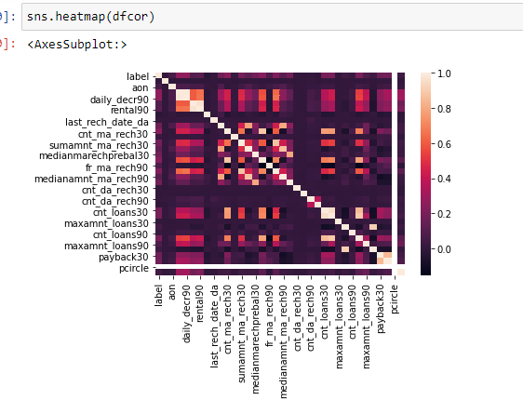
Heatmap
dfcor=df.corr()

Slide 17
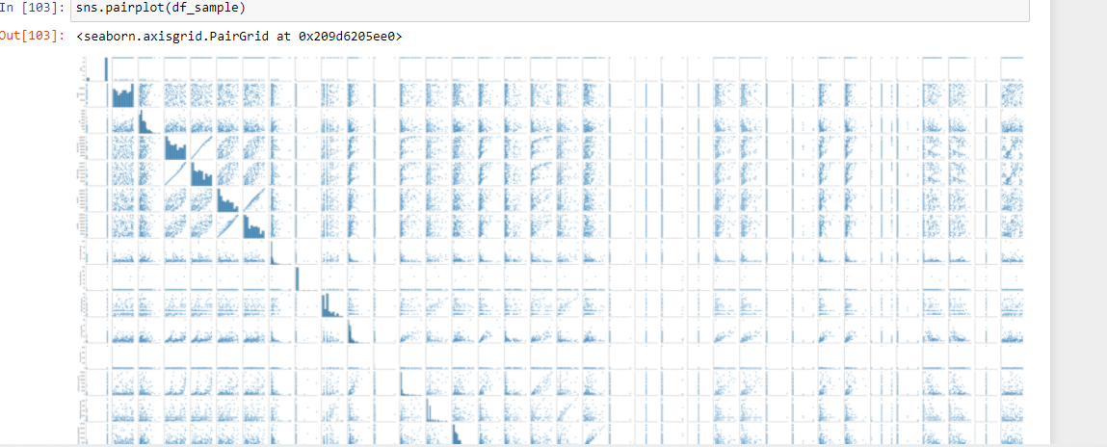
Pairplot

Slide 18
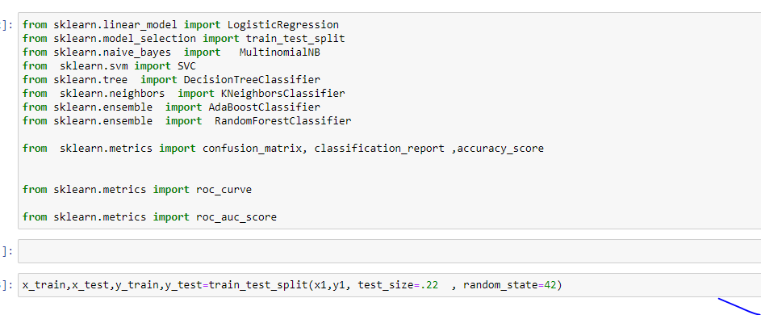
Train-test split
The train-test split is a technique for evaluating the performance of a machine learning algorithm. It can be used for classification or regression problems and can be used for any supervised learning algorithm. The procedure involves taking a dataset and dividing it into two subsets

Slide 19
Testing of Identified Approaches (Algorithms)
We have performed train test where we have send data to model ( some data for training and some for testing ). We have used 5 model inthis analysis
DecissionTree Classifier Model
Random Forest Model
Ada-boost Model
KNeighbour Model
SVC Model

Slide 20
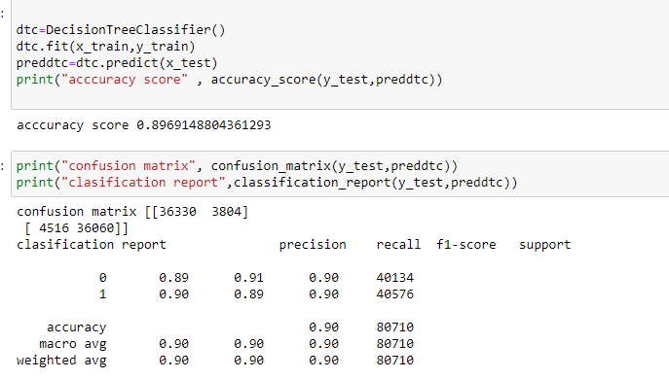
ALGORITHIM DecissionTree Classifier Model:

Slide 21
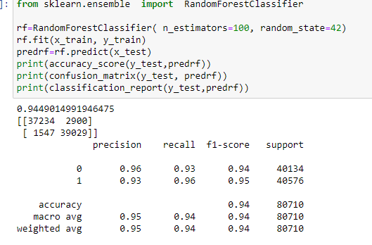
RandomForestClassifier

Slide 22
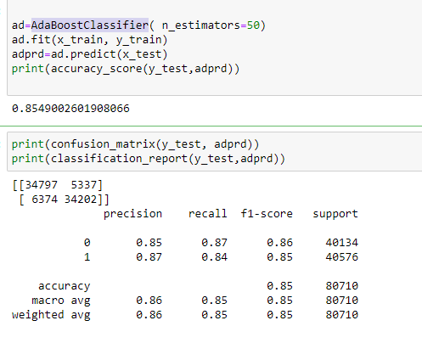
AdaBoostClassifier

Slide 23
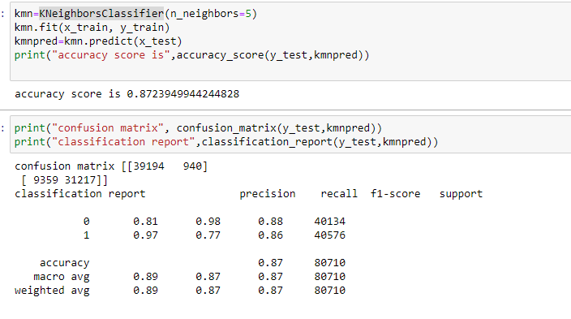
KNeighborsClassifier

Slide 24
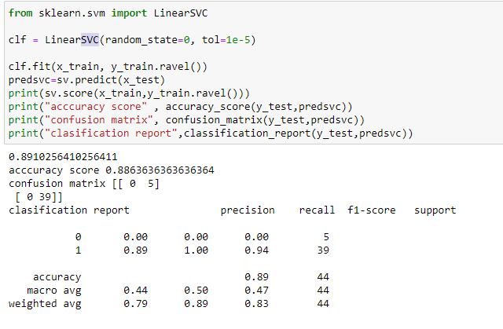
SVC

Slide 25
ROC-AUC curve
The ROC curve shows the trade-off between sensitivity (or TPR) and specificity (1 – FPR). Classifiers that give curves closer to the top-left corner indicate a better performance. As a baseline, a random classifier is expected to give points lying along the diagonal (FPR = TPR).
AUC ROC score:
AUC means area under the curve so to speak about ROC AUC score we need to define ROC curve first. It is a chart that visualizes the trade-off between true positive rate (TPR) and false positive rate (FPR). ... The more top-left your curve is the higher the area and hence higher ROC AUC score
Using” model. Predict .proba function we analyse all the model roc_auc score and curve we got Random foreset classifier having good roc_auc score and the more top-left your curve is the higher the area

Slide 26
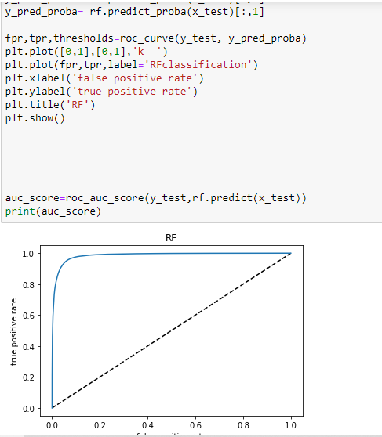



Slide 27
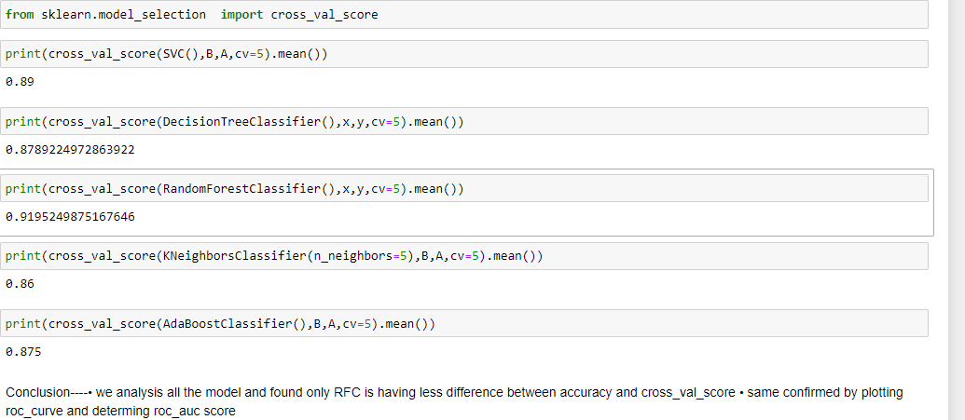
AS we will select best model where accuracy and cross val score will be minimum :

Slide 28
hyper tuning machine learning
We optimize model using hyper tuning parameter (hyper parameter optimization or tuning is the problem of choosing a set of optimal hyperparameters for a learning algorithm. These measures are called hyperparameters, and have to be tuned so that the model can optimally solve the machine learning problem)

Slide 29
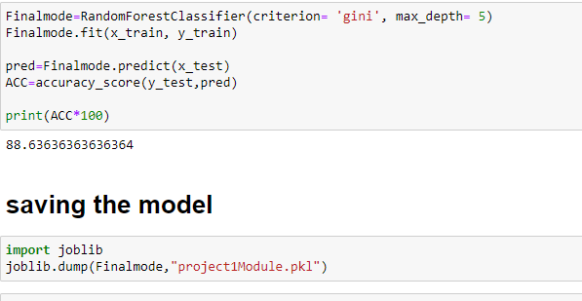
Final model selection and save final model :
Best Model Calculation: form analysis we found that RandonForestClassifier ,we are having less difference between accuracy and cross value score and from hyper parameter tuning we found (criterion= 'gini', max_depth= 5) we will get best model

Slide 30
Summery
we have transform categorical data to numeric using Label Encoder
We have plotted graphical view of each column to understand data distribution , kernel density, as well as for finding outlier concept
As this is categorical data we cannot remove outlier as mean concept not there in categorical data , same confirmed by Data Trained mentor
we drop ‘pcircle’ as all the value of this column is same so it don’t contribute any information to the dataset for analysis
we divided data x and y as a data and target
we analysis all the model and found only RFC is having less difference between accuracy and cross_val_score
same confirmed by plotting roc_curve and determine roc_auc score
We optimize model using hyper tuning parameter (hyper parameter optimization or tuning is the problem of choosing a set of optimal hyperparameters for a learning algorithm. These measures are called hyperparameters, and have to be tuned so that the model can optimally solve the machine learning problem)
We got our final model
We saved out final model in as .pkl file as per client requirement . It is basically Binary format of output

Slide 31
Challenges
The data could be incomplete. even the lack of a section or a substantial part of the data, could limit its usability.
We don’t get always accurate information as data might be not totally completed .
As it is real time data , it is complex data, took long time to execute

Slide 32


