Slide 1
HOUSING PROJECT

Slide 2
Presented by
Leena chatterjee

Slide 3
Contents:
Introduction
Problem Statement And Understanding
EDA Steps
Visualizations
Steps And Assumptions
Finalized Model
Conclusion

Slide 4
Introduction
Houses are one among the required need of every and each person round the globe and thus housing and land market is one among the markets which is one among the main contributors within the world’s economy.
It’s a really large market and there are various companies working within the domain. Data science comes as a really important tool to unravel problems within the domain to assist the businesses increase their overall revenue, profits, improving their marketing strategies and that specialize in changing trends in house sales and purchases.

Slide 5
Problem Statement And Understanding
A US-based housing company named Surprise Housing has decided to enter the Australian market. The corporate uses data analytics to get houses at a price below their actual values and flip them at a better price. For an equivalent purpose, the corporate has collected a knowledge set from the sale of homes in Australia. The corporate is watching prospective properties to shop for houses to enter the market.
The company wants to know:
Which variables are important to predict the worth of variable?
How do these variables describe the worth of the house?
In the real world the problem can be used to detect the worth of homes with the available independent variables.

Slide 6
EDA Steps
Variable Identification: Identification of target variable. The feature “SalePrice” is the target variable. As the problem statement explains the predict the Saleprice of the house, we can say that “SalePrice” is the target variable.
Missing values treatment:There are many missing values in the dataset. So,we imputed the missing values with the relevant values.
Outlier treatment: Handled the outliers by imputing them with nan and then with their median of the respective columns.
Encoder: Encoding the categorical data using Label Encoder.
Scaling: Scaling all the values to a single scale using standard scalar

Slide 7
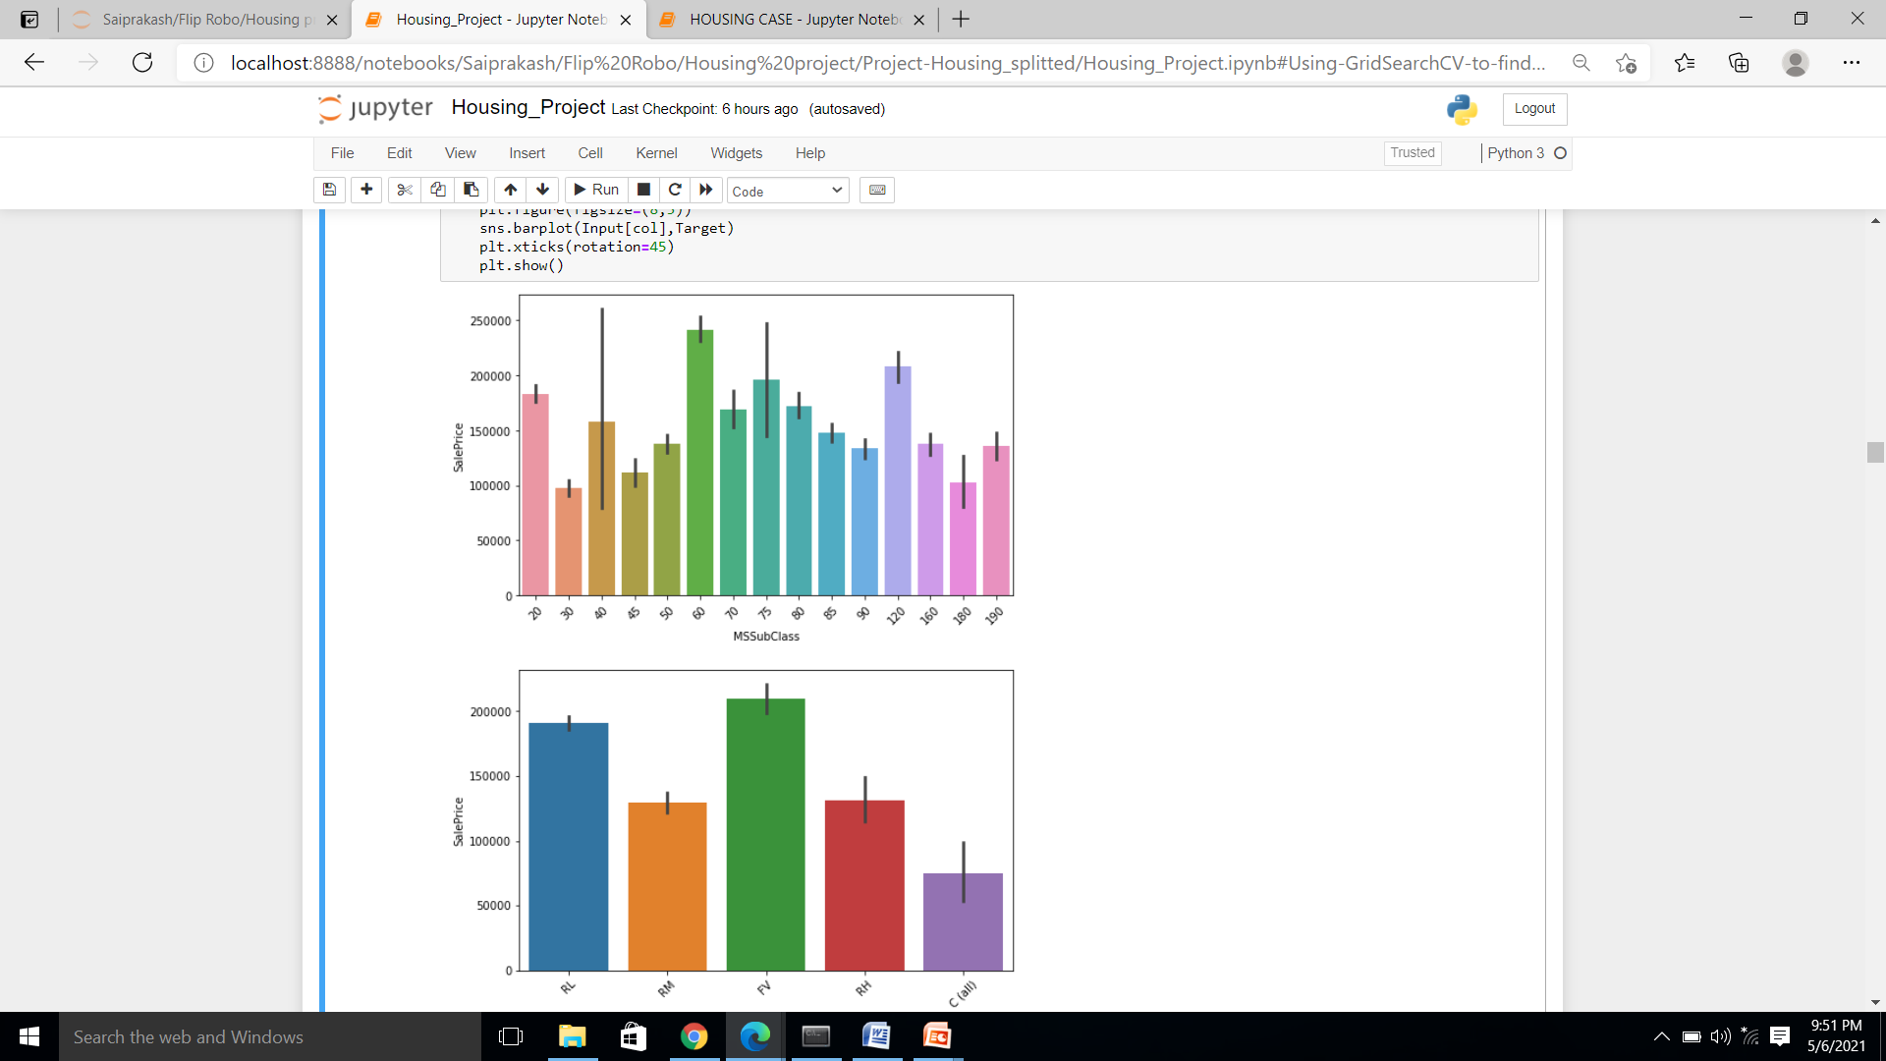
Visualizations
To know the relationship between the variables we used heatmap with correlation.
Used various plots to know the relationship among feature variables against target column.

Slide 8
Steps and assumptions
In the given dataset, 1161 out of 1168 houses have 0 pool area which means no pools and the PoolQC column have same 1161 missing values. So, we can replace the null values in "PoolQC" column with "No Pool".
We can see that Misc Val column has 1126 entries with a value of 0. Misc Feature has 1124 missing values. Then, as with Pool QC, we can say that each house without a "miscellaneous feature" has a missing value in Misc Feature column and a value of 0 in Misc Val column. So let's fill the missing values in Misc Feature column with "No Feature"
Feature Importance columns are chosen and passed into the model.

Slide 9
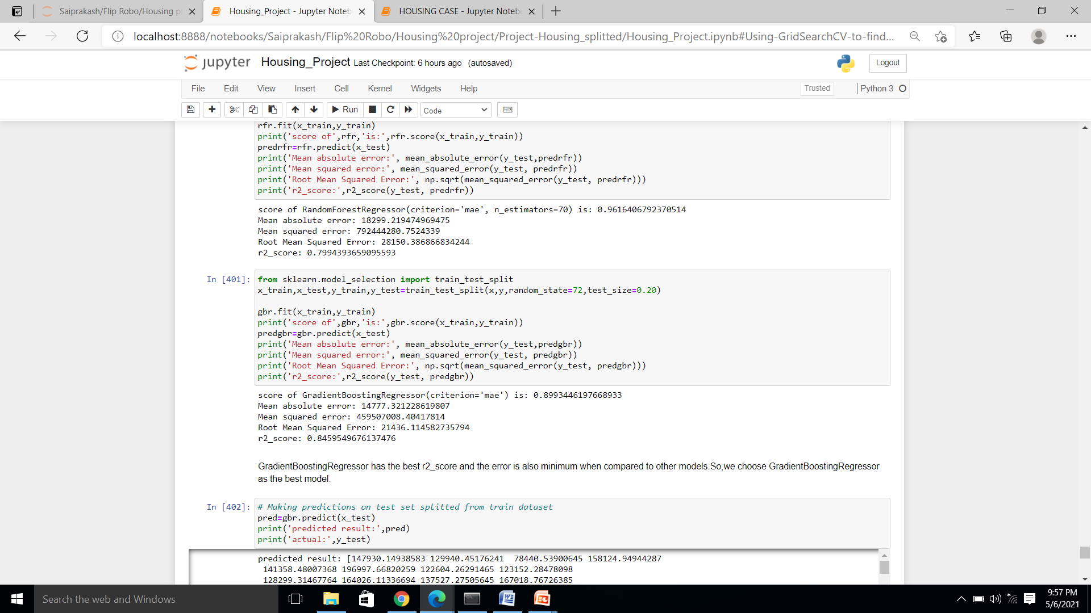
finalized model
GradientBoostingRegressor has the best performance metrics with a good R2 score. So, we chose GradientBoostingRegressor as the finalized model.

Slide 10
conclusion
The goal is to achieve the system which will reduce the human effort to find a house having reasonable price. The proposed system House Price Prediction model approximately tries to achieve the same one. We have managed out how to prepare a model that gives users for a best approach with future lodging value predictions. Proposed system focused on predict the house price according to the area and machine learning methods are used. The experimental results showed that this technique that is used while developing system will give best prediction of house price.

