Slide 1
Big Data Spark

Slide 2
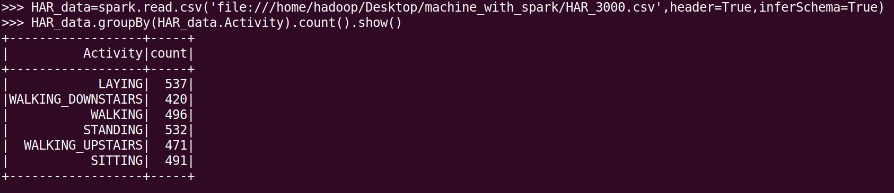
Problem 1 1. Use PySpark to read the data into a DataFrame and print the number of unique classes present in the 'Activity' column.

Slide 3
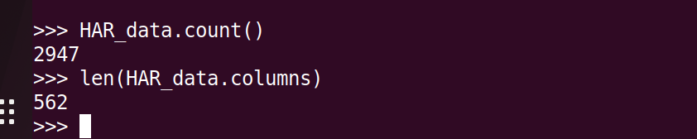
2. What are the dimensions of this dataset?

Slide 4
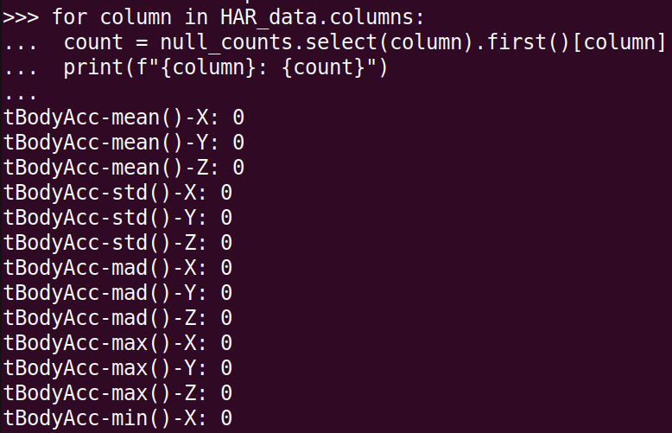
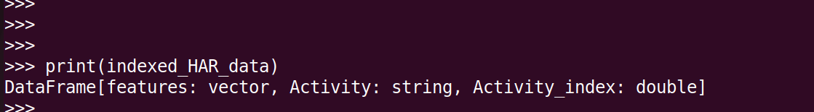
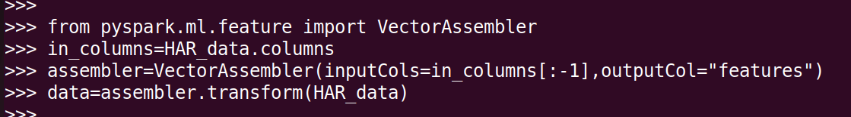
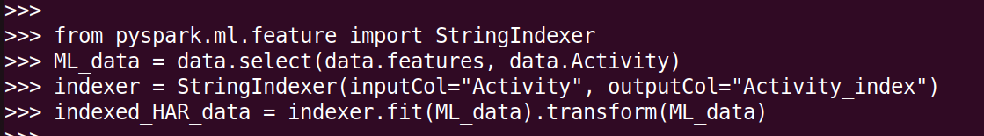
3. Prepare the dataset for the logistic regression classification algorithm.

Slide 5
4. Split the dataset into 80% for training and 20 for testing (use seed=3)

Slide 6
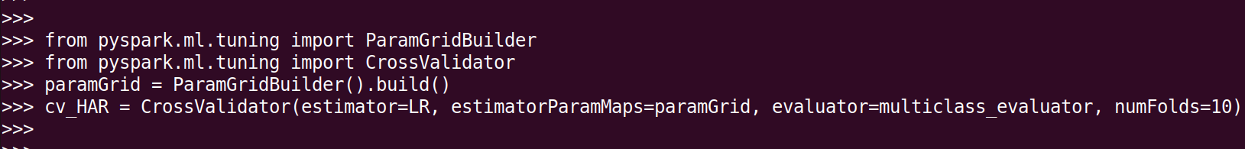
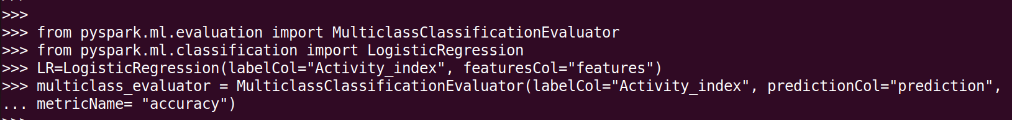

5. On the training dataset, apply logistic regression through cross-validation with a 10-fold.

Slide 7


6. Evaluate the best model on the unseen testing dataset generated above

Slide 8

7. Use multiclass classification evaluation and print out the accuracy

Slide 9
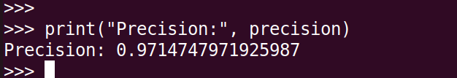
7. Use multiclass classification evaluation and print out the precision

Slide 10
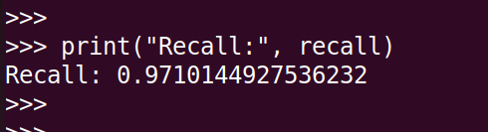
7. Use multiclass classification evaluation and print out the , recall

Slide 11
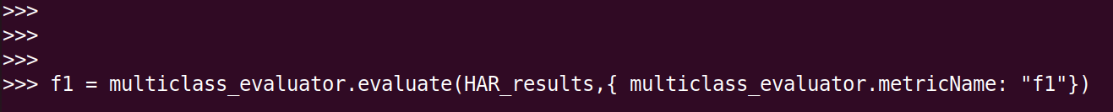

7. Use multiclass classification evaluation and print out the , F1-score

Slide 12
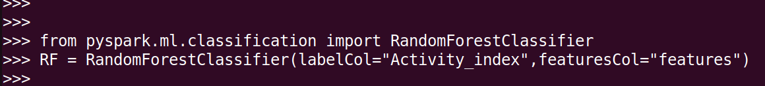
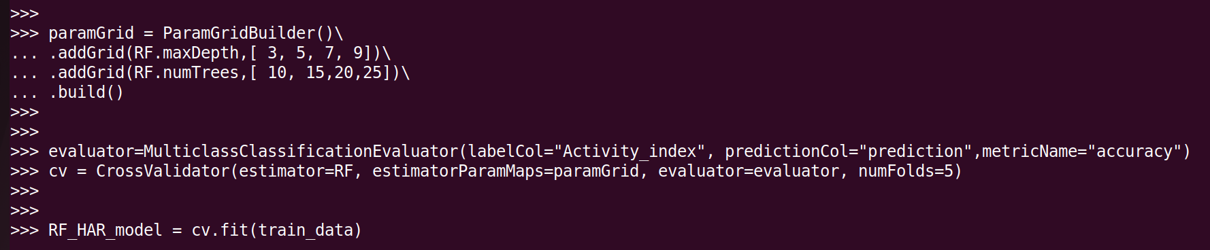
8.1 Use the grid search method to set the number of trees where the searching space is [ 10, 15, 20, 25]

Slide 13

8.1 Accuracy

Slide 14
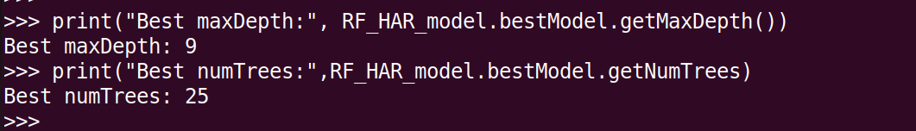
8.2 Which combination shows the maximum accuracy?

Slide 15
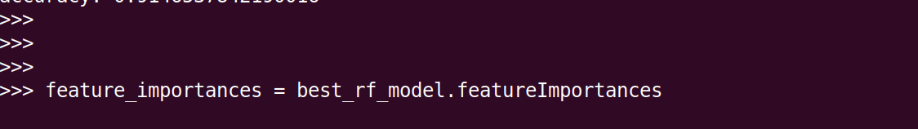
8.3 Extract the top 50 important features according to the RandomForest model you developed.

Slide 16
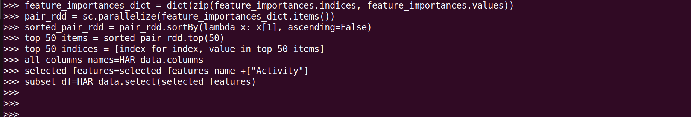
8.3 & (8.4 Subset the original dataset and keep only the top 50 features selected above + the Activity column)

Slide 17
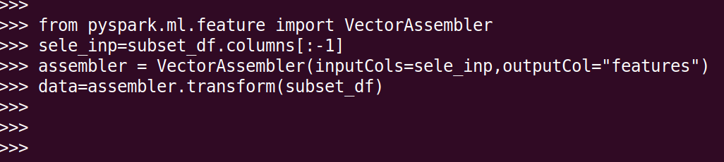
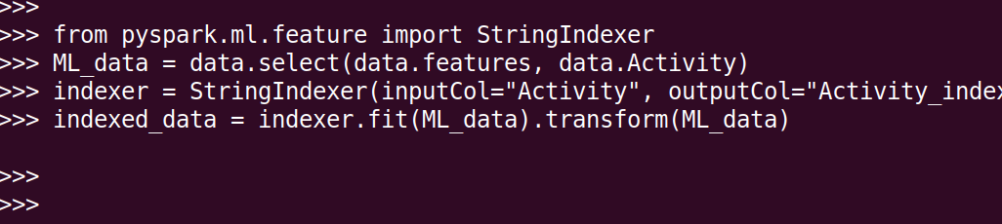
Prepare the new subset dataset (50 features + Activity label

Slide 18
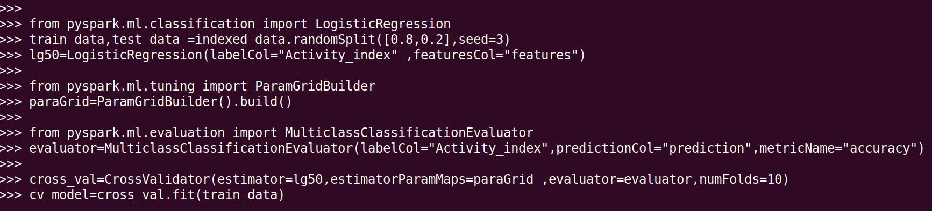
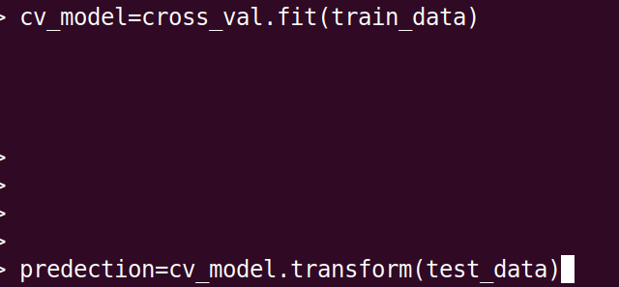
9.apply logistic regression again,and evaluate the model on the unseen testing dataset.

Slide 19
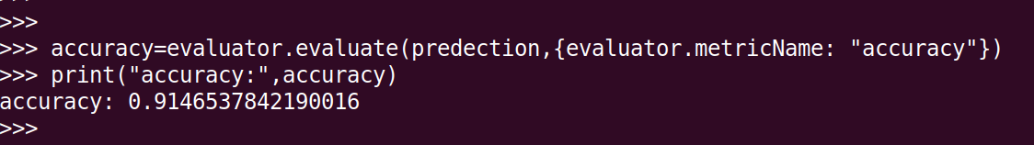
Accuracy after Extracting the top 50 important features

Slide 20
Accuracy for part 7
Accuracy for part 9

Slide 21
Comparing the accuracy in part (7) and part(9)
Upon implementing logistic regression across a spectrum of 562 features, an impressive accuracy of 97% was attained. Remarkably, the area under the curve (AUC=97) analysis indicates an absence of overfitting concerns. However, a nuanced revelation surfaces when logistic regression is confined to the top 50 features, yielding a slight reduction in accuracy, albeit maintaining a commendable level. The optimal choice between these approaches hinges upon the specific domain and objectives. In domains of heightened sensitivity such as medicine, allocating additional resources in terms of cost and computing time could be justified. Conversely, in less critical domains, a marginal sacrifice in accuracy, which remains robust, may be acceptable to achieve cost efficiency and expedited processing with reduced storage requirements.

Slide 22
In our case ( HAR)
In the realm of Human Activity Recognition (HAR), particularly crucial in the medical field, our preference leans heavily towards an impressive accuracy rate of 97%. Despite the associated costs in terms of financial investment, storage requirements, and processing time, this robust accuracy is deemed indispensable. The imperative lies in prioritizing precision and reliability, acknowledging the critical nature of HAR applications in the medical domain.

Slide 23
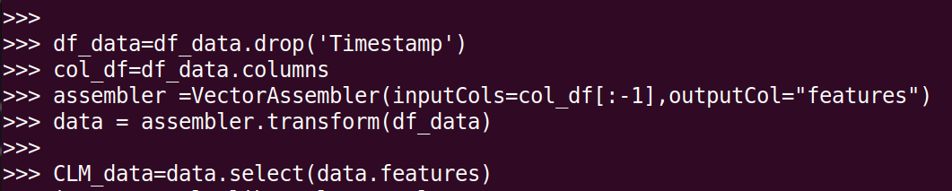
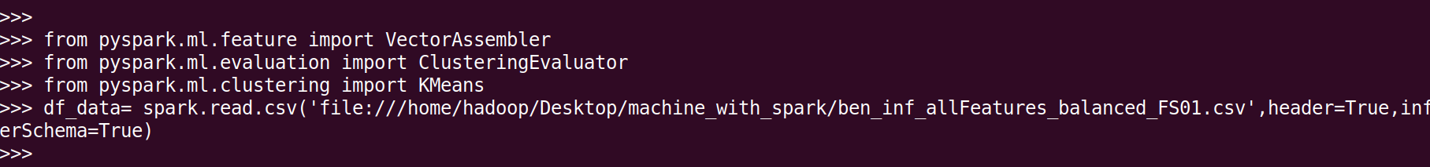
Problem 2
1. Read the dataset, create a data frame, and prepare the dataset for clustering using the PySpark k-mean algorithm. Please use seed= 99.

Slide 24
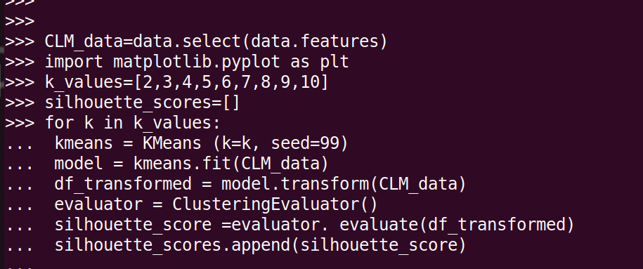
2. What is the value of K that maximizes the overall Silhouette Score? You may need to try values between 2 and 10. Remember, you need to show the evidence. A good one could be the figure in Ch05-Slide number 31

Slide 25
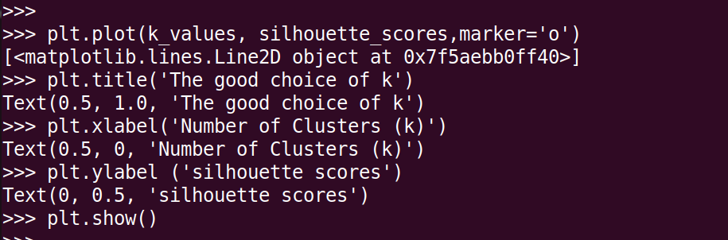
2. What is the value of K that maximizes the overall Silhouette Score? You may need to try values between 2 and 10. Remember, you need to show the evidence. A good one could be the figure in Ch05-Slide number 31

Slide 26
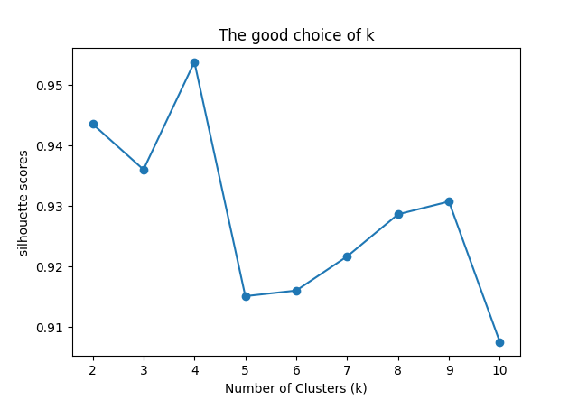
The figure
K=4 is the best because is Silhouette Score closest to 1

