Slide 1

Driver Drowsiness Detection
RNS INSTITUTE OF TECHNOLOGY
BENGALURU - 98
DEPARTMENT OF INFORMATION SCIENCE & ENGINEERING
Presentation on Internship
Leena Tripura Chandra
USN: 1RN18IS063
New Age Solutions Technologies
Internal Guide
Ms. Sudha Vinayakam
Asst. Prof, Dept of ISE, RNSIT
External Guide
Mr. Deepak Garg
CEO, NASTECH

Slide 2
AGENDA
Abstract
About the Company
Introduction
Literature Survey
Requirements
System Design
Implementation
Results
Conclusion
Future Enhancements
References

Slide 3
ABSTRACT
Drowsiness and Fatigue of drivers are amongst the significant causes of road accidents. Every year, they increase the amounts of deaths and fatalities injuries globally.
Therefore, there is a need to develop a systems that will detect the driver’s bad psychophysical condition, which could significantly reduce the number of fatigue-related car accidents.
However, the development of such systems encounters many difficulties related to fast and proper recognition of a driver’s fatigue symptoms.
One of the technical possibilities to implement driver drowsiness detection systems is to use the vision-based approach. The technical aspects of using the vision system to detect a driver drowsiness are also discussed.

Slide 4
About the Company
NASTECH – New Age Solutions & Technologies
Is a popular highly functioning IT Consulting Firm with offices in Nigeria, United Kingdom and United States.
Providing IT Consulting services in the areas of Software Development, E-Commerce and Payments, Workflow Improvement, Data Solutions, Network Infrastructure, Deployment and Support.
We transform great ideas and workflows into solutions and automated processes
Some of the industry and sector specific solutions offered by NASTECH are as follows:
AVIS-RDS - Omni-Channel Aviation Retailing System
FINAC - Accounts and Tax Solution for Small Businesses
HMIS - Hospital Management, Health Information System

Slide 5
INTRODUCTION
Real Time Drowsiness behaviors which are related to fatigue are in the form of eye closing, head nodding or the brain activity. Hence, we measure change in physiological signals, such as brain waves, heart rate and blinking to monitor drowsiness or consider physical changes such as sagging leaning of driver's head and open/closed state of eyes.
The former technique, while more accurate, is not realistic since highly sensitive electrodes would have to be attached directly on the driver body and hence which is distracting to the driver. Hence we are utilizing eyes and mouth as the region of interest.
The algorithm starts with the detection of face in the image using haar-cascade features and classify it. By normalizing the distance and position of the reference points, all faces should be transformed into the same size and position.
For normalization, eyes serve as point reference. Other OpenCV algorithm finds the eyes on any grayscale image by searching characteristic features of the eyes using haar-cascade file. Tests made on a standard database show that the algorithm works very fast and it is reliable

Slide 6
LITERATURE SURVEY
METHODOLOGIES There are different methodologies to identify drowsiness state of the driver. They can be categorized into the following three main categories:
1. Behavioral Parameters Based: Measuring the driver’s fatigue without using non-invasive instruments comes under this category. Analyzing the behavior of the driver based on his/her eye closure ratio, blink frequency, yawning, position of the head and facial expressions.
2. Vehicular Parameters Based: Measuring the fatigue nature of the driver through vehicle driving patterns comes under this category. parameters include lane changing patterns, steering wheel angle, steering wheel grip force etc.
3. Psychological Parameters Based: Measuring the drowsiness of the driver based on the physical conditions of the driver fall under this category. Parameters may be respiration rate, heart-beat rate, body temperature and many more.

Slide 7
LITERATURE SURVEY
DROWSINESS DETECTION THROUGH REGION OF INTEREST: Region of interest (ROI) can detect a driver’s face. As can be seen in the blue rectangle is the region of interest. The way to create an ROI area is to first obtain the green rectangle area from the Haar Cascade Classifier in the first frame, which includes height, width. Then, the rectangle is scaled up to create region of interest
DETECTION OF DROWSINESS THROUGH LBPH: In this algorithm the faces are detected by using local binary patterns histograms (LBPH). The first computational step in lbph is to create an intermediate images that describes the original image in a binary format. The image is converted into matrix form and we need to take a central value of the matrix to be used as and threshold value
MOUTH AND YAWNING ANALYSIS: Fatigue is the major reason for road accidents. To avoid the issue, Sarada Devi and Bajaj proposed the driver fatigue detection system based on mouth and yawning analysis. Firstly, the system locates and tracks the mouth of a driver using cascade of classifier training and mouth detection from the input images.
REAL TIME ANALYSIS USING EYE AND YAWNING: Kumar proposed the real time analysis of Driver Fatigue Detection using behavioral measures and gestures like eye blink, head movement and yawning to identify the drivers’ state. The basic purpose of the proposed method is to detect the close eye and open mouth simultaneously and generates an alarm on positive detection.

Slide 8
Requirements
Functional Requirements
Recording the driver's behavior the moment the trip begins.
Then recognizes changes and detect Eyes and Face to determine drowsiness
Classify the state of the Driver as Open, Closed, Yawn, No_Yawn.
Non- Functional Requirements
Image processing is done using the captured video.
Image is stored in a library called OpenCV.
Stored image undergo various algorithm and detects if the driver’s eyes are closed or open
and detects the presence of a yawn.
Hardware Requirements
Processor Intel or high level
RAM 2 GB
Space on disk Min 2 GB
Device that has internet access
Execution space Min 100mb

Slide 9
Requirements
Software Requirements
Machine learning: is the kind of programming which gives computers the capability to automatically learn from data without being explicitly programmed.
Python: object-oriented programming language created by Guido Rossum in 1989. It is ideally designed for rapid prototyping in complex applications.
TensorFlow: It is an open-source software library for dataflow programming across a range of tasks.
OpenCV: Open Source Computer Vision. It's an Open Source 850 sensed library that includes hundreds of advanced Computer Vision algorithms.
Sklearn: Scikit-learn is an open-source software machine learning library for the Python programming language.
Jupyter Notebook: is the original web application for creating and sharing computational documents.

Slide 10
System Design
The Driver's face is continuously monitored using a video camera. In order to detect drowsiness, the first step is to detect the face using a series of frame shots taken by the camera.
Then the location of the eyes is detected and the retina of the eye is continuously monitored. The captured image is converted to digital signal using Open CV.
To detect the yawn, only the face is considered. For open and closed eyes, face and eyes are detected. The image is then resized and converted to a numpy array with features and labels.
The labels are ‘yawn’, ‘no yawn’, ‘closed’, and ‘open’. During the monitoring, the system is able to decide if the eyes are opened or closed.
A system for driver safety and car security is presented only in the luxurious costly cars. Using drowsiness detection system, driver safety can be implemented in normal cars also.

Slide 11
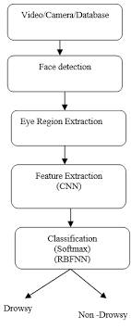
System Design
Model Architecture:
The model used is built with Keras using Convolutional Neural Networks (CNN).
A convolutional neural network is a special type of deep neural network which performs extremely well for image classification purposes.
A CNN basically consists of an input layer, an output layer and a hidden layer which can have multiple layers.
A convolution operation is performed on these layers using a filter that performs 2D matrix multiplication on the layer and filter.
Our model consists of 4 hidden layers and an output layer with 4 nodes.

Slide 12
Implementation
Face Detection
This module takes input from the camera and tries to detect a face in the video input. The detection of the face is achieved through the Haar classifiers mainly, the Frontal face cascade classifier. The face is detected in a rectangle format and converted to grayscale image and stored in the memory which can be used for training the model.
Cascade Classifier
The cascade classifier consists of number of stages, where each stage is a collection of weak learners. The weak learners are simple classifiers known as decision stumps. Boosting is used to train the classifiers. It provides the ability to train a highly accurate classifier by taking a weighted average of the decisions made by the weak learners.

Slide 13
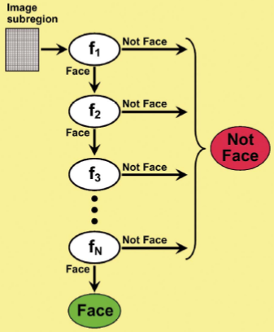
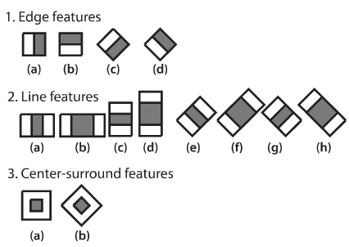
Implementation
Each stage of the classifier shows the region defined by the current location of the sliding window as either positive or negative. Positive indicates an object was found and negative indicates no object.

Slide 14
Implementation
Detect Multiscale detectMultiScale function is used to detect the faces. This function will return a rectangle with coordinates(x,y,w,h) around the detected face. It takes 3 common arguments — the input image, scaleFactor, and minNeighbours. scaleFactor specifies how much the image size is reduced with each scale.
Eye Detection
Since the model works on building a detection system for drowsiness we need to focus on the eyes to detect drowsiness. The eyes are detected through the video input by implementing a haar classifier namely Haar Cascade Eye Classifier. The eyes are detected in rectangular formats.
Face and eye tracking
Due to the real-time nature of the project, we need to track the faces continuously for any form of distraction. Hence the faces are continuously detected during the entire time and the state of the mouth is continuously monitored as yawn or no yawn. The eyes are also tracked continuously to check for open or closed eyes.

Slide 15
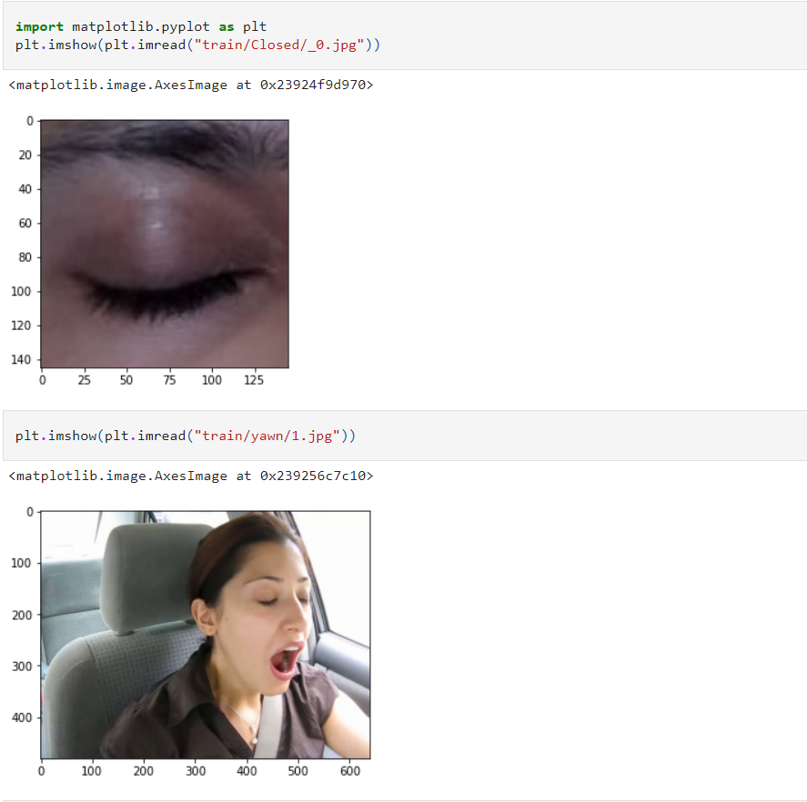
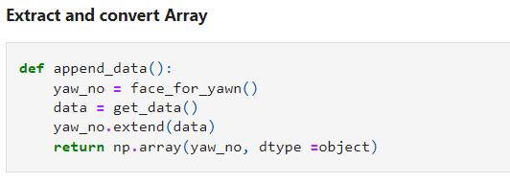
Coding Segment

Slide 16
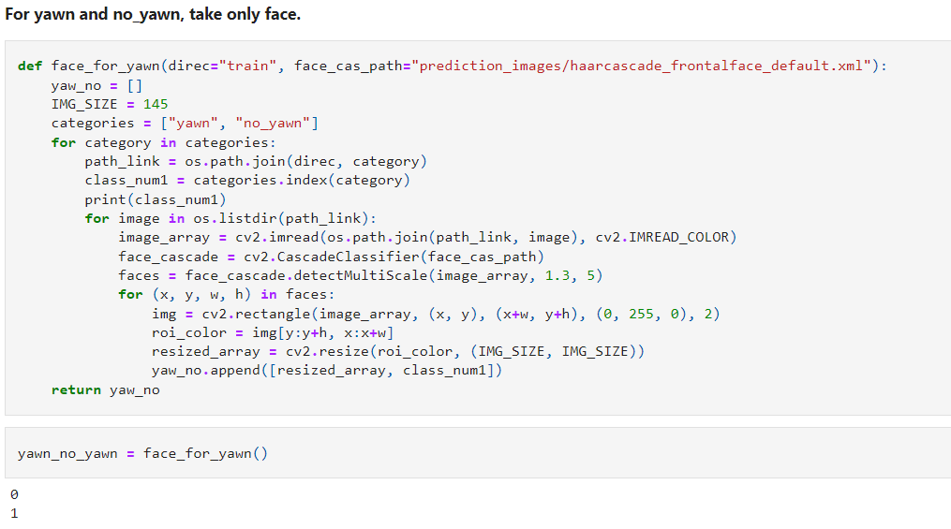
Coding Segment

Slide 17
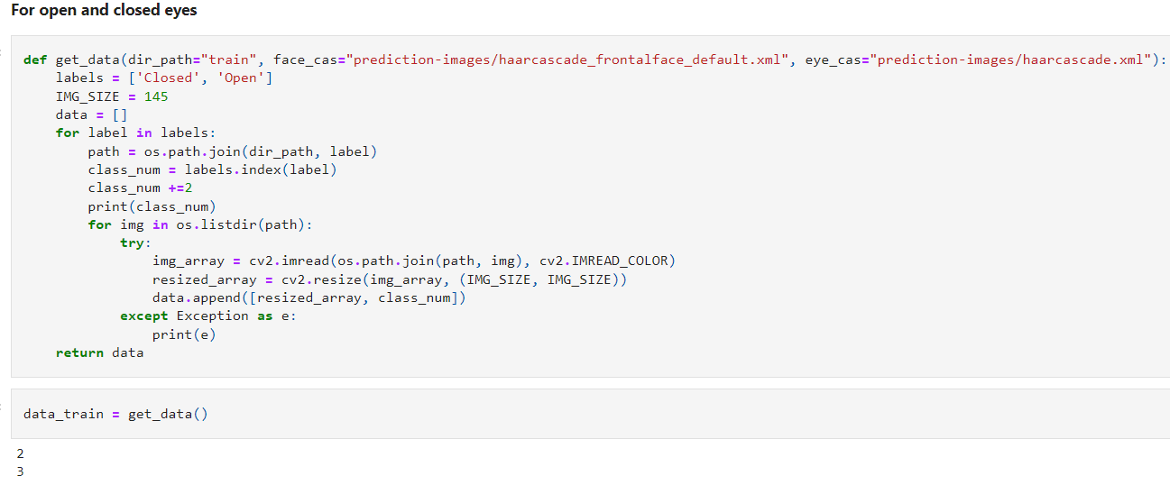
Coding Segment

Slide 18
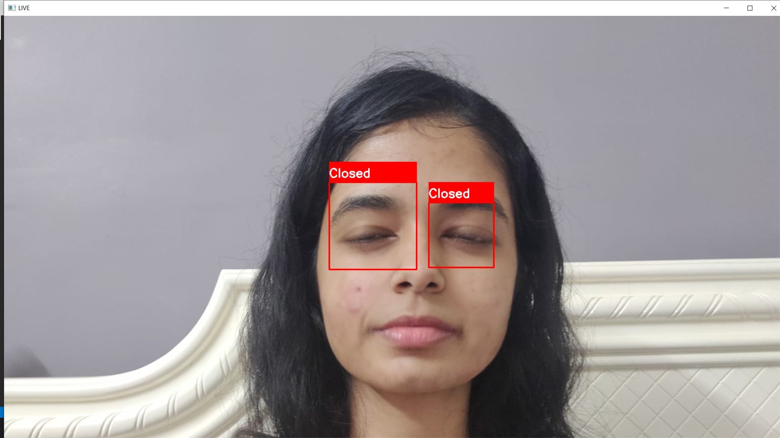
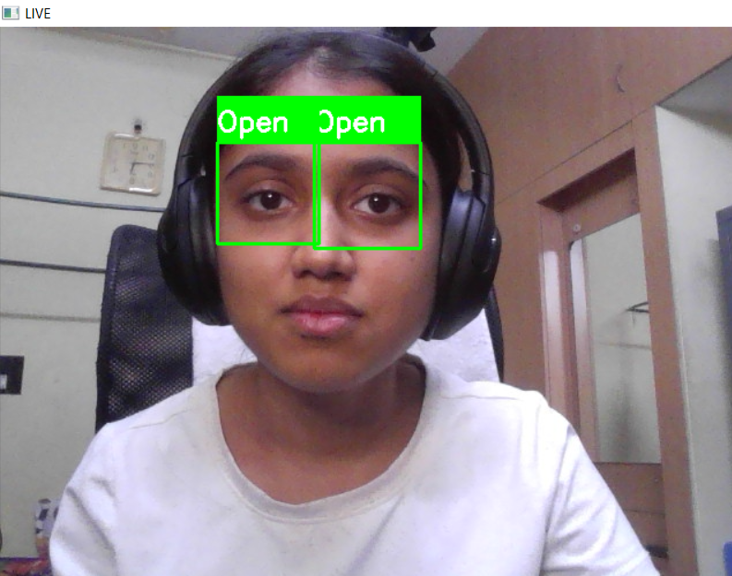
Results
The system detects eyes in the given particular frame in rectangular frames.
The algorithm used for detecting the eyes is haar cascade. It uses haar features which are used for detecting the eyes in rectangular frames.
Then the model classifies the image. draws rectangles around the region of interest along with the labels as ‘Open’ or ‘Closed’.

Slide 19
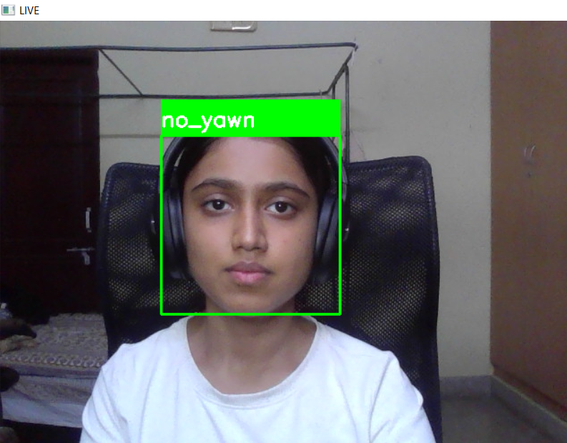
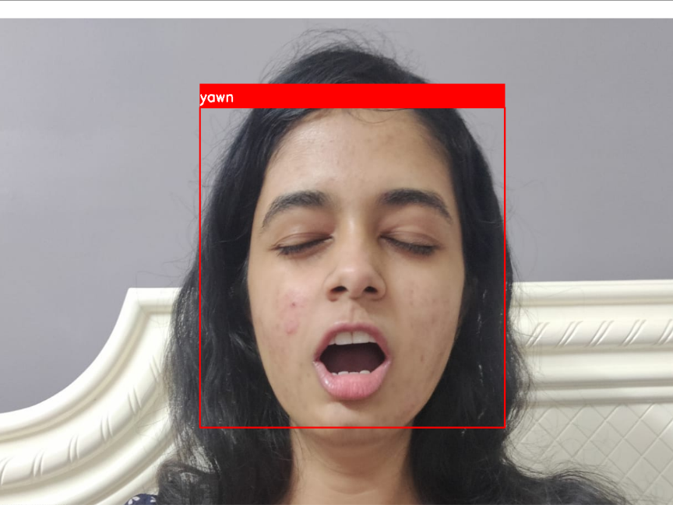
Results
Presented here is the output for face detection module.
The input to this module is continuous stream of video and output will be face detection with in rectangular bounds.
The face is detected by using haar cascade algorithm .
It uses haar features through which the face is detected in a rectangular frames.

Slide 20
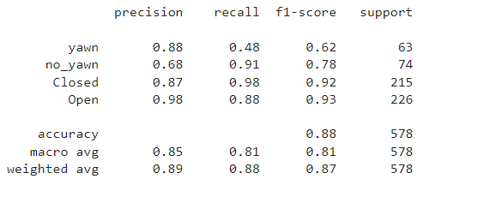
Results
Confusion Matrix

Slide 21
Conclusion
The current study developed an automated system for detecting drowsiness of the driver.
The continuous video stream is read from the system and is used for detecting the drowsiness.It is detected by using haar-cascade algorithm.
The haar-cascade algorithm uses haar features to detect face and eyes. Haar features are predefined are used for detecting different things.
It is used to detect face and eyes in the image which is then fed to the classifier to classify the images as ‘Open’, Closed’, ‘yawn’, and ‘no_yawn’.

Slide 22
Future Enhancements
This work can also be extended by implementing in full night light using IR web cam. It is camera which uses infrared radiations to detect whether the person is drowsy or not. While this is a research project, there is scope when this completely turns out to be developed into an application which can be run by the end users on their own for their own purposes on their own systems.
The work can be extended by recording the time for which the eyes remain closed and then defining a threshold, for example if score becomes greater than 15 that means the person’s eyes are closed for a long period of time. This is when we beep the alarm and notify the driver.

Slide 23
References
Warwick, B., Symons, N., Chen, X., & Xiong, K. (2015). Detecting Driver Drowsiness Using Wireless Wearables. 2015 IEEE 12th International Conference on Mobile Ad Hoc and Sensor Systems.
Dwivedi, K., Biswaranjan K & Sethi, A. (2014). Drowsy driver detection using representation learning. 2014 IEEE International Advance Computing Conference (IACC).
Yan, J.-J., Kuo, H.-H., Lin, Y.-F., & Liao, T.-L. (2016). Real-Time Driver Drowsiness Detection System.Based on PERCLOS and Grayscale Image Processing. 2016 International Symposium on Computer, Consumer and Control (IS3C).
Face detection using haar cascades tutorial https://docs.opencv.org/3.1.0/d7/d8b/tutorial_py_face_detection.html#gsc.tab=0
Hanojhan Rajahrajasingh (Author), 2019, Drowsiness Detection Using Image Processing, Munich, GRIN Verlag, https://www.grin.com/document/506703

Slide 24
THANK YOU

