Slide 1






ENHANCED PSO · GRANULAR NEURAL NETWORKS
Diabetes Risk Prediction
Hyperparameter Tuning with Baseline and Diversity-Adaptive-Inertia Particle Swarm Optimization
A fuzzy-granulated neural network, tuned end-to-end by two PSO variants, evaluated rigorously against logistic regression, manual tuning, and ensemble baselines on the Pima Indians Diabetes Database.
Presented By
Venkata Saileenath Reddy Jampala
Master's Final Project Presentation · October 2026

Slide 2




The Diabetes Prediction Challenge
Diabetes affects hundreds of millions of people, and early detection depends on machine-learning models that remain reliable on noisy, imbalanced clinical data.
Imbalanced Outcomes
Measurement Uncertainty
The Pima dataset is 65% negative / 35% positive; a model that chases raw accuracy quietly under-serves the diabetic minority class.
Clinical features like glucose and BMI don't split cleanly into "normal" vs. "abnormal" — crisp thresholds discard real information.
Costly Manual Tuning
No Principled Search
Hand-tuning a neural network's architecture and learning rate is slow, ad hoc, and hard to defend or reproduce.
Standard swarm search can stall; without an explicit exploration/exploitation balance, tuning quality depends on luck.
Our Approach: a fuzzy-granulated GNN, tuned by two PSO variants, evaluated end-to-end on a strict held-out test split.
02

Slide 3
Project Objectives
Build a modular, reproducible pipeline that turns raw clinical features into a tuned, honestly-evaluated diabetes classifier — with every claim checked against a held-out test set.
01
02
03
Fuzzy Granulation Pipeline
Granular Neural Network
Baseline + Enhanced PSO
Represent each clinical feature by its crisp value plus low / medium / high triangular-membership degrees.
A 2-3 layer network with a fuzzified input layer (32 units) and a single binary output.
A constant-inertia PSO tuner vs. a diversity-adaptive-inertia variant, tuning 5 hyperparameters jointly.
04
05
Rigorous Evaluation
Ceiling Analysis
A single held-out split, 3 seeds per variant, accuracy / F1 / AUC-ROC, and a swarm-size ablation.
Test, empirically, whether the proposal's 85-90% accuracy target is reachable with more tuning.
03

Slide 4



Methodology at a Glance
A five-stage pipeline: each stage has a single job, and the whole thing runs end-to-end from raw clinical records to an evaluated, tuned classifier.
→
→
→
→
Data Preparation
Granular Neural Network
Baseline PSO
Enhanced PSO
Evaluation Suite
Median-impute missing values, min-max normalize, and fuzzy-granulate each feature into low/medium/high.
32 inputs (8 crisp + 24 granule) feed 1-2 hidden layers and a sigmoid output.
Constant inertia weight (w = 0.72); 25 particles, 80 iterations; 3-fold CV fitness.
Diversity-adaptive inertia weight, w_min = 0.4 to w_max = 0.9, tracking swarm spread.
Held-out test, 3 seeds, ablations, and a ceiling analysis against stronger model families.
Design choice: every stage is evaluated on the same held-out split, so the final comparison across models is always apples-to-apples.
04

Slide 5
Dataset: Pima Indians Diabetes Database
A well-studied UCI benchmark of 768 female patients of Pima Indian heritage, aged 21+, used throughout this project exactly as published, with no filtering or augmentation.
768
8
65:35
20%
Patient Records
Clinical Features
Negative:Positive Split
Held-Out Test Split
Eight Clinical Features
Data Quality Handling
Pregnancies · Glucose · Blood Pressure · Skin Thickness
Insulin · BMI · Diabetes Pedigree Function · Age
Five columns (Glucose, Blood Pressure, Skin Thickness, Insulin, BMI) record a biologically impossible zero where a measurement is missing. These are median-imputed using statistics computed on the training fold only, then applied to the test fold — never the reverse.
05

Slide 6
Data Processing & Fuzzy Granulation
Before the network sees a single row, raw clinical values are cleaned, scaled, and re-expressed in both crisp and linguistic (fuzzy) form.
Imputation & Normalization
Fuzzy Granulation
Final Feature Vector
Zeros in 5 columns treated as missing
Triangular membership functions
8 crisp normalized values
Median-imputed on the training fold
Low / Medium / High per feature
+ 24 fuzzy granule memberships
Min-max scaled to [0, 1] per feature
Overlap width tuned by PSO, not fixed
= 32 inputs to the network
scikit-fuzzy was unavailable in this compute environment — the triangular membership math was implemented directly in NumPy with identical results.
06

Slide 7
Network Architecture & Search Space
The GNN's architecture, learning rate, regularization, and fuzzy-granule overlap are all tuned jointly by PSO — never hand-picked.
32
1-2
5
25 / 80
Input Features
Hidden Layers
Tuned Hyperparameters
Swarm Size / Iterations
8 crisp + 24 granule
ReLU, width tuned
arch., LR, α, overlap
per the proposal's target range
What PSO Searches Over
Hidden layer 1 size — 4 to 32 units
Hidden layer 2 size — 0 to 24 units (0-1 collapses to a single layer)
Learning rate — log-scaled, 1e-4 to 1e-1
L2 regularization (α) — log-scaled, 1e-6 to 1e-1
Fuzzy granule overlap — 0.15 to 1.0
07

Slide 8
Two PSO Variants, Head to Head
A single opinion about how to balance exploration and exploitation might be wrong — so both a constant-inertia baseline and a diversity-adaptive variant were implemented and compared.
1
Baseline PSO
2
Enhanced PSO
Constant inertia weight
Diversity-adaptive inertia weight
The classical Shi & Eberhart (1998) formulation. Every particle's velocity is damped by the same fixed weight at every iteration, regardless of how the swarm is behaving.
Inertia tracks real-time swarm diversity: high when particles are spread out (explore), decaying automatically as the swarm converges (exploit) — this project's own contribution.
w = 0.72 (fixed)
w(t) = w_min + (w_max - w_min) · diversity(t)
Serves as the control condition.
w_min = 0.4, w_max = 0.9
08

Slide 9
Experimental Design
Four experiments, all evaluated on the identical held-out test split, so every comparison in this deck is apples-to-apples.
1
2
3
4
Main Comparison
Swarm-Size Ablation
Non-PSO Baselines
Ceiling Analysis
Baseline vs. Enhanced PSO, 3 random seeds each, swarm = 25, iterations = 80. Fitness = 3-fold CV accuracy.
Both variants re-run at a smaller configuration (15 particles, 50 iterations) to test robustness.
Logistic regression (crisp & granular features) and a single manually-tuned GNN, for comparison.
Random Forest, Gradient Boosting, and a leakier evaluation protocol — to test the 85-90% target directly.
Evaluation Metrics
Accuracy · F1-score (weighted toward the minority / diabetic class) · AUC-ROC — with F1 and AUC given the most weight, since accuracy alone is a poor measure on imbalanced data.
09

Slide 10
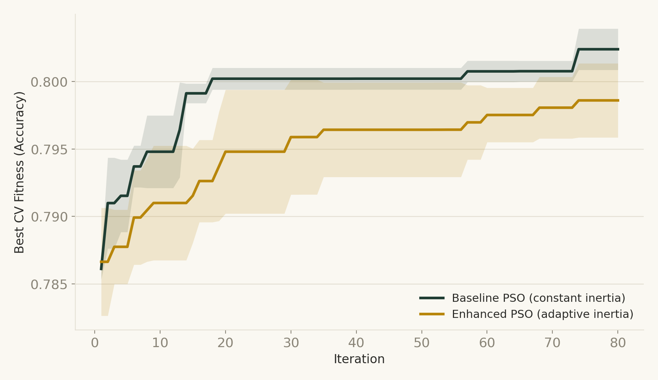
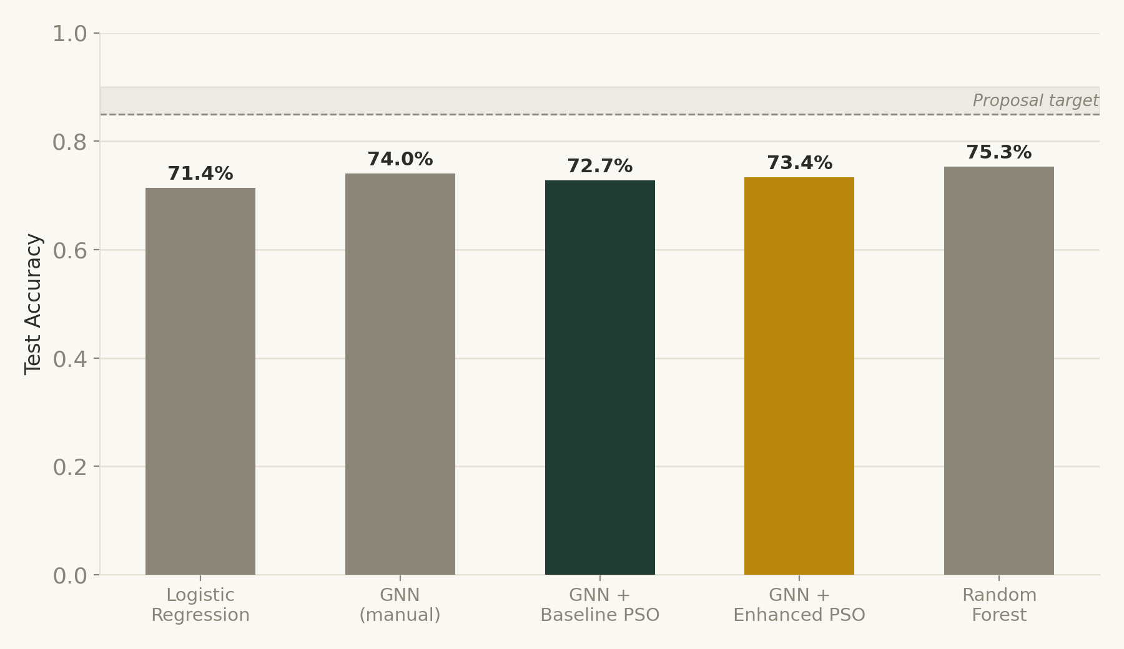
Results: Convergence & Accuracy
Mean best-so-far CV fitness across 3 seeds (±1 std), and final test accuracy against the non-PSO baselines.
Baseline PSO converges faster and reaches a slightly higher CV fitness than the adaptive variant.
Both PSO variants beat logistic regression, but neither clearly beats a single manually-tuned GNN on this split — PSO's real edge is a repeatable, lower-variance process.
10

Slide 11
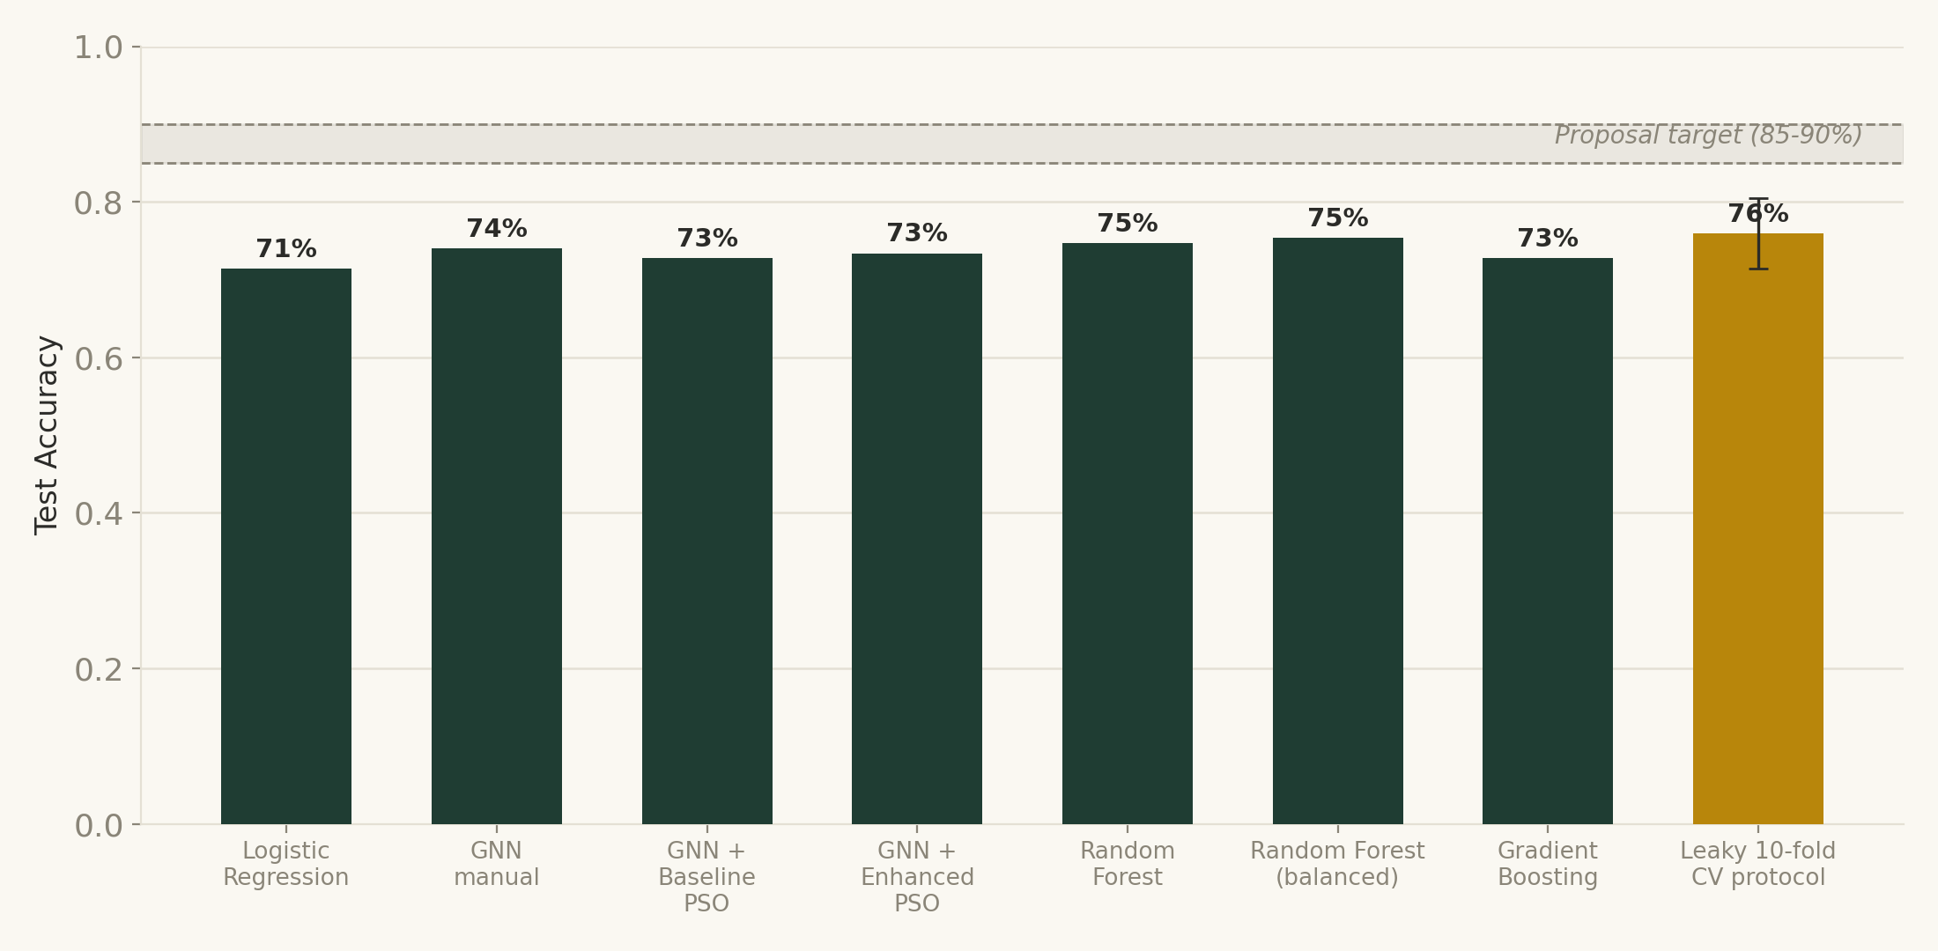
Ceiling Analysis: Is 85-90% Reachable?
Tested directly rather than assumed: every model family and evaluation protocol tried converges into a 71-76% band, well below the proposal's target.
Conclusion: the ceiling is set by the dataset (768 rows, 8 features) — not by insufficient tuning of any single model. A class-balanced Random Forest reached the best result of any model tried (75.3% accuracy), still 10+ points short of target.
11

Slide 12

Honest Findings
Two results ran against the project's own working hypothesis — reported here plainly, with the likely reasons, rather than smoothed over.
Adaptive Inertia Didn't Win
PSO ≈ Manual Tuning Here
Baseline PSO reached a comparable or higher CV fitness (0.802 vs. 0.799) and converged faster (iteration 8.7 vs. 11.7) than the adaptive variant, at both swarm sizes tested.
A single manually-tuned GNN (74.0% acc / 0.623 F1) matched or edged out both PSO variants (~72.7-73.4% acc). PSO's value here is a repeatable process, not a decisive accuracy jump.
Class Imbalance Still Shows Up
The best GNN run correctly flags 85 of 100 healthy patients (85% specificity) but only 30 of 54 diabetic patients (55.6% recall) — a direct consequence of training on raw accuracy with a 65/35 split.
12

Slide 13
Conclusion & Next Steps
What This Project Delivers
Next Steps
Working GNN + fuzzy granulation pipeline, end to end
Re-test adaptive inertia on a harder, higher-dimensional search space
Baseline and diversity-adaptive PSO tuners, compared fairly
Tune w_min / w_max themselves instead of using literature defaults
Rigorous held-out evaluation with cross-seed repetition
Optimize PSO fitness against F1 instead of raw accuracy
An honest ceiling analysis settling the 85-90% question
Add class balancing (weights or SMOTE) to the training loop
Full reproducible code, data, figures, and this report
Explore a GNN + Random Forest stacked ensemble
This project is a working, honestly-evaluated system rather than a best-case demo: every number shown today came from the identical held-out test split, and every claim that didn't hold up — adaptive inertia's edge, the 85-90% target — was tested and reported rather than assumed.
13

