Slide 1
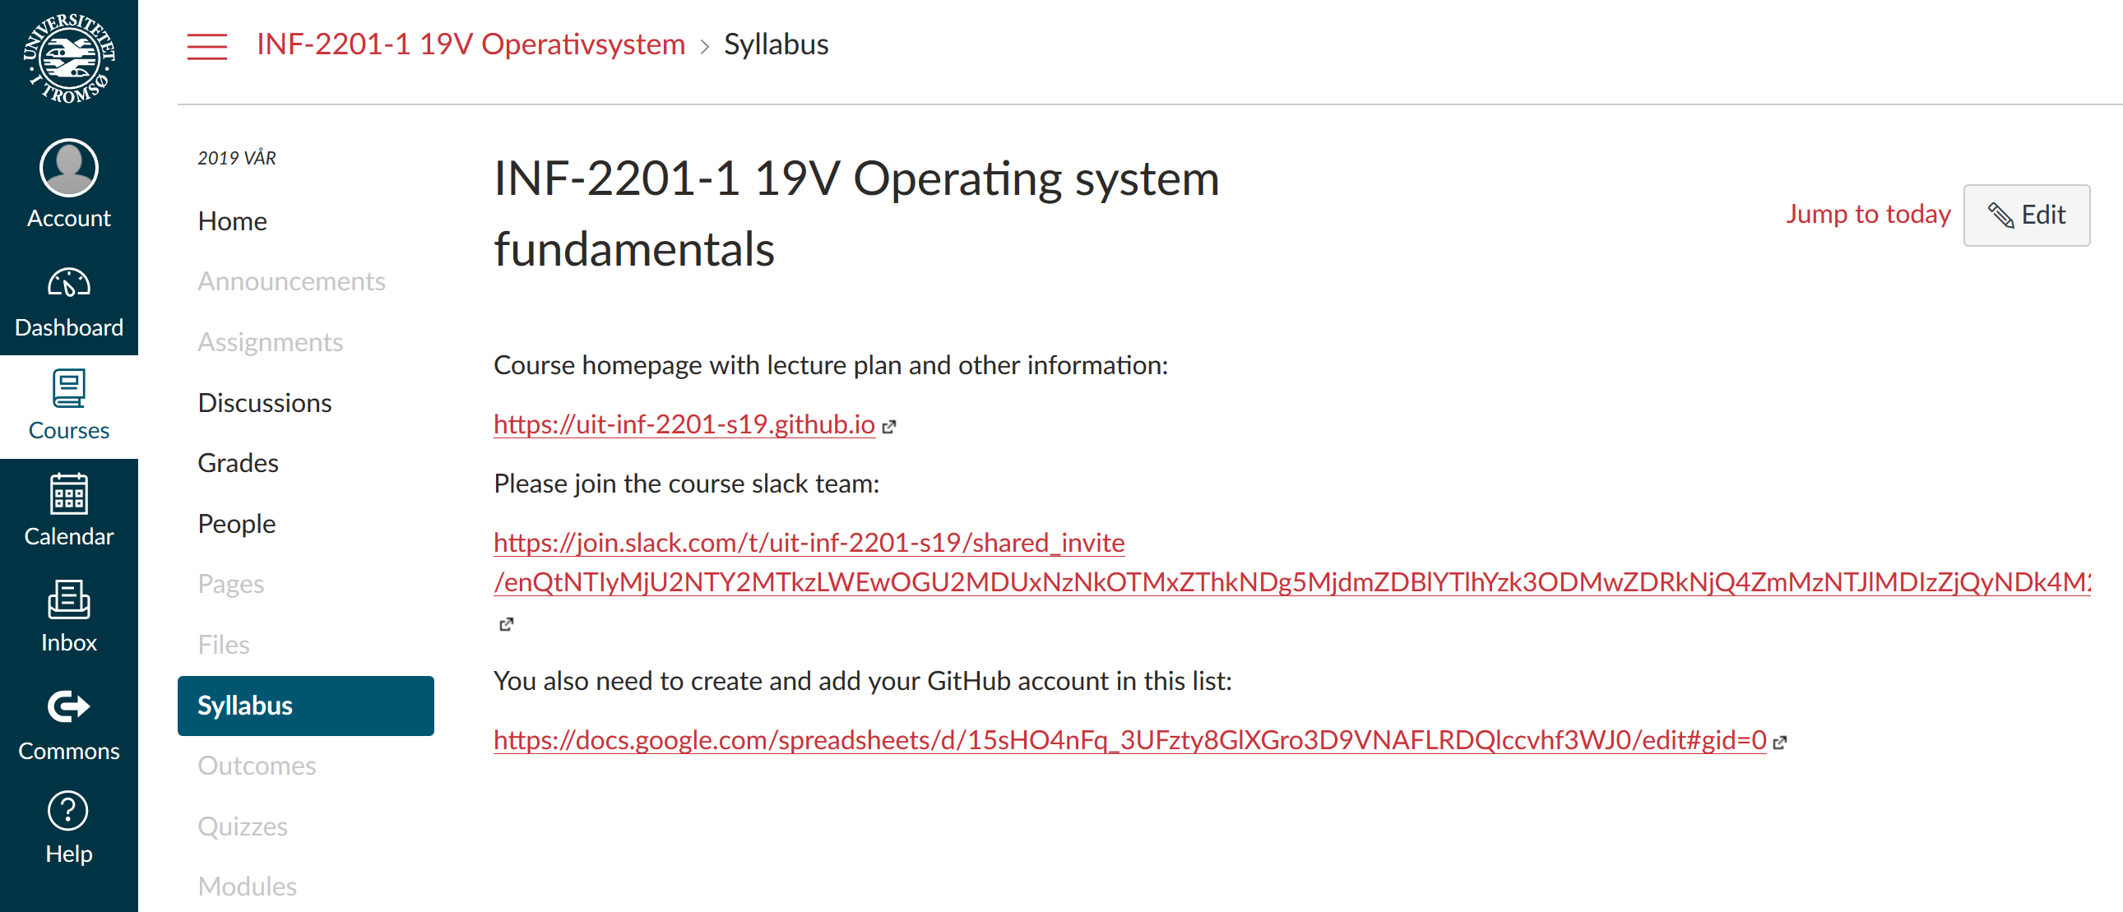
Introduction
inf-2201 Operating System Fundamentals
Spring 2019
Lars Ailo Bongo (larsab@cs.uit.no)

Slide 2



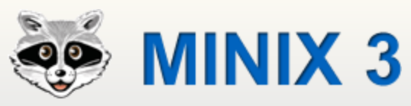

Slide 3













Slide 4
Multics
IBM OS/360
IBM VM/370
MS-DOS
Unix’es
Mach
L4
Exokernel
…
Barrelfish
Corey/ The Library OS
Tesselation
Vortex
…

Slide 5
Application
Operating System
Hardware
OS’es for many different types of devices…
Differing requirements (functionality, footprint, real-time)
… and applications
Abstractions and many design issues are still shared

Slide 6
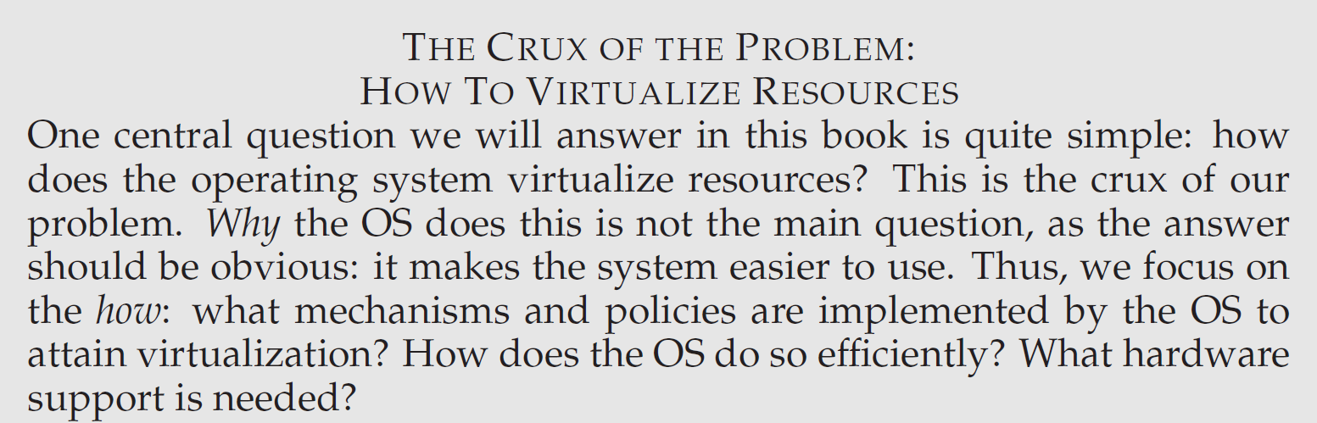
http://pages.cs.wisc.edu/~remzi/OSTEP/

Slide 7
New challenges
1000s of cores
TB’s of memory
100’000s of machines
GPU, TPU, accelerators
Power usage
Sensors
Privacy
…

Slide 8

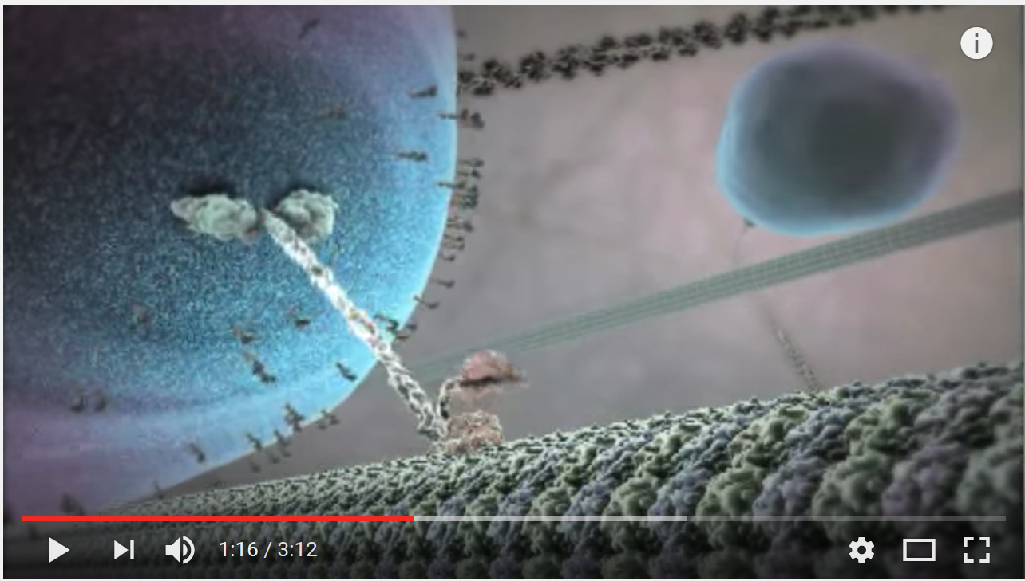
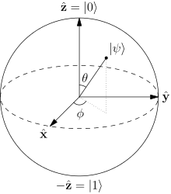
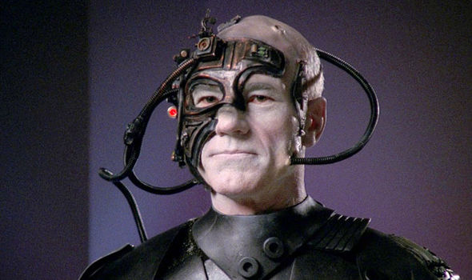
Future OS’es?

Slide 9
Outline
How?
Why?
What?

Slide 10
Teaching staff
Lectures:
Prof. Lars Ailo Bongo
Associate Prof. Tore Brox-Larsen
Teaching Assistants:
David Kristoffersen
Simon Solnes
Jo Inge Arnes
Our external sensor

Slide 11
Resources
Web page: http://www.cs.uit.no/kursinfo/inf2201
Lecture plan, including readings and slides
Project plan
Slack team: uit-inf-2201-s19
Discussions
GitHub organization: https://github.com/uit-inf-2201-s19
Project pre-code
Your solutions
Issues
Wiseflow?

Slide 12
TODO list 1:
Join Slack team
Create GitHub account
Add your email and GitHub username to list
Wait for GitHub organization invite

Slide 13
Why Study Operating Systems
Understand how computers work under the hood
“You need to understand the system at all abstraction levels or you don’t” (Yale Patt, private communications)
“The devil is in the details” (Unknown)
Magic to provide infinite CPUs, memory, devices, and networked computing.
Tradeoffs between performance and functionality, division of labor between HW and SW
Combine language, hardware, data structures, algorithms, money, art, luck, and hate/love
And operating systems are key components in most systems

Slide 14
How to Study Operating Systems?
Read text
Smaller exercises using existing operating systems
Modifications to exisiting systems
Emulator
NachOS
”Metal”, bare machine
Unix, Linux
Minix
Develop your own! Gain experience on fundamental issues

Slide 15
Why Build a Real OS Kernel?
Hear and forget (Paper approach)
See and remember (Exercise and Modification approaches)
Do and understand (Roll your own approach)
Overcome the barrier, dive into the system
Gain confidence: You have the power, not the SW, OS and computer vendors ☺

Slide 16
Our Approach
6 projects, all mandatory
From boot to a useful OS kernel w/demand paging & file system
We hand out templates (pre files), but never the finished source (post files)
New bugs discovered every time the course is given ☺
Lectures and Projects are (almost) synchronized
Design Review during first week of each project
Linux, C, assembler
Close to the computer, but bochs useful to reduce the number of reboots

Slide 17
Project OS History
LurOS
Stein Krogdahl, OS course, Dept. of computer science, UiTø, ca. 1978
Paper, but detailed
Mymux (Mycron Multiplexer)
Stein Gjessing (1979?), later implemented and reworked by Otto Anshus (1981), OS course, Dept. of computer science, UiTø, around 1981-82-83
Mycron 1 (64KILObyte RAM, no disk, 16 bit address space, Intel 8080/Zilog 80, Hoare monitors, flermaskin (3, UART, 300 bits/sec, transparent process and monitor location, process and monitor migration between machines)
POS (Project Operating System), a.k.a. TeachOS, a.k.a. LearnOS
Otto Anshus, Tore Larsen, first implementation by Åge Kvalnes (Brian Vinter), OS course, Dept. of computer science, UiTø, 1994-1998
Notebooks, Intel 486/Pentium
Princeton University, USA
Kai Li (1998), adopts and enhances the projects
Tromsø & Princeton
D240/COS 318, Kai Li, Otto Anshus, 1999
Tromsø/Princeton/Oslo
Inf-2201/COS318/INF242, 2001, Vera Goebel, Thomas Plagemann, Otto Anshus
Yale University

Slide 18
Course Approach
You will be building your own operating system
You will do it in steps
For each step
We’ll define what your OS should achieve for this step
We’ll provide you with a starting point (code)
You may well choose to use your own starting point
You will contemplate a design and present a brief design report indicating design issues, discussions, and decisions. The design report is presented, discussed, and reviewed by staff
You develop and implement your solution. The solution is reviewed etc.
For each step you will sweat
By early June you will be ”King of the hill!”

Slide 19
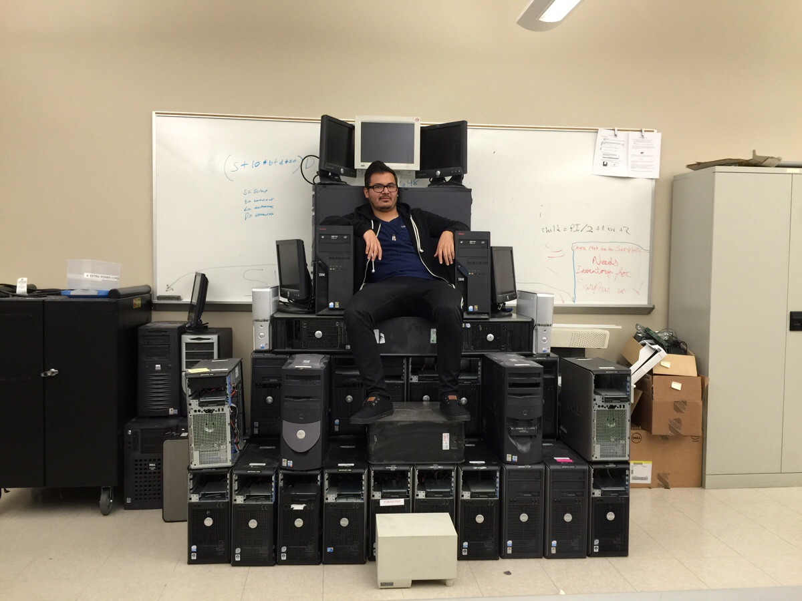
Conquer the Iron Computer Throne

Slide 20
Literature
Modern Operating Systems 4/E, by Andrew (Andy) Tanenbaum, Prentice-Hall, 2015
All information given on the course web pages. The links provided are mandatory readings to the extent they are relevant to the projects
We will also provide additional readings. Please, check the syllabus
All lectures, lecture notes, precept notes and topics notes
All projects
Other books that may help you are:
Protected Mode Software Architecture, by Tom Shanley, MindShare, Inc. 1996. This book rehashes several on-line manuals by Intel
Undocumented PC, 2nd Edition, by Frank Van Gilluwe, Addison-Wesley Developers Press, 1997
The C Programming Language, Brian W. Kerningham, Dennis M. Ritchie
Note! Lectures covers important topics that are not addressed by projects

Slide 21
Cooperation Policy: Working with your fellow students
Discuss all concepts, techniques, technologies, and peculiarities with your fellow students
But don’t in any way share your own code or copy code that is not developed by you.

Slide 22
Learning from Doing: Each student develops his/her own code
INF-2201 har en eksamensordning hvor oppgaver i kurset vurderes og gis veiledende karakterer som ved kursets slutt danner utgangspunkt for den endelige fastsettingen av karakter for kurset. På grunn av dette vil følgende bli betraktet som fusk iht. Forskrift for eksamener ved Universitetet i Tromsø:
Deling av kode (både i elektronisk og annen form) utviklet i forbindelse med oppgavene i kurset.
Kopiering av hele eller deler av løsning på oppgavene utviklet av andre.
Av hensyn til gjennomføring og karaktersetting for kurset i framtiden må kode og kursmateriale ikke på noe tidspunkt deles eller distribueres til andre enn faglig og administrativt personale ved UiT med ansvar for gjennomføring av kurset.

Slide 23
Grading Policy
“Mappe evaluering”:
X individual grades: combined to give final grade
No written exam
Wiseflow
More details TBA
Note! It is your responsibility to make sure you submit the correct assignment on time

Slide 24
Grading Mechanism
100 point scale (A is 90-100)
Extra credits are additional to 100 ordinary point
You can get an A without doing extra credits
But hard in practice
Examiners follow grading guidelines:
Each part of assignment gives X points
Most points are for code correctness
Some are for code readability (comments, structure)
A few are for documentation
Examiners may give short explanation for grades < A
You should discuss your code/ solution with TAs

Slide 25
TODO list 2
Read MOS 1.1-1.5
Learn GNU assembly syntax
Learn to use git/ GitHub

