Slide 1
The Battle of the Neighborhoods

Slide 2
Motivation
Suppose a person wants to move from New York to Toronto for a job. This person does not know anything about Toronto and he would like to move into a place similar to the place where he lives right now.
Is ist possible to create a system that can help our user showing to him the similarities between this two countries?

Slide 3
Objectives
Develop a system able to show similarities in terms ofneighborhoods in order to help a user decide whether to move near the center of Tornot or not

Slide 4
Approach
Neighbourhoods are downloaded
Venues are requested using Foursquare API
The categories of venues are encoded using One Hot
K-Means algorithm is used for finding similarities
The elbow method is used for select K

Slide 5
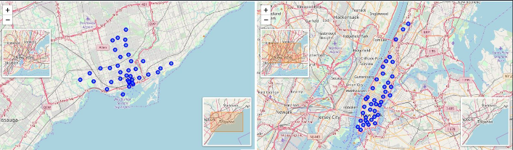
Geographical Location

Slide 6
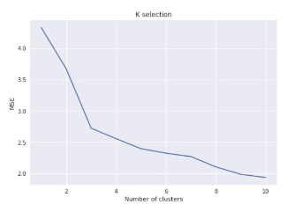
Selection of K
The best number of clusters is 5. That is, where the elbow is located.

Slide 7
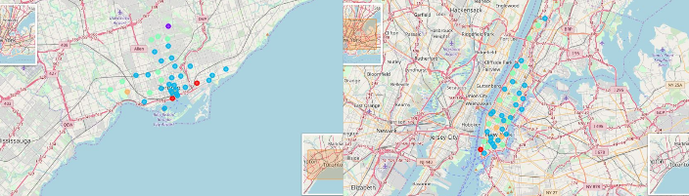
Geographical Location (Clustered)

Slide 8
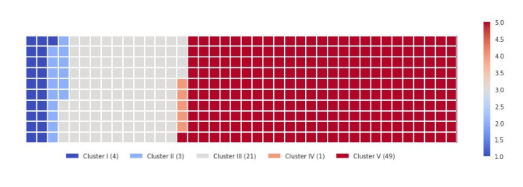
Proportion of Data Segmented

Slide 9
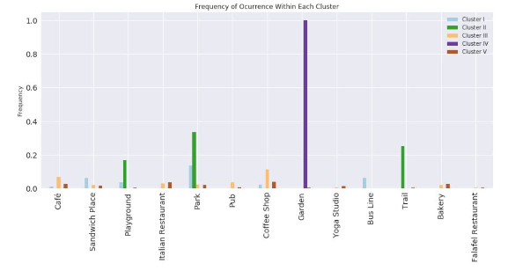
Frequent Venues

Slide 10
Conclusion
Neighbourhoods that have parks, bus lines and sandwich places
Neighbourhoods that have parks, playgrounds and trails
Neighbourhoods that have coffee shops, pubs and Italian restaurant
Neighbourhoods that have gardens
Neighbourhoods that have coffee shops, parks and bakeries

