Slide 1

QUARC-Magnetic Levitation Term Project
System Control
MECH322
4조 (값 도희)
20130419 김도희, 20130105 문준승, 20130401 이경용, 20130224 이민아
Term Project
2015/12/14
4조

Slide 2
System Control
MECH322
INDEX
Introduction
System Modeling
System State
Design of System Controller
Conclusion
Q&A
Term Project
2015/12/14
4조

Slide 3
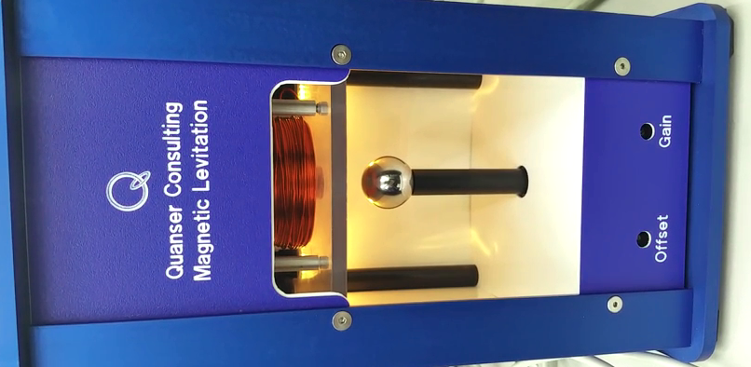
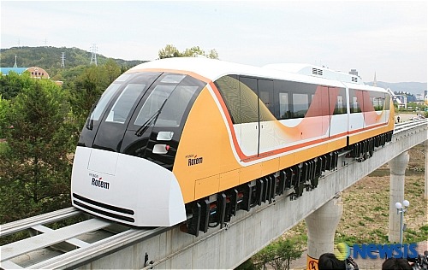
System Control
MECH322
Introduction
Term Project
2015/12/14
4조

Slide 4
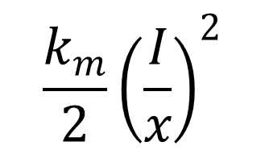
System Control
MECH322
System Modeling
$$\frac{k_{m}}{2}{\left(\frac{I}{x}\right)}^{2}$$
M
Mg
Term Project
2015/12/14
4조

Slide 5
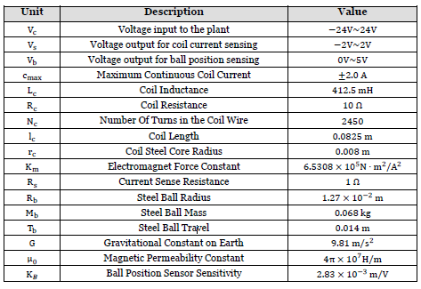
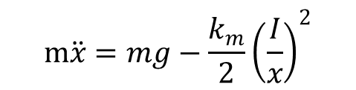

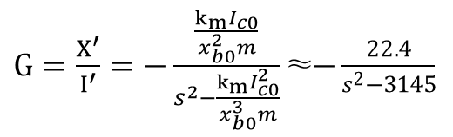
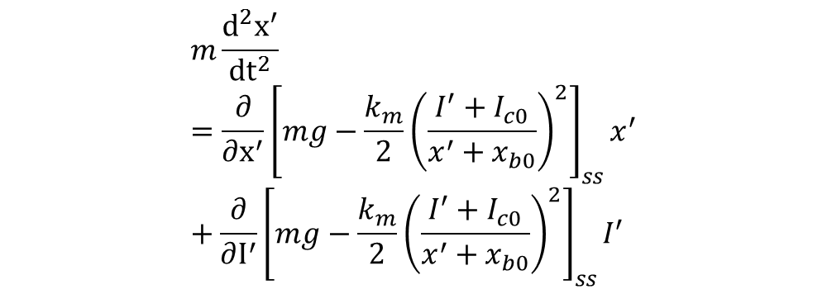
System Control
MECH322
System Modeling
1. Governing Equation
3. Transfer Function
$$m\ddot{x}=mg−\frac{k_{m}}{2}{\left(\frac{I}{x}\right)}^{2}$$
$G=\frac{X^{′}}{I^{′}}=−\frac{\frac{k_{m}I_{c0}}{x_{b0}^{2}m}}{s^{2}−\frac{k_{m}I_{c0}^{2}}{x_{b0}^{3}m}}$≈$−\frac{22.4}{s^{2}−3145}$
2. Linearizing
$$m\frac{d^{2}x^{′}}{{dt}^{2}}=\frac{∂}{∂x^{′}}{\left[mg−\frac{k_{m}}{2}{\left(\frac{I^{′}+I_{c0}}{x^{′}+x_{b0}}\right)}^{2}\right]}_{ss}x^{′}+\frac{∂}{∂I^{′}}{\left[mg−\frac{k_{m}}{2}{\left(\frac{I^{′}+I_{c0}}{x^{′}+x_{b0}}\right)}^{2}\right]}_{ss}I^{′}$$
* $x’(t)=x(t)−x_{b0}$, $I^{′}\left(t\right)=I\left(t\right)−I_{c0}$]
Term Project
2015/12/14
4조

Slide 6
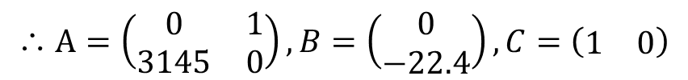

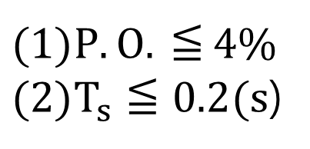


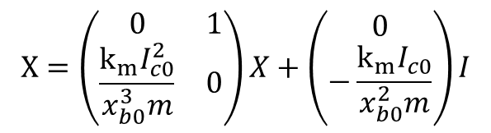
System Control
MECH322
System State
1. State Variable Equations
$$x=\left(\begin{matrix}x \\ \dot{x}\end{matrix}\right)이면,$$
$$X=\left(\begin{matrix}0 & 1 \\ \frac{k_{m}I_{c0}^{2}}{x_{b0}^{3}m} & 0\end{matrix}\right)X+\left(\begin{matrix}0 \\ −\frac{k_{m}I_{c0}}{x_{b0}^{2}m}\end{matrix}\right)I$$
$$\&$$
$$Y=\left(\begin{matrix}1 & 0\end{matrix}\right)X$$
∴ $A=\left(\begin{matrix}0 & 1 \\ 3145 & 0\end{matrix}\right), B=\left(\begin{matrix}0 \\ −22.4\end{matrix}\right), C=\left(\begin{matrix}1 & 0\end{matrix}\right)$
2. Spec of the System
$P.O.$ $≦$ 4%
$T_{s}≦0.2(s$)
Term Project
2015/12/14
4조

Slide 7
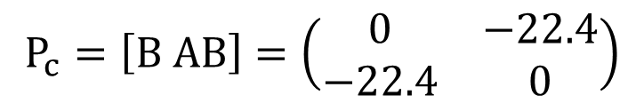


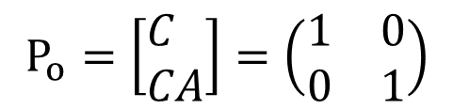
System Control
MECH322
System State
1. Controllability
3. Observability
$$P_{c}=\left[B AB\right]=\left(\begin{matrix}0 & −22.4 \\ −22.4 & 0\end{matrix}\right)$$
$$P_{o}=\left[\begin{aligned}&C \\ &CA\end{aligned}\right]=\left(\begin{matrix}1 & 0 \\ 0 & 1\end{matrix}\right)$$
$$\det\left(P_{c}\right)=−501.76≠0$$
$$\det\left(P_{o}\right)=1≠0$$
Controllable!
Observable!
Term Project
2015/12/14
4조

Slide 8
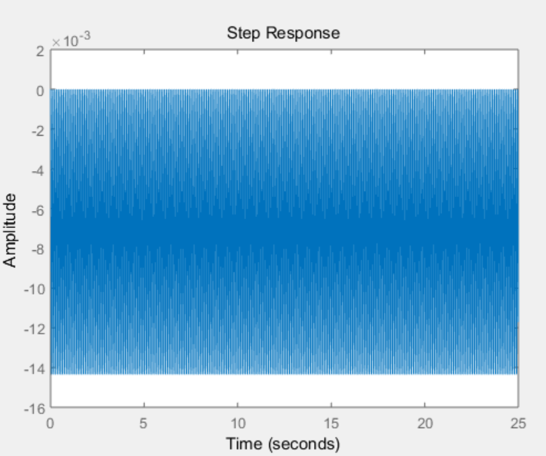
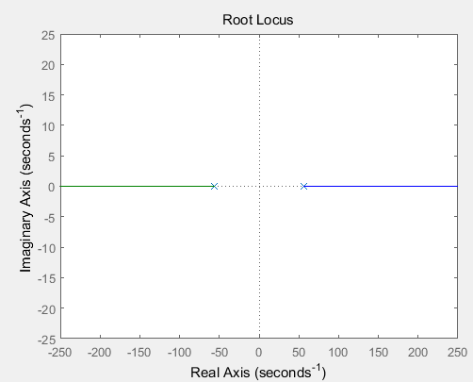
System Control
MECH322
Design of System Controller
Without Controller
Term Project
2015/12/14
4조

Slide 9
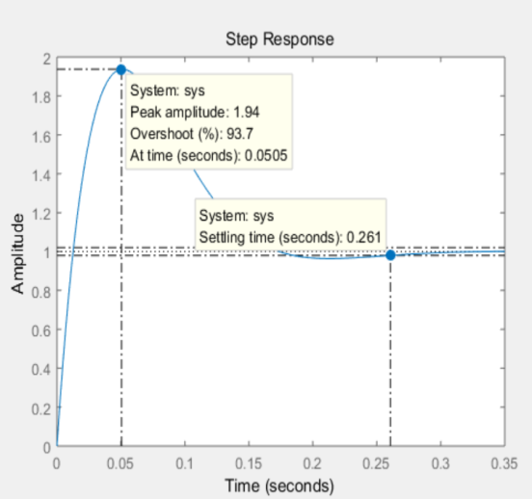
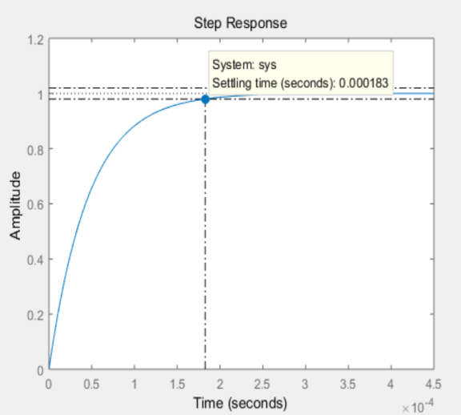
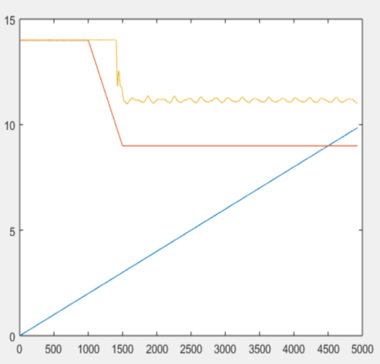
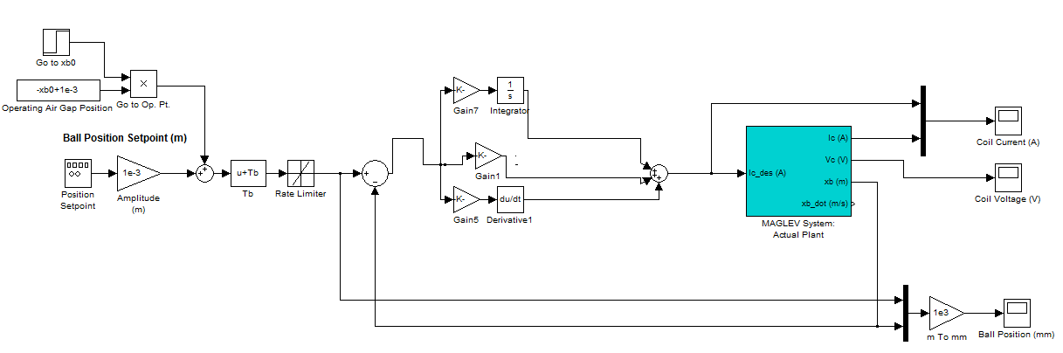


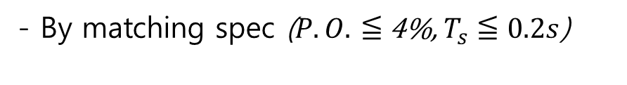
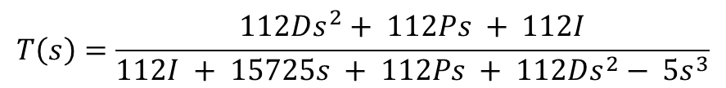
System Control
MECH322
Design of System Controller
3. Results & Revise
With Controller – PID Controller
$$G_{C}\left(s\right)=P+\frac{I}{s}+Ds$$
D =4.46
D =956
1. TF of the system
$$T\left(s\right)=\frac{112Ds^{2}+ 112Ps + 112I}{112I + 15725s + 112Ps + 112Ds^{2}− 5s^{3}}$$
D ↑
2. Characteristic Equation
- By calculating TF
$$q=s^{3}−22.4{Ds}^{2}−\left(22.4P+3145\right)s−22.4I$$
P.O. = 93.7% -> x satisfy!
Satisfy!
- By matching spec ($P.O.$ $≦$ 4%, $T_{s}≦0.2s$)
4. Real Result
$$q=s^{3}+\left(p+2ζω_{n}\right)s^{2}+\left(2pζω_{n}+{ω_{n}}^{2}\right)s+p{ω_{n}}^{2}$$
($ζ$=0.72, $ω_{n}$=27.8rad/s)
$$q_{spec}=s^{3}+100s^{2}+3175s+46370.4$$
P=-282.14, I=-2070.11, D=-4.46
Term Project
2015/12/14
4조

Slide 10
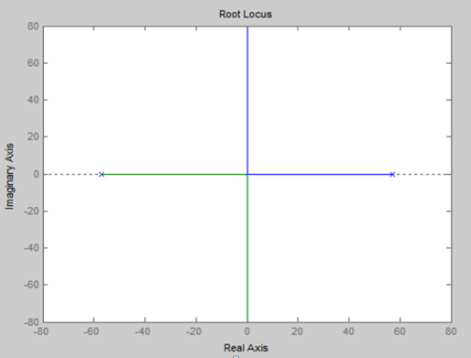
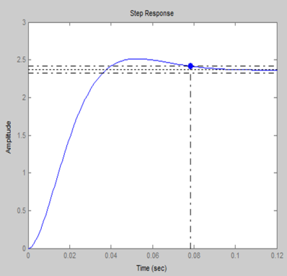
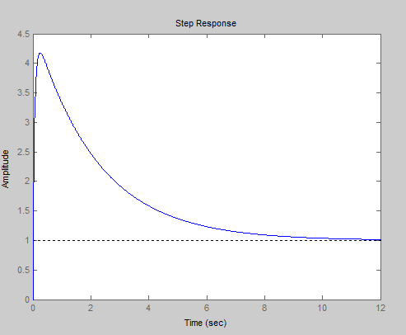
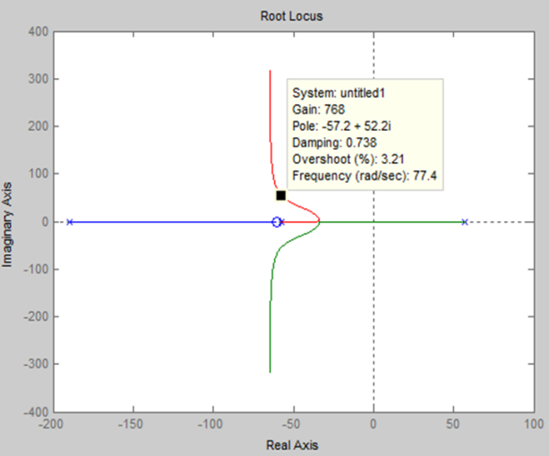
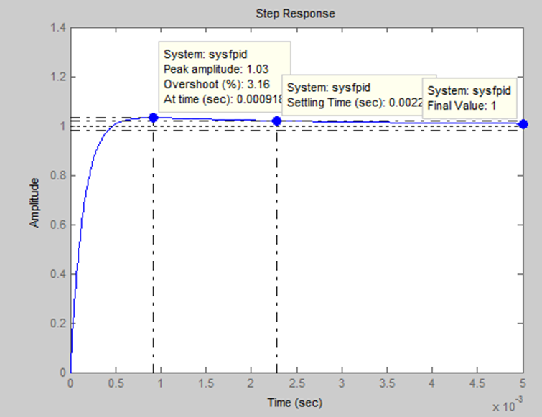
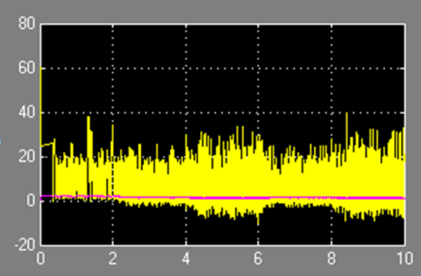

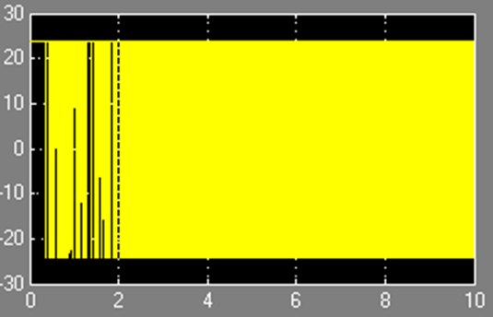



System Control
MECH322
Design of System Controller
With Controller – PID Controller + Compensator
1. Realize the plant
3. Results & Revise
P=-100, I=-10
Pole = $±$57.2
+ PI
2. Design Compensator
$e_{ss}=137\%$-> x satisfy!
P.O.↑$T_{s}$↑->x satisfy!
$ζ$=0.72, $ω_{n}$=27.8rad/s, desired root = 57.2, 55,62
4. Real Result
+ D
Term Project
2015/12/14
4조

Slide 11
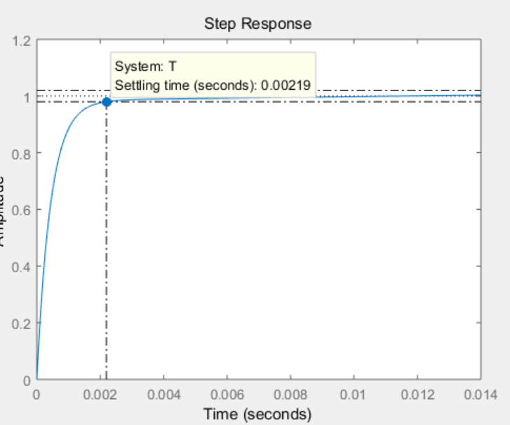
System Control
MECH322
Design of System Controller
With Controller – PID Controller + State Feedback
1. Resuslts & Revise
Trial & Error
P=--1000.14, I=-2075.11 D=-100, K1=-4, K2=-2
satisfy!
Term Project
2015/12/14
4조

Slide 12
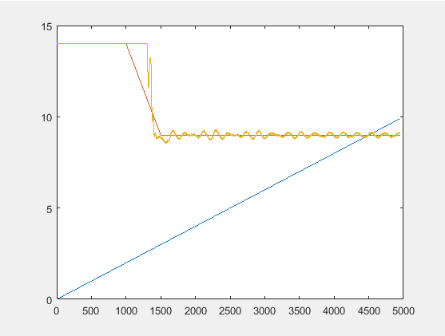
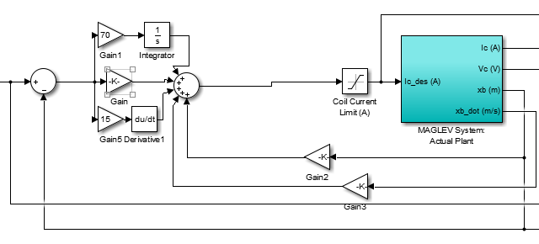
System Control
MECH322
Design of System Controller
With Controller – PID Controller + State Feedback
2. Real Result
Success!!!!!!!!!
K1=-2, K2=-3, P=-4, I=-1400, D=-300
Term Project
2015/12/14
4조

Slide 13
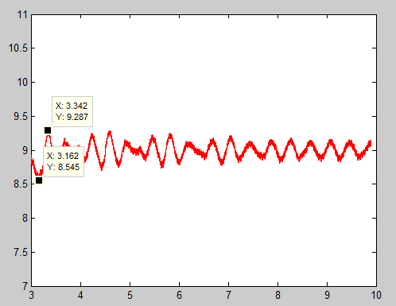
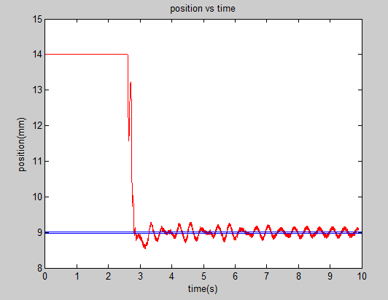
System Control
MECH322
Design of System Controller
With Controller – PID Controller + State Feedback
Max = 9.287
Min = 8.545
Final P.O. = 9.01%
Settling time cannot be defined.
Term Project
2015/12/14
4조

Slide 14
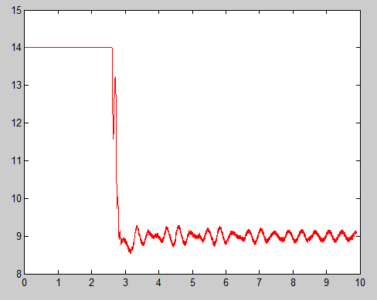
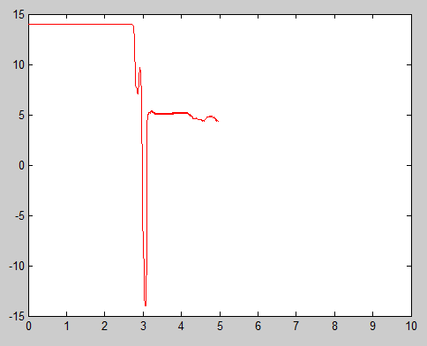
System Control
MECH322
Conclusion
Same Controller
Position of the ball changes the results
Term Project
2015/12/14
4조

Slide 15
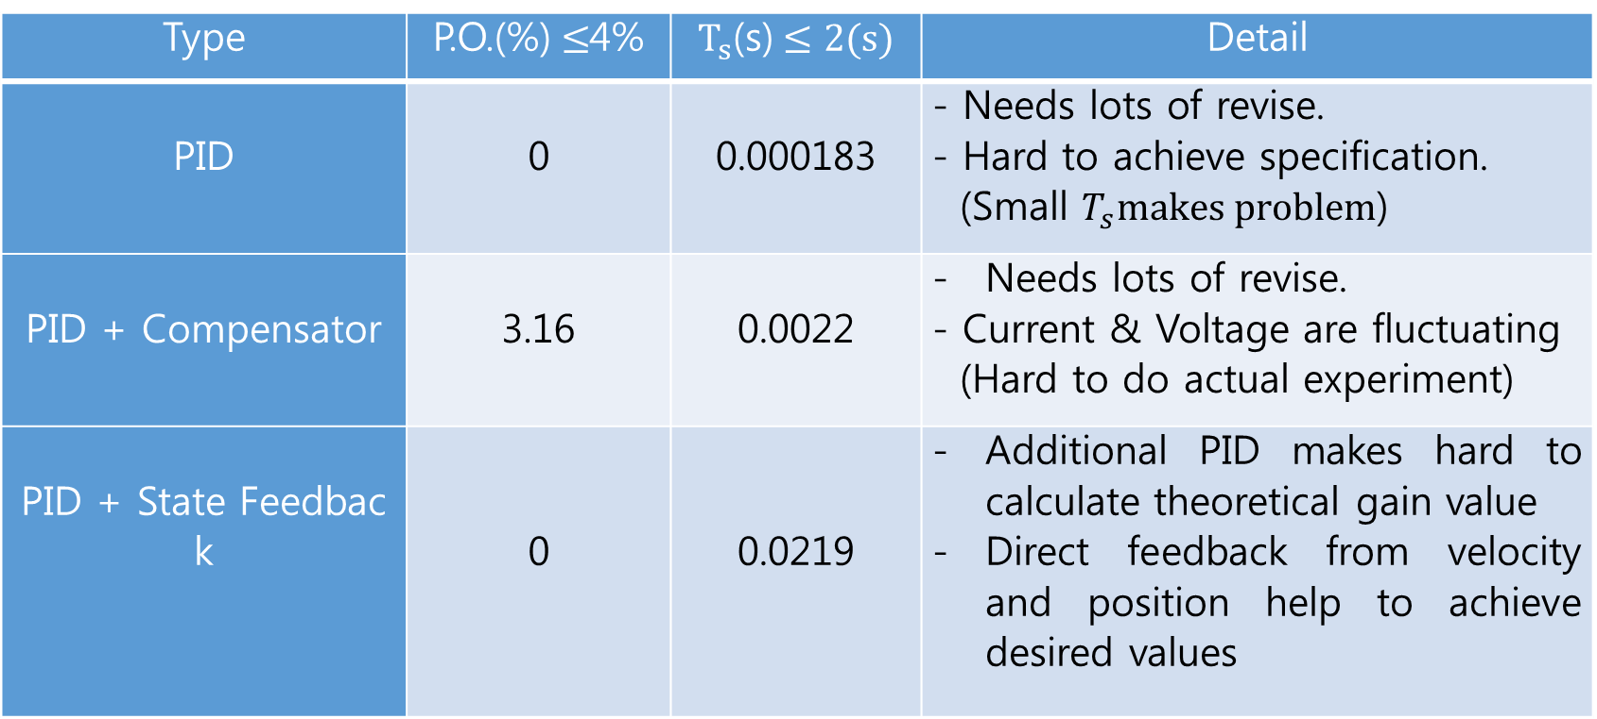
System Control
MECH322
Conclusion
Type |  |  | Detail
PID | 0 | 0.000183
PID + Compensator | 3.16 | 0.0022 | Needs lots of modification. - Current & Voltage are fluctuating (Hard to do actual experiment)
PID + State Feedback | 0 | 0.0219 | Additional PID makes hard to calculate theoretical gain value Direct feedback from velocity and position help to achieve desired values
Term Project
2015/12/14
4조

Slide 16
System Control
MECH322
Q&A
Term Project
2015/12/14
4조

