Slide 1
Figure Change Report
Manuscript Validation Results | March 2026

Slide 2
Background: Code Review for Rigor & Reproducibility
• Steffi requested independent review of Sanghoon's analysis code
• Goals: Biostatistical validation, reproducibility, documentation
• Context: Paper revisions before resubmission
• Approach: 3-tier validation pipeline (numerical, visual, claims)
Notes:
Steffi didn't trust Sanghoon's code and asked for review before resubmission. We built a validation pipeline to systematically compare manuscript figures against regenerated outputs from the refactored codebase.

Slide 3
Validation Summary: Most Issues Resolved
Status | Count | Action Required
PASS | 3 figures | No changes needed
REVIEW | 2 figures | Minor formatting (fixed)
RESOLVED | 1 figure | Curated L-R list found
FALSE ALARM | 1 claim | Wet lab vs computational data
Notes:
Overall the codebase is in good shape. Most figures pass validation. The numerical discrepancy (Spearman r) was a false alarm - the validation system incorrectly matched a wet lab correlation with a computational one.

Slide 4
Key Finding: Spearman r Discrepancy is FALSE ALARM
• Validation flagged: manuscript r=0.26 vs code r=0.216
• BUT these measure DIFFERENT things:
• - Manuscript r=0.26: HSD17B7 vs E2:E1 hormone ratio (wet lab mass spec)
• - Code r=0.216: HSD17B7 vs GSVA pathway score (computational)
• Conclusion: Not a discrepancy - out of scope for computational validation
• No manuscript changes needed
Notes:
The validation system incorrectly matched these because both mention HSD17B7 and estrogen. But the Y variables are completely different - one is wet lab hormone measurements, the other is computational pathway inference.

Slide 5
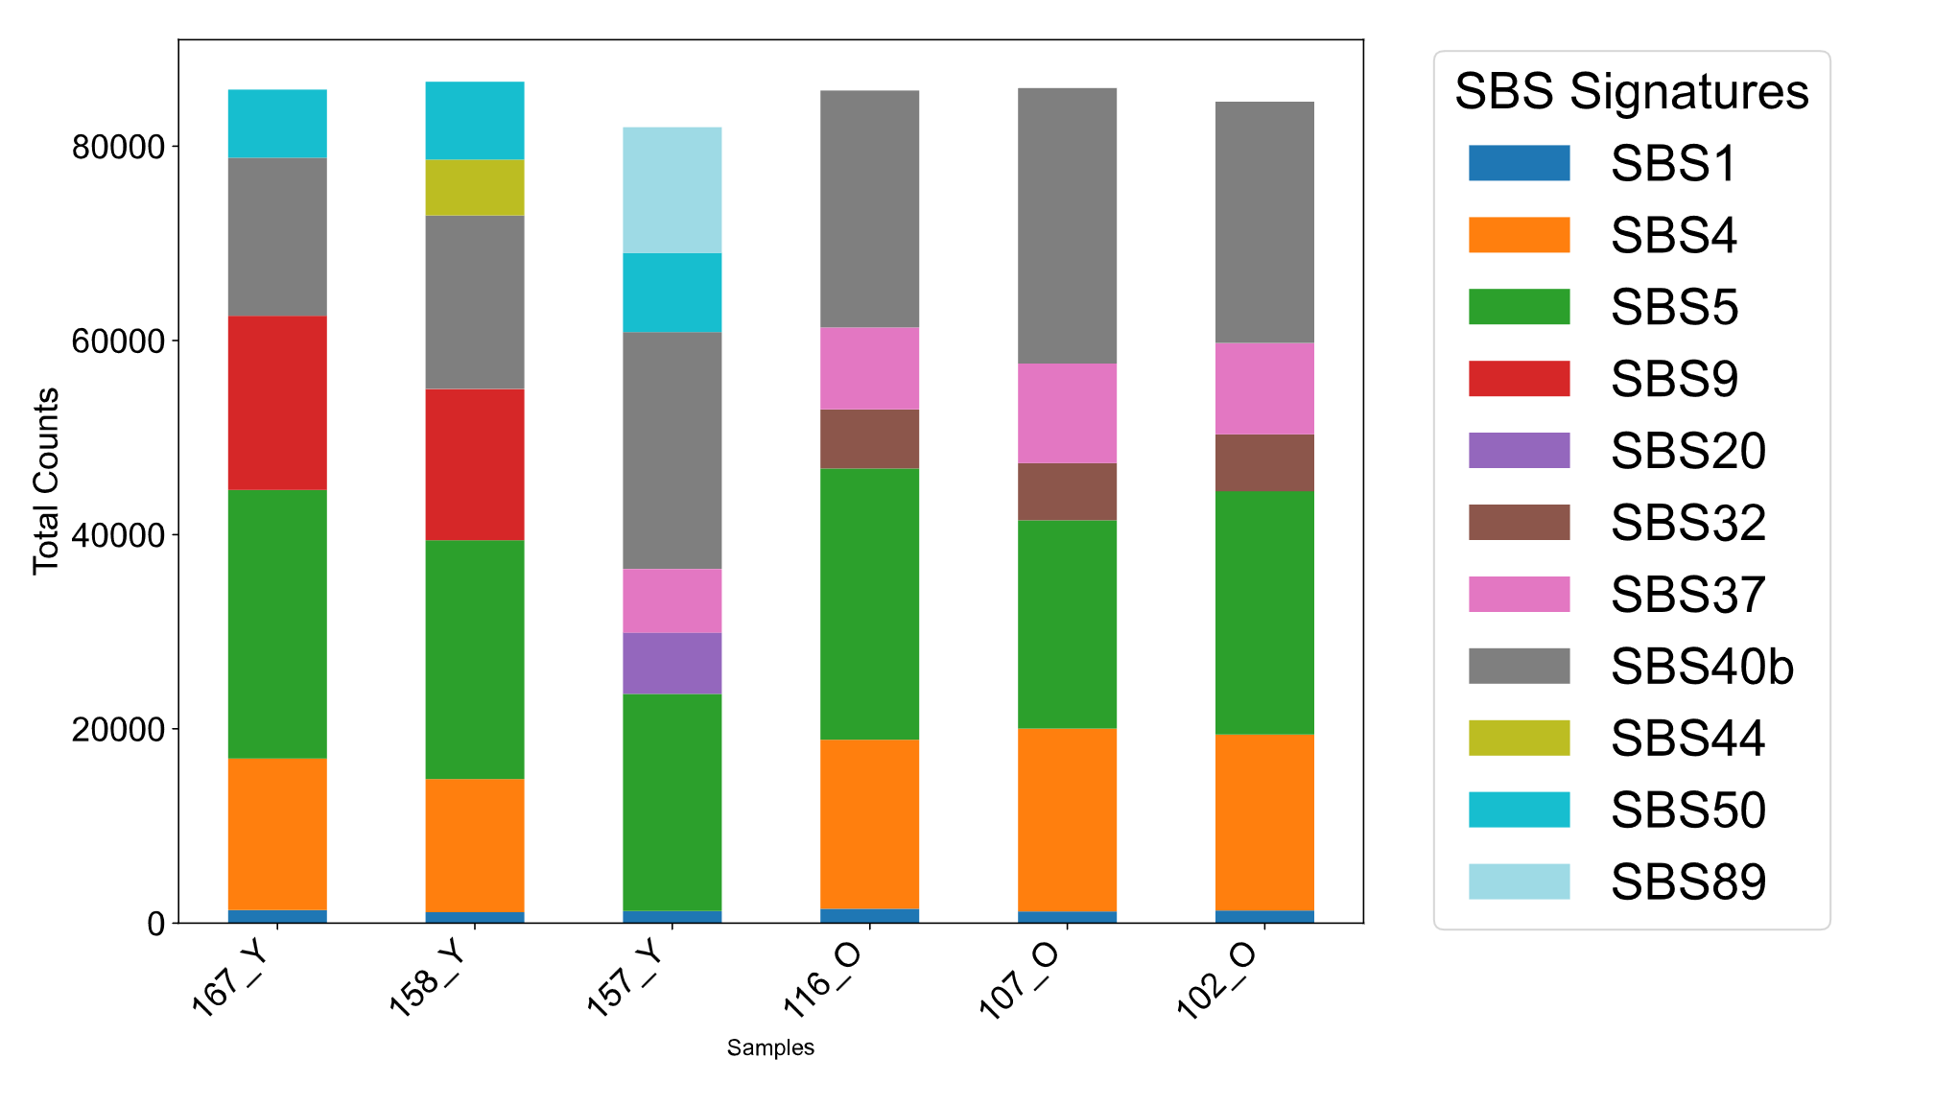
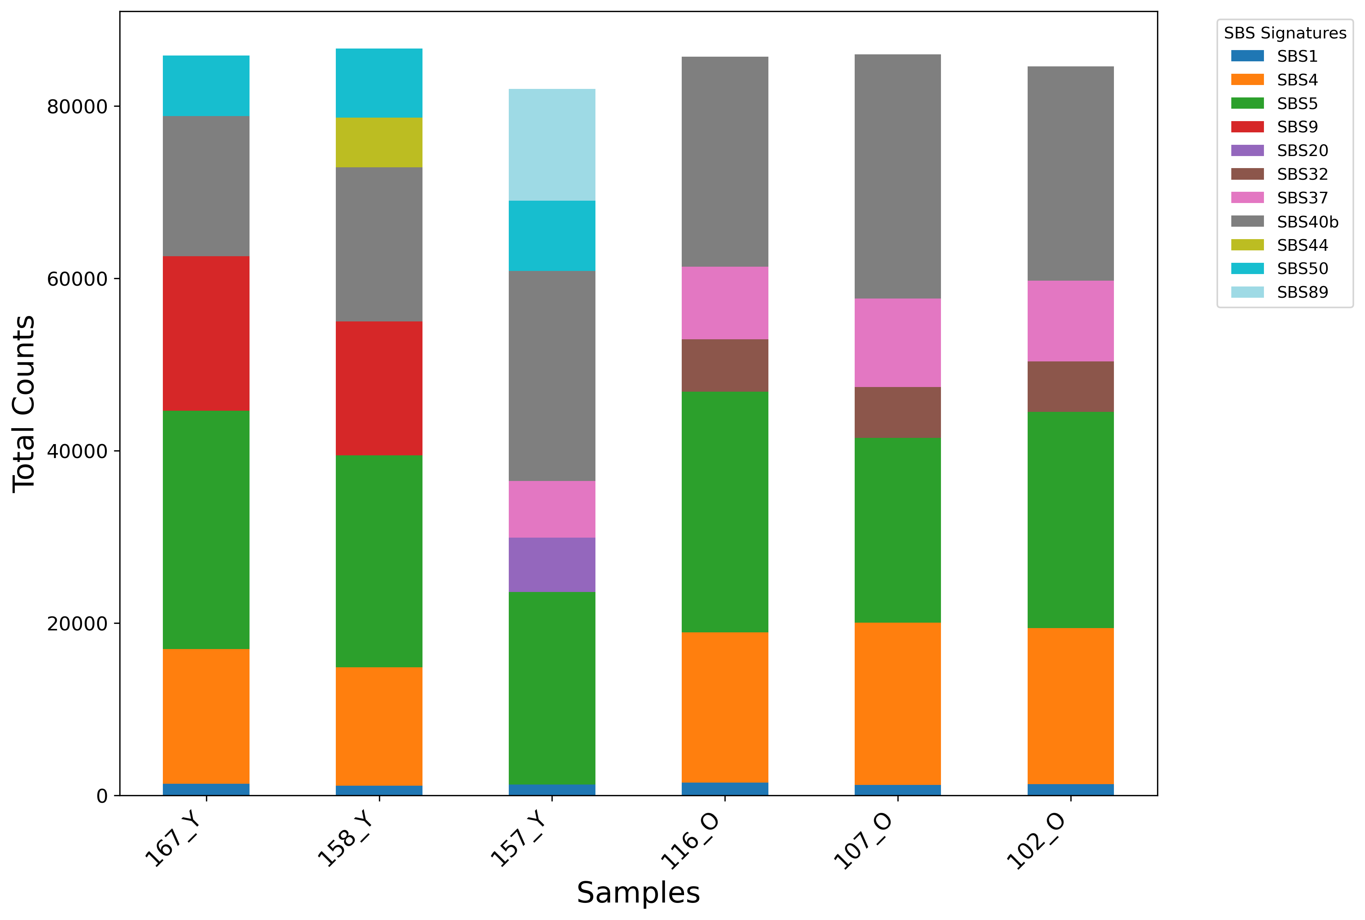
Fig 2B: COSMIC Signatures (PASS - Minor Change)
MANUSCRIPT (Original)
REGENERATED (Fixed)
• Change: Removed auto-generated title 'SBS Signature Counts per Sample'
• Data patterns: Identical
• Impact on interpretation: None
Notes:
The only change was removing an auto-generated title that wasn't in the original. Same data, same conclusions.

Slide 6
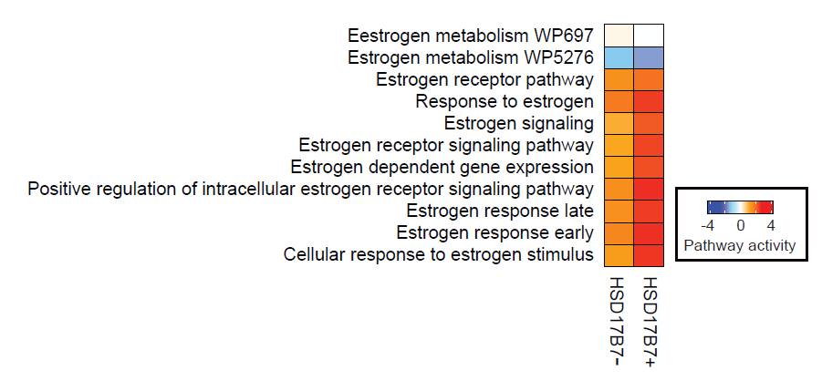
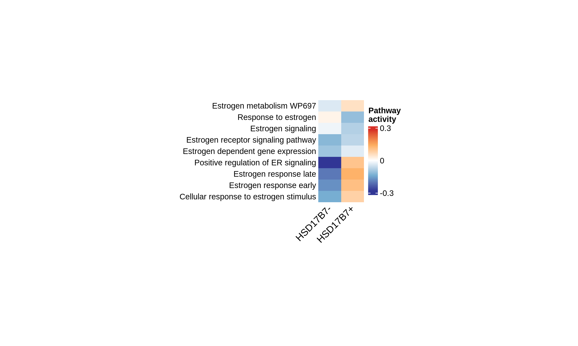
Fig 4E: Estrogen Pathway Heatmap (FIXED)
MANUSCRIPT (Original)
REGENERATED (Fixed)
• Styling fixed: Row labels on LEFT, 45° column rotation, NO cell borders
• Color scale: Auto-scaled to actual GSVA data range (~±0.3) for proper gradient
• Switched to ComplexHeatmap for publication-quality output
• Note: 9/11 pathways found (2 missing from msigdbr lookup)
Notes:
Major rewrite using ComplexHeatmap. Fixed scaling issue - now uses raw GSVA scores with auto-scaled colorbar based on actual data range.

Slide 7
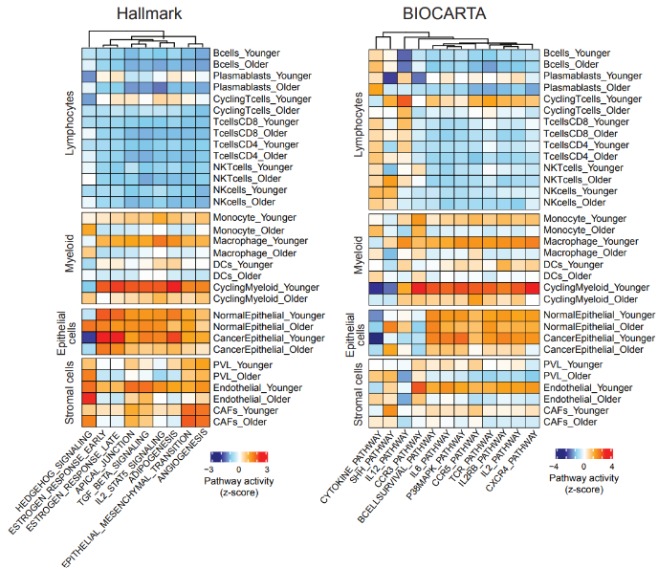
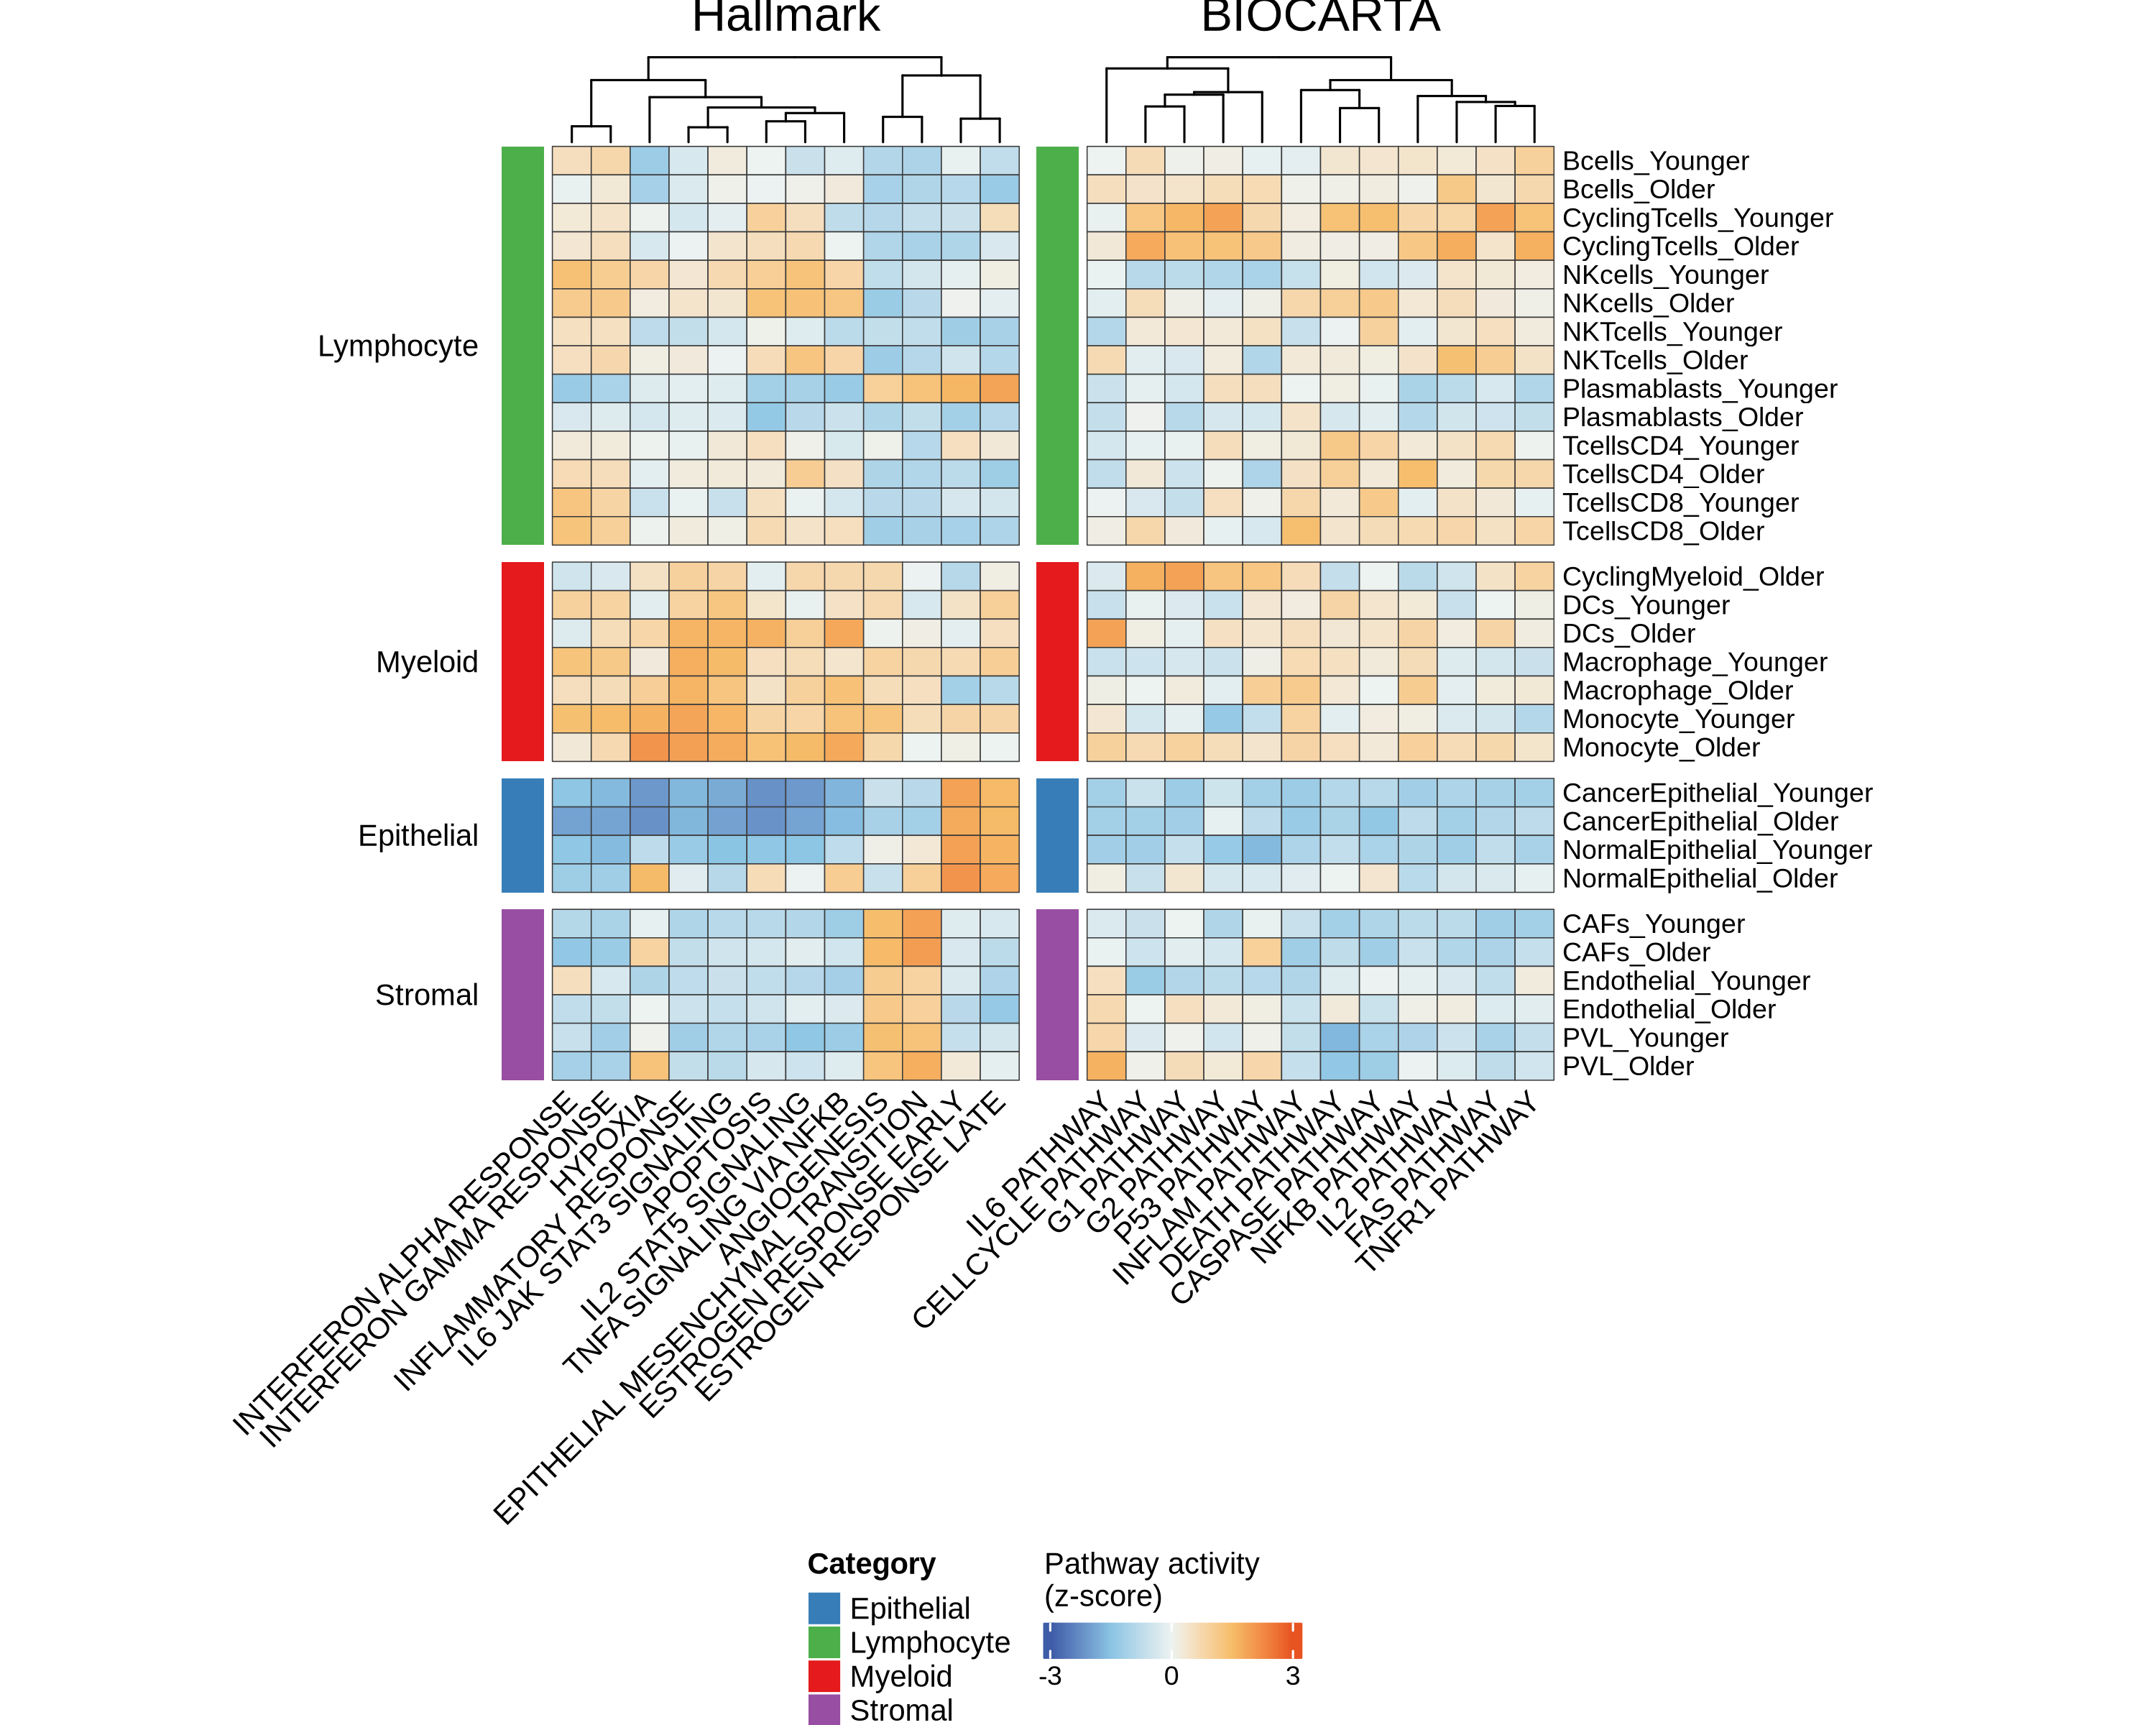
Fig 7B/C: Multi-Cell Type Pathway Heatmaps (FIXED)
MANUSCRIPT (Original)
REGENERATED (Fixed)
• Color palette: Blue-cyan → white → orange-red (matched from manuscript)
• Curated pathways: 12 HALLMARK + 12 BIOCARTA (readable labels, not all 340+)
• Cell borders: Thin dark borders, horizontal colorbar at bottom
• Switched to ComplexHeatmap for full styling control
Notes:
Complete rewrite using ComplexHeatmap to match manuscript styling exactly. Curated to ~12 pathways per panel for readability. Color palette sampled from manuscript.

Slide 8
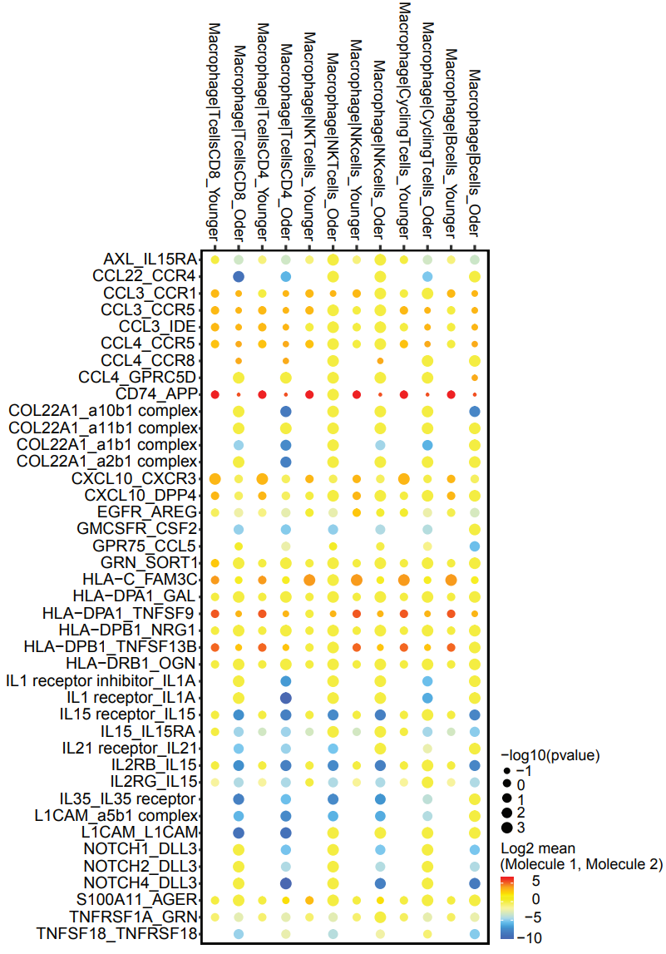
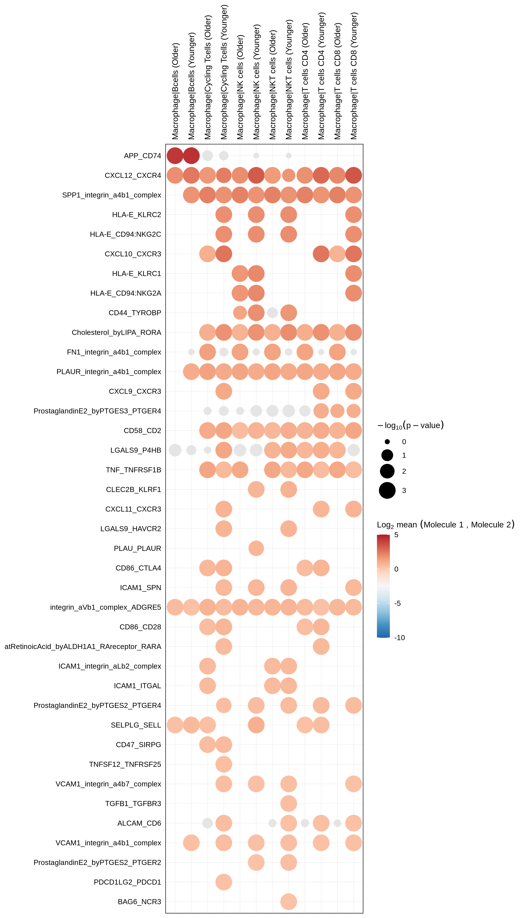
Fig 7D: Cell-Cell Communication (CellPhoneDB)
MANUSCRIPT (Original)
REGENERATED (CellPhoneDB v5)
• 39 L-R pairs × 6 Macrophage→target cell pairs (12 columns with age)
• Style: solid dots, blue-red color scale (-10 to +5), portrait orientation
• Note: Different CellPhoneDB database version = different L-R pair names
• Biological pattern preserved: Macrophage-immune communication by age
Notes:
Manuscript used older CellPhoneDB database with different L-R pair naming. Regenerated with CellPhoneDB v5 - same biological patterns but updated nomenclature.

Slide 9
Action Items for Neil
• Fig 7D: Verify L-R pairs match manuscript (curated list found)
• Fig 4E: Confirm aggregated heatmap matches intended visualization
• All figures: Check interpretation against manuscript text
• If any discrepancies: Flag for discussion before resubmission
Notes:
Neil should verify the regenerated figures match what was intended in the manuscript. The code is now documented and reproducible.

Slide 10
Code Quality Improvements Made
• Created CLAUDE.md with project guidelines for robustness
• Fixed Seurat 5.x + patchwork compatibility bug
• Added error handling and graceful degradation
• Dual output formats: PDF (vector) + PNG (validation)
• All scripts now set seeds for reproducibility
Notes:
Beyond the figure fixes, we improved the overall code quality to ensure the analysis is reproducible and robust for future revisions.

Slide 11
Files to Replace in Manuscript
• Fig 2B: analysis/03_rat_wes/figures/cosmic_signatures.png
• Fig 4E: analysis/04_human_scrnaseq/figures/gsva_heatmap.png
• Fig 7B/C: analysis/04_human_scrnaseq/figures/fig7bc_pathway_heatmaps.png
• Fig 7D: analysis/04_human_scrnaseq/figures/fig7d_cellchat_dotplot.png
•
• Full report: validation/report/figure_change_report_for_neil.md
Notes:
These are the regenerated figure files that should replace the originals in the manuscript PowerPoint.

