Slide 1
ERpBRCA_OlderWomen Biostatistical Corrections
Code Review Summary - February 2026

Slide 2
Overview of Corrections
• Added FDR (Benjamini-Hochberg) correction for multiple testing
• Added missing differential expression analysis for rat snRNA-seq
• Added missing differential abundance testing for rat snRNA-seq
• Added DoubletFinder for doublet detection
• Added random seeds for reproducibility
• Fixed Seurat v5 compatibility issues (JoinLayers)

Slide 3
Human Bulk RNA-seq: Correlation Analysis
Metric | Original | After FDR
Total tests | 50 | 50
Significant (p < 0.05) | 22 | 22
Significant (FDR < 0.05) | N/A | 20
Reproducibility | - | PASS (100%)

Slide 4
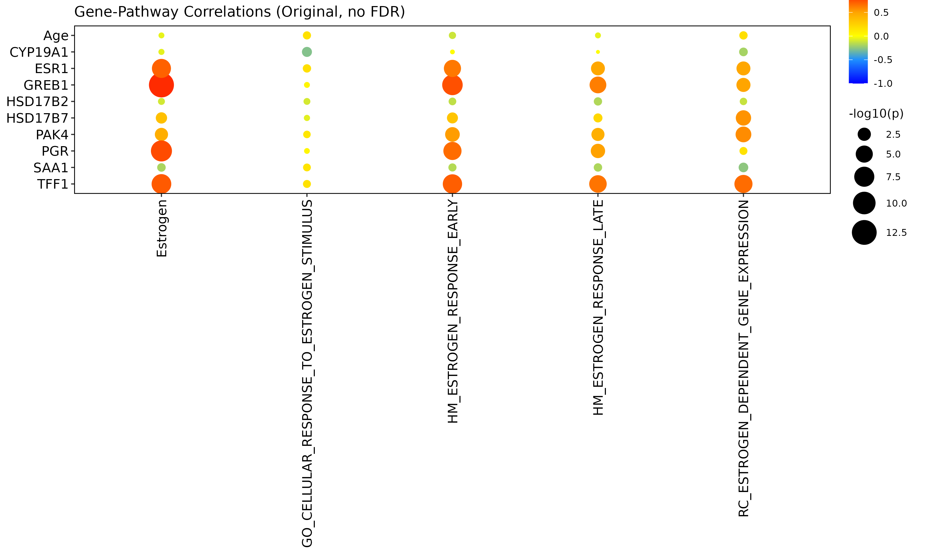
Human Bulk RNA-seq: Original Correlations (p < 0.05)
22 significant correlations at nominal p < 0.05

Slide 5
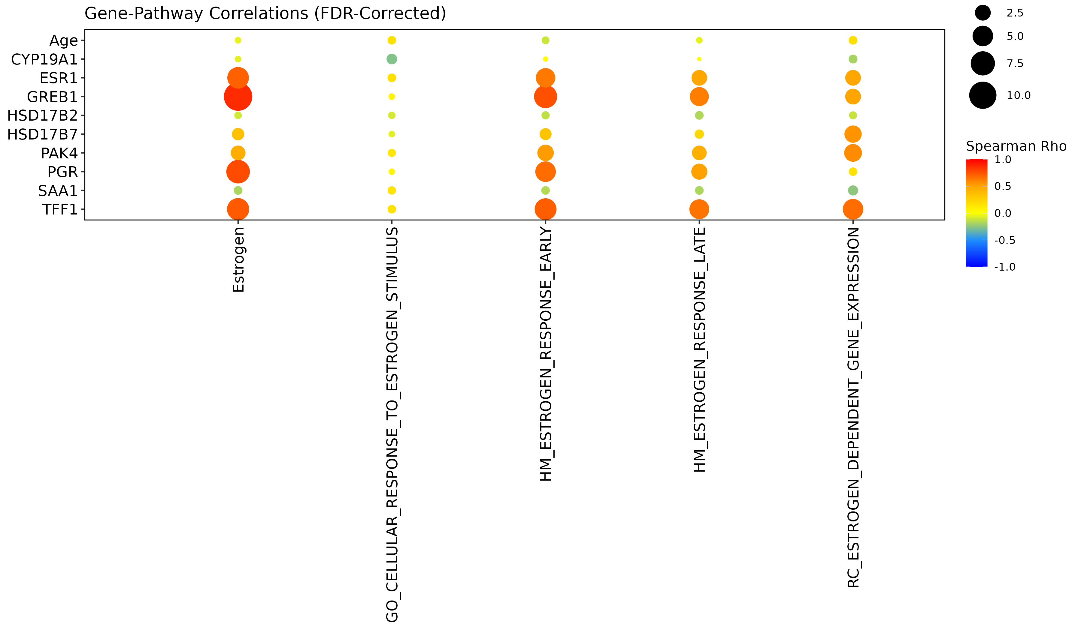
Human Bulk RNA-seq: FDR-Corrected Correlations
20 significant correlations at FDR < 0.05 (2 lost: HSD17B7 correlations)

Slide 6
Rat snRNA-seq: Differential Expression (NEW)
Cell Type | Total DE | FDR < 0.05 | Up in Aged | Down in Aged
Luminal | 3,482 | 3,335 | 978 | 2,357
Basal | 3,802 | 2,682 | 1,811 | 871
Fibroblasts | 4,747 | 1,631 | 1,479 | 152
Endothelial | 4,308 | 1,112 | 645 | 467
TOTAL | 16,339 | 8,760 | 4,913 | 3,847

Slide 7
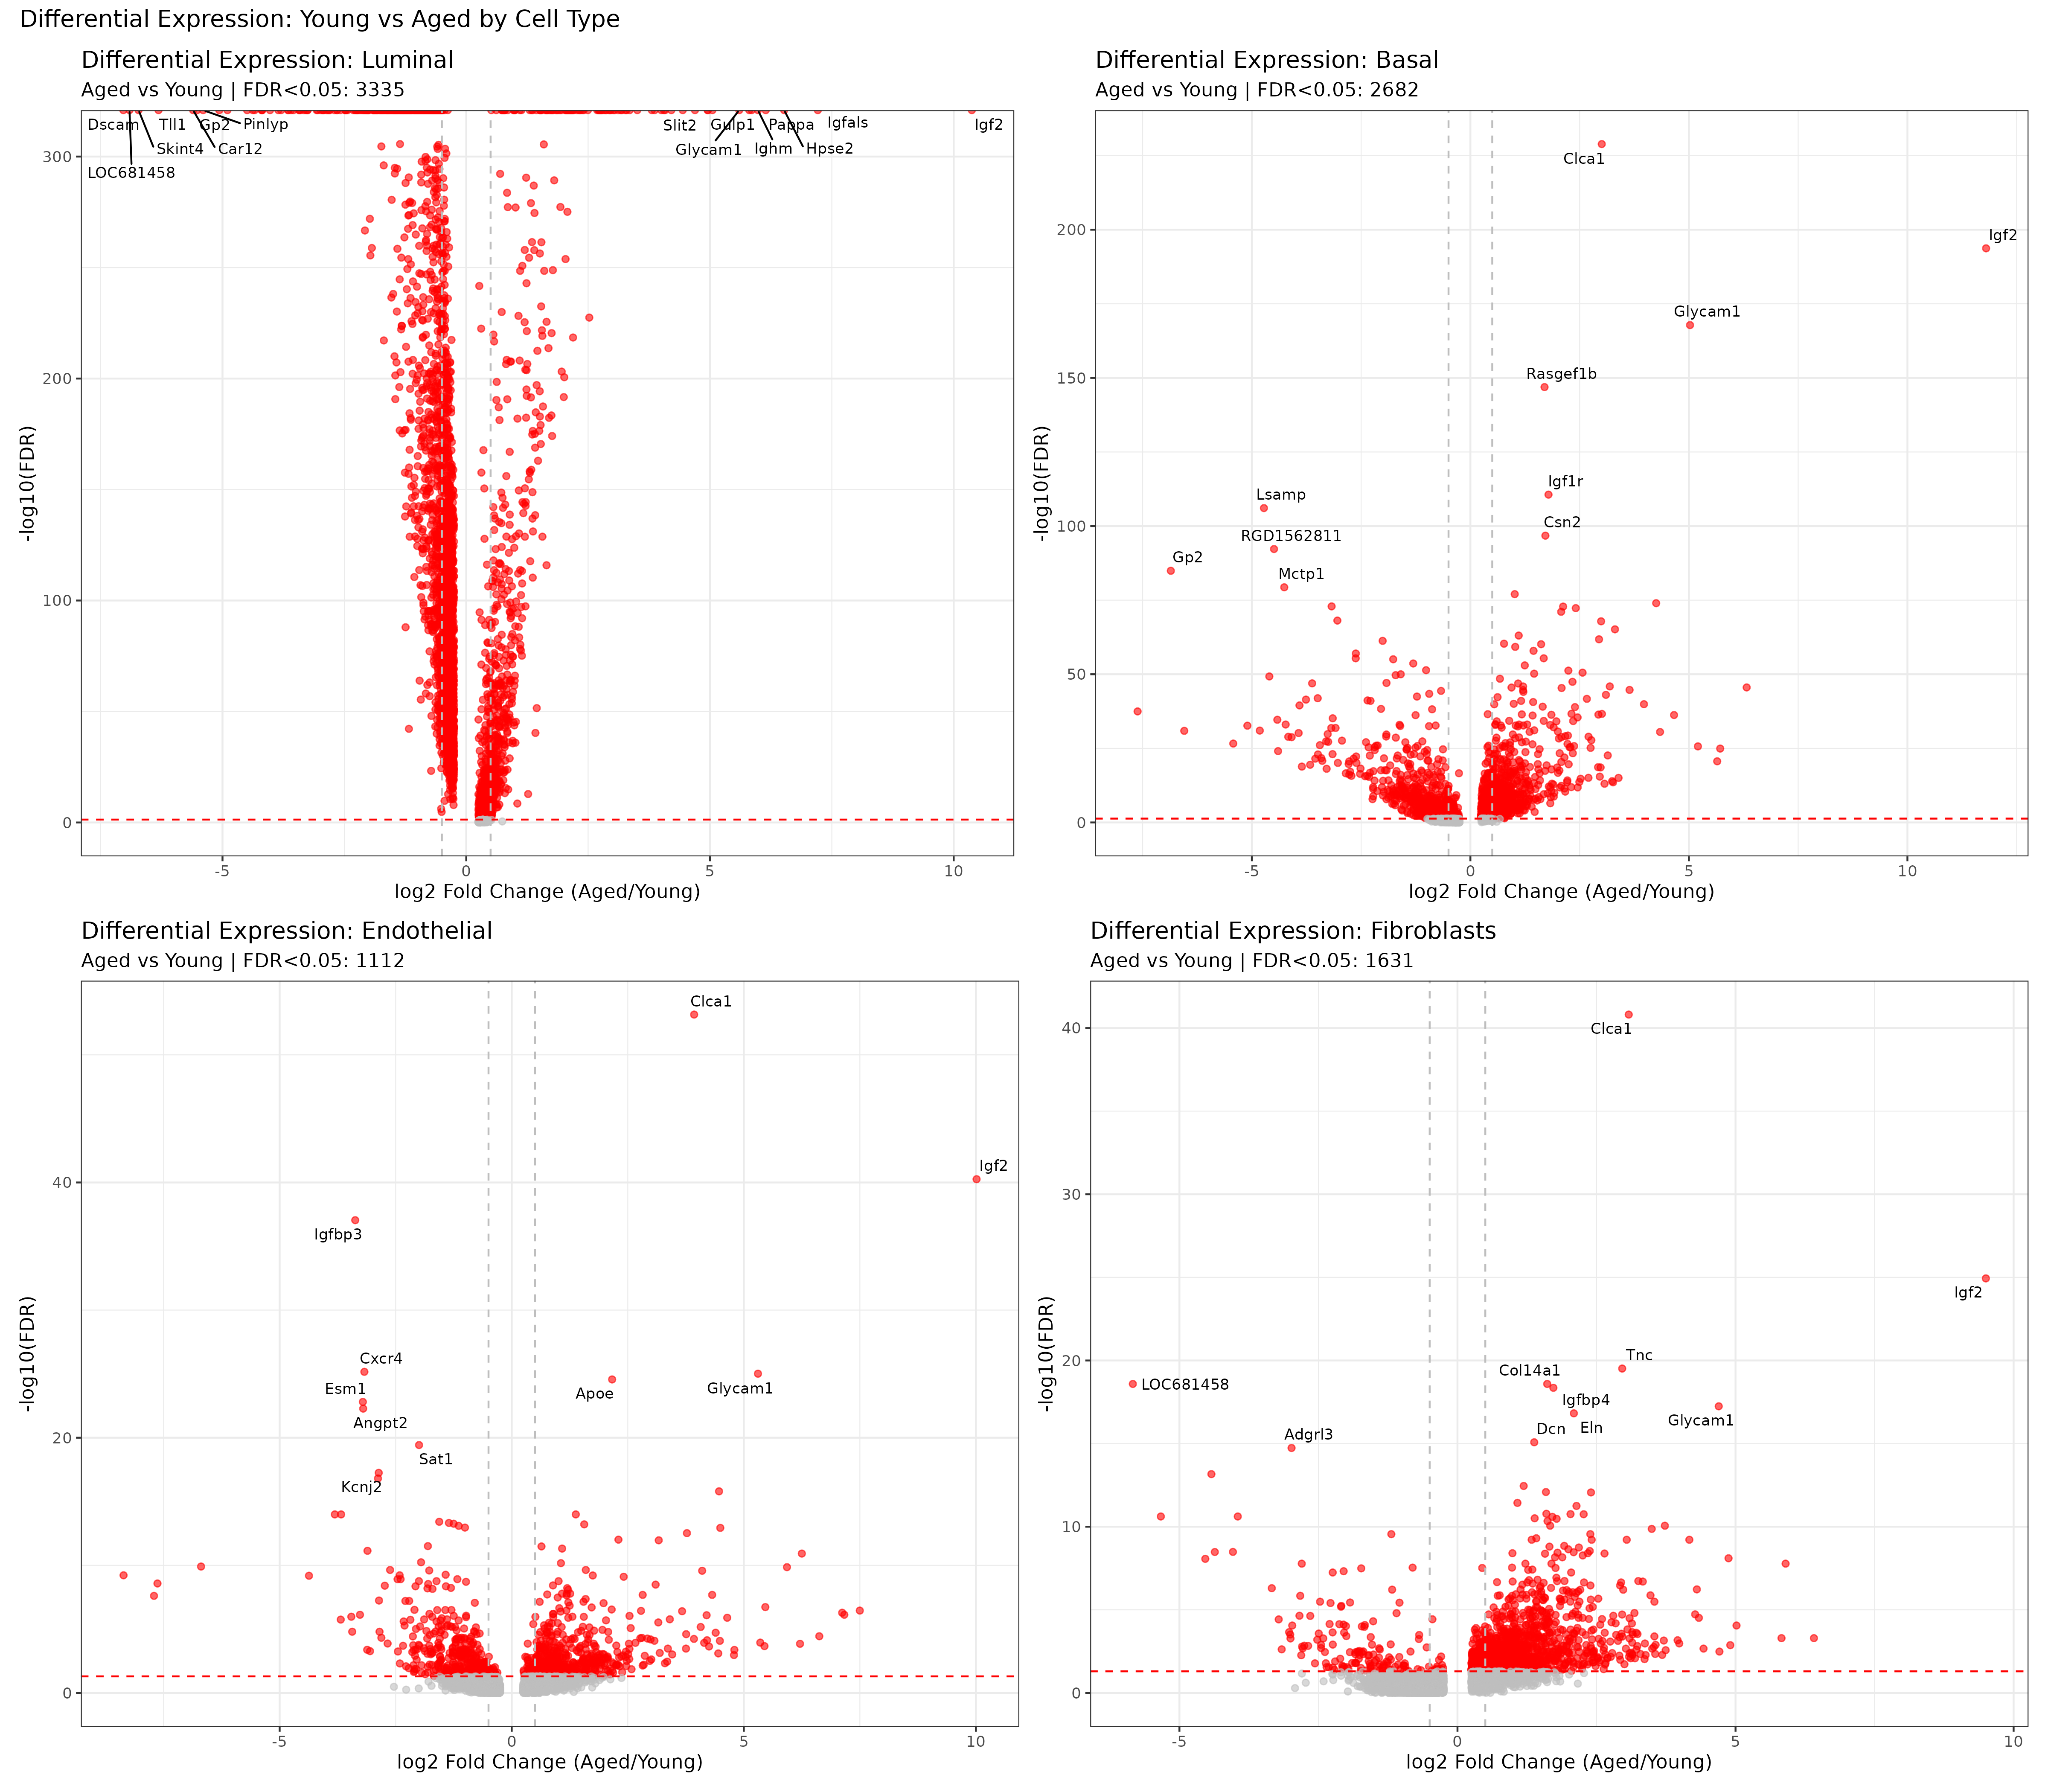
Rat snRNA-seq: DE Volcano Plots
Differential expression between Young and Aged per cell type

Slide 8
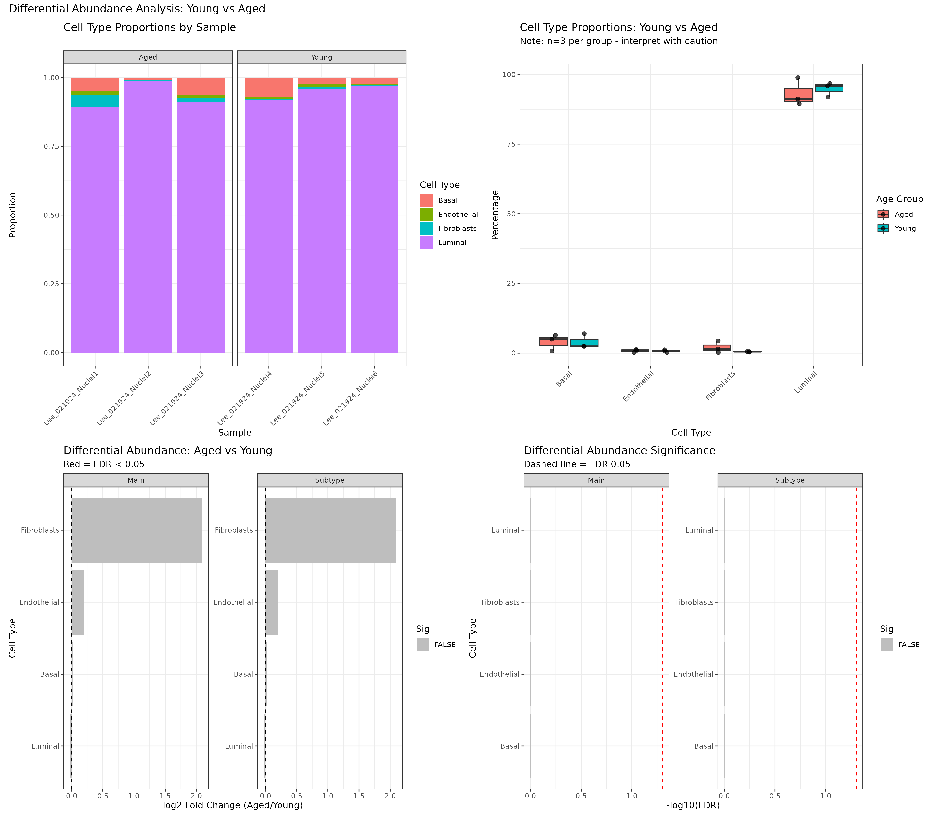
Rat snRNA-seq: Differential Abundance
Cell type proportions by age group (n=3 per group)

Slide 9
Technical Fixes Applied
• sys.frame(1)$ofile error: Replaced with commandArgs() for Rscript
• future.globals.maxSize: Increased to 4GB for large cell populations
• Cluster name 'g' prefix: Fixed Seurat v5 numeric cluster mapping
• JoinLayers(): Added before FindAllMarkers for Seurat v5
• tryCatch scope: Fixed variable scoping in error handlers

Slide 10
Conclusions
• Core results are REPRODUCIBLE - correlation values identical
• 91% of human correlations (20/22) remain significant after FDR
• Rat snRNA-seq now has complete DE/DA analyses (previously missing)
• 8,760 FDR-significant DE genes identified in rat mammary tissue
• All analyses now include proper multiple testing correction
• Random seeds ensure future reproducibility

