Slide 1
Shock Graphs and Shape Matching
Kaleem Siddiqi, Ali Shokoufandeh, Sven Dickinson and Steven Zucker

Slide 2
The Skeleton:
Blum’s Medial Axis
A connected collection of curves.
The set of all points within a closed, Jordan curve such that the largest circle contained within the curve touches two fronts.
Provided by Matlab’s bwmorph(‘skel’) function.

Slide 3
The Skeleton: Example

Slide 4
Problems With Skeletons
Small changes in curve may lead to big changes in skeleton.
What about occlusion?
It is like a graph, so why not represent it as one?

Slide 5
The Shocks
The singularities (corners, bridges, lines and points) that arise during evolution of the grassfire.
In terms of the skeleton, these are protrusions, necks, bends and seeds, described as first to fourth order shocks.
The union of the shocks is the skeleton.

Slide 6
The Shocks: Example
4th
3rd
2nd
1st
Seed
Bend
Neck
Protrusion

Slide 7
The Shock Graph
A description of a skeleton as a DAG. Combine adjacent shocks of same order into one node.
Label each node with the part, the time (distance from curve), and first order curves with the flow orientation and end-time.
Adjacent curves/points are adjacent in the graph, with edges pointing to the earlier node.
  Nodes closer to the root occur later.

Slide 8
The Shock Graph: Example
1st
#
2nd
Φ
3rd
4th
Φ
Φ
# Start
Φ
Φ
Φ Leaf

Slide 9
The Shock Graph Grammar
A non-context-free grammar to which all shock graphs conform.
Assigns some semantics to the different nodes:
  Birth
  Protrusion
  Union
  Death

Slide 10
Shock Trees
Canonical mapping from graph to tree.
Relies on the grammar to determine how to cut the graph.

Slide 11
Shock Trees
Formed by duplicating tips of loops.
#
Φ
Φ
Φ
Φ
Φ
Φ

Slide 12
Topological Distance
Idea: find the largest common subgraph, in this case, subtree.
The sum of the eigenvalues of a tree adjacency matrix are invariant to similarity transforms, meaning any consistent re-ordering of the tree.
So, color all vertexes with a vector made up of the eigenvalue sums of its children sorted by value: χ(u) in R^{δ(G)-1}
Closer vectors indicate closer isometries.

Slide 13
Vertex Distance
Need to take into account vertex shape/class/creation time.
Non-compatible vertices are assigned distance of ∞.
For points features, use distance between (x,y,t,α).
For curves, interpolate the 4D points and take Hausdorff distance.
Notes:
But aren’t 1 and 2 and 2 and three semantically equivalent sometimes?

Slide 14
Finding Matching Subtrees
For each pair of vertexes from G₁ and G₂, compute vertex distance times the Euclidean distance between their χ vectors.
From the minimum weight, maximal size matching, pick the least-weight edge.
  Recurse down each vertex’s subtree, finding best matches in maximal matching and building a subtree match.
  Remove subtrees of all matched vertexes, and repeat.

Slide 15
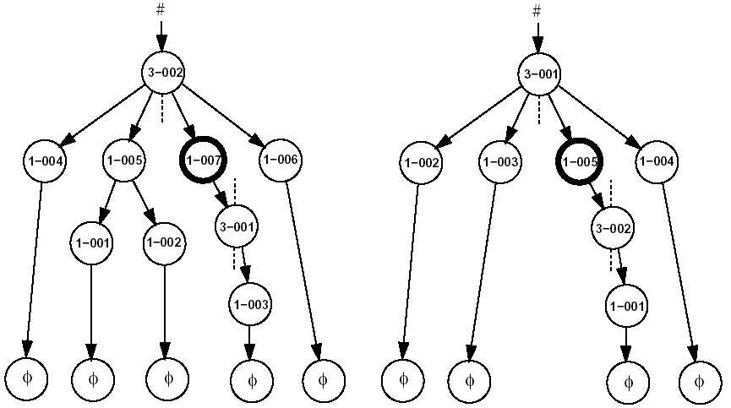
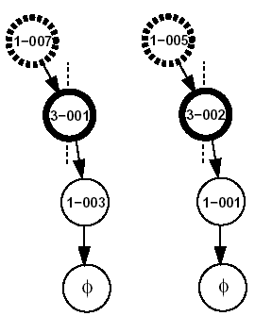
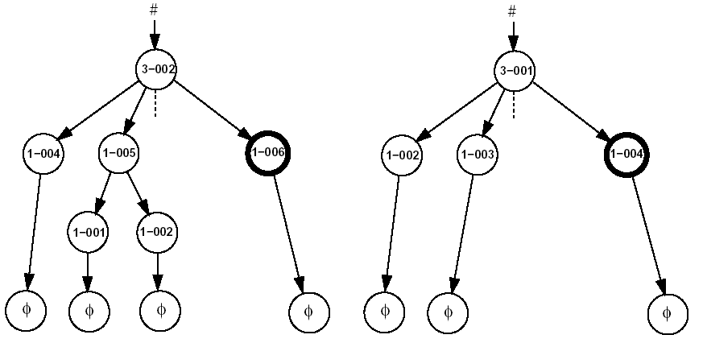
Finding Matching Subtrees

Slide 16
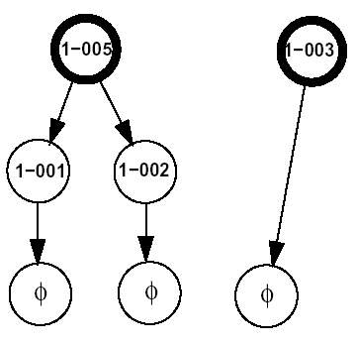
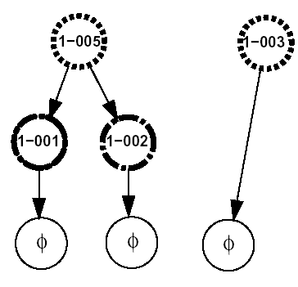
Cutting The Graph

Slide 17
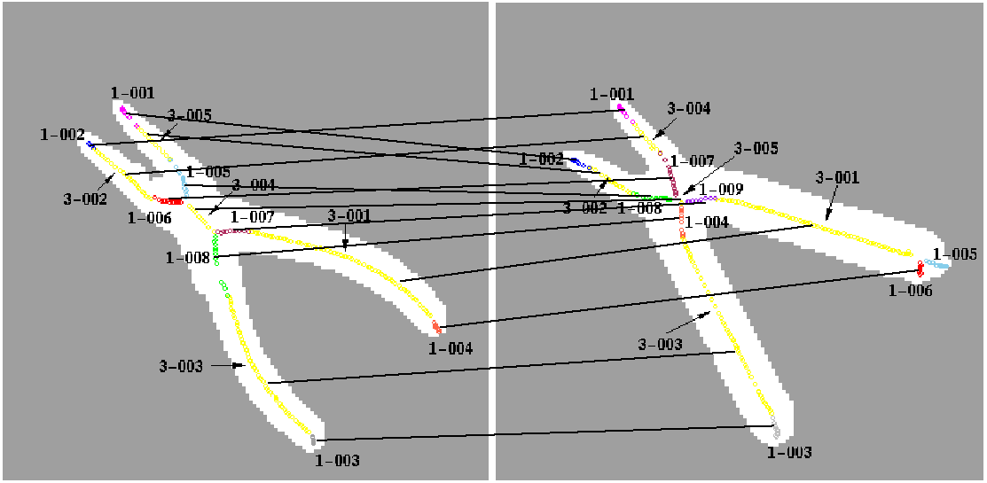
Computed Correspondences
Notes:
I thought you couldn’t correspond two different order shocks, but this graphs appears to do so.

Slide 18
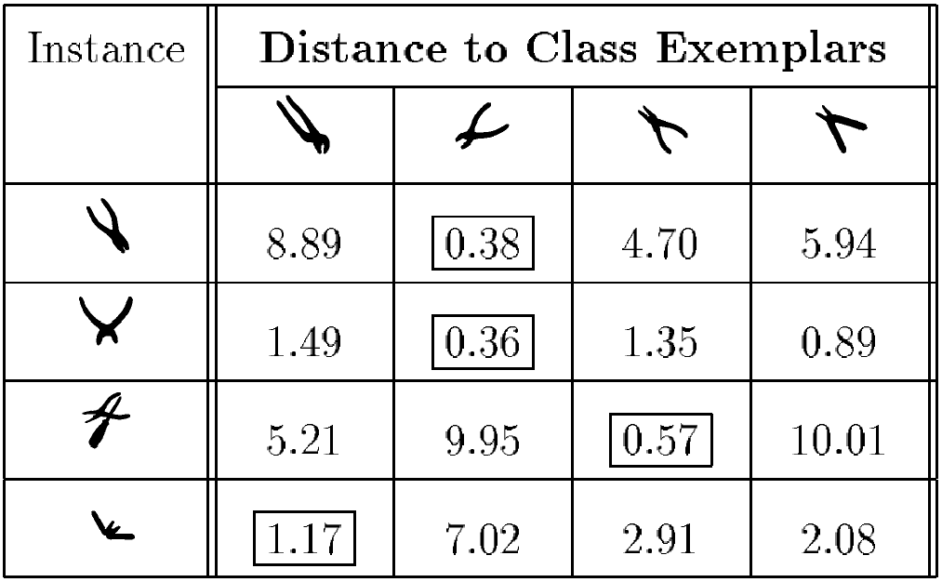
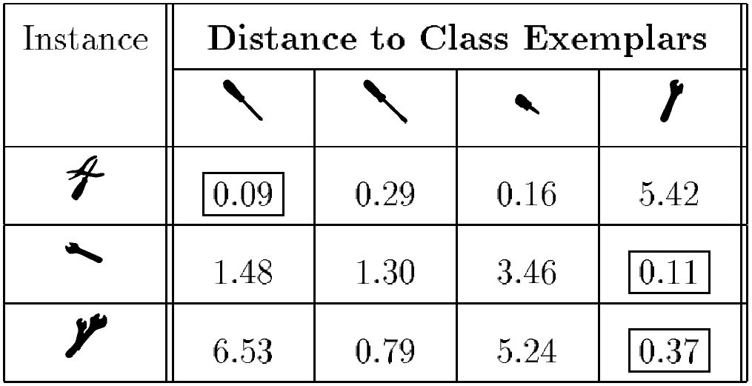
Exploratory Experiments

