Slide 1

Sales Performance Analysis of Walmart Stores Using Advanced MySQL Techniques

Slide 2
Table of contents
Identifying the Top Branch by Sales Growth Rate
Finding the Most Profitable Product Line for Each Branch
Analyzing Customer Segmentation Based on Spending
Detecting Anomalies in Sales Transactions
Most Popular Payment Method by City
Monthly Sales Distribution by Gender
Best Product Line by Customer Type
Identifying Repeat Customers
Finding Top 5 Customers by Sales Volume
Analyzing Sales Trends by Day of the Week
Conclusion
Q/A

Slide 3
Introduction
This project analyzes the sales performance of Walmart stores using advanced MySQL techniques.
Key objectives include:
- Identifying sales patterns and trends.
- Analyzing customer purchasing behavior.
- Discovering top-performing products and branches.
- Understanding payment method preferences and gender-based sales.
The insights generated aim to help Walmart optimize its sales strategies and improve customer satisfaction.

Slide 4
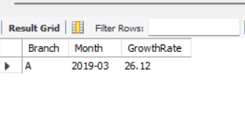
Identifying the Top Branch by Sales Growth Rate
Sql script
use walmartsales;
Monthly Sales: by calculating total sales of each branch each month.
WITH MonthlySales AS (
SELECT
Branch,
DATE_FORMAT(STR_TO_DATE(Date, '%d-%m-%Y'), '%Y-%m') AS Month,
SUM(Total) AS MonthlySales
FROM
walmartsales
GROUP BY
Branch, DATE_FORMAT(STR_TO_DATE(Date, '%d-%m-%Y'), '%Y-%m')
),

Slide 5
Identifying the Top Branch by Sales Growth Rate
Monthly Growth: Growth rate for each month compared to the previous month
MonthlyGrowth AS (
SELECT
Branch,
Month,
MonthlySales,
LAG(MonthlySales, 1) OVER (PARTITION BY Branch ORDER BY Month) AS PreviousMonthSales
FROM
MonthlySales
)

Slide 6
Identifying the Top Branch by Sales Growth Rate
Insights:-
- Branch A is the top-performing branch with a 26.12% growth rate in March 2019.
- This indicates strong sales improvement compared to the beginning of the year.
Top Growth Rate: Orders the results by growth rate and selects the highest growth rate.
SELECT
Branch,
Month,
ROUND((MonthlySales - PreviousMonthSales) / PreviousMonthSales * 100, 2) AS GrowthRate
FROM
MonthlyGrowth
WHERE
PreviousMonthSales IS NOT NULL
ORDER BY
GrowthRate DESC
LIMIT 1;

Slide 7
Identifying the Top Branch by Sales Growth Rate
use walmartsales;
Monthly Sales: by calculating total sales of each branch each month.
WITH MonthlySales AS (
SELECT
Branch,
DATE_FORMAT(STR_TO_DATE(Date, '%d-%m-%Y'), '%Y-%m') AS Month,
SUM(Total) AS MonthlySales
FROM
walmartsales
GROUP BY
Branch, DATE_FORMAT(STR_TO_DATE(Date, '%d-%m-%Y'), '%Y-%m')
),

Slide 8
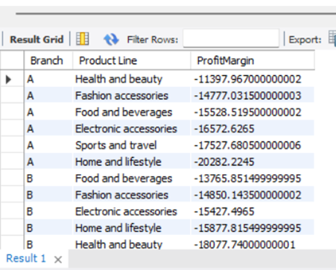
Finding the Most Profitable Product Line for Each Branch
Sql script
SELECT
Branch, `Product Line`, SUM(`gross income` - COGS) AS ProfitMargin
FROM walmartsales
GROUP BY Branch, `Product Line`
ORDER BY Branch, ProfitMargin DESC;

Slide 9
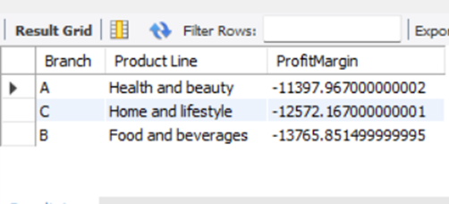
Finding the Most Profitable Product Line for Each Branch
Most Profitable ProductLine(in loss)
Instead of Profit there is a loss in the product line."Based on the dataset, Walmart's branches are experiencing losses in all product lines, as cost of goods sold(cogs) exceeds gross income."

Slide 10
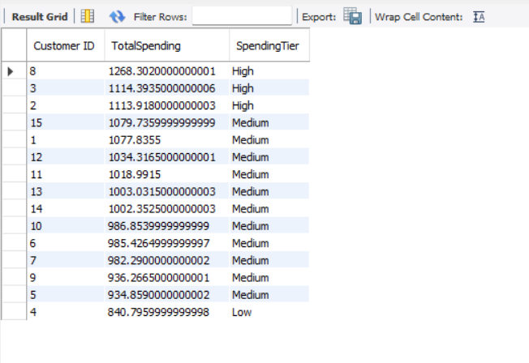
Analyzing Customer Segmentation Based on Spending
SELECT
`Customer ID`,
SUM(`gross income`) AS TotalSpending,
CASE
WHEN SUM(`gross income`) > 1100 THEN 'High'
WHEN SUM(`gross income`) BETWEEN 900 AND 1100 THEN 'Medium'
ELSE 'Low'
END AS SpendingTier
FROM
walmartsales
GROUP BY
`Customer ID`
ORDER BY
TotalSpending DESC;

Slide 11
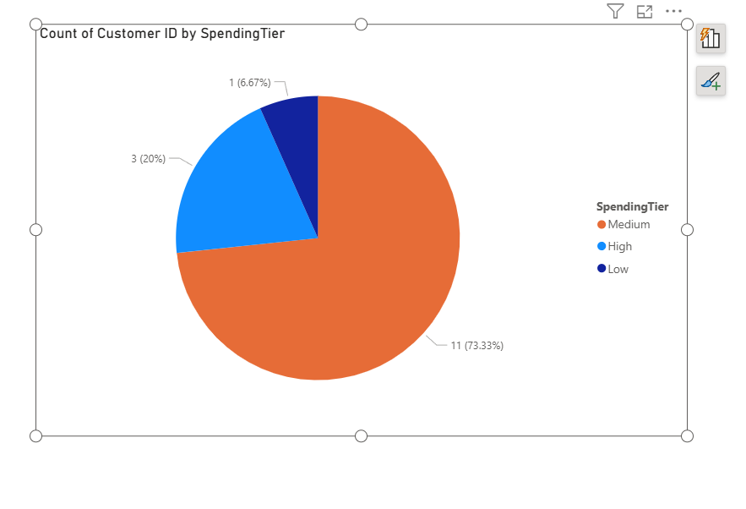
Analyzing Customer Segmentation Based on Spending
Customers are segmented into three groups based on their total spending:
High spenders: Total spending above 1100
Medium spenders: Total spending between 900 and 1100
Low spenders: Total spending below 900
High spenders can be targeted with exclusive offers and premium services.
Medium spenders might be encouraged to increase their purchases through promotions.
Low spenders By offering personalized discounts, special promotions, or loyalty rewards, Walmart can encourage these customers to spend more. Focusing on this group can help improve overall sales and customer retention.

Slide 12
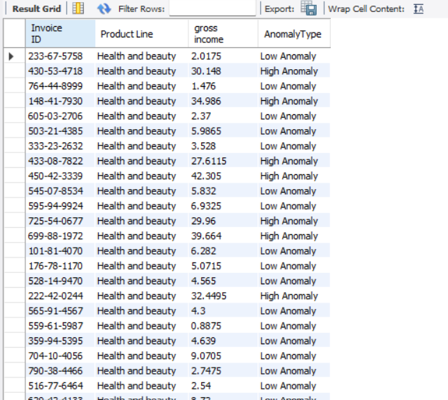
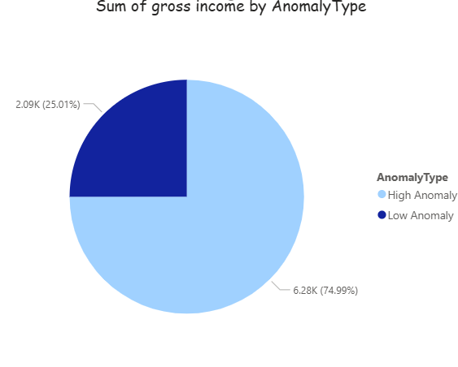
Detecting Anomalies in Sales Transactions

Slide 13
Sql script
SELECT
w.`Invoice ID`,
w.`Product Line`,
w.`gross income`,
CASE
WHEN w.`gross income` > stats.avg_sales + stats.stddev_sales THEN 'High Anomaly'
WHEN w.`gross income` < stats.avg_sales - (0.5 * stats.stddev_sales) THEN 'Low Anomaly'
ELSE 'Normal'
END AS AnomalyType
FROM
walmartsales w
JOIN (
SELECT
`Product Line`,
AVG(`gross income`) AS avg_sales,
STDDEV_POP(`gross income`) AS stddev_sales
FROM
walmartsales
GROUP BY
`Product Line`
) stats ON w.`Product Line` = stats.`Product Line`
WHERE
w.`gross income` > stats.avg_sales + stats.stddev_sales
OR
w.`gross income` < stats.avg_sales - (0.5 * stats.stddev_sales);

Slide 14
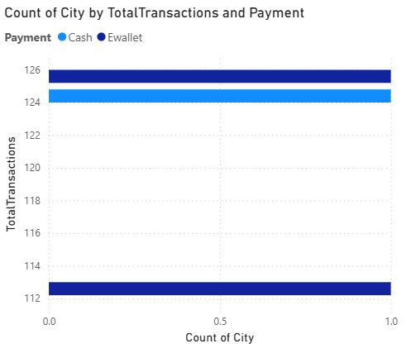
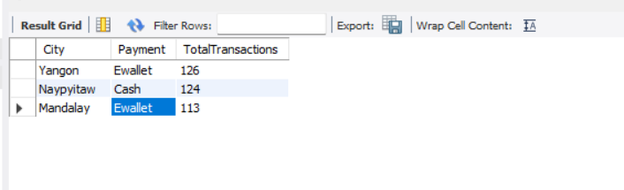
Most Popular Payment Method by City

Slide 15
Sql script
SELECT
w.City,
w.Payment,
COUNT(*) AS TotalTransactions
FROM
walmartsales w
GROUP BY
w.City, w.Payment
HAVING
TotalTransactions = (
SELECT
MAX(sub.TotalTransactions)
FROM (
SELECT
City,
Payment,
COUNT(*) AS TotalTransactions
FROM
walmartsales
GROUP BY
City, Payment
) sub
WHERE
sub.City = w.City
);

Slide 16
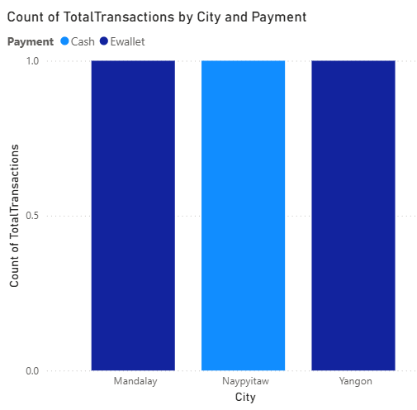
Insights
In Yangon and Mandalay, most people like to pay using E-wallets. In Naypyitaw, people mostly pay with cash. This means digital payments are popular in big cities, but cash is still common in some places.
Opportunities for Digital Payment Growth: Yangon and Mandalay already prefer Ewallet. There is a chance to increase digital payments in Naypyitaw by running special promotions or awareness programs.
Branch-Specific Promotions: Promotions can be designed according to each city's favorite payment method. For example, give Ewallet discounts in Yangon and Mandalay, and offer cashback for cash payments in Naypyitaw.

Slide 17
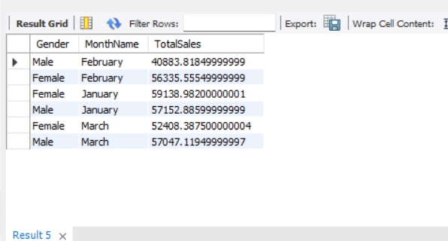
Monthly Sales Distribution by Gender
SELECT
Gender,
MONTHNAME(STR_TO_DATE(`Date`, '%d-%m-%Y')) AS MonthName,
SUM(Total) AS TotalSales
FROM
walmartsales
GROUP BY
Gender, MonthName
ORDER BY
MonthName

Slide 18
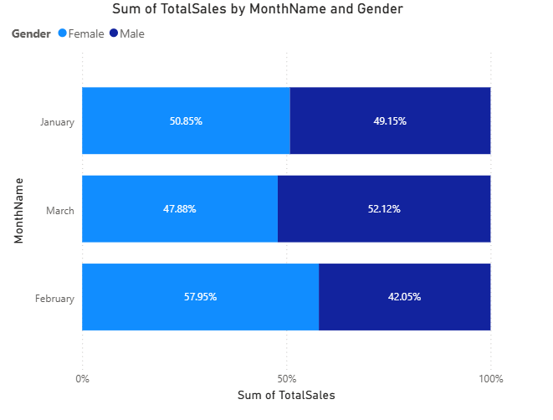
Monthly Sales Distribution by Gender
Monthly sales are consistent between genders, with females slightly outpacing males in most months. Targeted promotions for male customers could balance the sales distribution.
The gender contribution to sales fluctuates month-to-month, with February being the month where females have a clear advantage, while males lead in March. This suggests potential seasonal or product preferences that vary by gender and time, which Walmart could explore for targeted marketing.

Slide 19
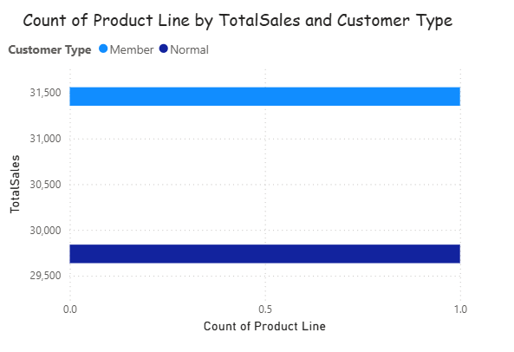
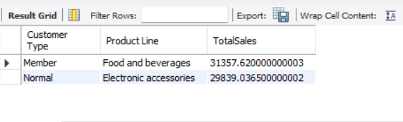
Best Product Line by Customer Type
Members mainly buy Food & Beverages, driving sales of 31,357.62, while normal customers prefer Electronic Accessories with sales of 29,839.03. Targeted offers can boost sales in these categories.
This pattern highlights different buying behaviors, indicating an opportunity to create customized marketing strategies — for example, promoting food and beverage deals to members, and tech or electronic accessories promotions to normal customers to maximize revenue.

Slide 20
Best Product Line by Customer Type
WITH RankedSales AS (
SELECT
`Customer Type`,
`Product Line`,
SUM(`Total`) AS TotalSales,
ROW_NUMBER() OVER (PARTITION BY `Customer Type` ORDER BY SUM(`Total`) DESC) AS rn
FROM
walmartsales
GROUP BY
`Customer Type`, `Product Line`
)
SELECT
`Customer Type`,
`Product Line`,
TotalSales
FROM
RankedSales
WHERE
rn = 1;

Slide 21
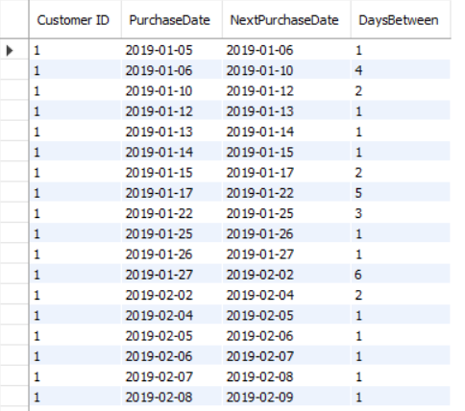
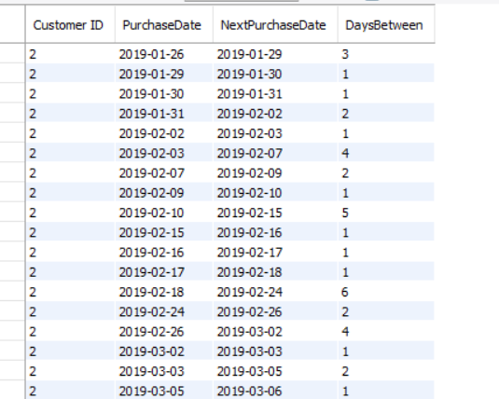
Identifying Repeat Customers

Slide 22
Identifying Repeat Customers
`Customer ID`,
STR_TO_DATE(`Date`, '%d-%m-%Y') AS PurchaseDate
FROM walmartsales) AS SubQuery
)
SELECT `Customer ID`,
PurchaseDate,
NextPurchaseDate,
DaysBetween
FROM
CustomerPurchases
WHERE
DaysBetween > 0 AND DaysBetween <= 30;
WITH CustomerPurchases AS (
SELECT
`Customer ID`,
PurchaseDate,
LEAD(PurchaseDate, 1) OVER (PARTITION BY `Customer ID` ORDER BY PurchaseDate) AS NextPurchaseDate,
DATEDIFF(
LEAD(PurchaseDate, 1) OVER (PARTITION BY `Customer ID` ORDER BY PurchaseDate),
PurchaseDate
) AS DaysBetween
FROM (
SELECT

Slide 23
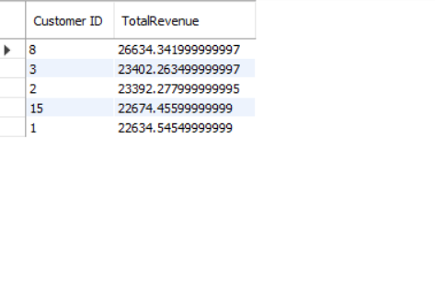
Finding Top 5 Customers by Sales Volume.
SELECT
`Customer ID`,
SUM(`Total`) AS TotalRevenue
FROM
walmartsales
GROUP BY
`Customer ID`
ORDER BY
TotalRevenue DESC
LIMIT 5;

Slide 24
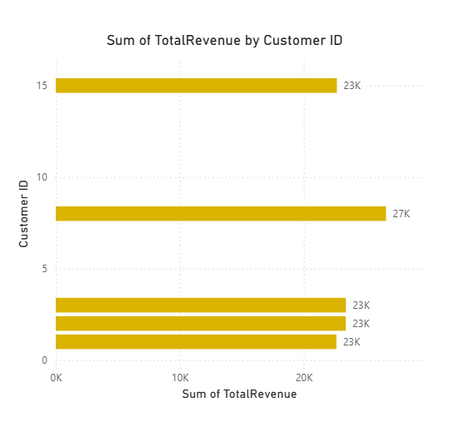
Finding Top 5 Customers by Sales Volume.
These top 5 customers contribute the highest sales revenue.
They are critical for Walmart's business and could be targeted for loyalty programs or special offers to retain and grow their spending.
Since these customers contribute a significant portion of revenue, loyalty programs or exclusive offers targeted at these individuals may help boost repeat purchases and increase overall sales.

Slide 25
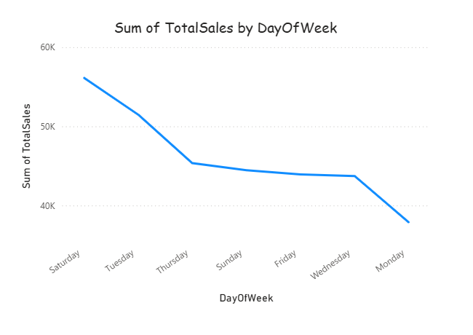
Analyzing Sales Trends by Day of the Week.
Saturday has the highest total sales, indicating strong customer activity on weekends.
Tuesday is the second-best day for sales, showing mid-week shopping interest.
Sales gradually decline from Thursday through Monday, with Monday having the lowest total sales.
The dip on Monday could be due to the start of the workweek when customers shop less.
The steady sales from Thursday to Sunday suggest that weekends and the days leading up to it are generally good for business.

Slide 26
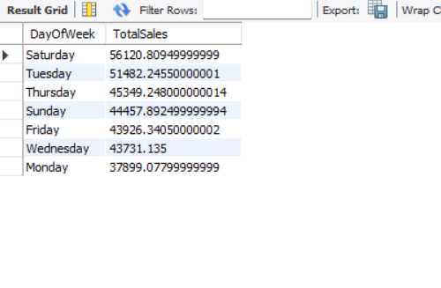
Sql script & output.
SELECT
DAYNAME(STR_TO_DATE(`Date`, '%d-%m-%Y')) AS DayOfWeek,
SUM(`Total`) AS TotalSales
FROM
walmartsales
GROUP BY
DayOfWeek
ORDER BY
TotalSales DESC;

Slide 27

Thank you
Name : Leepakshi Patankar
Email:leepakshipatankar@gmail.com
Career interest: Data Analyst

