Slide 1
Comparing Models of Subject-Clustered Single-Cell Data
Lee Panter
Audrey Hendricks¹, PhD---------------------(Committee Chair and Advisor)
Stephanie Santorico¹, PhD------------------(Committee Member)
Rhonda Bacher², PhD------------------------(Committee Member)
¹The University of Colorado-Denver
²The University of Florida

Slide 2
Project Overview
Slide 2/total
Project Summary
What problem is being addressed?
Single-cell (SC) data is increasing in prevalence
SC data with multiple subjects emerging for analysis
Not clear how to analyze subject level relationships (SLRs)
What do I do to address the problem?
Outline five modeling methods
Demonstrate how (if) the models account for SLRs in SC data
Compare how (if) model frameworks account for SLRs in theory
Apply modeling methods to motivating SC data example
Demonstrate how (if) the models account for SLRs in the motivating example SC data
Compare how (if) model frameworks account for SLRs in practice
What needs to be done?
Demonstrate: existing statistical models account for SLRs in SC data
Compare: how each method differs/resembles the others

Slide 3
Presentation Overview
Slide 3/total
Presentation Goals
Demonstrate a need for the analysis
Describe motivating SC data example, and why it is relevant to the analysis needed
Outline methods and how they address established needs. Why are the methods relevant to motivating SC data example
Highlight important results from applying methods to motivating SC data example
Show that results are relevant to the demonstrated analysis need

Slide 4
Presentation Outline
Slide 4/total
Outline
Introduction
Single-Cell data basics
Motivation
Description of motivating example data
SC Data Motivating Example Analysis Results
Comparisons of models from estimated parameter values directly
Comparisons of models using nested model calculations
Model Descriptions
Overview of selected models, notation
Individual model descriptions
Model comparisons
Parameter interpretations
Nested structures
Discussion
Interpretation of noted results
Justification of importance

Slide 5
Introduction/Single-Cell Data Basics
Slide 5/total
Overview of General SC Data Sampling

Slide 6
Introduction/Motivation
Slide 6/total
The SC Data Advantage
“Bulk” Sequencing Methods:
Analyze combined expression from thousands/millions of cells
Often fail to capture variability within sample
SC Sequencing Methods:
Analyze expression measurements specific to individual cells
Hundreds/thousands of SC measurements used for one “SC sample”
Benefits of SC methods
Detecting values differentially expressed across conditions [1]
Identifying rare cellular subpopulations [2]
Production of SC data & technology
Increasingly economical to produce SC data with further sampling integration (MORE SUBJECTS!)
Multiple-source samples enable analysis of source-level relationships

Slide 7
Introduction/Motivation
Slide 7/total
The SC Data (Dis)advantage
SC Sequencing Methods:
Developmental phases of integrating multiple subjects/samples into a single data set
Statistical modeling methods incomplete
Reliability, accuracy, protocol independence still concerning
“Bulk” Sequencing Methods:
Measurement accuracy less concerning
Protocol dependencies less influential
Motivation
Outcomes of SC data analysis are desirable.
Incorporating multiple subject into one SC data set can allow for further SC data outcomes
Integration and analysis methods still being developed.
Developed analysis methods for estimating subject level associations in SC data will be desirable once multiple-subject SC data integration methods are established.

Slide 8
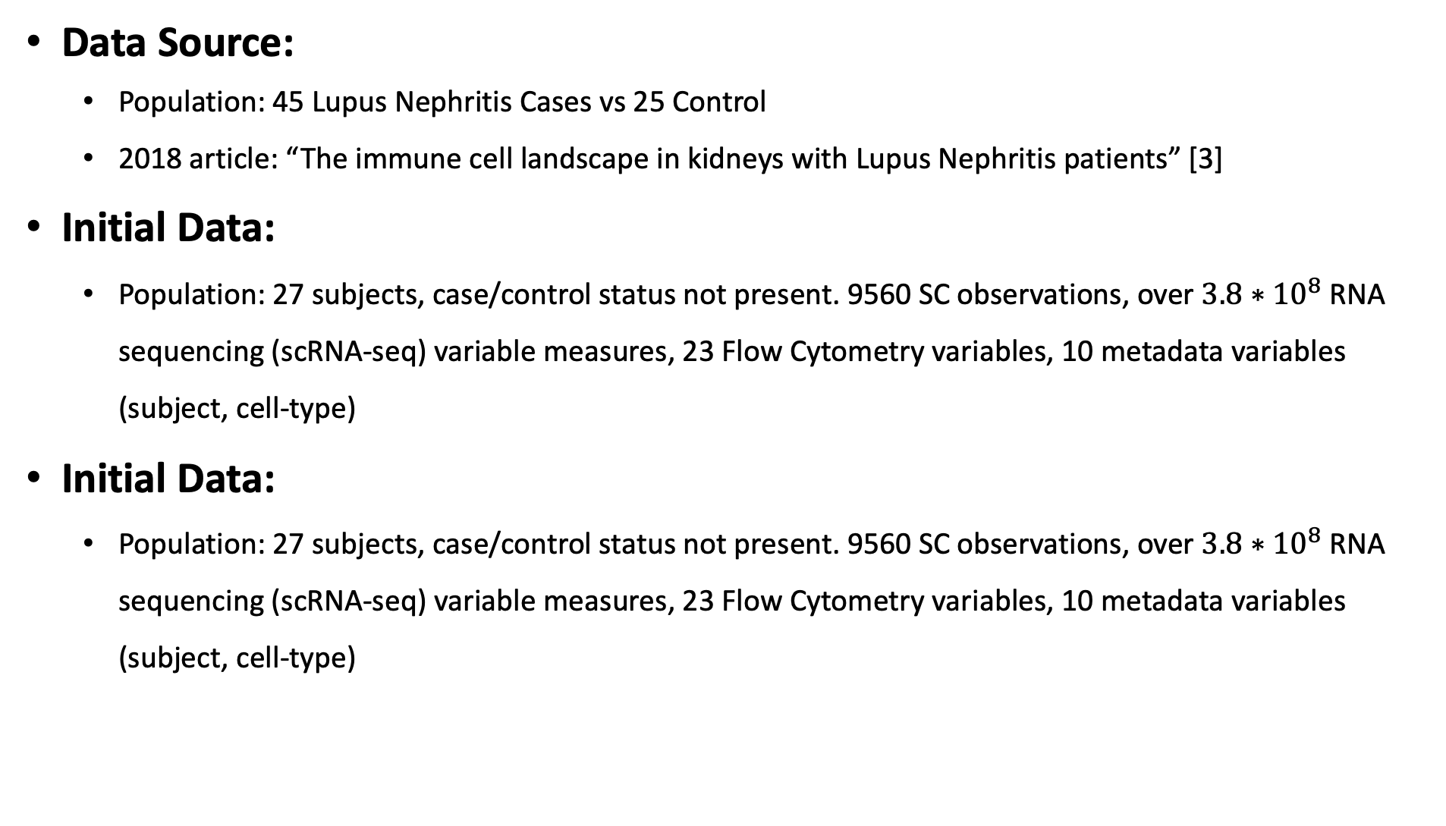
Introduction/Description of Motivating Example Data
Slide 8/total
Description of Motivating Example
Data Source:
Population: 45 Lupus Nephritis Cases vs 25 Control
2018 article: “The immune cell landscape in kidneys with Lupus Nephritis patients” [3]
Initial Data:
Population: 27 subjects, case/control status not present. 9560 SC observations, over $3.8∗{10}^{8}$ RNA sequencing (scRNA-seq) variable measures, 23 Flow Cytometry variables, 10 metadata variables (subject, cell-type)
Initial Data:
Population: 27 subjects, case/control status not present. 9560 SC observations, over $3.8∗{10}^{8}$ RNA sequencing (scRNA-seq) variable measures, 23 Flow Cytometry variables, 10 metadata variables (subject, cell-type)

Slide 9

Introduction/Description of Motivating Example Data
Slide 8/total
Description of Motivating Example
Quality Control Processing:
Filters employed
Appropriate population representation-multiple, partial or missing cells, using read-count limitations
Tests for living material using reads that map to Mitochondrial Genome
Regularize/homogenize feature expressions by reducing to B-Cell classified observations only
Resulting data: 1110 Observations originating from 15 subjects
Initial Data Used:
Population: 27 subjects, case/control status not present. 9560 SC observations, over $3.8∗{10}^{8}$ RNA sequencing (scRNA-seq) variable measures, 23 Flow Cytometry variables, 10 metadata variables (subject, cell-type)
Describe motivating SC data example, and why it is relevant to the analysis needed
Proposal: A method for estimating subject level associations in SC data
Data Requirements:
Single-cell level variable measurements -------------------Initial Data is scRNA-seq expression ✔
Detectable, subject-level associations between predictor and outcome--------✔

