Slide 1
Comparing Models of Subject-Clustered Single-Cell Data
Lee Panter
Audrey Hendricks¹, PhD---------------------(Committee Chair and Advisor)
Stephanie Santorico¹, PhD------------------(Committee Member)
Rhonda Bacher², PhD------------------------(Committee Member)
¹The University of Colorado-Denver
²The University of Florida

Slide 2
Introduction
Single-Cell (SC) Basics

Slide 3
“Bulk” Sequencing Methods
Analyze combined expression from thousands/millions of cells
Often fail to capture variability within sample
Measurement accuracy less concerning, and protocol dependencies less influential
SC Sequencing Methods
Analyze expression measurements specific to individual cells
Hundreds/thousands of SC measurements used for one “SC sample”

Slide 4
Applications of SC methods
Detecting values differentially expressed across conditions [1]
Identifying rare cellular subpopulations [2]
Production of SC data & technology
Increasingly economical to produce SC data with further sampling integration
Multiple-source samples enable analysis of source-level relationships
Developmental phases of integrating multiple subjects/samples into a single data set
Statistical modeling methods incomplete
Reliability, accuracy, protocol independence still concerning

Slide 5
Introduction
Motivation

Slide 6
What problem am I addressing?
In order to solve the problem, what needs to be done?
What do I do to solve the problem?

Slide 7
What problem am I addressing?
Single-cell (SC) data is increasing in prevalence
SC data with multiple subjects emerging for analysis
Not clear how to analyze subject level relationships (SLRs)

Slide 8
In order to solve the problem, what needs to be done?
Demonstrate: existing statistical models account for SLRs in SC data
Compare: how each method differs/resembles the others

Slide 9
What do I do to solve the problem?
Outline five modeling methods and how the models account for SLRs in SC data
Apply the modeling methods to motivating SC data example
Demonstrate how (if) the models account for SLRs in the motivating example SC data
Compare how (if) model frameworks account for SLRs in practice

Slide 10
Model Descriptions
Overview of Selected Models

Slide 11
The Models
Linear Model (LM)
Linear Model with Fixed Effect for Subject (LM-FE)
Linear Mixed Effect Model with Random Intercept for Subject (LMM-RI)
Linear Mixed Effect Model with Random Intercept and Random Slope for Subject (LMM-RS)
Generalized Estimating Equations (GEE)

Slide 12
Model Descriptions
Notation

Slide 13
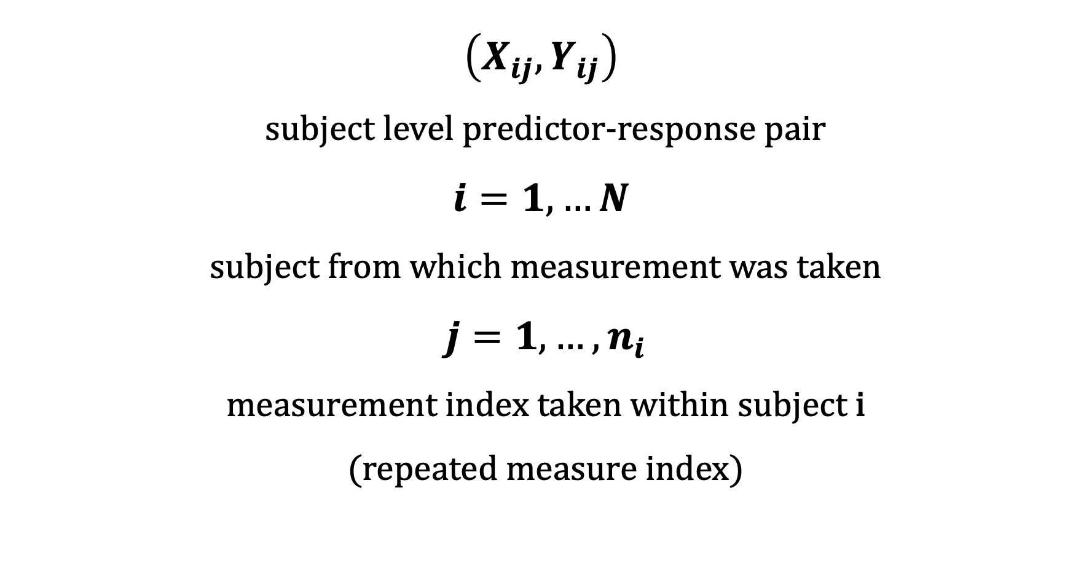
$$\left(X_{ij}, Y_{ij}\right)$$
subject level predictor-response pair
$$i=1,…N$$
subject from which measurement was taken
$j=1,…,n_{i}$
measurement index taken within subject i
(repeated measure index)

Slide 14
Overview of Selected Models
Linear Model (LM)

Slide 15
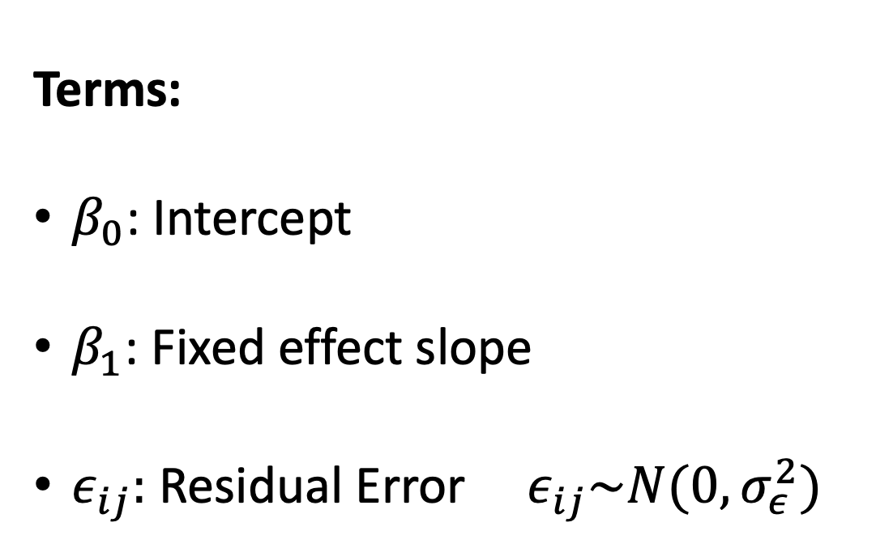
$$Y_{ij}= β_{0}+β_{1}X_{ij}+ ε_{ij}$$
Terms:
$β_{0}$: Intercept
$β_{1}$: Fixed effect slope
$ε_{ij}:$ Residual Error ${ ε}_{ij}\sim N(0, σ_{ε}^{2})$

Slide 16
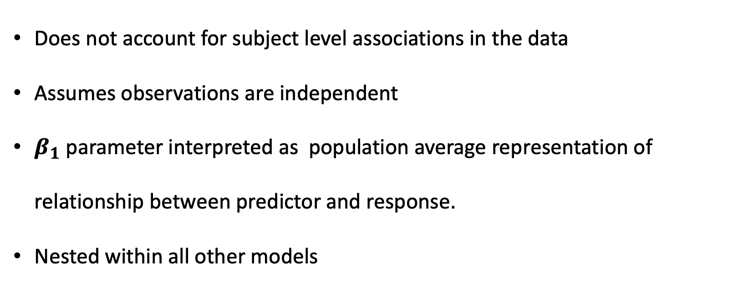
Linear Model (LM) Further Information
$$Y_{ij}= β_{0}+β_{1}X_{ij}+ ε_{ij}$$
Does not account for subject level associations in the data
Assumes observations are independent
$β_{1}$ parameter interpreted as population average representation of relationship between predictor and response.
Nested within all other models

Slide 17
Overview of Selected Models
Linear Model with Fixed Effect (LM-FE)

Slide 18
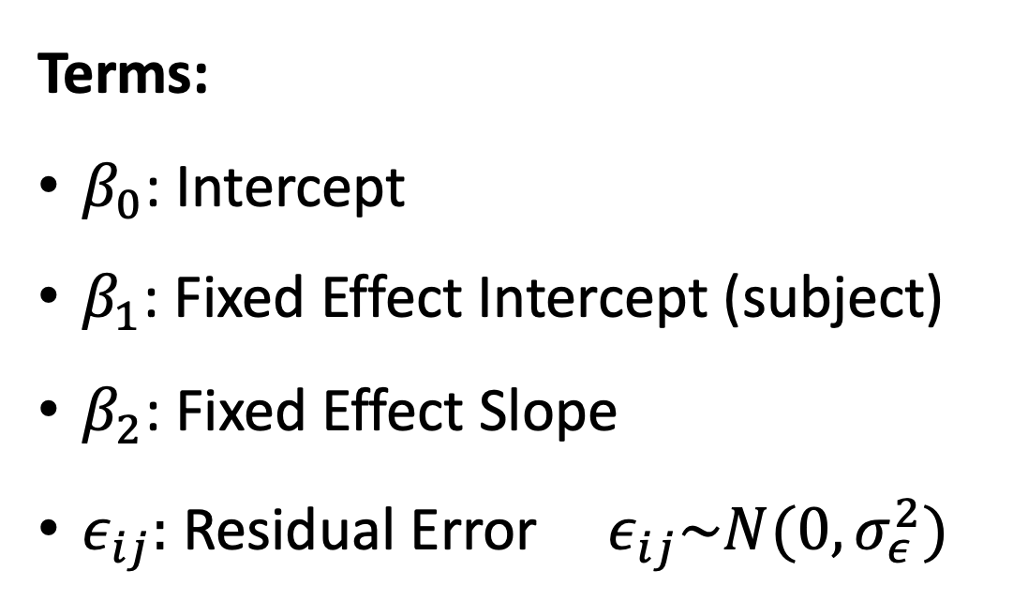
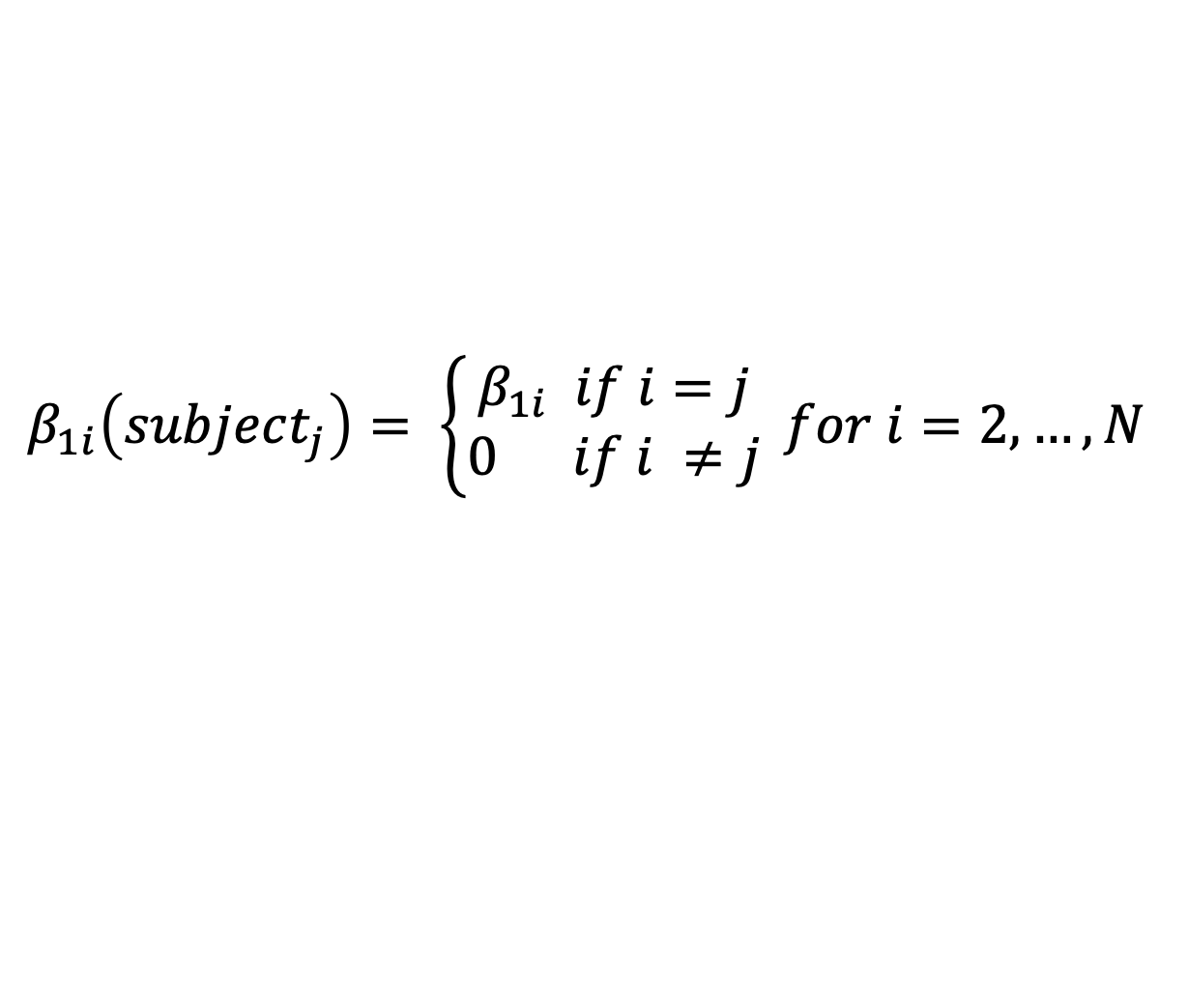
$$Y_{ij}= β_{0}+β_{1i}\left(subject_{j}\right)+{β_{2}X}_{ij}+ ε_{ij}$$
Terms:
$β_{0}$: Intercept
$β_{1}$: Fixed Effect Intercept (subject)
$β_{2}$: Fixed Effect Slope
$ε_{ij}:$ Residual Error ${ ε}_{ij}\sim N(0, σ_{ε}^{2})$
$β_{1i}\left(subject_{j}\right)= \left\{\begin{aligned}β_{1i} if i=j \\ 0 if i ≠j\end{aligned}\right. for i=2,…, N$

Slide 19
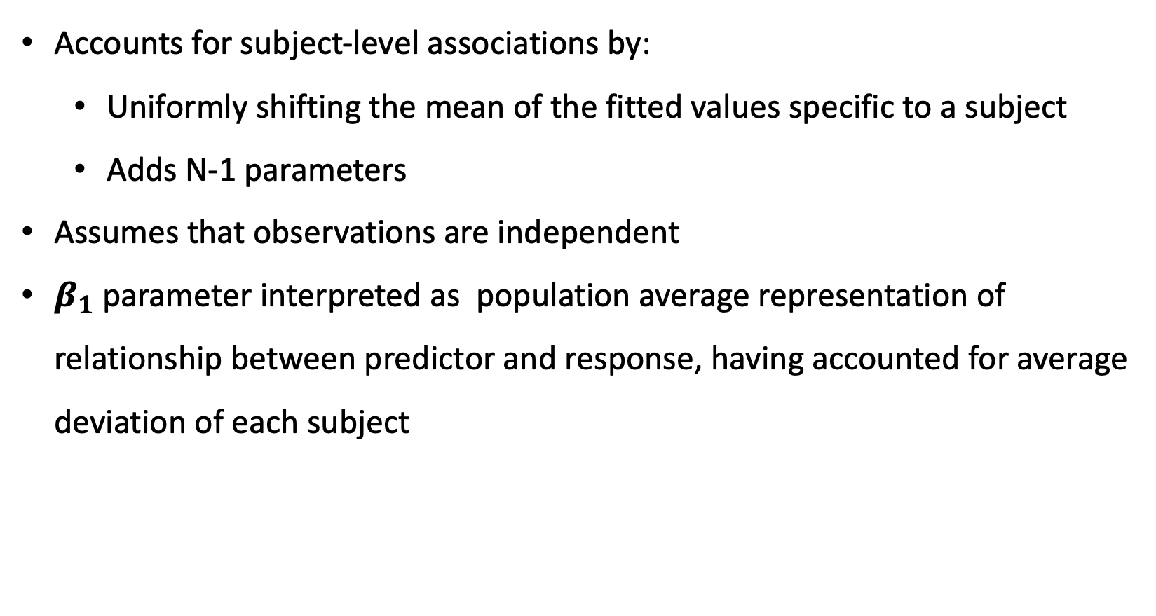
Linear Model with Fixed Effect (LM-FE) Further Information
$$Y_{ij}= β_{0}+β_{1i}\left(subject_{j}\right)+{β_{2}X}_{ij}+ ε_{ij}$$
Accounts for subject-level associations by:
Uniformly shifting the mean of the fitted values specific to a subject
Adds N-1 parameters
Assumes that observations are independent
$β_{1}$ parameter interpreted as population average representation of relationship between predictor and response, having accounted for average deviation of each subject

Slide 20
Overview of Selected Models
Linear Mixed Model with Random Effect Intercept (LMM-RI)

Slide 21
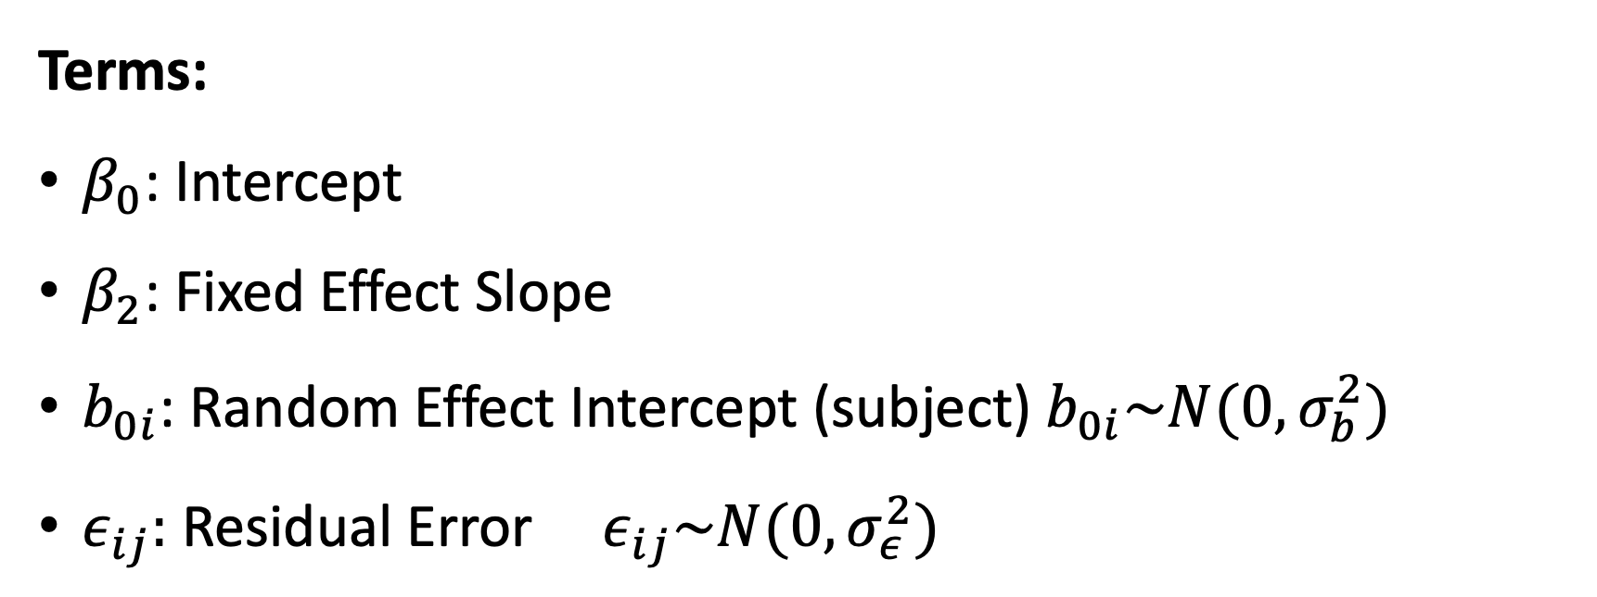
$$Y_{ij}= β_{0}+{β_{1}X}_{ij}+b_{0i}\left(subject_{j}\right)+ ε_{ij}$$
Terms:
$β_{0}$: Intercept
$β_{2}$: Fixed Effect Slope
$b_{0i}$: Random Effect Intercept (subject) $b_{0i}\sim N(0, σ_{b}^{2})$
$ε_{ij}:$ Residual Error ${ ε}_{ij}\sim N(0, σ_{ε}^{2})$

Slide 23
Overview of Selected Models
Linear Mixed Model with Random Effect Intercept and Slope (LMM-RS)

Slide 26
Overview of Selected Models
Generalized Estimating Equations (GEE)

Slide 29
Motivating Example
Data

Slide 30
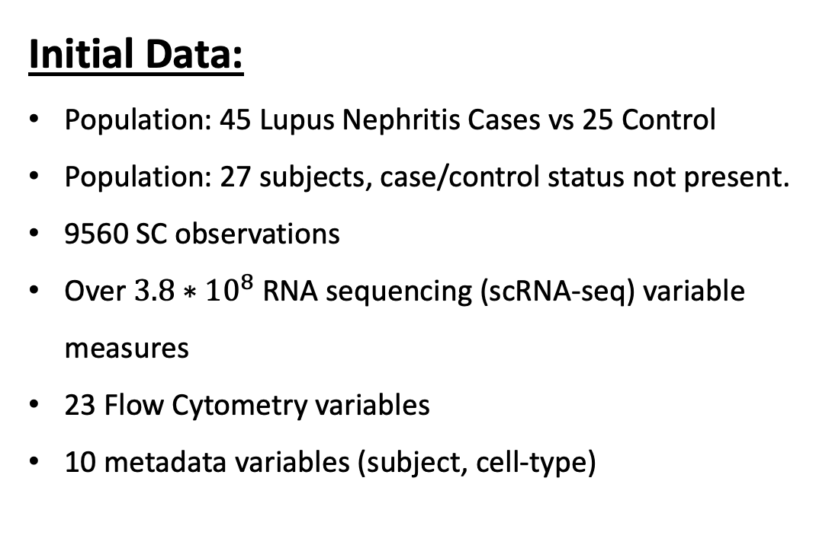
Initial Data:
Population: 45 Lupus Nephritis Cases vs 25 Control
Population: 27 subjects, case/control status not present.
9560 SC observations
Over $3.8∗{10}^{8}$ RNA sequencing (scRNA-seq) variable measures
23 Flow Cytometry variables
10 metadata variables (subject, cell-type)
Quality Control Data
15 Subjects
1110 SC Observations
2 log-transformed scRNA-seq Predictor-Response Pairs
Data Source: 2018 article: “The immune cell landscape in kidneys with Lupus Nephritis patients” [3]

Slide 31
Motivating Example
Models

Slide 32
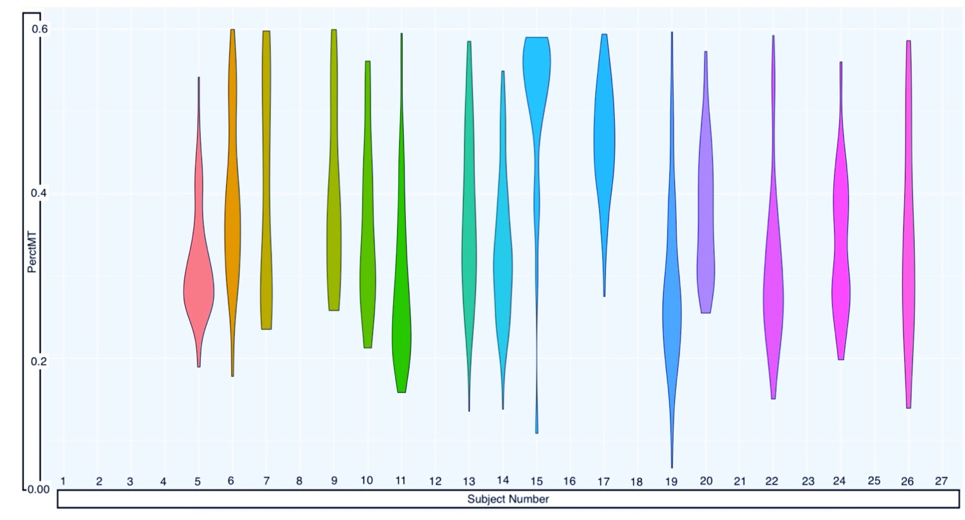
Proposal: A method for estimating subject level associations in SC data
Data Requirements:
Single-cell level variable measurements
Data is scRNA-seq expression ✔
Detectable, subject-level associations between predictor and outcome
✔

Slide 33
Results
Model Parameters

Slide 34
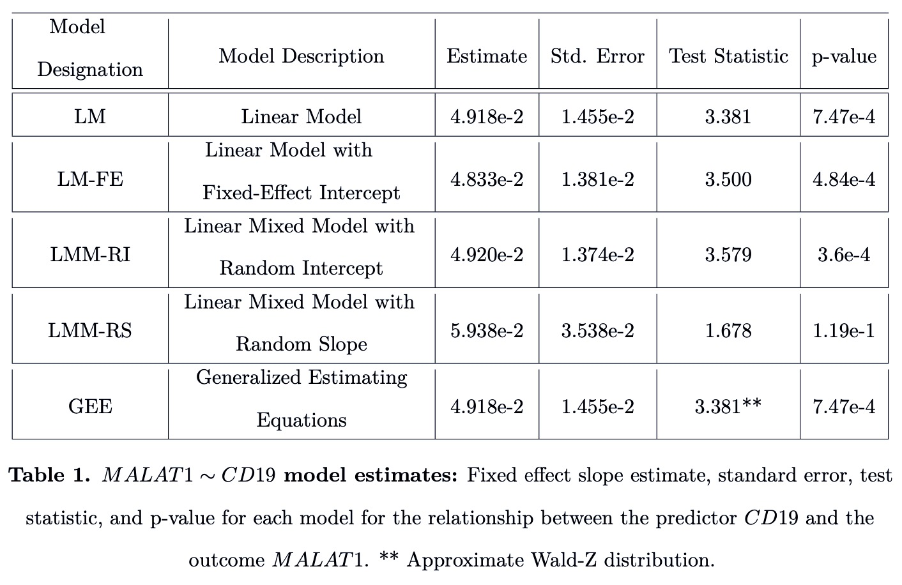
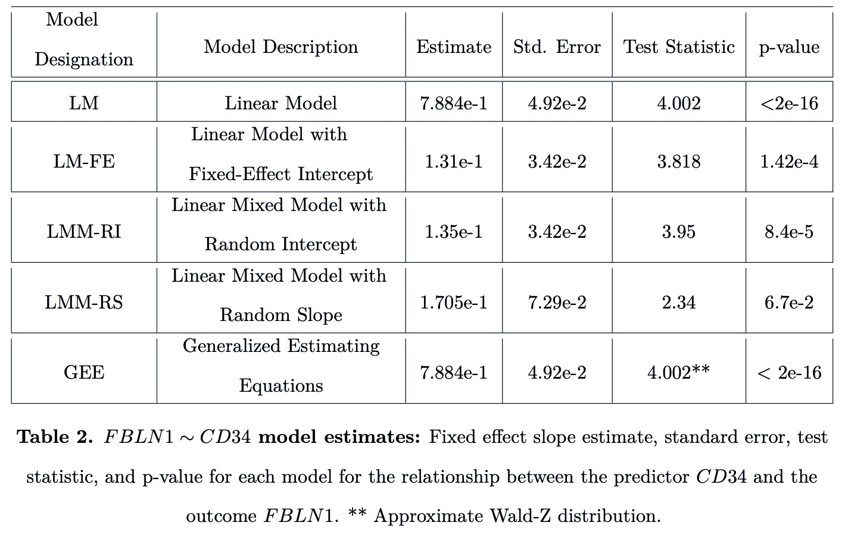
Variable Pair #1:
MALAT1<--CD19
Variable Pair #1:
FBLN1<--CD34

Slide 35
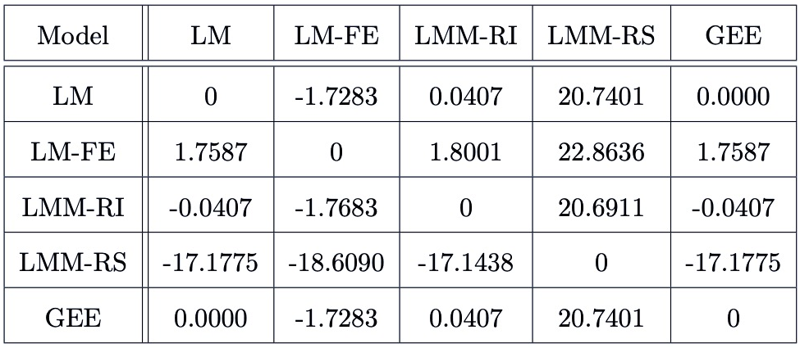
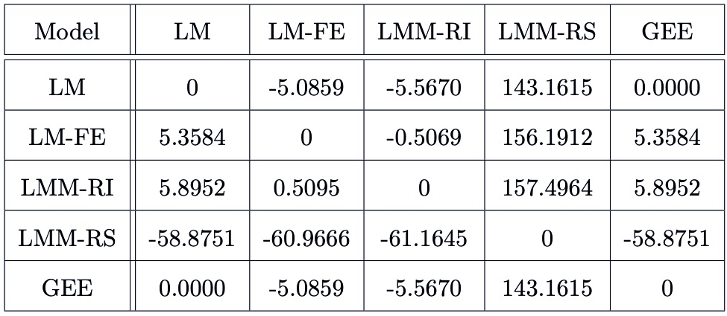
Variable Pair #1:
MALAT1<--CD19
% Change Matrix
Fixed Effect Slope Coefficient
Variable Pair #2:
FBLN<--CD34
% Change Matrix
Fixed Effect Slope Coefficient

Slide 36
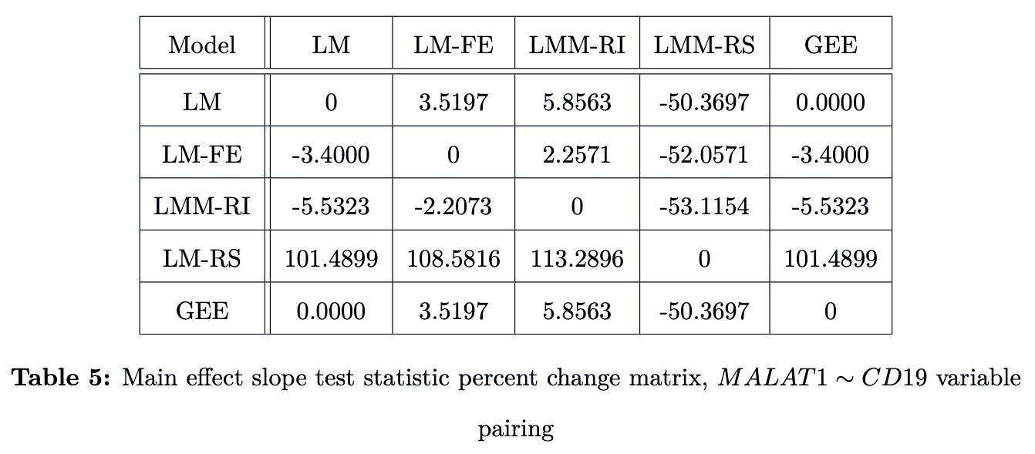

Slide 40
Results
Nested Models

Slide 47
Conclusion
Overall Conclusions

Slide 49
Conclusion
Limitations

Slide 51
THANK YOU
References

