Slide 1
Comparing Models of Subject-Clustered Single-Cell Data
Lee Panter
Audrey Hendricks¹, PhD---------------------(Committee Chair and Advisor)
Stephanie Santorico¹, PhD------------------(Committee Member)
Rhonda Bacher², PhD------------------------(Committee Member)
¹The University of Colorado-Denver
²The University of Florida

Slide 2
Introduction
Single-Cell (SC) Basics

Slide 3
“Bulk” Sequencing Methods
Analyze combined expression from thousands/millions of cells
Often fail to capture variability within sample
Measurement accuracy less concerning, and protocol dependencies less influential
SC Sequencing Methods
Analyze expression measurements for individual cells
Hundreds/thousands of SC measurements -- one “SC sample”

Slide 4
Applications of SC methods
Detecting values differentially expressed across conditions [1]
Identifying rare cellular subpopulations [2]
Production of SC data & technology
Increasingly economical to produce SC data
Multiple-source samples enable analysis of source-level associations
e.g., multiple subject sample --> analysis of subject-level associations
Problematic to integrate multiple samples into a single data set
Protocol dependencies affect data quality and reliability

Slide 5
Introduction
Motivation

Slide 6
What problem am I addressing?
Single-cell (SC) data is increasing in prevalence
SC data with multiple subjects emerging for analysis
Not clear how to analyze subject level relationships

Slide 7
What do I do to solve the problem?
Outline five modeling methods and how the models account for subject level relationships in SC data
Apply the modeling methods to motivating SC data example
Describe how the models account for subject level relationships in the motivating SC data example
Compare how (if) model frameworks account for SLRs in practice

Slide 8
Model Descriptions
Overview of Selected Models

Slide 9
The Models
Linear Model (LM)
Linear Model with Fixed Effect for Subject (LM-FE)
Linear Mixed Effect Model with Random Intercept for Subject (LMM-RI)
Linear Mixed Effect Model with Random Intercept and Random Slope for Subject (LMM-RS)
Generalized Estimating Equations (GEE)

Slide 10
Model Descriptions
Notation

Slide 11

$\left(X_{ij}, Y_{ij}\right)$ - subject level predictor-response pair
$i=1,…N$- subject from which measurement was taken
N - Total number of subjects
$j=1,…,n_{i}$ measurement index taken within subject i
(repeated measure index)
$n_{i}$ - Total number of repeated measurements within subject i

Slide 12
Overview of Selected Models
Linear Model (LM)

Slide 13
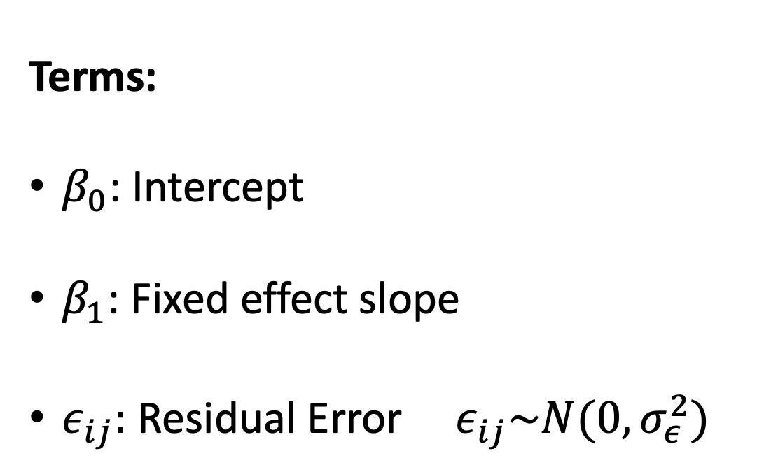
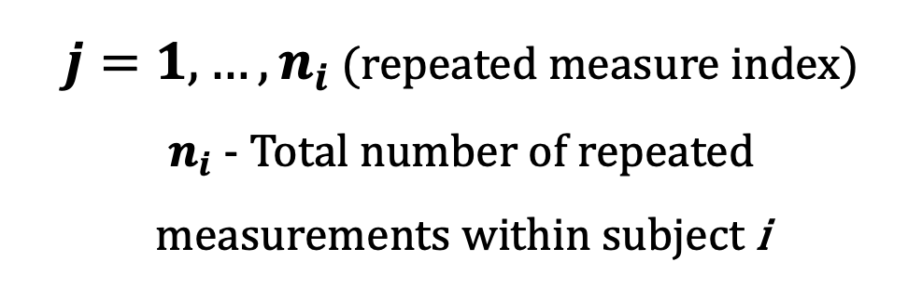
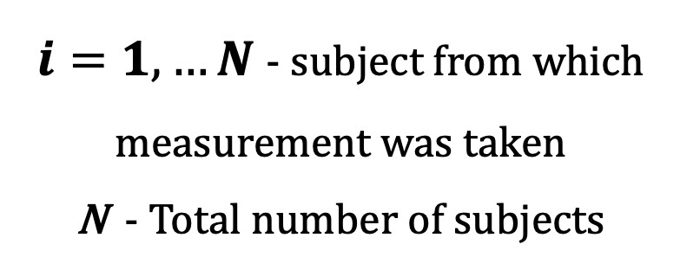
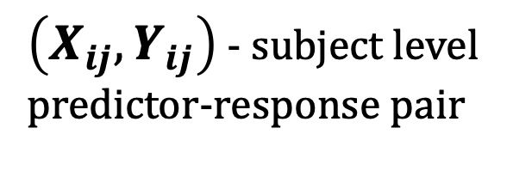
MODEL DEFINITION:
Linear Model (LM)
$$Y_{ij}= β_{0}+β_{1}X_{ij}+ ε_{ij}$$
Terms:
$β_{0}$: Intercept
$β_{1}$: Fixed effect slope
$ε_{ij}:$ Residual Error ${ ε}_{ij}\sim N(0, σ_{ε}^{2})$
$\left(X_{ij}, Y_{ij}\right)$ - subject level predictor-response pair
$i=1,…N$- subject from which measurement was taken
N - Total number of subjects
$j=1,…,n_{i}$ (repeated measure index)
$n_{i}$ - Total number of repeated measurements within subject i

Slide 14
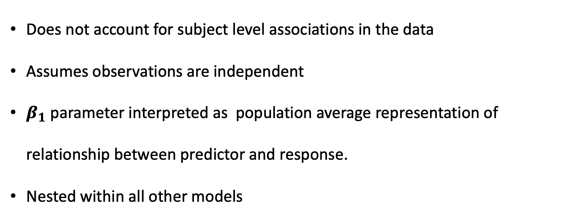
MODEL INFORMATION:
Linear Model (LM)
$$Y_{ij}= β_{0}+β_{1}X_{ij}+ ε_{ij}$$
Does not account for subject level associations in the data
Assumes observations are independent
$β_{1}$ parameter interpreted as population average representation of relationship between predictor and response.
Nested within all other models

Slide 15
Overview of Selected Models
Linear Model with Fixed Effect (LM-FE)

Slide 16
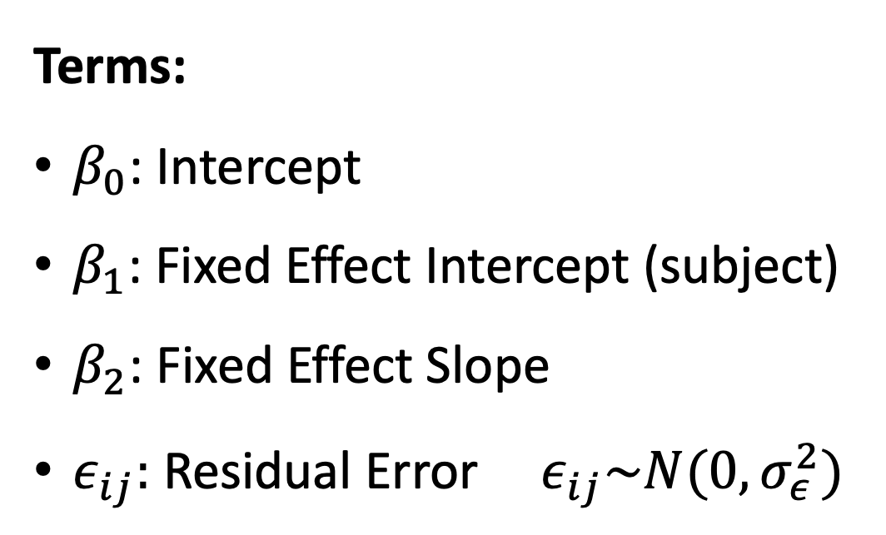
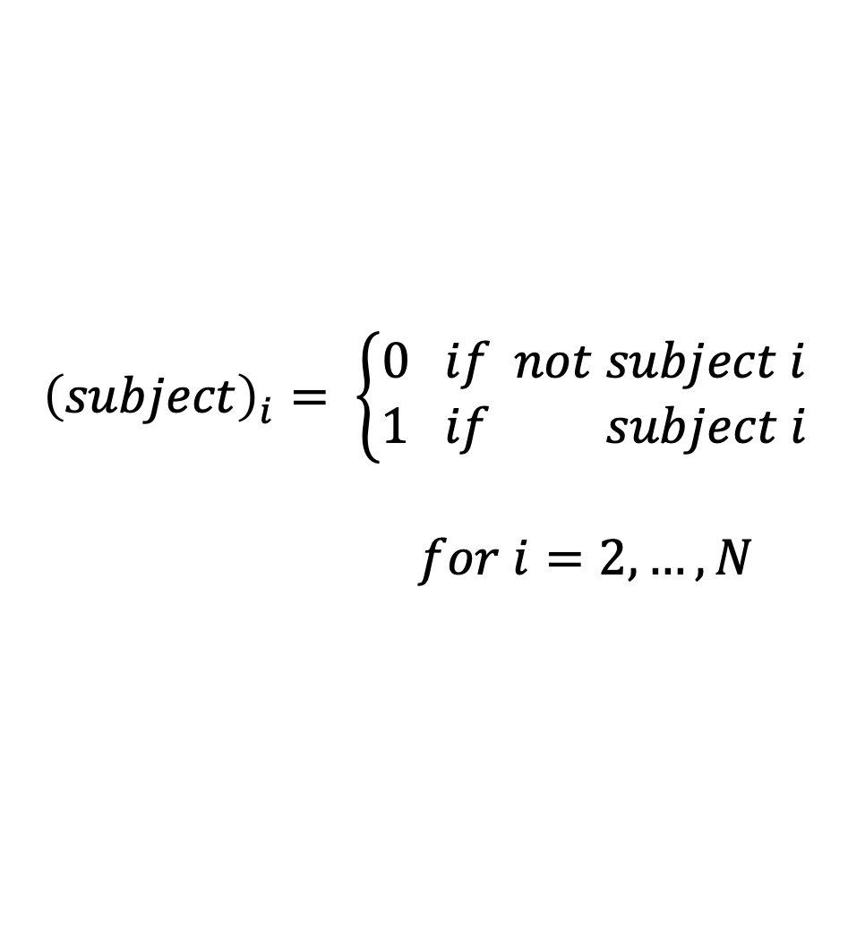
MODEL DEFINITION:
Linear Model with Fixed Effect (LM-FE)
$$Y_{ij}= β_{0}+β_{1i}{\left(subject\right)}_{i}+{β_{2}X}_{ij}+ ε_{ij}$$
Terms:
$β_{0}$: Intercept
$β_{1}$: Fixed Effect Intercept (subject)
$β_{2}$: Fixed Effect Slope
$ε_{ij}:$ Residual Error ${ ε}_{ij}\sim N(0, σ_{ε}^{2})$
$${\left(subject\right)}_{i}= \left\{\begin{aligned}0 if not subject i \\ 1 if subject i\end{aligned}\right.$$
$for i=2,…, N$

Slide 17
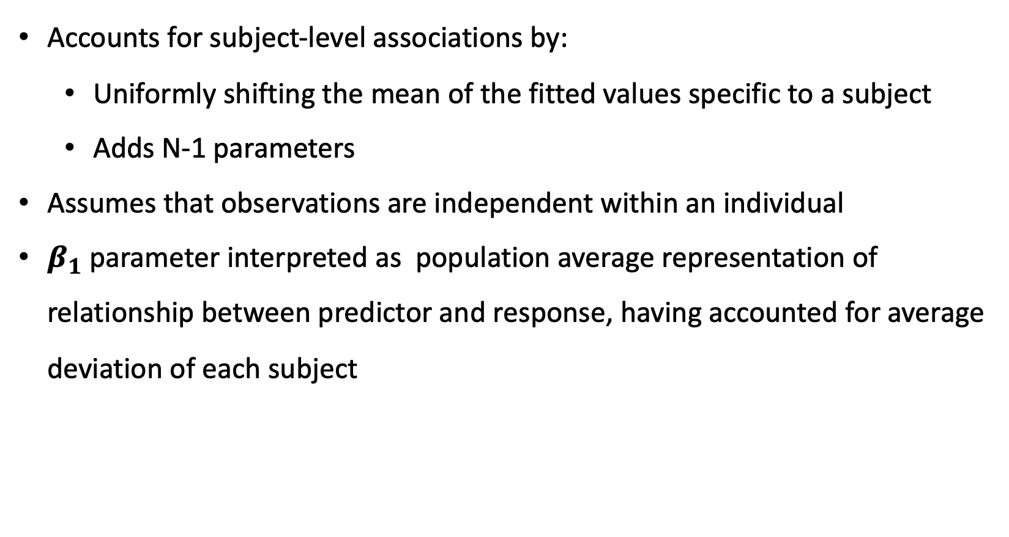
MODEL INFORMATION:
Linear Model with Fixed Effect (LM-FE)
$$Y_{ij}= β_{0}+β_{1i}{\left(subject\right)}_{i}+{β_{2}X}_{ij}+ ε_{ij}$$
Accounts for subject-level associations by:
Uniformly shifting the mean of the fitted values specific to a subject
Adds N-1 parameters
Assumes that observations are independent within an individual
$β_{1}$ parameter interpreted as population average representation of relationship between predictor and response, having accounted for average deviation of each subject

Slide 18
Overview of Selected Models
Linear Mixed Model with Random Effect Intercept (LMM-RI)

Slide 19
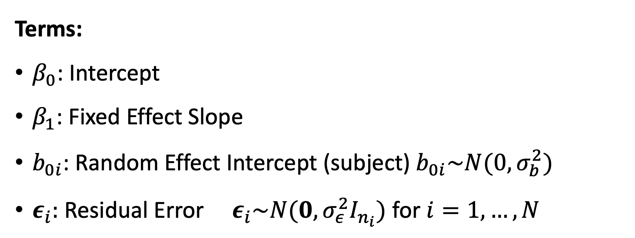


MODEL DEFINITION:
Linear Mixed Model with Random Effect Intercept (LMM-RI)
$$Y_{ij}= β_{0}+{β_{1}X}_{ij}+b_{0i}{\left(subject\right)}_{i}+ ε_{ij}$$
Terms:
$β_{0}$: Intercept
$β_{1}$: Fixed Effect Slope
$b_{0i}$: Random Effect Intercept (subject) $b_{0i}\sim N(0, σ_{b}^{2})$
$ε_{i}:$ Residual Error ${ ε}_{i}\sim N(0, σ_{ε}^{2}I_{n_{i}})$ for $i=1,…, N$
$$ε_{i}=\left[\begin{matrix}ε_{i1} \\ ⋮ \\ ε_{in_{i}}\end{matrix}\right]$$
$$I_{n_{i}}=\left[\begin{matrix}1 & ⋯ & 0 \\ ⋮ & 1 & ⋮ \\ 0 & ⋯ & 1\end{matrix}\right]$$

Slide 20
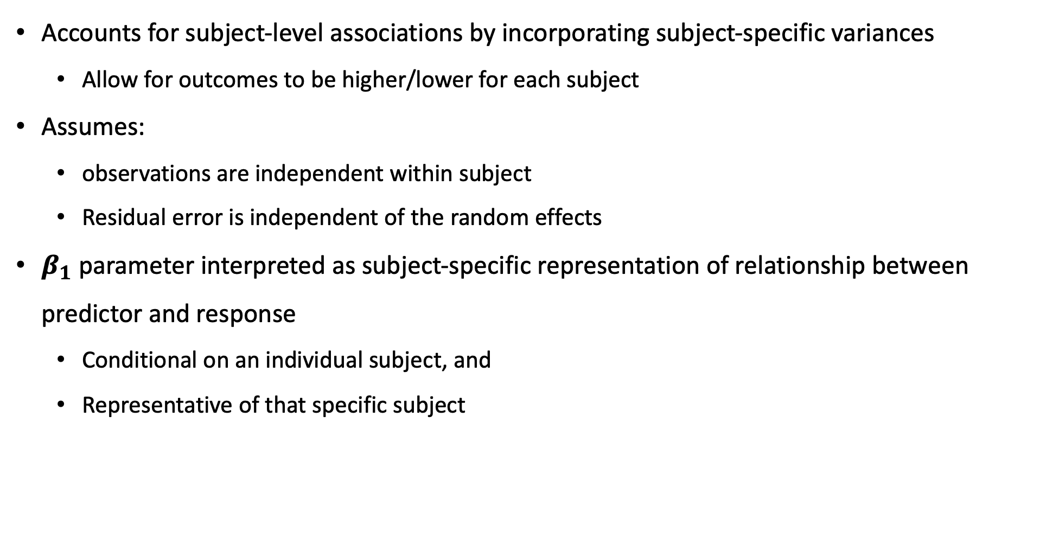
MODEL INFORMATION:
Linear Mixed Model with Random Effect Intercept (LMM-RI)
$$Y_{ij}= β_{0}+{β_{1}X}_{ij}+b_{0i}{\left(subject\right)}_{i}+ ε_{ij}$$
Accounts for subject-level associations by incorporating subject-specific variances
Allow for outcomes to be higher/lower for each subject
Assumes:
observations are independent within subject
Residual error is independent of the random effects
$β_{1}$ parameter interpreted as subject-specific representation of relationship between predictor and response
Conditional on an individual subject, and
Representative of that specific subject

Slide 21
Overview of Selected Models
Linear Mixed Model with Random Effect Intercept and Slope (LMM-RS)

Slide 22
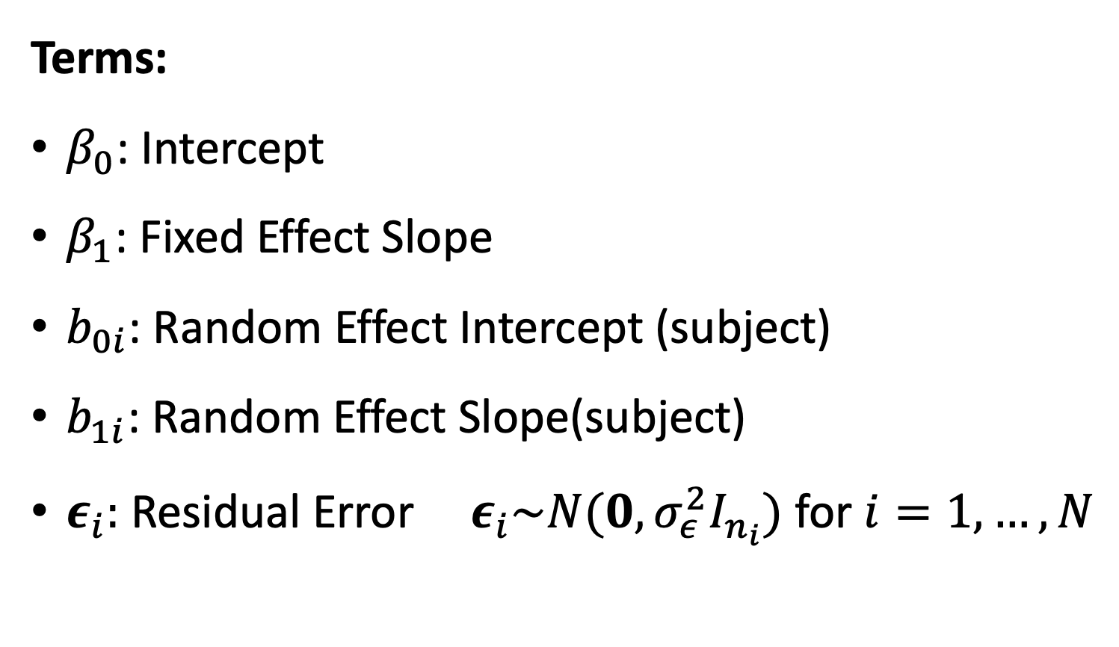
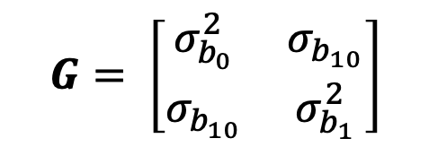
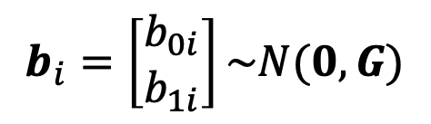
MODEL DEFINITION:
Linear Mixed Model with Random Effect Intercept and Random Effect Slope (LMM-RS)
$$Y_{ij}= β_{0}+{β_{1}X}_{ij}+b_{0i}{\left(subject\right)}_{i}+\left[b_{1i}{\left(subject\right)}_{i}X_{ij}\right]+ε_{ij}$$
Terms:
$β_{0}$: Intercept
$β_{1}$: Fixed Effect Slope
$b_{0i}$: Random Effect Intercept (subject)
$b_{1i}$: Random Effect Slope(subject)
$ε_{i}:$ Residual Error ${ ε}_{i}\sim N(0, σ_{ε}^{2}I_{n_{i}})$ for $i=1,…, N$
$$b_{i}=\left[\begin{matrix}b_{0i} \\ b_{1i}\end{matrix}\right]\sim N(0, G)$$
$$G= \left[\begin{matrix}σ_{b_{0}}^{2} & σ_{b_{10}} \\ σ_{b_{10}} & σ_{b_{1}}^{2}\end{matrix}\right]$$

Slide 23
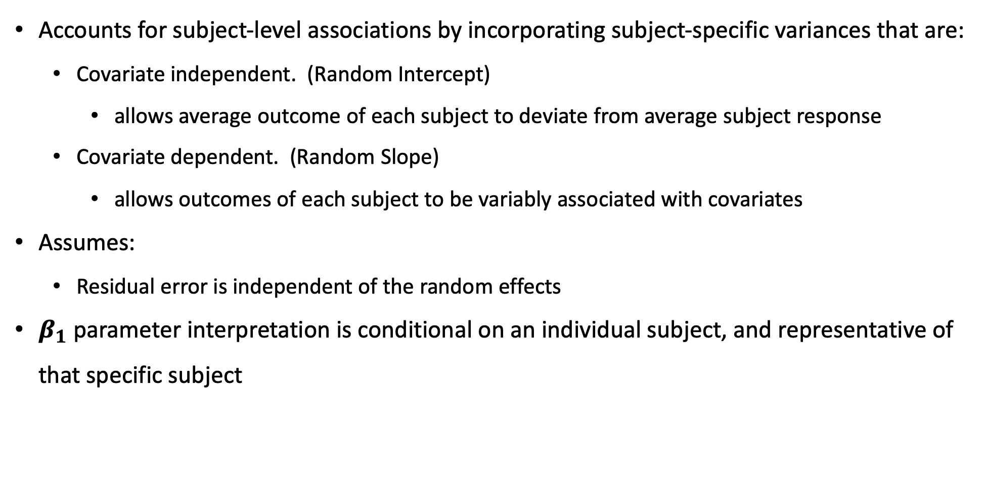
MODEL INFORMATION:
Linear Mixed Model with Random Effect Intercept and Random Effect Slope (LMM-RS)
$$Y_{ij}= β_{0}+{β_{1}X}_{ij}+b_{0i}{\left(subject\right)}_{i}+\left[b_{1i}{\left(subject\right)}_{i}X_{ij}\right]+ε_{ij}$$
Accounts for subject-level associations by incorporating subject-specific variances that are:
Covariate independent. (Random Intercept)
allows average outcome of each subject to deviate from average subject response
Covariate dependent. (Random Slope)
allows outcomes of each subject to be variably associated with covariates
Assumes:
Residual error is independent of the random effects
$β_{1}$ parameter interpretation is conditional on an individual subject, and representative of that specific subject

Slide 24
Overview of Selected Models
Generalized Estimating Equations (GEE)

Slide 25



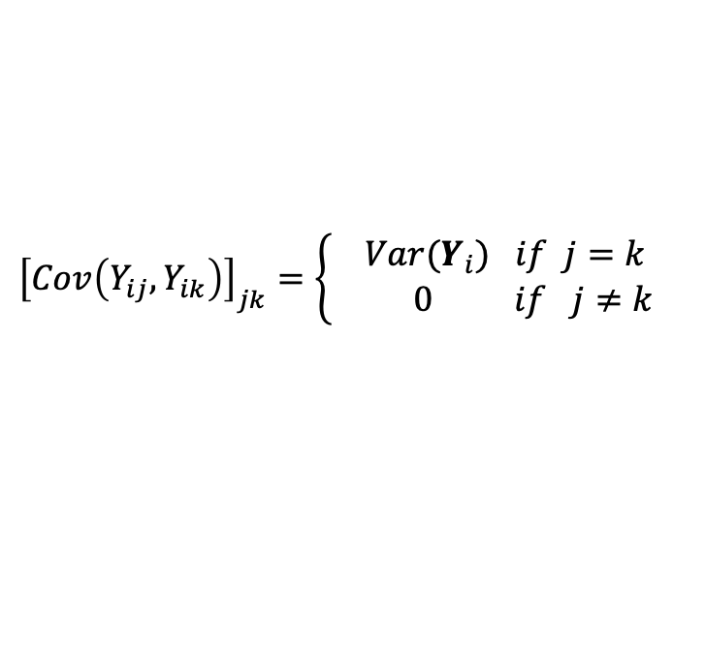

MODEL DEFINITION:
Generalized Estimating Equations (GEE)
Model Requires Individual Specification of:
Random Component
Probability Distribution: assumed for the responses
Systematic Components
Linear Predictor: a linear function of the explanatory variables
Link Function: establishes the relationship between Linear Predictor and Expected Outcome
Working Covariance Structure
Assumed to approximate true within-subject correlation
Used for this Analysis
$$Y_{ij} \sim N(μ, σ^{2})$$
$$η_{ij}= β_{0}+β_{1} X_{ij}$$
$$E\left[Y_{ij} | X_{ij}\right]=g\left(μ_{ij}\right)= μ_{ij}=η_{ij}$$
$${\left[Cov\left(Y_{ij}, Y_{ik}\right)\right]}_{jk}=\left\{\begin{aligned}Var(Y_{i}) if j=k \\ 0 if j≠k \end{aligned}\right.$$
$$j, k ∈\{1,…,n_{i}\}$$

Slide 26
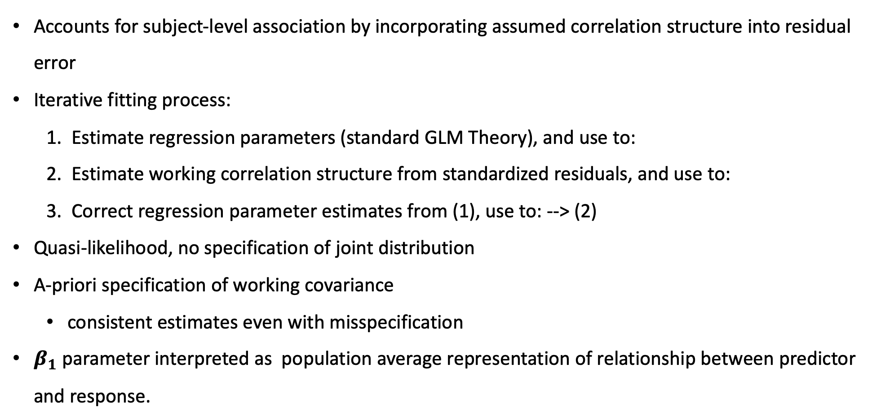
MODEL INFORMATION:
Generalized Estimating Equations (GEE)
Accounts for subject-level association by incorporating assumed correlation structure into residual error
Iterative fitting process:
Estimate regression parameters (standard GLM Theory), and use to:
Estimate working correlation structure from standardized residuals, and use to:
Correct regression parameter estimates from (1), use to: --> (2)
Quasi-likelihood, no specification of joint distribution
A-priori specification of working covariance
consistent estimates even with misspecification
$β_{1}$ parameter interpreted as population average representation of relationship between predictor and response.

Slide 27
Motivating Example
Data

Slide 28
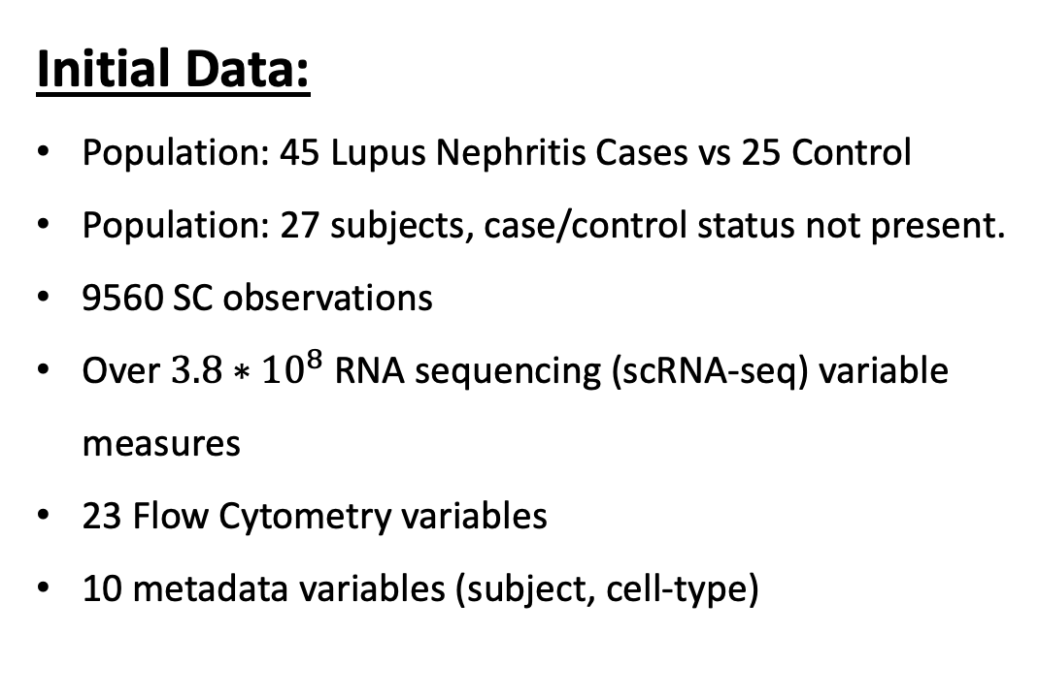
Initial Data:
Population: 45 Lupus Nephritis Cases vs 25 Control
Population: 27 subjects, case/control status not present.
9560 SC observations
Over $3.8∗{10}^{8}$ RNA sequencing (scRNA-seq) variable measures
23 Flow Cytometry variables
10 metadata variables (subject, cell-type)
Quality Control Data
15 Subjects
1110 SC Observations
2 log-transformed Predictor-Response Pairs
Model 1: Predictor log(CD19) --> Response log(MALAT1)
Model 2: Predictor log(CD34) --> Response log(FBLN1)
Data Source: 2018 article: “The immune cell landscape in kidneys with Lupus Nephritis patients” [3]

Slide 29
Motivating Example
Models

Slide 30
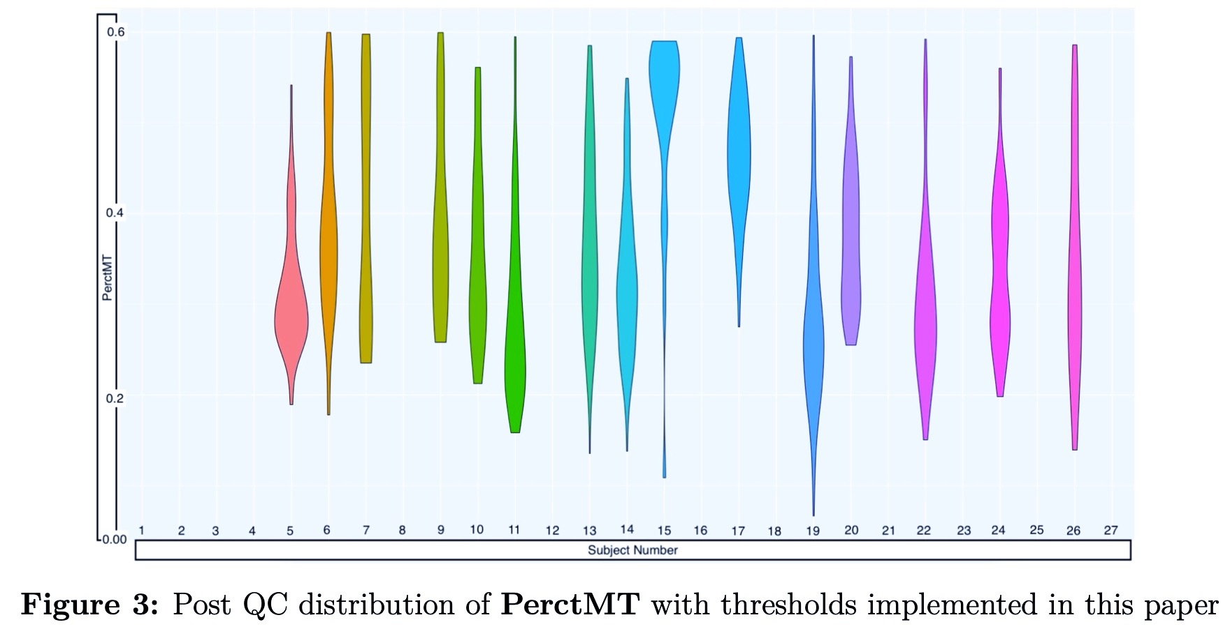
Proposal: A method for estimating subject level associations in SC data
Data Requirements:
Single-cell level variable measurements
Data is scRNA-seq expression ✔
Detectable, subject-level associations between predictor and outcome
0.6
✔
0.4
PerctMT
0.2
0
3
6
9
Subject Number
18
21
24
27

Slide 31
Results
Model Parameters

Slide 32
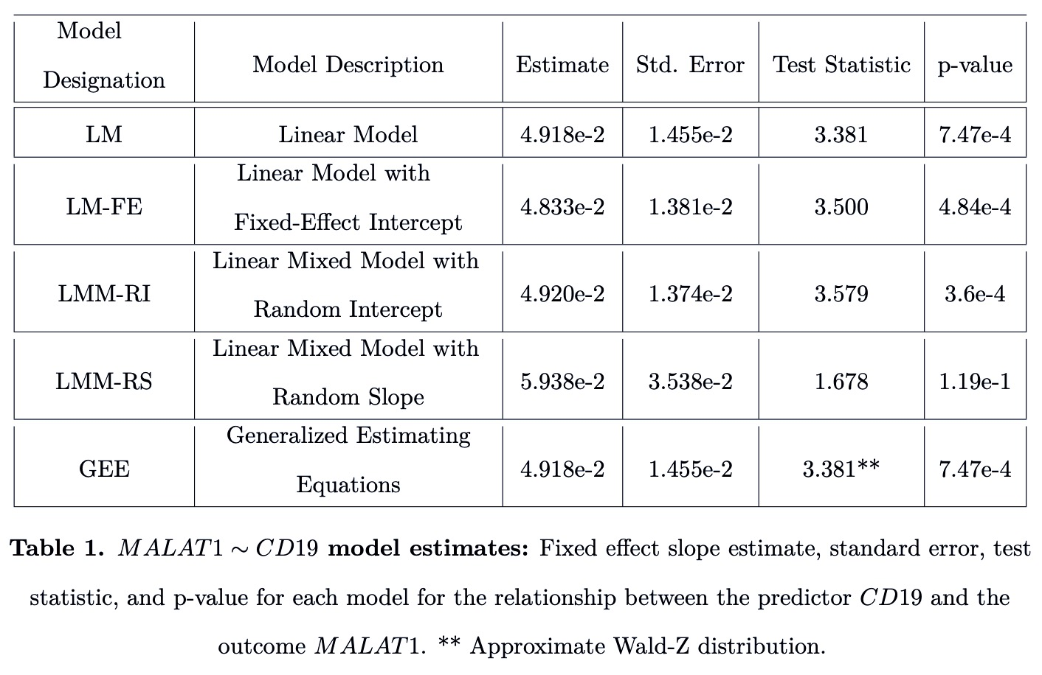
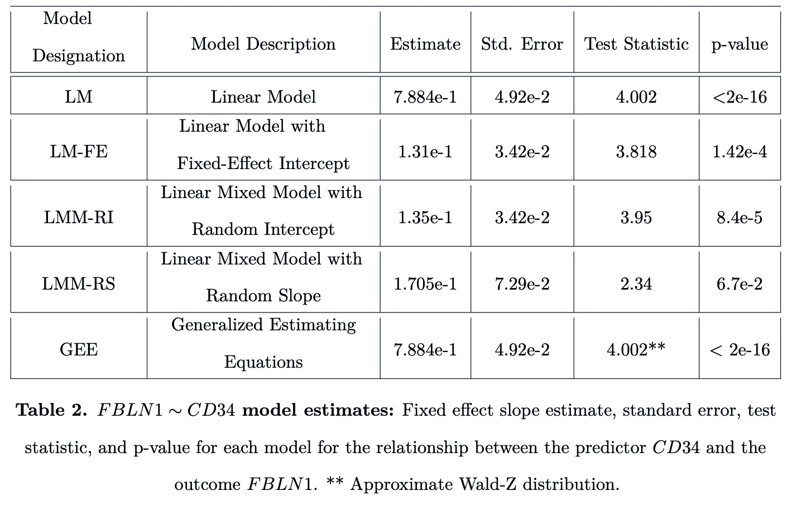
Variable Pair #1:
MALAT1<--CD19
Variable Pair #2:
FBLN1<--CD34

Slide 33
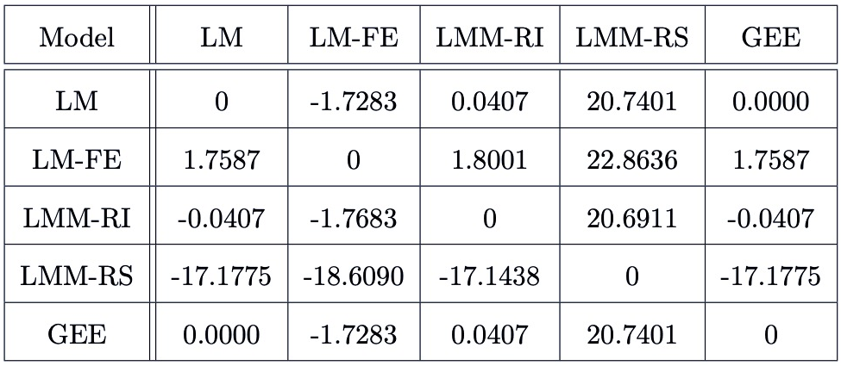
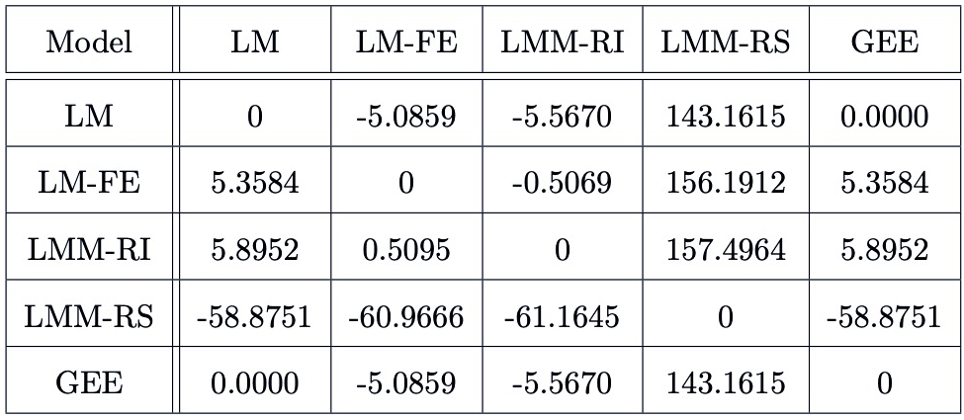
Slope Percent Change
Variable Pair #1:
MALAT1<--CD19
Variable Pair #2:
FBLN<--CD34

Slide 34
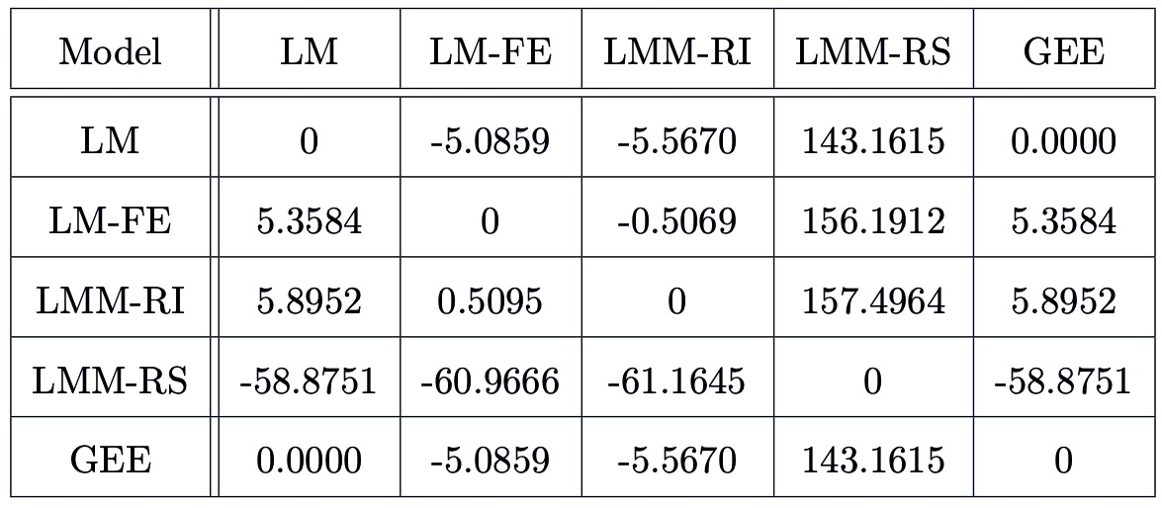
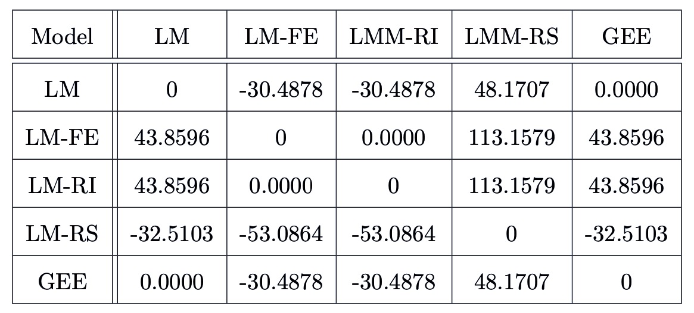
Standard Error Percent Change
Variable Pair #1:
MALAT1<--CD19
Variable Pair #2:
FBLN<--CD34
Results | Model Parameters
34

Slide 35
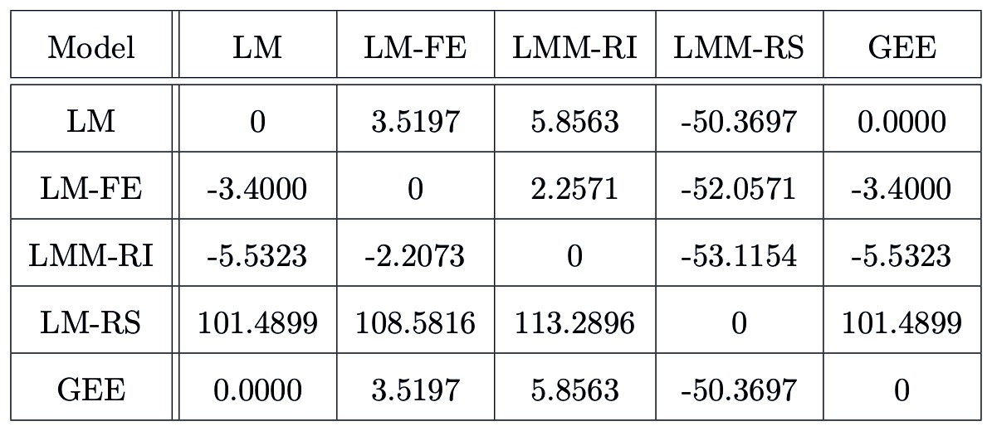
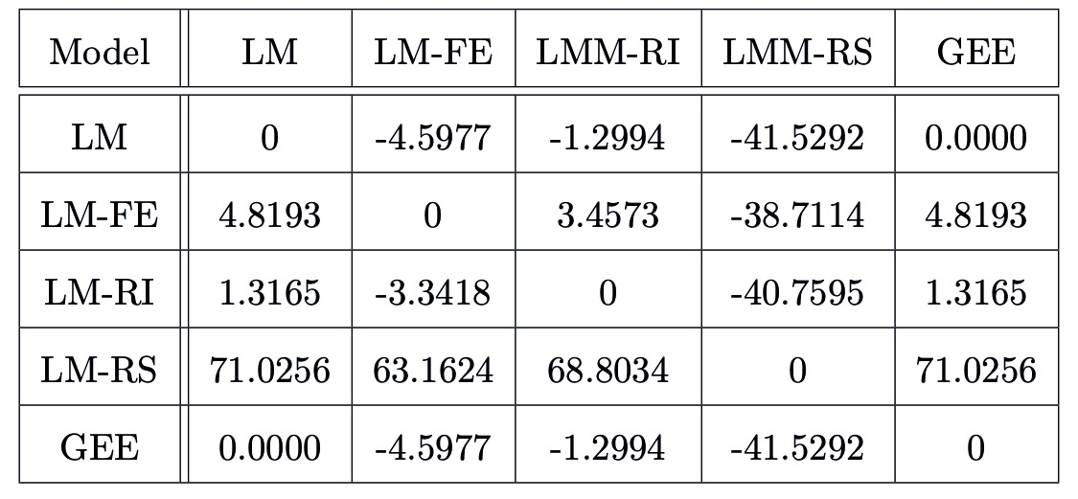
Test Statistic Percent Change
Variable Pair #1:
MALAT1<--CD19
Variable Pair #2:
FBLN<--CD34
Results | Model Parameters
Results | Model Parameters
35
35

Slide 36
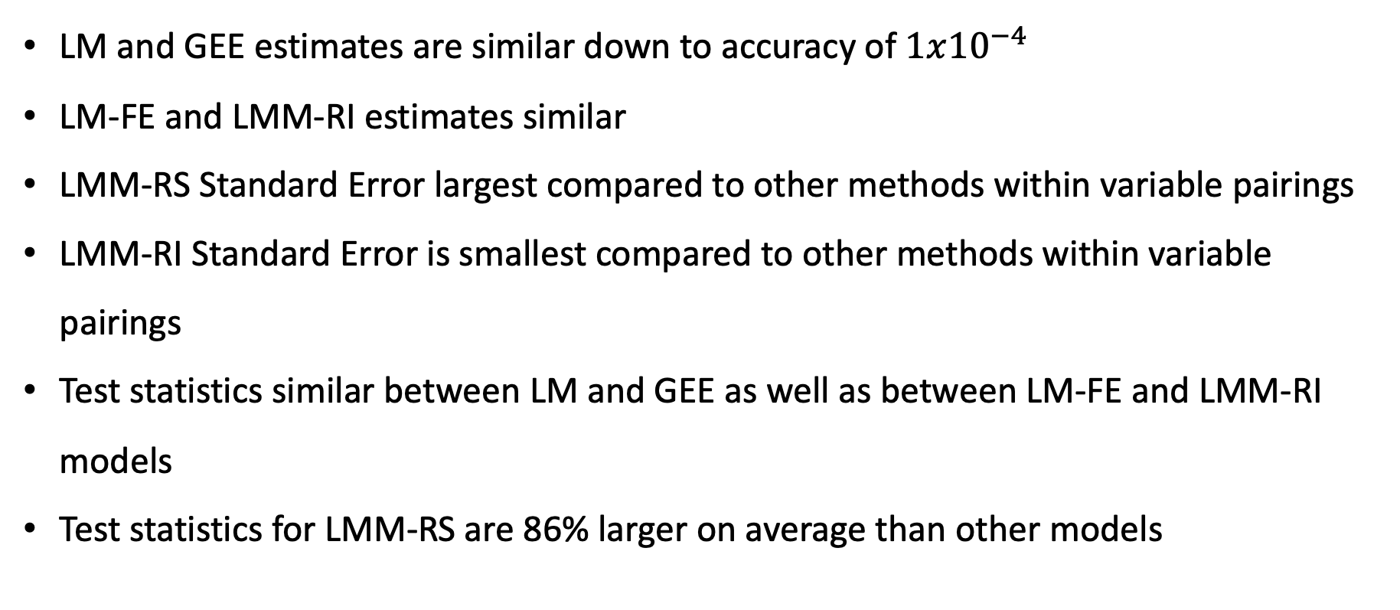
Model Parameter Comparison Results
LM and GEE estimates are similar down to accuracy of $1x{10}^{−4}$
LM-FE and LMM-RI estimates similar
LMM-RS Standard Error largest compared to other methods within variable pairings
LMM-RI Standard Error is smallest compared to other methods within variable pairings
Test statistics similar between LM and GEE as well as between LM-FE and LMM-RI models
Test statistics for LMM-RS are 86% larger on average than other models

Slide 37
Results
Nested Models

Slide 38
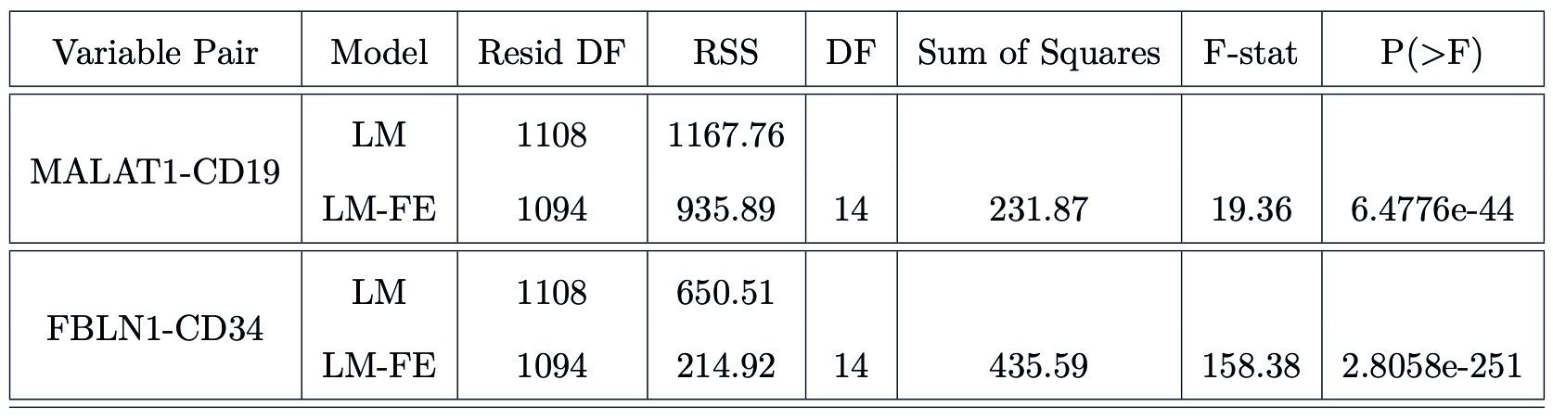
Nested Model Comparisons:
Testing Inclusion of Fixed Effect Intercept
Support for inclusion of subject-specific fixed effect intercept

Slide 39
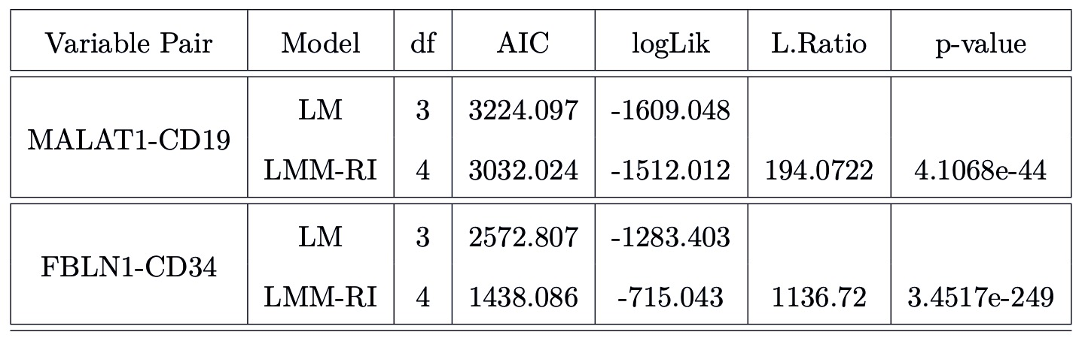
Nested Model Comparisons:
Testing Inclusion of Random Effect Intercept
Support for inclusion of subject-specific random effect intercept

Slide 40
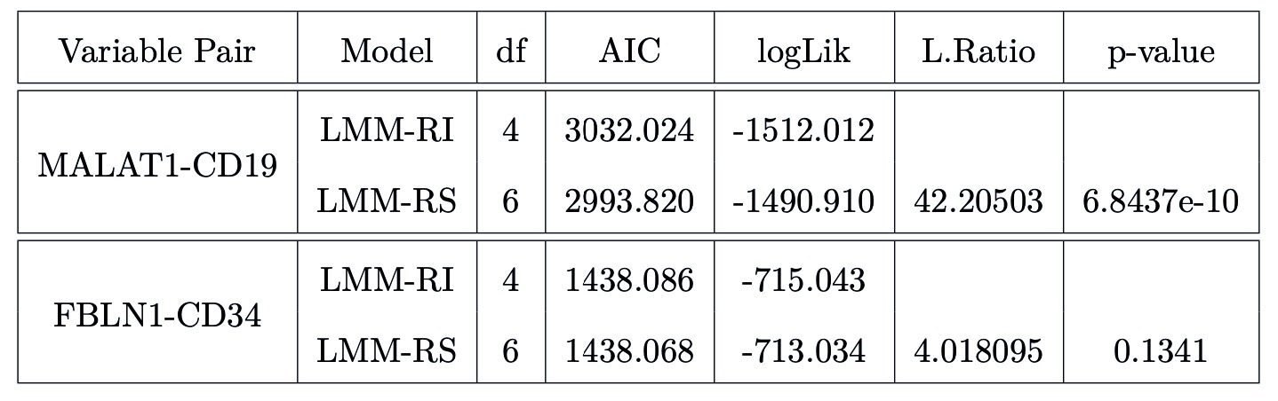
Nested Model Comparisons:
Testing Inclusion of Random Effect Slope
Borderline support for inclusion of subject-specific random effect slope for the MALAT1 ~ CD19 variable pairing

Slide 41
Conclusion
Overall Conclusions

Slide 42
Population average models (LM and GEE) & models with subject specific intercept terms (LM-FE and LMM-RI) have:
Similar estimates within/differing estimates between descriptions
Nested Model Comparisons --> sufficient evidence to support inclusion of:
Subject specific fixed effect intercept
Subject specific random effect intercept
Indicative of subject-specific, covariate independent associations not accounted for in overall population averaged/marginal models

Slide 43
LMM-RS model has largest standard errors
Nested model comparisons: borderline or insufficient evidence to support inclusion of subject-specific random slope
Indicative that subject-specific associations are NOT covariate dependent

Slide 44
Conclusion
Limitations & Future Work

Slide 45
Limitations
All results based on just two scRNA-seq variable pairs
scRNA-seq data heavily influenced by protocol dependencies & measurement inconsistencies
Future Work
Extending analysis to all variable pairs
Overfitting considerations: test/train model development not implemented but should be going forward

Slide 46
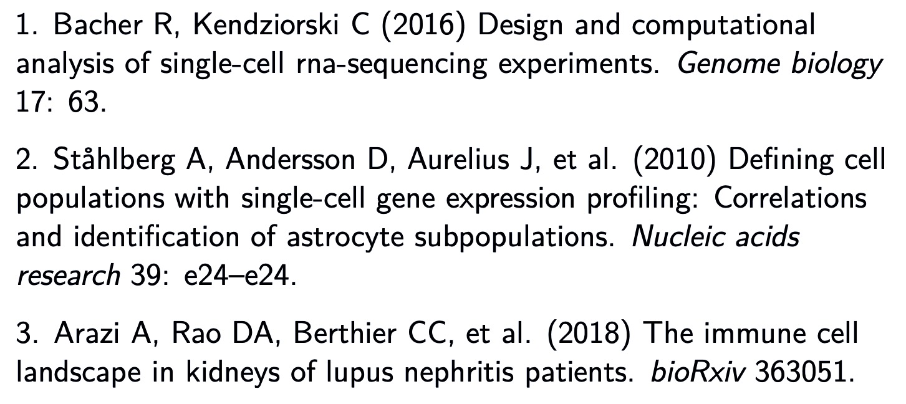
THANK YOU
References

