Slide 1
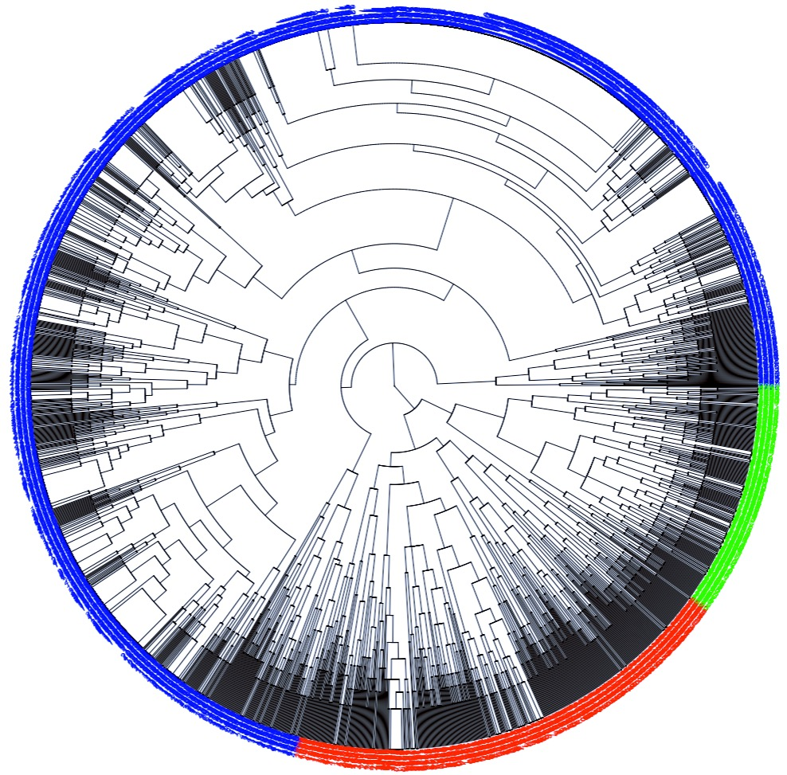
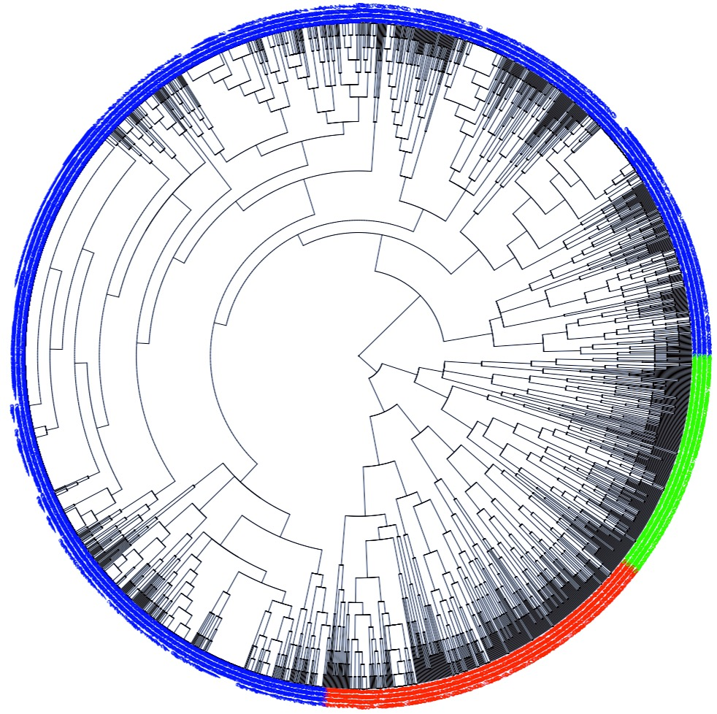
C1
C2
C3
Figure XXa: Hierarchical Clustering 3 Clusters
Euclidean Metric
Figure XXb: Hierarchical Clustering 3 Clusters
Manhattan Metric

