Slide 1
Update: Probabilistic Scoring
Client: Alan Malik, Patient Tools INC
Consultant: Lee Panter

Slide 2
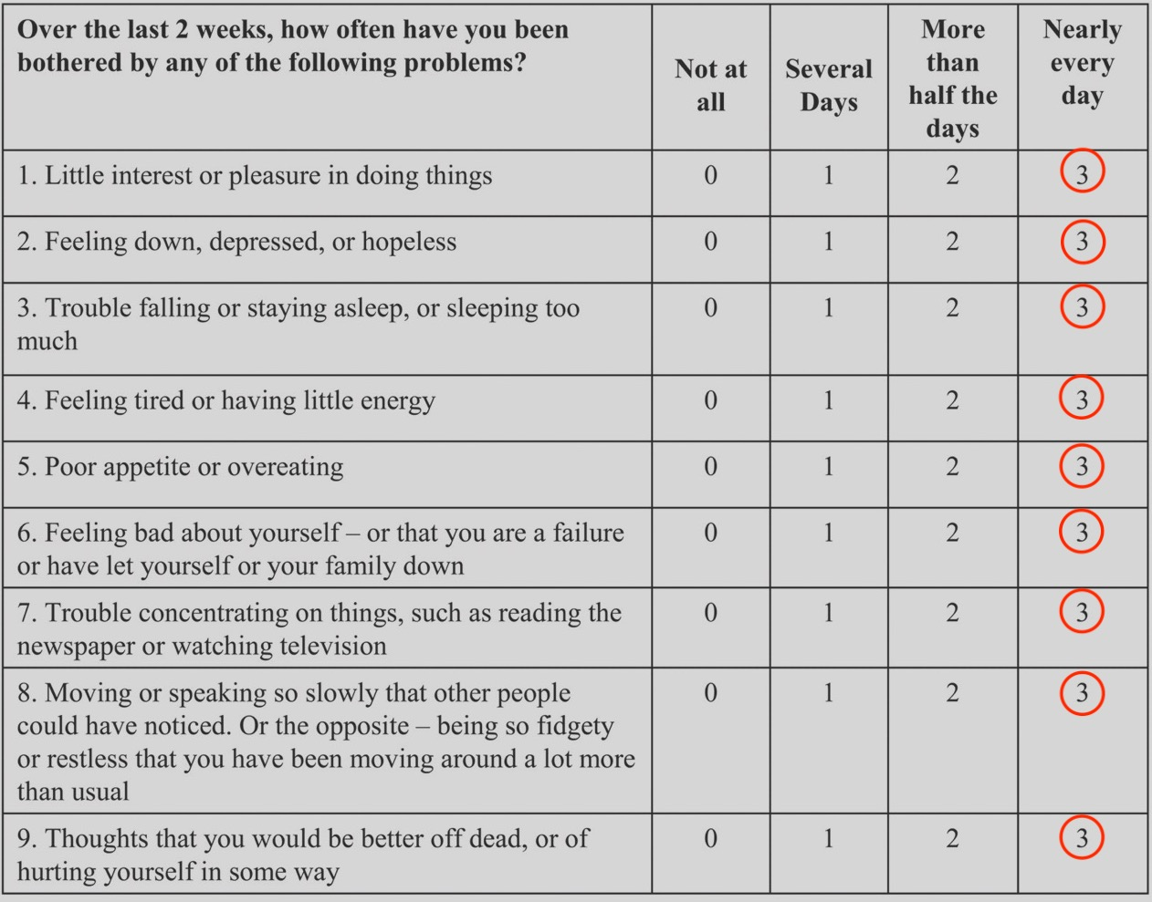
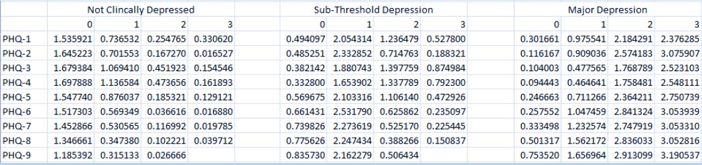

Let’s tell someone how they’re feeling:
An Example Evaluation of a Probabilistic Score (P-Score) Calculation for a PHQ9
Lots of PHQ9s
Calculate the “look-up weights”
Used to “update” a probabilistic score for being classified “Not Clinically Depressed” when they answers “3” on question # 2
i is the Depression Classification
i=1,2,3
j is the question number
j=1,2,3,4,5,6,7,8,9
${P\left(C_{i} \right| E}_{j}=k )=\frac{{P (E}_{j}=k |{ C}_{i})}{P(E_{j}=k)}∗P(C_{i})$
k is the provided answer magnitude: k=1,2,3,4

Slide 3
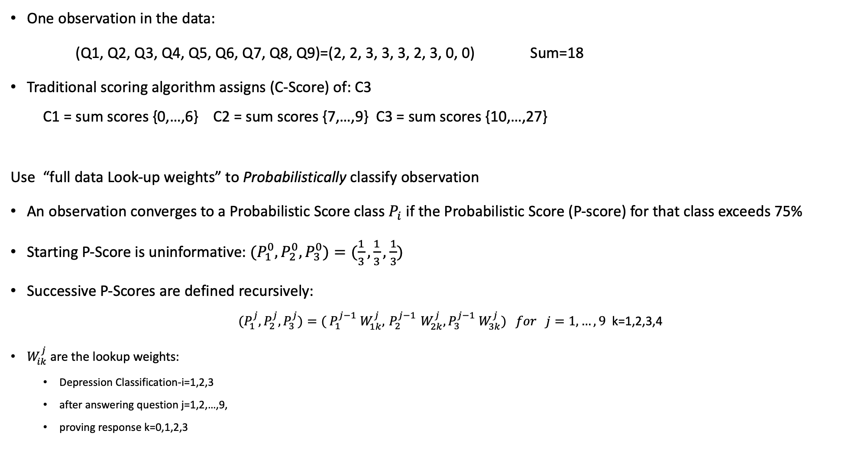
One observation in the data:
(Q1, Q2, Q3, Q4, Q5, Q6, Q7, Q8, Q9)=(2, 2, 3, 3, 3, 2, 3, 0, 0) Sum=18
Traditional scoring algorithm assigns (C-Score) of: C3
C1 = sum scores {0,…,6} C2 = sum scores {7,…,9} C3 = sum scores {10,…,27}
Use “full data Look-up weights” to Probabilistically classify observation
An observation converges to a Probabilistic Score class $P_{i}$ if the Probabilistic Score (P-score) for that class exceeds 75%
Starting P-Score is uninformative: ${(P}_{1}^{0},P_{2}^{0},P_{3}^{0})=(\frac{1}{3},\frac{1}{3},$ $\frac{1}{3})$
Successive P-Scores are defined recursively:
${(P}_{1}^{j},P_{2}^{j},P_{3}^{j})={( P}_{1}^{j−1} W_{1k}^{j},{ P}_{2}^{j−1} W_{2k}^{j},P_{3}^{j−1} W_{3k}^{j}) for j=1,…,9$ k=1,2,3,4
$W_{ik}^{j}$ are the lookup weights:
Depression Classification-i=1,2,3
after answering question j=1,2,…,9,
proving response k=0,1,2,3

Slide 4



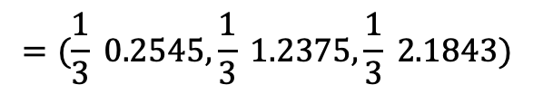


(Q1, Q2, Q3, Q4, Q5, Q6, Q7, Q8, Q9)=(2, 2, 3, 3, 3, 2, 3, 0, 0)
${(P}_{1}^{0},P_{2}^{0},P_{3}^{0})=(\frac{1}{3},\frac{1}{3},$ $\frac{1}{3})$
$${(P}_{1}^{1},P_{2}^{1},P_{3}^{1})={( P}_{1}^{0} W_{12}^{1},{ P}_{2}^{0} W_{22}^{1},P_{3}^{0} W_{32}^{1})$$
This sequence takes only two iterations of the Probabilistic Scoring Algorithm to converge!
$$=(\frac{1}{3} 0.2545,\frac{1}{3} 1.2375,\frac{1}{3} 2.1843)$$
$$=\left(0.0848, 0.4125, 0.7281\right)∝(0.0692, 0.3366, 0.5942)$$
$${(P}_{1}^{2},P_{2}^{2},P_{3}^{2})={( P}_{1}^{1} W_{12}^{2},{ P}_{2}^{1} W_{22}^{2},P_{3}^{1} W_{32}^{2})$$
$=(0.0692∗0.1673, 0.3366∗0$.7148$, 0.5942∗2.5742)$
$$=\left(0.0116, 0.2406, 1.5296\right)∝(0.0065, 0.1350, 0.8585)$$
$$P_{3}$$

Slide 5
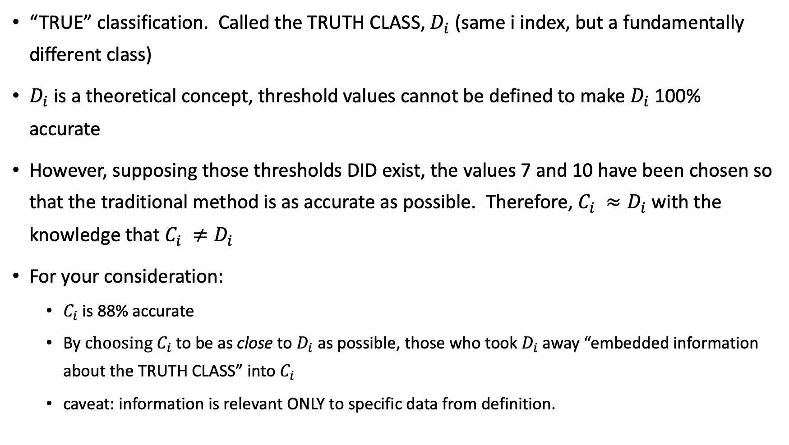
GREAT… NOW WHAT?
“TRUE” classification. Called the TRUTH CLASS, $D_{i}$ (same i index, but a fundamentally different class)
$D_{i}$ is a theoretical concept, threshold values cannot be defined to make $D_{i}$ 100% accurate
However, supposing those thresholds DID exist, the values 7 and 10 have been chosen so that the traditional method is as accurate as possible. Therefore, $C_{i} ≈D_{i}$ with the knowledge that $C_{i} ≠D_{i}$
For your consideration:
$C_{i}$is 88% accurate
By $choosing{ C}_{i}$to be as close to $D_{i}$ as possible, those who took $D_{i}$away “embedded information about the TRUTH CLASS” into $C_{i}$
caveat: information is relevant ONLY to specific data from definition.

Slide 6
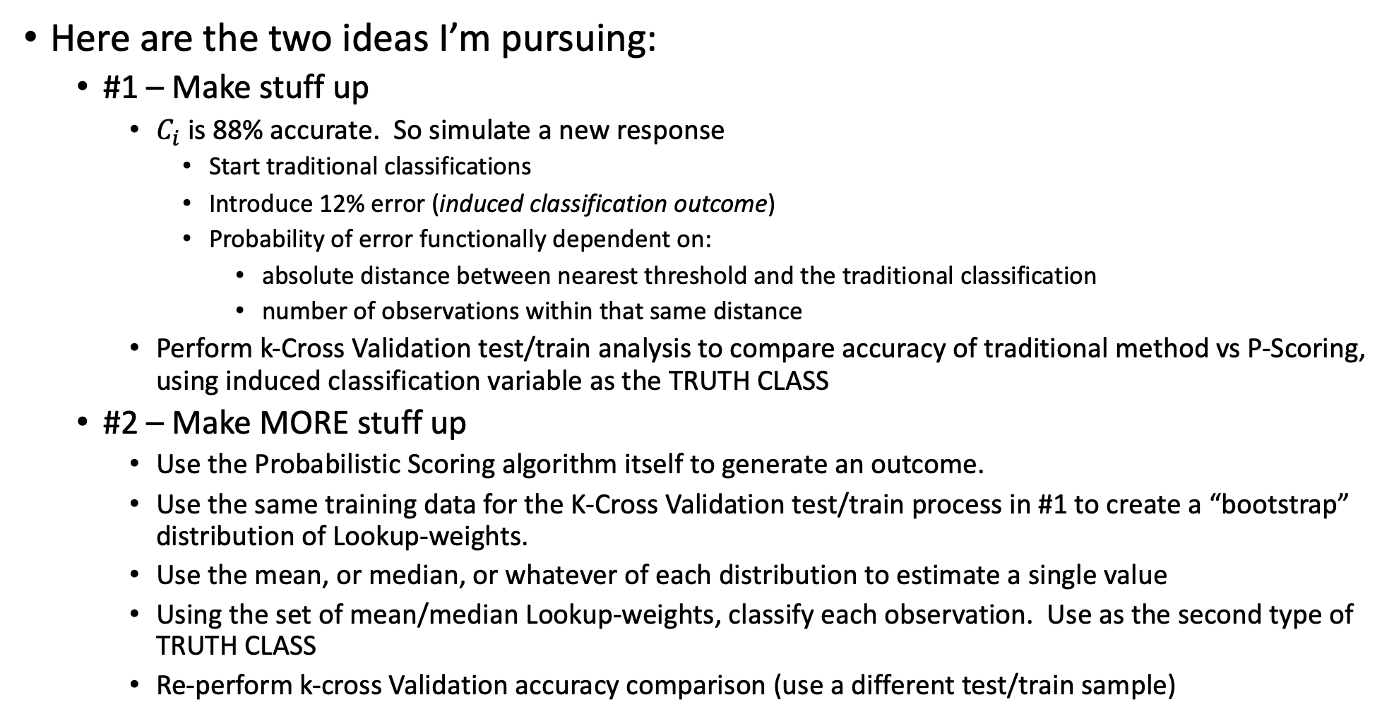
That…wasn’t helpful
Here are the two ideas I’m pursuing:
#1 – Make stuff up
$C_{i}$ is 88% accurate. So simulate a new response
Start traditional classifications
Introduce 12% error (induced classification outcome)
Probability of error functionally dependent on:
absolute distance between nearest threshold and the traditional classification
number of observations within that same distance
Perform k-Cross Validation test/train analysis to compare accuracy of traditional method vs P-Scoring, using induced classification variable as the TRUTH CLASS
#2 – Make MORE stuff up
Use the Probabilistic Scoring algorithm itself to generate an outcome.
Use the same training data for the K-Cross Validation test/train process in #1 to create a “bootstrap” distribution of Lookup-weights.
Use the mean, or median, or whatever of each distribution to estimate a single value
Using the set of mean/median Lookup-weights, classify each observation. Use as the second type of TRUTH CLASS
Re-perform k-cross Validation accuracy comparison (use a different test/train sample)

Slide 7
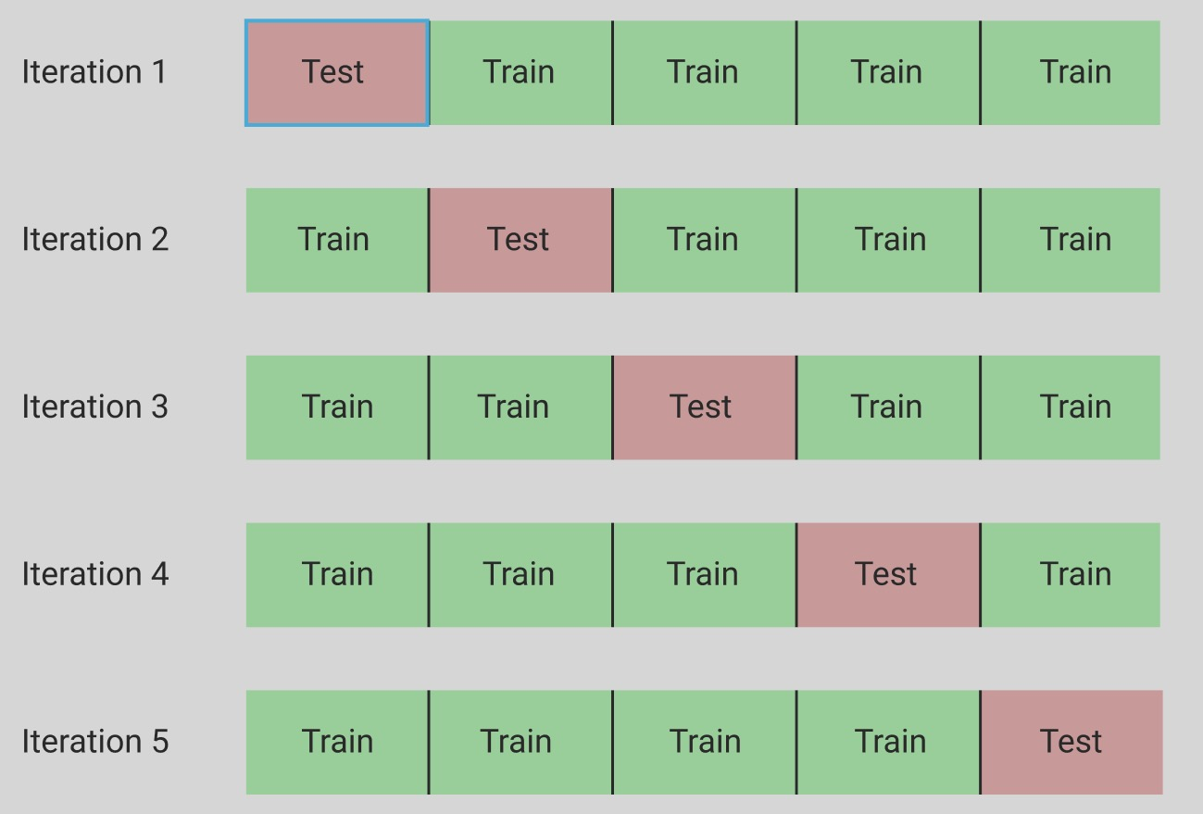
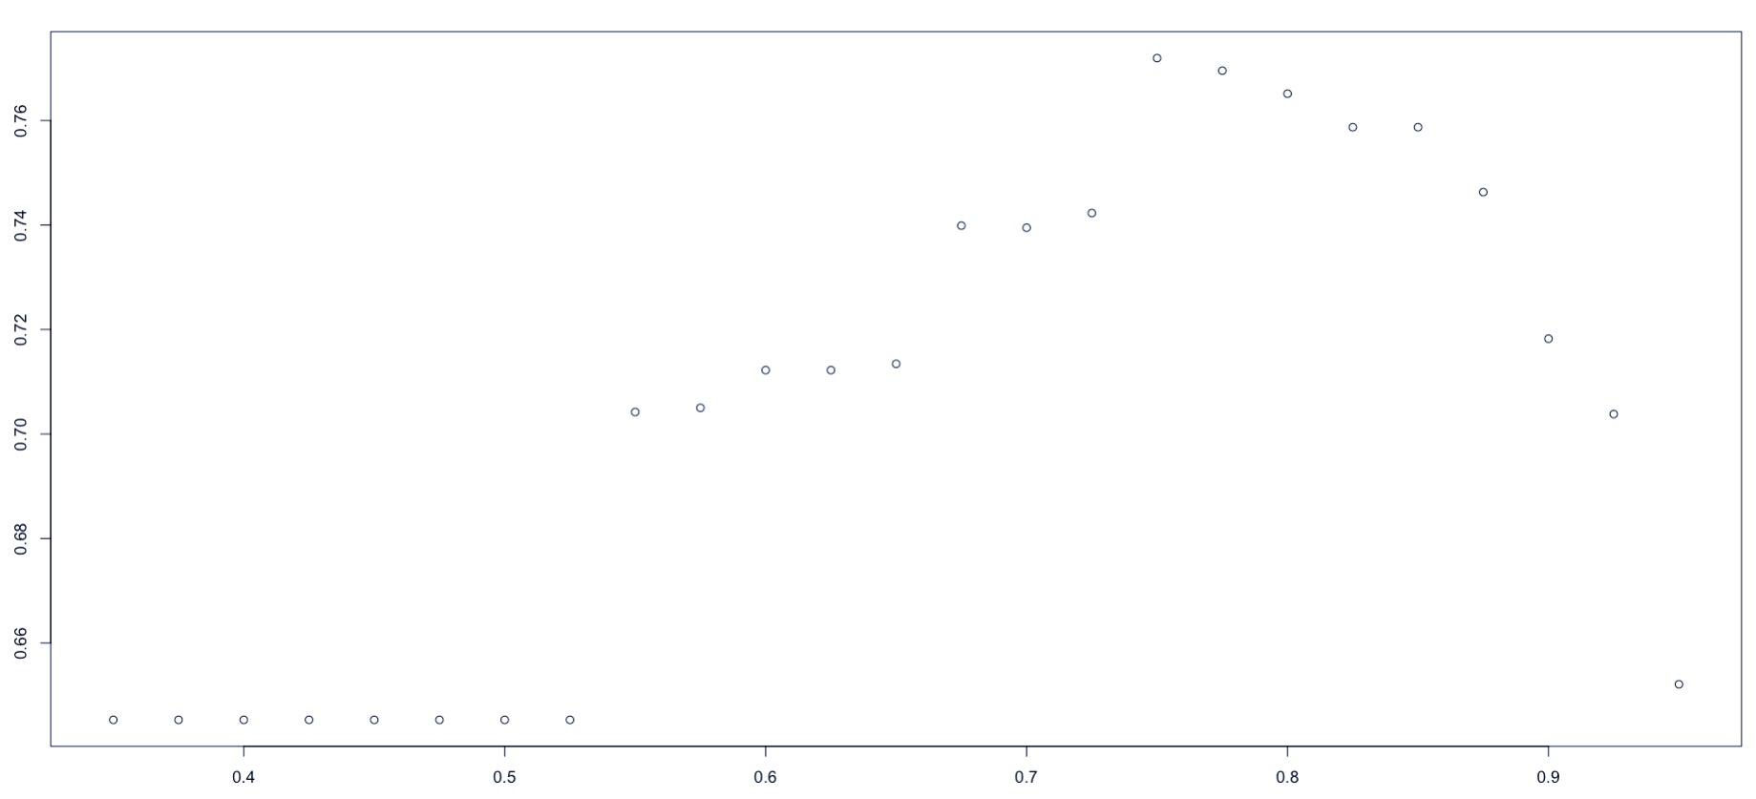
K-Fold Cross-Validation Train/Test Sets
I split data into 15 different values of K.
Might be possible to show training size-dependency
Accuracy is higher for k-values corresponding to higher count training sets
# of subsample sets
I used the full data set to identify an adequate stopping probability threshold for the P-scoring algorithm.
This value optimizes approach #1 accuracy
This should probably be done for each k value, for each approach, on each data set, but that sounds…hard.

Slide 8
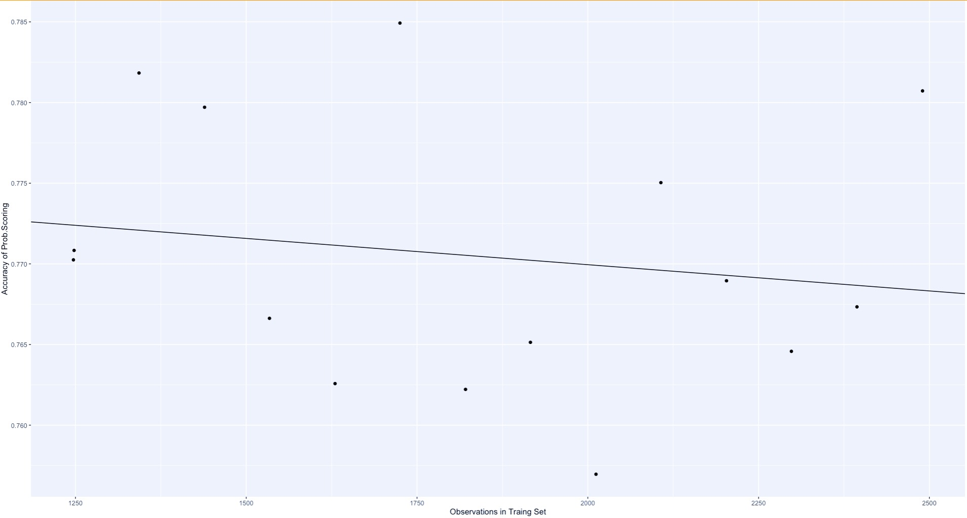
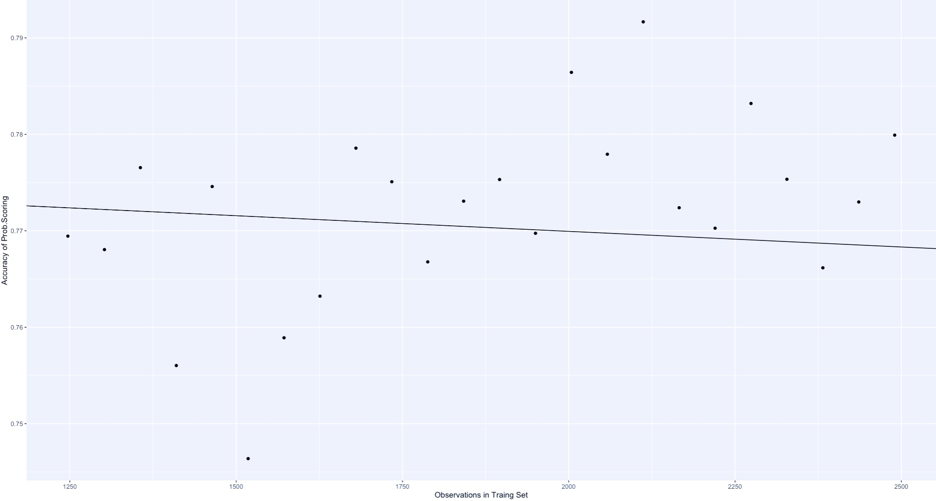
Initial Results Approach #1
15 K values
I might be able to show that accuracy increase with training sample size in the P-score algorithm
25 K values

Slide 9
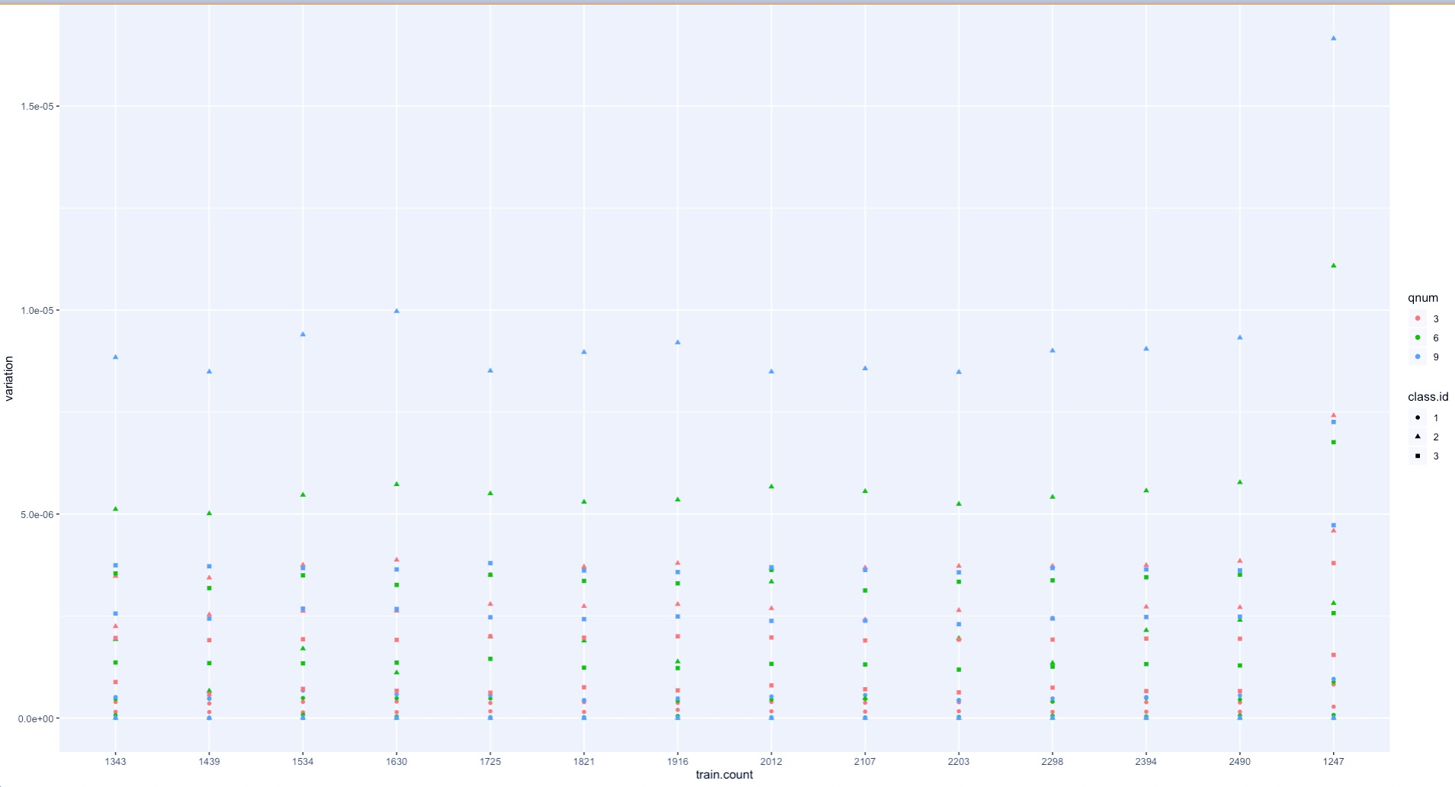
Initial Results Approach #2
What’s Done:
Variance plot for 17 different lookup weights, calculated for the 15 different values of K-cross fold training data sets
Each value of K generated one bootstrap distribution for each Look-up weight
WHY???
If this is a reasonable idea, the variances of the bootstrap distributions for each look-up weight should feature some of:
Convergent/converging to zero
Bounded above
Monotonic
“small” in value
What are the result’s:
The plot noted is displayed below…and the numbers are small
Not the most powerful result, but I will most likely proceed with creating the 2nd outcome
1.5e-05
Depression Class 2
Question 9
Depression Class 2
Question 6
1.0e-05
5.0e-06
0

Slide 10
What’s Leftover, and What’s the Timeline
Things I still needs to do for the analysis:
Complete Analysis #2
Generate P-score outcomes
Repeat CV accuracy analysis
Get K iterations UP & Experiment approach #1 Training Set definitions
Limited success with k=50
Saving data has been an issue
Projected Timeline
I will be finishing the analysis between 4/14 - 4/21
Following methods presentation

Slide 11
Questions?
Keeping in mind that Alan is going for Peace of Mind, not “proof”, are there any other methods you suggest?
Approach #2 is “hand wavy”. I get it
How can I justify this approach?
Note: my justification so far is “…why not?”
I am still working on notation and nomenclature. I realize everything is confusing. Please let me know what is clear, so I can stop trying to un-confuse stuff.

Slide 12
THANK YOU!

