Slide 1
Determining the Accuracy of Probabilistic Scoring
Client:
Alan Malik
Patient Tools
Lee Panter

Slide 2
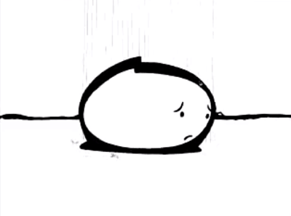
ARE YOU SAD?

Slide 3

Do your Patient Health Questionnaire (PHQ) summaries give you feelings of:
Inaccuracy
Low specificity
Low sensitivity

Slide 4
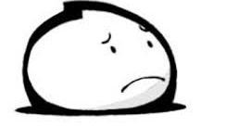
These may be symptoms of a more serious condition:
Insufficient Statistic (itus)™

Slide 5
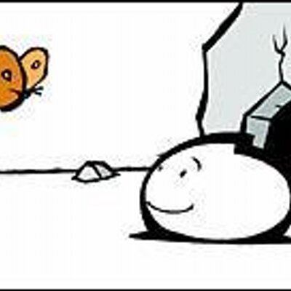
Talk to your statistician today about:
PROBABILISTIC SCORING
* Results may vary, Use as directed, May cause drowsiness-do not operate machinery until you know how this treatment affects you…

Slide 6
Client Proposal-Problem Statement
Questionnaires are standard approach to preventative screening for mental health disorders
Designed to be:
Easy to use, track and record
Quick (maximum average of 6.5 minutes)
Reduced to minimum necessary questions, prioritizing answers with higher risk for further evaluation
Standard Testing Protocol
PHQ-2 → PHQ-9 → QDP → Mental Healthcare Specialist
PHQ-2 (Patient Health Questionnaire)
First two questions of PHQ-9
Scores are 0-6
Scores higher than 2 considered “at risk"
PHQ-9
Scores are 0-27
Scores higher than 9 considered “at risk”
QDP (Quick PsychoDiagnostic Panel)
Dynamic decision-tree protocol based on DSM-V
Can classify 11 disorders
What’s the Problem?
Poor quality statistics used for classification
Inferior performance due to poor classification caused clinical fatigue
One study found that after using the PHQ-2, providers did not refer a positive result 95% of the time!

Slide 7
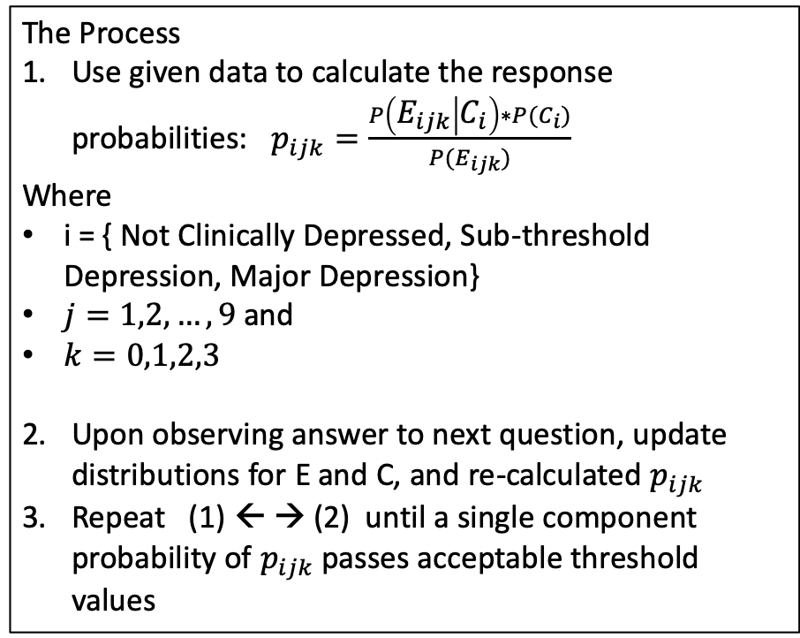
Client Proposal-Solution
Definitions
E = percent of cases endorsing a specific item answer
(e.g percent of cases that answered 0 on q1)
C = outcome class
(e.g. the outcome class of case 1 is ”Major Depression”)
Collected Data:
2,495 total cases (observations)
PHQ-9 & QDP results
Collected over six months
Federally Qualified Health Center in Montana
QDP administration was randomized
Before/after taking PHQ-9
Some cases only took PHQ-9
The Process
Use given data to calculate the response probabilities: $p_{ijk}=\frac{P\left(E_{ijk} | C_{i}\right)∗P(C_{i})}{P(E_{ijk})}$
Where
i = { Not Clinically Depressed, Sub-threshold Depression, Major Depression}
$j=1,2,…,9$ and
$k=0,1,2,3$
Upon observing answer to next question, update distributions for E and C, and re-calculated $p_{ijk}$
Repeat (1) ← → (2) until a single component probability of $p_{ijk}$ passes acceptable threshold values
Probabilistic Scores
Iterative process
Updated after another question is answered
A single score
Probability that the given series of answers dictates a certain classification
PHQ-9 has three categories to classify therefore each score is three numbers

Slide 8
Client and Consultant Goals
Main Consultant Goals
Mathematically prove that Probabilistic scoring is more accurate than conventional scoring
”…show that information is not lost when applying Bayes’ Theorem”
Establish minimum sample size needed for Probabilistic Scoring error to be smaller than that of conventional scoring.
Mathematically prove that probabilistic scoring derived from a conventional scored validation dataset is essentially as accurate as using the original validation dataset and therefore still more accurate than conventional scoring
Initial Steps
Literature Review
Item Response Theory
Bayesian sufficiency
Discuss areas of confusion with client and class
Obtain client coding methods including data used to generate results
Possibly inquire into previous proof attempts made, and other resources that might be useful
Client Goals
Patent Concept (Complete)
Educate medical practitioners (spreading the word)
Getting the concept accepted as Clinically appropriate
Obtain large PHQ-9 data set to test error convergence based upon error size

Slide 9
I have a question…
There are several times in the paper where accuracy, false positives, false negatives,…, etc. are referenced. How are you calculating these values?
What are the “cut scores” for each test you implemented? How are/were they determined?
Is there a standard decision-tree you have been using that minimizes the error? Have you tried re-ordering the responses?
Along a similar line, what sort of case/question independence assumptions are you making?
Are the cases independent?
How about the questions (assuming no decision tree)?
Are you assuming that your sample is representative of your population of interest?
Will your database of weights be continually reset (i.e. go back to the original settings after each test), or will each test also be factored in?
Are asymptotic results and/or asymptotic-dependent results acceptable?
What parametric assumptions were made in your analysis? Is a proof that is specific to certain parametric values desirable?

Slide 10
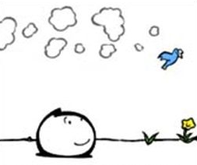
You should stop Probabilistic Scoring if:
THANK YOU!!
You are allergic to math
You dislike being correct
Seek immediate Statistical Assistance if you experience a positive predictive value greater than one
For external use only
Rinse mouth thoroughly after each use
May cause drowsiness
Package is NOT child resistant

