Slide 1
Probabilistic Scoring
Client: Alan Malik—Patient Tool
Lee Panter

Slide 2
Updates: Ideal Outcomes
Show that probabilistic scoring is superior in accuracy to conventional-linear scoring by using existing data from PHQ9 research
Show that Probabilistic Scoring accuracy is a function of sample size, and that larger sample sized imply better classification accuracy
Show that Probabilistic Scoring converges to the best estimate of “Baseline Truth” in higher Sample Numbers

Slide 3
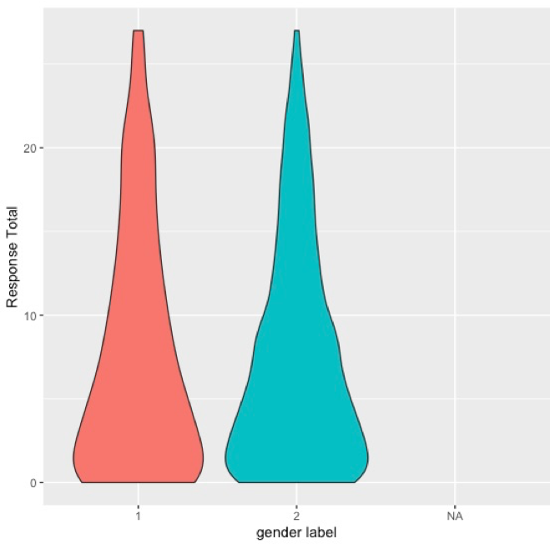
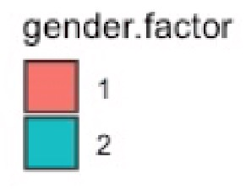
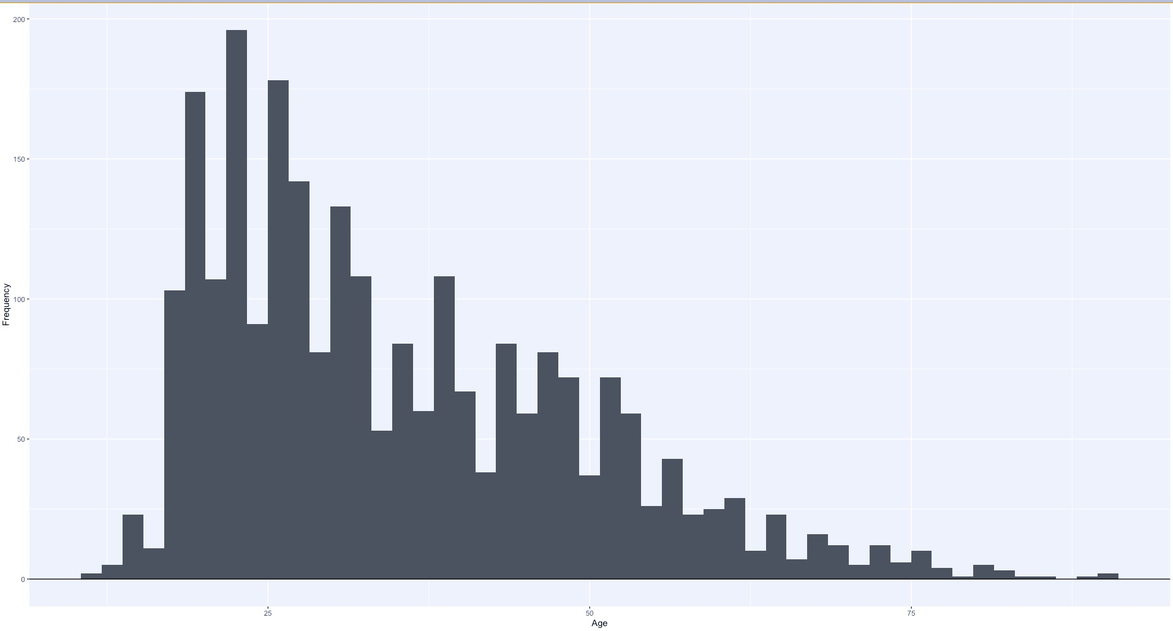
Data
Full data is 286 variables, 2495 observations
PHQ2, PHQ9, QDP
Data dictionary needed if further analyses will be expected
Lots of calculated and ”nested” variables
Demographic data: Age & Gender
150
50
25
AGE
75

Slide 4
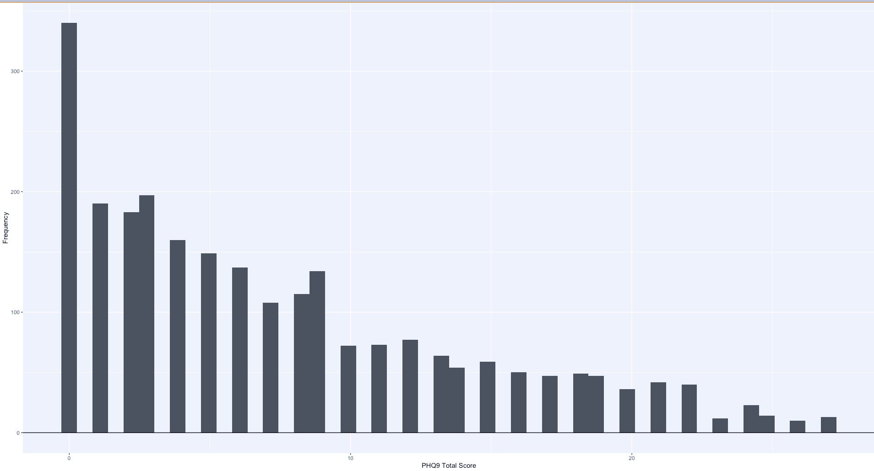
So how crazy am I?
300
Frequency
100
0
10
Response Total
20
27

Slide 5
Immediate Goals
Replicate analysis or get Alan to walk me through an analysis
Cross-validation sample-size convergence:
Generate algorithm for calculating Evidence Coefficients, and accuracy measures as a function of sample size
Create cross-validation test-training data sets based upon an increasing sample-size
Compare average (minimum) accuracy across CV sets as sample size increases for Probabilistic Score and Conventional Score
Investigate stability of convergence
Are some points converging faster? Not at all?
Can the limit be determined? Can a generalized proof of convergence be obtained?

Slide 6
THANK YOU!
Suggestions, comments, concerns:
Lee.panter@ucdenver.edu

