Slide 1
An Application of Self Organizing Maps
Organized by Lee Panter

Slide 2
Presentation Goals
Establish motivation. Why should I care?
Overview of mathematical methodology
Applied example

Slide 3
Motivation/Caring/etc…
Qualitative Description of Self Organizing Maps (SOMs)
Why it matters to my consultation

Slide 4
Qualitative Description of Self Organizing Maps (SOMs)
K-Means Clustering
Similar in SOMs with small output node counts
SOMs with many output nodes very different [2]
Artificial Neural Network learning:
Backpropagation & gradient descent (optimization)
Applications
Visualization: multidimensional scaling
Projecting high-dimensional data onto 2-dimensional structures
Preserving topological properties of high-dimensionality [3]
Classification: vector mapping
Classifying high-dimensional vectors from input data by associating a projected node chosen by training process
Competition --> Adaptation --> Cooperation [4]

Slide 5
Great, but I Still Don’t Care!
PROBLEM
SOLUTION
Subject | Q1 | Q2 | Q3 | Q4 | Q5 | Q6 | Q7 | Q9 | TOTAL
1 | 0 | 2 | 1 | 3 | 2 | 1 | 1 | 1 | 11
2 | 1 | 2 | 1 | 0 | 1 | 1 | 0 | 0 | 6
… | … | … | … | … | … | … | … | … | …
Let the DATA speak for itself!
Use an unsupervised method to generate a classification mapping
Use SOM to classify observations into three output nodes
Assign Depression Score Class (TRUTH) to each output node
Justify assignments on observable characteristics of observations within each node
Mean total score
Mean score on certain questions
TRUTH is not given in the data
Need the TRUTH to determine accuracy of any classification method
Simulation of responses helpful, but not conclusive
What ELSE could determine the TRUTH?

Slide 6
Overview of Mathematical Methodology
Algorithm Description
More “math-y” version
What are SOMs useful for? When should I use them?

Slide 7
HOW DO SOMs WORK?
The Three Learning Concepts [4]
Competition: Output layer nodes compete for proximity to input layer (observation) locations. “Winning” output layer node defined by closest proximity.
Adaptation: Output layer weights update to reflect optimal response to information from (1)
Cooperation: Optimal response in (2) determined by neighborhood function limiting magnitude of influence from unrelated observations.
[2]
Input layer locations (observations) (STATIC)
Output layer nodes (weights) (dynamic)

Slide 8
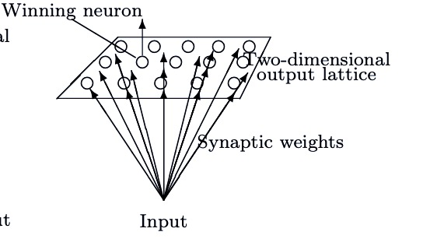
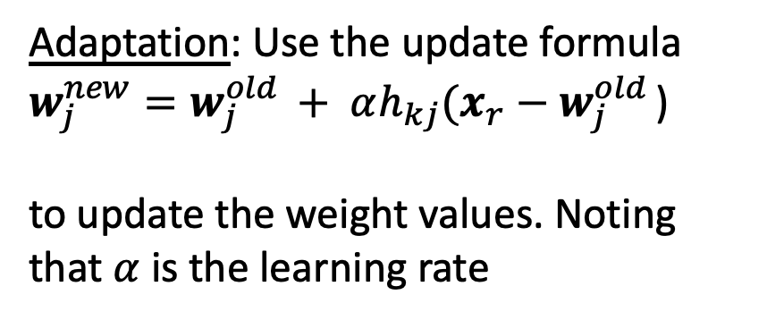
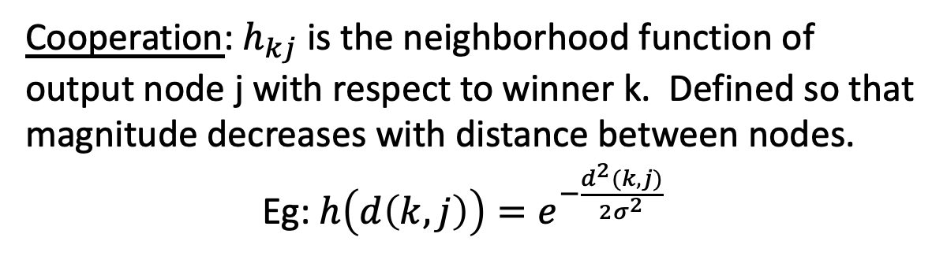
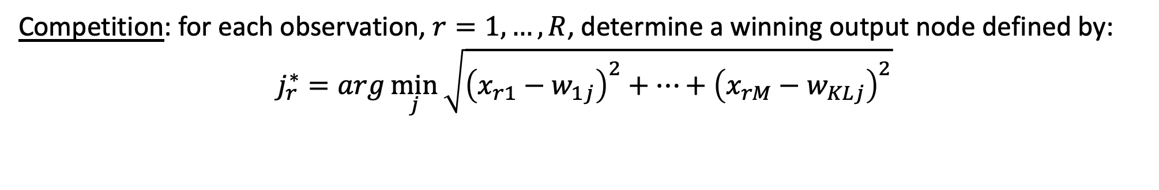
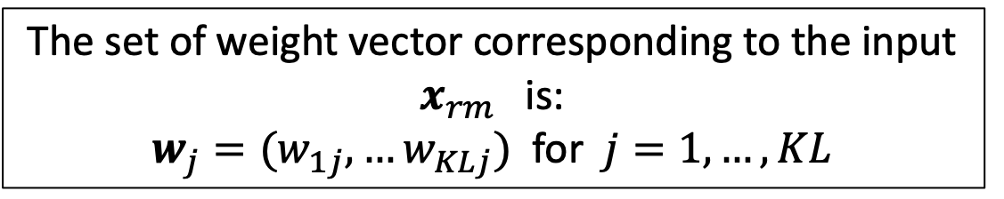
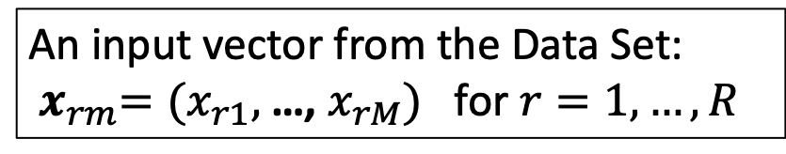
The “Math-y” Stuff
Output lattice K x L
Data Set
An input vector from the Data Set: ${ x}_{rm}=(x_{r1},$…, $x_{rM})$ for $r=1,…, R$
R X M
The set of weight vector corresponding to the input $x_{rm}$ is:
$w_{j}=(w_{1j},…w_{KLj})$ for $j=1, …, KL$
Algorithm[4]:
Competition: for each observation, $r=1,…,R$, determine a winning output node defined by:
$$j_{r}^{∗}=arg\min_{j}{\sqrt{{\left(x_{r1}−w_{1j}\right)}^{2}+⋯+{\left(x_{rM}−w_{KLj}\right)}^{2}}}$$
Adaptation: Use the update formula
$w_{j}^{new}=w_{j}^{old }+ αh_{kj}(x_{r}−w_{j}^{old }$)
to update the weight values. Noting that $α$ is the learning rate
Cooperation: $h_{kj}$ is the neighborhood function of output node j with respect to winner k. Defined so that magnitude decreases with distance between nodes.
Eg: $h\left(d\left(k,j\right)\right)=e^{−\frac{d^{2}(k, j)}{2σ^{2}}}$

Slide 9
Visualization
Uses: Mapping high dimensional data to low dimensional clustered representations
Advantages:
Topological relationships preserved
Output node coordinates represent inherent features of input space
Disadvantages:
Distance quantities not preserved
What are SOMs useful for? When should I use them?
Classification
Uses: Mapping un-labeled data
Advantages:
No reliance on predefined target outcomes that would guide the learning process [3]
Missing data is incorporated into training of map [3]
Disadvantages:
Computationally expensive
Input & output metrics need consideration
Assumptions [1]
Events in the environment can be clustered together according to their similarity
There is some kind of topology or ordered relationship among different clusters
Weight values need to be bounded

Slide 10
Applied Example
Introduce Applied Data, Context and Objective
Overview of Results
How Results are Used
How this Process Applies to the Consult

Slide 11
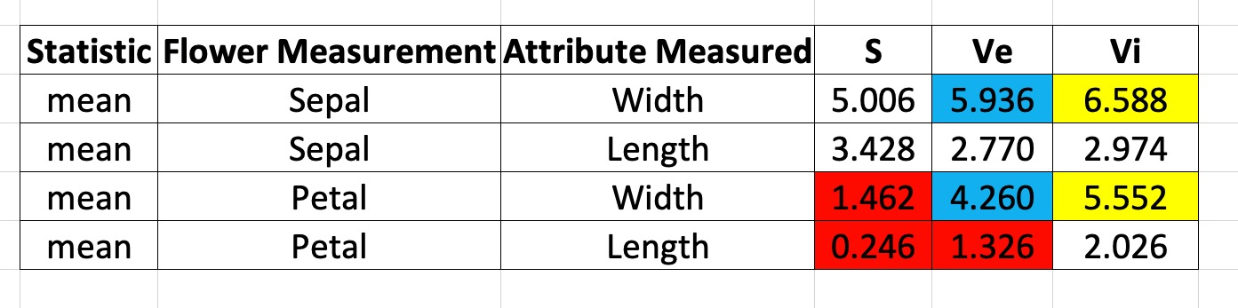
Let’s stop and smell the Irises..Iri?
Consider data with the following information
Sepal Width, Sepal Length, Petal Width, and Petal Length
All continuous measurements
150 distinct flower observations
NO species information
No measure TRUTH provided
Obtained from previous/outside sources
Average values of each variable corresponding to each species
OBJECTIVE: Classify the observations into the three species categories
PROCESS:
Step 1: Generate Self-Organizing Map that clusters observations into two-dimensional lattice structure
Step 3: Cross-examine features unique to nodes with previously obtained information (table above) to identify probable species classification for all observations within each output node
Step 2: Identify unique input characteristics of each node within lattice node

Slide 12
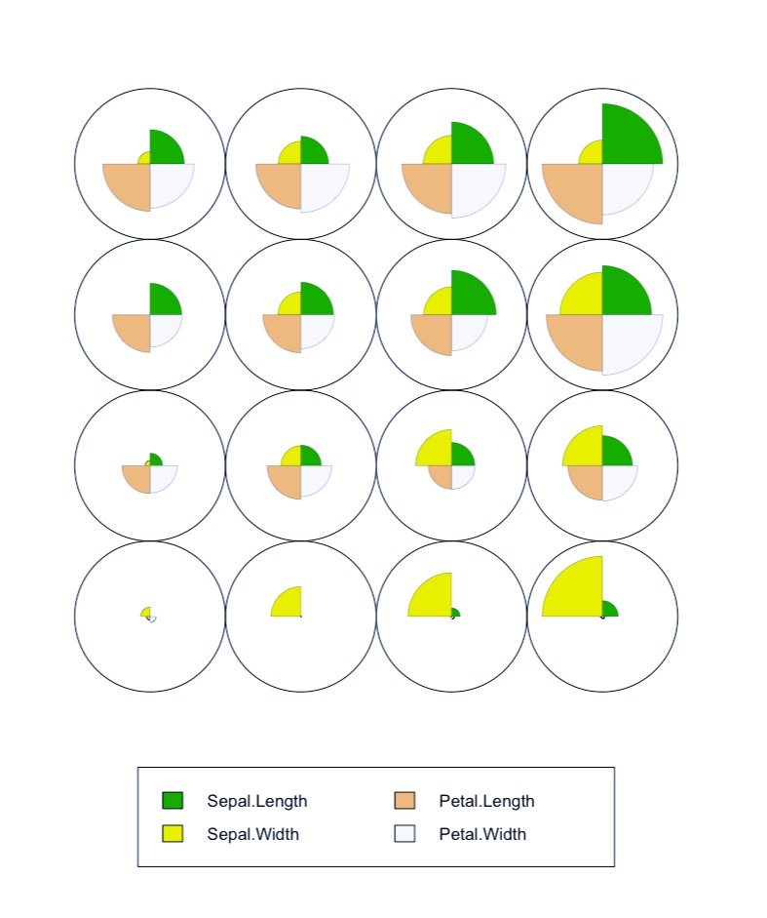
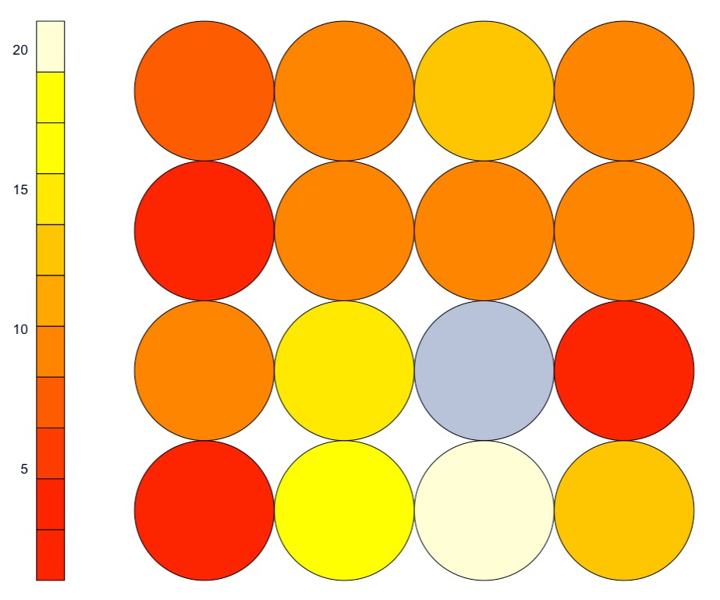
Output Node Code Visualization Plot
13
14
15
16
Magnitude of pie sections represent average expression feature for all observations classified within that node
Self Organizing Map with 4x4 output visualization layer
9
12
5
8
1
4
2
3
Output Node Number
Quantity Chart. Observations within node

Slide 13
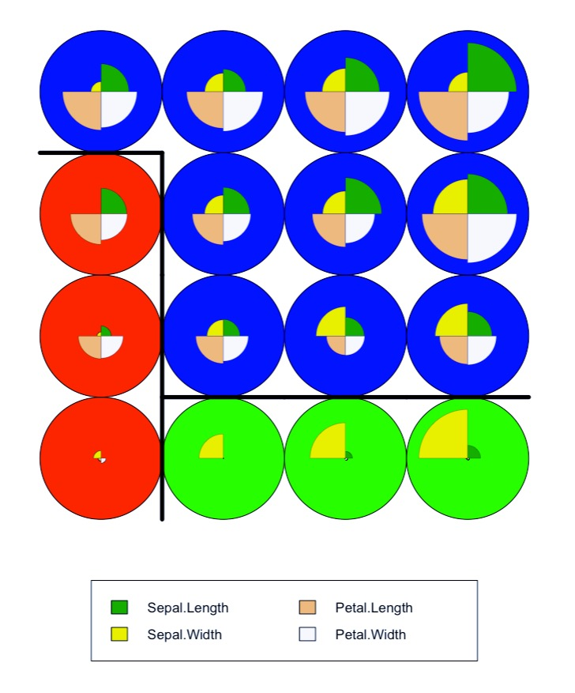
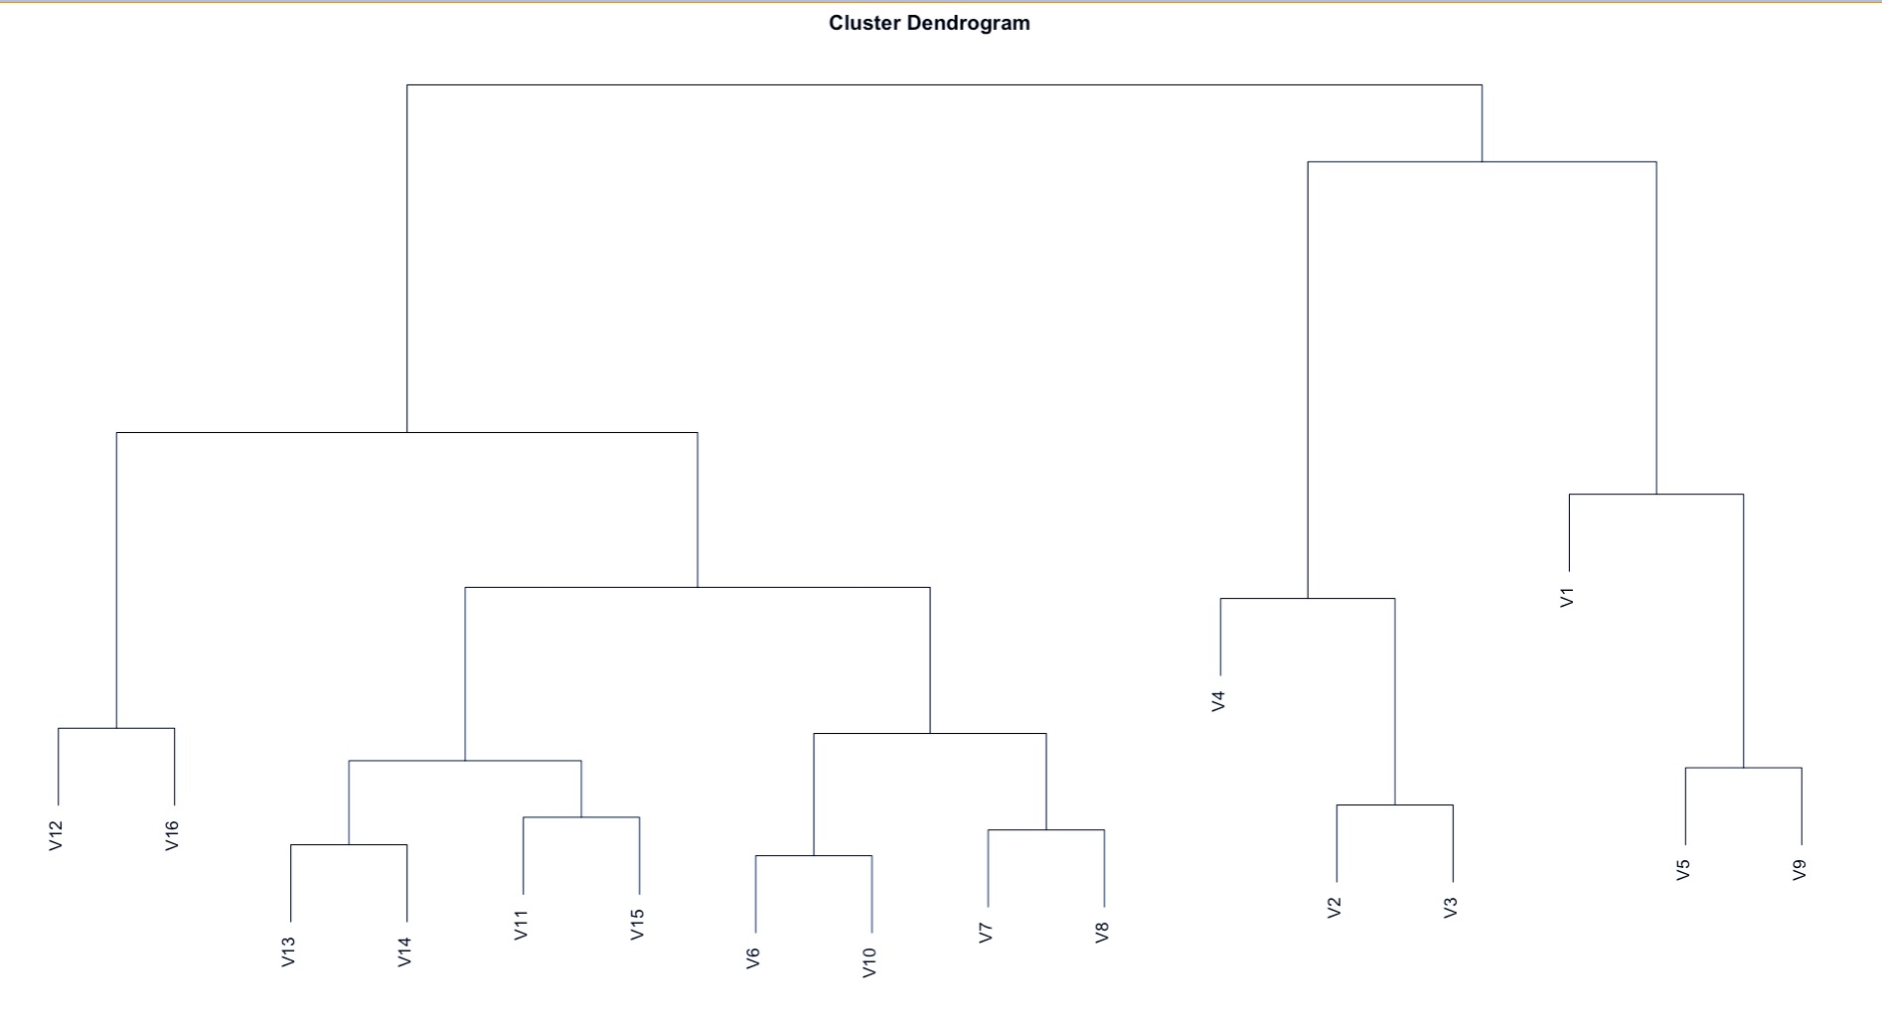
Inferential Mapping
Cutline for 3 clusters

Slide 14
Compound Mapping
Sepal.Length | Sepal.Width | Petal.Length | Petal.Width
5.1 | 3.5 | 1.4 | 0.2
5.7 | 2.8 | 4.5 | 1.3
… | … | … | …
SOM Output Node
3
6
…
SOM (clustering)
SOM Output Node
3
6
…
SOM Outcome Classification
S
Ve
…
SOM (mapping)
I have generated an independent supervision variable, which is approximately 69% the same as the original.
SOM Outcome Classification | Outcome TRUTH
S | S
Ve | Ve
… | …
Accuracy = 68.667%
NOTE: still cannot “optimize accuracy”

Slide 15
How Do We Implement?
Using a SOM to generate a supervision set.
Option 1: generate a SINGLE supervision set using the full-data
Option 2: Accuracy is being evaluated using repeated CV processes (iterations over K cross-fold values)
Generate new SOM supervision set corresponding to each “K-fold subset”
For each value of ”K” generate a single SOM supervision set
Option 1 seems the more probable route.

Slide 16
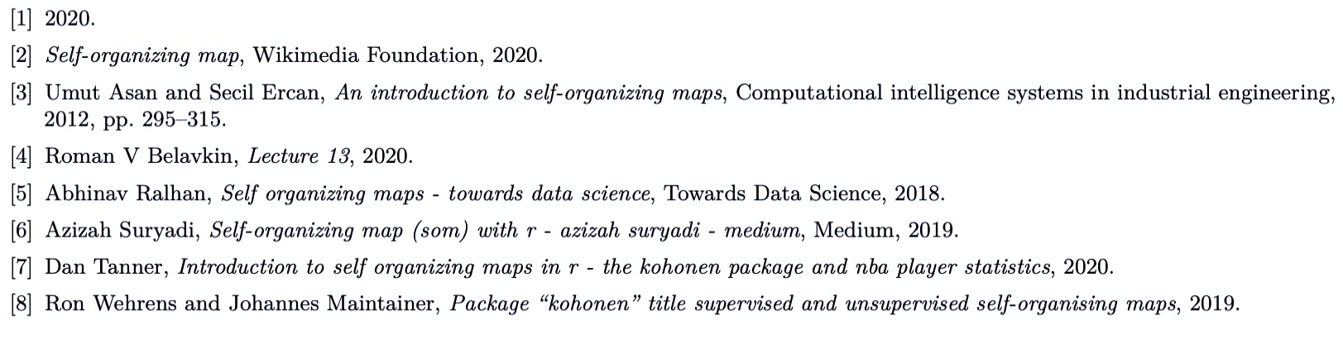
References
Resources
https://github.com/leepanter/SelfOrganizingMaps.git
Contains: this presentation (PPT, and video), Code, references.
Soon to contain: paper (writeup), write-code, more reference stuff
THANK YOU!

