Slide 1
An Application of Self Organizing Maps
Organized by Lee Panter

Slide 2
Presentation Goals
Establish motivation. Why should I care?
Overview of mathematical methodology
Applied example

Slide 3
Motivation/Caring/etc…
Qualitative Description of Self Organizing Maps (SOMs)
Why it matters to my consultation

Slide 4
Qualitative Description of Self Organizing Maps (SOMs)
K-Means Clustering
Similar in SOMs with small output node counts
SOMs with many output nodes very different
Artificial Neural Network learning:
Backpropagation & gradient descent (optimization)
Applications
Visualization: multidimensional scaling
Projecting high-dimensional data onto 2-dimensional structures
Preserving topological properties of high-dimensionality
Classification: vector mapping
Classifying high-dimensional vectors from input data by associating a projected node chosen by training process
Competition --> Adaptation --> Cooperation

Slide 5
Great, but I Still Don’t Care!
PROBLEM
SOLUTION
Subject | Q1 | Q2 | Q3 | Q4 | Q5 | Q6 | Q7 | Q9 | TOTAL
1 | 0 | 2 | 1 | 3 | 2 | 1 | 1 | 1 | 11
2 | 1 | 2 | 1 | 0 | 1 | 1 | 0 | 0 | 6
… | … | … | … | … | … | … | … | … | …
Let the DATA speak for itself!
Use an unsupervised method to generate a classification mapping
Use SOM to classify observations into three output nodes
Assign Depression Score Class (TRUTH) to each output node
Justify assignments on observable characteristics of observations within each node
Mean total score
Mean score on certain questions
TRUTH is not given in the data
Need the TRUTH to determine accuracy of any classification method
Simulation of responses helpful, but not conclusive
What ELSE could determine the TRUTH?

Slide 6
Overview of Mathematical Methodology
Algorithm Description
More “math-y” version

Slide 7
HOW DO SOMs WORK?
The Three Learning Concepts
Competition: Output layer nodes compete for proximity to input layer (observation) locations. “Winning” output layer node defined by closest proximity.
Adaptation: Output layer weights update to reflect optimal response to information from (1)
Cooperation: Optimal response in (2) determined by neighborhood function limiting magnitude of influence from unrelated observations.
Input layer locations (observations) (STATIC)
Output layer nodes (weights) (dynamic)

Slide 8
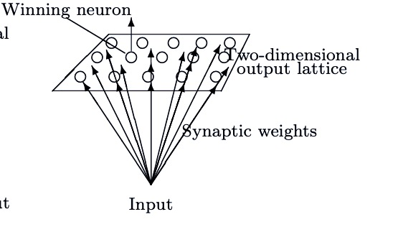
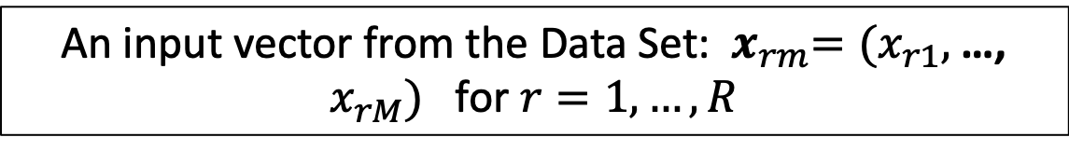
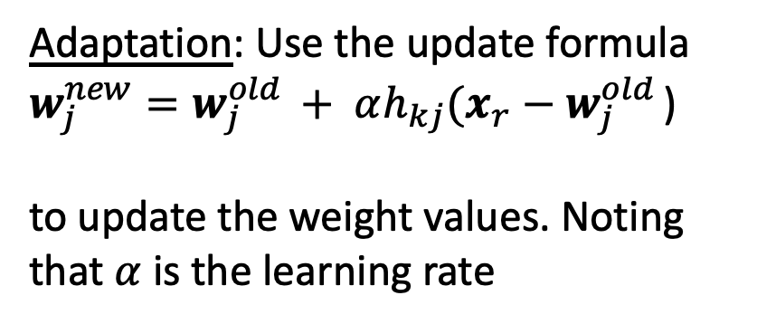
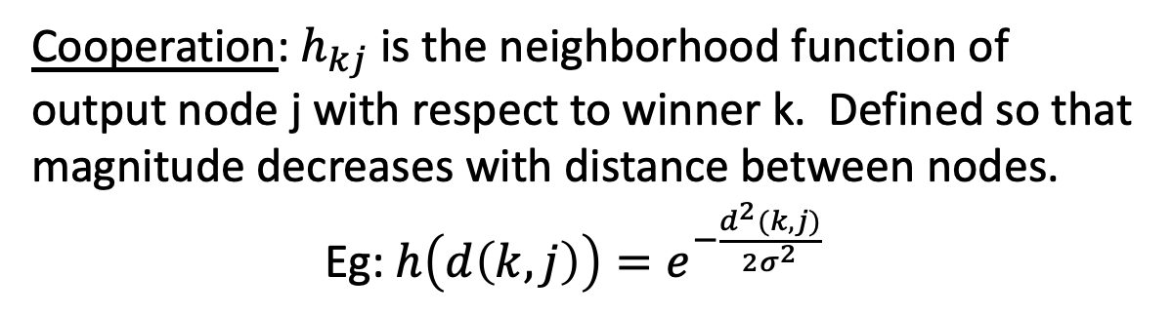
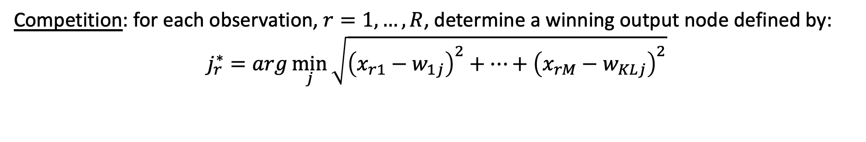
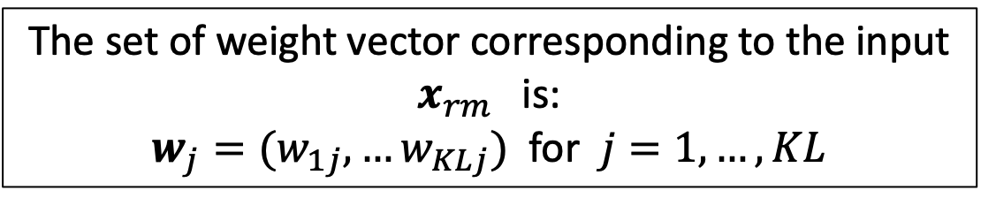
The “Math-y” Stuff
Output lattice K x L
Data Set
An input vector from the Data Set: ${ x}_{rm}=(x_{r1},$…, $x_{rM})$ for $r=1,…, R$
R X M
The set of weight vector corresponding to the input $x_{rm}$ is:
$w_{j}=(w_{1j},…w_{KLj})$ for $j=1, …, KL$
Algorithm:
Competition: for each observation, $r=1,…,R$, determine a winning output node defined by:
$$j_{r}^{∗}=arg\min_{j}{\sqrt{{\left(x_{r1}−w_{1j}\right)}^{2}+⋯+{\left(x_{rM}−w_{KLj}\right)}^{2}}}$$
Adaptation: Use the update formula
$w_{j}^{new}=w_{j}^{old }+ αh_{kj}(x_{r}−w_{j}^{old }$)
to update the weight values. Noting that $α$ is the learning rate
Cooperation: $h_{kj}$ is the neighborhood function of output node j with respect to winner k. Defined so that magnitude decreases with distance between nodes.
Eg: $h\left(d\left(k,j\right)\right)=e^{−\frac{d^{2}(k, j)}{2σ^{2}}}$

