Slide 1

Predicting Fire
Team Wildcats
Margaret Hughes Amissah-Mensah, Jiyeon Park, Lee Park
Notes:
Welcome
The team members are Maggie, Jiyeon, and me. And my name is Lee.

Slide 2

Flexibility and agility of the approach
Similar to the Covid-19 pandemic, fast and reliable prediction of the fire is the key to manage the wild fire
The approach 1 is simple and fast
Frequent flights to take images of the area can expidite the process
When they are not available, we still have a backup plan
This backup plan can also be used to predict possible
Notes:
Let me provide the elevator pitch before discussing our approaches in detail
Similar to the Covid19 pandemic, fast and reliable prediction of the fire is the key to manage the wild fire
We prepared two approaches to make the process flexible to various situations.
When we have chronologically and geographically relevant data, we go for the first approach which is fast and reliable.
When the first approach is not ideal due to the lack of the relevant data, we can go for the second approach which is still reliable but requires heavier feature engineering.
In short, we approached this problem flexibly to address the client's concern.

Slide 3
Approaching flexibly
Wild fire is wild. A static approach to this problem would not be ideal
Due to various conditions fire authorities face, we should provide flexible approaches.
When they had chronologically and geographically relevant data, we recommend the first approach: overlap-and-mask
When they are not available, we use the logistic regression for the clear area and the linear SVC (support vector machine classifier) for the smoky area
For this approach, heavier feature engineering is required
Notes:
Before discussing the models, we need to identify the concerns that the client has.
Wild fire is wild. So, they want a model that is flexible to different situations
So, we approached this problem by some conditions that the fire authority might have.
As aforementioned, we prepared two approaches and they can be used depending on the situation.

Slide 4
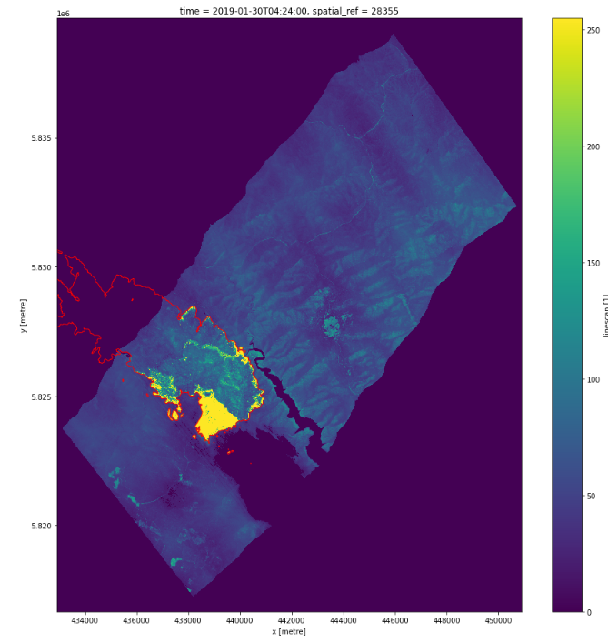
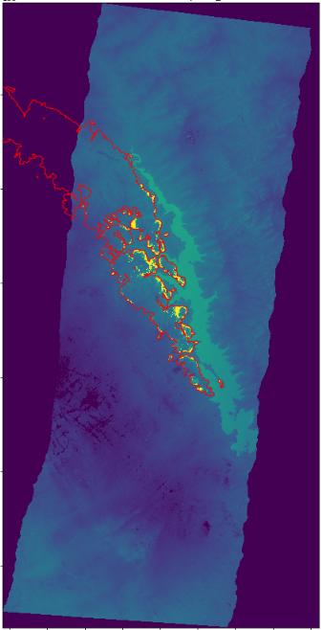
Behavior of Fire
The first linescan image was taken at 4:24 1/30/2019
The second linescan image was taken at 9:46 2/1/2019
Linescan value has changed, but the area on fire has not really changed
After the area experience an extreme fire, they remain on fire for a reasonable hours
Notes:
Let's talk about the behavior of fire.
The image you see on the left was taken at 4:24 AM Jan/30/2019
Then now you see the second linescan image that was taken at 9:46 Feb/1/2019
Linescan value has decreased over the single day, but they are still on fire.
It is mainly because they were fire before and fire remains there after being fierce.

Slide 5
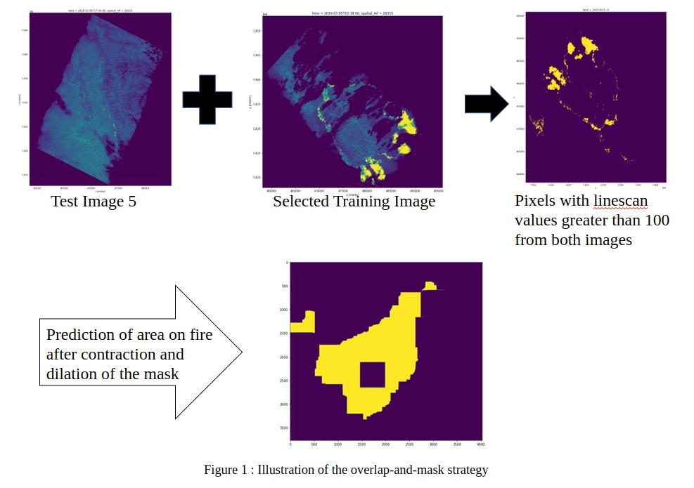
Approach 1 : Overlap-and-Mask
Find the chronologically and geographically relevant training image
Overlap the training and test image in line with their coordinate information
Sort out the pixels whose linescan values are greater than 100
Create smoother fire boundary by contracting and dilating the size of the pixels
Notes:
Understanding the basic characteristic of the wild fire, we applied the overlap-and-mask method
The method is simple and straightforward.
When we have chronologically and geographically relevant training data, we simply overlap those images in line with their coordinate information.
Then we single out the pixels whose linescan values are greater than 100
Finally, we create a smoother boundary by contracting and dilating the size of the pixels.

Slide 6
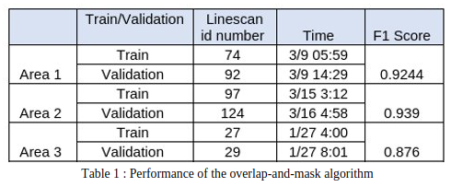
Approach 1 : Overlap-and-Mask
The algorithm works well
The key is to determine whether the available training image is chronologically and geographically relevant
Exhaustive effort to extinguish the fire might affect the performance of the model as this model assumes continued spread of fire
Notes:
We validated this method by testing pairs from the training image set.
They all performed fairly well and they were fast to make prediction.
In other words, this approach fulfills the need of the client; however, again, this requires a chronologically and geographically relevant training image.

Slide 7
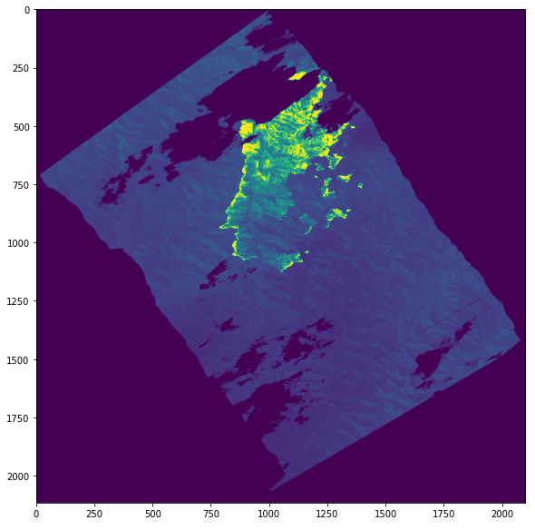








Approach 2
Not every linescan image is clear and nice
We conjectured the main reason for the missing pixels is that big smoke interfered the airplane taking the linescan image
Therefore, we need a different approach for the smoky area (where the linescan value is 0) and the clear area (where the linescan value is greater than 0)
In addition, we need to cut-off the pixels outside the linescan image
Notes:
The second approach adopted the traditional data mining method.
To address the concern that the linescan image is not clear, we have to split the data into smoky area, where linescan values are 0 inside the frame, and clear area whose linescan value is greater than 0.
Also, the pixels outside of the linscan frame has to be removed from the data.

Slide 8
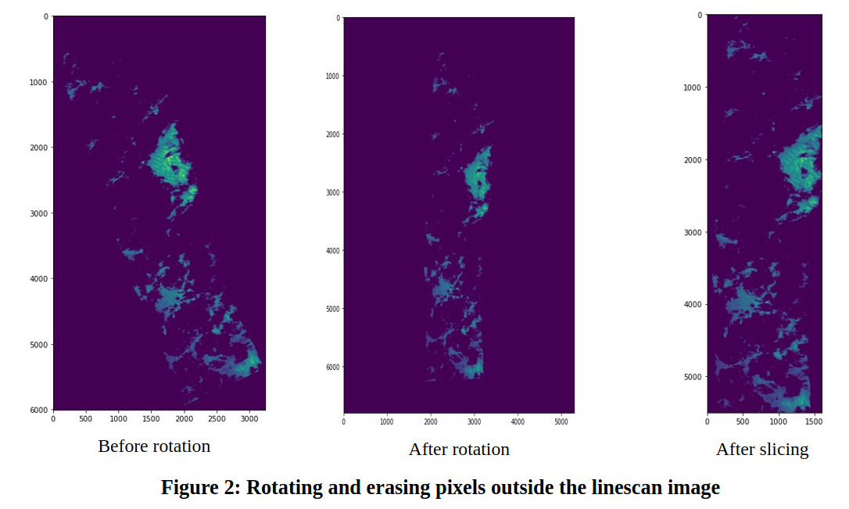
Approach 2 : Feature Engineering
Pixels outside of the linescan image must be cut off.
They can give a false representation of the smoky area if they are included in the dataset
We adopted the rotation-and-cut method to straighten up the frame and cut off the pixels outside the frame
Notes:
The way we did was rotate and cut.
We tested about 51 different angles between 0 and 45 degree and found the best angle to stragithen up the frame.
Then we cut off the pixels outside of the linescan frame and rotated back to retain the coordinate information

Slide 9
Approach 2 : Feature Engineering (Cont.)
We also extracted historical satellite data
Due to wild terrain of the Australian wild forest, we used the NBART colors (red, green, blue, nir, swir_1, and swir_2)
Computed the NDVI and the NMDWI
We finally created 25 binary features indicating whether a given pixel is inside a mask engineered by combinations of various kernelOpen and kernelClose parameters
We transformed the numeric features using the Yeo-Johnson transformation and created quadratic and interaction terms
Lastly, standardized the numeric features
Notes:
In addition to the linescan values, we also extracted 7 numeric features from the historical satellite images of the past 2 years.
25 binanry features were also created. They indicate whether a given pixel is within a mask engineered by a different set of kernelOpen and kernelClose parameters.
Then we transformed the numeric features using the Yeo-Jeonson transformation and created quadratic and interaction terms
Lastly, standardizaed the numeric features

Slide 10
Approach 2 : Models
For the smoky area : the linear SVC with the C value 5
For the clear area : the logistic regression with the C value 100
Parameters and models were selected after the 10-fold cross-validations.
Notes:
The models we found performed steadily and well were the linear SVC with the C parameter 5 for the smoky area
For the clear area, the logistic regression with the C parameter 100 performed stablly and well.
The parameter and the model were chosen after 10 fold cross validation

Slide 11
Conclusion
As fire is affected by various factors, models predicting fire must also be conditional to what we have on our hand
The speed is the key.
Similar to field-artillery, the essence is how fast the first prediction can be made with a reasonable precision level
When no chronologically and geographically relevant data are available, we rely on the classic data mining methods with heavier feature engineering
Smoky and clear area behave differently
Linescan images are not always fit into the rectangular image frame
Notes:
As a conclusion, our primary concern was whether our approach can meet the client's need.
Like the Field Artillary, goal of wild fire managmenet is fast and accurate; the first approach meets their needs when the releavant data are available.
Even if relevant data are not available, we still have a back-up plan, which is also reliable but requires heavier feature engineering.
Thank you for listening to our presentation, and have a nice day.

