Slide 1
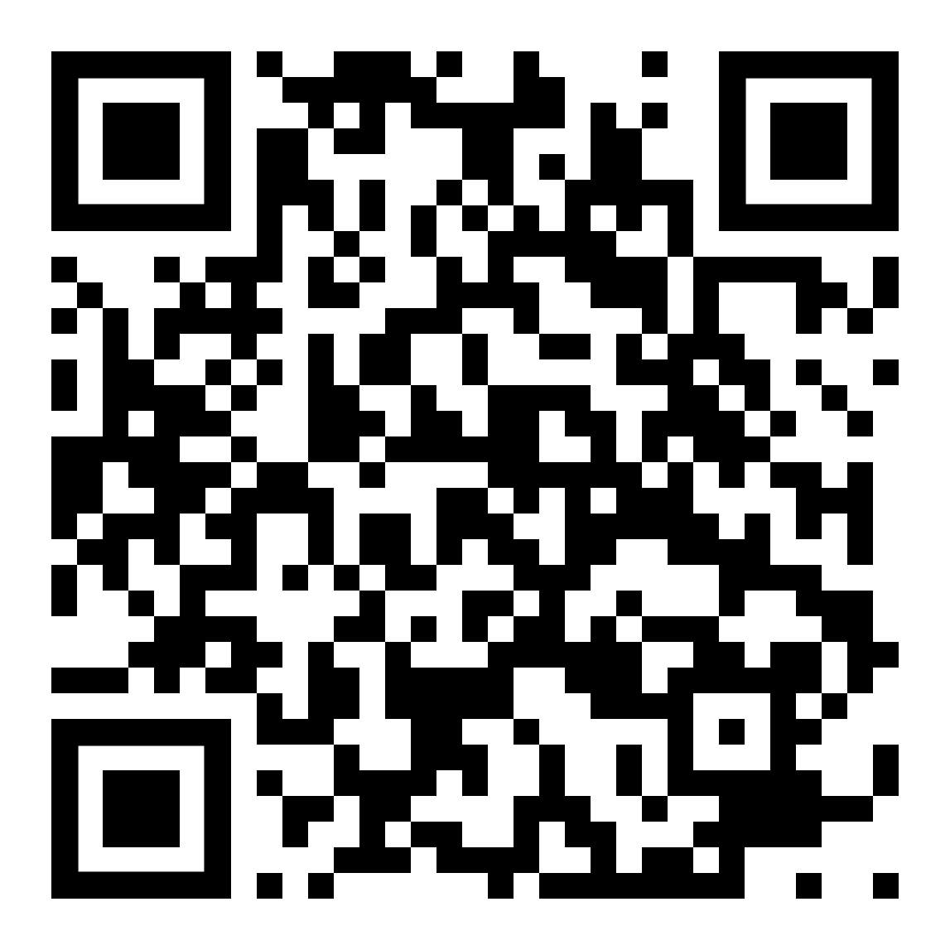
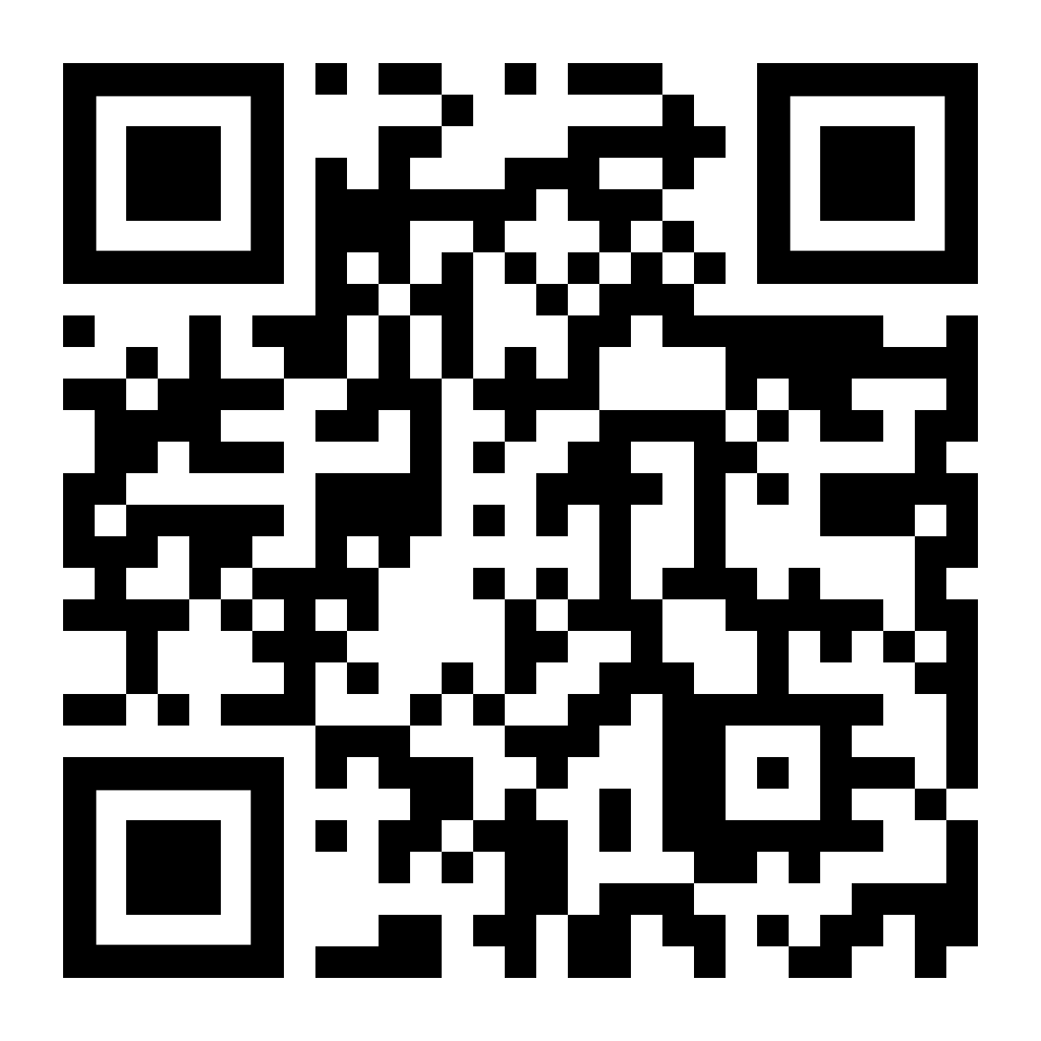
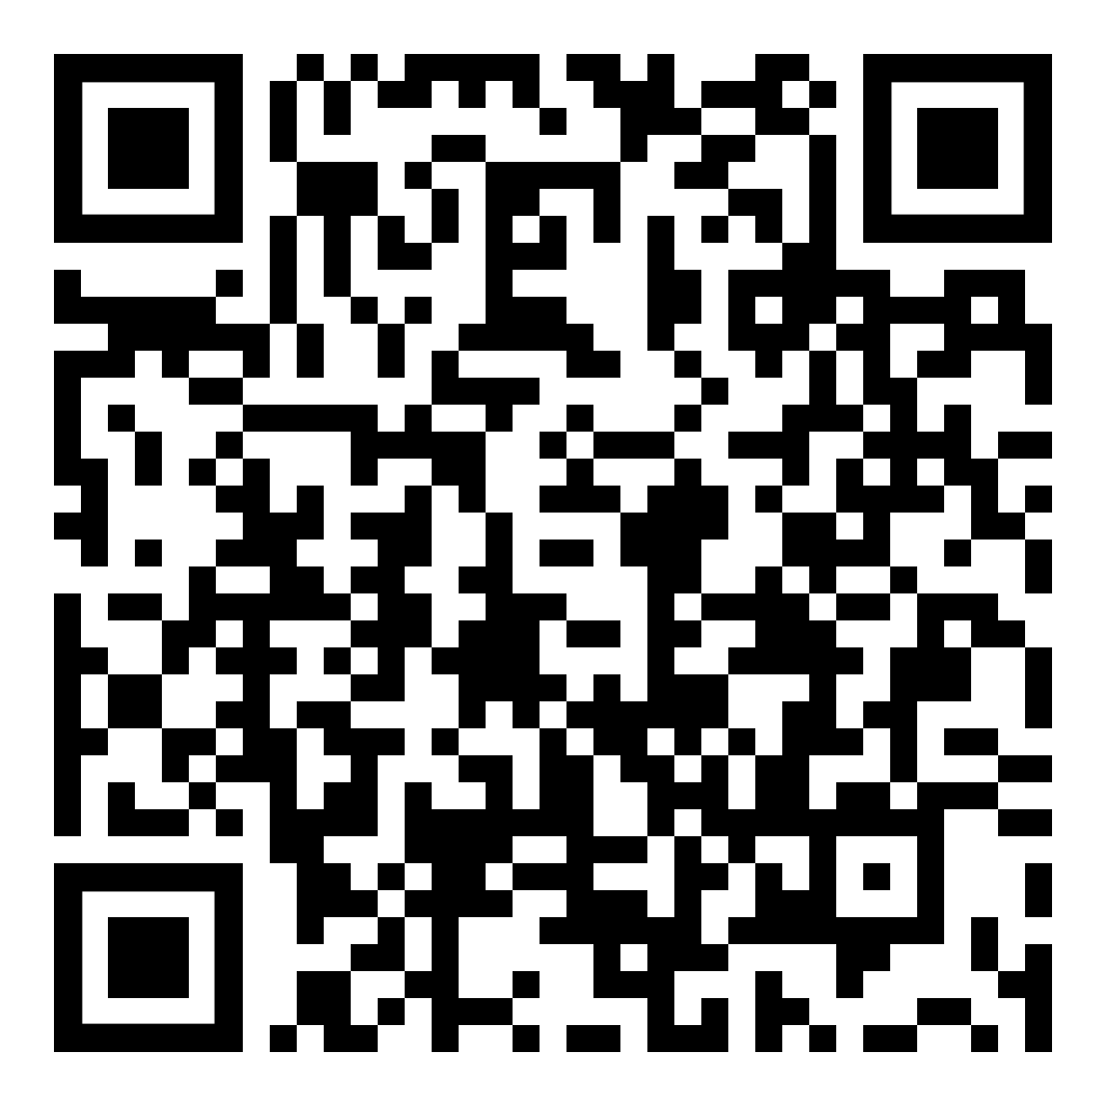
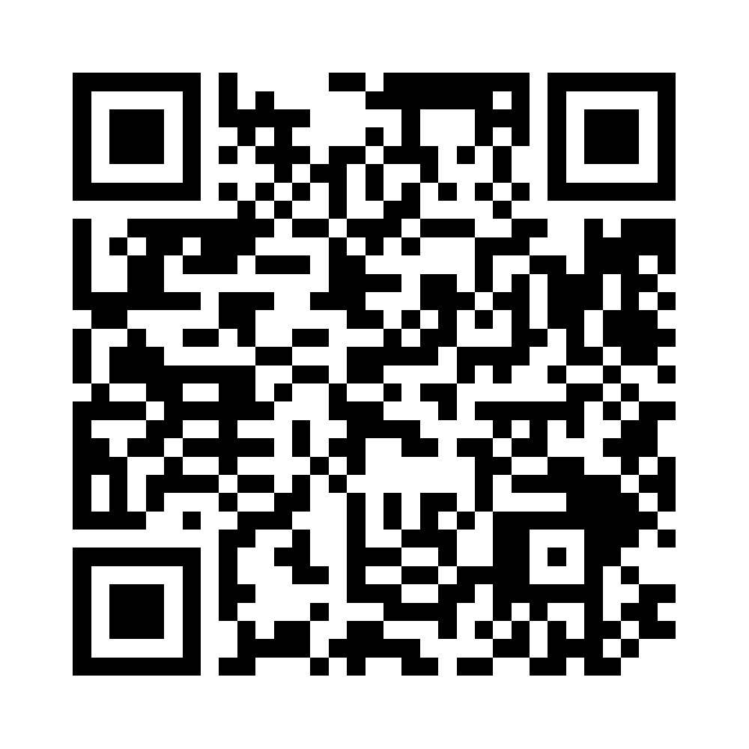
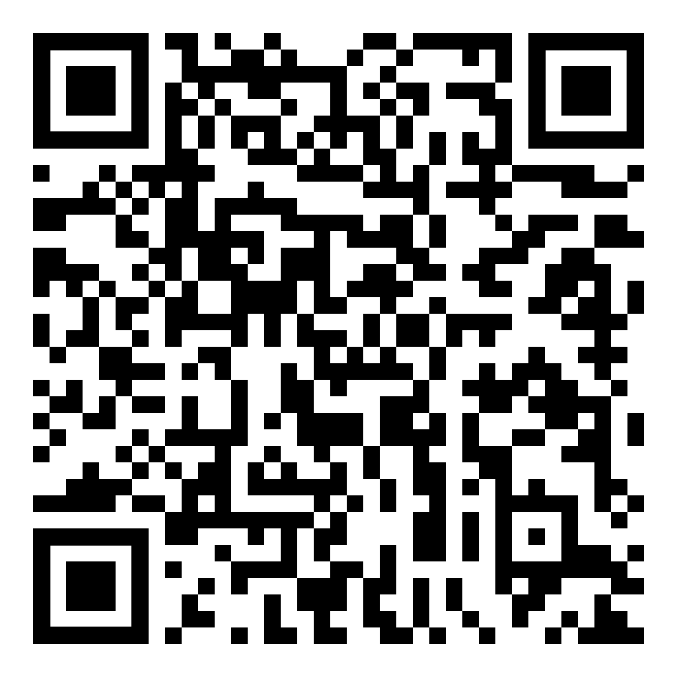
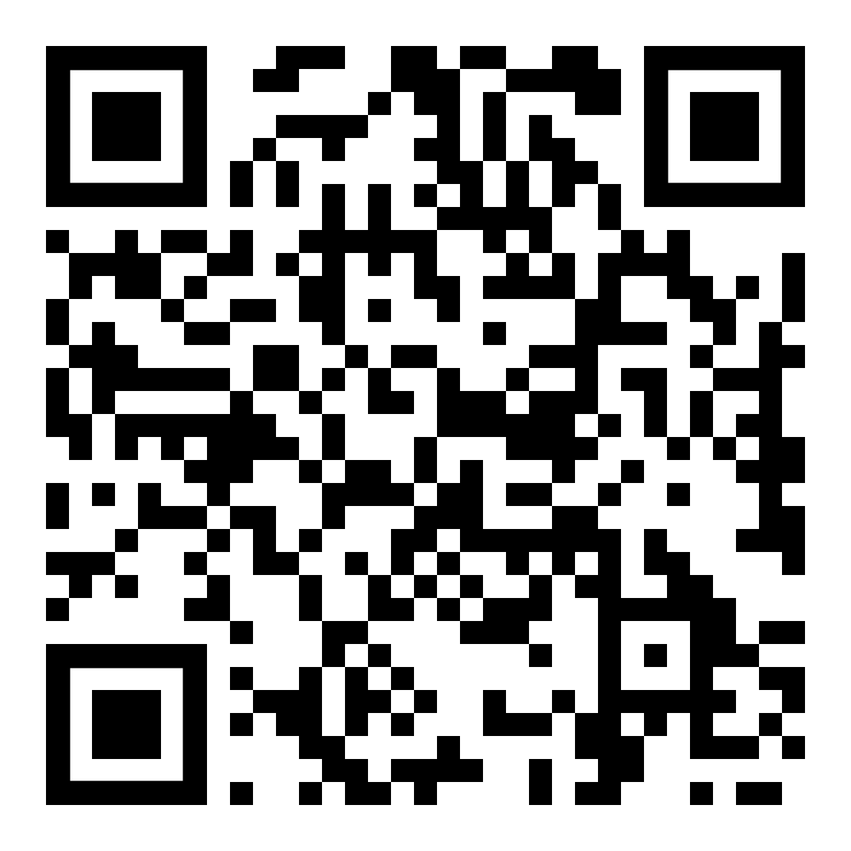
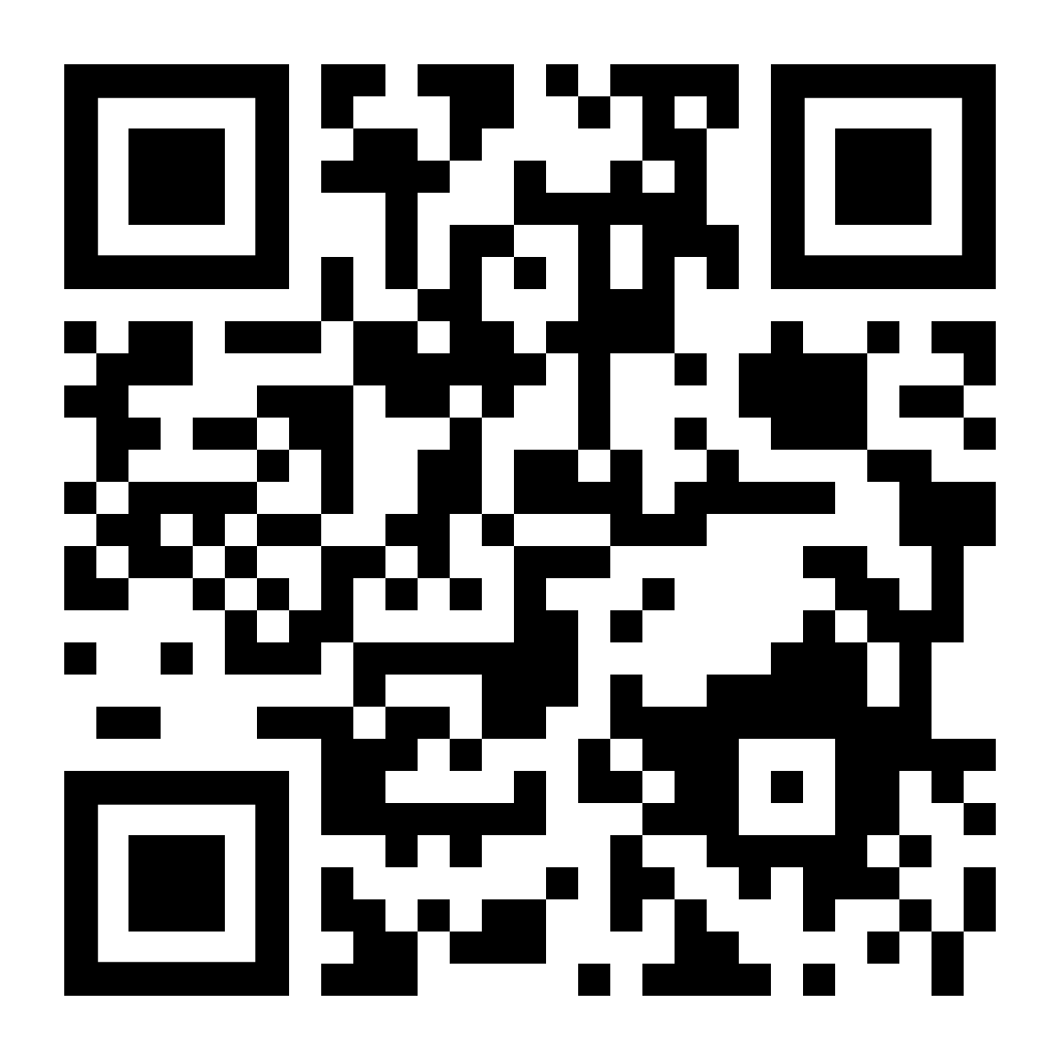
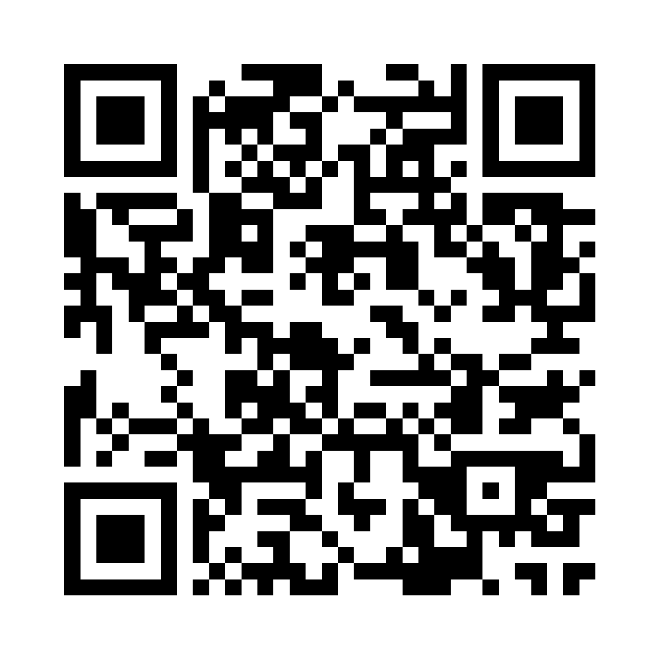
YouTube | Rick Astley - Never Gonna Give You Up
https://www.youtube.com/watch?v=dQw4w9WgXcQ
YouTube Shorts | The cutest video you'll see today 🥹 …
https://www.youtube.com/shorts/wOvTBNDoZMI
https://drive.google.com/file/d/1vKS07_w6Hd2nz-QQg8CNyVdl1FwFkq2g/view (Mystery Video)
Easter Egg: Did you notice the QR code in the intro video?
****************************************
Scan this QR code with Healthy 365 app
By today to earn rewards! T&Cs apply.
Want to earn Healthpoints automatically?
Learn how: https://go.fpg.sg/H365
****************************************
****************************************
Tr:0000
****************************************
Scan this QR code with Healthy 365 app
By today to earn rewards! T&Cs apply.
Want to earn Healthpoints automatically?
Learn how: https://go.fpg.sg/H365
****************************************
****************************************
Tr:0001
****************************************
Scan this QR code with Healthy 365 app
By today to earn rewards! T&Cs apply.
Want to earn Healthpoints automatically?
Learn how: https://go.fpg.sg/H365
****************************************
****************************************
Tr:0010
****************************************
Scan this QR code with Healthy 365 app
By today to earn rewards! T&Cs apply.
Want to earn Healthpoints automatically?
Learn how: https://go.fpg.sg/H365
****************************************
****************************************
Tr:0011
****************************************
Scan this QR code with Healthy 365 app
By today to earn rewards! T&Cs apply.
Want to earn Healthpoints automatically?
Learn how: https://go.fpg.sg/H365
****************************************
****************************************
Tr:0100
****************************************
Scan this QR code with Healthy 365 app
By today to earn rewards! T&Cs apply.
Want to earn Healthpoints automatically?
Learn how: https://go.fpg.sg/H365
****************************************
****************************************
Tr:0101
****************************************
Scan this QR code with Healthy 365 app
By today to earn rewards! T&Cs apply.
Want to earn Healthpoints automatically?
Learn how: https://go.fpg.sg/H365
****************************************
****************************************
Tr:0110
****************************************
Scan this QR code with Healthy 365 app
By today to earn rewards! T&Cs apply.
Want to earn Healthpoints automatically?
Learn how: https://go.fpg.sg/H365
****************************************
****************************************
Tr:0111
https://www.fairprice.com.sg/product/l-blossom-apple-broccoli-puffs-40g-13212834 (Baby Food)
YouTube | The Duck Song
https://www.youtube.com/watch?v=MtN1YnoL46Q
Hourglass Realm Portal
https://bit.ly/er001-hourglass-realm
Easter Egg: What are the transaction numbers representing?

Slide 2
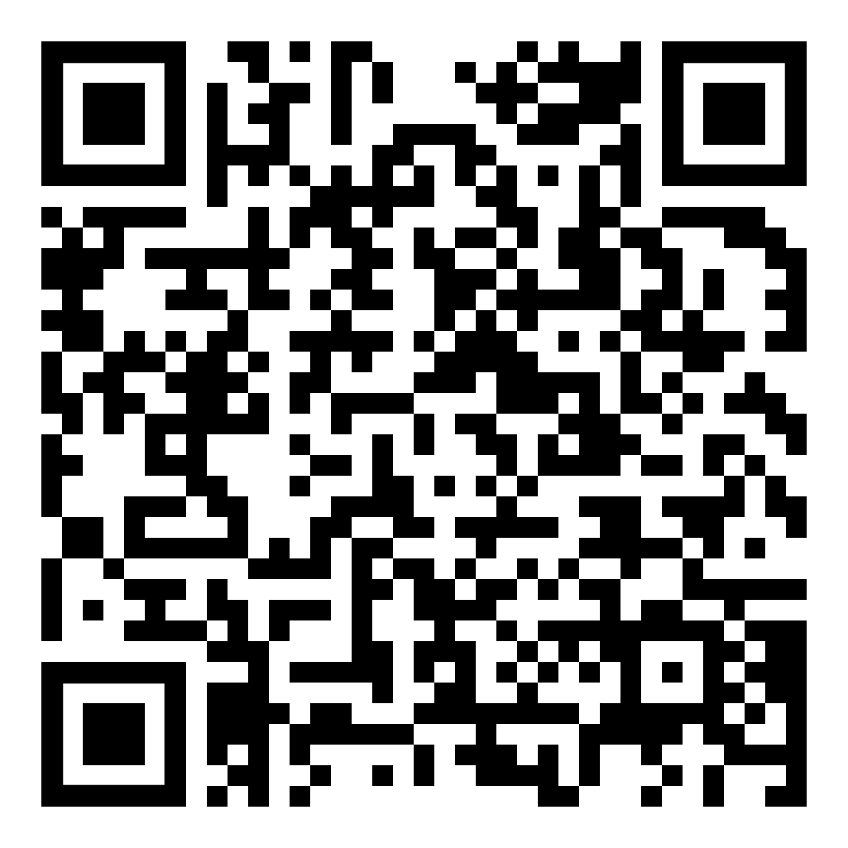
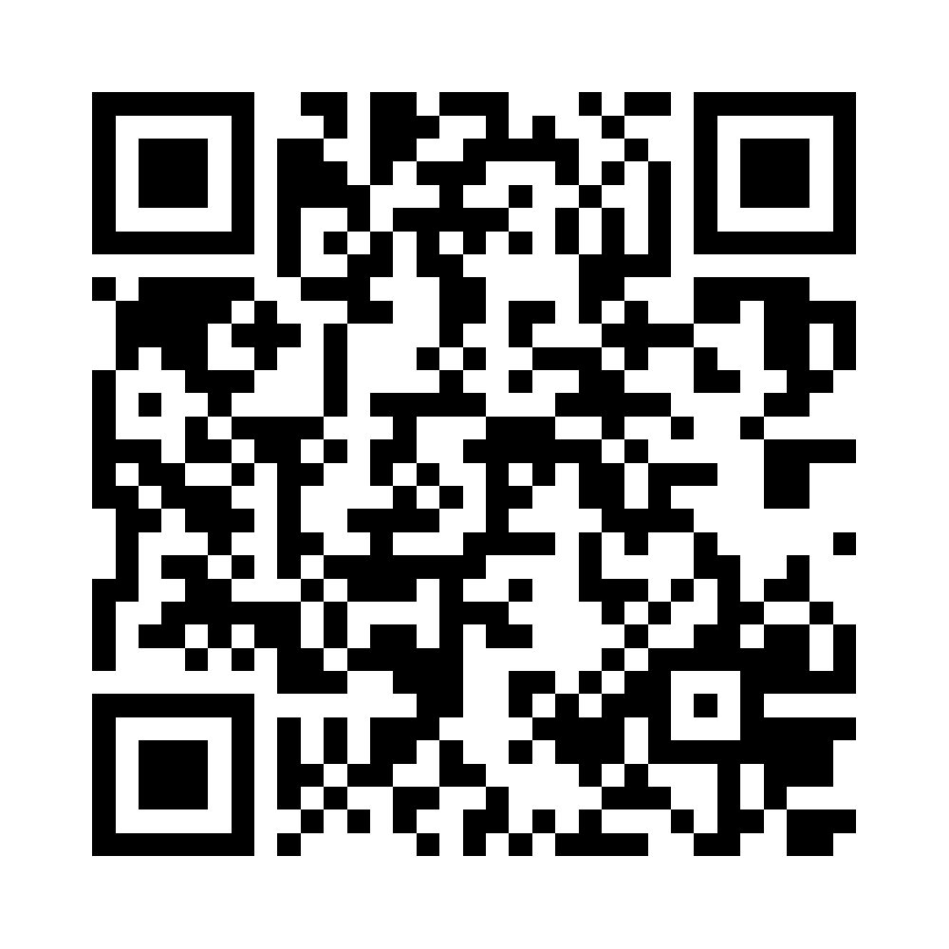
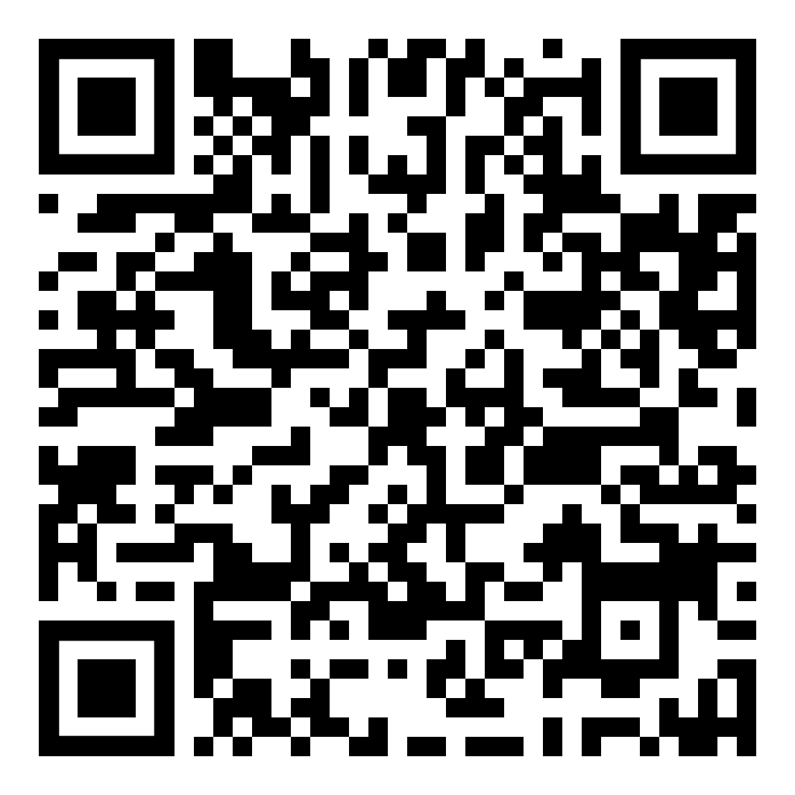
YouTube | Rick Astley - Never Gonna Give You Up
https://www.youtube.com/watch?v=dQw4w9WgXcQ
YouTube Shorts | The cutest video you'll see today 🥹 …
https://www.youtube.com/shorts/wOvTBNDoZMI
https://drive.google.com/file/d/1vKS07_w6Hd2nz-QQg8CNyVdl1FwFkq2g/view (Mystery Video - Lovell Birthday 2023)
https://drive.google.com/file/d/1eAXXHOCy1XzIY62ShH62cPtpeiRtL2Dq/view (Morse Code Translator)
****************************************
Scan this QR code with Healthy 365 app
By today to earn rewards! T&Cs apply.
Want to earn Healthpoints automatically?
Learn how: https://go.fpg.sg/H365
****************************************
****************************************
Tr:1000
****************************************
Scan this QR code with Healthy 365 app
By today to earn rewards! T&Cs apply.
Want to earn Healthpoints automatically?
Learn how: https://go.fpg.sg/H365
****************************************
****************************************
Tr:1001
****************************************
Scan this QR code with Healthy 365 app
By today to earn rewards! T&Cs apply.
Want to earn Healthpoints automatically?
Learn how: https://go.fpg.sg/H365
****************************************
****************************************
Tr:1010
****************************************
Scan this QR code with Healthy 365 app
By today to earn rewards! T&Cs apply.
Want to earn Healthpoints automatically?
Learn how: https://go.fpg.sg/H365
****************************************
****************************************
Tr:1011
****************************************
Scan this QR code with Healthy 365 app
By today to earn rewards! T&Cs apply.
Want to earn Healthpoints automatically?
Learn how: https://go.fpg.sg/H365
****************************************
****************************************
Tr:1100
****************************************
Scan this QR code with Healthy 365 app
By today to earn rewards! T&Cs apply.
Want to earn Healthpoints automatically?
Learn how: https://go.fpg.sg/H365
****************************************
****************************************
Tr:1101
****************************************
Scan this QR code with Healthy 365 app
By today to earn rewards! T&Cs apply.
Want to earn Healthpoints automatically?
Learn how: https://go.fpg.sg/H365
****************************************
****************************************
Tr:1110
****************************************
Scan this QR code with Healthy 365 app
By today to earn rewards! T&Cs apply.
Want to earn Healthpoints automatically?
Learn how: https://go.fpg.sg/H365
****************************************
****************************************
Tr:1111
https://www.fairprice.com.sg/product/l-blossom-apple-broccoli-puffs-40g-13212834 (Baby Food)
YouTube | The Duck Song
https://www.youtube.com/watch?v=MtN1YnoL46Q
The URL shortener bit.ly helps keep things neat!
https://drive.google.com/file/d/10Wr2GA_QF68BL8cG3qCvCHp9AfeZagOX/view (Mystery Sound - Morse Code)

