Slide 1






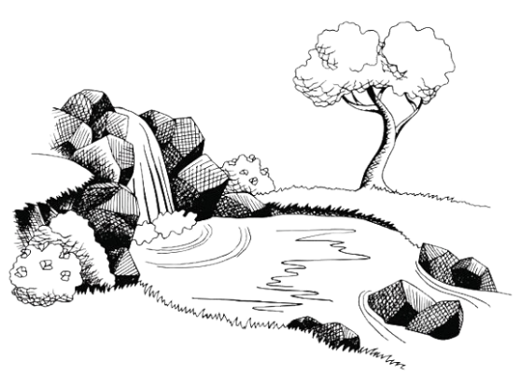

목마름
Dunia dan keinginannya
berlalu begitu sahaja
❌❤️🌍
✅❤️יהוה
Vermin
Matthew 6:19-21
19 “Do not store up for yourselves treasures on earth, where moths and vermin destroy, and where thieves break in and steal. 20 But store up for yourselves treasures in heaven, where moths and vermin do not destroy, and where thieves do not break in and steal. 21 For where your treasure is, there your heart will be also.
John 4:13-14
13 Jesus answered, “Everyone who drinks this water will be thirsty again, 14 but whoever drinks the water I give them will never thirst. Indeed, the water I give them will become in them a spring of water welling up to eternal life.”
1 John 2:15-18
15 Do not love the world or anything in the world. If anyone loves the world, love for the Father is not in them. 16 For everything in the world—the lust of the flesh, the lust of the eyes, and the pride of life—comes not from the Father but from the world. 17 The world and its desires pass away, but whoever does the will of God lives forever.

