Slide 1
Smart Touchless Control with Millimeter-Wave Radar Sensor and Artificial Intelligence
DIP: AY2122s1 - E047
Supervisor: Prof LU YiLong
25 Aug 2021

Slide 2
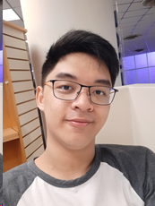
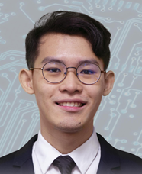

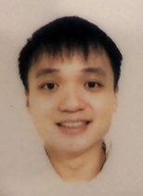
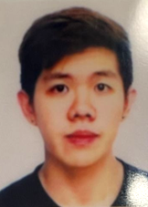
0. Students & Plan
Group Leader: Philip Lee Hann Yung
Treasurer: Thum Yi Wen
Sub-group 1: Acconeer 112
Sub-group 2: Acconeer 122
Photo | photo | photo | photo | photo
PHILIP LEE HANN YUNG | LEE WAI YEONG | THUM YI WEN | TAN WEN HAN DAVIS | GOH JUN DE
PLEE016@e.ntu.edu.sg | WLEE086@e.ntu.edu.sg | THUM0010@e.ntu.edu.sg | DTAN118@e.ntu.edu.sg | JGOH117@e.ntu.edu.sg
94708875 | 81304199 | 84258300 | 83498287 | 90096863

Slide 3
Plan & Schedule
Plan & Schedule
Tasks | Week
 | 1 | 2 | 3 | 4 | 5 | 6 | 7 | 8 | 9 | 10 | 11 | 12 | 13
Background information and theory
Purchasing radar sensor and Rasbery Pi
Sample radar signal/data processing in Matlab
Sample ML processing in Matlab
Radar signal/data processing in Rasbery Pi
ML processing in Rasbery Pi
Integration and Testing

Slide 4
Week 1 Updates
Nomination of the Group Leader and Treasurer. The subgroups will be discussed further when we meet up next week.
Familiarize ourselves with the material that Prof Lu has kindly provided us including but not limited to MATLAB, Python on Raspberry Pi, STFT and Chloe’s FYP report.
Research about the Acconeer radar sensor and Raspberry Pi and place an order by Week 3/2 latest.

Slide 5
Week 2 Updates
Completed the lab safety modules and then discussed the devices to buy – eventually settling for XB112 & XB122 Acconeer Radar Sensor modules, Raspberry Pi 3 Model B+ and 4 Model B 8 GB RAM, 64 GB micro SD card, and some cables/wires for the devices.
The sample codes were also shared and we learned how to use GitHub to share our files with the whole team.
Prof Lu provided us with an Acconeer XB112 Module to experiment with.
Within the week, we placed the orders and hope that the hardware will arrive by our next meeting. We also plan to have a look at the SDK provided by Acconeer to explore the features of the sensor.

Slide 6
Week 3: Received Ordered Items
Received orders #1 to #5
Supplier | Product | Uni Price | Quantity | Cost | Receipt Total | Order
Digi-key | Acconeer XM112 | 94.13 | 1 | 94.13
 | Acconeer XB112 | 105.84 | 1 | 105.84 | 199.97 | 1
Digi-key | Acconeer XM122 | 49.8 | 1 | 49.80
 | Acconeer XB122 | 136.38 | 1 | 136.38
 | Acconeer XA122 | 23.88 | 1 | 23.88 | 210.06 | 2
Cytron | Rasberry Pi 4B (8GB) | 119.99 | 1 | 119.99 | 119.99 | 3
Cytron | Rasberry Pi 3B+ | 57.86 | 1 | 57.86
 | Raspberry Pi Universal Power Supply 5.1V 2.5A micro B | 16.07 | 1 | 16.07
 | Rpi 15W (5V/3A) PSU USB C UK Plug-White USB c | 12.5 | 1 | 12.50 | 86.43 | 4
Shopee | 64GB microSD card | 18.9 | 2 | 37.80 | 37.80 | 5
 |  |  | Total | 654.25

Slide 7
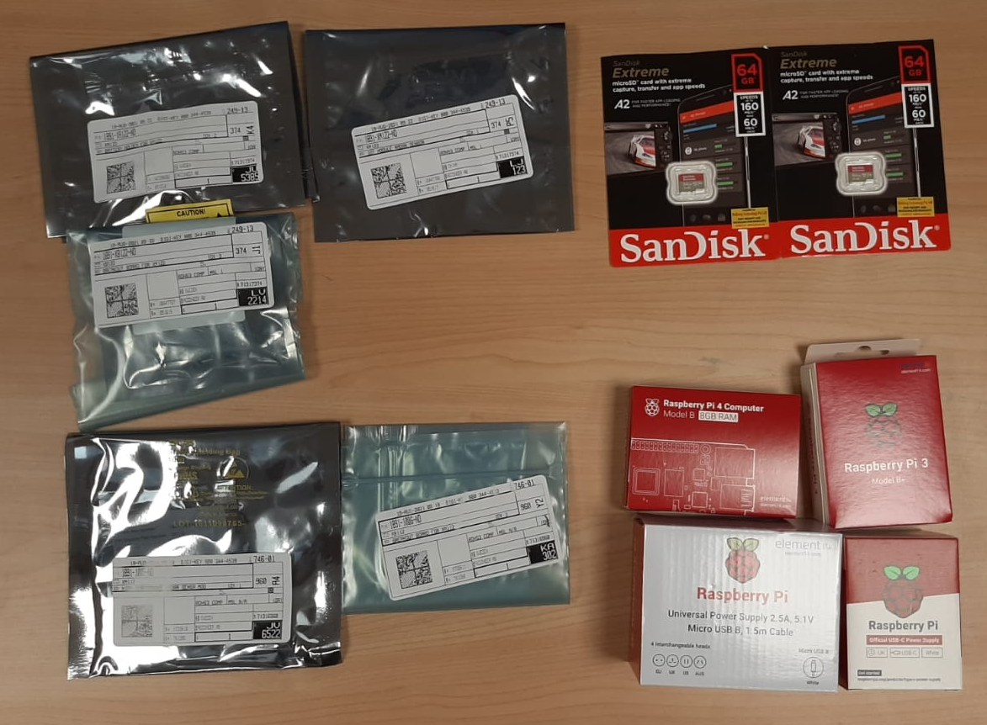
Week 3 Updates

Slide 8
Week 3 Updates
Reading and downloading documentation for the sensors found at https://acconeer-python-exploration.readthedocs.io/en/latest/index.html and the Acconeer developer site.
Before using the sensors, we need to flash a binary file onto the device. During the configuration, we found that only 1 of our member’s laptop was able to interface with the devices and we spent most of the time debugging this.
In the end, it was because we had to install a virtual COM driver so that the radar sensor will be recognized as a serial UART.
Experimenting with the demo application to see the potential use cases and limitations of the radar sensor.
Explore the data that can be collected by the sensor via the h5 file format.

Slide 9
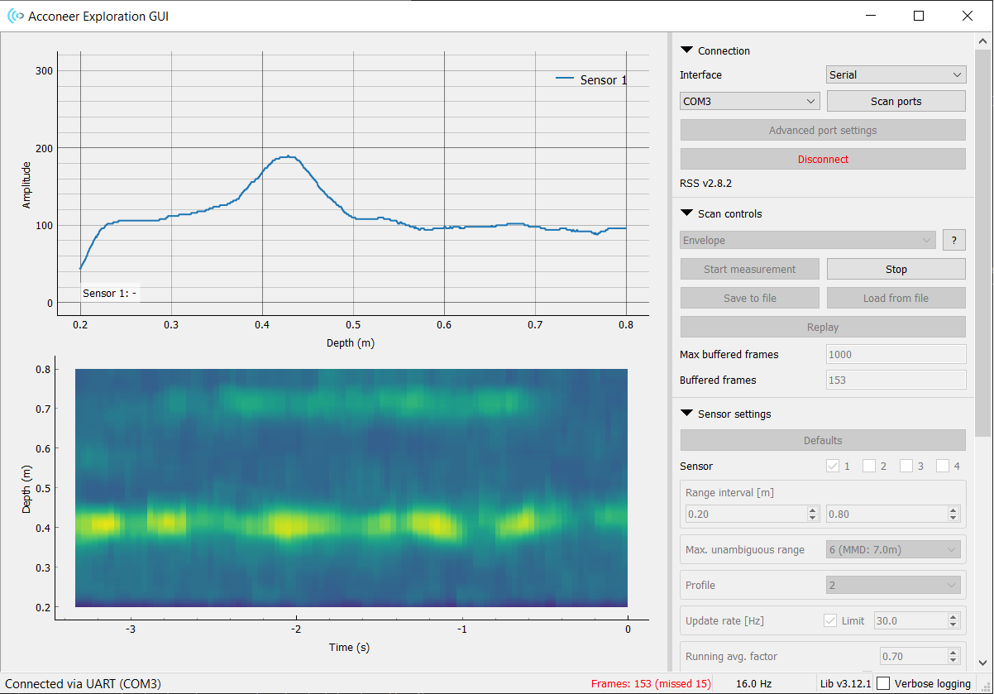
Week 3 Updates

Slide 10
Week 4 Updates
Items we learned/achieved today:
IQ mode: In-phase and quadrature data has the most information so we should extract this as raw data to be processed in MATLAB/Python.
Recorded background data at fixed target distances (wall) of 0.5, 1.0, 1.5, 2.0 m.
To do this week:
Purchase container for sensors (Jun De)
Make a script for h5 reading and STFT to generate signatures in Python (Philip)
Gather sample hand gestures eg. 5 x 3 different gestures and perform STFT to compare results
Read Chloe’s FYP report so we are clear about the theory
Watch https://www.youtube.com/watch?v=0xROkVQ1XWQ or https://www.autosofdallas.com/blog/learn-how-to-use-the-bmw-5-series-gesture-control-feature/ for inspiration for possible hand gestures

Slide 11
Week 4 Updates
Finalized pipeline:
Collect radar sensor data (IQ mode) and export it as h5 file
Parameters: frames 128/256, rate: 30Hz
Process extracted h5 files via Python (code converted from MATLAB)
Perform STFT on processed h5 file and export as png as a signature
Intuition of RGB compressed into a grayscale image
RGB equivalent to depth
Window Size
Image file (png file format) is a numpy array of shape 2
Png file feed into ML Model to perform object classification via sklearn
Implement into Raspberry Pi and integrate into workable product ie volume control, switching on/off

Slide 12
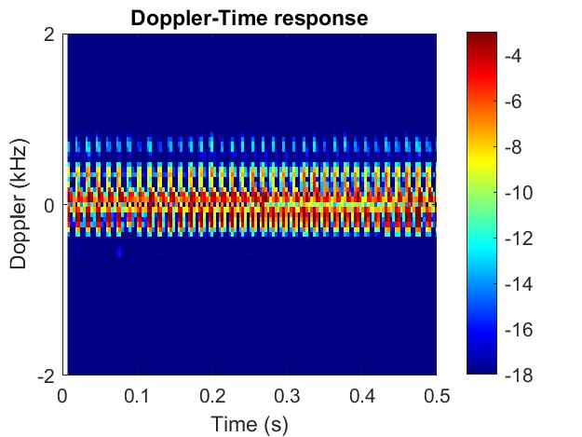
Week 5 Updates
Examined the MATLAB script to see what features does it extract, and started conversion to Python (except one function which has an error).
Obtained data samples to see differences in STFT signatures.
Packaged the sensor hardware into a container for safekeeping.

Slide 13
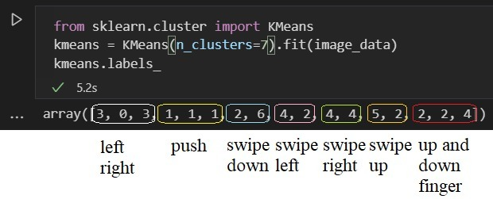
Week 6 Updates
We had gathered some images based on the gestures such as pushing, swiping left, swiping right, swiping left and right, swipe up, swipe down and switching. Based on those data gathered alongside with the help of machine learning we observed that swiping left and right could not be differentiated.

Slide 14
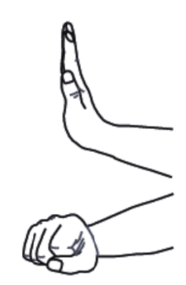
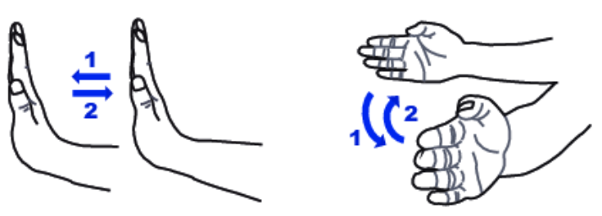
Week 6 Updates
Our team has done some testing on the gestures and had finalized 3 gestures, namely, (i) swiping, (ii) pushing and (iii) opening/closing palm
We are also working on a Python script to implement the pipeline we mentioned. And for systematic and semi-automated data collection for gestures (to prepare for ML pipeline)

Slide 15
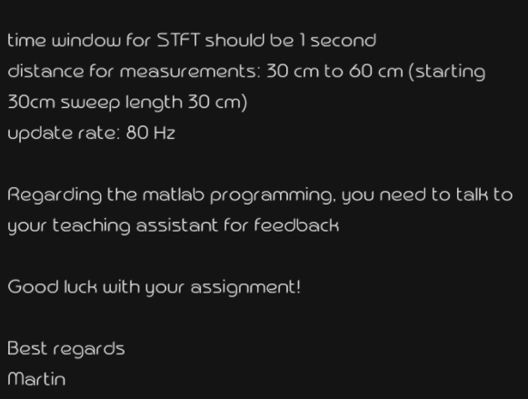
Week 6 Updates
We have asked the relevant department from Acconeer and they had responded the following. We would like to inquire based on the following data that was given on their end, the update rate could be manually tuned on the GUI, but specifically for the time window segment for the STFT where should we change the time window to 1 second.

Slide 16
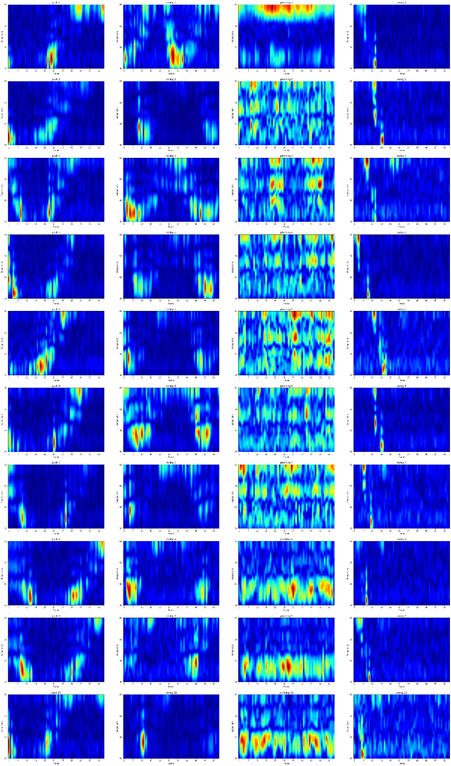
Week 7 Updates
We have finalized the gestures that we will collect after discussing with Prof Lu. A preview of the magnitude plots is on the right, which gives a good indication of whether our data collected is good.
We discovered there were some alignment issues so we made a data sampler tool to help this process (see section 2).

Slide 17
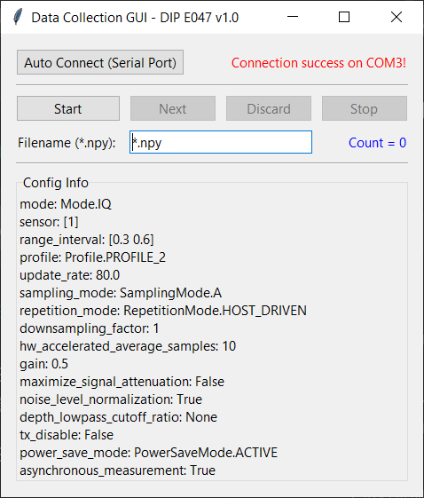
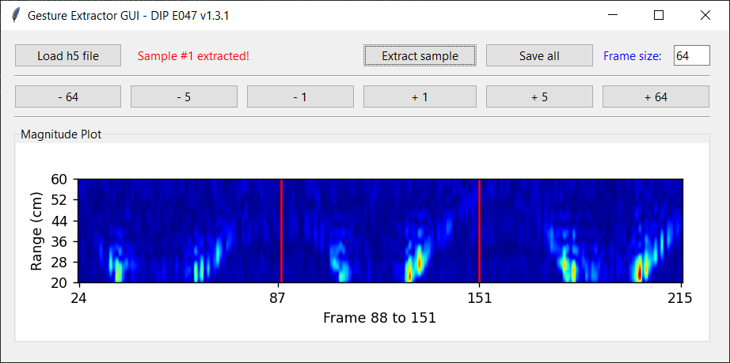
Week 7 Updates
We made a customized Graphical User Interface (GUI) for radar data collection (left) and for gesture extractor (right)
(left) Radar data collection
(right) Gesture extractor

Slide 18
Week 7 Updates
The GUI for gesture extractor loads in a h5 file and enables the user to extract frames containing gestures with a preview from the magnitude plot and by specifying the width and position of each frame.
gui-dip-demo/gesture_extractor_gui.py is a Python script developed to automate the process of extracting gesture samples from a continuous recording obtained from the GUI tool provided by Acconeer. This fixes the alignment issue faced when recording one sample at a time.
The tool saves extracted samples in .npz format with the intention of a small file size. To read data from these new files, please use np.load('filename-000.npz')['sample'], where filename is a placeholder.
For ease of running the tool, an alternative Windows executable file gui-dip-demo/gesture_extractor_gui_v1.3.2.exe is available too.

Slide 19
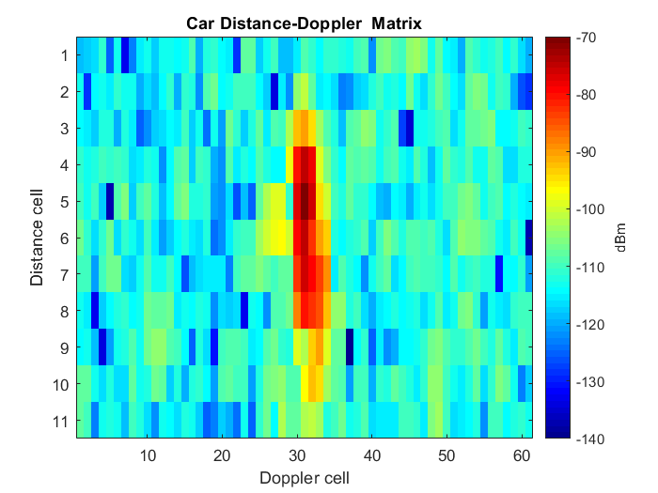
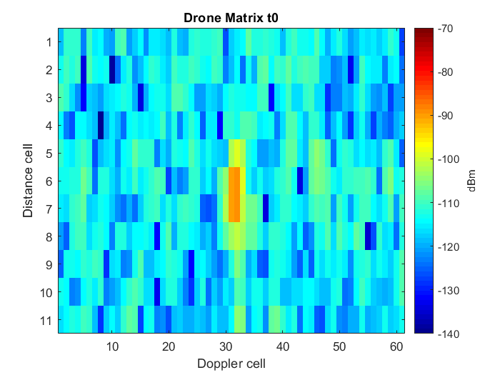
Recess Week Updates
We used a mock radar dataset of cars/drones/people (https://www.kaggle.com/iroldan/real-doppler-raddar-database) to test our machine learning pipeline when we didn’t have enough data.
The diagrams below show examples of Doppler matrices of the mock dataset to be fed into the models.

Slide 20
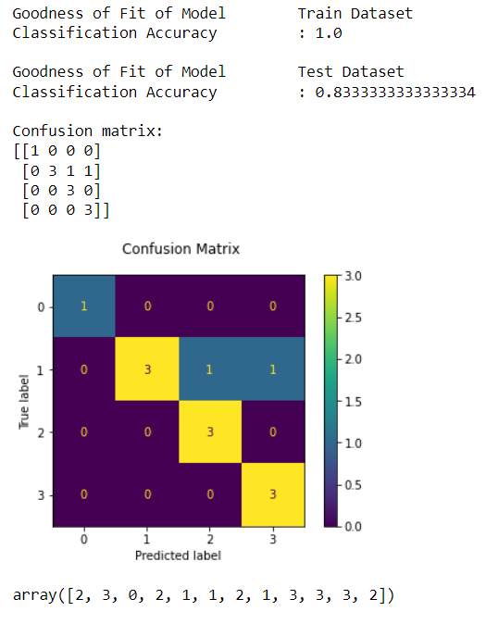
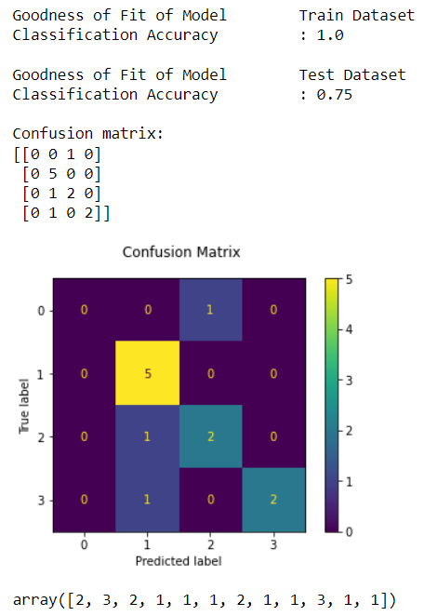
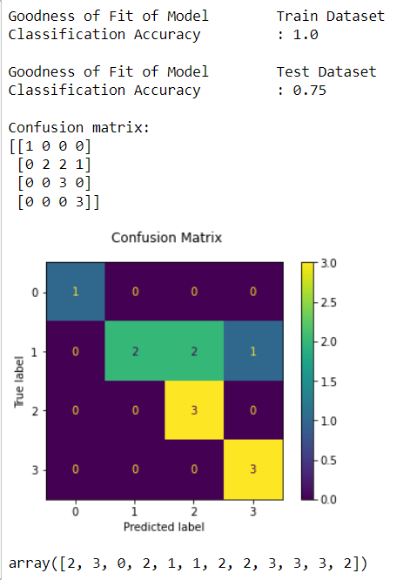
Recess Week updates
We then implemented the pipeline using our own dataset based on the collected radar data, with a train-test-split ratio of 0.7.
The dataset size consists of 40 magnitude plots of four gestures (10 plots each) (i) pushing, (ii) rolling forward, (iii) pinching, and (iv) swipe left to run some machine learning models such as KNN, linearSVM, logistic regression etc to find out the best model performance.
We found that linear SVM, decision tree and logistic regression model can show good classification results on our radar dataset. Improvement will be done in the subsequent meeting.
(i) LinearSVM model
(ii) Decision Tree model
(iii) Logistic Regression model

Slide 21
Week 8 Updates
Data Collection
During the process of data collection, We had finalised the range interval to be 0.2m-0.5m. The range was chosen as such is because it can detect proper peaks
During the process, we had tried various different parameters namely adjusting the followings.
Smoothing factor ( 0.9 )
Downsampling factor.
HW acceleration average samples.
One key observation made during the data collection, When the gesture tend to be rapid, the sensor was not able to pick up any peaks, hence we have to slow down our hand gesture in order for the radar to peak up sensible data.

Slide 22
Week 9 Updates
Data Collection
Collected more gesture samples from all members due to insufficient data for the machine learning to detect many other different forms of abnormality/ non-ideal case (e.g. direction of swiping, hand size etc.).
Gathered background data as well for the purpose of better supervision of the learning and not detect any form of gesture when it is not performed.
After many observations from the GUI, the depth of rolling and pushing gestures is very much similar to one another, hence rolling will be removed and pushing will still be one of our primarily gesture.
Raspberry Pi
Managed to connect the RPi to Acconeer radar sensor and display it via VNC Viewer.
RPi3B+ operates using a Static IP address while RPi4 operates via a router
Installed python package dependencies (e.g., tensorflow, opencv, numpy) using pip3.

Slide 23
Week 9 Updates
Issues faced
Librosa/numpy cannot be installed in the raspberry pi model 3B+.
Solution
We decided to use Conda which caused a massive destruction and changed the environment path variables.
We needed to temporarily add the correct system path to obtain sudo command privileges, and go into the bashrc file and modify the path variables to uninstall conda from the Raspberry Pi

Slide 24
Week 10 Updates
Data Collection
To be filled
Raspberry Pi
Managed to run the real-time python code on Raspberry Pi
User Interface
Pitched up some ideas on the User Interface for DIP presentation, which include
Whiteboard
Directory
Games

