Slide 1
Smart Touchless Control with Millimeter-Wave Radar Sensor and Artificial Intelligence
DIP: AY2122s1 - E047
Supervisor: Prof LU YiLong
25 Aug 2021

Slide 2

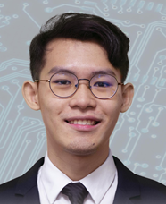
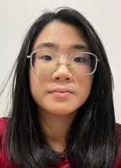
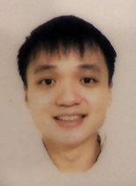
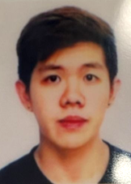
0. Students & Plan
Group Leader: Philip Lee Hann Yung
Treasurer: Thum Yi Wen
Sub-group 1: Acconeer 112
Sub-group 2: Acconeer 122
Photo | photo | photo | photo | photo
PHILIP LEE HANN YUNG | LEE WAI YEONG | THUM YI WEN | TAN WEN HAN DAVIS | GOH JUN DE
PLEE016@e.ntu.edu.sg | WLEE086@e.ntu.edu.sg | THUM0010@e.ntu.edu.sg | DTAN118@e.ntu.edu.sg | JGOH117@e.ntu.edu.sg
94708875 | 81304199 | 84258300 | 83498287 | 90096863

Slide 3
Plan & Schedule
Plan & Schedule
Tasks | Week
 | 1 | 2 | 3 | 4 | 5 | 6 | 7 | 8 | 9 | 10 | 11 | 12 | 13
Background information and theory
Purchasing radar sensor and Rasbery Pi
Sample radar signal/data processing in Matlab
Sample ML processing in Matlab
Radar signal/data processing in Rasbery Pi
ML processing in Rasbery Pi
Integration and Testing

Slide 4
Week 3: Received Ordered Items
Received orders #1 to #5
Supplier | Product | Uni Price | Quantity | Cost | Receipt Total | Order
Digi-key | Acconeer XM112 | 94.13 | 1 | 94.13
 | Acconeer XB112 | 105.84 | 1 | 105.84 | 199.97 | 1
Digi-key | Acconeer XM122 | 49.8 | 1 | 49.80
 | Acconeer XB122 | 136.38 | 1 | 136.38
 | Acconeer XA122 | 23.88 | 1 | 23.88 | 210.06 | 2
Cytron | Rasberry Pi 4B (8GB) | 119.99 | 1 | 119.99 | 119.99 | 3
Cytron | Rasberry Pi 3B+ | 57.86 | 1 | 57.86
 | Raspberry Pi Universal Power Supply 5.1V 2.5A micro B | 16.07 | 1 | 16.07
 | Rpi 15W (5V/3A) PSU USB C UK Plug-White USB c | 12.5 | 1 | 12.50 | 86.43 | 4
Shopee | 64GB microSD card | 18.9 | 2 | 37.80 | 37.80 | 5
 |  |  | Total | 654.25

Slide 5
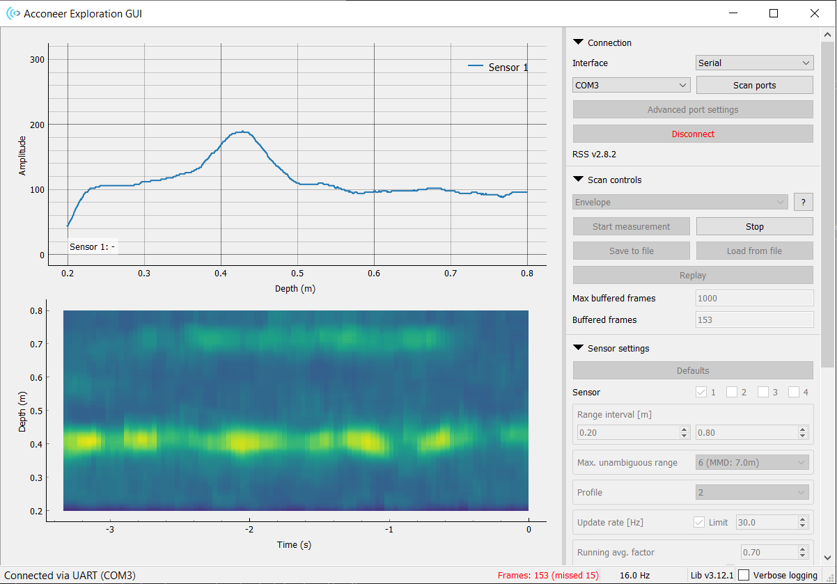
Testing XM112/XB112 ?
We managed to get the demo working after a long troubleshooting session

Slide 6
Testing XM122/XA122/XB122 ?
?

Slide 7
Problems / Questions

