Slide 1
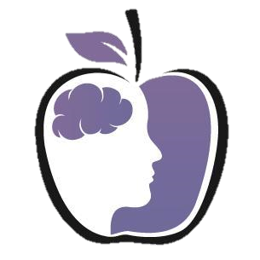


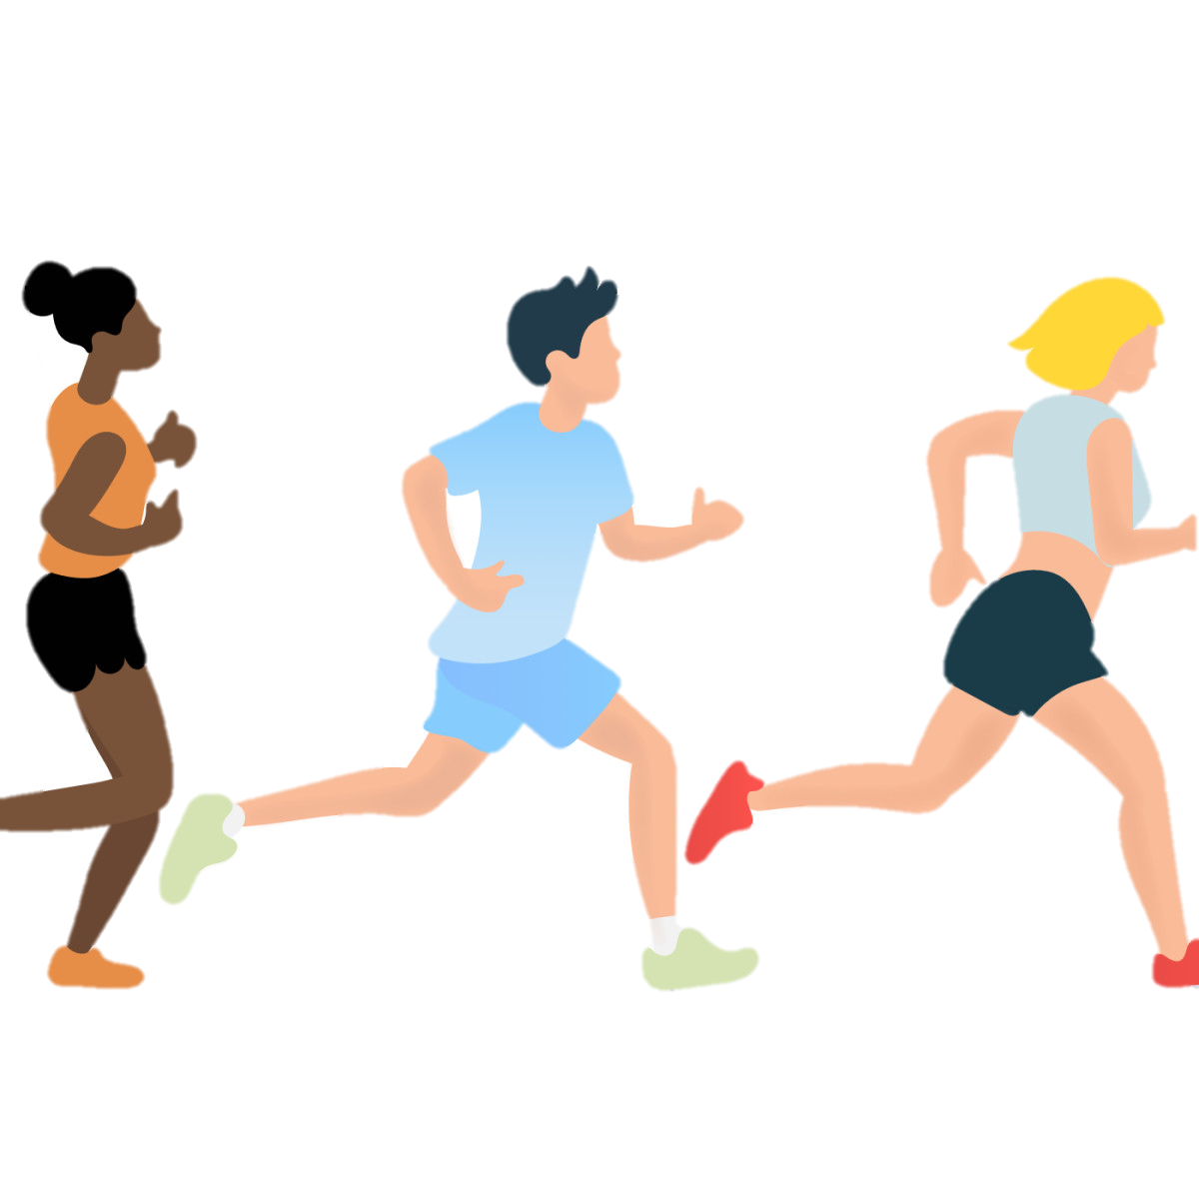

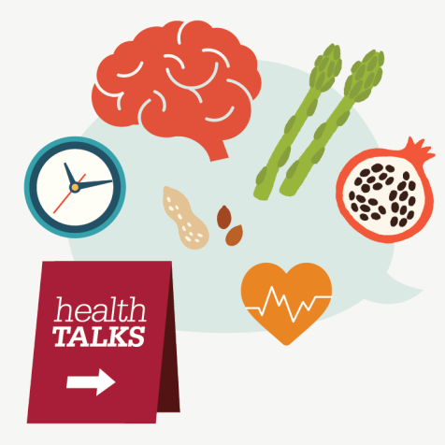




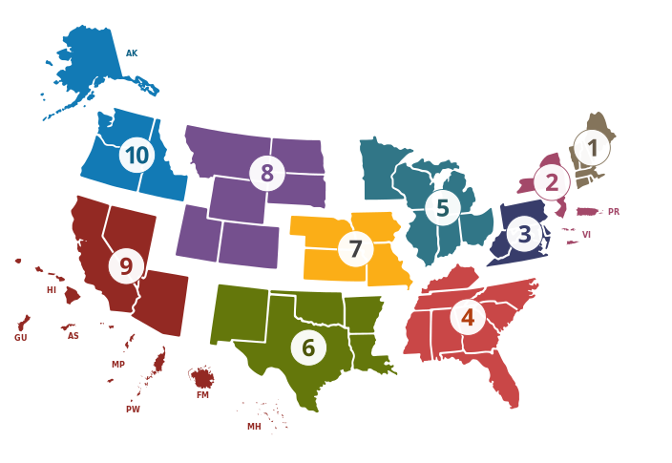




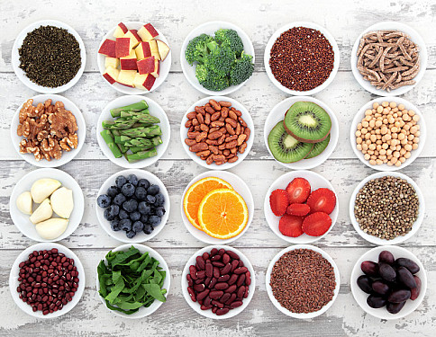
Preventing eating disorders: Educating about early intervention, fostering healthy relationships with food, and promoting body positivity.
Preventing eating disorders involves early intervention education, fostering healthy relationships with food, and promoting body positivity. These strategies aim to raise awareness of warning signs and risks, develop healthier attitudes towards food and bodies, and create a supportive environment. By prioritizing mental health and embracing balanced approaches, we can cultivate a society that values well-being and empowers individuals to maintain positive relationships with food and their bodies.
The National Eating Disorder Association (NEDA)
Stanford Center for Health Education: Anorexia: 5 Common Myths Busted by an Eating Disorder Expert
NEDA is one of the largest nonprofit organizations dedicated to supporting individuals and families affected by eating disorders. This website provides multiple services like Support Groups & Research Studies, Get Screened for an Eating Disorder, Awareness Week, NEDA Walks, etc. For more information click the link below!
The Stanford Center for Health Education (SCHE) designs and delivers online education experiences. They extend health education to a global network of health professionals, individuals, and communities, creating a more informed public and improving health outcomes. One on the topic they addressed are the common myths and misconception about Anorexia. To learn more, click the link below!
Want to see more?
https://www.nationaleatingdisorders.org/about-us/our-work.
https://healtheducation.stanford.edu/
or www.youtube.com/watch?v=rFTwuYN9Wa8
The Office on Women's Health (OASH)
The Office on Women's Health, which is part of the U.S. Department of Health and Human Services, has a comprehensive website that addresses various aspects of preventing eating disorders, promoting healthy relationships with food, and body positivity. The website provides evidence-based information, resources, and tools for individuals, families, and healthcare professionals. You can access the website at:
https://www.womenshealth.gov/mental-health/mental-health-conditions/eating-disorders
The National Institute of Mental Health (NIMH)
Reference
1. Healing the Hidden Wounds: Understanding the Intersection of Eating Disorders and PTSD. National Eating Disorders Association. June 12, 2023. Accessed July 4, 2023. https://www.nationaleatingdisorders.org/blog/healing-hidden-wounds-understanding-intersection-eating-disorders-and-ptsd.
2. Anorexia: 5 Common Myths Busted by an Eating Disorder Expert | Stanford. YouTube; 2022. Accessed July 4, 2023. https://www.youtube.com/watch?v=rFTwuYN9Wa8.
3. Eating disorders. Eating disorders | Office on Women’s Health. Accessed July 4, 2023. https://www.womenshealth.gov/mental-health/mental-health-conditions/eating-disorders.
4. L.L.C. RW. Rise up + recover: An eating disorder monitoring and management tool for anorexia, bulimia, binge eating, and ednos. App Store. February 19, 2013. Accessed July 4, 2023. https://apps.apple.com/us/app/rise-up-recover-an-eating-disorder-monitoring/id509287014.
5. Eating disorders. National Institute of Mental Health. Accessed July 4, 2023. https://www.nimh.nih.gov/health/topics/eating-disorders.
Rise Up + Recover: An Eating Disorder Monitoring and Management Tool for Anorexia, Bulimia, Binge Eating, and EDNOS
The National Institute of Mental Health (NIMH), a part of the U.S. Department of Health and Human Services, has a dedicated section on their website that provides in-depth information on eating disorders. This section offers resources, research updates, and educational materials about various types of eating disorders, their symptoms, risk factors, treatment options, and prevention strategies. You can access the NIMH's website section on eating disorders at:
This app, available for both iOS and Android devices, offers support for individuals in eating disorder recovery or seeking to develop a healthier relationship with food and their bodies. It includes features such as meal tracking, journaling, coping skills, motivational messages, and connection to a supportive community. The app aims to promote self-care, mindfulness, and positive body image.
https://www.nimh.nih.gov/health/topics/eating-disorders
https://apps.apple.com/us/app/rise-up-recover-an-eating-disorder-monitoring/id509287014

