Slide 1
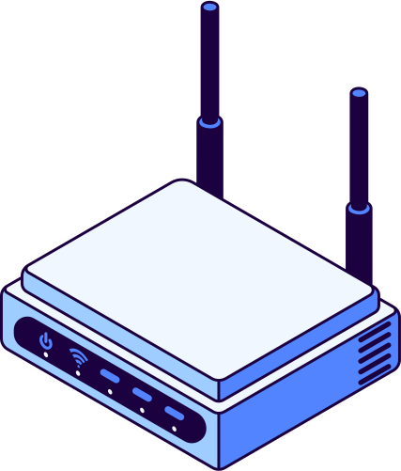
Configuring Wireless Security Settings to Secure Your Network
Securing a wireless network is essential to protect sensitive data and prevent unauthorized access. Here’s a detailed guide on how to configure wireless security settings effectively.
1. Change Default SSID and Password
SSID: The Service Set Identifier (SSID) is the name of your Wi-Fi network. Change it from the default to something unique but avoid using personal information.
Password: Use a strong password with a mix of letters, numbers, and special characters. Avoid common phrases or easily guessable information.
2. Enable WPA3 Encryption
Encryption Protocol: Use WPA3 (Wi-Fi Protected Access 3), the latest and most secure encryption protocol. If your router doesn’t support WPA3, WPA2 is the next best option. Avoid WEP and WPA, as they are outdated and vulnerable.
How to Set: Navigate to the wireless security settings on your router’s admin page and select WPA3 or WPA2 under the security options.
3. Disable WPS (Wi-Fi Protected Setup)
Why: WPS is known for its vulnerabilities and can be exploited by attackers to gain access to your network.
How to Disable: Find the WPS settings on your router’s admin page and disable it.

Slide 2

4. Use a Guest Network
Purpose: Isolate guest devices from your main network to limit access to sensitive information.
Configuration: Enable the guest network feature and set a different SSID and strong password for it. Ensure that guests cannot access your main network.
5. Enable MAC Address Filtering
MAC Filtering: Allows only specific devices to connect to your network by adding their MAC addresses to a whitelist.
How to Configure: Find the MAC filtering option in your router settings, enable it, and add the MAC addresses of your trusted devices.
6. Reduce Wi-Fi Range
Purpose: Limit the physical range of your wireless signal to prevent unauthorized access from outside your premises.
How to Adjust: Decrease the transmission power in your router’s advanced wireless settings.

Slide 3
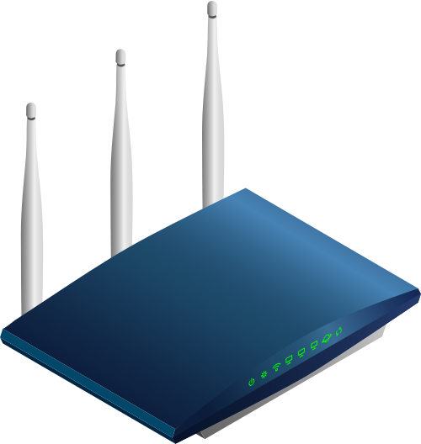
8. Use a Strong Admin Password
Why: Prevent unauthorized access to your router’s configuration settings.
How to Set: Change the default admin password to a strong, unique password.
SSID: MySecureNetwork
Password: aStrongP@ssw0rd!
Security Mode: WPA3-Personal
WPS: Disabled
Guest Network: Enabled
Guest SSID: GuestNetwork
Guest Password: guestP@ssw0rd!
MAC Filtering: Enabled
Allowed MAC Addresses: 00:1A:2B:3C:4D:5E, 11:22:33:44:55:66
Transmission Power: 50%
Admin Password: @dm1n$tr0ngP@ss
By implementing these wireless security settings, you can significantly enhance the security of your network, making it more resilient against unauthorized access and cyber threats.

