Slide 1

НАЦИОНАЛЬНЫЙ ИССЛЕДОВАТЕЛЬСКИЙ ЯДЕРНЫЙ УНИВЕРСИТЕТ «МИФИ» Проектирование информационных систем Технологический радар
Студент: Леонов Владислав Вячеславович
Группа: М23-524
Москва, 2023

Slide 2
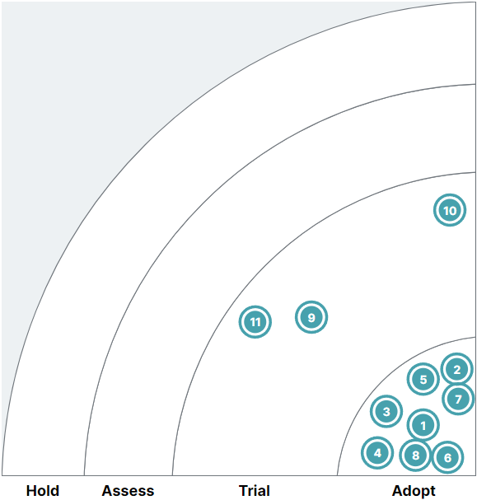
Techniques
Adopt | Trial | Assess | Hold
1. Git | 9. MsgBrokers
2. Internet | 10. Virtualization
3. Conteiners | 11. Caching
4. API
5. Databases
6. CI/CD
7. WebServers
8. OOP

Slide 3
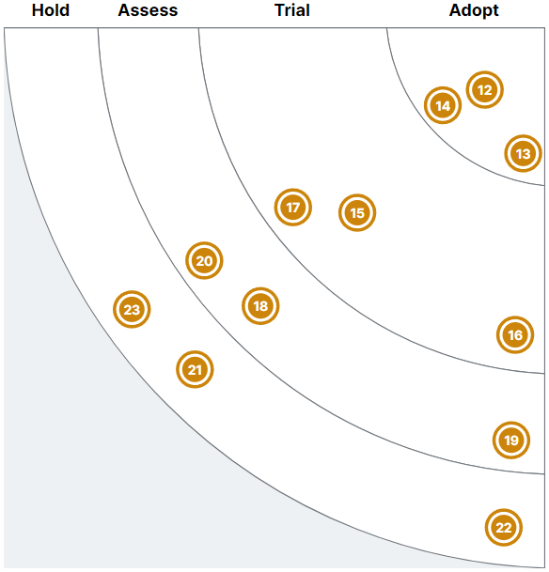
Platforms
Adopt | Trial | Assess | Hold
12. Windows | 15. Android | 18. Blockchain | 21. Unix
13. Linux | 16. IOS | 19. Arduino | 22. FreeDOS
14. Web | 17. Clouds | 20. Rasberry Pi | 23. Mainframes

Slide 4
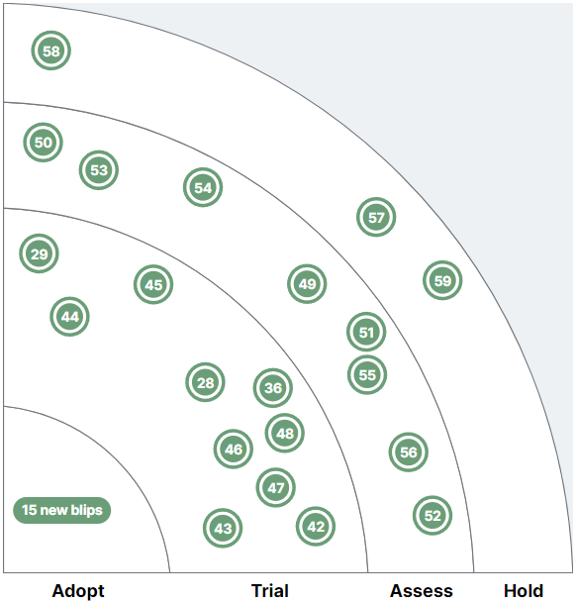
Tools
Adopt | Trial | Assess | Hold
24. GitHub | 28. RabbitMQ | 49. BitBucket | 57. MySQL
25. PostgreSQL | 29. ELK | 50. MariaDB | 58. Memcached
26. MongoDB | 36. Jenkins | 51. Firebase | 59. Apache
27. Redis | 42. GitLab | 52. AWS
30. Docker | 43. Oracle | 53. Azure
31. Nginx | 44. Cassandra | 54. Google Cloud
32. Prometheus | 45. Kafka | 55. Terraform
33. Graphana | 46. Kubernetes | 56. Vault
34. DBeaver | 47. ChatGPT
35. VS Code | 48. Postman
37. Notepad++
38. Swagger
39. Markdown
40. Latex
41. Ansible

Slide 5
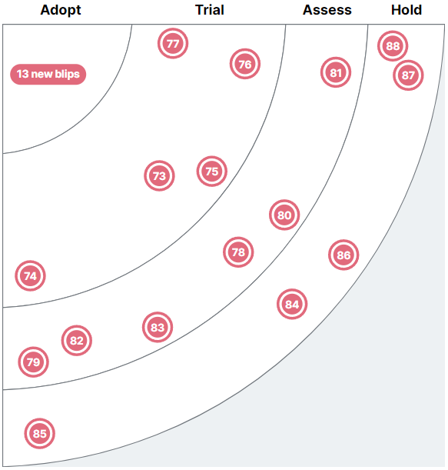
Languages&Frameworks
Adopt | Trial | Assess | Hold
60. Go | 73. Java | 78. Ruby | 84. Pascal
61. Python | 74. JavaScript | 79. Rust | 85. Perl
62. C++ | 75. Swift | 80. Tornado | 86. Fortran
63. C | 76. Kotlin | 81. Pyramid | 87. Lisp
64. Gin | 77. Beego | 82. UE | 88. Prolog
65. Echo |  | 83. Unity
66. Django
67. Flask
68. FastAPI
69. QT
70. OpenCV
71. PyTorch
72. Tensorflow

