Slide 1
Appendix

Slide 2
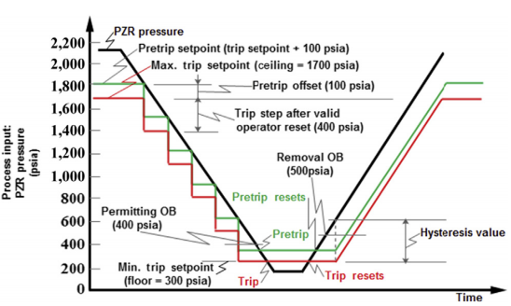
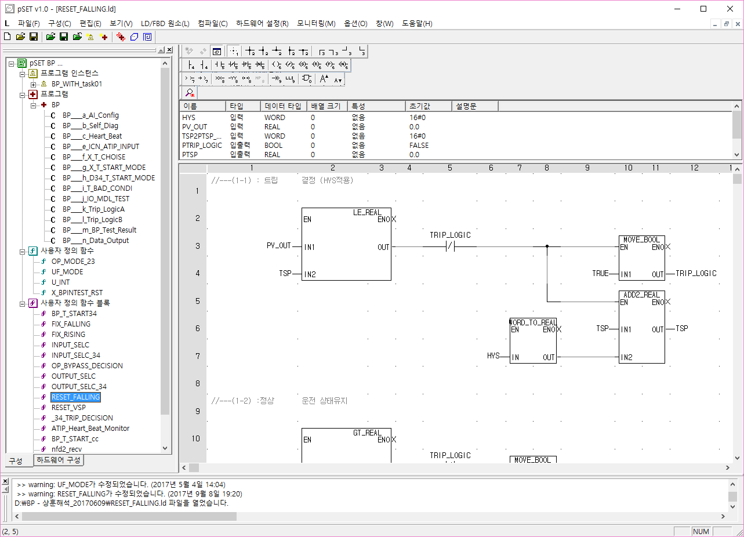
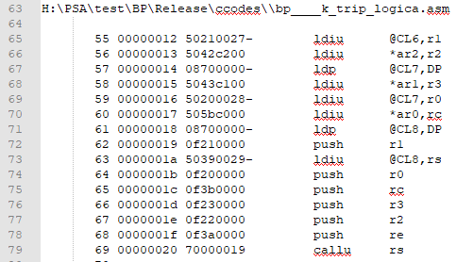
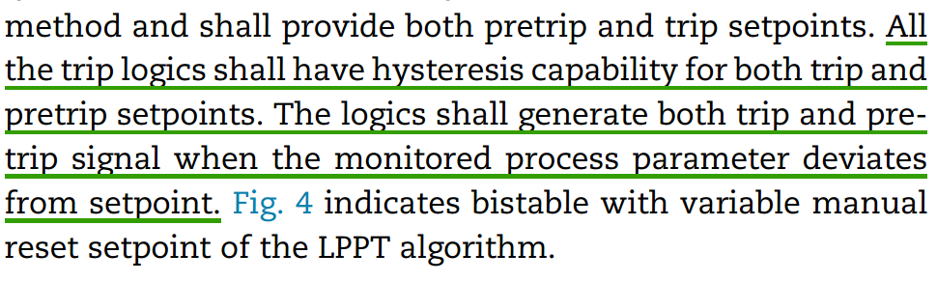
Appendix I.
The scope of the method development in this research is limited to modeling NPP software failures for ‘failure on-demand’ scenario (focus of NPP PRA model).
The method assumes FBD programs exactly represent the initial software requirements; thus, test cases generated from FBD program reflect all the on-demand situations of that NPP safety software.
Software life cycle and related development/verification processes of a typical NPP safety software
Software Life Cycle
1) Requirement
2) Design
3) Implementation
4) Test ing
5) Installation/Checkout
Development Process
Natural-language specification
FBD programs
Executable machine code for PLC
FBD programs
FBD programs
Automatic synthesis
Compiled into
NuSCR toFBD
V&V process
Formal verification
FBD design verification
FBDVerifier
NuSRS
Executable code is used for testing
CTL model checking
(Cadence SMV)
LTL model checking
(Cadence SMV)
Equivalence
Checking (VIS)
The test cases are derived from SDS
* Existing tools used for conducting the task.
* FBD : function block diagram / PRA : probabilistic risk assessment / CTL : Computation tree logic / LTL : Linear temporal logic / VIS : Verification Interacting with Synthesis / SMV : Symbolic model verifier / SDS : software design specifications (e.g. design documents, FBD files)
Notes:
https://ieeexplore.ieee.org/stamp/stamp.jsp?tp=&arnumber=4814957

Slide 3
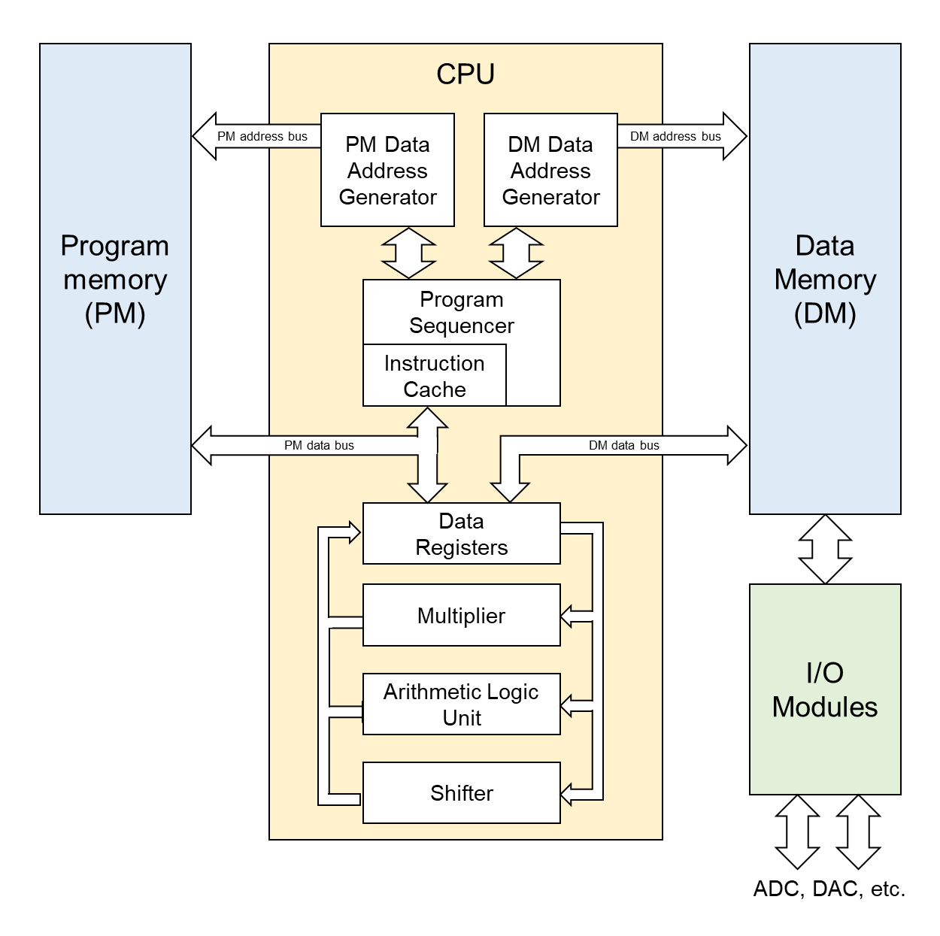
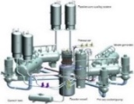

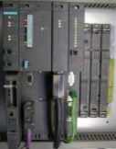
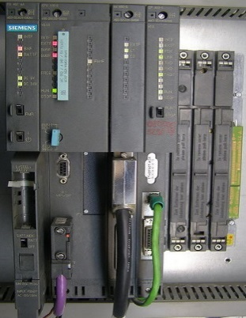
Appendix II.
Basic operation of NPP Safety-graded PLC
1) Fetch: the executable code in the memory map is fetched.
2) Decode: the fetched code is decoded into a specific instruction set.
3) Read: the address is generated and the operands are read from the registers.
4) Execute: the operation of the decoded instruction set is performed and the operation results are stored in the CPU register or the memory.
Plant Process Parameter
Operator action
Inputs from plant operation
Inputs from other digital system
AI/DI/SDL/SDN
I/O Memory area
reads inputs
Test Module
Computation &
Logic Execution
PLC Memory
updates variable
Internal Variable
Generate output
SW
I/O Memory area
HW
Safety-critical PLC
DO/SDL/SDN
Output signal to relay/controller
Operating mechanism of a Typical NPP safety PLC
Block diagram of a typical PLC CPU architecture
Notes:
Especially, the programmable logic controller, or PLC, has been used for safety systems which is critical to the safe shutdown of NPP in case of accident.
However, unlike hardware-based analog I&C system, the use of hardware-software-combined digital I&C system in NPP has raised issues in terms of PRA,
Since it was very hard to capture the software failure
The software reliability growth model have been used in commercial software engineering field;
however, the lack of software failure data due to short operation history made SRGM not applicable to reliability quantification.
BBN is a kind of model-based method that aggregates various SW development information and generates a model;
however, since the parameter quantification and model generation is often based on experts’ opinion; so we expect high uncertainty in the result of BBN model.
Another method is to quantify SW reliability based on test result.
Especially, black-box test-based method is a method which takes samples from SW operational profile and quantify the reliability using the statistical analysis based on test results;
however, the method inherently suffers from addressing the test coverage and often has long test execution time.

Slide 4
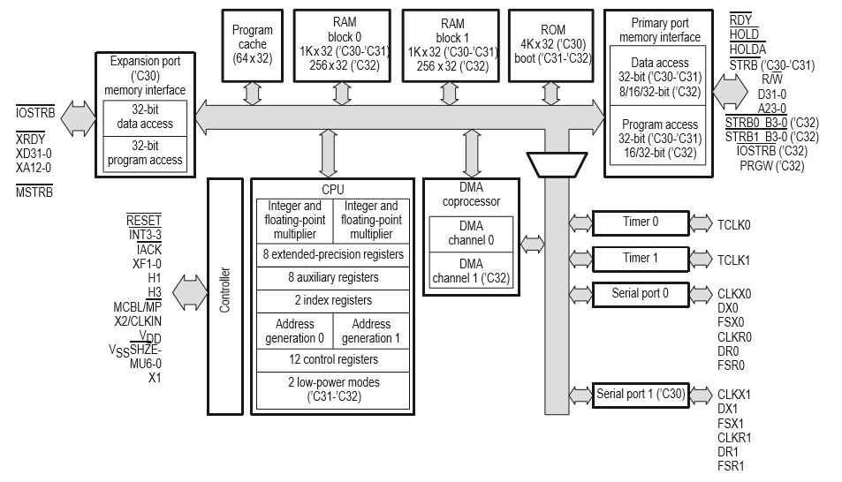
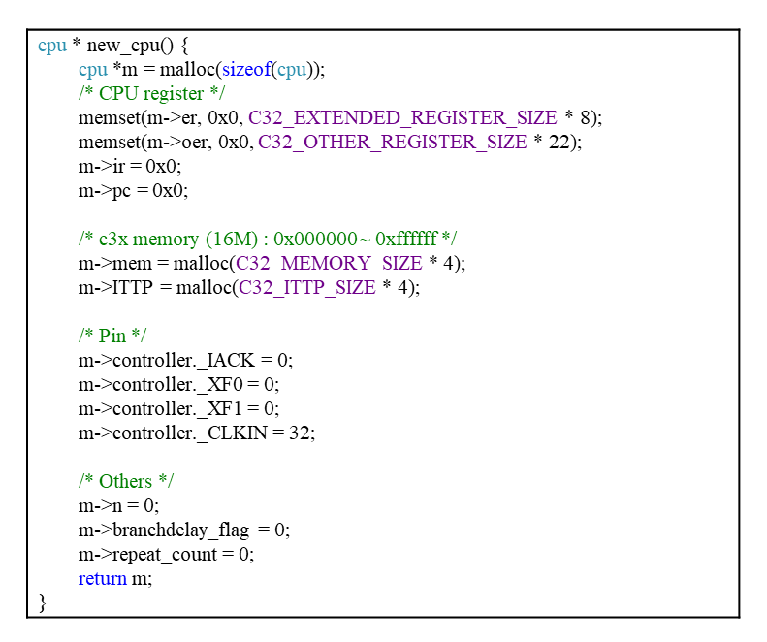
Appendix III.
Development of NPP safety software test-bed (NSTM)
1) Emulation of microprocessor architecture of POSAFE-Q PLC
CPU registers (30 registers)
Extended-precision registers – extended-precision floating-point expression
Auxiliary registers – indirect addressing, 32-bit integer/logical expression
Other registers : system functions (e.g., stack, condition, block repeat)
Memory map (16 Mbyte; 0x000000 ~ 0xFFFFFF)
16Mbyte 32-bit words of program, data, I/O space
Accessible by various addressing modes (e.g. direct, indirect, immediate)
Create virtual CPU register and Memory map
CPU registers
Memory map (RAM, ROM)
TMS320C3x CPU registers and Memory map
CPU and memory emulation in test-bed (C code)
Notes:
a software test-bed is developed that captures both the internal (CPU and memory architecture) and external (states of program input and output variables) aspects of the PLC scan cycle. The test-bed is developed in C code by emulating the PLC microprocessor architecture, such as the CPU register and the memory map [24] and the assembly language instructions.

Slide 5
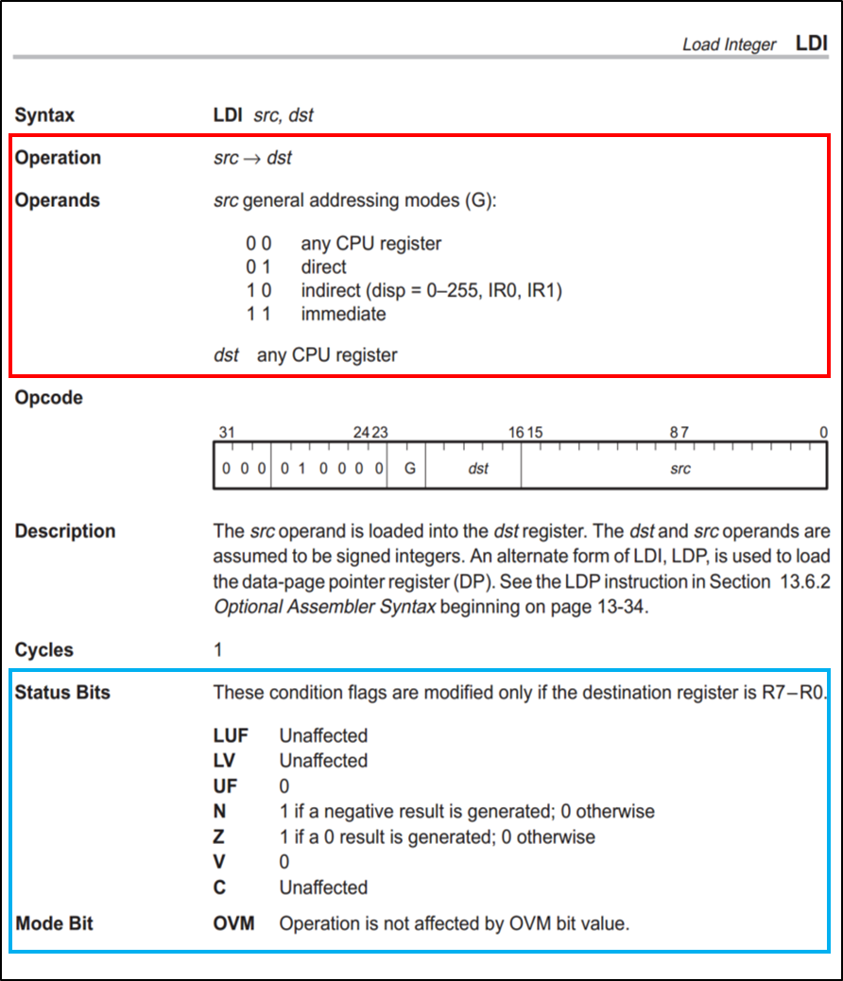
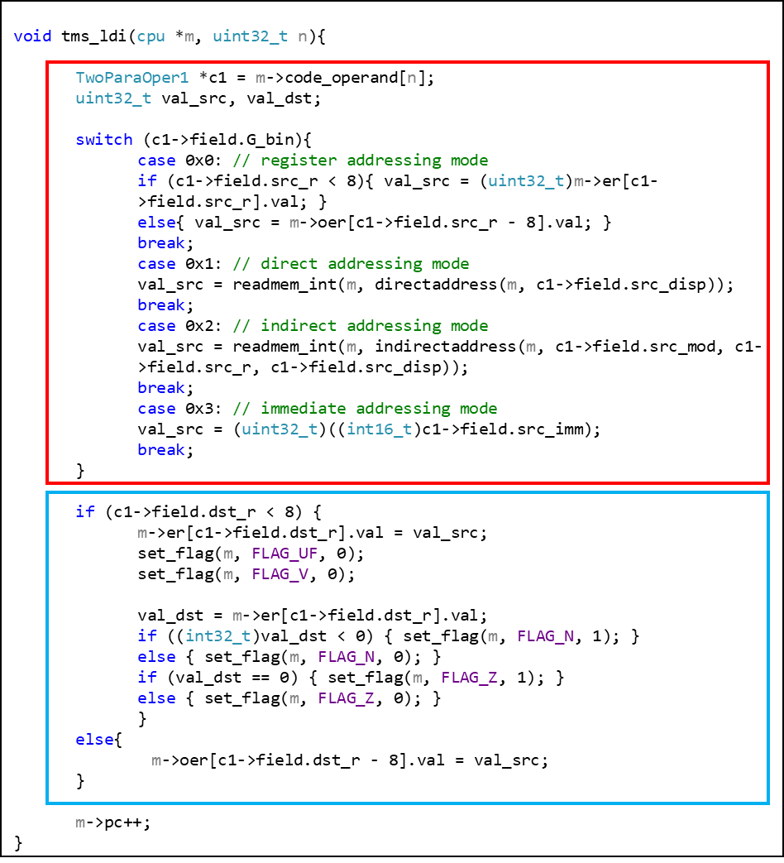
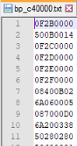
Appendix III.
Development of NPP safety software test-bed (NSTM)
2) Implementation of microprocessor (TMS320c3x) instruction sets
Total of 118 assembly language instructions
Types of instruction set:
1) Load and store
2) 2-operand arithmetic/logical
3) 3-operand arithmetic/logical
4) Program control
5) Interlocked operations
6) Parallel operations
Decode machine code
Description of LDI (load integer) instruction set operation
Emulated operation of LDI (load integer) instruction set in test-bed
Notes:
a software test-bed is developed that captures both the internal (CPU and memory architecture) and external (states of program input and output variables) aspects of the PLC scan cycle. The test-bed is developed in C code by emulating the PLC microprocessor architecture, such as the CPU register and the memory map [24] and the assembly language instructions.

Slide 6
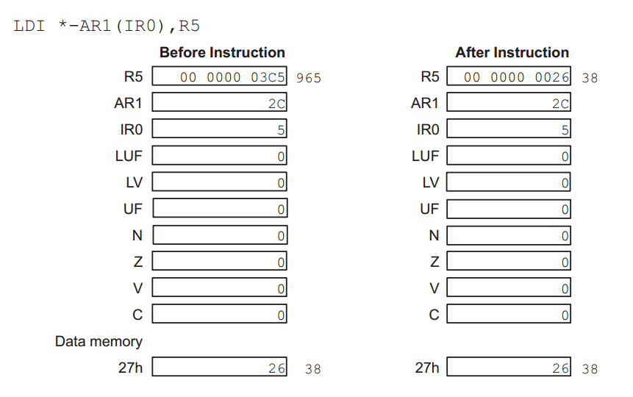
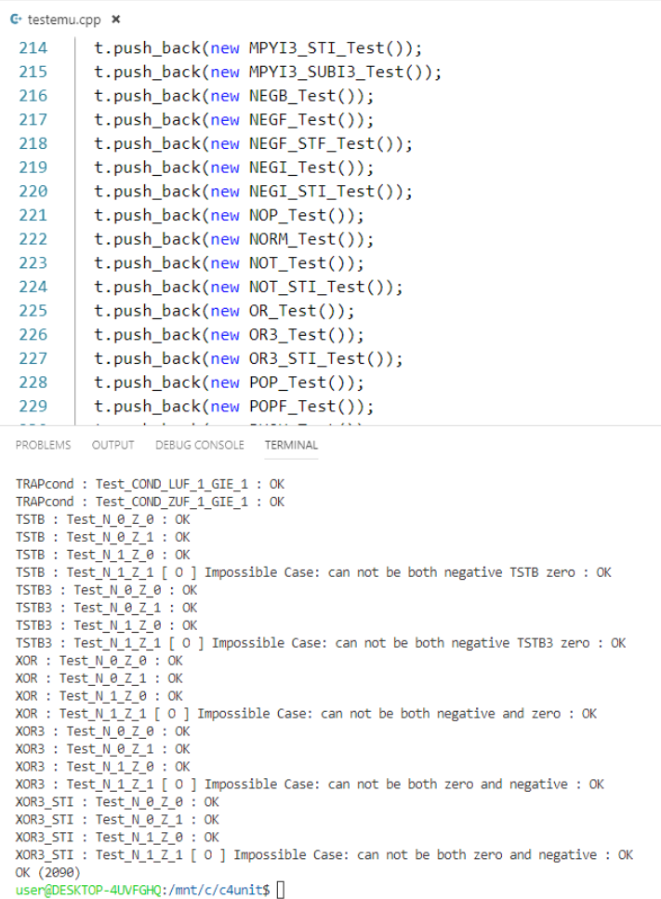
Appendix IV.
V&V of NPP safety software test-bed (NSTM)
Instruction set testing (using CppUnit*) : A total of 2090 unit test cases were developed and tested to verify the correctness of emulated instruction set.
Start
Develop unit test cases for instruction set
Implement unit test cases to test-bed
Contains unit test cases for OR instruction set
Example of unit test case developed for LDI (load integer) instruction
Verify the instruction output with expected output
Debug/ Review
No
Result of unit testing for each instruction set
Yes
End
Summary of test result for all unit test cases
Verification process of the software test-bed with instruction set unit test cases
Result of unit testing for software test-bed
* CppUnit : xUnit tool for C/C++ programming languages
Notes:
D:\Cppexample\Cppunit_for_C_4

Slide 7
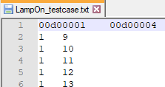
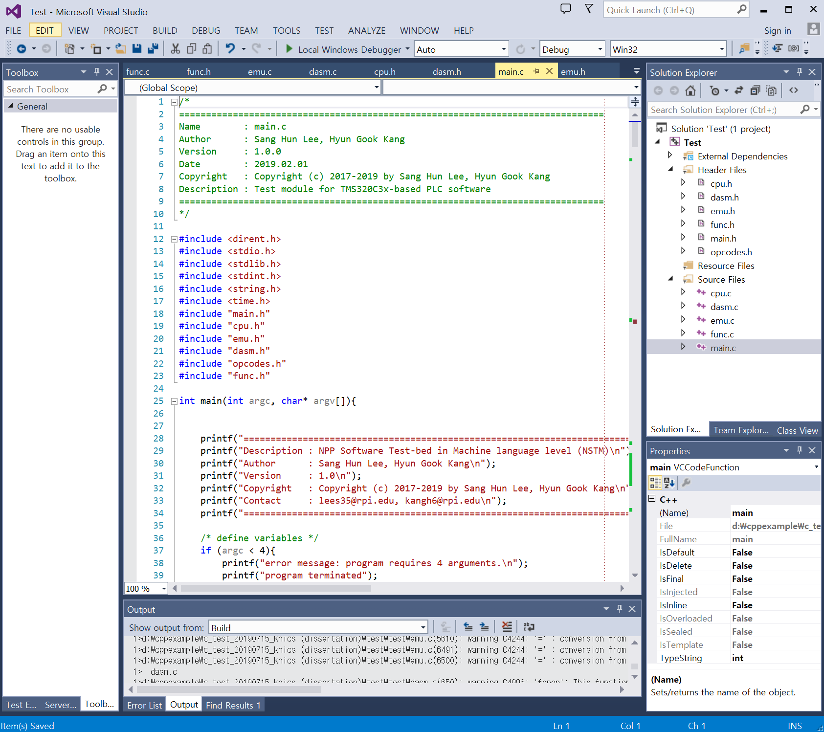
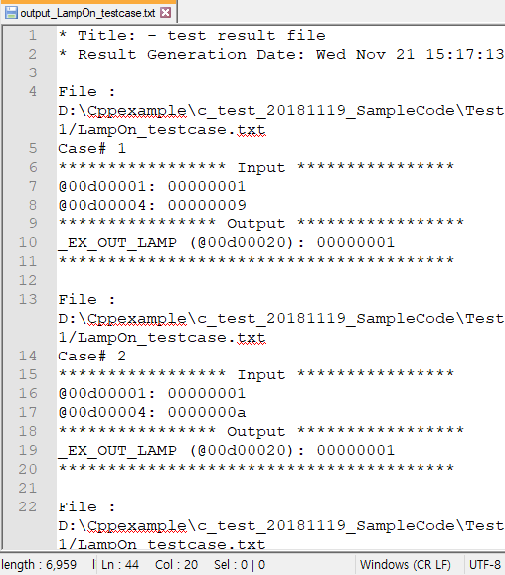
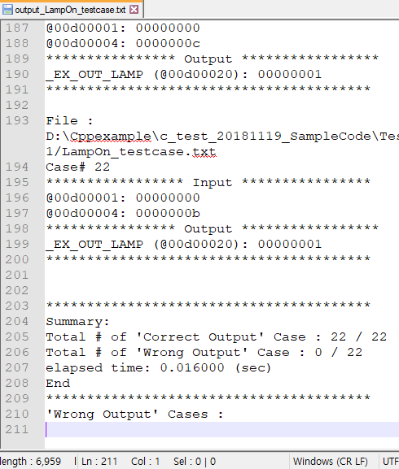
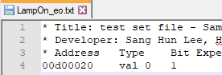
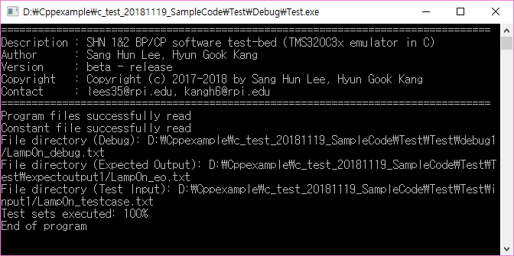
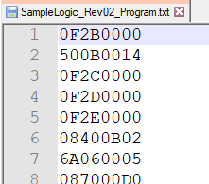
Appendix IV.
V&V of NPP safety software test-bed (NSTM)
Functional testing : The test cases for benchmark programs were developed and tested to verify the overall functionality of test-bed.
Lamp On/Off software : 22 cases for Lamp On scenario
KNICS IDiPS-RPS BP software : 659 cases for trip scenario (15 trip logics)
Test case file
Expected output file
Program file (executable code)
Screenshot of test-bed execution
Test result file
Notes:
D:\Cppexample\Cppunit_for_C_4

Slide 8












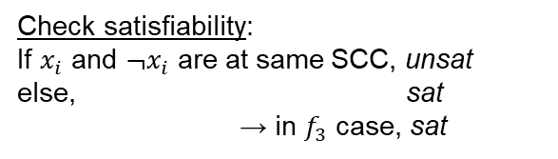


Appendix V.
Theoretical Basis of Exhaustive Test Case Generation
Example algorithms to solve an SAT example (SSC):
$$f_{1}=x_{1}∨x_{2}≡¬x_{1}⇒x_{2}$$
: Satisfiable
$f_{2}=(x_{1}∨x_{1})∧(¬x_{1}∨¬x_{1})$ $≡¬x_{1}⇒x_{1}$, $x_{1}⇒¬x_{1}$
: Unsatisfiable
$$f_{3}=\left(x_{1}∨¬x_{2}\right)∧\left(x_{2}∨¬x_{3}\right)∧\left(x_{3}∨¬x_{1}\right)∧\left(¬x_{4}∨¬x_{2}\right)$$
$≡¬x_{1}⇒¬x_{2}$, $¬x_{2}⇒¬x_{3}$, $¬x_{3}⇒¬x_{1}$, $x_{4}⇒¬x_{2}$
SCC $C_{1}$
SCC $C_{3}$
Check satisfiability:
If $x_{i}$ and $¬x_{i}$ are at same SCC, unsat
else, sat
→ in $f_{3}$ case, sat
$$x_{1}$$
$$x_{2}$$
$$x_{3}$$
$$x_{4}$$
Derive interpretation:
For each SCC $C_{1}$, set vertices’ value to false,
(to avoid true → false cases), and check the contradictions between SCCs.
→ in $f_{3}$ case,
$$\left\{x_{1},x_{2},x_{3},x_{4}\right\}=\{false,false,false,true\}$$
SCC $C_{2}$
SCC $C_{4}$
$$¬x_{1}$$
$$¬x_{2}$$
$$¬x_{3}$$
$$¬x_{4}$$
* SCC : Strongly Connected Component (A directed graph is strongly connected if there is a path between all pairs of vertices)
Notes:
https://people.eecs.berkeley.edu/~sseshia/pubdir/SMT-BookChapter.pdf
https://algospot.com/wiki/read/2-SAT
http://blog.naver.com/PostView.nhn?blogId=kks227&logNo=220803009418
Other algorithms: Floyd-warshall, DPLL

Slide 9

Appendix V.
Theoretical Basis of Exhaustive Test Case Generation
Expansion from SAT to SMT problem:
arithmetic
Arrays
Uninterpreted functions
$$f_{4}=(x+5=read(A,5))∧\left(A≠B∨read(B,5)≤g\left(x\right)\right)$$
Abstract to Propositional Logic
$$f_{4}= \left( P \right)∧\left( Q ∨ R \right)$$
Find satisfying assignment
$$x+5=read(A,5) ,A≠B$$
Determine if consistent according to theory solver (arithmetic, equalities, etc.)
* read(a, i) means to read the i-th element in array a.
Notes:
https://people.eecs.berkeley.edu/~sseshia/pubdir/SMT-BookChapter.pdf
http://fmv.jku.at/rerise14/rerise14-smt-slides-1.pdf
Dpll
https://ptolemy.berkeley.edu/projects/embedded/eecsx44/fall2011/lectures/SATSolving.pdf
https://en.wikipedia.org/wiki/DPLL_algorithm

Slide 10
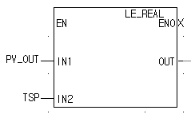
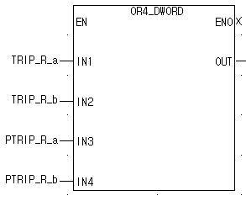
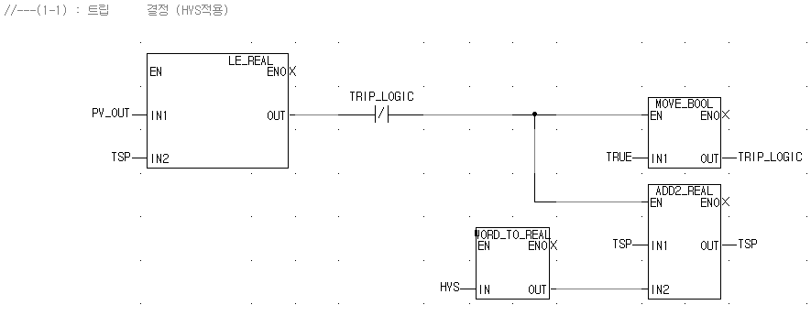
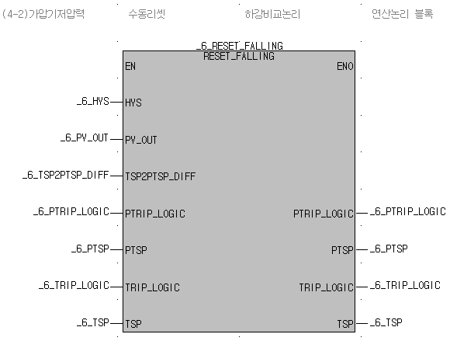
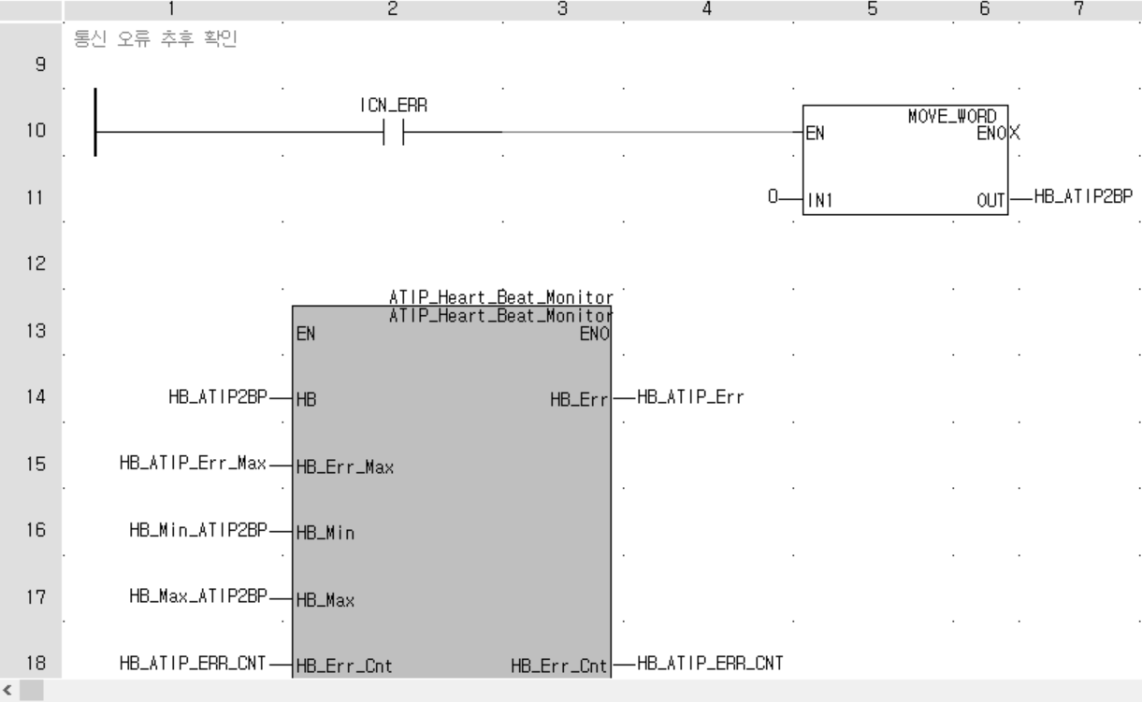
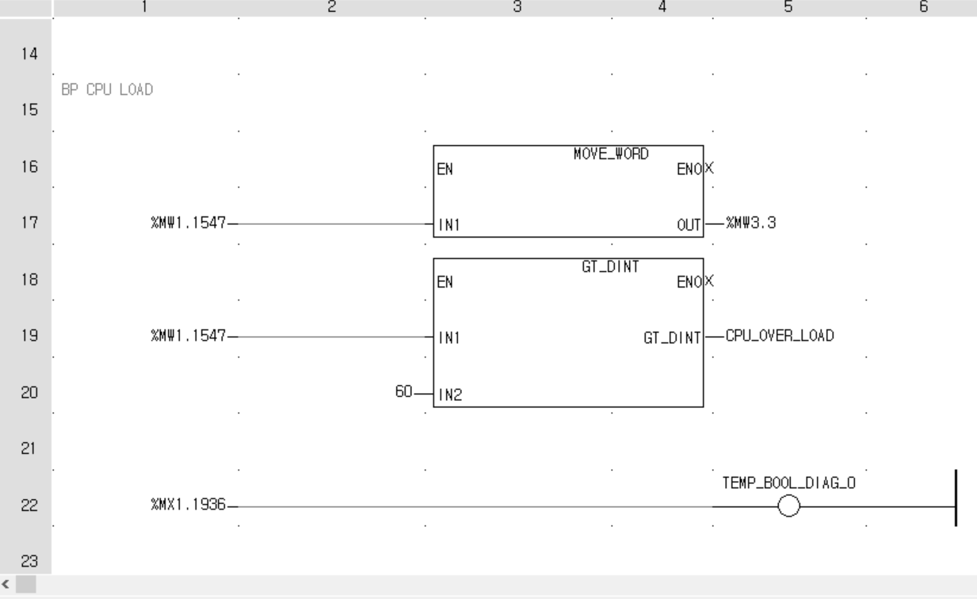
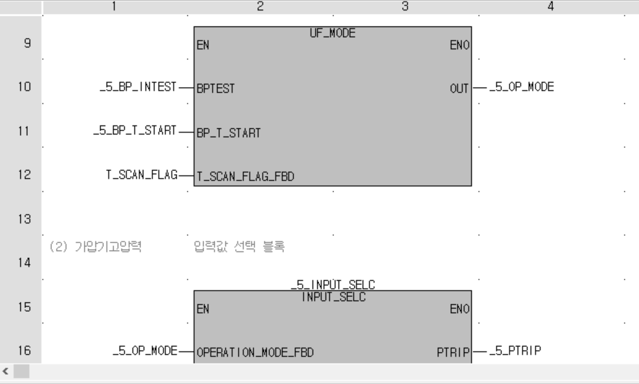
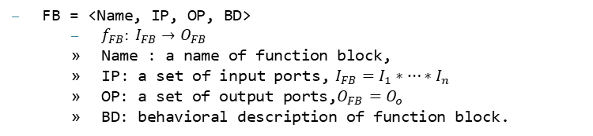
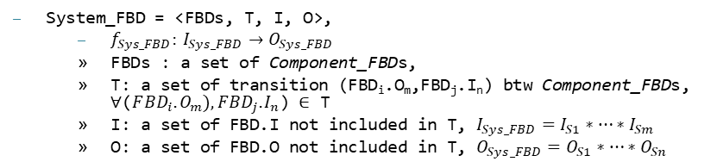
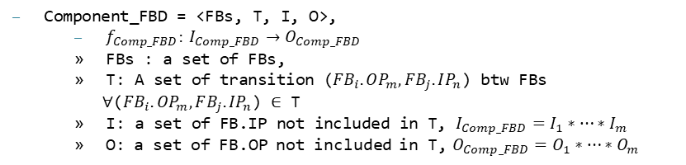
Appendix VI.
NPP safety software language – FBD/LD program
FBD is a graphical language used for PLC design that describes the function between input and output variables expressed with a set of elementary blocks.
Definition of Function Block (FB)
Definition of Component FBD (Comp_FBD)
Definition of System FBD (Sys_FBD)
FB = <Name, IP, OP, BD>
$f_{FB}: I_{FB}→O_{FB}$
Name : a name of function block,
IP: a set of input ports, $I_{FB}=I_{1}∗…∗I_{n}$
OP: a set of output ports,$O_{FB}=O_{o}$
BD: behavioral description of function block.
Component_FBD = <FBs, T, I, O>,
$f_{Comp_FBD}: I_{Comp_FBD}→O_{Comp_FBD}$
FBs : a set of FBs,
T: A set of transition ($FB_{i}.OP_{m},FB_{j}.IP_{n}$) btw FBs
∀($FB_{i}.OP_{m},FB_{j}.IP_{n}$) ∈ T
I: a set of FB.IP not included in T, $I_{Comp_FBD}=I_{1}∗…∗I_{m}$
O: a set of FB.OP not included in T, $O_{Comp_FBD}=O_{1}∗…∗O_{m}$
System_FBD = <FBDs, T, I, O>,
$f_{Sys_FBD}: I_{Sys_FBD}→O_{Sys_FBD}$
FBDs : a set of Component_FBDs,
T: a set of transition (FBD_{i}.O_{m},FBD_{j}.I_{n}) btw Component_FBDs, ∀($F{BD}_{i}.O_{m}),F{BD}_{j}.I_{n}$) ∈ T
I: a set of FBD.I not included in T, $I_{Sys_FBD}=I_{S1}∗…∗I_{Sm}$
O: a set of FBD.O not included in T, $O_{Sys_FBD}=O_{S1}∗…∗O_{Sn}$

Slide 11
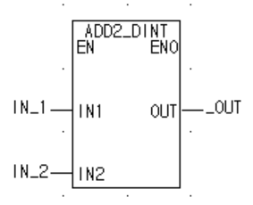
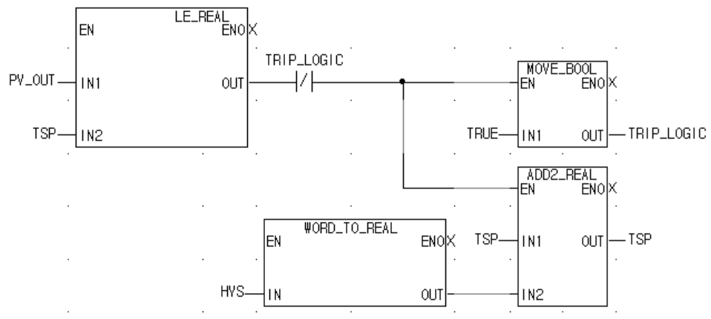
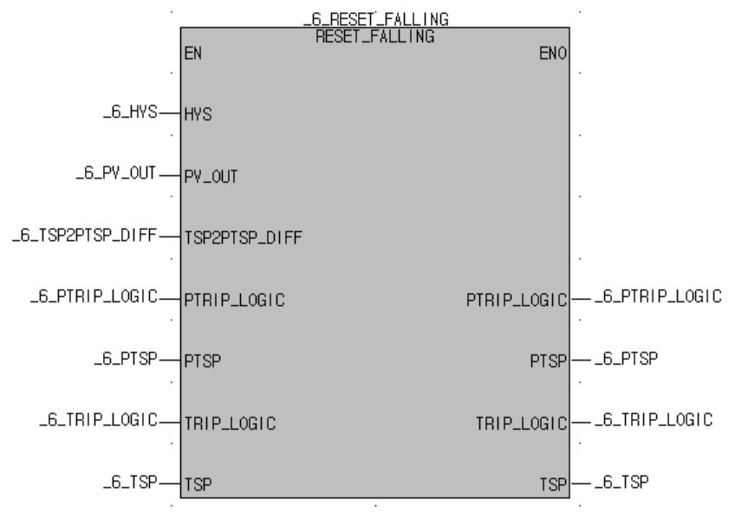
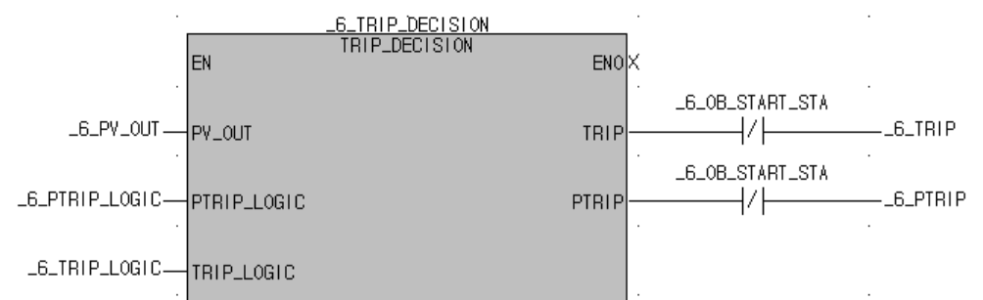
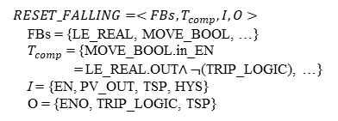


Appendix VII.
Translation from FBD into SMT format
The FBD-to-SMT translation rules are developed based on FBD formal definition.
The translation starts with generating SMT formulas for all FBs, and continues for component FBD and system FBD.
Function Block (FB = <Name, IP, OP, BD>)
Component FBDs
(Comp_FBD = <FBs, T_{comp}, I, O>)
System FBDs
(Sys_FBD = <Comp_FBDs, T_{sys}, I, O>)
Transitions btw FBs
Transitions btw Comp_FBDs
$FB_{ADD2_DINT}=<Name,IP,OP,BD>$
Name = ADD2_DINT
IP = {EN, IN1, IN2}
OP = {ENO, OUT}
BD = IN1 + IN2
$RESET_FALLING=<FBs,T_{comp},I,O>$
FBs = {LE_REAL, MOVE_BOOL, …}
$T_{comp}$ = {MOVE_BOOL.in_EN = LE_REAL.OUT$∧¬$(TRIP_LOGIC), …}
I = {EN, PV_OUT, TSP, HYS}
O = {ENO, TRIP_LOGIC, TSP}
$BP_k_Trip_LogicA=<Comp_FBDs,T_{sys},I,O>$
Comp_FBDs = {_6_RESET_FALLING, _6_TRIP_DECISION, …}
$T_{sys}$ = {_6_TRIP_DECISION.in_TRIP_LOGIC = _6_RESET_FALLING.out_TRIP_LOGIC, …}
I = {_6_HYS, _6_TRIP_LOGIC, …}
O = {_6_TRIP, _6_TSP, …}
def ADD2_DINT(EN, IN1, IN2):
# -- define BD of FB --
BD = IN1 + IN2
# -- define ENO/outputs of FB --
ENO1 = If(EN, True, False)
OUT1 = If(EN, BD, OUT)
# -- return ENO/outputs of FB --
return ENO1, OUT1
def RESET_FALLING(EN,PV_OUT,in_HYS, in_PV_OUT,…,ENO,…,out_TRIP_LOGIC) # -- temporary variables --
temp1 = False
# -- function operation --
LE_REAL0_OUT = LE_REAL(True, in_PV_OUT , in_TSP, …) temp1 = And(LE_REAL0_OUT, Not(in_TRIP_LOGIC)) TRIP_LOGIC1 = MOVE_BOOL(temp1, True, …) # return ENO/outputs of FB --
ENO1 = If(EN, True, False)
TRIP_LOGIC5 = If(EN, TRIP_LOGIC4 , out_TRIP_LOGIC) return ENO1, …, TRIP_LOGIC5
#define FB
def BP_k_Trip_LogicA(BP_k_Trip_LogicA_in):
# define ENO and outputs of FB
…, _6_TRIP_LOGIC2, … = RESET_FALLING( …, _6_TRIP_LOGIC1, …)
…, TRIP_DECISION51_out_TRIP, … = TRIP_DECISION(…, _6_TRIP_LOGIC2, …) …
# return ENO and outputs of FB
return BP_k_Trip_LogicA_out
Notes:
----------------------------

Slide 12
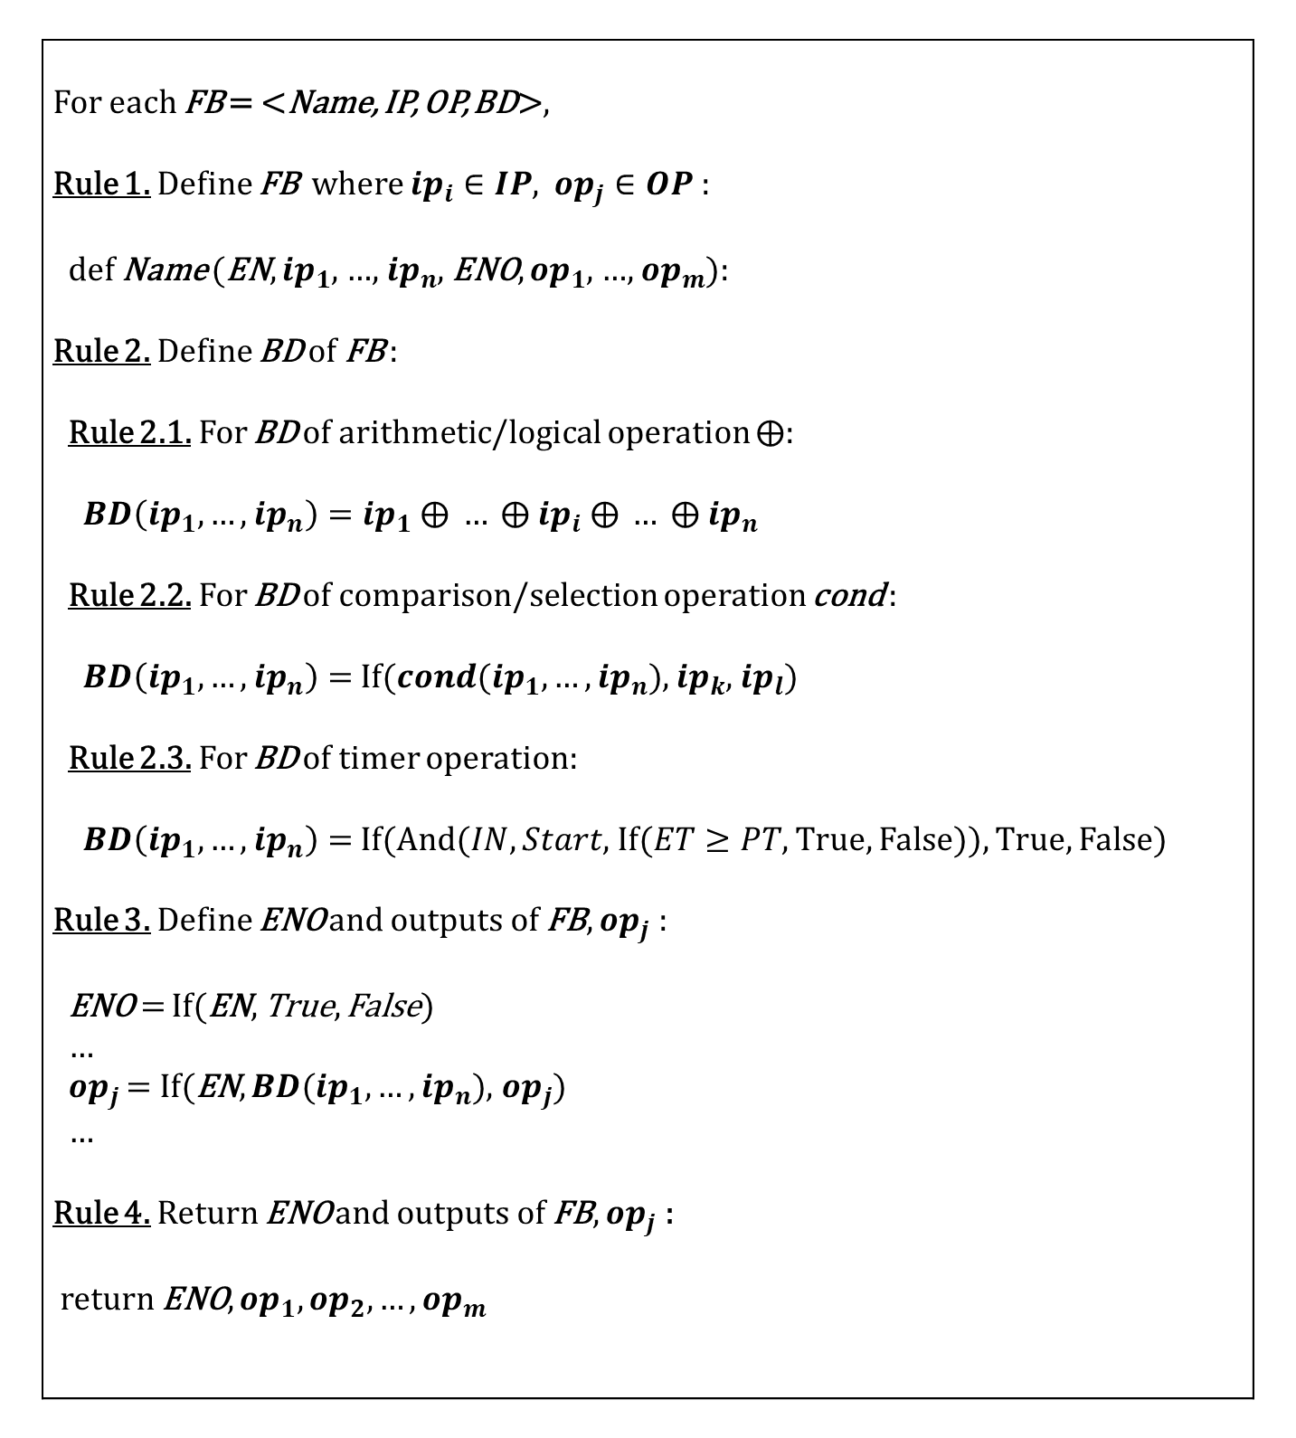
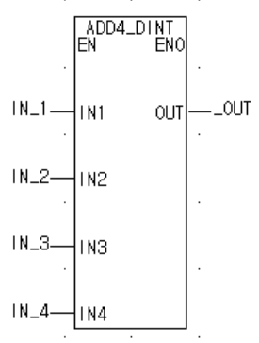

Appendix VII.
Translation of Function Block (FB) to SMT formula
Rule 1 : Define the elements of FB (name, I/O ports)
Rule 2 : Define the FB operation
Rule 3 : Define the FB output ports
Rule 4 : Return the FB output ports
$FB_{ADD4_DINT}=<Name,IP,OP,BD>$
$Name=ADD4_DINT$
$IP=\{EN, IN1, IN2, IN3, IN4\}$
$OP=\{ENO,OUT\}$
$BD=IN1+IN2+IN3+IN4$
#define FB
def ADD4_DINT(EN, IN1, IN2, IN3, IN4, ENO, OUT):
# define BD of FB
BD = IN1 + IN2 + IN3 + IN4
# define ENO and outputs of FB
ENO2 = If(EN, True, False)
OUT2 = If(EN, BD, OUT)
# return ENO and outputs of FB
return ENO2, OUT2
FBD-to-SMT translation rules for FBs
Formal definition and translation for example FB, ADD4_DINT

Slide 13


Appendix VII.
Translation of Component FBD (Comp_FBD) to SMT formula
Rule 5 : Define the elements of component FBD (name, I/O ports)
Rule 6 : Define the program flow according to execution order of FBs in Comp_FBD
Rule 7 : Define the Comp_FBD output ports
Rule 8 : Return the Comp_FBD output ports
Temporary variables are used to model a set of transitions btw FBs.
01 02 03 04 05 06 07 08 09 10 11 12 13 14 15 16 17 18 | # Define Component FBD def RESET_FALLING__(EN, HYS, PV_OUT, ENO, TRIP_LOGIC, TSP): … # Define Component FBD operation and all translation relation ENO__1__RESET_FALLING, OUT__1__RESET_FALLING = LE_REAL(True, PV_OUT, TSP, ENO__1__RESET_FALLING, OUT__1__RESET_FALLING) __tbool = If(True, And(OUT__1__RESET_FALLING,Not(TRIP_LOGIC)), __tbool) … ENO__3__RESET_FALLING, OUT__3__RESET_FALLING = MOVE_BOOL( __tbool, True, ENO__3__RESET_FALLING, OUT__3__RESET_FALLING) … # Define ENO and output of Component FBD ENO2 = If(EN, ENO1, False) TRIP_LOGIC2 = If(EN, TRIP_LOGIC1, TRIP_LOGIC) TSP2 = If(EN, TSP1, TSP) # return ENO and outputs of Component FBD return ENO2, TSP2, TRIP_LOGIC2
FBD-to-SMT translation rules for component FBDs
An example of translation for the component FBDs

Slide 14



Appendix VII.
Translation of System FBD (Sys_FBD) to SMT formula
Rule 9 : Define the elements of system FBD (name, I/O ports)
Rule 10 : Define the program flow according to execution order in Sys_FBD
Rule 11 : Define the Sys_FBD output ports
Rule 12 : Return the Sys_FBD output ports
(1)
(2)
01 02 03 04 05 06 07 08 09 10 11 12 13 14 15 16 17 18 19 20 21 22 23 24 | # Define System FBD def BP___k_Trip_LogicA(BP____k_Trip_LogicA_in): … # rung 147 RESET_FALLING50_out_ENO, … RESET_FALLING50_out_TRIP_LOGIC = RESET_FALLING(RESET_FALLING50_in_EN, RESET_FALLING50_in_HYS, … , RESET_FALLING50_out_ENO, …, RESET_FALLING50_out_TRIP_LOGIC) _6_TRIP_LOGIC__2 = If(RESET_FALLING50_out_ENO, RESET_FALLING50_out _TRIP_LOGIC, _6_TRIP_LOGIC__1) … # rung 148 TRIP_DECISION51_in_TRIP_LOGIC = _6_TRIP_LOGIC__2 … TRIP_DECISION51_out_ENO, …, TRIP_DECISION51_out_TRIP, TRIP_DECISION51_out_PTRIP = TRIP_DECISION(TRIP_DECISION51_in_EN , TRIP_DECISION51_in_TRIP_LOGIC, …, TRIP_DECISION51_out_TRIP) _6_TRIP__2 = And(TRIP_DECISION51_out_TRIP,Not(_6_OB_START_STA__1)) … # Define outputs of Sys_FBD BP____k_Trip_LogicA_out = [] BP____k_Trip_LogicA_out.append(_6_TRIP__2) … # Return outputs of Sys_FBD return BP____k_Trip_LogicA_out
FBD-to-SMT translation rules for system FBD
An example of translation for the system FBD

Slide 15


Appendix VIII.
Background on SMT Solving Techniques – DPLL algorithm
DPLL algorithm is a complete, backtracking-based search algorithm for solving the CNF-SAT problem.
Complete: guarantees to find a solution if there is any
Backtracking: exercise all possible paths to solve SAT/SMT problem.
Existing SMT solver: CVC4 (Stanford), Yices (SRI), Z3 (Microsoft) ^{[7]}
Z3 ~ DPLL-(T), a theorem prover for first-order logic about an arbitrary theory T.
p
1
$F= ¬p∧¬q∧r$
0
q
1
1
{$p=false, q=false,r=true$ }
r
1
0
0
1
0
invalid
invalid
invalid
invalid
valid
* DPLL: Davis–Putnam–Logemann–Loveland
Notes:
In order to finally generate test cases, we need to solve the translated SMT formula.
There are several existing SMT solving techniques which can be applied in this research.
DPLL algorithm is one of the representative SMT solving techniques, which is a search-based algorithm,
1) that is complete, meaning 1) it guarantees to find a solution if there is any,
2) and is based on backtracking meaning 1) it enables finding all solution to a specific problem.
For example, for the formula in conjugate normal form,
The algorithm incrementally builds candidates to the solutions,
and abandons a candidate, or backtracks, as soon as it determines that the candidate cannot possibly be completed to a valid solution.
And it repeats this process until it finds a valid model that makes the formula valid.
There are several powerful tools that solve the complex formulas with hundreds of variables.
Among those tools, in this research, we will utilize the Z3 SMT solver leveraging its ability for its advanced model generation capability,
along with supporting APIs for other programming languages (e.g. Python/C/Java).
----------------------
https://en.wikipedia.org/wiki/Clause_(logic)#Empty_clauses
https://www.youtube.com/watch?v=i8SDkVGclYk
Completeness: https://en.wikipedia.org/wiki/Completeness
Backtracking: https://cs.uwaterloo.ca/~vanbeek/Publications/survey06.pdf
https://en.wikipedia.org/wiki/Backtracking
Basic SAT algorithm:
https://www.win.tue.nl/~jschmalt/teaching/2IMF20/BMC-lecture_slides_SAT.pdf
PPT 대사에 위 link의 introduction에 있는 내용을 말하자 (간단하게만)

Slide 16










Appendix VIII.
SMT Solving Technique – DPLL algorithm ($DPLL(F, U)$)
UP($F$, $U$); - Unit-propagate
if $F$ contains the empty clause ($F=⏊$) then return;
if $F$ is empty formula ($F=⏉$), then exit with model of U;
$L$ $←$ a literal containing an atom from $F$;
$DPLL(F{\left.​\right|}_{L},U⋃\left\{L\right\})$;
$DPLL(F{\left.​\right|}_{\overline{L}},U⋃\left\{\overline{L}\right\})$;
$F=(¬p∨q)∧(¬p∨r)∧(q∨r)∧(¬q∨¬r)$
$DP(\left(¬p∨q\right)∧\left(¬p∨r\right)∧\left(q∨r\right)∧\left(¬q∨¬r\right), ∅)$
└ $UP(\left(¬p∨q\right)∧\left(¬p∨r\right)∧\left(q∨r\right)∧\left(¬q∨¬r\right), ∅)$
$L←¬p$
$DP\left({\left.\left(¬p∨q\right)∧\left(¬p∨r\right)∧\left(q∨r\right)∧\left(¬q∨¬r\right)\right|}_{¬p} ,\{¬p\}\right)$
$DP\left(\left(q∨r\right)∧\left(¬q∨¬r\right),\{¬p\}\right)$
└ $UP\left(\left(q∨r\right)∧\left(¬q∨¬r\right),\{¬p\}\right)$
$L←q$
$DP\left({\left.\left(q∨r\right)∧\left(¬q∨¬r\right)\right|}_{q} ,\{¬p,q\}\right)$
└ $UP\left(¬r,\{¬p,q\}\right)$
$L←¬r$
$DP\left(⏉,\{¬p,q,¬r\}\right)$
└ return model $\left\{¬p,q,¬r\right\}$
$F=(¬p∨q)∧(¬p∨r)∧(q∨r)∧(¬q∨¬r)$
$$p$$
$$¬p$$
$$⏊$$
$(q∨r)∧(¬q∨¬r)$
$$q$$
$$¬q$$
$$¬r$$
$r$
An example of SMT solving using DPLL algorithm
Notes:
https://en.wikipedia.org/wiki/Clause_(logic)#Empty_clauses
https://www.youtube.com/watch?v=i8SDkVGclYk
Before mentioning about the exhaustive test case generation, I would like to discuss some important aspects in proposed test case generation procedure for a single test case.
The developed algorithm for a single test case for safety software includes three parts:
1) first, analyzing translating the program under test and defining the SW program as a formula to be solved.
2) second, defining test requirements (or the target software output);
3) third, solving the test requirements by checking the satisfiability and finding a model (or solution for the software inputs).
In result, if the SW program is satisfiable for the software output the tester defined,
the algorithm would retrieve one solution which satisfies the formula and this will be saved as a single test case.

Slide 17

Appendix VIII.
Z3: DPLL-based SAT + Theory solver (Arithmatic, Array, Bit-vector)
Invoke DPLL(T) for theory T = LIA (Linear Integer Arithmetic)
Map : {$A↔x+1>0$, $B↔x+y>0$, $C↔x<0$, $D↔x+y>4$}
Invoke SAT solver:
Propagate: $B→false$, Propagate: $A→true$
Decide: $C→true$
Invoke theory solver for LIA on: $\{A,¬B,C\}$ $→$ {$x+1>0$, $¬\left(x+y>0\right)$, $x<0$}
$x+1>0$ $∧$ $x<0$ is LIA-unsatisfiable.
$→\left(¬A∨¬C\right)$ is added to list of clauses.
$$Φ=\left(x+1>0 ∨x+y>0\right)∧\left(x<0∨x+y>4\right)∧¬\left(x+y>0\right)$$
$$Φ=\left( A ∨ B \right)∧\left( C ∨ D \right)∧¬B$$
$$Φ=\left( A ∨ B \right)∧\left( C ∨ D \right)∧¬B∧\left( ¬A ∨ ¬C \right)$$
Notes:
DPLL algorithm to incorporate reasoning about a theory T
https://people.eecs.berkeley.edu/~sseshia/pubdir/SMT-BookChapter.pdf
http://fmv.jku.at/rerise14/rerise14-smt-slides-1.pdf
Dpll
https://ptolemy.berkeley.edu/projects/embedded/eecsx44/fall2011/lectures/SATSolving.pdf
https://en.wikipedia.org/wiki/DPLL_algorithm
http://homepage.divms.uiowa.edu/~ajreynol/pres-dpllt15.pdf
https://web.stanford.edu/class/cs357/lectures/lec9.pdf
https://www.cs.tau.ac.il/~msagiv/courses/ATP/smt.pdf

Slide 18

Appendix VIII.
Z3: DPLL-based SAT + Theory solver (Arithmatic, Array, Bit-vector)
Invoke DPLL(T) for theory T = LIA (Linear Integer Arithmetic)
Invoke SAT solver:
Backtrack decision on C ($C→true$)
Propagate $C→false$
Propagate $D→true$
Invoke LIA on: $\left\{A,¬B,¬C,D\right\}→$ {$x+1>0$, $¬\left(x+y>0\right)$, $x<0$, $x+y>4$}
$¬\left(x+y>0\right)∧x+y>4$ is LIA-unsatisfiable.
$→\left(B∨¬D\right)$ is added to list of clauses.
No decisions to backtrack $→$ The formula is LIA-unsatisfiable.
$$Φ=\left(x+1>0 ∨x+y>0\right)∧\left(x<0∨x+y>4\right)∧¬\left(x+y>0\right)$$
$$Φ=\left( A ∨ B \right)∧\left( C ∨ D \right)∧¬B∧\left( ¬A ∨ ¬C \right)$$
$$Φ=\left( A ∨ B \right)∧\left( C ∨ D \right)∧¬B∧\left( ¬A ∨ ¬C \right)∧\left( B ∨ ¬D \right)$$
Notes:
DPLL algorithm to incorporate reasoning about a theory T
https://people.eecs.berkeley.edu/~sseshia/pubdir/SMT-BookChapter.pdf
http://fmv.jku.at/rerise14/rerise14-smt-slides-1.pdf
Dpll
https://ptolemy.berkeley.edu/projects/embedded/eecsx44/fall2011/lectures/SATSolving.pdf
https://en.wikipedia.org/wiki/DPLL_algorithm
http://homepage.divms.uiowa.edu/~ajreynol/pres-dpllt15.pdf
https://web.stanford.edu/class/cs357/lectures/lec9.pdf

Slide 19


Appendix IX.
Single Test Case Generation for NPP Safety Software
Algorithm for a single test case generation of an example FBD program
An example FBD program
STEP 1: Define problem set
1-1) Declaration of the FBD variables (line 6~20)
1-2) Declaration of FBD program logic (line 22~39)
STEP 2: Define test requirement
2-1) Assertion of test requirement (line 41~42):
STEP 3: Solve test requirement
3-1) Check satisfiability given constaint (line 45):
3-2) Find a model for FBD program (line 46):
Z3 input file for one test case generation of FBD program
Notes:
This shows an single test case generation algorithm for an example FBD program.
1) Environmental setting (lines 1~4): Commands pertinent to our application of SAT/SMT framework are defined here.
2) Declaration of the FBD variables (line 6~20):
All variables and constants included in the target FBD program are declared here.
3) Declaration of FBD program logic (line 22~39):
The FBD blocks used in the program as well as the program logic flow are declared here.
4) Assertion of test requirement (line 41~42):
The software output is defined as a test requirement and add it as a constraint of the model to be solved.
5) Find a model for FBD program (line 44~46):
check() finds whether the set of formulas is satisfiable.
model() is used to retrieve an interpretation that makes all formulas true and return as a test case.

Slide 20


Appendix IX.
Single Test Case Generation for NPP Safety Software
Execution of a single test case generation algorithm for example FBD program
An example FBD program
Definition of function blocks
Screenshot of single test case generation algorithm execution
Z3 input file for single test case generation of FBD program
Notes:
Definition of function blocks (explicitly defined based on IEC 61131-3 std.)
So this shows the execution result of a single test case generation algorithm.
After it check the satisfiability, it return one model that satisfies the formula given the test requirement.

Slide 21

Appendix X.
Exhaustive Test Case Generation for NPP Safety Software
To derive all interpretations (solutions) to FBD program, at each iteration, the algorithm:
1) Derives the model from satisfiability check
2) Saves the model as a single test case
3) Adds a new constraint that negates the last found interpretation to the test requirement at each iteration.
4) If the formula is unsatisfiable, return the derived model as exhaustive test cases.
Unsatisfiable means there exist no interpretation (solution) that evaluates a given formula to true under given constraints.
1)
2)
3)
4)
Exhaustive test case generation algorithm for FBD programs
Notes:
This shows the detailed aspects of exhaustive test case generation proposed in this study utilizing SAT/SMT framework.

Slide 22


Appendix XI.
Example of Exhaustive Test Case Generation for Simple FBD Program
1st Iteration result
2nd Iteration result
Initial Test Requirement (TR₁)
The negation of TestCase₁ is added to TR₂ as new constraint
TestCase₁ generated for TR₁
TestCase₂ generated for TR₂
TestCase₁ = [PV_OUT = 17780, TSP = 17780, TRIP_LOGIC = False]
TestCase₂ = [PV_OUT = 17781, TSP = 17781, TRIP_LOGIC = False]
Execution result of exhaustive test case generation algorithm for an example PLC program
Notes:
This shows an example illustration on how FBDET algorithm generates exhaustive test cases for a specific FBD program.
At the first iteration, the solver checks that the formula is satisfiable, generated the model.
Here the new constraint, is formulated as the negation of the solution found in current iteration,
And is added as a new constraint to the original formula to be solved at next iteration,
Therefore, the derived model at the second iteration is exclusive from the model derived from first iteration.
This process is repeated until

Slide 23




Appendix XI.
Example of Exhaustive Test Case Generation for Simple FBD Program
66th and 67th Iteration result
…
TestCase₆₆ generated for TR₆₆
Given TR_{67,} the formula is unsatisfiable → return TestSet
TestCase₆₆ = [PV_OUT = 17784, TSP = 17789, TRIP_LOGIC = False]
Generated Exhaustive Test Cases (TestSet)
Execution result of exhaustive test case generation algorithm for an example PLC program
Notes:
until the SMT solver return the satisfiability check result as unsatisfiable.
As a result of the FBDET algorithm execution, the test case file are generated which lists the name of the variables and their states

