Slide 1
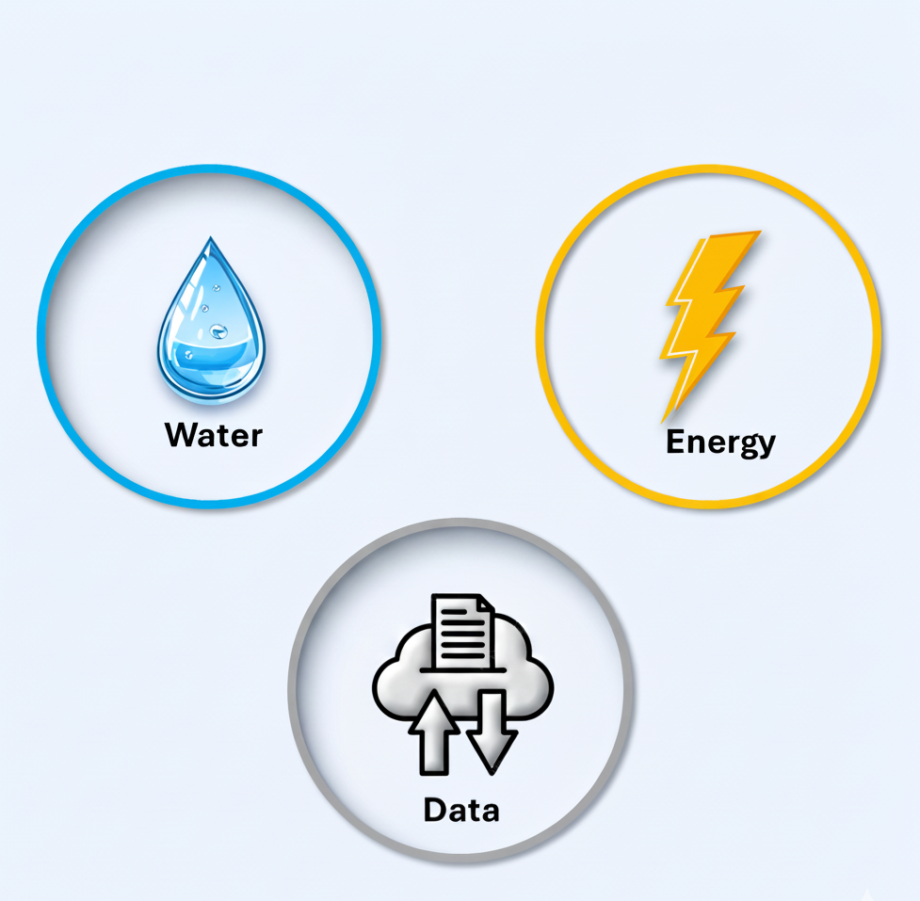
Power generation
requires water
Cooling
demands
water
Server
consumes
electricity

Slide 2
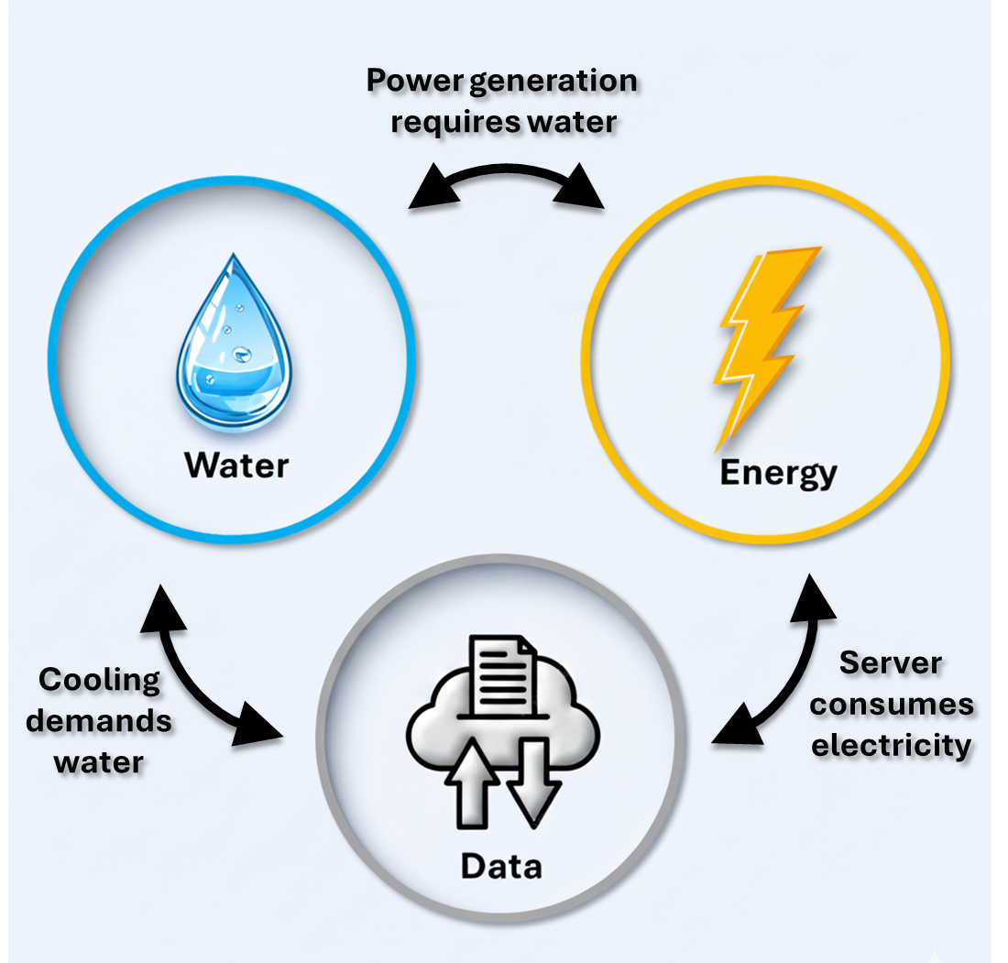

Slide 3
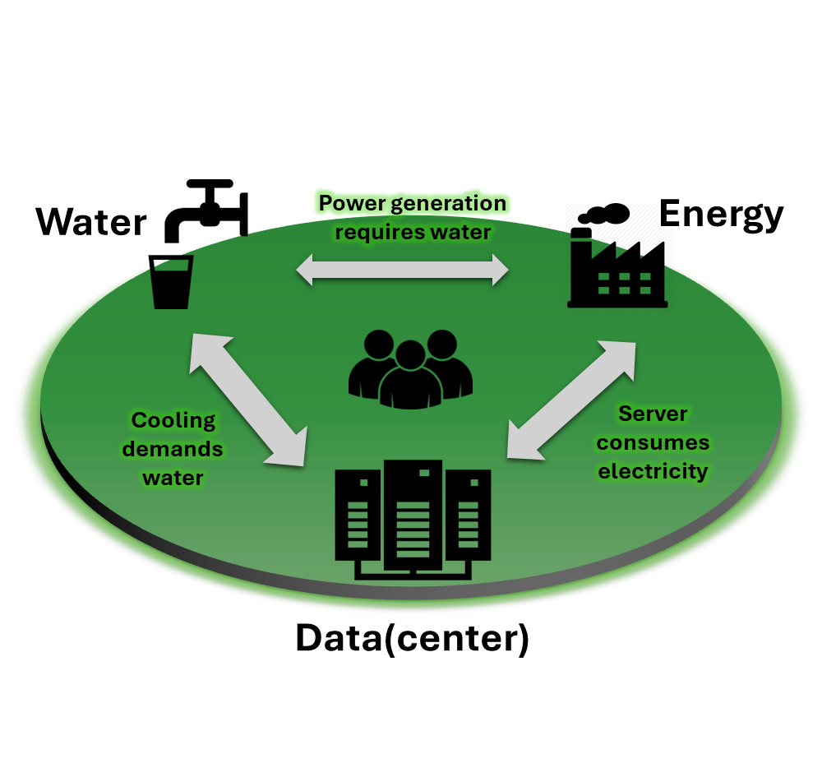




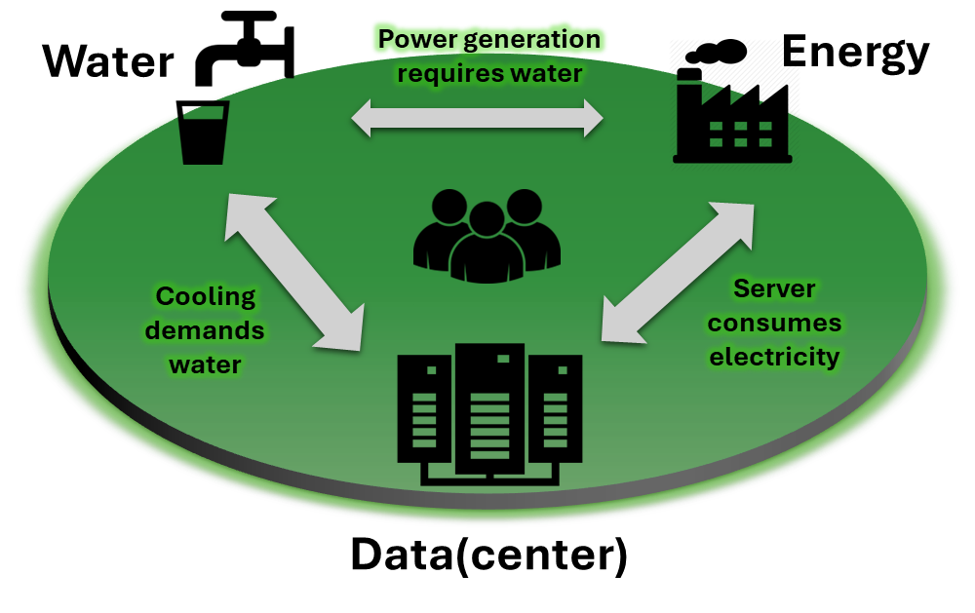
Water
Power generation requires water
Energy
Cooling demands water
Server
consumes
electricity
Data(center)

