Slide 1


Awareness Training: Protecting Against Phishing
Focused support for team winner

Slide 2

What is phishing?
It is the a type of cyberattack that uses fraudulent emails, text, messages and phone calls to trick people into sharing sensitive data (Kosinskie, 2024).

Slide 3

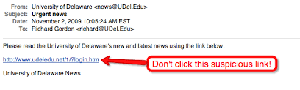


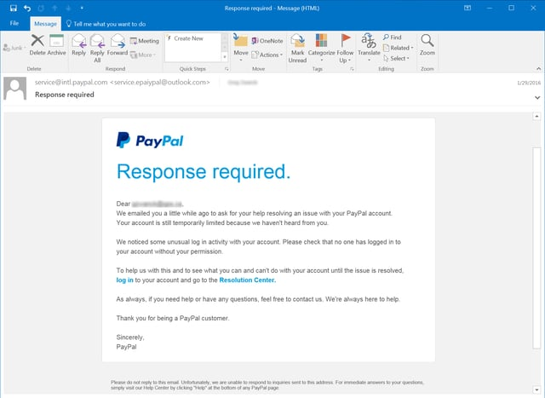

1. How to spot a phishing email
Is the sender’s email slightly misspelled?
Is there urgency (e.g, “Act Now”)?
Are there suspicious links or attachments ?
Is the greeting generic? (e,g “Dear user”)

Slide 4
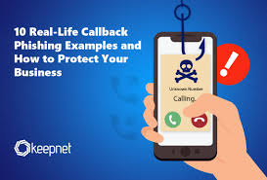
2. Voice Phishing Tactics (Phone calls)
Caller pretends to be from IT, HR or a bank.
You are asked for sensitive information like passwords or one-time PINs.
Call includes threats(“your account will be locked”) or urgency.
Caller ID may appear spoofed(looks legitimate)

Slide 5
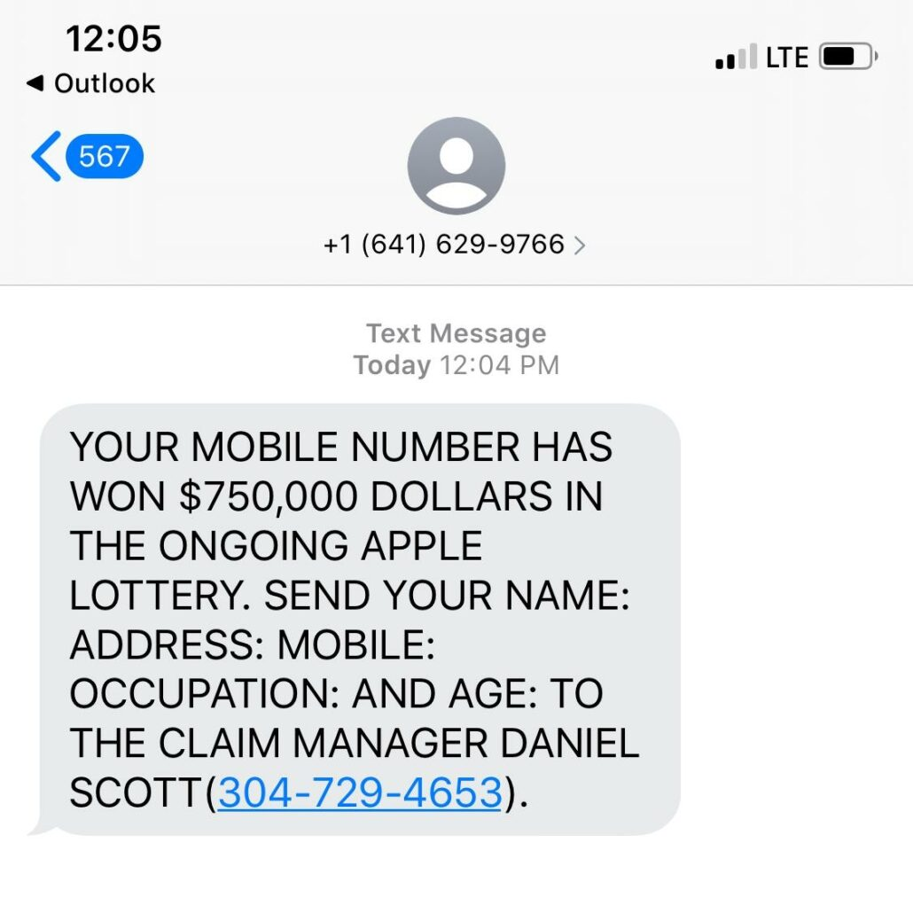
3. Text Phishing Tactics(SMS)
Messages contain shortened or odd-looking links
Urgent language (“your package delayed”, “confirm your account now”)
Request for sensitive info or to call a number.

Slide 6
AI-Driven Phishing Attacks
What is AI Phishing?
Cybercriminals now use Artificial Intelligence (AI) to create more convincing phishing attacks.
AI-powered attacks appear more personalized and harder to detect.
Examples of AI Phishing:
1. AI-Generated Emails – flawless grammar, realistic tone, and personalization.
2. Deepfake Voice Phishing – AI mimics a manager’s or colleague’s voice.
3. Chatbot Phishing – malicious bots posing as customer support agents.
4. AI-Enhanced SMS Phishing – smarter, context-aware text messages.
How to Defend Against AI Phishing:
Verify requests (Zero Trust principle).
Stay updated through awareness and training.
Use Multi-Factor Authentication (MFA).
Employ AI-driven detection tools.

Slide 7
How to stop Phishing
Tips
Hover before clicking: Check where links actually lead.
Don’t share credentials: Even if the email looks official
Report suspicious emails: use the “Report Phishing” button or contact IT
Take your time: Pause and think before reacting.

Slide 8

Recognizing Fake Websites
Check the URL carefully: Look for subtle misspellings or extra characters.
Look for HTTPS: While not foolproof, secure sites should have a padlock symbol.
Inspect the design: Low-quality images, broken links, or outdated layouts can be signs.
Verify legitimacy: Type the official web address into your browser instead of clicking links.
Check contact information: Legitimate sites usually list verifiable phone numbers or address

Slide 9
Social Engineering Tactics Attackers use
Pretexting: Fabricating a scenario to gain trust (e.g., pretending to be IT support).
Baiting: Offering something enticing (e.g., free downloads) to trick you into action. –
Quid pro quo: Offering a service in exchange for information.
Tailgating: Physically following someone into a restricted area.
Emotional manipulation: Creating fear, urgency, or curiosity to push quick decisions.

Slide 10

Real-World Examples
Example 1: An email claiming to be from your bank asking you to 'verify your account' with the company.
Example 2: A text saying your delivery is delayed and asking you to click a shortened URL3.
Example 3: A phone call from 'IT' telling you your password will expire unless you reset it in an hour.

Slide 11
Quiz-Time
Question 1
You get an email from 'support@micros0ft.com' asking you to reset your password.
A. Nothing—it’s Microsoft.
B. The domain is misspelled.
C. It’s a normal request.
Question 2
A website says you’ve won a prize and asks for your credit card to 'process ship’.
A. Give details.
B. Close the site and report it.
C. Call the number provided on the page.
Question 3
A coworker asks for a file via e-mail but their tone seems unusual. What should you do?
A. Send the file.
B. Call or message them through another method to confirm.
C. Ignore the request completely.

Slide 12
Correct Answers
Ouestion 1: B
Question 2: B
Question 3: B

