Slide 1




Computer Network & Programming Term Project
Cupet
Team3 - 김기현, 노인욱, 김소정, 신승건, 이서빈

Slide 2


CONTENTS
01
Title
02
Member information
03
Main goal & Brief description of project
04
Contents
05
Key features
06
Required technology for implementation
07
Roles of each member

Slide 3
01
Title
Cupet
(Cupid + pet)
Raising a virtual pet for people suffering from social depression, such as distance-keeping
in Corona mix

Slide 4

02
Member information
김기현
201732506
노인욱
201731316
rlgus2738@naver.com
niu9786@gmail.com
김소정
201833610
이서빈
201935096
thth806@gachon.ac.kr
신승건
201935069
leeseobin000709@gmail.com
ssg2864@gmail.com

Slide 5

03
Main goal
Raising a virtual pet
for people
Chatting to communicate with the pet

Slide 6



03
Brief description of project
Selecting a pet
Raising a pet
Communicating with a pet

Slide 7
04
Contents
Selecting a pet
- first-time users choose which pet to grow using the button
- enter a string from the user to name the pet
Raising a pet
- image representation of pet growth process
- add variable background music depending on the situation
- feeding/shower/play function implemented as a button
- user: Implemented by the GUI button to receive command
- server: output to the pet’s response string for that command
Communicating with a pet
- user: enter what user want to say to the pet in the text box
- server: output as a response string to a user’s word

Slide 8
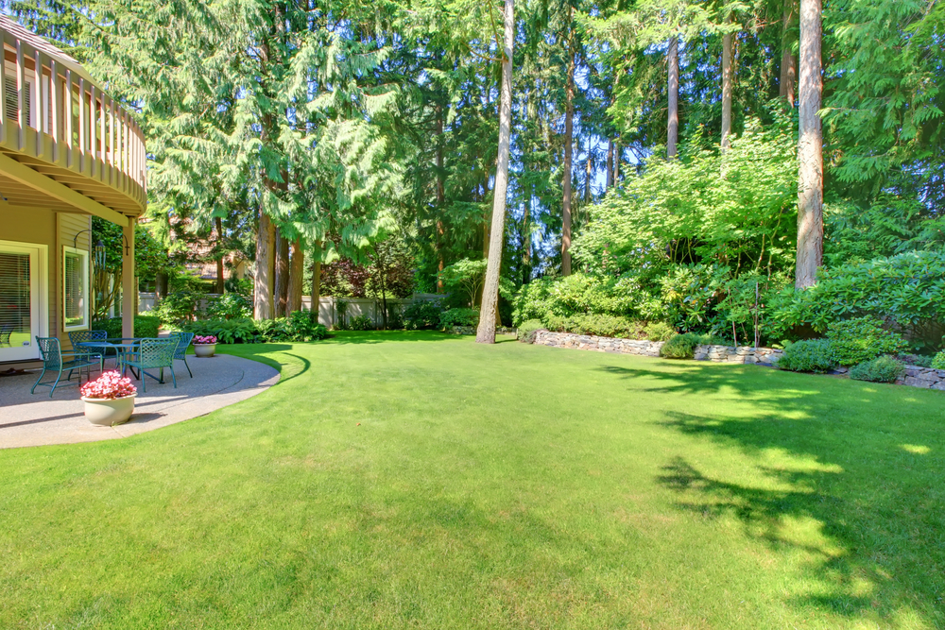
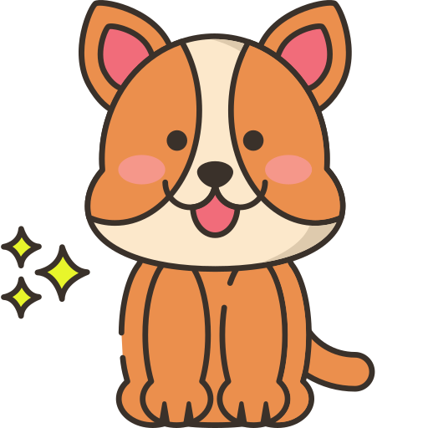


05
Key features – selecting a pet
Puppies/Cats/Meerkats are selected using buttons implemented using the GUI
CuPet
반려동물을 선택하세요.
Name the pet after selection
강아지
고양이
미어캣
Add background music

Slide 9





05
Key features - feeding
CuPet
User: Click the Feed/Snack button to feed the pet
다롱이
Server: Pet responds, “얌얌 맛있어요＂

Slide 10
05
Key features - shower
CuPet
User : Click the shower button implemented using the GUI
다롱이
Server: Pet responds, “아이 개운해요＂

Slide 11
05
Key features - playing
CuPet
다롱이
User : Click the Play button
Server: Pet responds, “즐거워요＂

Slide 12
05
Key features - communicating
CuPet
Server : Response to a given keyword
다롱이
Recognize strings except for interrogations, emoticons, etc.
“잘 모르겠습니다＂answers difficult sentences, typos, etc.
Keywords are specified so that users can enter content for keywords.

Slide 13
05
Key features – pet growth
CuPet
다롱이
Image of pet size change over time/with food intake

Slide 14


06
Required technology for implementation
Network formation between servers and clients
- client/server structure
- Implemented through Socket programming/multi-thread using Python

Slide 15


06
Required technology for implementation
Image / Button/Dialog Window Implementation using GUI
- Image: Show pet size changes and express movement as animation or image changes - Pet's reaction: The pet responds according to the button pressed by the user - Button: Dog/cat/meerkat, feeding/showering/playing, feeding/snacking, and throwing/taking a walk. - Chatting service through text boxes that users can type in and output boxes that can hear answers from the pet.
CuPet
CuPet
다롱이
다롱이
CuPet
CuPet
얌얌 맛있어요.
다롱이
다롱이

Slide 16
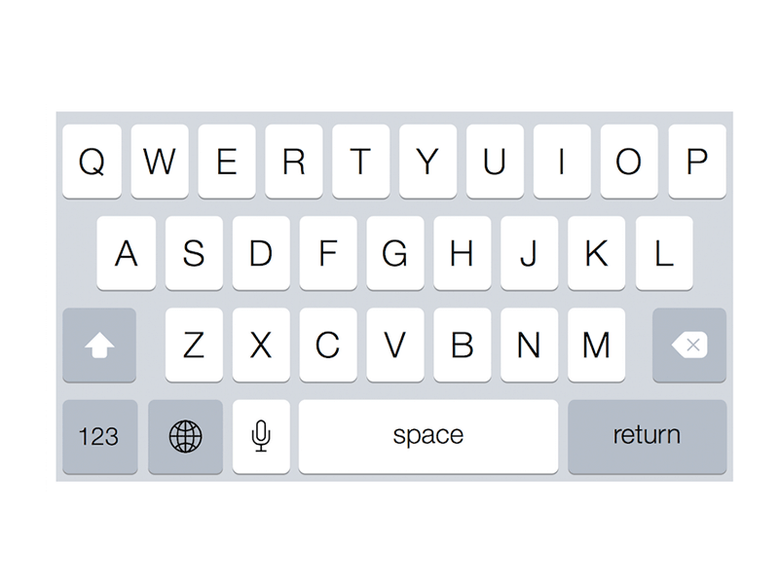
06
Required technology for implementation
chat service - Implementing a text box using Python GUI for users to enter text - Distinguish characters, emoticons, etc. from the entered string - Find the specified keyword in the text - The response output of the pet that matches the keyword. - Output a string "잘 모르겠습니다." when the user enters a difficult or misspelled sentence.
CuPet
다롱이

Slide 17


06
Required technology for implementation
client
Server
client
Server
Click snake button
Input “안녕” string
Print “얌얌 맛있어요”
Print the corresponding “안녕” recognition of the keyword “안녕”
Click shower button
Input “오늘 몇시에 잘거야?”
The keyword has not been determined, so we have printed “잘모르겠습니다”
Print “아이 개운해요”
.
.
.
.
.
.

Slide 18




07
Roles of each member
Name : 김기현
Role: presentation + implement chat service
Name : 노인욱
Role: proposal + implement GUI image
Name : 김소정
Role: final report + implement chat service
Name : 신승건
Role: final report + implement network & chat service
Name : 이서빈
Role: proposal + implement GUI button & conversation screen

Slide 19
08
Implementation issue & error situation

Slide 20
Thank you

