Slide 1

Ch. 1 Introduction
Division of Computer Science and Engineering
Hanyang University

Slide 2

Contents
Introduction, Key Security Concepts
Security Trends
Security attacks, Security services, Security mechanisms
A Model for Network Security
& A Model for Computer Security

Slide 3
Introduction
Information security
  Securing all kinds of data even if they are not electronic.
    For example, the use of lock for a cabinet storing sensitive information
Computer security
  Securing data stored in computers
Network security or Internet security
  Securing data transmitted over interconnected networks.

Slide 4

Introduction
Computer security (By NIST Computer Security Handbook)
  The protection afforded to an automated information system in order to attain the applicable objectives of preserving the integrity, availability, and confidentiality of information system resources (including H/W, S/W, firmware, information/data, and telecommunications)
Confidentiality
  Assures that private or confidential information is not made available or disclosed to unauthorized individuals
Integrity
  Assures that information and program should be changed only in a specified and authorized manner
Availability
  Assures that systems work promptly and service is not denied to authorized users.

Slide 5

Key Security Concepts
Notes:
These three concepts form what is often referred to as the CIA triad (Figure 1.1). The three concepts embody the fundamental security objectives for both data and for information and computing services. FIPS PUB 199 provides a useful characterization of these three objectives in terms of requirements and the definition of a loss of security in each category:
• Confidentiality: Preserving authorized restrictions on information access and disclosure, including means for protecting personal privacy and proprietary information. A loss of confidentiality is the unauthorized disclosure of information.
• Integrity: Guarding against improper information modification or destruction, and includes ensuring information non-repudiation and authenticity. A loss of integrity is the unauthorized modification or destruction of information.
• Availability: Ensuring timely and reliable access to and use of information. A loss of availability is the disruption of access to or use of information or an information system.
Although the use of the CIA triad to define security objectives is well established, some in the security field feel that additional concepts are needed to present a complete picture. Two of the most commonly mentioned are:
• Authenticity: The property of being genuine and being able to be verified and trusted; confidence in the validity of a transmission, a message, or message originator. • Accountability: The security goal that generates the requirement for actions of an entity to be traced uniquely to that entity.

Slide 6
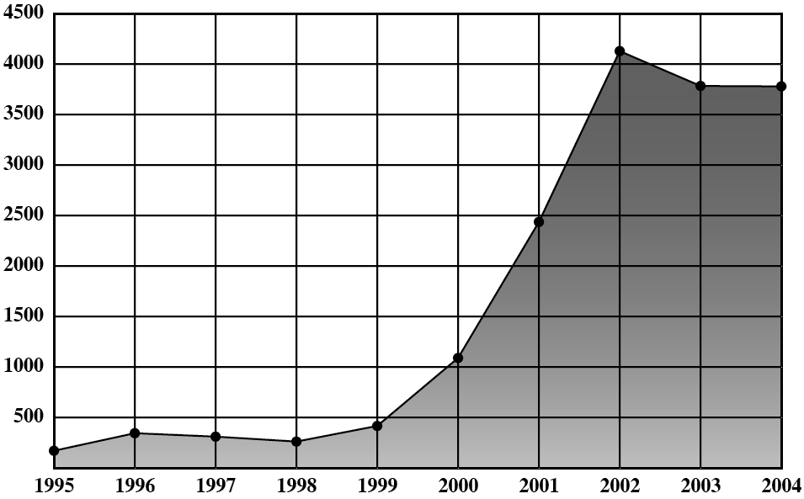
Security Trends
Internet–related vulnerabilities

Slide 7
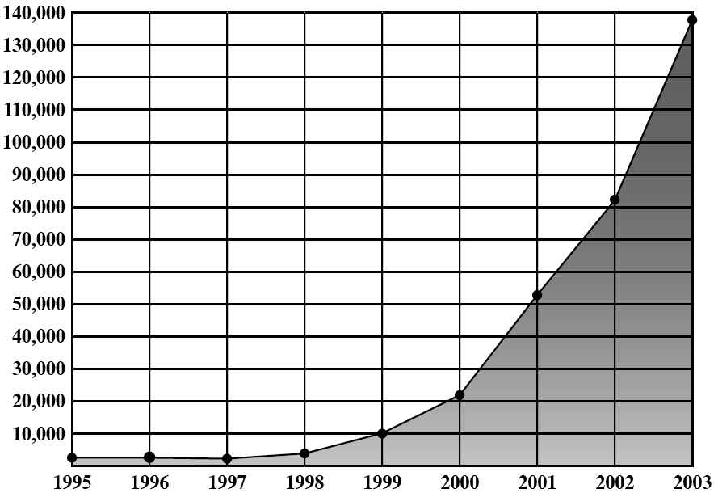
Security Trends
Security-related incidents

Slide 8
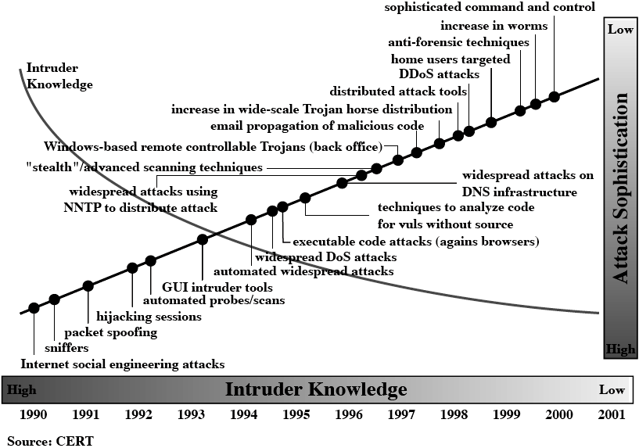
Security Trends
Attack sophistication and intruder knowledge
High
Low

Slide 9
The OSI Security Architecture
ITU-T Recommendation X.800, Security Architecture for OSI defines
  Security attack
    Any action that compromises the security of information
  Security service
    A service making use of security mechanisms to counter security attacks.
  Security mechanism
    A process designed to detect, prevent, or recover from a security attack

Slide 10
Security Attacks
Security Attacks
  Passive Attacks
    Observing the information from the system
    without affecting system resources.
  Active Attacks
    Try to alter system resources or affect their operation.

Slide 11
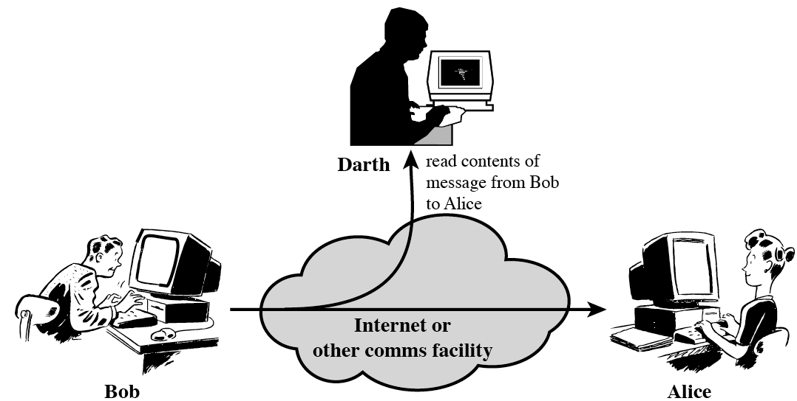
Passive Attacks
Release of message contents

Slide 12
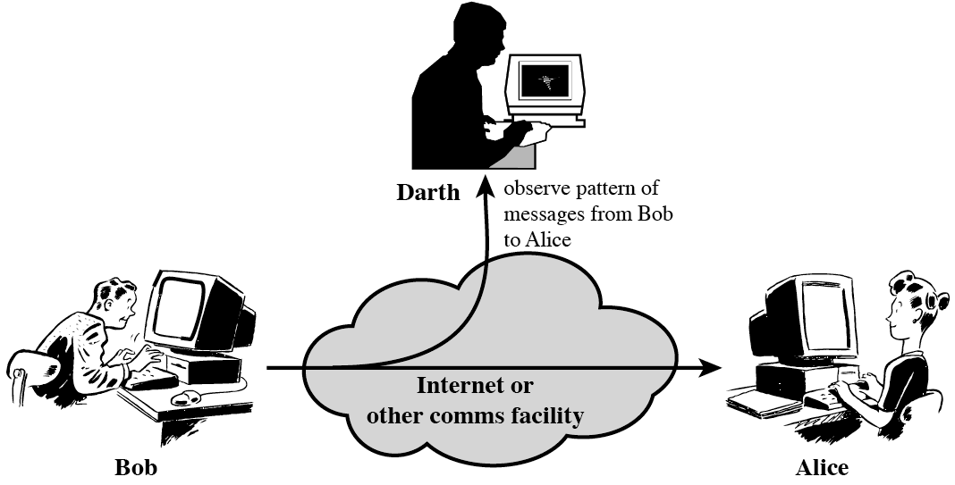
Passive Attacks
Traffic analysis

Slide 13
Passive Attacks
Passive Attacks
  Difficult to detect (after they occurred)
    ➔ because they do not involve any change of the data.
  Thus, they should be prevented rather than be detected.

Slide 14
Active Attacks
Active attacks
  Creating illegitimate messages
    Masquerade (who)
    Replay (when)
    Modification of messages (what)
  Denying legitimate messages
    Repudiation
  Making system facilities unavailable

Slide 15
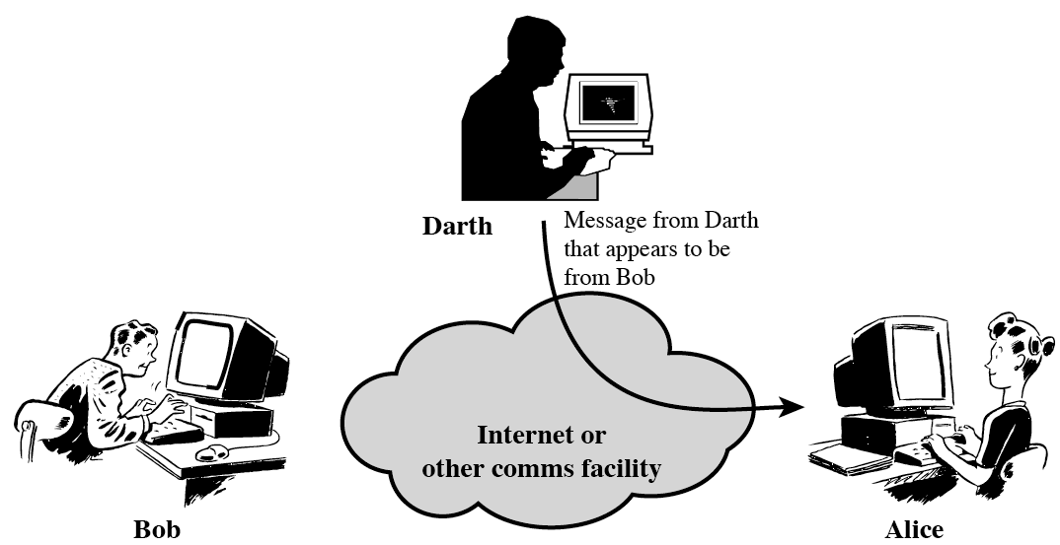
Active Attacks
Masquerade
  One entity pretends to be a different entity.

Slide 16
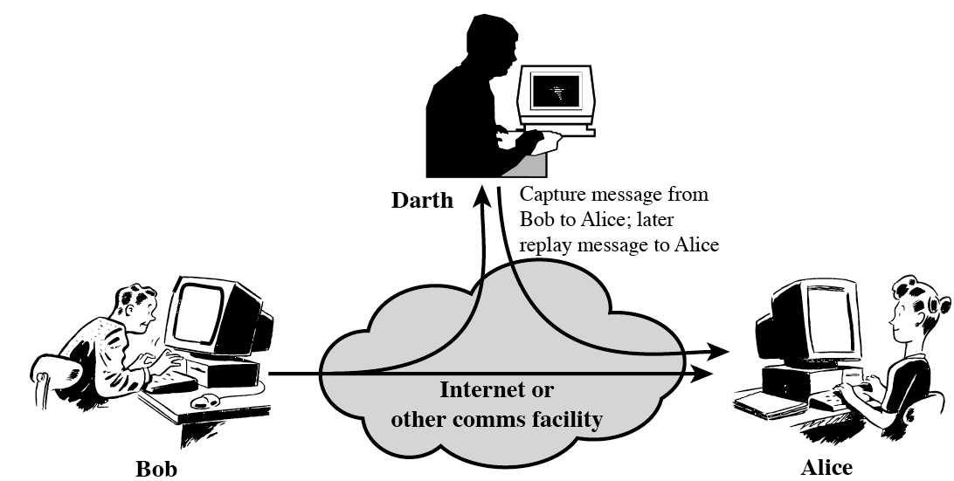
Active Attacks
Replay
  A message is captured and retransmitted later.

Slide 17
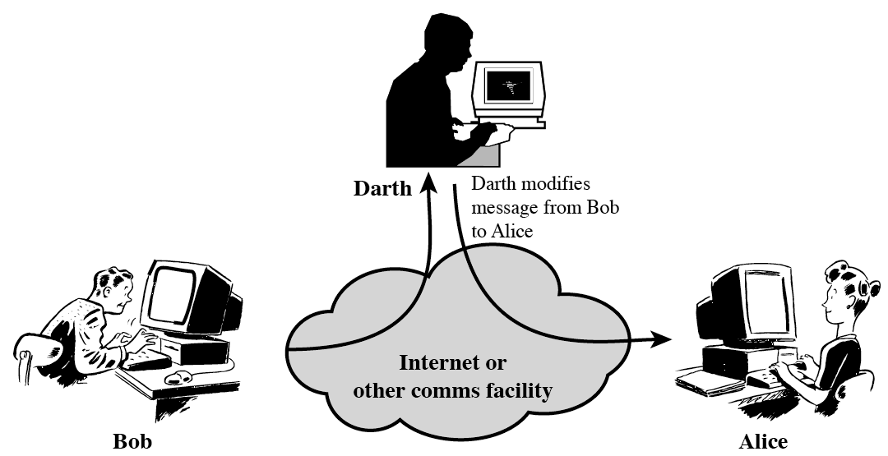
Active Attacks
Modification of messages
  A message is captured, modified, and transmitted.

Slide 18
Active Attacks
Repudiation
  Denial of sending or receiving legitimate messages.

Slide 19
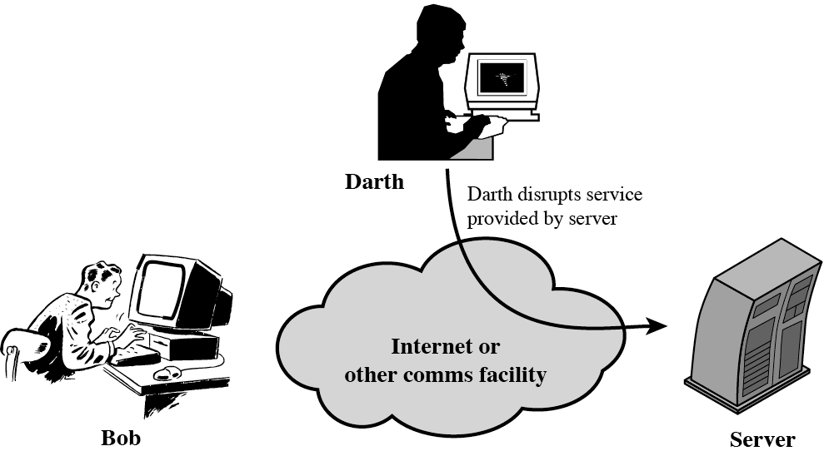
Active Attacks
Denial of service
  Making system facilities unavailable.

Slide 20
Active Attacks
Active Attacks
  Difficult to prevent
    Because of new vulnerabilities, new diverse attacks
  So, the goal is to detect active attacks and to recover as soon as possible.

Slide 21
Threat and Attacks
Threat and Attack
  Threat
    A possible danger
  Attack
    An assault on system security

Slide 22
Security Services
Security service
  A service making use of security mechanisms to counter security attacks.
  Categories of security services
    Authentication
    Access Control
    Data Confidentiality
    Data Integrity
    Non-Repudiation
    Availability

Slide 23
Security Services
Authentication
  Assuring the communicating entity is the one that it claims to be.
  To protect network from masquerade and replay
  Data origin authentication
    In a connectionless protocol,
    to assure the recipient that a single message is from the source that it claims to be.
  Peer entity authentication
    In a logical connection,
    to assure that the two entities are authentic and
    that the connection is not interfered by a third party.

Slide 24
Security Services
Access Control
  To prevent unauthorized use of a resource.
  This service controls
    who can have access to a resource,
    under what conditions access can occur, and
    what those accessing the resource are allowed to do.

Slide 25
Security Services
Data Confidentiality
  To protect data from release of message contents and traffic analysis.

Slide 26
Security Services
Data Integrity
  To assure that the data has not been modified during transmission.

Slide 27
Security Services
Non-repudiation
  To provide protection against denial by the sender or the receiver.
  Non-repudiation, Origin
    To prove that the message was sent by the sender
  Non-repudiation, Destination
    To prove that the message was received by the receiver

Slide 28
Security Services
Availability
  To provide system availability against denial-of-service attack.

Slide 29
Security Mechanisms
Security Mechanisms
  A process designed to detect, prevent, or recover from a security attack
  A security mechanism is a basic building block of security services.

Slide 30
Security Mechanisms
Specific Security Mechanisms
  Encipherment
  Digital Signature
  Access Control
  Data Integrity
  Authentication Exchange
  Traffic Padding
  Routing Control
  Notarization

Slide 31
Security Mechanisms
Encipherment
    (mathematical) algorithm to transform data into a form that is not readily intelligible.
Digital Signature
    Data appended to, or cryptographic transformation of, a data unit that allows a recipient of the data unit to prove the source of integrity and integrity of data, and protect against forgery.
Access Control
    A mechanism that enforces access rights to resources
Data Integrity
    A mechanism used to assure the integrity of a data unit

Slide 32
Security Mechanisms
Authentication Exchange
    A mechanism intended to ensure the identity of an entity by means of information exchange
Traffic Padding
    The insertion of bits into gaps in a data stream to frustrate traffic analysis attempts
Routing Control
    (Physically) secure routing scheme for certain data to defend against traffic analysis
Notarization
    The use of a trusted third party to assure certain properties of a data exchange

Slide 33
Security Mechanisms
Encipherment: Chapter 2, 3, 4, 5, 6, 7, 8, 9
Digital signature : Chapter 13
Access control : (Chapter 16), out-of-scope
Data Integrity: Chapter 12
Authentication Exchange : Chapter 14, 15, 16
Traffic padding: out-of-scope of our course
Routing control: out-of-scope
Notarization: out-of-scope
    Relationship between Security Services and Mechanisms
 | Encipherment | Digital Signature | Access Control | Data Integrity | Authentication Exchange | Traffic padding | Routing Control | Notarization
Peer entity authentication | Y | Y |  |  | Y
Data origin Authentication | Y | Y
Access Control |  |  | Y
Confidentiality | Y |  |  |  |  |  | Y
Traffic flow confidentiality | Y |  |  |  |  | Y | Y
Data integrity | Y | Y |  | Y
Nonrepudiation |  | Y |  | (Y) |  |  |  | Y
Availabilty |  |  |  | (Y) | (Y)
Notes:
Encipherment: Chapter 2, 3, 4, 5, 6, 7, 8, 9
Digital signature : Chapter 13
Access control : (Chapter 16), out-of-scope of our course (refer to another course)
Data Integrity: Chapter 12
Authentication Exchange : Chapter 14, 15, 16
Traffic padding: out-of-scope of our course
Routing control: out-of-scope
Notarization: out-of-scope

Slide 34
2 models for security
A model for network security
A model for computer security

Slide 35
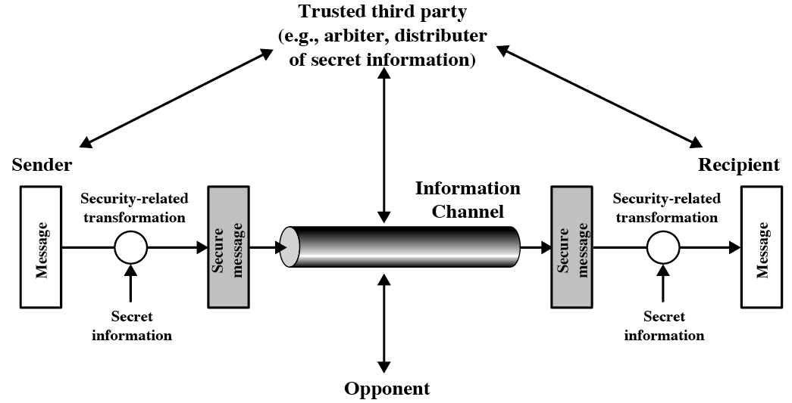
A Model for Network Security
Figure 1.5
  Protect the communication from opponents.

Slide 36
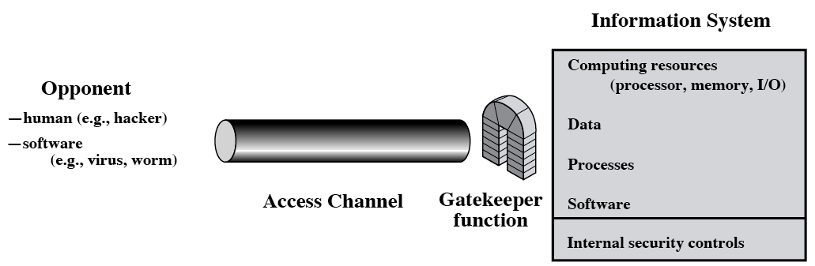
A Model for Computer Security
Figure 1.6
  Protect a system from unwanted access

Slide 37
A Model for Computer Security
  Information access threat
    To see or modify data in the system.
  Service threat
    To prevent legitimate users from using services of the system.

Slide 38
A Model for Computer Security
Security mechanisms against unwanted access are categorized as
  Gatekeeper function (prevention)
    Password-based login procedures to deny access to unauthorized users
    Screening logic to detect and reject worms, viruses.
  Monitoring activity (detection)
    Monitoring abnormal activities to detect unwanted intruders.

Slide 39
QnA
Thank you very much

