Slide 1
Semantic Web of Financial Information
PyData June 2016
Eric Tham
Enterprise Data Scientist

Slide 2
Contents
Background and evolution of information retrieval
Semantic Web of Information 3.0
Graphical Databases & RDFs
Demonstration
Use Cases in Finance

Slide 3
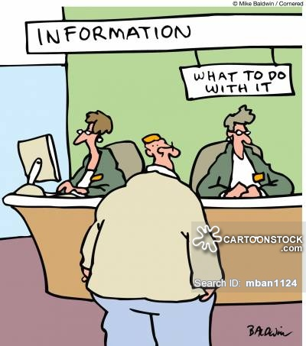

Slide 4
Information retrieval (IR) is the activity of obtaining information resources relevant to an information need from a collection of information resources. Searches can be based on or on full-text (or other content-based) indexing.
Wikipedia

Slide 5
Practical use of Information Retrieval
Topic classification
Sentiment analysis
Search Engine
Automatic classification
Auto-bot

Slide 6
Background of Information Retrieval
Word vector
Tf-idf
3. Similarity scoring: cosine similarity
4. Page Rank
LSI : latent semantic analysis

Slide 7
QUESTION: What is the unifying theme amongst these algorithms?

Slide 8
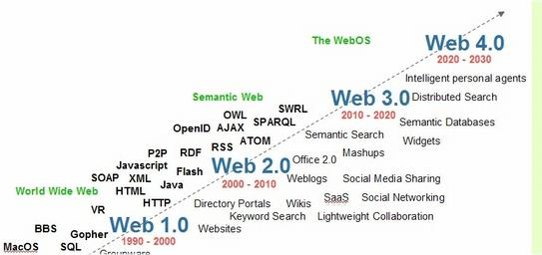
Semantic Web of Information 3.0

Slide 9
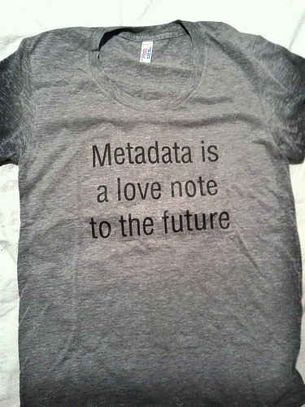
So is RDF!

Slide 10
Graphical Databases: RDF
A metadata data model that is a family of World Wide Web Consortium W3C
Similar to relational entities but at a granular level → triples
First released as W3C in 2004 then RDF 1.1 specification in 2014
In different serialisation format: n-triples, turtles, RDF/XML
Related ‘tools’ →SPARQL, OWL ontolgoy

Slide 11
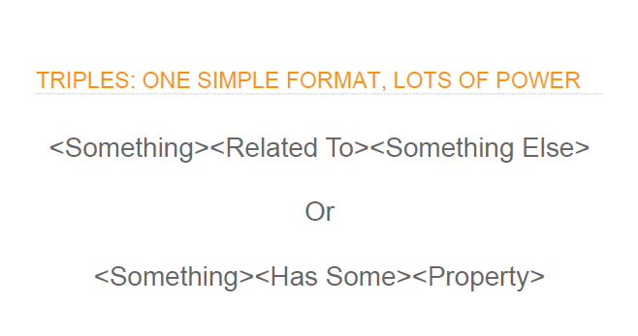
Subject -> Predicate -> Object

Slide 12
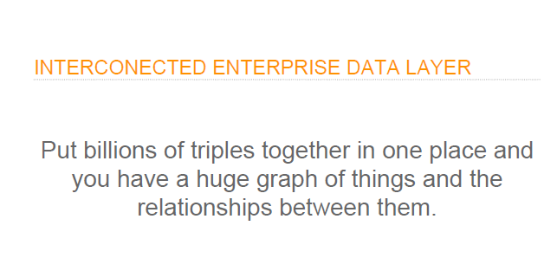
Principles of Big Open Linked Data

Slide 13
Thomson Reuters Initiatives:
PermIDs : http://www.permid.org
Open Calais : http://www.opencalais.com
DataFusion: https://www.youtube.com/watch?v=VkNG8TkEhBY
BOLD : Big Open Linked Data → part of linking data together

Slide 14
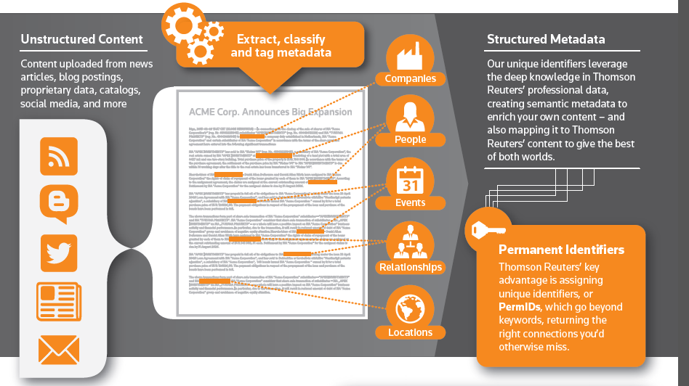
PermID and Intelligent Tagging (TRIT)
PermID are Permanent, unique Identifiers that can be used to classify and link information.
Intelligent Tagging is a Natural Language Processing engine to extract metadata from unstructured content, linking to PermIDs
PermID is FREE
Get your API key from http://permid.org

Slide 15




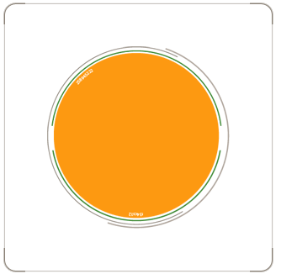

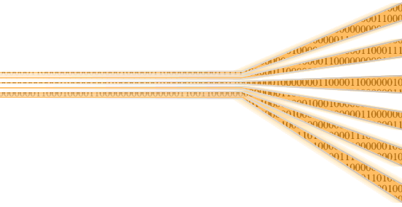



PermID and Intelligent Tagging (TRIT)
Client call transcripts
Client data
Filings
Broker Research
Internal Research
Emails
Legal Documents
Earnings calls
News
Blogs
Social Media
Internet
Paper archives
Structured Metadata
Our unique identifiers leverage the deep knowledge in Thomson Reuters’ professional data, creating semantic metadata to enrich your own content – and also mapping it to Thomson Reuters’ content to give the best of both worlds
TR Content
Market data
Company Data
Legal Entity data
IP & Science
etc
Intelligent and Actionable Insight and
Output:
To Staff and Clients
Proprietary Data
&
Client Data
Intelligent Tagging
Permanent Identifiers
Thomson Reuters’ key advantage is assigning unique identifiers, or PermIDs, which go beyond keywords, returning the right connections you’d otherwise miss
Proprietary Identifiers / Identifier Database Management

Slide 16
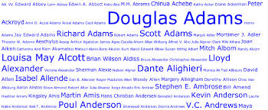


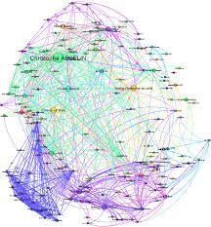
DATA FUSION – DATA Integration Process
TAG
INTEGRATE
STITCH
VISUALIZE
AND MINE ALL YOUR UNSTRUCTURED DATA WITH INTELLIGENT TAGGING
ALL YOUR PRIVATE AND PUBLIC DATA SETS
YOUR INTEGRATED DATA WITH UNIQUE PERMIDS
VIEW CONNECTIONS AND DRAW INSIGHTS

Slide 17
Demonstration (Jupyter Python)
Jupyter Python Notebook … …
Open Calais, PermID

Slide 18
Example Use Cases in Finance:
  Compliance and Risk
  Credit Risk Network: contagion
  Supply Chain Value Analysis
  Causality Analysis in Stress Testing

Slide 19
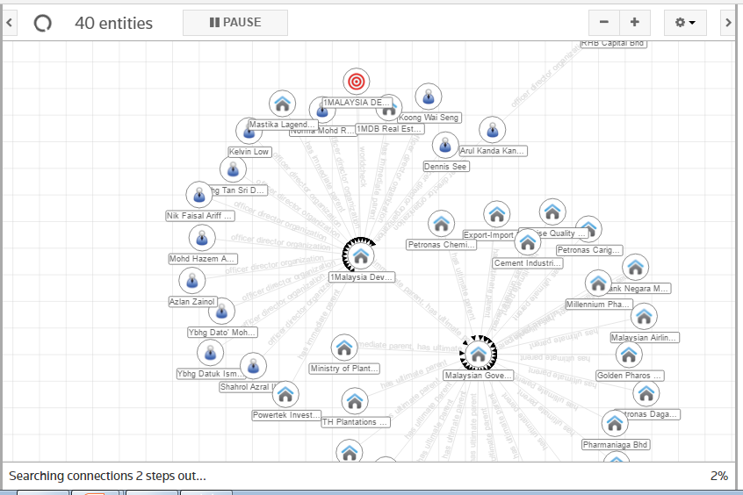
Compliance & Risk: KYC Application (if time permits)

Slide 20
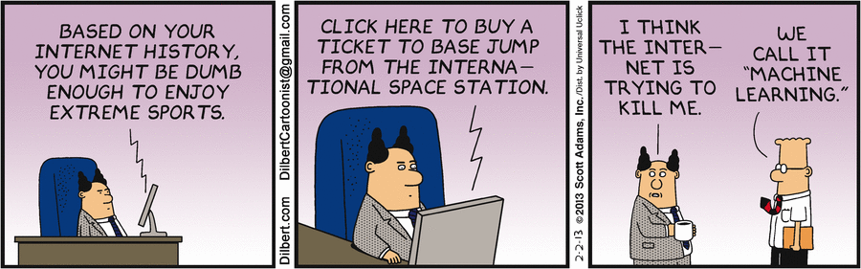
Finance: Not just patterns but causality
Social science not physical laws

Slide 21
Credit Risk Network (if time permits)
See demonstration … … of website

Slide 22
Conclusion
  Information ‘granules’ – the next Web 3.0
  Thomson Reuters : leading advocate of Big Open Linked Data
  Wide applications in risk management, compliance, asset management

