Slide 1

Python과 Tensorflow
딥러닝의 이해 및 응용
한림대학교 미래융합스쿨
김승찬
Week 01
2018/09/11

Slide 2
조별활동 (~중간고사)
남홍근 | 김혜주 | 장민욱 | 이용준 | 신예림 | 김현주 | 이소창
윤수정 | 고영우 | 김지호 | 전찬혁 | 이지원 | 이유경 | 최지원

Slide 3
Python 기초 및 설정

Slide 4
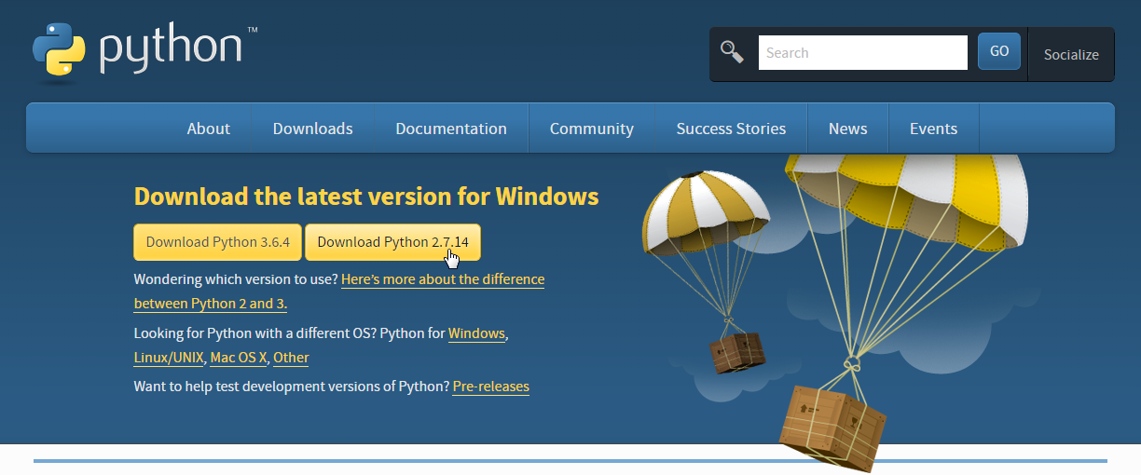

Slide 5
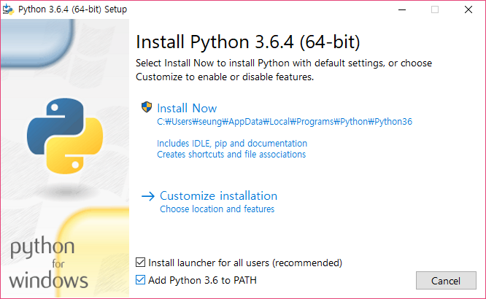

Slide 6
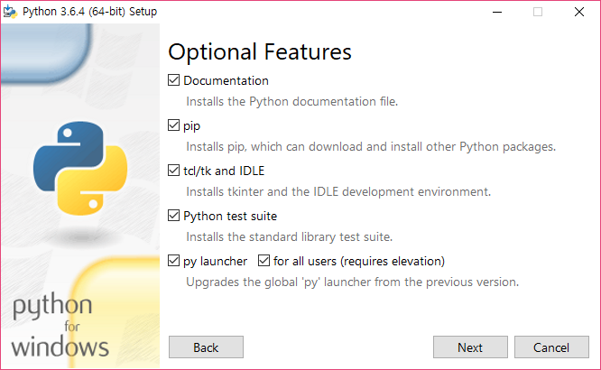

Slide 7
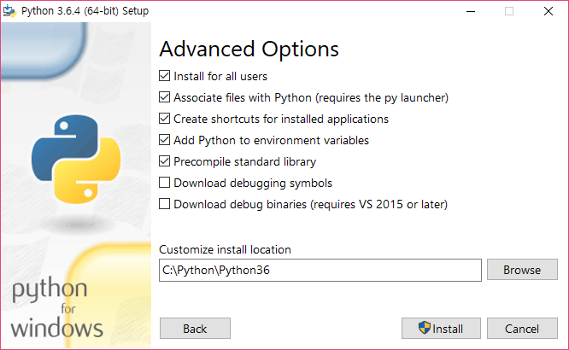

Slide 8
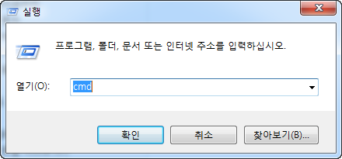
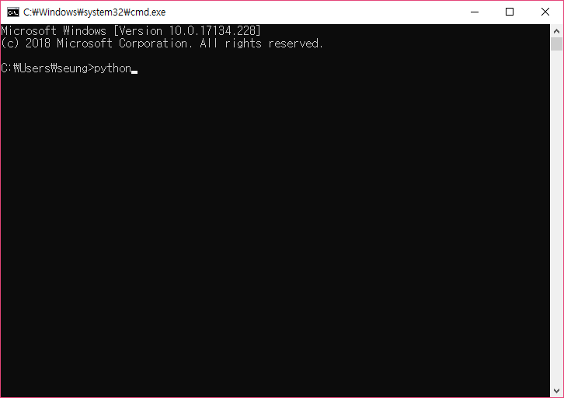
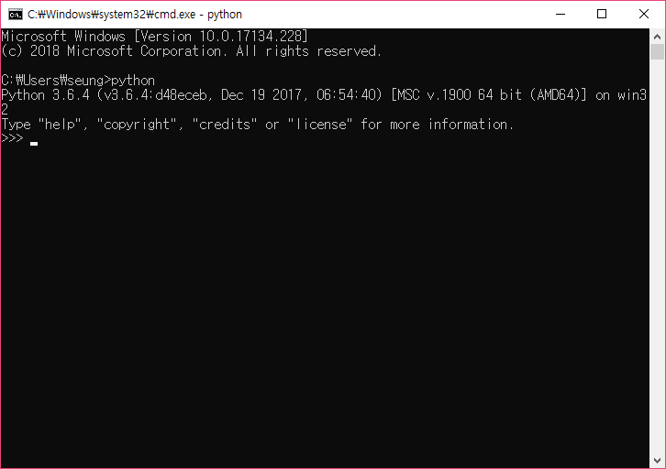
Notes:
https://github.com/rajathkmp/Python-Lectures/blob/master/00.ipynb

Slide 9
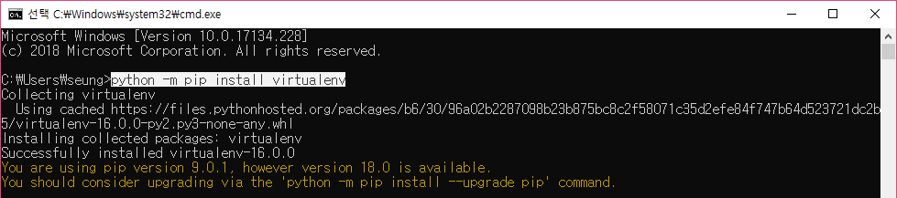
가상환경 구성
가상환경 구성 : Virtualenv
python –m pip install virtualenv
python의 가상환경이란, 작은 python을 새로 설치해서 내가 원하는 모듈만 운용하는 바구니라고 생각하면 된다. 운영체제 안에서 새로 운영체제를 만들어내는 가상 머신(virtual machine)과 같은 맥락이라고 볼 수 있다.

Slide 10
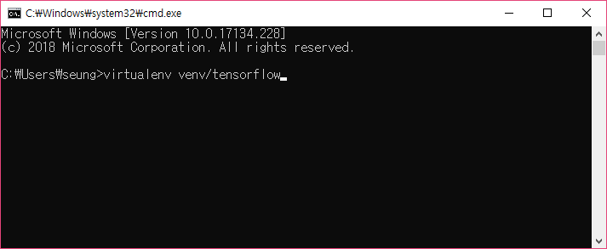
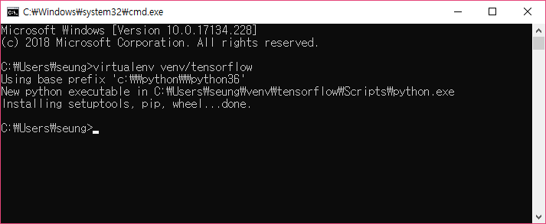
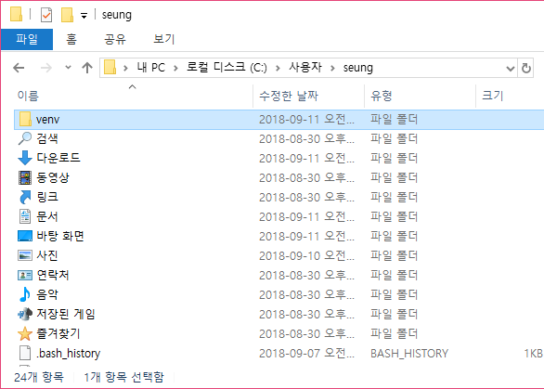
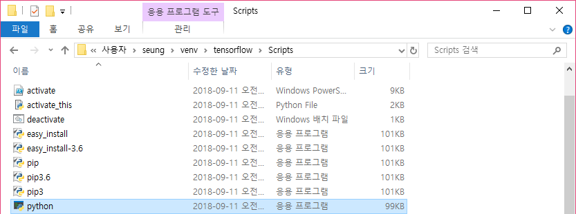
위치 기억 !
Python이 생겼음 !!

Slide 11
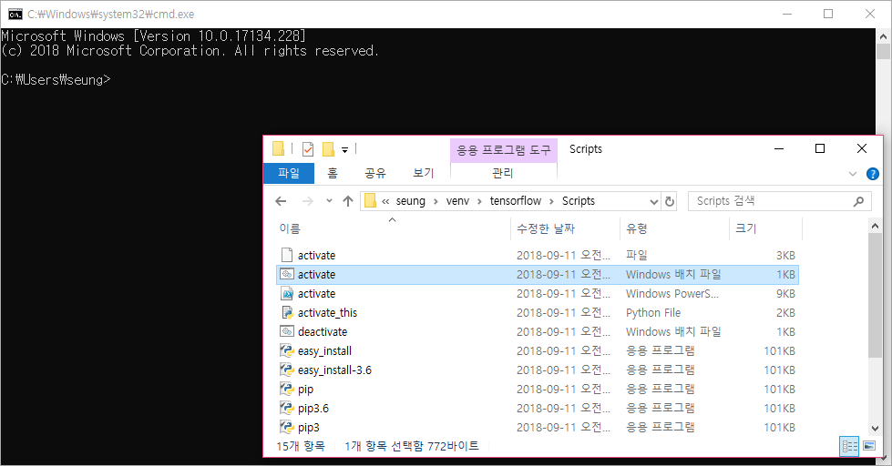
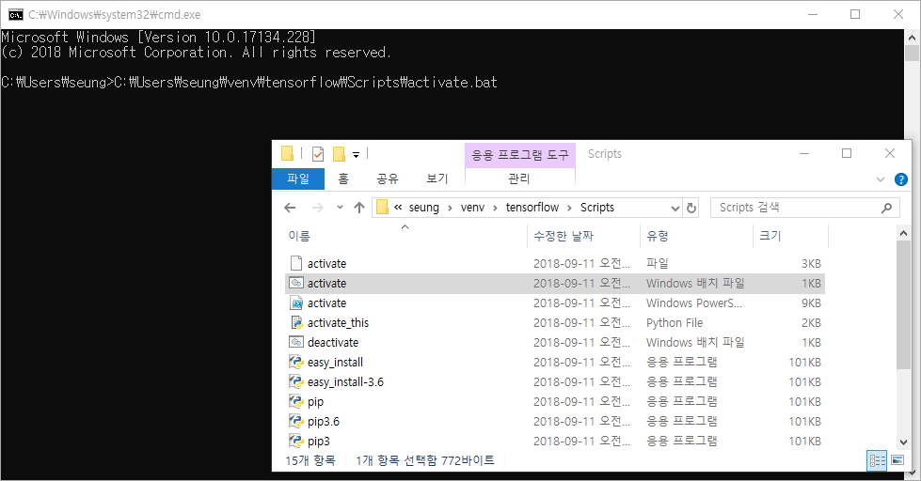
Drag
For beginners ☺

Slide 12
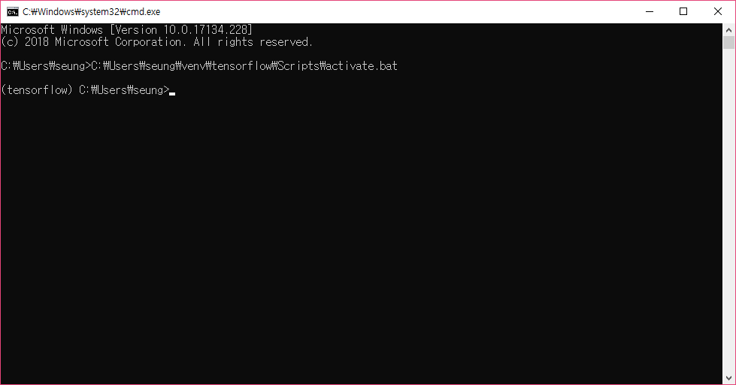

Slide 13
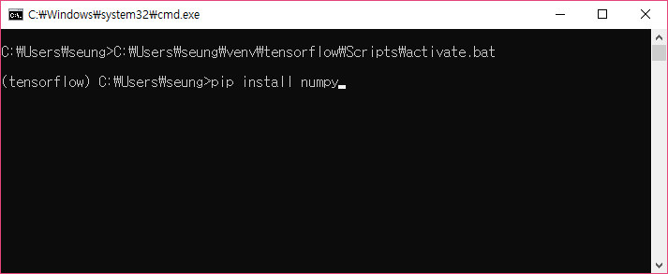
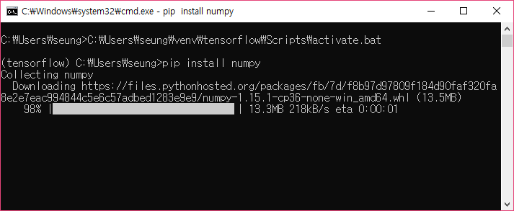
파이썬 패키치 설치
numpy
scipy
matplotlib
tensorflow
ipython[all]
tqdm
…

Slide 14
설치시 문제 1
Tensorflow 설치는 되나 import가 안됨
2018/9/13일 기준 : tensorflow 1.10 : python 3.6.6
이 경우 tensorflow를 삭제하고 (tensorflow) C:\Users\Hyejoo\710231> pip uninstall tensorflow
낮은 버전을 선택하여 재설치 (tensorflow) C:\Users\Hyejoo\710231> pip install tensorflow==1.6
Notes:
(tensorflow) C:\Users\Hyejoo\710231>pip install tensorflow==1.6
Collecting tensorflow==1.6
Downloading https://files.pythonhosted.org/packages/56/7d/a0e3ae33e8034be8e7d6b99a7f512c6e71b2180603fc3e0cfb6047b7374f/tensorflow-1.6.0-cp36-cp36m-win_amd64.whl (32.3MB)
100% |????????????????????????????????| 32.3MB 121kB/s
Requirement already satisfied: numpy>=1.13.3 in c:\users\hyejoo\venv\tensorflow\lib\site-packages (from tensorflow==1.6) (1.14.5)
Requirement already satisfied: six>=1.10.0 in c:\users\hyejoo\venv\tensorflow\lib\site-packages (from tensorflow==1.6) (1.11.0)
Requirement already satisfied: wheel>=0.26 in c:\users\hyejoo\venv\tensorflow\lib\site-packages (from tensorflow==1.6) (0.31.1)
Requirement already satisfied: grpcio>=1.8.6 in c:\users\hyejoo\venv\tensorflow\lib\site-packages (from tensorflow==1.6) (1.14.2)
Collecting tensorboard<1.7.0,>=1.6.0 (from tensorflow==1.6)
Downloading https://files.pythonhosted.org/packages/b0/67/a8c91665987d359211dcdca5c8b2a7c1e0876eb0702a4383c1e4ff76228d/tensorboard-1.6.0-py3-none-any.whl (3.0MB)
100% |????????????????????????????????| 3.1MB 137kB/s
Requirement already satisfied: protobuf>=3.4.0 in c:\users\hyejoo\venv\tensorflow\lib\site-packages (from tensorflow==1.6) (3.6.1)
Requirement already satisfied: absl-py>=0.1.6 in c:\users\hyejoo\venv\tensorflow\lib\site-packages (from tensorflow==1.6) (0.4.1)
Requirement already satisfied: termcolor>=1.1.0 in c:\users\hyejoo\venv\tensorflow\lib\site-packages (from tensorflow==1.6) (1.1.0)
Requirement already satisfied: astor>=0.6.0 in c:\users\hyejoo\venv\tensorflow\lib\site-packages (from tensorflow==1.6) (0.7.1)
Requirement already satisfied: gast>=0.2.0 in c:\users\hyejoo\venv\tensorflow\lib\site-packages (from tensorflow==1.6) (0.2.0)
Requirement already satisfied: markdown>=2.6.8 in c:\users\hyejoo\venv\tensorflow\lib\site-packages (from tensorboard<1.7.0,>=1.6.0->tensorflow==1.6) (2.6.11)
Collecting bleach==1.5.0 (from tensorboard<1.7.0,>=1.6.0->tensorflow==1.6)
Downloading https://files.pythonhosted.org/packages/33/70/86c5fec937ea4964184d4d6c4f0b9551564f821e1c3575907639036d9b90/bleach-1.5.0-py2.py3-none-any.whl
Collecting html5lib==0.9999999 (from tensorboard<1.7.0,>=1.6.0->tensorflow==1.6)
Downloading https://files.pythonhosted.org/packages/ae/ae/bcb60402c60932b32dfaf19bb53870b29eda2cd17551ba5639219fb5ebf9/html5lib-0.9999999.tar.gz (889kB)
100% |????????????????????????????????| 890kB 162kB/s
Requirement already satisfied: werkzeug>=0.11.10 in c:\users\hyejoo\venv\tensorflow\lib\site-packages (from tensorboard<1.7.0,>=1.6.0->tensorflow==1.6) (0.14.1)
Requirement already satisfied: setuptools in c:\users\hyejoo\venv\tensorflow\lib\site-packages (from protobuf>=3.4.0->tensorflow==1.6) (39.1.0)
Building wheels for collected packages: html5lib
Running setup.py bdist_wheel for html5lib ... done
Stored in directory: C:\Users\Hyejoo\AppData\Local\pip\Cache\wheels\50\ae\f9\d2b189788efcf61d1ee0e36045476735c838898eef1cad6e29
Successfully built html5lib
Installing collected packages: html5lib, bleach, tensorboard, tensorflow
Found existing installation: html5lib 1.0.1
Uninstalling html5lib-1.0.1:
Successfully uninstalled html5lib-1.0.1
Found existing installation: bleach 2.1.4
Uninstalling bleach-2.1.4:
Successfully uninstalled bleach-2.1.4
Found existing installation: tensorboard 1.10.0
Uninstalling tensorboard-1.10.0:
Successfully uninstalled tensorboard-1.10.0
Successfully installed bleach-1.5.0 html5lib-0.9999999 tensorboard-1.6.0 tensorflow-1.6.0

Slide 15
IPython
Python 개발 환경 설정

Slide 16

pip install ipython[all]

Slide 17
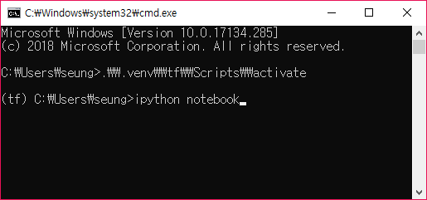
개인마다 다를 수 있음

Slide 18
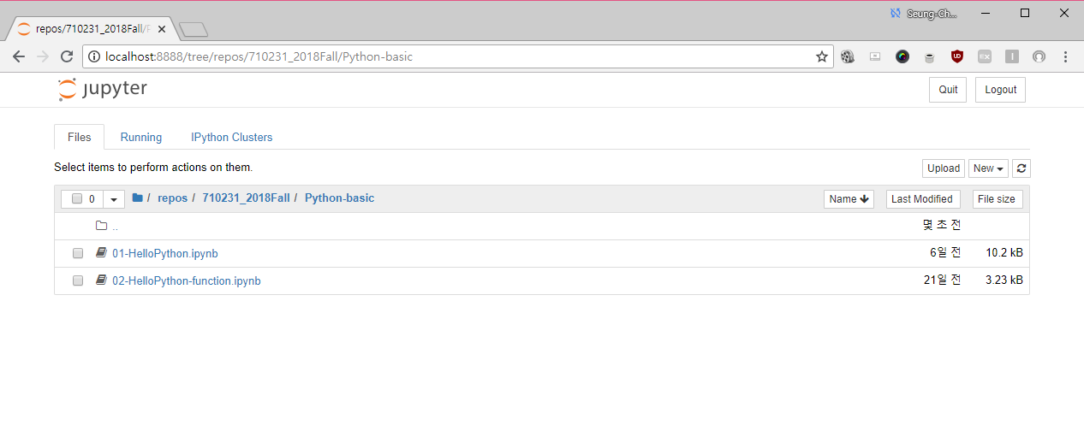

Slide 19
Pycharm (추후 사용 예정)
Python 개발 환경 설정

Slide 20
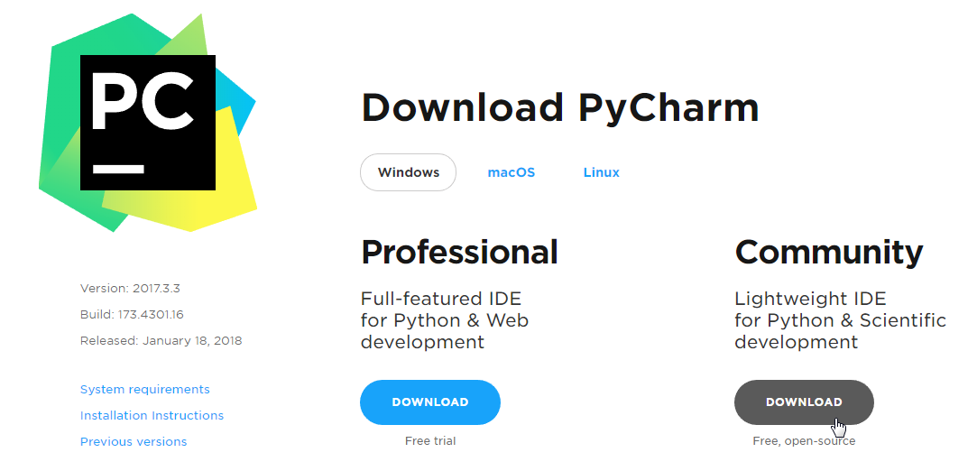

Slide 21

Pycharm-community 설치
직접 다운로드 및 설치
https://download.jetbrains.com/python/pycharm-community-2017.1.4.exe
또는
https://d.pr/FhSUkq (위의 링크가 느린 경우)
Community 버전을 다운로드

Slide 22
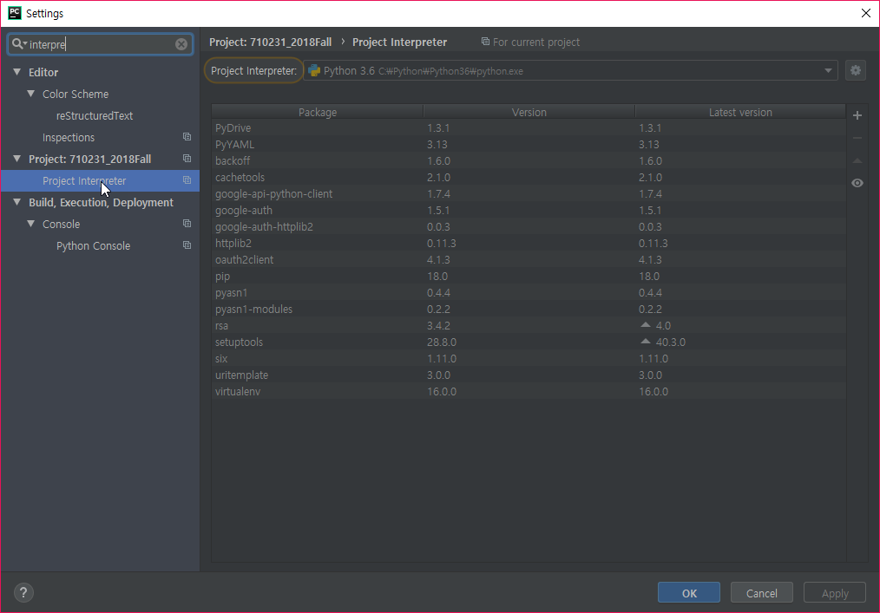
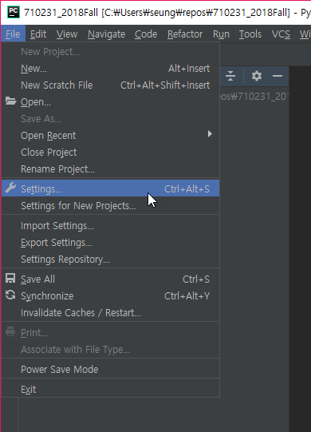
프로젝트 Interpreter 설정하기
Notes:
Interpreter 설정하기

Slide 23
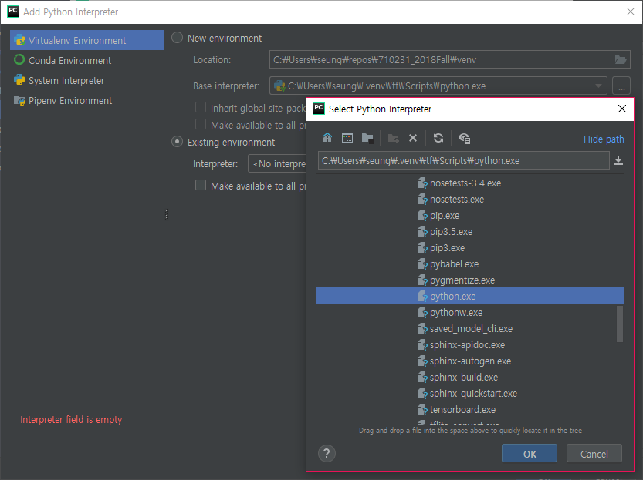
virtualenv 로 설치한 Python 폴더를 찾아가서 python.exe를 찾아서 OK를 누릅니다 (학생들마다 다를 수 있음)

Slide 24
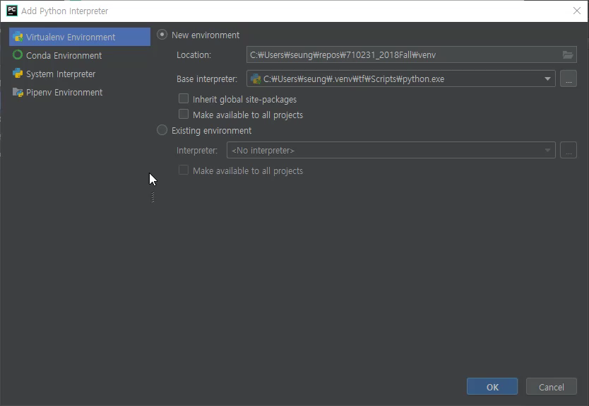

Slide 25
Tensorflow
소개

Slide 26
What’s TensorFlow™?
“Open source software library for numerical computation using data flow graphs”

Slide 27
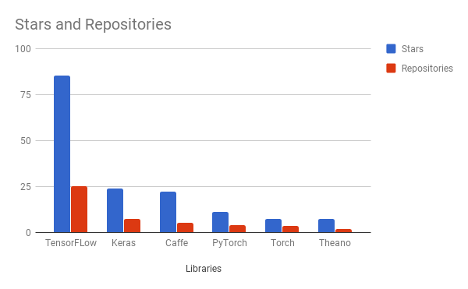
Why TensorFlow?
Flexibility + Scalability
Popularity

Slide 28
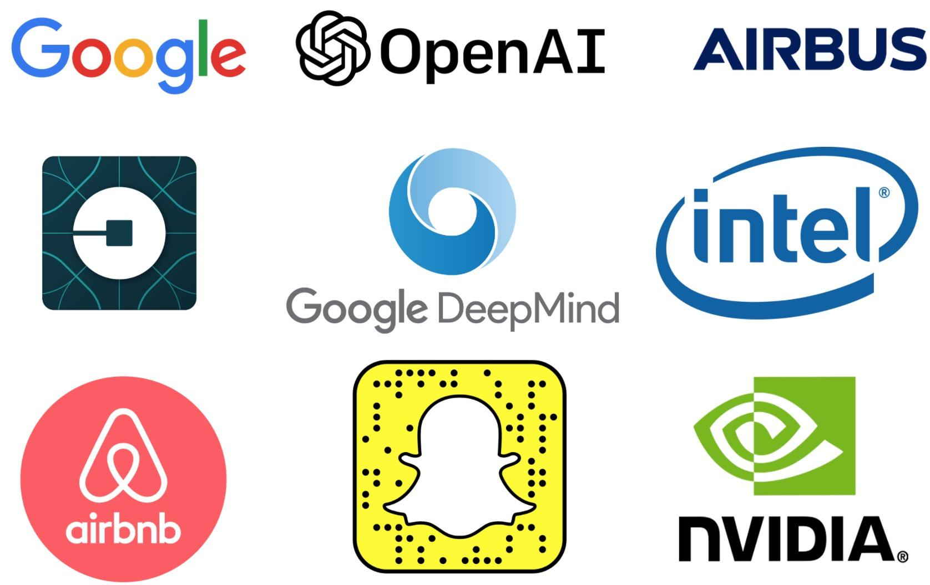
Companies using TensorFlow

Slide 29
Some cool projects using TensorFlow

Slide 30
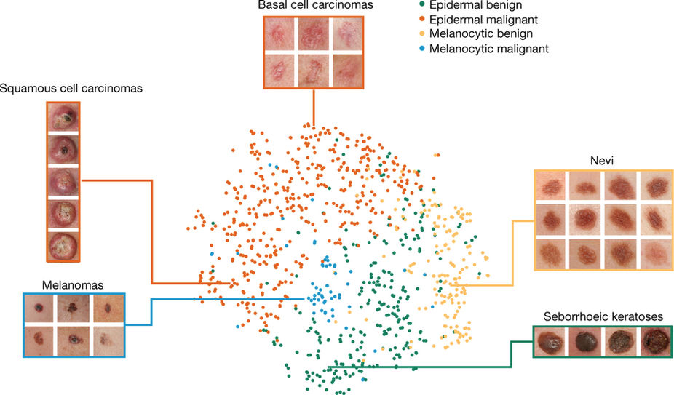
Classify skin cancer
https://www.nature.com/articles/nature21056
Dermatologist-level classification of skin cancer with deep neural networks (Esteva et al., Nature 2017)

Slide 31
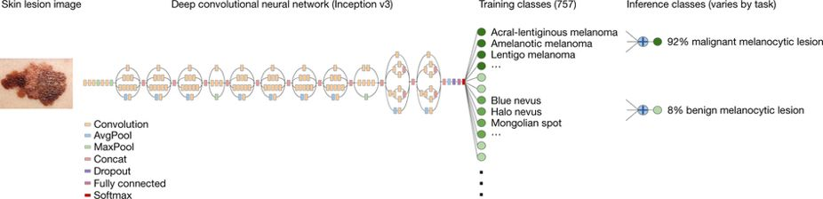
Classify skin cancer
악성 멜라닌(생성)세포 병변
양성 멜라닌(생성)세포 병변

Slide 32
Drawing
Draw Together with a Neural Network (Ha et al., 2017)

Slide 33
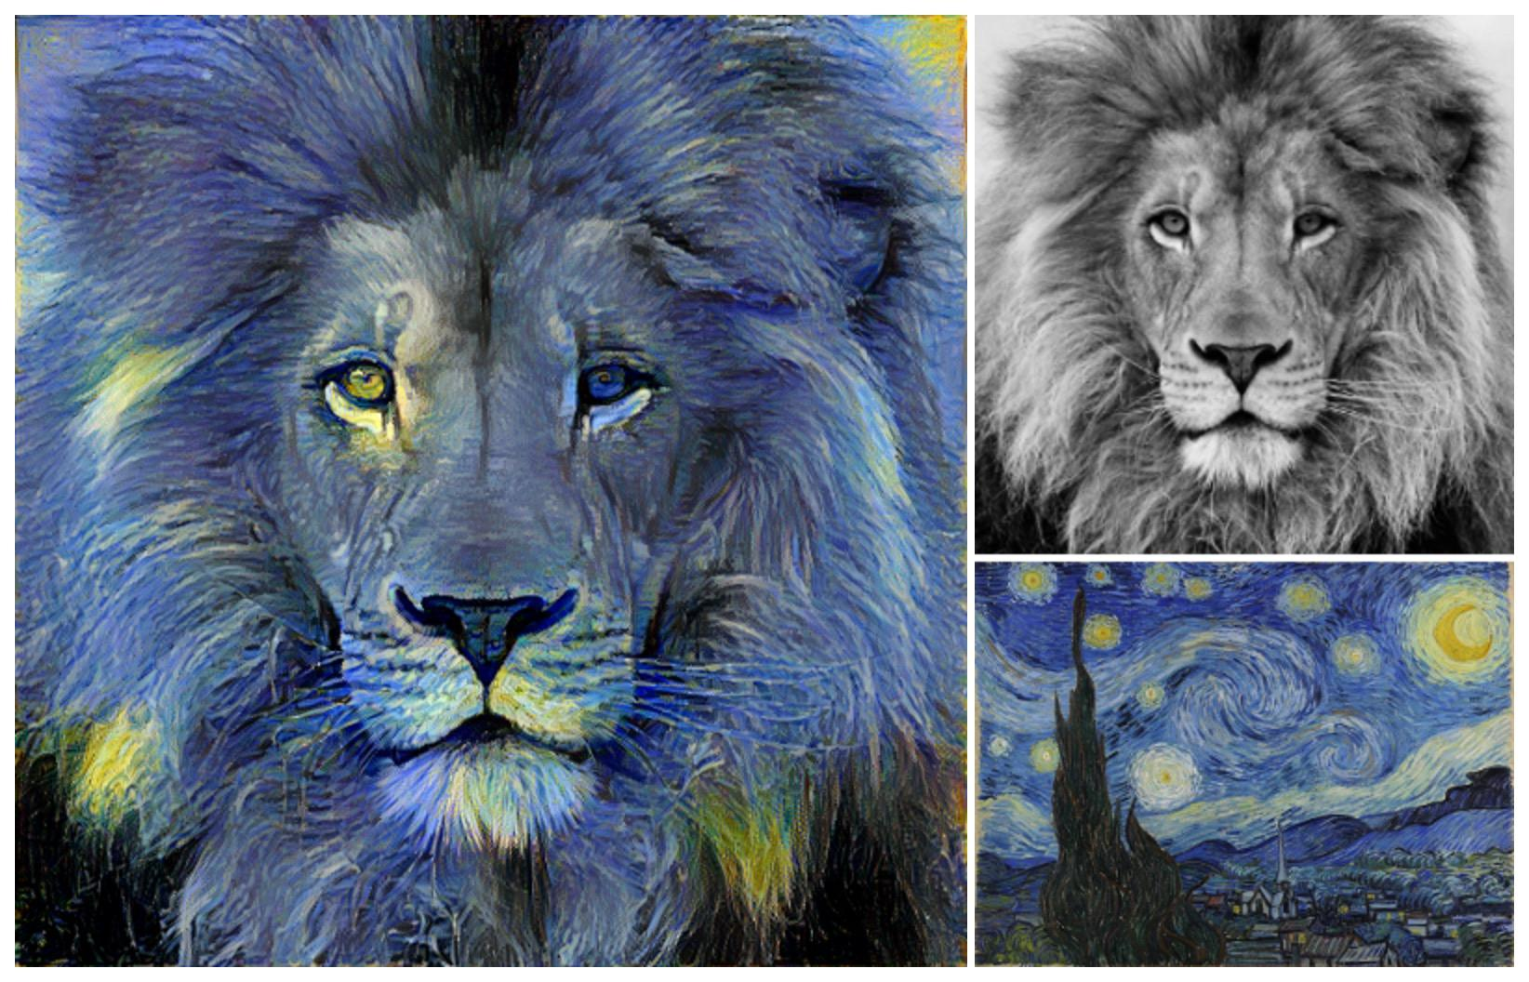
Neural Style Transfer
Image Style Transfer Using Convolutional Neural Networks (Gatys et al., 2016)
Tensorflow adaptation by Cameroon Smith (cysmith@github)
Notes:
Leon A. Gatys, Alexander S. Ecker, Matthias Bethge, (2015). A Neural Algorithm of Artistic Style

Slide 34
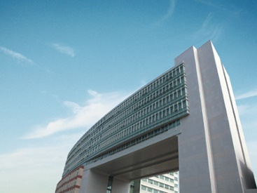
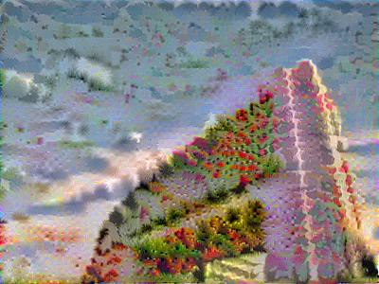
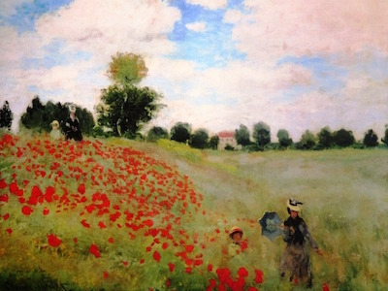
Neural Style Transfer

Slide 35
참고자료
CS20, Stanford University

Slide 36
Thank you!
Seung-Chan Kim
dalek@hallym.ac.kr

