Slide 1
회사 | 제품군 | 테마 | 제품명 | As-Is | 테마 | 색감
SOL | 서버보안 |  | RedCastle Manager | Red
 |  |  | EnterpriseCastle Manager | Blue
 |  |  | SentryAIR | Red
 | 클라우드보안 | Black | cAegis | Gray | Black
 |  |  | vAegis | Gray | Black
 | 모니터링 | Black | SentryVisual | Gray | Black
 |  |  | ZTA-Portal | Gray | Black
SGN | 접근제어 |  | ICAM | Blue
 |  |  | PAM | Green
 |  |  | PM | Orange
EPS | Endpoint보안 |  | VirusChaser | Green
 |  |  | 내PC지킴이/UEM | Blue/Green
 |  |  | VirusChaser Intelligence | White

Slide 2
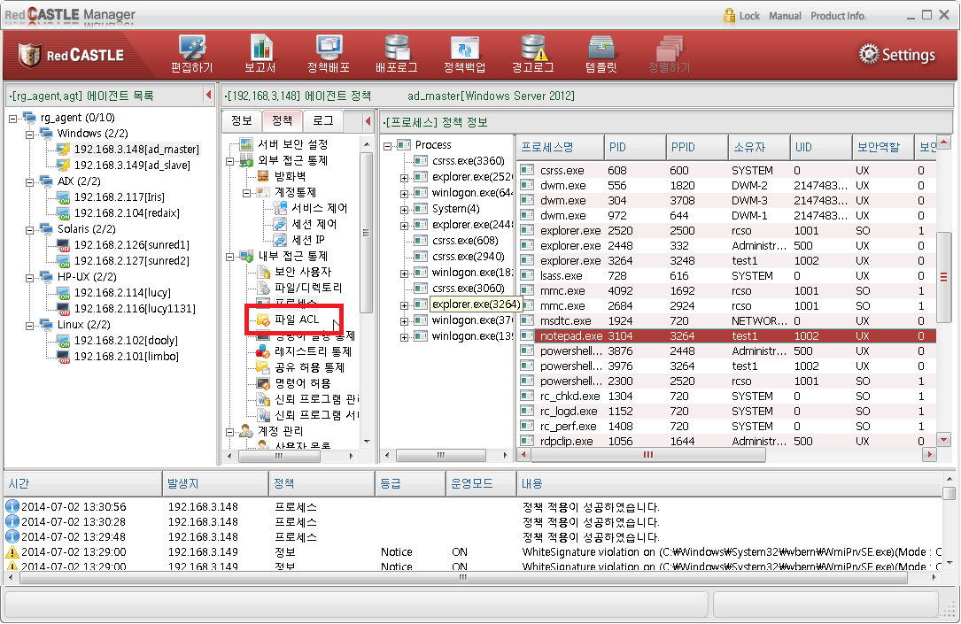
RedCastle Manager

Slide 3
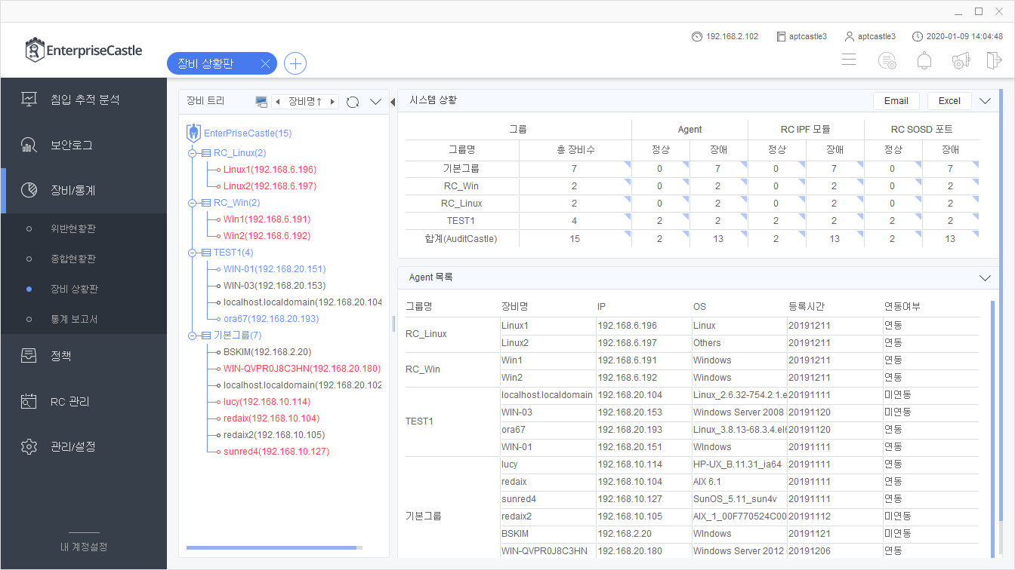
EnterpriseCastle Manager(1/2)

Slide 4
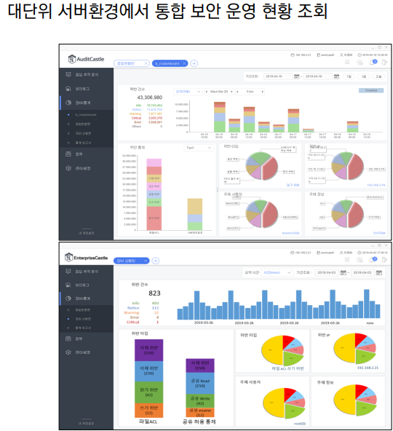
EnterpriseCastle Manager(2/2)

Slide 5
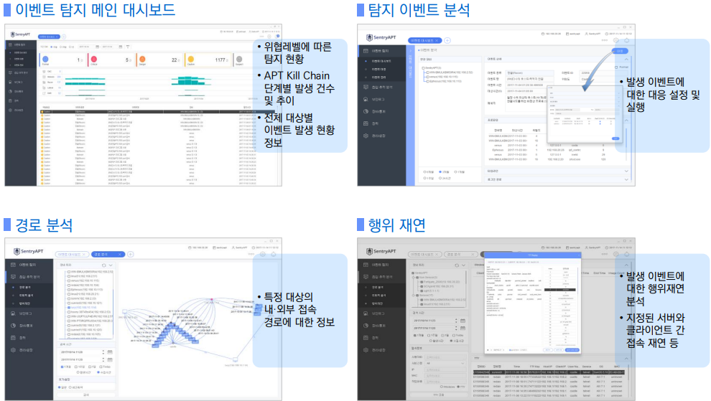
SentryAir

Slide 6
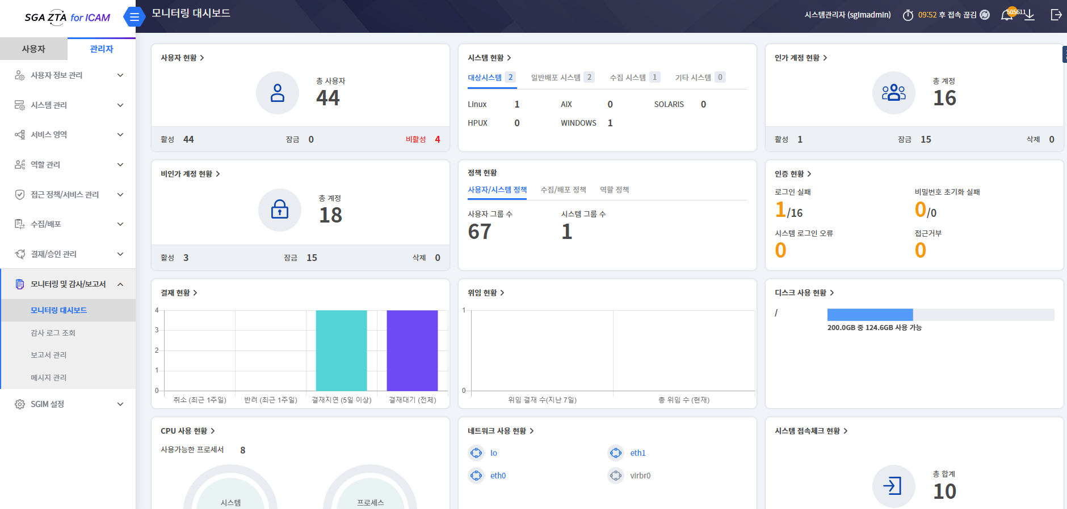
ICAM

Slide 7
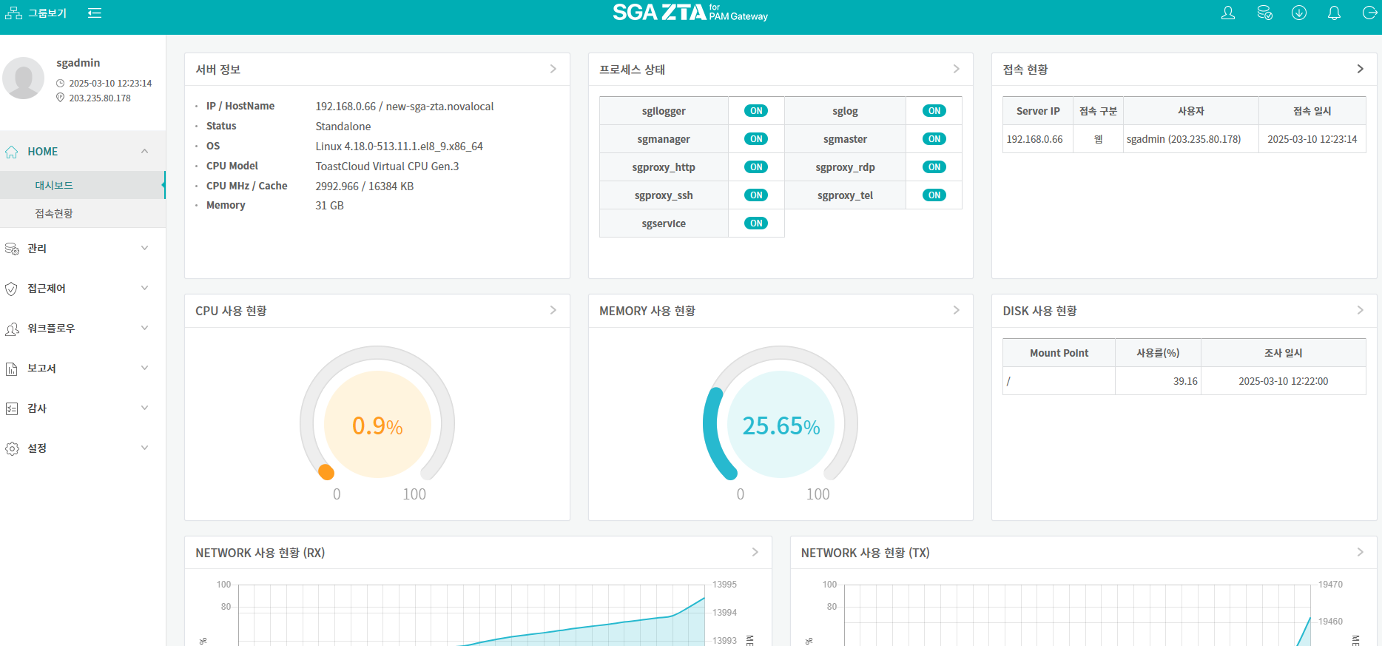
AM

Slide 8
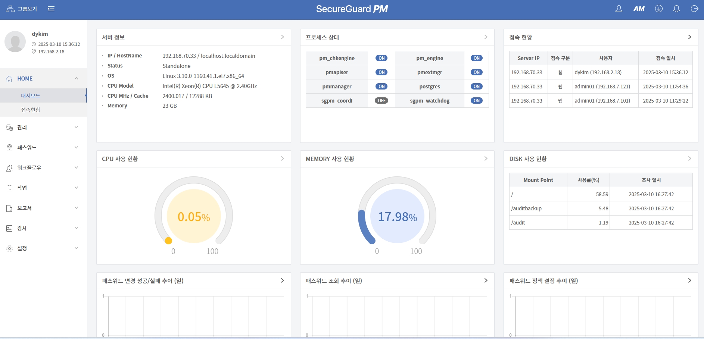
PM

Slide 9
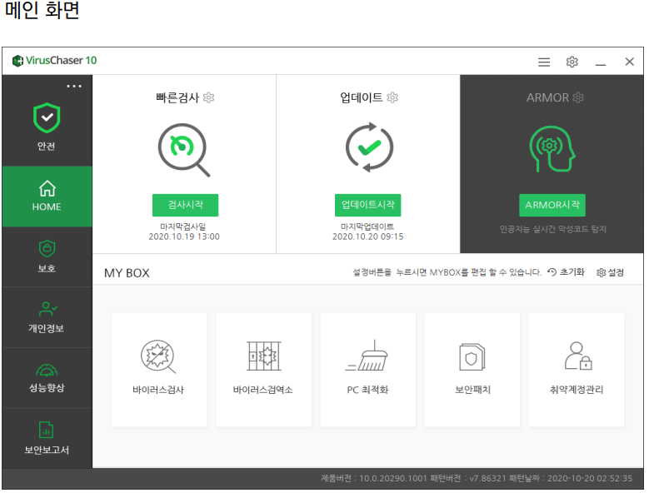
VirusChaser(1/3)

Slide 10
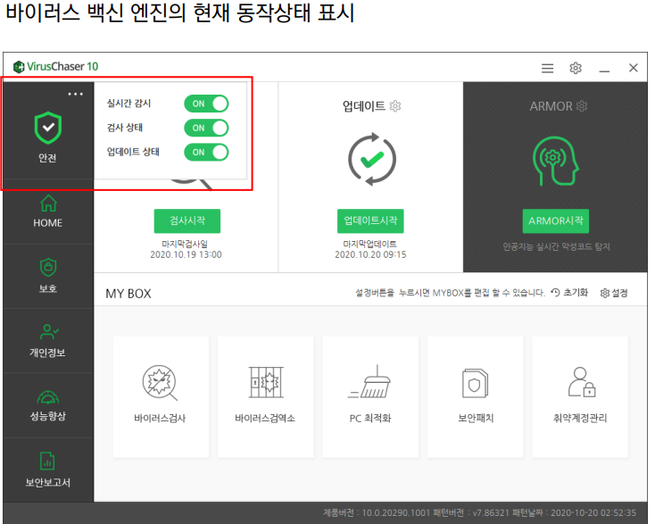
VirusChaser(2/3)

Slide 11
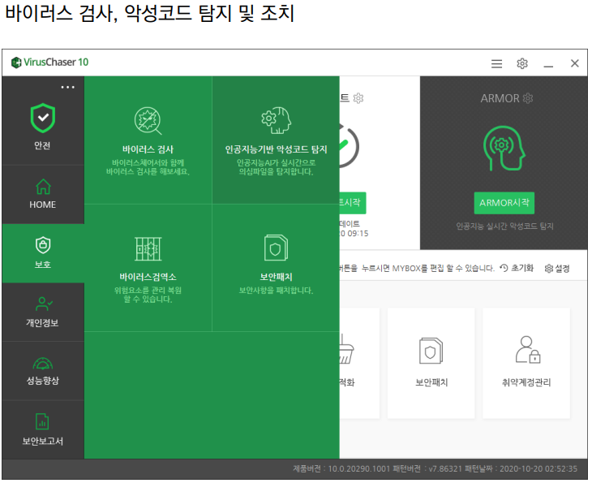
VirusChaser(3/3)

Slide 12
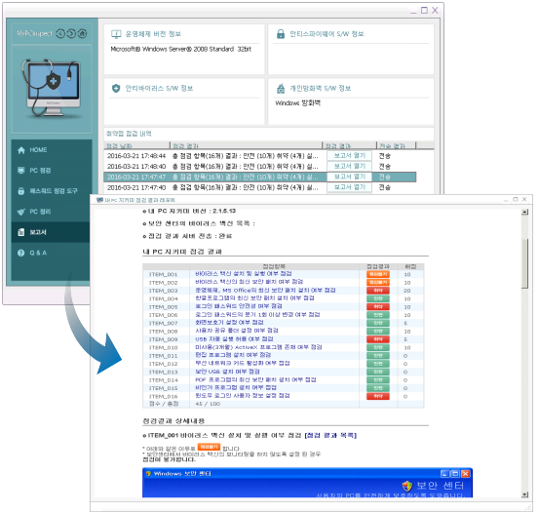
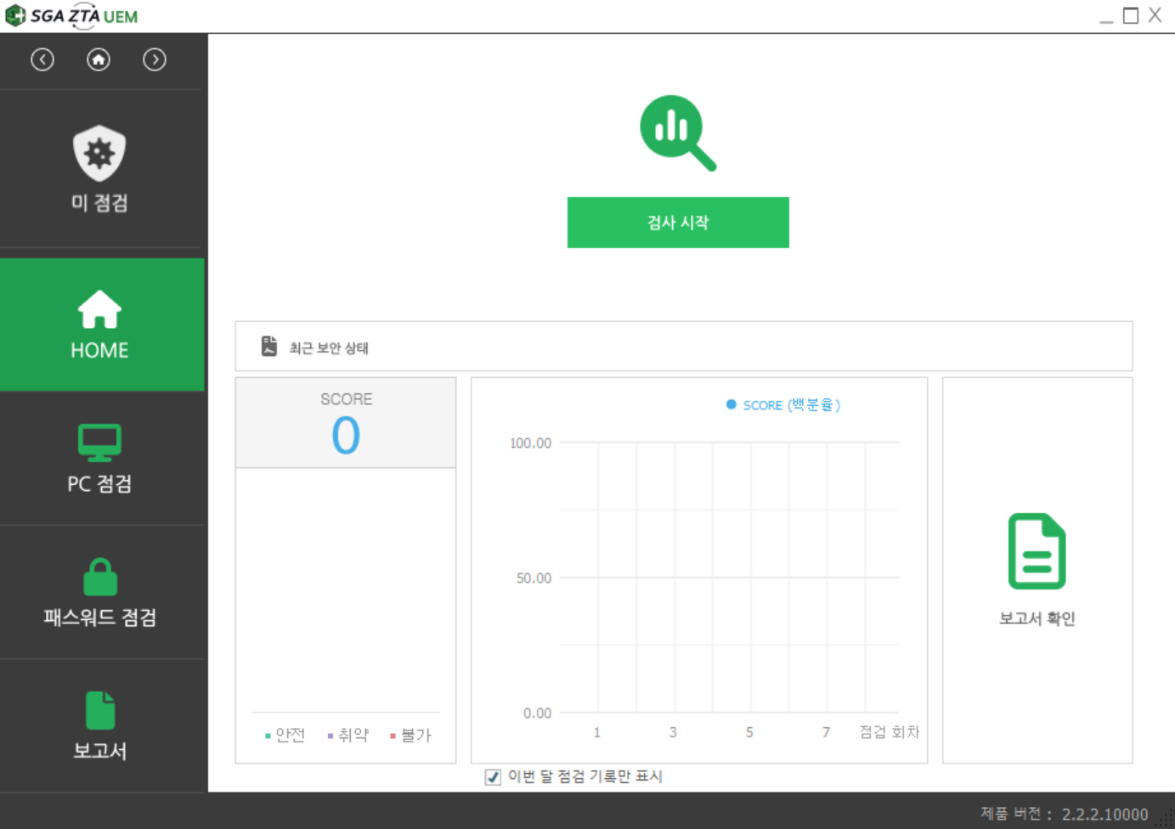
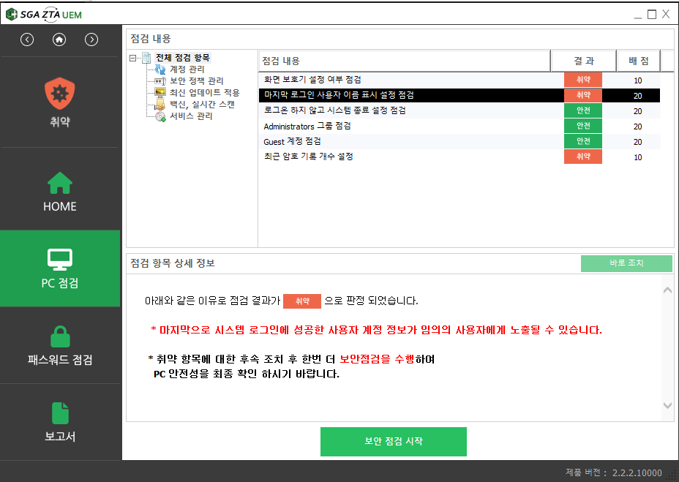
내PC지킴이
UEM

Slide 13
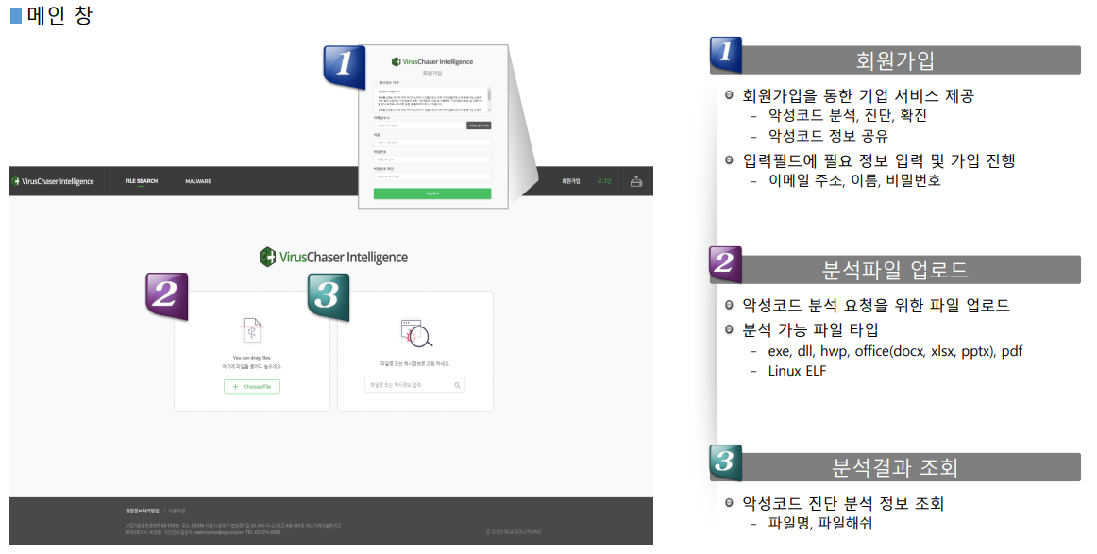
VirusChaser Intelligence(1/4)

Slide 14
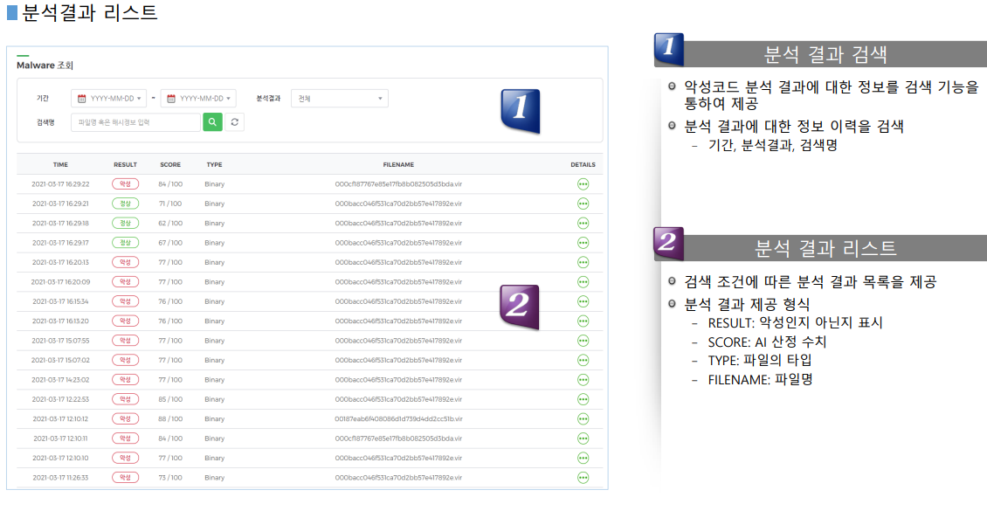
VirusChaser Intelligence(2/4)

Slide 15
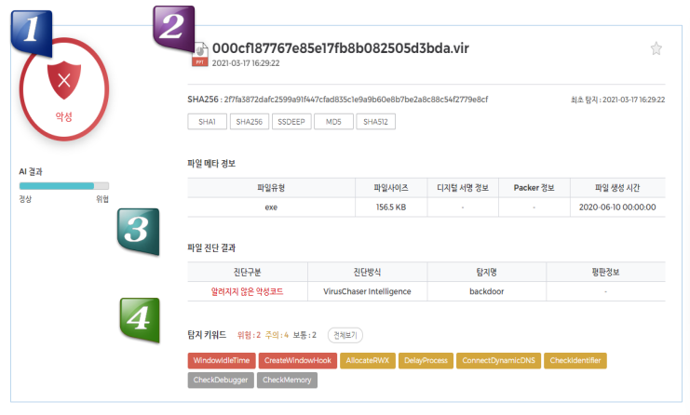
VirusChaser Intelligence(3/4)

Slide 16
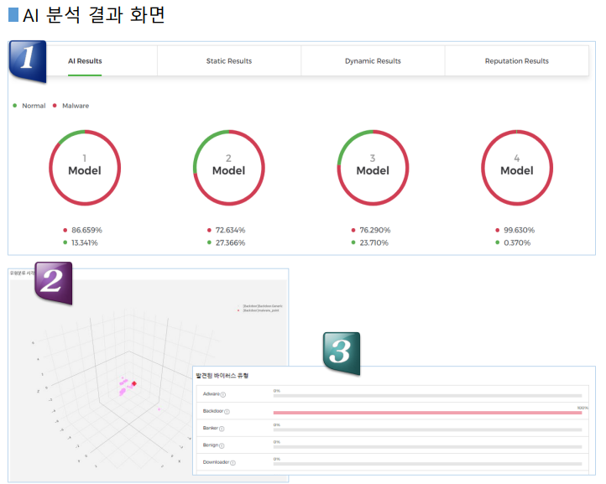
VirusChaser Intelligence(4/4)

