Slide 1

Chapter 3
Transport Layer
Computer Networking: A Top Down Approach
7th edition
Jim Kurose, Keith Ross
Pearson/Addison Wesley
April 2016

Slide 2
Chapter 3: Transport Layer
our goals:
understand principles behind transport layer services:
  multiplexing, demultiplexing
  reliable data transfer
  flow control
  congestion control
learn about Internet transport layer protocols:
  UDP: connectionless transport
  TCP: connection-oriented reliable transport
  TCP congestion control

Slide 3
Chapter 3 outline
3.1 transport-layer services
3.2 multiplexing and demultiplexing
3.3 connectionless transport: UDP
3.4 principles of reliable data transfer
3.5 connection-oriented transport: TCP
  segment structure
  reliable data transfer
  flow control
  connection management
3.6 principles of congestion control
3.7 TCP congestion control

Slide 4

















Transport services and protocols
application
transport
network
data link
physical
provide logical communication between app processes running on different hosts
transport protocols run in end systems
  send side: breaks app messages into segments, passes to network layer
  rcv side: reassembles segments into messages, passes to app layer
more than one transport protocol available to apps
  Internet: TCP and UDP
logical end-end transport
application
transport
network
data link
physical

Slide 5
Internet transport-layer protocols
reliable, in-order delivery (TCP)
  congestion control
  flow control
  connection setup
unreliable, unordered delivery: UDP
  no-frills extension of “best-effort” IP
services not available:
  delay guarantees
  bandwidth guarantees
application
transport
network
data link
physical
network
data link
physical
network
data link
physical
network
data link
physical
logical end-end transport
network
data link
physical
network
data link
physical
network
data link
physical
network
data link
physical
application
transport
network
data link
physical

Slide 6
Chapter 3 outline
3.1 transport-layer services
3.2 multiplexing and demultiplexing
3.3 connectionless transport: UDP
3.4 principles of reliable data transfer
3.5 connection-oriented transport: TCP
  segment structure
  reliable data transfer
  flow control
  connection management
3.6 principles of congestion control
3.7 TCP congestion control

Slide 7

Multiplexing/demultiplexing
multiplexing at sender:
handle data from multiple
sockets, add transport header (later used for demultiplexing)
demultiplexing at receiver:
use header info to deliver
received segments to correct
socket
application
application
P1
P2
application
socket
P3
transport
P4
process
transport
network
transport
network
link
network
link
physical
link
physical
physical

Slide 8
How demultiplexing works
host receives IP datagrams
  each datagram has source IP address, destination IP address
  each datagram carries one transport-layer segment
  each segment has source, destination port number
host uses IP addresses & port numbers to direct segment to appropriate socket
32 bits
source port #
dest port #
other header fields
application
data
(payload)
TCP/UDP segment format

Slide 9
Connectionless demultiplexing
UDP socket identified by two-tuple (not 4 like TCP):
  destination IP address
  destination port #
create socket with host-local port #:
DatagramSocket mySocket1 = new DatagramSocket(12534);
when host receives UDP segment:
  checks destination port # in segment
  directs UDP segment to socket with that port #
IP datagrams with same dest. port #, but different source IP addresses and/or source port numbers will be directed to same socket at dest

Slide 10
Connectionless demux: example
DatagramSocket serverSocket = new DatagramSocket
(6428);
DatagramSocket mySocket2 = new DatagramSocket
(9157);
DatagramSocket mySocket1 = new DatagramSocket (5775);
application
application
P1
application
P2
P3
transport
transport
network
transport
network
link
network
link
physical
link
physical
physical
source port: 6428
dest port: 9157
source port: ?
dest port: ?
source port: 9157
dest port: 6428
source port: ?
dest port: ?

Slide 11
Connection-oriented demux
TCP socket identified by 4-tuple:
  source IP address
  source port number
  dest IP address
  dest port number
demux: receiver uses all four values to direct segment to appropriate socket
server host may support many simultaneous TCP sockets:
  each socket identified by its own 4-tuple
web servers have different sockets for each connecting client
  non-persistent HTTP will have different socket for each request

Slide 12
Connection-oriented demux: example
application
application
P4
P5
P6
application
P1
P2
P3
transport
transport
network
transport
network
link
network
link
physical
link
physical
server: IP address B
physical
host: IP address A
source IP,port: B,80
dest IP,port: A,9157
host: IP address C
source IP,port: C,5775
dest IP,port: B,80
source IP,port: A,9157
dest IP, port: B,80
source IP,port: C,9157
dest IP,port: B,80
three segments, all destined to IP address: B,
dest port: 80 are demultiplexed to different sockets

Slide 13
Chapter 3 outline
3.1 transport-layer services
3.2 multiplexing and demultiplexing
3.3 connectionless transport: UDP
3.4 principles of reliable data transfer
3.5 connection-oriented transport: TCP
  segment structure
  reliable data transfer
  flow control
  connection management
3.6 principles of congestion control
3.7 TCP congestion control

Slide 14
UDP: User Datagram Protocol [RFC 768]
“no frills,” “bare bones” Internet transport protocol
“best effort” service, UDP segments may be:
  lost
  delivered out-of-order to app
connectionless:
  no handshaking between UDP sender, receiver
  each UDP segment handled independently of others
UDP use:
  streaming multimedia apps (loss tolerant, rate sensitive)
  DNS
  SNMP (net mgmt.)
transfer over UDP:
  add reliability at application layer
  application-specific error recovery!

Slide 15
UDP: segment header
length, in bytes of UDP segment, including header
32 bits
source port #
dest port #
length
checksum
why is there a UDP?
no connection establishment (which can add delay)
simple: no connection state at sender, receiver
small header size
no congestion control: UDP can blast away as fast as desired (more later…)
application
data
(payload)
UDP segment format

Slide 16
Chapter 3 outline
3.1 transport-layer services
3.2 multiplexing and demultiplexing
3.3 connectionless transport: UDP
3.4 principles of reliable data transfer
3.5 connection-oriented transport: TCP
  segment structure
  reliable data transfer
  flow control
  connection management
3.6 principles of congestion control
3.7 TCP congestion control

Slide 17

Principles of reliable data transfer
important in application, transport, link layers
  top-10 list of important networking topics!
characteristics of unreliable channel will determine complexity of reliable data transfer protocol (rdt)

Slide 18
Principles of reliable data transfer
important in application, transport, link layers
  top-10 list of important networking topics!
characteristics of unreliable channel will determine complexity of reliable data transfer protocol (rdt)

Slide 19
Principles of reliable data transfer
important in application, transport, link layers
  top-10 list of important networking topics!
characteristics of unreliable channel will determine complexity of reliable data transfer protocol (rdt)

Slide 20

Reliable data transfer: getting started
rdt_send(): called from above, (e.g., by app.). Passed data to
deliver to receiver upper layer
deliver_data(): called by rdt to deliver data to upper
send
side
receive
side
udt_send(): called by rdt,
to transfer packet over
unreliable channel to receiver
rdt_rcv(): called when packet arrives on rcv-side of channel

Slide 21
Flow Control
End-to-end flow and Congestion control study is complicated by:
  Heterogeneous resources (links, switches, applications)
  Different delays due to network dynamics
  Effects of background traffic
We start with a simple case: hop-by-hop flow control

Slide 22
Hop-by-hop flow control
Approaches/techniques for hop-by-hop flow control
  Stop-and-wait
  sliding window
    Go back N
    Selective reject

Slide 23
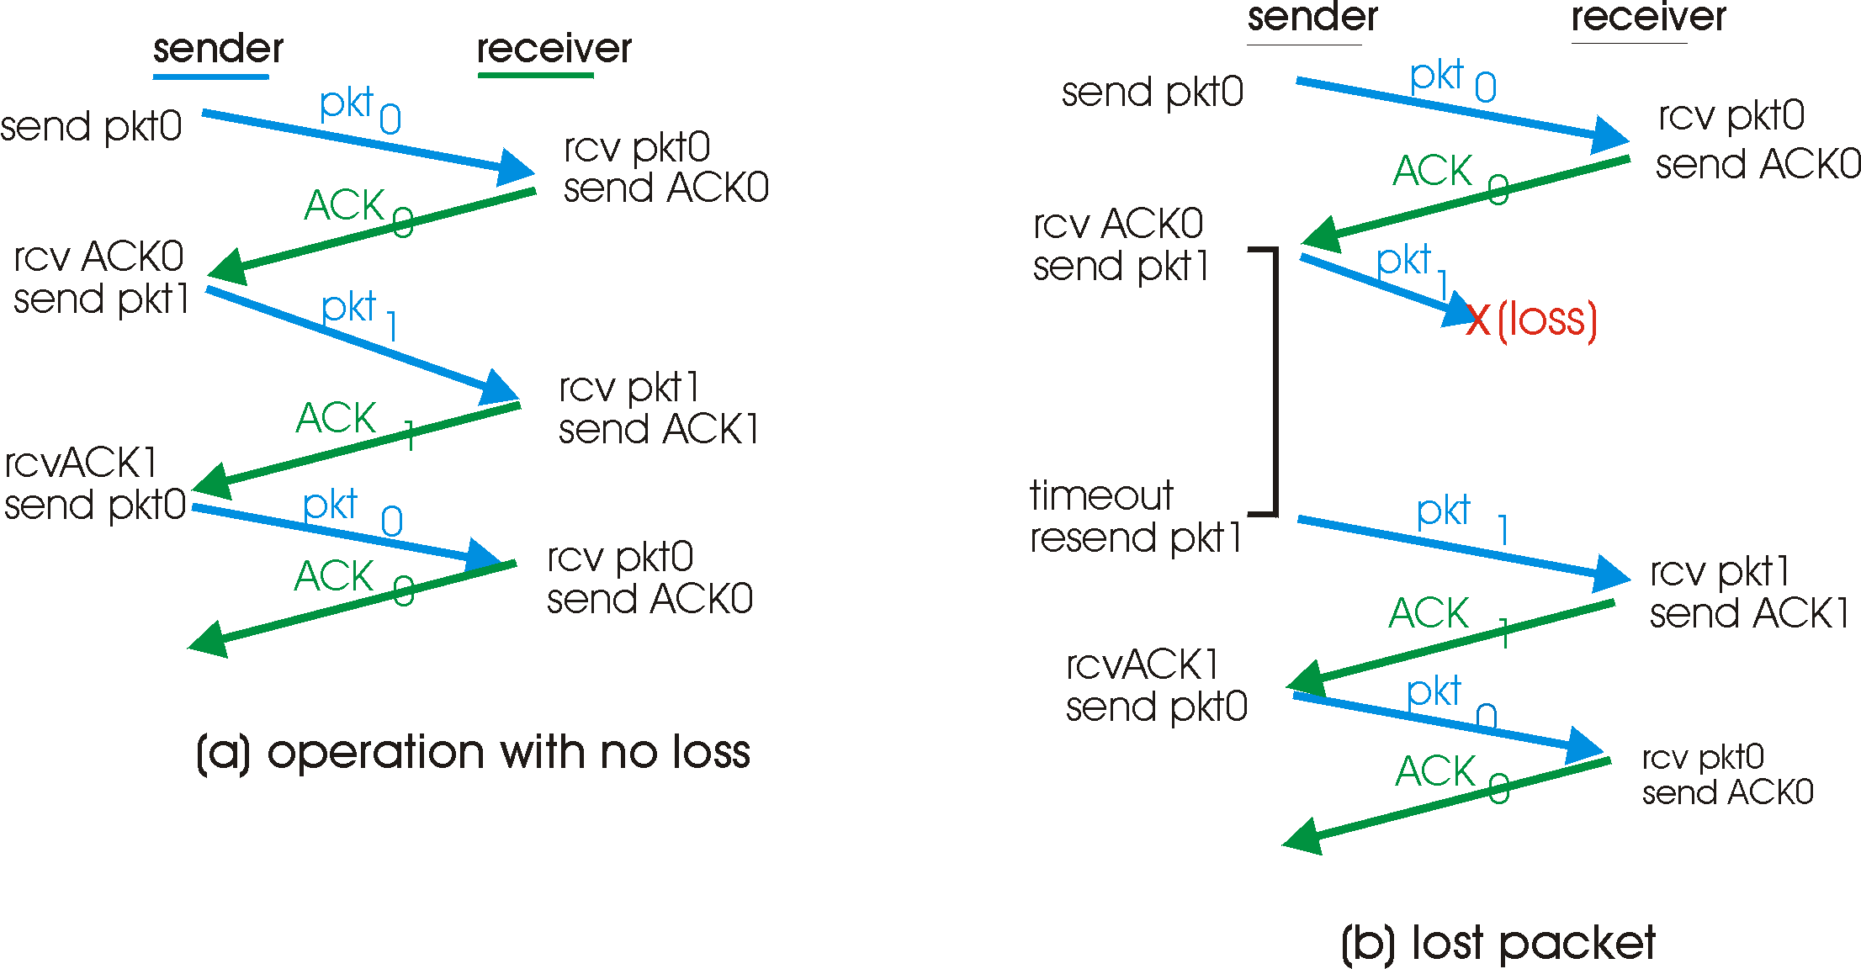
Stop-and-wait: reliable transfer over a reliable channel
underlying channel perfectly reliable
  no bit errors, no loss of packets
stop and wait
Sender sends one packet,
then waits for receiver
response

Slide 24
channel with bit errors
underlying channel may flip bits in packet
  checksum to detect bit errors
the question: how to recover from errors:
  acknowledgements (ACKs): receiver explicitly tells sender that pkt received OK
  negative acknowledgements (NAKs): receiver explicitly tells sender that pkt had errors
  sender retransmits pkt on receipt of NAK
need mechanisms for:
  error detection
  feedback: control msgs (ACK,NAK) from receiver to sender

Slide 25
Stop-and-wait operation Summary
Stop and wait:
  sender awaits for ACK to send another frame
  sender uses a timer to re-transmit if no ACKs
  if ACK is lost:
    A sends frame, B’s ACK gets lost
    A times out & re-transmits the frame, B receives duplicates
    Sequence numbers are added (frame0,1 ACK0,1)
  timeout: should be related to round trip time estimates
    if too small → unnecessary re-transmission
    if too large → long delays

Slide 26
ACK/NACK corruption!
what happens if ACK/NAK corrupted?
sender doesn’t know what happened at receiver!
can’t just retransmit: possible duplicate
handling duplicates:
sender retransmits current pkt if ACK/NAK corrupted
sender adds sequence number to each pkt
receiver discards (doesn’t deliver up) duplicate pkt
stop and wait
sender sends one packet,
then waits for receiver
response

Slide 27
NAK-free protocol
instead of NAK, receiver sends ACK for last pkt received OK
  receiver must explicitly include seq # of pkt being ACKed
duplicate ACK at sender results in same action as NAK: retransmit current pkt

Slide 28

Stop-and-wait with lost packet/frame
sender
receiver
sender
receiver
send pkt0
pkt0
send pkt0
pkt0
rcv pkt0
rcv pkt0
ack0
send ack0
ack0
send ack0
rcv ack0
rcv ack0
send pkt1
pkt1
send pkt1
pkt1
rcv pkt1
X
ack1
send ack1
loss
rcv ack1
send pkt0
pkt0
rcv pkt0
timeout
resend pkt1
ack0
send ack0
pkt1
rcv pkt1
ack1
send ack1
rcv ack1
send pkt0
pkt0
(a) no loss
rcv pkt0
ack0
send ack0
(b) packet loss

Slide 29
sender
receiver
sender
receiver
send pkt0
pkt0
send pkt0
pkt0
rcv pkt0
rcv pkt0
ack0
send ack0
send ack0
rcv ack0
ack0
send pkt1
pkt1
rcv ack0
rcv pkt1
send pkt1
pkt1
send ack1
rcv pkt1
ack1
send ack1
ack1
X
loss
timeout
resend pkt1
pkt1
rcv pkt1
timeout
resend pkt1
rcv ack1
pkt1
rcv pkt1
pkt0
(detect duplicate)
send pkt0
send ack1
ack1
(detect duplicate)
ack1
rcv pkt0
rcv ack1
send ack1
rcv ack1
ack0
send ack0
pkt0
send pkt0
pkt0
send pkt0
rcv pkt0
rcv pkt0
ack0
(detect duplicate)
ack0
send ack0
send ack0
(c) ACK loss
(d) premature timeout/ delayed ACK

Slide 30
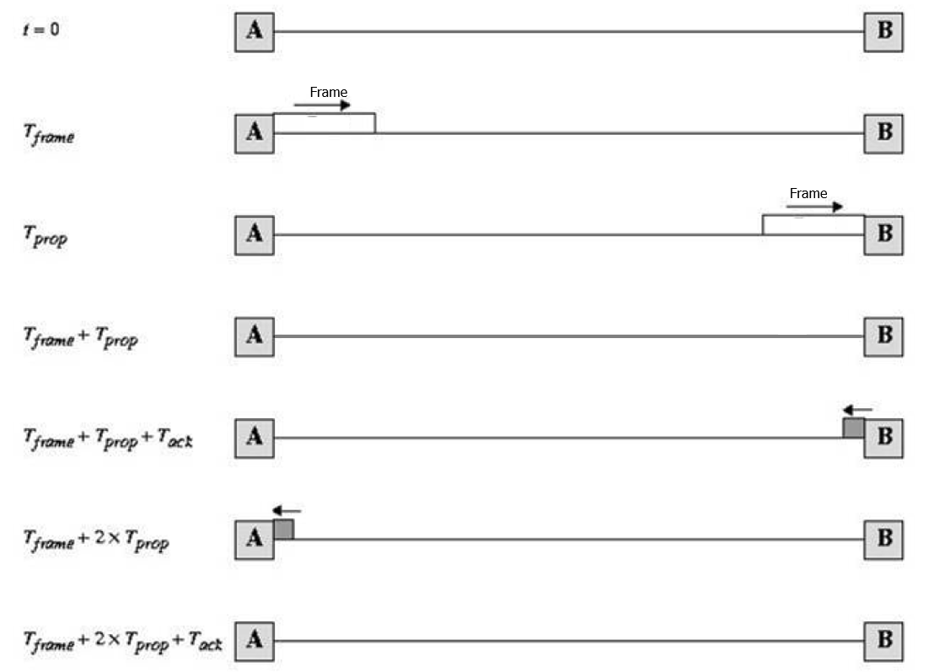
Stop-and-wait link utilization

Slide 31
Stop and wait performance
utilization – fraction of time sender busy sending
ideal case (error free)
  u=Tframe/(Tframe+2Tprop)=1/(1+2a), a=Tprop/Tframe

Slide 32
Performance of stop-and-wait
e.g.: 1 Gbps link, 15 ms prop. delay, 1KB packet:
L
8000 bits
D_{trans} =
=
=
8 microsecs
R
10⁹ bits/sec
  U _{sender}: utilization – fraction of time sender busy sending
  if RTT=30 msec, 1KB pkt every 30 msec: 33kB/sec thruput over 1 Gbps link
network protocol limits use of physical resources!

Slide 33
stop-and-wait operation
sender
receiver
first packet bit transmitted, t = 0
last packet bit transmitted, t = L / R
first packet bit arrives
RTT
last packet bit arrives, send ACK
ACK arrives, send next
packet, t = RTT + L / R

Slide 34
Sliding window techniques
TCP is a variant of sliding window
Includes Go back N (GBN) and selective repeat/reject
Allows for outstanding packets without Ack
More complex than stop and wait
Need to buffer un-Ack’ed packets & more book-keeping than stop-and-wait

Slide 35


Pipelined (sliding window) protocols
pipelining: sender allows multiple, “in-flight”, yet-to-be-acknowledged pkts
  range of sequence numbers must be increased
  buffering at sender and/or receiver
two generic forms of pipelined protocols: go-Back-N, selective repeat

Slide 36
Pipelining: increased utilization
sender
receiver
first packet bit transmitted, t = 0
last bit transmitted, t = L / R
first packet bit arrives
RTT
last packet bit arrives, send ACK
last bit of 2nd packet arrives, send ACK
last bit of 3rd packet arrives, send ACK
ACK arrives, send next
packet, t = RTT + L / R
3-packet pipelining increases
utilization by a factor of 3!

Slide 37
Pipelined protocols: overview
Go-back-N:
sender can have up to N unacked packets in pipeline
receiver only sends cumulative ack
  doesn’t ack packet if there’s a gap
sender has timer for oldest unacked packet
  when timer expires, retransmit all unacked packets
Selective Repeat:
sender can have up to N unack’ed packets in pipeline
rcvr sends individual ack for each packet
sender maintains timer for each unacked packet
  when timer expires, retransmit only that unacked packet

Slide 38

Go-Back-N: sender
k-bit seq # in pkt header
“window” of up to N, consecutive unack’ed pkts allowed
ACK(n): ACKs all pkts up to, including seq # n - “cumulative ACK”
  may receive duplicate ACKs (see receiver)
timer for oldest in-flight pkt
timeout(n): retransmit packet n and all higher seq # pkts in window

Slide 39
GBN: receiver side
ACK-only: always send ACK for correctly-received pkt with highest in-order seq #
  may generate duplicate ACKs
  need only remember expectedseqnum
out-of-order pkt:
  discard (don’t buffer): no receiver buffering!
  re-ACK pkt with highest in-order seq #

Slide 40
GBN in action
sender window (N=4)
sender
receiver
0 1 2 3 4 5 6 7 8
send pkt0
send pkt1
send pkt2
send pkt3
(wait)
0 1 2 3 4 5 6 7 8
receive pkt0, send ack0
receive pkt1, send ack1
receive pkt3, discard,
(re)send ack1
0 1 2 3 4 5 6 7 8
X
0 1 2 3 4 5 6 7 8
loss
0 1 2 3 4 5 6 7 8
rcv ack0, send pkt4
rcv ack1, send pkt5
0 1 2 3 4 5 6 7 8
receive pkt4, discard,
(re)send ack1
ignore duplicate ACK
receive pkt5, discard,
(re)send ack1
pkt 2 timeout
0 1 2 3 4 5 6 7 8
send pkt2
send pkt3
send pkt4
send pkt5
0 1 2 3 4 5 6 7 8
0 1 2 3 4 5 6 7 8
rcv pkt2, deliver, send ack2
rcv pkt3, deliver, send ack3
rcv pkt4, deliver, send ack4
rcv pkt5, deliver, send ack5
0 1 2 3 4 5 6 7 8

Slide 41
Selective repeat
receiver individually acknowledges all correctly received pkts
  buffers pkts, as needed, for eventual in-order delivery to upper layer
sender only resends pkts for which ACK not received
  sender timer for each unACKed pkt
sender window
  N consecutive seq #’s
  limits seq #s of sent, unACKed pkts

Slide 42

Selective repeat: sender, receiver windows

Slide 43
Selective repeat in action
sender window (N=4)
sender
receiver
0 1 2 3 4 5 6 7 8
send pkt0
send pkt1
send pkt2
send pkt3
(wait)
0 1 2 3 4 5 6 7 8
receive pkt0, send ack0
receive pkt1, send ack1
receive pkt3, buffer,
send ack3
0 1 2 3 4 5 6 7 8
X
0 1 2 3 4 5 6 7 8
loss
0 1 2 3 4 5 6 7 8
rcv ack0, send pkt4
rcv ack1, send pkt5
0 1 2 3 4 5 6 7 8
receive pkt4, buffer,
send ack4
record ack3 arrived
receive pkt5, buffer,
send ack5
pkt 2 timeout
0 1 2 3 4 5 6 7 8
send pkt2
0 1 2 3 4 5 6 7 8
record ack4 arrived
0 1 2 3 4 5 6 7 8
rcv pkt2; deliver pkt2,
pkt3, pkt4, pkt5; send ack2
record ack5 arrived
0 1 2 3 4 5 6 7 8
Q: what happens when ack2 arrives?

Slide 44
performance:
selective repeat:
  error-free case:
    if the window is w such that the pipe is full→U=100%
    otherwise U=w*Ustop-and-wait=w/(1+2a)
  in case of error:
    if w fills the pipe U=1-p
    otherwise U=w*Ustop-and-wait=w(1-p)/(1+2a)

Slide 45
Chapter 3 outline
3.1 transport-layer services
3.2 multiplexing and demultiplexing
3.3 connectionless transport: UDP
3.4 principles of reliable data transfer
3.5 connection-oriented transport: TCP
  segment structure
  reliable data transfer
  flow control
  connection management
3.6 principles of congestion control
3.7 TCP congestion control

Slide 46
TCP: Overview RFCs: 793,1122,1323, 2018, 2581
point-to-point:
  one sender, one receiver
reliable, in-order byte stream:
  no “message boundaries”
pipelined:
  TCP congestion and flow control set window size
full duplex data:
  bi-directional data flow in same connection
  MSS: maximum segment size
connection-oriented:
  handshaking (exchange of control msgs) inits sender, receiver state before data exchange
flow controlled:
  sender will not overwhelm receiver

Slide 47
TCP segment structure
32 bits
URG: urgent data
(generally not used)
counting
by bytes
of data
(not segments!)
source port #
dest port #
sequence number
ACK: ACK #
valid
acknowledgement number
head
len
not
used
U
receive window
A
PSH: push data now
(generally not used)
P
R
S
F
# bytes
rcvr willing
to accept
checksum
Urg data pointer
RST, SYN, FIN:
connection estab
(setup, teardown
commands)
options (variable length)
application
data
(variable length)
Internet
checksum
(as in UDP)

Slide 48
Receive window: credit (in octets) that the receiver is willing to accept from the sender starting from ack #
flags:
  SYN: synchronizing at initail connection time
  FIN: end of sender data
  PSH: when used at sender the data is transmitted immediately, when at receiver, it is accepted immediately
options:
  window scale factor (WSF): actual window = 2^{F}xwindow field, where F is the number in the WSF
  timestamp option: helps in RTT (round-trip-time) calculations

Slide 49
credit allocation scheme
  (A=i,W=j) [A=Ack, W=window]: receiver acks up to ‘i-1’ bytes and allows/anticipates i up to i+j-1
  receiver can use the cumulative ack option and not respond immediately
performance: depends on
  transmission rate, propagation, window size, queuing delays, retransmission strategy which depends on RTT estimates that affect timeouts and are affected by network dynamics, receive policy (ack), background traffic….. it is complex!

Slide 50
TCP seq. numbers, ACKs
outgoing segment from sender
sequence numbers:
  byte stream “number” of first byte in segment’s data
acknowledgements (ACKs):
  seq # of next byte expected from other side
  cumulative ACK
Q: how receiver handles out-of-order segments
  A: TCP spec doesn’t say, - up to implementor
source port #
dest port #
sequence number
acknowledgement number
rwnd
checksum
urg pointer
window size
N
  sender sequence number space
sent
ACKed
sent, not-yet ACKed
(“in-flight”)
usable
but not
yet sent
not
usable
incoming segment to sender
source port #
dest port #
sequence number
acknowledgement number
A
rwnd
checksum
urg pointer

Slide 51
TCP seq. numbers, ACKs
Host A
Host B
User
types
‘C’
Seq=42, ACK=79, data = ‘C’
host ACKs
receipt of
‘C’, echoes
back ‘C’
Seq=79, ACK=43, data = ‘C’
host ACKs
receipt
of echoed
‘C’
Seq=43, ACK=80
simple telnet scenario

Slide 52
TCP retransmission strategy:
TCP performs end-to-end flow/congestion control and error recovery
TCP depends on implicit congestion signaling and uses an adaptive re-transmission timer, based on average observation of the ack delays.

Slide 53
ack delays may be misleading due to the following reasons:
  Cumulative acks render this estimate inaccurate
  Abrupt changes in the network
  If ack is received for a re-transmitted packet, sender cannot distinguish between ack for the original packet and ack for the re-transmitted packet

Slide 54
Reliability in TCP
Components of reliability
  1. Sequence numbers
  2. Retransmissions
  3. Timeout Mechanism(s): function of the round trip time (RTT) between the two hosts (is it static?)

Slide 55
TCP round trip time, timeout
Q: how to set TCP timeout value?
longer than RTT
  but RTT varies
too short: premature timeout, unnecessary retransmissions
too long: slow reaction to segment loss
Q: how to estimate RTT?
SampleRTT: measured time from segment transmission until ACK receipt
  ignore retransmissions
SampleRTT will vary, want estimated RTT “smoother”
  average several recent measurements, not just current SampleRTT

Slide 56
TCP round trip time, timeout
EstimatedRTT(k)=(1- α)*EstimatedRTT(k-1)+ α*SampleRTT(k)
=(1- α)*((1- α)*EstimatedRTT(k-2)+ α*SampleRTT(k-1))+ α *SampleRTT(k)
=(1- α)^{k} *SampleRTT(0)+ α(1- α)^{k-1} *SampleRTT)(1)+…+ α *SampleRTT(k)
exponentially-weighted moving average (EWMA)
influence of past sample decreases exponentially fast
typical value: α = 0.125
RTT: gaia.cs.umass.edu to fantasia.eurecom.fr
RTT (milliseconds)
sampleRTT
EstimatedRTT
time (seconds)

Slide 57
∝=0.5
∝=0.125

Slide 58
∝=0.125
∝=0.125

Slide 59

TCP round trip time, timeout
timeout interval: EstimatedRTT plus “safety margin”
  large variation in EstimatedRTT -> larger safety margin
1. estimate SampleRTT deviation from EstimatedRTT:
DevRTT = (1-β)*DevRTT +
β*|SampleRTT-EstimatedRTT|
(typically, β = 0.25)
2. set timeout interval:
TimeoutInterval = EstimatedRTT + 4*DevRTT
estimated RTT
“safety margin”
  3. for further re-transmissions (if the 1st re-tx was not Ack’ed)
  - RTO=q.RTO, q=2 for exponential backoff
  - similar to Ethernet CSMA/CD backoff
* Check examples: http://gaia.cs.umass.edu/kurose_ross/interactive/

Slide 60
TCP reliable data transfer
TCP creates reliable service on top of IP’s unreliable service
  pipelined segments
  cumulative acks
  single retransmission timer
retransmissions triggered by:
  timeout events
  duplicate acks
Initially consider simplified TCP sender:
  ignore duplicate acks
  ignore flow control, congestion control

Slide 61
TCP: retransmission scenarios
Host A
Host B
Host A
Host B
SendBase=92
Seq=92, 8 bytes of data
Seq=92, 8 bytes of data
timeout
timeout
Seq=100, 20 bytes of data
ACK=100
X
ACK=100
ACK=120
Seq=92, 8 bytes of data
Seq=92, 8
bytes of data
SendBase=100
SendBase=120
ACK=100
ACK=120
SendBase=120
lost ACK scenario
premature timeout

Slide 62
TCP: retransmission scenarios
Host A
Host B
Seq=92, 8 bytes of data
Seq=100, 20 bytes of data
timeout
ACK=100
X
ACK=120
Seq=120, 15 bytes of data
cumulative ACK

Slide 63
TCP ACK generation [RFC 1122, RFC 2581]
event at receiver
arrival of in-order segment with
expected seq #. All data up to
expected seq # already ACKed
arrival of in-order segment with
expected seq #. One other
segment has ACK pending
arrival of out-of-order segment
higher-than-expect seq. # .
Gap detected
arrival of segment that
partially or completely fills gap
TCP receiver action
delayed ACK. Wait up to 500ms
for next segment. If no next segment,
send ACK
immediately send single cumulative
ACK, ACKing both in-order segments
immediately send duplicate ACK,
indicating seq. # of next expected byte
immediate send ACK, provided that
segment starts at lower end of gap

Slide 64
TCP fast retransmit
time-out period often relatively long:
  long delay before resending lost packet
detect lost segments via duplicate ACKs.
  sender often sends many segments back-to-back
  if segment is lost, there will likely be many duplicate ACKs.
TCP fast retransmit
if sender receives 3 ACKs for same data
(“triple duplicate ACKs”), resend unacked segment with smallest seq # to avoid timeout
  likely that unacked segment lost, so don’t wait for timeout
(“triple duplicate ACKs”),

Slide 65
TCP fast retransmit
Host A
Host B
Seq=92, 8 bytes of data
Seq=100, 20 bytes of data
X
ACK=100
timeout
ACK=100
ACK=100
ACK=100
Seq=100, 20 bytes of data
fast retransmit after sender
receipt of triple duplicate ACK
(Self-clocking)

Slide 66
TCP flow control
application
process
application may
remove data from
TCP socket buffers ….
application
TCP socket
receiver buffers
OS
… slower than TCP
receiver is delivering
(sender is sending)
TCP
code
flow control
IP
code
receiver controls sender, so sender won’t overflow receiver’s buffer by transmitting too much, too fast
from sender
receiver protocol stack

Slide 67
TCP flow control
receiver “advertises” free buffer space by including rwnd (RcvWindow) value in TCP header of receiver-to-sender segments
  RcvBuffer size set via socket options (typical default is 4096 bytes)
  many operating systems autoadjust RcvBuffer
sender limits amount of unacked (“in-flight”) data to receiver’s rwnd value
guarantees receive buffer will not overflow
to application process
RcvBuffer
buffered data
rwnd
free buffer space
TCP segment payloads
receiver-side buffering
match the send rate to the receiving app’s drain rate

Slide 68
Principles of congestion control
congestion:
informally: “too many sources sending too much data too fast for network to handle”
different from flow control!
manifestations:
  lost packets (buffer overflow at routers)
  long delays (queueing in router buffers)
a key problem in the design of computer networks

Slide 69
Congestion Control & Traffic Management
Does adding bandwidth to the network or increasing the buffer sizes solve the problem of congestion?
No. We cannot over-engineer the whole network due to:
Increased traffic from applications (multimedia,etc.)
Legacy systems (expensive to update)
Unpredictable traffic mix inside the network: where is the bottleneck?
Congestion control & traffic management is needed
  To provide fairness
  To provide QoS and priorities

Slide 70
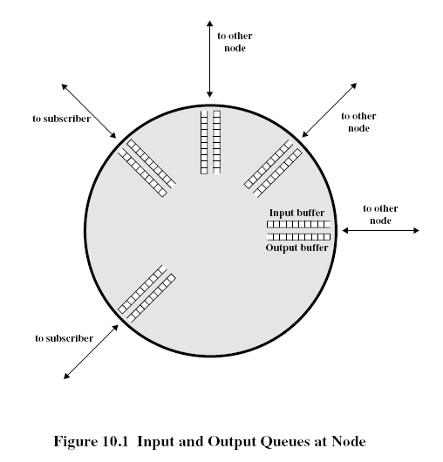
Network Congestion
Modeling the network as network of queues: (in switches and routers)
  Store and forward
  Statistical multiplexing
Limitations: -on buffer size
  -> contributes to packet loss
if we increase buffer size?
  excessive delays
if infinite buffers
  infinite delays

Slide 71
solutions:
  policies for packet service and packet discard to limit delays
  congestion notification and flow/congestion control to limit arrival rate
  buffer management: input buffers, output buffers, shared buffers

Slide 72
Propagation of congestion
if flow control is used hop-by-hop then congestion may propagate throughout the network

Slide 73

congestion phases & effects: scenario 1
original data: λ_{in}
throughput: λ_{out}
two senders, two receivers
one router, infinite buffers
output link capacity: R
no retransmission
Host A
unlimited shared output link buffers
Host B
R/2
λ_{out}
delay
λ_{in}
R/2
λ_{in}
R/2
maximum per-connection throughput: R/2
large delays as arrival rate, λ_{in}, approaches capacity

Slide 74
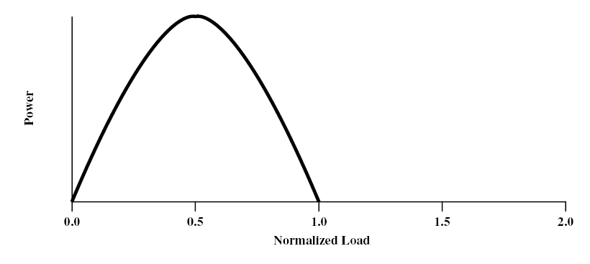
congestion phases & effects: scenario I
ideal case: infinite buffers,
  Tput increases with demand & saturates at network capacity
Delay
Tput/Gput
Network Power = Tput/delay
Representative of Tput-delay design trade-off

Slide 75
congestion phases & effects: scenario 2
one router, finite buffers
sender retransmission of timed-out packet
  application-layer input = application-layer output: λ_{in} = λ_{out}
  transport-layer input includes retransmissions : λ_{in} λ_{in}
‘
λ_{in} : original data
λ'_{in}: original data, plus retransmitted data
λ_{out}
Host A
finite shared output link buffers
Host B

Slide 76


congestion phases & effects: scenario 2
Realistic: duplicates
packets can be lost, dropped at router due to full buffers
sender times out prematurely, sending two copies, both of which are delivered
R/2
when sending at R/2, some packets are retransmissions including duplicated that are delivered!
λ_{out}
λ_{in}
R/2
λ_{in}
copy
λ'_{in}
λ_{out}
timeout
A
free buffer space!
Host B

Slide 77
congestion phases & effects: scenario 2
Realistic: duplicates
packets can be lost, dropped at router due to full buffers
sender times out prematurely, sending two copies, both of which are delivered
R/2
when sending at R/2, some packets are retransmissions including duplicated that are delivered!
λ_{out}
λ_{in}
R/2
“costs” of congestion:
more work (retrans) for given “goodput”
unneeded retransmissions: link carries multiple copies of pkt
  decreasing goodput

Slide 78
congestion phases & effects: scenario 3
Q: what happens as λ_{in} and λ_{in}’ increase ?
four senders
multihop paths
timeout/retransmit
A: as red λ_{in}’ increases, all arriving blue pkts at upper queue are dropped, blue throughput g 0
Host A
λ_{in} : original data
λ_{out}
Host B
λ'_{in}: original data, plus retransmitted data
finite shared output link buffers
Host D
Host C

Slide 79
congestion phases & effects: scenario 3
C/2
λ_{out}
λ_{in}’
C/2
another effect of congestion:
when packet dropped, any “upstream” transmission capacity used for that packet was wasted!

Slide 80
practical case: finite buffers, loss
Phase 1: no congestion: near ideal performance
Phase II : overall moderate congestion:
  severe congestion in some nodes
  dynamics of the network/routing and overhead of protocol adaptation decreases the network Tput
Phase III: severe congestion:
  loss of packets and increased discards
  extended delays leading to timeouts
  both factors trigger re-transmissions
  leads to chain-reaction bringing the Tput down

Slide 81
(I)
(II)
(III)
(I) No Congestion
(II) Moderate Congestion
(III) Severe Congestion (Collapse)
What is the best operational point and how do we get (and stay) there?

Slide 82
Congestion Control (CC)
Congestion is a key issue in network design
various techniques for CC
1.Back pressure
  hop-by-hop flow control (X.25, HDLC, Go back N)
  May propagate congestion in the network
2.Choke packet
  generated by the congested node & sent back to source
  example: ICMP source quench
  sent due to packet discard or in anticipation of congestion

Slide 83
Congestion Control (CC) (contd.)
3.Implicit congestion signaling
  used in TCP
  delay increase or packet discard to detect congestion
  may erroneously signal congestion (i.e., not always reliable) [e.g., over wireless links]
  done end-to-end without network assistance
  TCP cuts down its window/rate

Slide 84
Congestion Control (CC) (contd.)
4.Explicit congestion signaling
  (network assisted congestion control)
  gets indication from the network
    forward: going to destination
    backward: going to source
  three approaches
    Binary: uses 1 bit (DECbit, TCP/IP ECN, ATM)
    Rate based: specifying bps (ATM)
    Credit based: indicates how much the source can send (in a window)

Slide 86
Chapter 3 outline
3.1 transport-layer services
3.2 multiplexing and demultiplexing
3.3 connectionless transport: UDP
3.4 principles of reliable data transfer
3.5 connection-oriented transport: TCP
  segment structure
  reliable data transfer
  flow control
  connection management
3.6 principles of congestion control
3.7 TCP congestion control

Slide 87
TCP congestion control: additive increase multiplicative decrease (AIMD)
approach: sender increases transmission rate (window size), probing for usable bandwidth, until loss occurs
  additive increase: increase congestion window (cwnd) by 1 segment (max segment size MSS) every RTT until loss detected
  multiplicative decrease: cut cwnd in half after loss
additively increase window size …
…. until loss occurs (then cut window in half)
AIMD saw tooth
behavior: probing
for bandwidth
cwnd: TCP sender
congestion window size
time

Slide 88
TCP Congestion Control: details
sender sequence number space
TCP sending rate:
roughly: send cwnd bytes, wait RTT for ACKS, then send more bytes
cwnd
last byte
ACKed
last byte sent
sent, not-yet ACKed
(“in-flight”)
rate
cwnd
sender limits transmission:
cwnd is dynamic, function of perceived network congestion
~
bytes/sec
~
RTT
LastByteSent-
LastByteAcked
cwnd
<

Slide 89
TCP Congestion Control: details
How does sender perceive congestion?
loss event = timeout or duplicate Acks
TCP sender reduces rate (CongWin) after loss event
Is loss always due to congestion? And is reducing the rate always the optimal response to loss?! [hint: think wirelss!]
How is the rate reduced?
- Three mechanisms for window management:
  AIMD
  slow start
  conservative after timeout events

Slide 90
TCP window management
At any time the allowed window (awnd): awnd=min[rwnd, cwnd],
where rwnd is given by the receiver (i.e., Receive Window) and cwnd is the congestion window
Slow-start algorithm:
  start with CongWin=1, then CongWin=CongWin+1 with every ‘Ack’
  This leads to ‘doubling’ of the CongWin with RTT; i.e., exponential increase

Slide 91
TCP Slow Start
Host A
Host B
when connection begins, increase rate exponentially until first loss event:
  initially cwnd = 1 MSS
  double cwnd every RTT
  done by incrementing cwnd for every ACK received
summary: initial rate is slow but ramps up exponentially fast
one segment
RTT
two segments
four segments
time

Slide 92
TCP: detecting, reacting to loss
Initially slow start: cwnd=cwnd+1 with every Ack
loss indicated by timeout (congestion avoidance):
  threshold ssthresh=cwnd/2; cwnd =1 MSS;
  cwnd grows exponentially (slow start) to ssthresh
  then grows linearly: cwnd=cwnd+1 with every RTT, or cwnd=cwnd+1/cwnd for every Ack
  Additive increase, multiplicative decrease (AIMD)
loss indicated by 3 duplicate Acks: TCP RENO
  dup ACKs indicate network capable of delivering some segments (non-severe congestion)
  cwnd is cut in half window then grows linearly
TCP Tahoe always sets cwnd=1 (timeout or 3 dup Acks)

Slide 94
Slow start
Exponential increase
Congestion Avoidance
Linear increase
CongWin
(RTT)

Slide 95

TCP: switching from slow start to CA
Q: when should the exponential increase switch to linear?
A: when cwnd gets to 1/2 of its value before timeout.
Implementation:
variable ssthresh
on loss event, ssthresh is set to 1/2 of cwnd just before loss event
* Check interactive exercises : http://gaia.cs.umass.edu/kurose_ross/interactive/

Slide 96
Fast Retransmit & Recovery
Fast retransmit:
  receiver sends Ack with last in-order segment for every out-of-order segment received
  when sender receives 3 duplicate Acks it retransmits the missing/expected segment
Fast recovery: when 3rd dup Ack arrives
  ssthresh=cwnd/2
  retransmit segment, set cwnd=ssthresh+3
  for every duplicate Ack: cwnd=cwnd+1
  (note: beginning of window is ‘frozen’)
  after receiver gets cumulative Ack: cwnd=ssthresh
  (beginning of window advances to last Ack’ed segment)
cwnd

Slide 98
TCP throughput
avg. TCP thruput as function of window size, RTT?
  ignore slow start, assume always data to send
W: window size (measured in bytes) where loss occurs
  avg. window size (# in-flight bytes) is ¾ W
  avg. thruput is 3/4W per RTT
avg TCP thruput =
3
W
4
RTT
bytes/sec
W
W/2

Slide 99
TCP Futures: TCP over “long, fat pipes”
example: 1500 byte segments, 100ms RTT, want 10 Gbps throughput
requires W = 83,333 in-flight segments
throughput in terms of segment loss probability, L [Mathis 1997]:
  ➜ to achieve 10 Gbps throughput, need a loss rate of L = 2·10⁻¹⁰ – a very small loss rate!
new versions of TCP for high-speed
1.22
.
MSS
TCP throughput =
RTT
L

Slide 100
TCP Fairness
fairness goal: if K TCP sessions share same bottleneck link of bandwidth R, each should have average rate of R/K
TCP connection 1
bottleneck
router
capacity R
TCP connection 2

Slide 101
Why is TCP fair?
two competing sessions:
additive increase gives slope of 1, as throughout increases
multiplicative decrease decreases throughput proportionally
R
equal bandwidth share
loss: decrease window by factor of 2
congestion avoidance: additive increase
Connection 2 throughput
loss: decrease window by factor of 2
congestion avoidance: additive increase
Connection 1 throughput
R

Slide 102
Fairness (more)
Fairness and UDP
multimedia apps often do not use TCP
  do not want rate throttled by congestion control
instead use UDP:
  send audio/video at constant rate, tolerate packet loss
Fairness, parallel TCP connections
application can open multiple parallel connections between two hosts
web browsers do this
e.g., link of rate R with 9 existing connections:
  new app asks for 1 TCP, gets rate R/10
  new app asks for 11 TCPs, gets R/2

Slide 103
Explicit Congestion Notification (ECN)
network-assisted congestion control:
two bits in IP header (ToS field) marked by network router to indicate congestion
congestion indication carried to receiving host
receiver (seeing congestion indication in IP datagram) ) sets ECE (ECN Echo) bit on receiver-to-sender ACK segment to notify sender of congestion
source
TCP ACK segment
destination
application
transport
network
link
physical
ECE=1
application
transport
network
link
physical
ECN=00
ECN=11
IP datagram

Slide 104
Chapter 3: summary
principles behind transport layer services:
  multiplexing, demultiplexing
  reliable data transfer
  flow control
  congestion control
instantiation, implementation in the Internet
  UDP
  TCP
next:
leaving the network “edge” (application, transport layers)
into the network “core”
two network layer chapters:
  data plane
  control plane

