Slide 1

Chapter 7
Wireless and
Mobile Networks
Computer Networking: A Top Down Approach
7th edition
Jim Kurose, Keith Ross
Pearson/Addison Wesley
April 2016

Slide 2
Ch. 6: Wireless and Mobile Networks
Background:
# wireless (mobile) phone subscribers now exceeds # wired phone subscribers (5-to-1)!
# wireless Internet-connected devices equals # wireline Internet-connected devices
  laptops, Internet-enabled phones promise anytime untethered Internet access
two important (but different) challenges
  wireless: communication over wireless link
  mobility: handling the mobile user who changes point of attachment to network

Slide 3
Chapter 7 outline
7.1 Introduction
Wireless
7.2 Wireless links, characteristics
  CDMA
6.73 IEEE 802.11 wireless LANs (“Wi-Fi”)
67.4 Cellular Internet Access
  architecture
  standards (e.g., 3G, LTE)
Mobility
7.5 Principles: addressing and routing to mobile users
7.6 Mobile IP
7.7 Handling mobility in cellular networks
7.8 Mobility and higher-layer protocols

Slide 4






Elements of a wireless network
wireless hosts
laptop, smartphone
run applications
may be stationary (non-mobile) or mobile
  wireless does not always mean mobility
network
infrastructure

Slide 5

Elements of a wireless network
base station
typically connected to wired network
relay - responsible for sending packets between wired network and wireless host(s) in its “area”
  e.g., cell towers, 802.11 access points
network
infrastructure

Slide 6
Elements of a wireless network
wireless link
typically used to connect mobile(s) to base station
also used as backbone link
multiple access protocol coordinates link access
various data rates, transmission distance
network
infrastructure

Slide 7
Characteristics of selected wireless link standards
200
802.11n
54
802.11a,g
802.11a,g point-to-point
data
5-11
802.11b
802.16 (WiMAX), LTE
4G?!
3G cellular
enhanced
4
UMTS/WCDMA-HSPDA, CDMA2000-1xEVDO
Data rate (Mbps)
1
802.15
.384
UMTS/WCDMA, CDMA2000
3G
.056
IS-95, CDMA, GSM
2G
Indoor
10-30m
Outdoor
50-200m
Mid-range
outdoor
200m – 4 Km
Long-range
outdoor
5Km – 20 Km

Slide 8
Characteristics of selected wireless links
10,000
802.11 ax (WiFi 6)
1,300
802.11 ac
5G?!
450
802.11n
54
802.11a,g
802.11a,g point-to-point
5-11
802.11b
4G: LTWE WIMAX
4G
3G cellular
enhanced
4
3G: UMTS/WCDMA-HSPDA, CDMA2000-1xEVDO
Data rate (Mbps)
1
802.15
.384
2.5G: UMTS/WCDMA, CDMA2000
3G
.056
2G: IS-95, CDMA, GSM
2G
Indoor
10-30m
Outdoor
50-200m
Mid-range
outdoor
200m – 4 Km
Long-range
outdoor
5Km – 20 Km

Slide 9
Elements of a wireless network
infrastructure mode
base station connects mobiles into wired network
handoff: mobile changes base station providing connection into wired network
network
infrastructure

Slide 10
Elements of a wireless network
ad hoc mode
no base stations
nodes can only transmit to other nodes within link coverage
nodes organize themselves into a network: route among themselves

Slide 11
Wireless network taxonomy
single hop
multiple hops
1
host connects to
base station (WiFi,
WiMAX, cellular)
which connects to
larger Internet
3
host may have to
relay through several
wireless nodes to
connect to larger
Internet: Mesh Nets
infrastructure
(e.g., APs)
2
4
no base station, no
connection to larger
Internet. May have to
relay to reach other
a given wireless node
MANET, VANET
no
infrastructure
no base station, no
connection to larger
Internet (Bluetooth,
1-hop ad hoc nets)
Mobile Adhoc Networks
Wireless Sensor Networks (WSNs)
Delay Tolerant Networks (DTNs)
Internet of Things (IoT)
Vehicular Adhoc Networks

Slide 12
Chapter 7 outline
7.1 Introduction
Wireless
7.2 Wireless links, characteristics
7.3 IEEE 802.11 wireless LANs (“Wi-Fi”)
7.4 Cellular Internet Access
  architecture
  standards (e.g., 3G, LTE)
Mobility
7.5 Principles: addressing and routing to mobile users
7.6 Mobile IP
7.7 Handling mobility in cellular networks
7.8 Mobility and higher-layer protocols

Slide 13
Wireless Communication Systems & Networking
What complicates wireless networking vs. wired networking?
1- Channel characteristics
  high bit error rate ‘BER’ (much higher than optical fiber, coax.)
  - asymmetry in bandwidth and delay
  unidirectional links
  effects of wave propagation, attenuation,… etc.
  for satellite we get extended propagation delays
2- Mobility: continuous and introduces topology dynamics
  Mobility understanding and modeling is key
3- Power constraints in lots of the wireless devices

Slide 14
Wireless Link Characteristics (1)
important differences from wired link ….
  decreased signal strength: radio signal attenuates as it propagates through matter (path loss)
  interference from other sources: standardized wireless network frequencies (e.g., 2.4 GHz) shared by other devices (e.g., phone); devices (motors) interfere as well
  multipath propagation: radio signal reflects off objects ground, arriving ad destination at slightly different times
…. make communication across (even a point to point) wireless link much more “difficult”

Slide 15
Wireless Link Characteristics (2)
10⁻¹
SNR: signal-to-noise ratio
  larger SNR – easier to extract signal from noise (a “good thing”)
SNR versus BER tradeoffs
  given physical layer: increase power -> increase SNR->decrease BER
  given SNR: choose physical layer that meets BER requirement, giving highest thruput
    SNR may change with mobility: dynamically adapt physical layer (modulation technique, rate)
10⁻²
10⁻³
BER
10⁻⁴
10⁻⁵
10⁻⁶
10⁻⁷
10
20
30
40
SNR(dB)
QAM256 (8 Mbps)
QAM16 (4 Mbps)
BPSK (1 Mbps)
Quadrature Amplitude Modulation (QAM)
Binary Phase Shift Keying (BPSK)

Slide 16


Wireless network characteristics
Multiple wireless senders and receivers create additional problems (beyond multiple access):
A
B
C
C
A’s signal
strength
C’s signal
strength
B
A
Hidden terminal problem
B, A hear each other
B, C hear each other
A, C can not hear each other means A, C unaware of their interference at B
space
Signal attenuation:
B, A hear each other
B, C hear each other
A, C can not hear each other interfering at B

Slide 17
Chapter 7 outline
7.1 Introduction
Wireless
7.2 Wireless links, characteristics
  CDMA
7.3 IEEE 802.11 wireless LANs (“Wi-Fi”)
7.4 Cellular Internet Access
  architecture
  standards (e.g., 3G, LTE)
Mobility
7.5 Principles: addressing and routing to mobile users
7.6 Mobile IP
7.7 Handling mobility in cellular networks
7.8 Mobility and higher-layer protocols

Slide 18
IEEE 802.11 Wireless LAN
802.11b
2.4-5 GHz unlicensed spectrum
up to 11 Mbps
direct sequence spread spectrum (DSSS) in physical layer
  hosts use same chipping code
802.11a
  5-6 GHz range
  up to 54 Mbps
802.11g
  2.4-5 GHz range
  up to 54 Mbps
802.11n: multiple antennae
  2.4-5 GHz range
  up to 200 Mbps
802.11ac: 6-7 Gbps
802.11ax (WiFi 6): 9-10 Gbps
all use CSMA/CA for multiple access
all have base-station and ad-hoc network versions

Slide 19




802.11 LAN architecture
wireless host communicates with base station
  base station = access point (AP)
Basic Service Set (BSS) (aka “cell”) in infrastructure mode contains:
  wireless hosts
  access point (AP): base station
  ad hoc mode: hosts only
Internet
hub, switch
or router
BSS 1
BSS 2

Slide 20
802.11: Channels, association
802.11b: 2.4GHz-2.485GHz spectrum divided into 11 channels at different frequencies
  AP admin chooses frequency for AP
  interference possible: channel can be same as that chosen by neighboring AP!
host: must associate with an AP
  scans channels, listening for beacon frames containing AP’s name (SSID) and MAC address
  selects AP to associate with
  may perform authentication [Chapter 8]
  will typically run DHCP to get IP address in AP’s subnet

Slide 21


802.11: passive/active scanning
BBS 1
BBS 2
BBS 1
BBS 2
1
AP 2
AP 1
1
1
AP 2
AP 1
2
2
2
3
3
4
H1
H1
passive scanning:
beacon frames sent from APs
association Request frame sent: H1 to selected AP
association Response frame sent from selected AP to H1
active scanning:
Probe Request frame broadcast from H1
Probe Response frames sent from APs
Association Request frame sent: H1 to selected AP
Association Response frame sent from selected AP to H1

Slide 22



IEEE 802.11: multiple access
avoid collisions: 2⁺ nodes transmitting at same time
802.11: CSMA - sense before transmitting
  don’t collide with ongoing transmission by other node
802.11: no collision detection!
  difficult to receive (sense collisions) when transmitting due to weak received signals (fading)
  can’t sense all collisions in any case: hidden terminal, fading
  goal: avoid collisions: CSMA/C(ollision)A(voidance)
A
B
C
C
B
A’s signal
strength
C’s signal
strength
A
space

Slide 23
IEEE 802.11 MAC Protocol: CSMA/CA
802.11 sender
1 if sense channel idle for DIFS (distributed inter-frame space) then transmit entire frame (no CD)
2 if sense channel busy then
  start random backoff time
  timer counts down while channel idle
  transmit when timer expires
  if no ACK, increase random backoff interval, repeat 2
802.11 receiver
- if frame received OK
return ACK after SIFS (short inter-frame space). ACK needed due to hidden terminal problem.
sender
receiver
DIFS
data
SIFS
ACK

Slide 24
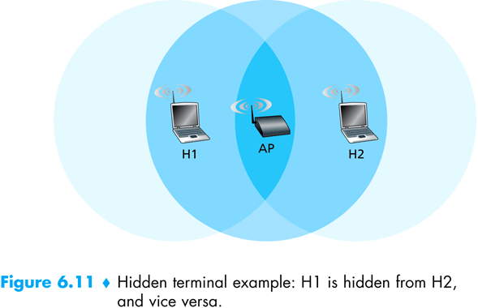
Hidden Terminal Problem in WLANs

Slide 25
Avoiding collisions (more)
idea: allow sender to “reserve” channel rather than random access of data frames: avoid collisions of long data frames
sender first transmits small request-to-send (RTS) packets to BS using CSMA
  RTSs may still collide with each other (but they’re short)
BS broadcasts clear-to-send CTS in response to RTS
CTS heard by all nodes
  sender transmits data frame
  other stations defer transmissions
avoid data frame collisions completely
using small reservation packets!

Slide 26


Collision Avoidance: RTS-CTS exchange
A
B
AP
RTS(B)
RTS(A)
reservation collision
RTS(A)
CTS(A)
CTS(A)
DATA (A)
defer
time
ACK(A)
ACK(A)

Slide 27
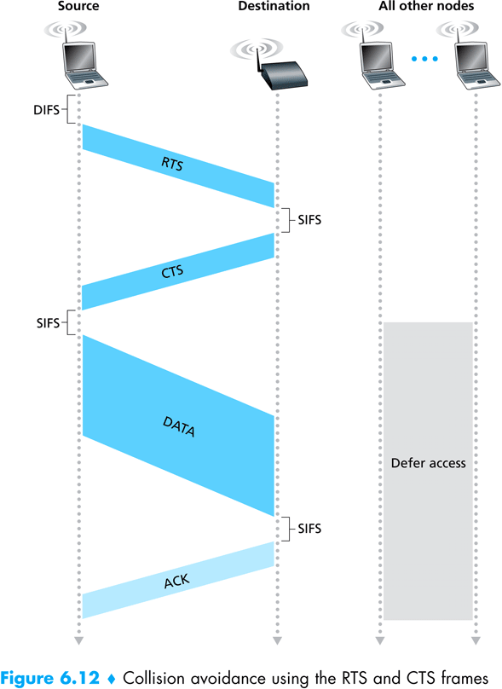
Check Animations on-line (applet & ns)

Slide 28
802.11 frame: addressing
2
2
6
6
6
2
6
0 - 2312
4
frame
control
duration
address
1
address
2
address
3
seq
control
address
4
payload
CRC
Address 4: used only in ad hoc mode
Address 1: MAC address
of wireless host or AP
to receive this frame
Address 3: MAC address
of router interface to which AP is attached
Address 2: MAC address
of wireless host or AP
transmitting this frame

Slide 29

802.11 frame: addressing
Internet
H1
R1
router
R1 MAC addr H1 MAC addr
dest. address
source address
802.3 frame
AP MAC addr H1 MAC addr R1 MAC addr
address 1
address 2
address 3
802.11 frame

Slide 30
802.11 frame: more
frame seq #
(for reliability ARQ)
duration of reserved
transmission time (RTS/CTS)
2
2
6
6
6
2
6
0 - 2312
4
frame
control
duration
address
1
address
2
address
3
seq
control
address
4
payload
CRC
2
2
4
1
1
1
1
1
1
1
1
Protocol
version
Type
Subtype
To
AP
From
AP
More
frag
Retry
Power
mgt
More
data
WEP
Rsvd
frame type
(RTS, CTS, ACK, data)

Slide 31

802.11: mobility within same subnet
H1 remains in same IP subnet: IP address can remain same
switch: which AP is associated with H1?
  self-learning (Ch. 5): switch will see frame from H1 and “remember” which switch port can be used to reach H1
BBS 1
H1
BBS 2

Slide 32
802.11: advanced capabilities
Rate adaptation
base station, mobile dynamically change transmission rate (physical layer modulation technique) as mobile moves, SNR varies
10⁻¹
10⁻²
10⁻³
QAM256 (8 Mbps)
QAM16 (4 Mbps)
BER
10⁻⁴
BPSK (1 Mbps)
operating point
10⁻⁵
10⁻⁶
10⁻⁷
10
20
30
40
SNR(dB)
1. SNR decreases, BER increase as node moves away from base station
Rate adaptation can change rate from
100Mbps to 1Mbps !!
Does this affect higher protocol layers?
2. When BER becomes too high, switch to lower transmission rate but with lower BER

Slide 33
802.11: advanced capabilities
power management
node-to-AP: “I am going to sleep until next beacon frame”
  AP knows not to transmit frames to this node
  node wakes up before next beacon frame
beacon frame: contains list of mobiles with AP-to-mobile frames waiting to be sent
  node will stay awake if AP-to-mobile frames to be sent; otherwise sleep again until next beacon frame

Slide 34
802.15: personal area network
less than 10 m diameter
replacement for cables (mouse, keyboard, headphones)
ad hoc: no infrastructure
master/slaves:
  slaves request permission to send (to master)
  master grants requests
802.15: evolved from Bluetooth specification
  2.4-2.5 GHz radio band
  up to 721 kbps
S
P
P
radius of
coverage
M
S
S
P
P
M
Master device
Slave device
Parked device (inactive)
S
P

Slide 35
Chapter 7 outline
7.1 Introduction
Wireless
7.2 Wireless links, characteristics
  CDMA
7.3 IEEE 802.11 wireless LANs (“Wi-Fi”)
7.4 Cellular Internet access
  architecture
  standards (e.g., 3G, LTE)
Mobility
7.5 Principles: addressing and routing to mobile users
7.6 Mobile IP
7.7 Handling mobility in cellular networks
7.8 Mobility and higher-layer protocols

Slide 36

Components of cellular network architecture
MSC
connects cells to wired tel. net.
manages call setup (more later!)
handles mobility (more later!)
cell
covers geographical region
base station (BS) analogous to 802.11 AP
mobile users attach to network through BS
air-interface: physical and link layer protocol between mobile and BS
Mobile
Switching
Center
Public telephone
network
Mobile
Switching
Center
wired network

Slide 37
Wireless Comm. Systems
In general a wireless communication network consists of:
1- Users [Mobile Node/station] (MN)
2- Base Station (BS): connects users to MSC
3- Mobile Switching Center (MSC):
  connects the base stations with each other, and to the PSTN (public switched telephone network)

Slide 38
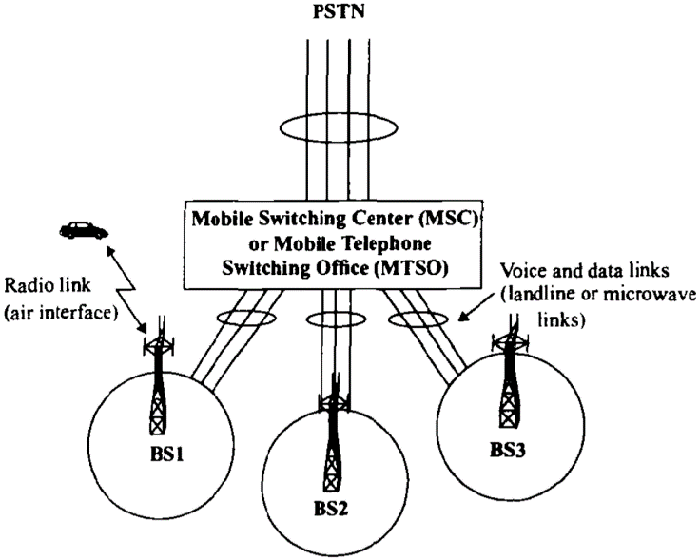
Block Diagram of a Cellular System

Slide 39
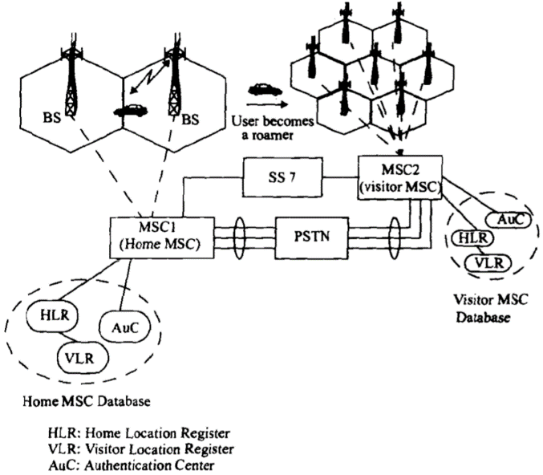
Block Diagram of a Cellular Radio Network

Slide 40
Cellular Networking Terminology
Hand-off: the process of transferring the mobile from one base station to another
Roamer: a mobile operating in a coverage area other than the one in which it subscribed (moving to another MSC)

Slide 41
Cellular Systems
A cellular system services a large number of users over extended geographical coverage with limited frequency spectrum.
High capacity is attained by limiting the coverage of the base station to a cell, so that the same frequency can be re-used in other cells
A problem may occur when moving from one cell to another while keeping the call un-interrupted. [the hand-off problem]

Slide 42
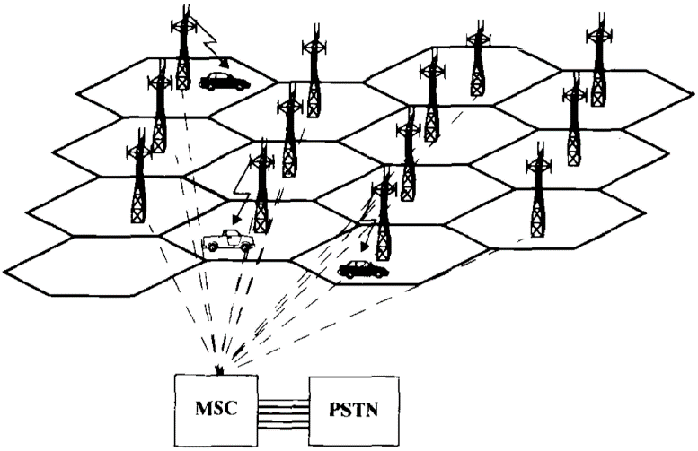
An illustration of a cellular system: The towers are base stations providing
Access between mobile users and the Mobile Switching Center (MSC)

Slide 43
Design concepts: The Cellular Concept and Frequency Re-use
The cellular concept was introduced to solve the problem of frequency limitation,“spectral congestion”, and user capacity
Replace a single high power base station with several lower power base stations, each covering a smaller geographical area, a ‘cell’.
Each of the base stations is allocated a number of channels (portion of the overall system channels)

Slide 44
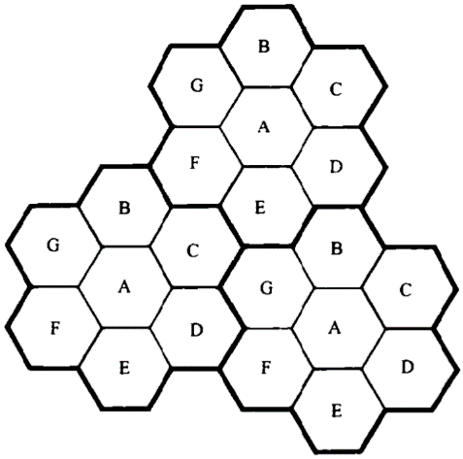
Frequency Re-use
Neighboring base stations (in general) use different frequency channels to reduce interference
A cell uses a set of frequencies
A ‘cluster’ holds several cells
Frequency re-use factor: 1/#cells per cluster

Slide 45
Cluster
B
G
C
B
Cell
A
G
C
B
F
D
A
G
C
E
F
D
A
B
E
F
D
G
C
B
E
A
G
C
F
D
A
E
F
D
E
Cellular frequency re-use concept: cells with the same letter use the same set of frequencies.
A cluster of cells (highlighted in bold) is replicated over the coverage area. The cluster size,
N, is equal to 7. Since each cell contains one-seventh of the overall channels, the cell
frequency re-use factor is 1/7.
This requires channel/frequency planning and allocation!

Slide 46
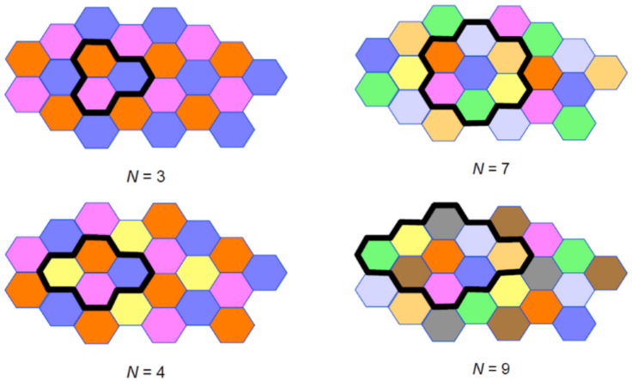
Cluster size of 3, 4, 7, 9
[different colors mean different channels/frequencies used]

Slide 47
Channel assignment strategies
Channel assignment affects handoff
(1) Fixed Assignment:
  Each cell allocated pre-determined set of channels frequencies
  If a call request is made and no available channels exist, it will be blocked (may lead to high blocking probability)
(2) Dynamic Assignment: channels allocated on-demand
The notion of ‘borrowing’ used to alleviate blocking
Reduces blocking
Requires that MSC collect real-time iformation about channel occupancy, traffic distribution, radio signal strength indications (RSSI), periodically for all channels

Slide 48
Hand-off strategies
Mobile moves into a different cell
It monitors the signal strength from the current base station
When power drops below a certain threshold we need hand off

Slide 49
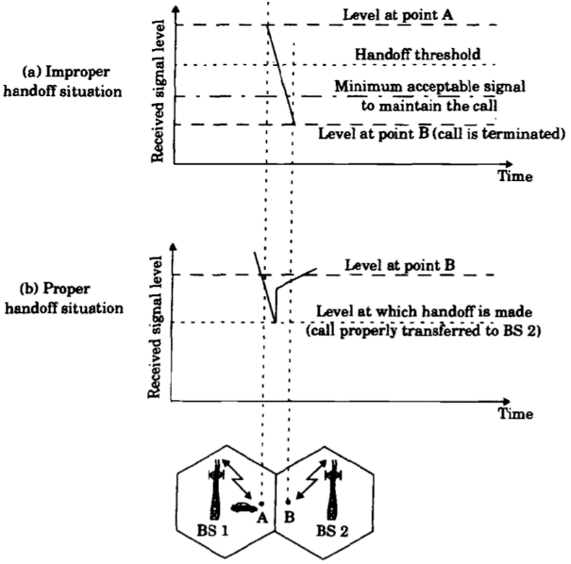
Illustration of a handoff scenario at cell boundary

Slide 50
During handoff: to avoid call termination, allow a safety margin
  Δ=Power__{handoff} – Power__{min usable}
Note:
  Does handoff occur only during movement?
  Even if the mobile is stationary, the signal strength may vary
  with changes in the surrounding environment, so we may need
  a handoff

Slide 51
Handoff in 1st generation:
  Strength of signal measurement is done by the base station and supervised by MSC
Hand off in 2nd generation:
In TDMA: it is mobile assisted handoff (MAHO).
  Every mobile measures the strength of signal to base stations and reports to the serving base station
  Mobile performs measurement during idle time slots
In CDMA: (code division multiple access)
  Soft handoff:
  No change of channel, only change of base station
  The cells use the same frequency and channels
[More later when we talk about CDMA/TDMA]

Slide 52
Interference in Cellular Networks
Main types on interference:
  ‘Co-channel’ interference
  ‘Adjacent channel’ interference
  External sources
  Effects of fading, self-interference
  …
fading
self-interference

Slide 53
Co-channel Interference
Exists between signals from co-channel cells (in different clusters)
Co-channel cells are those cells that use the same set of frequencies
Co-channel interference cannot be reduced by strengthening the signal.

Slide 54
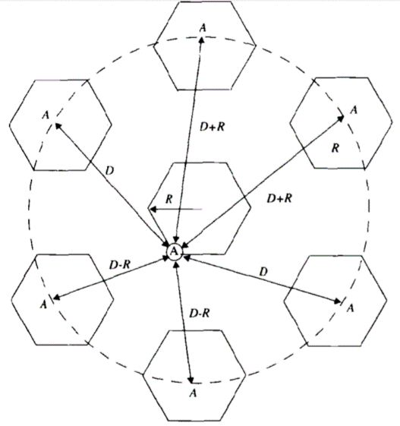
Illustration of co-channel cells for a cluster size of N=7.
When the mobile is at the cell boundary (A), it experiences
worst case co-channel interference on the forward channel.

Slide 55

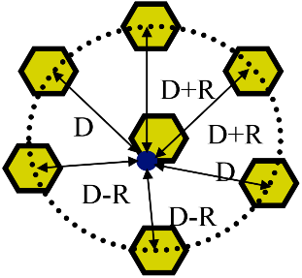
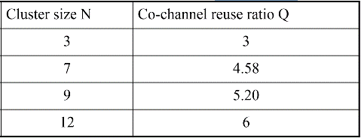
Co-channel Interference (contd.)
Function of cell radius (R), co-channel cell distance (D)
Q=D/R, “Q: co-channel re-use ratio”
As Q increases, the spatial separation between co-channel cells relative to the cell size increases, so interference decreases
Typical co-channel re-use ratio (Q) is 3 - 6

Slide 56
Adjacent Channel Interference
Signals that occupy frequency spectrum adjacent to the desired signal, may cause interference due to imperfect filtering (at the receivers).
The worst interference occurs when the adjacent frequencies are used within the same cell
Can be reduced by filtering and careful channel assignment

Slide 57
Adjacent Channel Interference (contd.)
(1) Channel assignment in a cell:
  Instead of assigning channels from a contiguous band of frequencies
  Channels are assigned such that frequency separations between channels are maximized.
  For example, by sequentially assigning adjacent bands to different cells
  This is called ‘frequency planning’.
(2) A filter is used in the base station to reject power from adjacent channels.

Slide 58
1
2
3
4
5
6
7
8
9
10
11
12
13
14
freq
adjacent
channels
adjacent
channels
B
2
9
G
4
C
5
11
12
1
A
8
F
6
D
7
13
14
E
3
10
Frequency Planning/Channel Assignment

Slide 59
Multiple Access (MA) Techniques for Wireless Communications
MA schemes allow multiple mobile users to share a limited frequency spectrum using multiplexing
Main MA schemes:
  FDMA (frequency division multiple access)
  TDMA (time division multiple access)
  SSMA (spread spectrum multiple access)
  - FHMA (frequency hopping multiple access)
  - CDMA (code division multiple access)
  or DSMA (direct sequency multiple access)
  SDMA (space division multiple access)

Slide 60
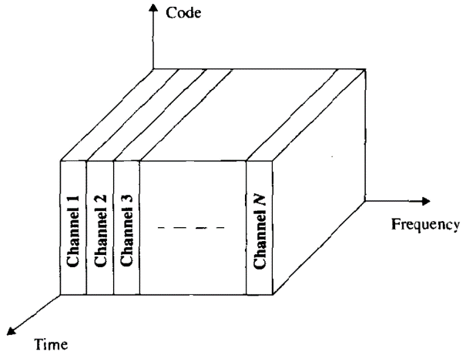
FDMA where different channels are assigned different frequency bands

Slide 61
Frequency Division Multiple Access (FDMA)
Assigns individual channels to individual users on demand
Only 1 user utilizes the channel at a time. Idle times are wasted. Capacity is not shared.
Communication is continuous
Does not need synchronization
Costly filters at the base station
Need guard bands to alleviate interference

Slide 62
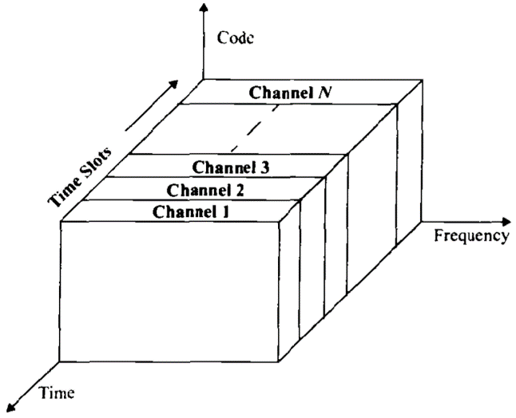
TDMA where each channel occupies a cyclically repeating time slot

Slide 63
Time Division Multiple Access (TDMA)
In a time slot only 1 user transmits (or receives)
Several users share a single frequency channel
Transmission is non-continuous
Power consumption is lower than FDMA (e.g., the transmitter can be turned off when idle)
During idle time, a mobile performs MAHO
Synchronization is needed

Slide 64
Spread Spectrum Multiple Access (SSMA)
Traditional communication techniques
  Strive to conserve bandwidth
By contrast, Spread spectrum techniques
  use bandwidth several orders of magnitude larger than the min. required bandwidth !!

Slide 65
Spread Spectrum Multiple Access (SSMA)
Spread spectrum techniques use bandwidth larger than the min. required bandwidth
Modulation (sender-side encoding):
  Uses pseudo-noise (PN) sequence to convert the signal into wideband
  The PN is random, but can be re-produced by receiver
Demodulation (receiver-side decoding):
  Correct correlation using a PN re-produces the signal
  Using wrong PN sequence produces noise, hence this scheme is ‘secure’

Slide 66
SSMA (continued)
Spread Spectrum (SS) uses two techniques:
  FHMA: frequency hopped MA
  DSMA: direct sequence MA (also called CDMA: code division multiple access)
Frequency Hopped MA (FHMA)
  Frequencies of individual users are varied in a pseudo-random fashion within the wideband range
  The signal is broken into bursts and each burst is sent on a different frequency
Code Division Multiple Access (CDMA) or Direct Sequence Spread Spectrum (DSSS or DSMA)
[next few slides]

Slide 67
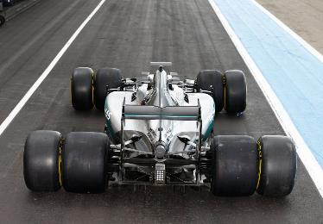
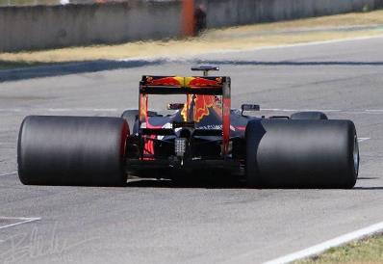

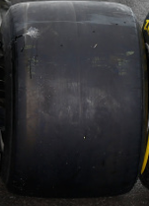
Spread Spectrum Analogy
resilience to fading (bumps on the road)
Frequency hopping (FHMA):
using many wheels,
if some get affected others work
Direct sequence (DSMA/DSSS):
using wide wheels,
if some parts get affected others work

Slide 68
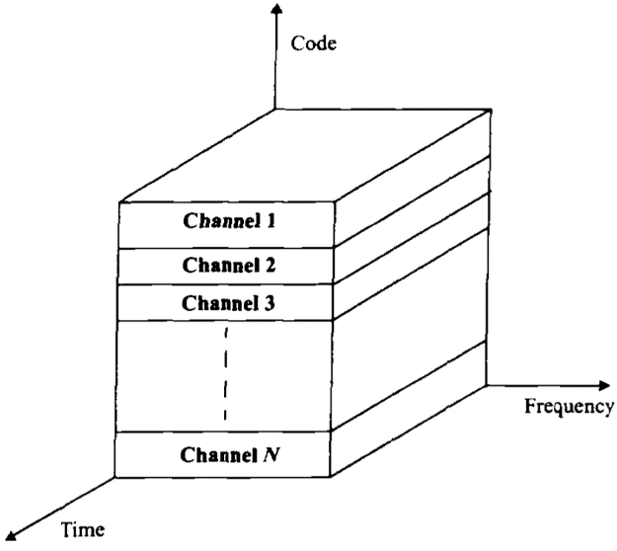
CDMA where each channel is assigned a unique PN code which is
orthogonal to PN codes used by other users

Slide 69
Code Division Multiple Access (CDMA)
used in several wireless broadcast channels (cellular, satellite, etc) standards
unique “code” assigned to each user; i.e., code set partitioning
all users share same frequency, but each user has own “chipping” sequence (i.e., code) to encode data
encoded signal = (original data) X (chipping sequence)
decoding: inner-product of encoded signal and chipping sequence
allows multiple users to “coexist” and transmit simultaneously with minimal interference (if codes are “orthogonal”)

Slide 70
CDMA Advantages
Secure: non-intended recipients (with wrong PN) get noise
Speading the signal power over a wide spread of the frequency spectrum reduces fading effects
  only part of the spectrum & the signal, is affected by fading
  802.11 uses it for its resilience to fading and interference
No frequency planning; users use same frequency
Soft hand-off can be provided since all the cells use the same frequency. MSC monitors signals.
  In soft hand-off the channel frequency remains the same and the base station changes
Supports higher number of users
  not limited by spectrum but by the ‘noise floor’
  Supports 15 times more users than FDMA, 3-5 times TDMA

Slide 71
Direct Sequence Spread Spectrum
Original signal is m(t)
The spreading signal is p(t) [the PN sequence]
The spread spectrum signal is S_{ss}(t)
A single pulse or symbol of the PN waveform is called a chip

Slide 72
Spread Spectrum Transmitter: Modulation and encoding at sender-side
S_{ss}(t) ~ m(t)p(t)cos(2πf_{c}t+θ)
B: is the bandwidth of m(t)cos(2πf_{c}t+θ)
W_{ss}: is the bandwidth of S_{ss}(t)
W_{ss} >> B
Phase modulation
S_{ss}(t)
Data m(t)
Transmitted Signal
p(t)
PN Code
Generator
Oscillator
f_{c}
Chip Clock
(c)
Block diagram of a DS-SS (direct sequence – spread spectrum) system with binary phase modulation Transmitter

Slide 73
Spread Spectrum Operation
Symbol
(A)
Channel
en/decoder
(B)
f(B,C)
Chip
(C)
Symbol duration for m(t): Ts
Chip duration for p(t): Tc
Processing Gain PG=W_{ss}/B=Ts/Tc, a measure of interference rejection capability
Example:
  f(B,C)=B⊕C, where
    1 ⊕ 1= 0, 1 ⊕ 0 = 1, 0 ⊕ 1 = 1, 0 ⊕ 0 = 0
  if we have received f(B,C) and we are able to re-generate the PN (C), then we can get B.

Slide 74
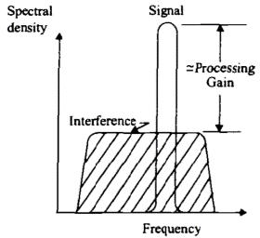
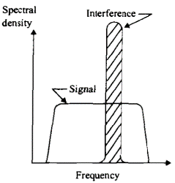
Spread Spectrum Signals
Ts
Signal to send
(B)
m(t)
Tc
Pseudo-noise
sequence
(C)
p(t)
Intended recipient
gets strong
signal and filters
out the noise
Non-intended recipient gets strong noise and cannot receive signal
Noise floor
Noise floor increases
with number of
simultaneous users

Slide 75
Near-far effect in CDMA
all users use same frequency
a user near BS generates high power signal (noise) received at the cell tower
a far away sender will generate less power and its signal may be drowned out by near user
Solutions:
PTx₂
PRx₂
PTx₁
PRx₁
PTx₁: power transmitted by near node
PTx₂: power transmitted by far node
PRx₁: power received from near node
PRx₂: power received from far node
1- Dynamic power control: cell tower tells near users to decrease their power so that all signals arrive at the receiver with similar signal strengths.
2- CDMA-TDMA: Allow one user per time-slot, no noise. Limits number of users but gets some CDMA benefits

Slide 76
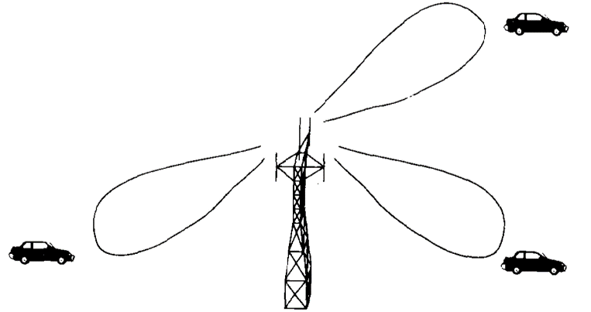
Space Division MA (SDMA)
Controls the radiated energy for each user in space using spot beam (directional) antennas
A spatially filtered base station antenna serving different users by using spot beams

Slide 77
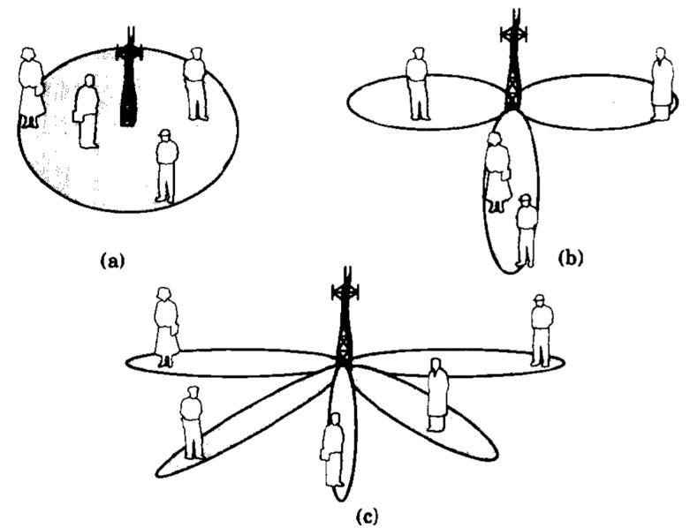
Base Station Antenna Patterns
Omni-directional
Sectorized
Adaptive antenna provides individual spot beams for each user in the cell

Slide 78
Multiple Access (MA) & Multiplexing
MA schemes allow multiple mobile users to share a limited frequency spectrum using multiplexing
Main MA schemes:
  FDMA (frequency division multiple access)
  TDMA (time division multiple access)
  SSMA (spread spectrum multiple access)
  - FHMA (frequency hopping multiple access)
  - CDMA (code division multiple access)
  or DSMA (direct sequency multiple access)
  SDMA (space division multiple access)
  WDM (wavelength division multiplexing)
One more thing!

Slide 79
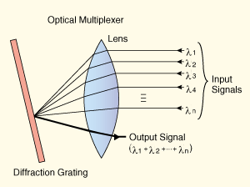
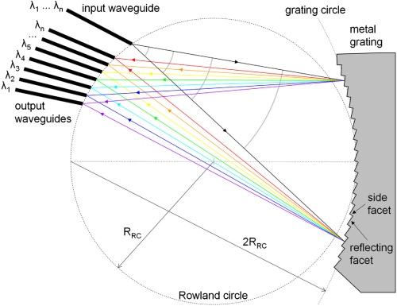
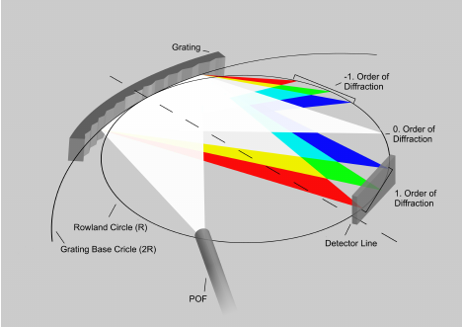
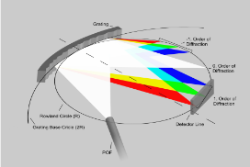
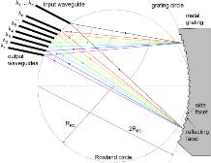

Wavelength Division Multiplexing (WDM)
separates signal in optical (light) networks
wavelength (λ) corresponds to color
  $λ=\frac{c}{f}$ , c : speed of light, f : frequency
uses lenses/mirrors (diffraction grating) for de/multiplexing laser pulses in fiber
suffers electro-optical bottleneck to transform light to electronic signals & back (to be buffered, processed...)
work on ‘all-optical’ networks continues

Slide 80

Hybrid Mobile Access Systems
FDMA/TDMA: divide spectrum in frequency channels, divide each channel into time slots
time slots
frequency
bands

Slide 81
Hybrid Mobile Systems (contd.)
Time division frequency hopping (TDFH): (GSM)
  User hop to new frequency at start of a TDMA frame
  Hence reducing interference and fading effects
  User hops over pre-defined frequencies
TDMA/CDMA: (CDMA-2000)
  Use CDMA in each time slot
  Get advantages of security and interference resistance, without noise from multiple simultaneous users

Slide 82
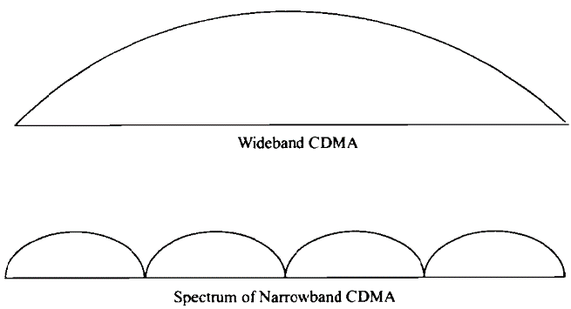
FDMA/CDMA:
  Bandwidth split into subspectra. Each uses CDMA
  Allows to assign subspectra on-demand
FDMA/CDMA
Spectrum of wideband CDMA compared to the spectrum of a hybrid, frequency
Division, direct sequence multiple access

Slide 83
2G (voice) network architecture
Base station system (BSS)
MSC
BTS
BSC
G
Public
telephone
network
Gateway
MSC
Legend
Base transceiver station (BTS)
Base station controller (BSC)
Mobile Switching Center (MSC)
Mobile subscribers

Slide 84
3G (voice+data) network architecture
MSC
G
Public
telephone
network
radio
network
controller
Gateway
MSC
G
Public
Internet
SGSN
Key insight: new cellular data
network operates in parallel
(except at edge) with existing
cellular voice network
voice network unchanged in core
data network operates in parallel
GGSN
Serving GPRS Support Node (SGSN)
Gateway GPRS Support Node (GGSN)

Slide 85
3G (voice+data) network architecture
MSC
G
Public
telephone
network
radio
network
controller
Gateway
MSC
G
Public
Internet
SGSN
GGSN
radio interface
(WCDMA, HSPA)
radio access network
Universal Terrestrial Radio
Access Network (UTRAN)
core network
General Packet Radio Service
(GPRS) Core Network
public
Internet

Slide 86
3G versus 4G LTE network architecture
MSC
G
Public
telephone
network
3G
radio
network
controller
Gateway
MSC
G
Public
Internet
SGSN
GGSN
4G-LTE
HSS
MME
G
G
Public
Internet
S-GW
P-GW
radio access network
Universal Terrestrial Radio
Access Network (UTRAN)
Evolved Packet Core
(EPC)

Slide 87
4G: differences from 3G
all IP core: IP packets tunneled (through core IP network) from base station to gateway
no separation between voice and data – all traffic carried over IP core to gateway
Mobility
Management
Entity (MME)
Home Subscriber
Server(HSS)
(like HLR+VLR)
Serving
Gateway
(S-GW)
Packet data
network
Gateway
(P-GW)
UE
(user element)
eNodeB
(base station)
HSS
MME
control
G
G
Public
Internet
data
S-GW
P-GW
radio access network
Universal Terrestrial Radio
Access Network (UTRAN)
Evolved Packet Core
(EPC)

Slide 88
Chapter 7 outline
7.1 Introduction
Wireless
7.2 Wireless links, characteristics
  CDMA
7.3 IEEE 802.11 wireless LANs (“Wi-Fi”)
7.4 Cellular Internet Access
  architecture
  standards (e.g., 3G, LTE)
Mobility
7.5 Principles: addressing and routing to mobile users
7.6 Mobile IP
7.7 Handling mobility in cellular networks
7.8 Mobility and higher-layer protocols

Slide 89
What is mobility?
spectrum of mobility, from the network perspective:
no mobility
high mobility
mobile wireless user,
using same access
point
mobile user, connecting/ disconnecting from network using DHCP.
mobile user, passing through multiple access point while maintaining ongoing connections (like cell phone)

Slide 90



Mobility: vocabulary
home network: permanent “home” of mobile
(e.g., 128.119.40/24)
home agent: entity that will perform mobility functions on behalf of mobile, when mobile is remote
wide area network
permanent address: address in home network, can always be used to reach mobile
e.g., 128.119.40.186

Slide 91
Mobility: more vocabulary
permanent address: remains constant (e.g., 128.119.40.186)
visited network: network in which mobile currently resides (e.g., 79.129.13/24)
care-of-address: address in visited network.
(e.g., 79,129.13.2)
wide area network
foreign agent: entity in visited network that performs mobility functions on behalf of mobile.
correspondent: wants to communicate with mobile

Slide 92



How do you contact a mobile friend:
Consider friend frequently changing addresses, how do you find her?
I wonder where Alice moved to?
search all phone books?
call her parents?
expect her to let you know where he/she is?
Facebook!

Slide 93
Mobility: approaches
let routing handle it: routers advertise permanent address of mobile-nodes-in-residence via usual routing table exchange.
  routing tables indicate where each mobile located
  no changes to end-systems
let end-systems handle it:
  indirect routing: communication from correspondent to mobile goes through home agent, then forwarded to remote
  direct routing: correspondent gets foreign address of mobile, sends directly to mobile

Slide 94
Mobility: approaches
let routing handle it: routers advertise permanent address of mobile-nodes-in-residence via usual routing table exchange.
  routing tables indicate where each mobile located
  no changes to end-systems
let end-systems handle it:
  indirect routing: communication from correspondent to mobile goes through home agent, then forwarded to remote
  direct routing: correspondent gets foreign address of mobile, sends directly to mobile
not
scalable
to millions of
mobiles

Slide 95
Mobility: registration
visited network
home network
1
2
wide area network
mobile contacts foreign agent on entering visited network
foreign agent contacts home agent home: “this mobile is resident in my network”
end result:
foreign agent knows about mobile
home agent knows location of mobile

Slide 96

Mobility via indirect routing
foreign agent receives packets, forwards to mobile
home agent intercepts packets, forwards to foreign agent
visited
network
home
network
3
wide area network
2
1
correspondent addresses packets using home address of mobile
4
mobile replies directly to correspondent

Slide 97
Indirect Routing: comments
mobile uses two addresses:
  permanent address: used by correspondent (hence mobile location is transparent to correspondent)
  care-of-address: used by home agent to forward datagrams to mobile
foreign agent functions may be done by mobile itself
triangle routing: correspondent-home-network-mobile
  inefficient when
  correspondent, mobile
  are in same network

Slide 98
Indirect routing: moving between networks
suppose mobile user moves to another network
  registers with new foreign agent
  new foreign agent registers with home agent
  home agent update care-of-address for mobile
  packets continue to be forwarded to mobile (but with new care-of-address)
mobility, changing foreign networks transparent: on-going connections can be maintained!

Slide 99



Mobility via direct routing
foreign agent receives packets, forwards to mobile
correspondent forwards to foreign agent
visited
network
home
network
3
1
2
4
correspondent requests, receives foreign address of mobile
mobile replies directly to correspondent

Slide 100

Mobility via direct routing: comments
overcome triangle routing problem
non-transparent to correspondent: correspondent must get care-of-address from home agent
  what if mobile changes visited network?
3
1
2
4

Slide 101

Accommodating mobility with direct routing
anchor foreign agent: FA in first visited network
data always routed first to anchor FA
when mobile moves: new FA arranges to have data forwarded from old FA (chaining)
foreign net visited
at session start
anchor
foreign
agent
wide area network
2
1
4
5
3
new
foreign
network
correspondent
agent
new foreign
agent
correspondent

Slide 102
Chapter 7 outline
7.1 Introduction
Wireless
7.2 Wireless links, characteristics
  CDMA
7.3 IEEE 802.11 wireless LANs (“Wi-Fi”)
7.4 Cellular Internet Access
  architecture
  standards (e.g., 3G, LTE)
Mobility
7.5 Principles: addressing and routing to mobile users
7.6 Mobile IP
7.7 Handling mobility in cellular networks
7.8 Mobility and higher-layer protocols

Slide 103
Mobile IP
RFC 2002, 3344
Goal: attempts to support host mobility while maintaining ‘transparency’:
  correspondent node need not know mobile node location
  already-established connections should be maintained during movement even if point-of-attachment changes
Has many features we have already seen:
  home agents, foreign agents, registration, care-of-address, encapsulation/tunneling (packet-within-a-packet, IP-in-IP)
Three components to standard:
  indirect routing of datagrams
  agent discovery
  registration with home agent

Slide 104


Mobile IP: registration example
visited network: 79.129.13/24
home agent
HA: 128.119.40.7
foreign agent
COA: 79.129.13.2
mobile agent
MA: 128.119.40.186
ICMP agent adv.
COA: 79.129.13.2
….
registration req.
registration req.
COA: 79.129.13.2
HA: 128.119.40.7
MA: 128.119.40.186
Lifetime: 9999
identification: 714
encapsulation format
….
COA: 79.129.13.2
HA: 128.119.40.7
MA: 128.119.40.186
Lifetime: 9999
identification:714
….
registration reply
HA: 128.119.40.7
MA: 128.119.40.186
Lifetime: 4999
Identification: 714
encapsulation format
….
registration reply
HA: 128.119.40.7
MA: 128.119.40.186
Lifetime: 4999
Identification: 714
….
time

Slide 105

Mobile IP: indirect routing
foreign-agent-to-mobile packet
packet sent by home agent to foreign agent: a packet within a packet
dest: 128.119.40.186
dest: 79.129.13.2
dest: 128.119.40.186
Permanent address: 128.119.40.186
Care-of address: 79.129.13.2
dest: 128.119.40.186
packet sent by correspondent

Slide 106
Components of cellular network architecture
recall:
correspondent
wired public telephone
network
MSC
MSC
MSC
MSC
MSC
different cellular networks,
operated by different providers

Slide 107
Handling mobility in cellular networks
home network: network of cellular provider you subscribe to (e.g., Sprint, Verizon)
  home location register (HLR): database in home network containing permanent cell phone #, profile information (services, preferences, billing), information about current location (could be in another network)
visited network: network in which mobile currently resides
  visitor location register (VLR): database with entry for each user currently in network
  could be home network

Slide 108

GSM: indirect routing to mobile
HLR
home
network
2
correspondent
home
Mobile
Switching
Center
home MSC consults HLR,
gets roaming number of
mobile in visited network
1
call routed
to home network
3
Public switched
telephone
network
VLR
Mobile
Switching
Center
4
home MSC sets up 2nd leg of call
to MSC in visited network
mobile
user
MSC in visited network completes
call through base station to mobile
visited
network

Slide 109
GSM: handoff with common MSC
handoff goal: route call via new base station (without interruption)
reasons for handoff:
  stronger signal to/from new BSS (continuing connectivity, less battery drain)
  load balance: free up channel in current BSS
  GSM doesn't mandate why to perform handoff (policy), only how (mechanism)
handoff initiated by old BSS
VLR
Mobile
Switching
Center
old
routing
new
routing
old BSS
new BSS

Slide 110
GSM: handoff with common MSC
1. old BSS informs MSC of impending handoff, provides list of 1⁺ new BSSs
2. MSC sets up path (allocates resources) to new BSS
3. new BSS allocates radio channel for use by mobile
4. new BSS signals MSC, old BSS: ready
5. old BSS tells mobile: perform handoff to new BSS
6. mobile, new BSS signal to activate new channel
7. mobile signals via new BSS to MSC: handoff complete. MSC reroutes call
8 MSC-old-BSS resources released
VLR
Mobile
Switching
Center
4
2
1
8
7
3
old BSS
5
6
new BSS

Slide 111
GSM: handoff between MSCs
anchor MSC: first MSC visited during call
  call remains routed through anchor MSC
new MSCs add on to end of MSC chain as mobile moves to new MSC
optional path minimization step to shorten multi-MSC chain
home network
correspondent
Home MSC
anchor MSC
PSTN
MSC
MSC
MSC
(a) before handoff

Slide 112
GSM: handoff between MSCs
anchor MSC: first MSC visited during call
  call remains routed through anchor MSC
new MSCs add on to end of MSC chain as mobile moves to new MSC
optional path minimization step to shorten multi-MSC chain
home network
correspondent
Home MSC
anchor MSC
PSTN
MSC
MSC
MSC
(b) after handoff

Slide 113

Handling Mobility in LTE
Paging: idle UE may move from cell to cell: network does not know where the idle UE is resident
  paging message from MME broadcast by all eNodeB to locate UE
handoff: similar to 3G:
  preparation phase
  execution phase
  completion phase
source
MME
P-GW
target
MME
old
routing
new
routing
old
eNodeB
new
eNodeB

Slide 114
Mobility: cellular versus Mobile IP
cellular element |  | Comment on cellular element | Mobile IP element
Home system | Network to which mobile user’s permanent phone number belongs |  |  | Home network
Gateway Mobile Switching Center, or “home MSC”. Home Location Register (HLR) | Home MSC: point of contact to obtain routable address of mobile user. HLR: database in home system containing permanent phone number, profile information, current location of mobile user, subscription information |  |  | Home agent
Visited System | Network other than home system where mobile user is currently residing |  |  | Visited network
Visited Mobile services Switching Center. Visitor Location Record (VLR) | Visited MSC: responsible for setting up calls to/from mobile nodes in cells associated with MSC. VLR: temporary database entry in visited system, containing subscription information for each visiting mobile user |  |  | Foreign agent
Mobile Station Roaming Number (MSRN), or “roaming number” | Routable address for telephone call segment between home MSC and visited MSC, visible to neither the mobile nor the correspondent. |  |  | Care-of-address

Slide 115
Wireless, mobility: impact on higher layer protocols
logically, impact should be minimal …
  best effort service model remains unchanged
  TCP and UDP can (and do) run over wireless, mobile
… but performance-wise:
  packet loss/delay due to bit-errors (discarded packets, delays for link-layer retransmissions), and handoff
  TCP interprets loss as congestion, will decrease congestion window un-necessarily
  delay impairments for real-time traffic
  limited bandwidth of wireless links

Slide 116
Chapter 7 summary
Wireless
wireless links:
  capacity, distance
  channel impairments
  CDMA
IEEE 802.11 (“Wi-Fi”)
  CSMA/CA reflects wireless channel characteristics
cellular access
  architecture
  standards (e.g., 3G, 4G LTE)
Mobility
principles: addressing, routing to mobile users
  home, visited networks
  direct, indirect routing
  care-of-addresses
case studies
  mobile IP
  mobility in GSM, LTE
impact on higher-layer protocols

Slide 117
Extra Slides

Slide 118
Code Division Multiple Access (CDMA)
unique “code” assigned to each user; i.e., code set partitioning
  all users share same frequency, but each user has own “chipping” sequence (i.e., code) to encode data
  allows multiple users to “coexist” and transmit simultaneously with minimal interference (if codes are “orthogonal”)
encoded signal = (original data) X (chipping sequence)
decoding: inner-product of encoded signal and chipping sequence

Slide 119
CDMA encode/decode
channel output Z_{i,m}
Z_{i,m}= d_{i}.c_{m}
data
bits
d₀ = 1
1
1
1
1
1
d₁ = -1
1
1
1
-
-
-
-
1
-
-
-
1
-
1
1
1
1
1
sender
1
1
slot 1
channel
output
slot 0
channel
output
1
1
1
1
1
code
1
1
-
-
-
1
-
1
1
1
-
-
-
1
-
1
1
1
slot 1
slot 0
M
D_{i} = Σ Z_{i,m}.c_{m}
m=1
M
received
input
1
1
1
1
1
1
1
1
d₀ = 1
-
-
-
-
1
-
-
-
1
-
1
1
1
1
1
1
d₁ = -1
1
slot 1
channel
output
slot 0
channel
output
1
1
1
1
1
code
1
1
-
-
-
1
-
1
1
1
-
-
-
1
-
1
1
1
receiver
slot 1
slot 0

Slide 120

CDMA: two-sender interference
channel sums together transmissions by sender 1 and 2
Sender 1
Sender 2
using same code as sender 1, receiver recovers sender 1’s original data from summed channel data!

Slide 121
Analysis
A cellular system with ‘S’ duplex channels
Each cell has ‘k’ channels. There are N cells with identical number of channels: S=k.N
If the cluster is repeated M times then (overall capacity)=M.S=M.k.N
N: cluster size, typically 4,7,12
Frequency re-use factor = 1/N
Each cell is assigned 1/N of total bandwidth

Slide 122
Example: Total of 33MHz bandwidth is available. Cellular phone channel uses 25kHz in simplex mode (i.e. 50kHz in duplex mode). Get the number of channels available per cell if we have 4-cell re-use. If 1 MHz is allocated for control. How many control channels per cell will there be?

Slide 123
Each duplex channel uses 2x25kHz=50kHz
Total number of channels=33M/50k=660 channels
For 4-cell reuse, channels per cell = 660/4=165
1Mhz of control
Total control 1MHz/50k=20 control channels
number of control channels per cell = 20/4 =5, 165-5=160 voice channels per cell

Slide 124
Mobile IP
Each mobile node has a home network, home address and home agent
Correspondent Node
Home Agent (HA)
Home Network
Mobile Node

Slide 125
When mobile node (MN) moves to a foreign network it obtains a
care-of-address (COA) from the foreign agent (FA) that registers
it with the home agent (HA)
COA is used by HA to forward packets destined to MN
Foreign Agent (FA)
Advertisement (FA,COA)
Foreign Network
Solicitation
Correspondent Node
Register
Mobile Node
Register (HA)
Home Agent
Home Network

Slide 126
Packets sent by MN go
directly to CN
Correspondent
Node (CN)
Mobile Node (MN)
Packets to MN are
picked up by the HA
and tunneled to MN
Home Agent (HA)
Triangle Routing in Mobile-IP

Slide 127
Triangular routing can be very inefficient, especially when
C << B+A, where A (as shown) is the shortest path from
CN to MN
C
Correspondent
Node (CN)
Mobile Node (MN)
A
B
Home Agent (HA)
Triangle Routing in Mobile-IP

Slide 128
Drawbacks of Mobile IP
Other than (the main problem) of triangular routing
  Mobile IP incurs lots of communication with the home agent with every movement
  so, may not be fit for ‘micro’ mobility [e.g., move between rooms or buildings within the same network domain]
  handoff delays are significant since registration/packets need to go through the home agent first

Slide 129
Suggested solutions
To avoid triangular routing
  use ‘route optimization’
  use micro-mobility architectures
    Cellular IP (CIP)
    Hawaii
    Multicast-based Mobility (M&M)

Slide 130
(3) When MN gets packets from CN
it sends a Binding Update to CN with
its new address
(4) CN changes the destination
address of the packets to go to
MN’s new address
Correspondent
Node (CN)
Mobile Node (MN)
(2) Initial packets
to MN are sent
through HA to MN
(1) MN registers with HA as in
basic Mobile IP.
Home Agent (HA)
Route Optimization (simple illustration)

Slide 131
With route optimization
  Triangular routing is avoided
  Still have problems with micro mobility and smooth hand-off
  Need additional mechanisms to deal with these issues, which makes the protocol complex.

Slide 132
Micro-Mobility
Hierarchical approach to mobility:
  During frequent, intra-domain, movement only local efficient handoff is performed without notifying the home agent (HA) or the correspondent node (CN)
  For inter-domain mobility use Mobile IP. Notify HA or CN only during inter-domain movement

Slide 133
Distribution tree dynamics while roaming
Domain Root
FA or CN
Wireless link
Mobile Node

Slide 134
M&M: Join/Prune dynamics to modify distribution
Domain Root
Wireless link
Mobile Node

