Slide 1
Algorithm
Assignment 4
물리학과 20182326 이선민

Slide 2
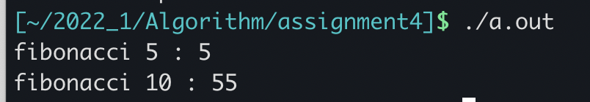
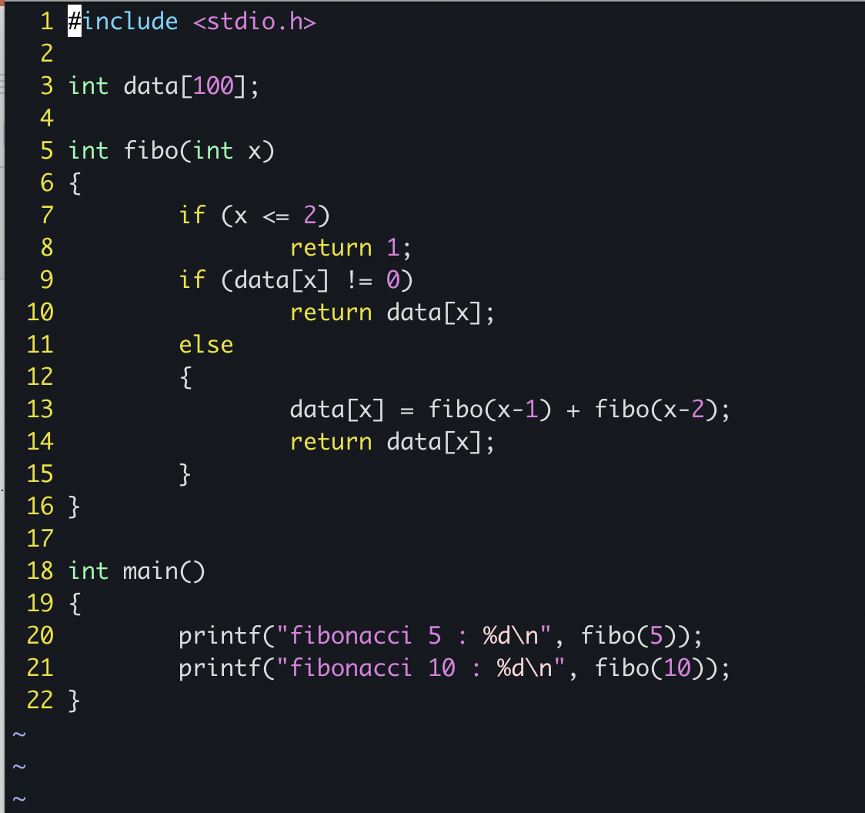
problem1
The array of data was declared as a global variable. The fibonacci recursive function was stored in data, and if there was a value in data, the recursive function was not called and the value was immediately taken from the data and returned.

Slide 3
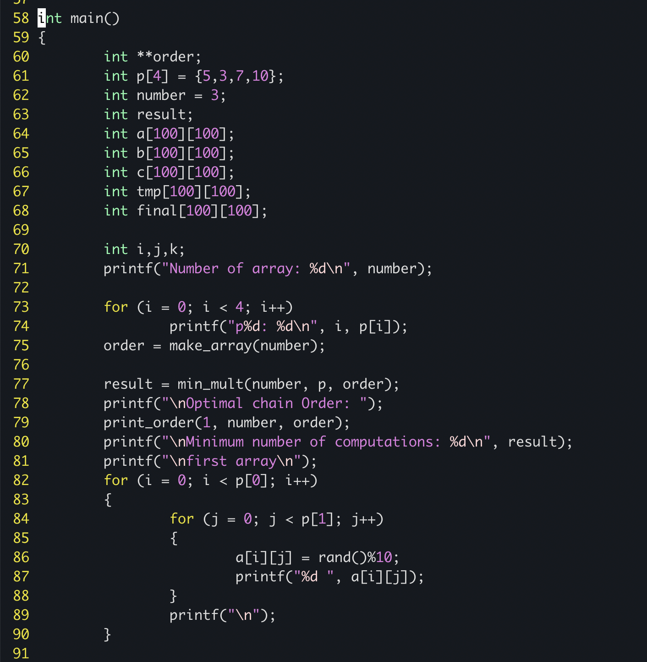
Problem2 -code
The main function outputs the number of matrices to be calculated first, and the row and column values (p) of each matrix.
And it initializes the order array through a function called make array.
The minimum number of computation value is calculated with a function called min_mult and an optical chain order is output through the print_order function.

Slide 4
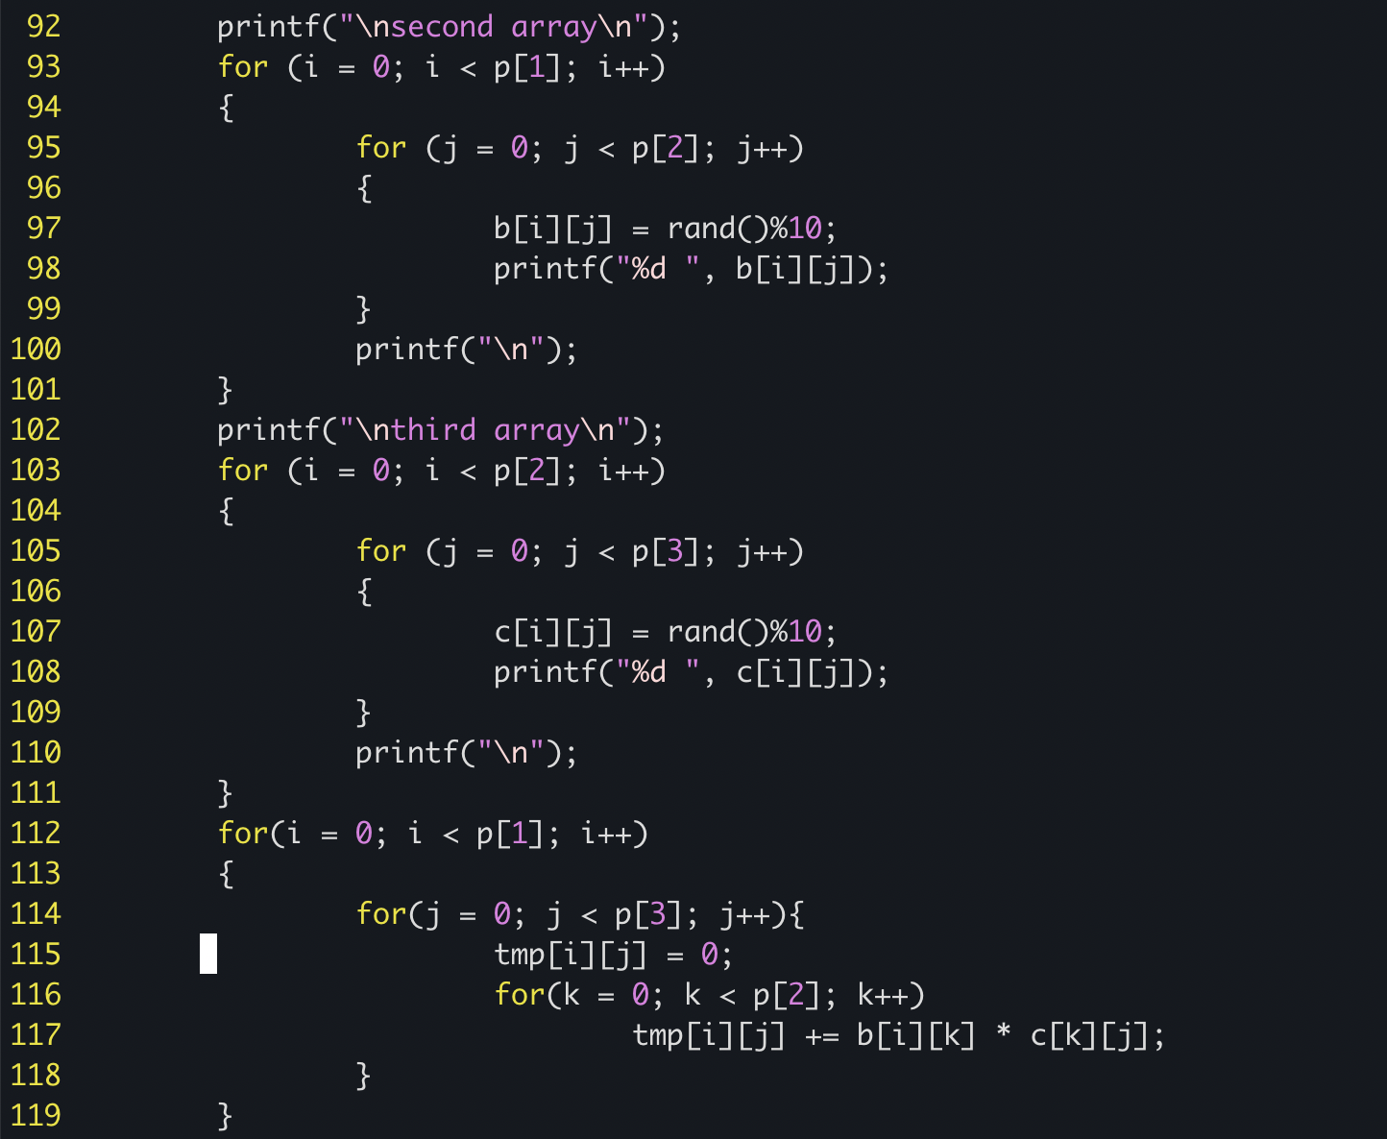
Problem2 - code
The three matrices to be calculated were made from random number generation.
First, calculate the second and third matrices, and then multiply the results with the first matrix.

Slide 5
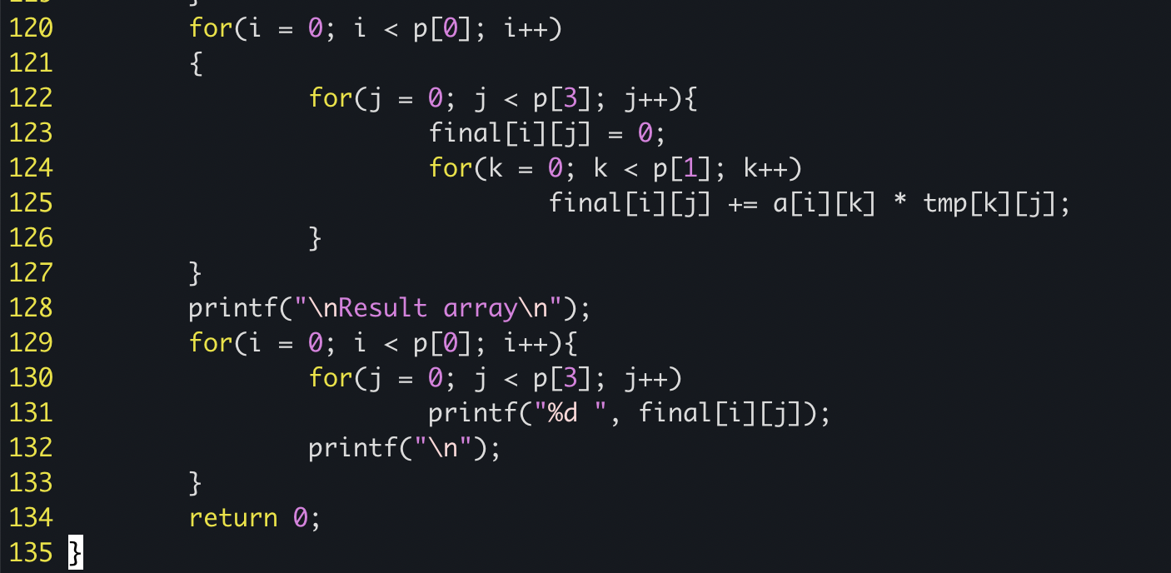
Problem2 – code

Slide 6
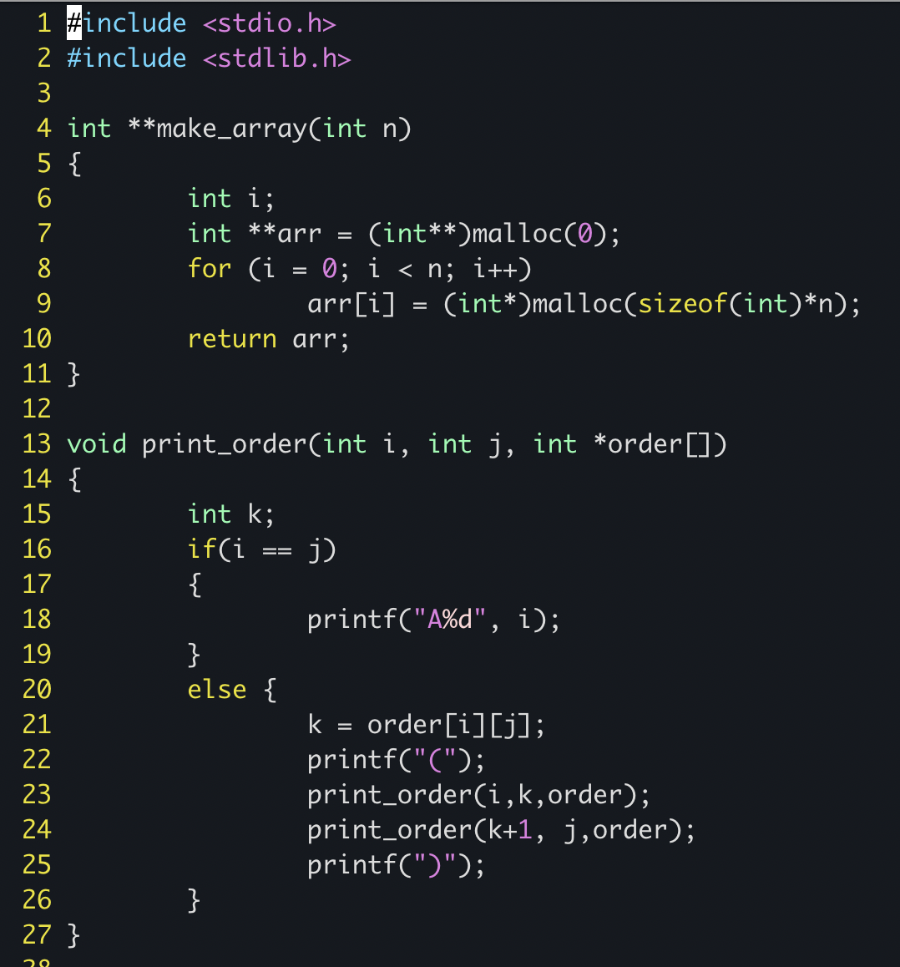
Problem2 - code

Slide 7
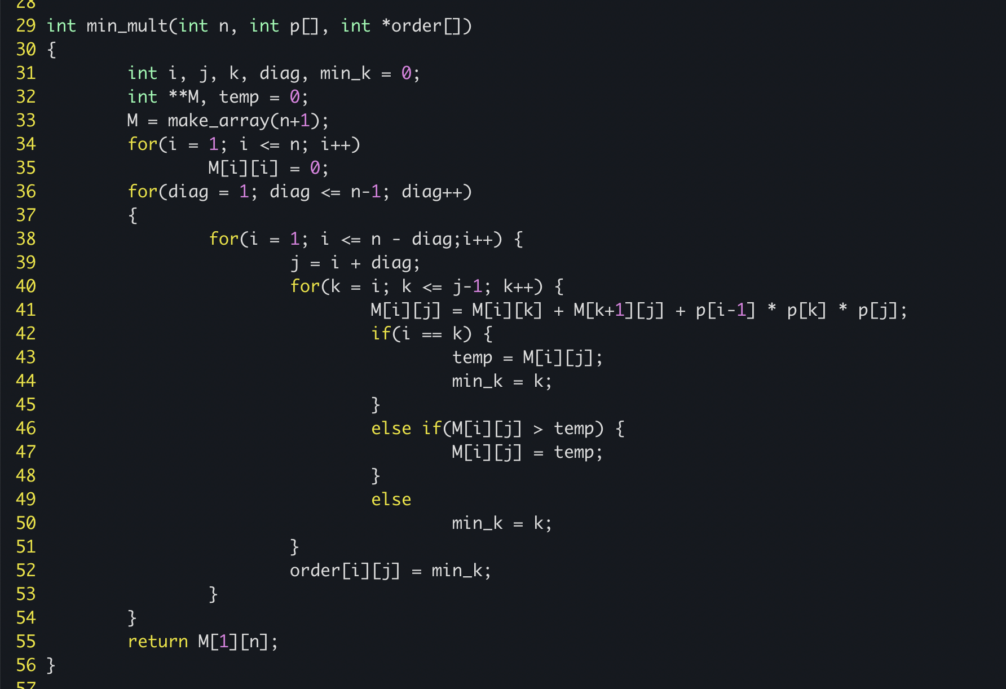
Problem2 - code

Slide 8
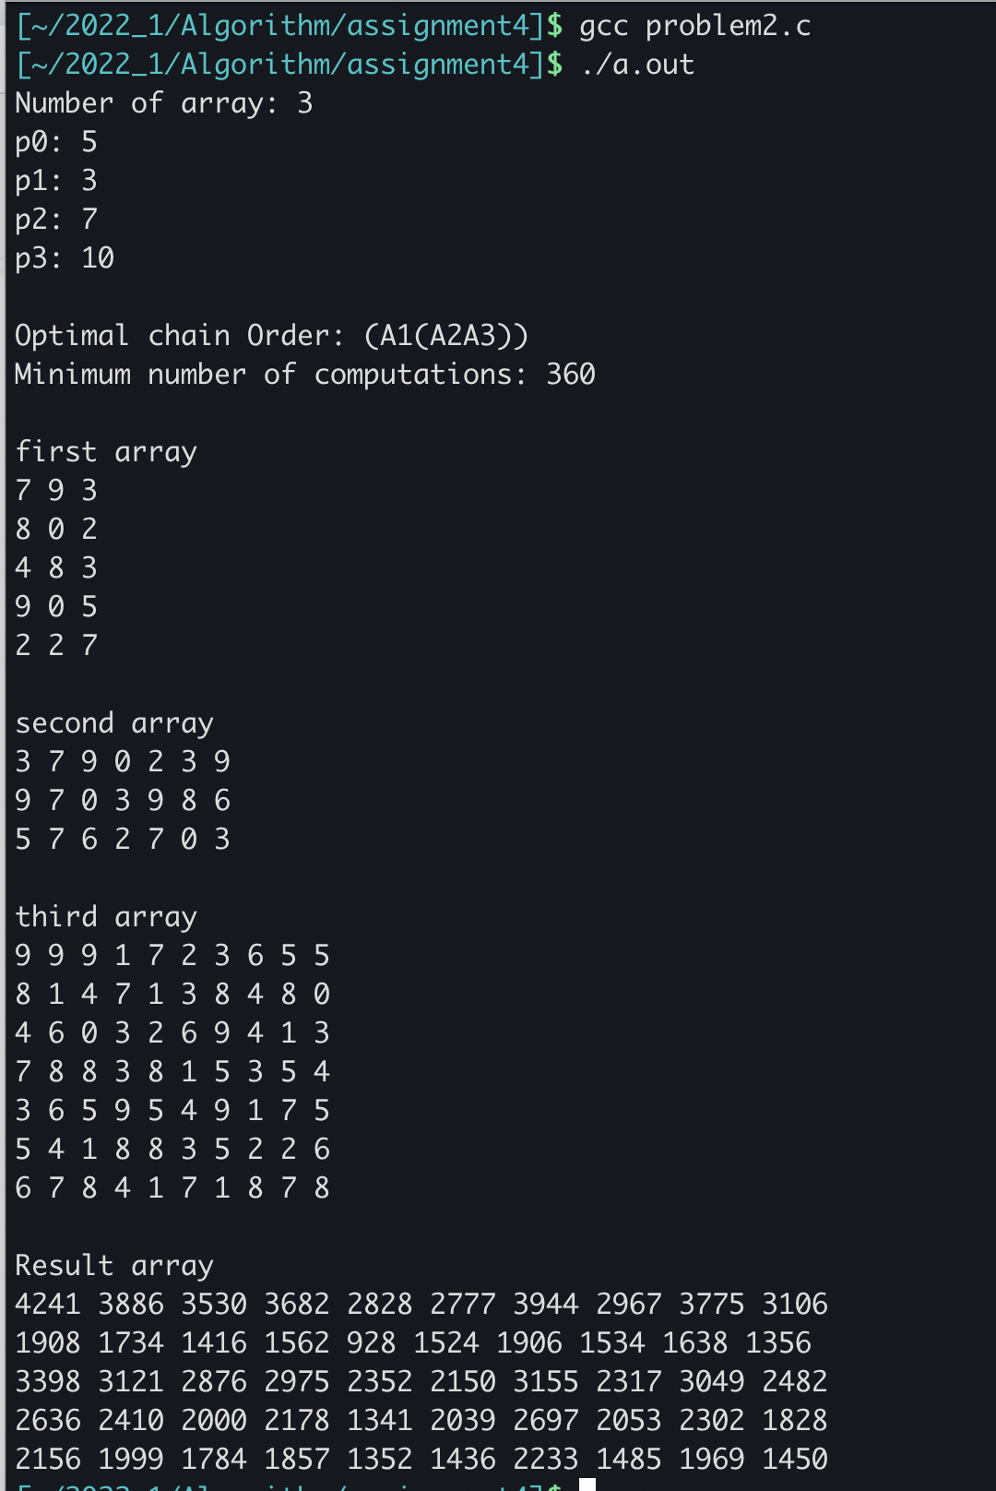
Problem2 - result

Slide 9
Problem2 - code

