Slide 1
You Draw I Guess
Team 331
Hancheng Zhong, Xuhui Wang, Peipei Li

Slide 2
Completed
User interface: game center, painting room, round interaction
Storing information from canvas in database
Game Round Interaction
Socket.io used in real-time updates
Tests
Notes:
When to start: all players are ready
When to stop: 1. Time out 2. All people get the correct answer 3. The painter exits 4. No guessers in the room (eq. 2)

Slide 3
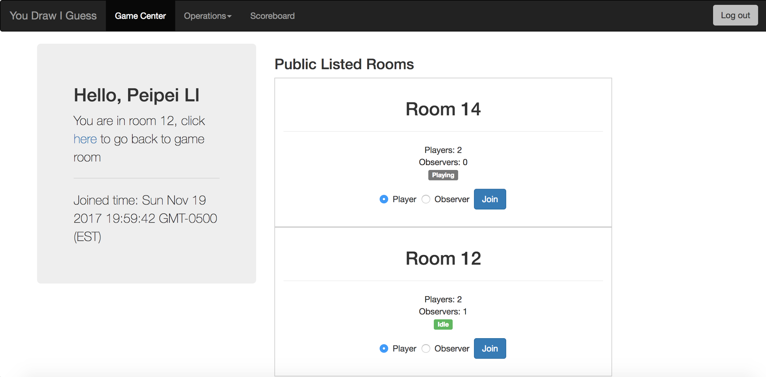
UI - Game Center

Slide 4
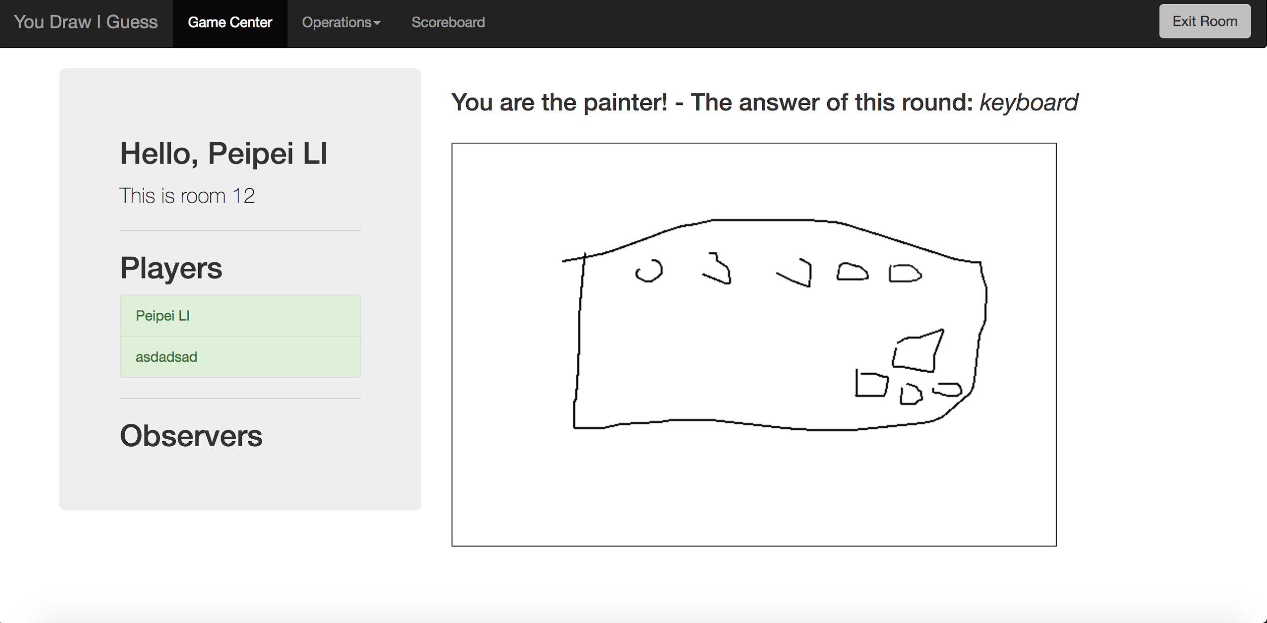
Game Round

Slide 5
Round Management
When to start a round
all players are ready
at least two players
When to end a round
Time out
All guessers have the correct answer
The painter exits
All guessers exits (eq. 2)

Slide 6
Websocket
Purposes
Push events
Dead user detection
Implementation
Express-ws or socket.io?
Authentication
Notes:
Express-ws: incompatible with express-session
Socket.IO: more high level interface, supports both ws and polling
Authentication: no cookie on ws, use random token generated at user login

Slide 7
Demo

Slide 8
Database Design

Slide 9
Unit Tests

Slide 10
TODO
Larger Dictionary
User Testing
UI Improvements
Code Cleanup
Deployment

