Slide 1
“Word Crimes”
by “Weird Al” Yankovic
Good writing always counts!

Slide 2
What difference does good writing make?
Does anyone really care?

Slide 3
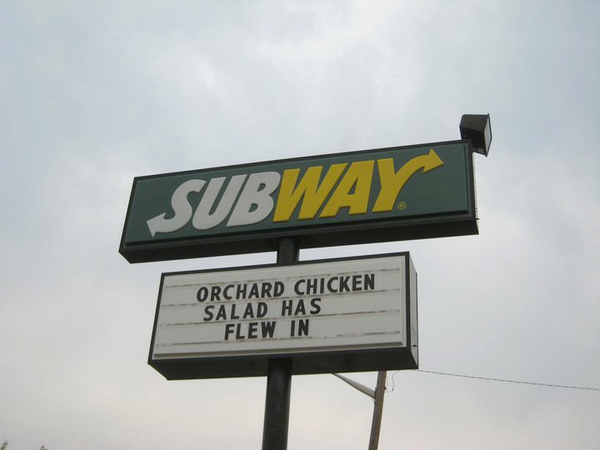
What’s wrong with this sign? (Talk to the person sitting next to you. I’ll wait.)

Slide 4

“Has flew in” should be “has flown in.”
This nonstandard usage detracts from the image this company wants to present. In a competitive environment, every sale counts. This usage might send some customers to other stores.

Slide 5
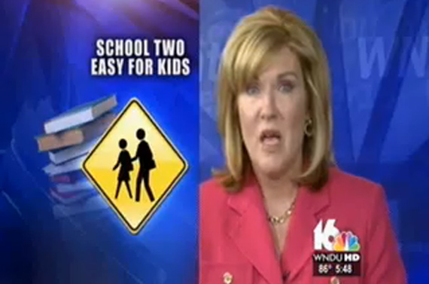
What’s wrong with this?

Slide 6
It should say “School too easy for kids”
Using the homophone “two” instead of “too” makes the reporter, the station, and the network look like maybe school was too easy for them, too.

Slide 7
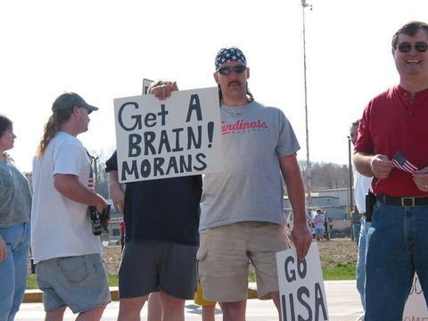
What do you think of the man holding the sign?

Slide 8
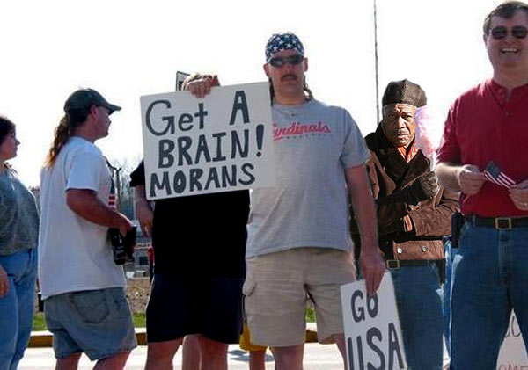
“Morans” should be “morons.”
The irony of the bad spelling overshadows the message this person wanted to send. It also tempts us to think of the man holding the sign as the one who needs to “get a brain.”

Slide 9
What difference does good writing make?
We want to present ourselves professionally and personally as well as possible. Good writing always counts!

Slide 10
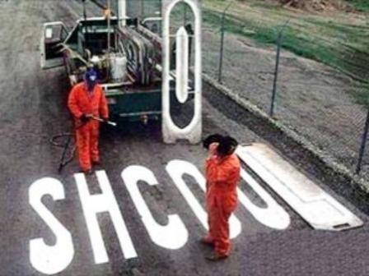
ALWAYS counts!

