Slide 1


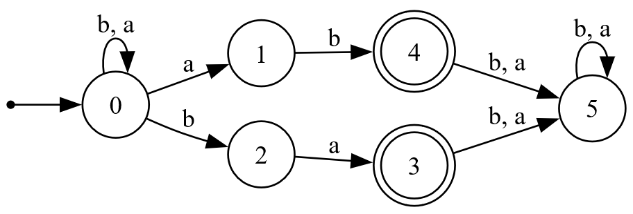
Efficient Regular Pattern Matching avoiding Denial of Service
Speaker
Daniel Afonso de Resende
Supervisor
Rogério Ventura Lages dos Santos Reis, Professor Auxiliar
Co-supervisor
Nelma Resende Araújo Moreira, Professora Associada
Master in Information Security
Department of Computer Science

Slide 2
Contents
Motivation
Regex Matchers
ReDoS Problem
Real-World Cases
Legacy
Regular expressions & Automata
State Of The Art
Counting
Fixed & Bounded Repetition
Implementation
Examples
Matching and Enumerating
Strengths & Limitations
Conclusion
Future Work

Slide 3



Motivation
Input validation, data extraction, text replacement, log analysis, security, etc..
Should be safe, predictable, and efficient – but sometimes they aren’t!
Notes:
Expressões regulares existem em todo o lado
Validação de entradas de dados, extração de dados, procura/troca de padrões em textos, análise de logs, segurança, etc…
Devem ser seguros, previsiveis e eficientes – mas às vezes não são!

Slide 4
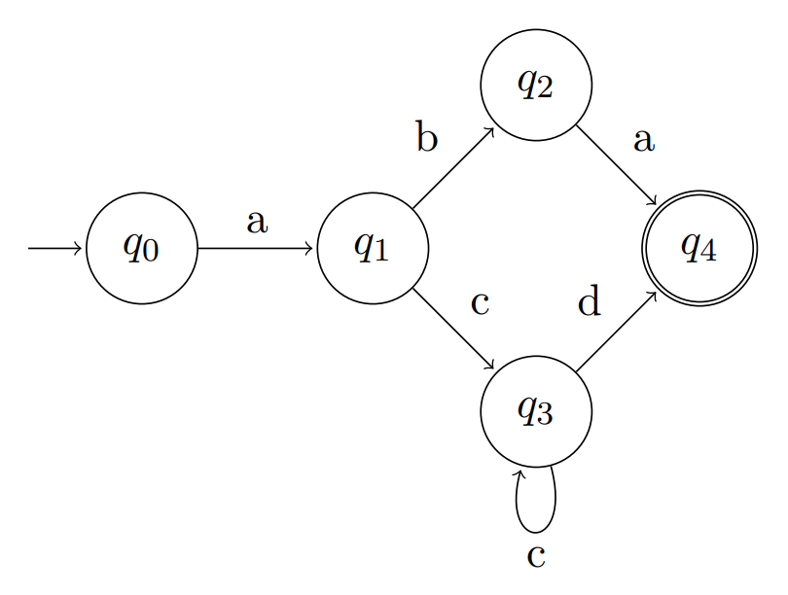
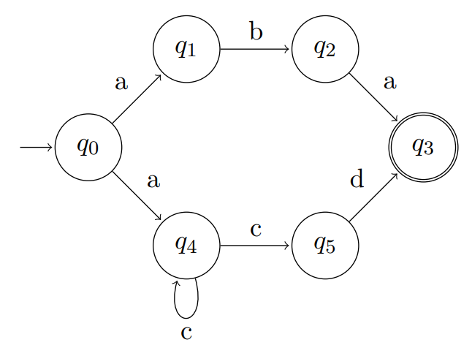
Automata
Notes:
Os automatos são uma parte crucial
Existem vários tipos de automatos – os relevantes para esta apresentação são os deterministicos e os não deterministicos
Os deterministicos têm apenas uma transição por cada símbolo em cada estado – é rápido e previsível, mais fácil de implementar mas pode precisar de imensos estados
Os não-deterministicos podem ter várias transições para o mesmo simbolo a partir de um estado – pode utilizar menos estados para representar a mesma expressão

Slide 5
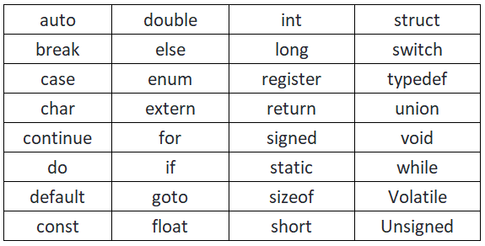
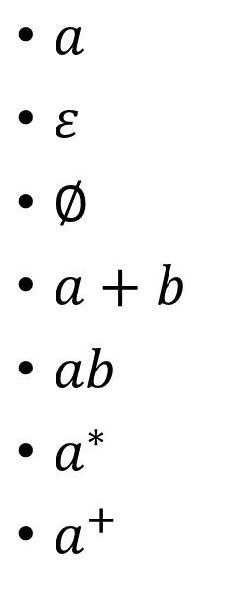
Regular Expressions
$a$
$ε$
$∅$
$a+b$
$ab$
$a^{∗}$
$a^{+}$
“a”
“x”
“”
“a”, “b”
“ab”
zero or more of the ‘a’ symbol
one or more of the ‘a’ symbol
Notes:
“a” é um símbolo
O alfabeto de uma linguagem é o conjunto de todos os símbolos da mesma
Um exemplo de um alfabeto seria o da linguagem C – que está presente nesta tabela
As expressões regulares descrevem conjuntos de sequências de símbolos sobre um alfabeto dos mesmos

Slide 6
Regex Matchers
Backtracking NFA
POSIX NFA
DFA
Hybrid
Notes:
Catastrophic backtracking: nested repetition
Ambiguous alternation with overlapping prefixes

Slide 7
Regular Expression
Denial of Service
Worst-case behavior of certain “regular expressions”
Catastrophic backtracking
^(a+)+$
^a+$
^(foo|fo)+$
^(?:foo|fo)+$
Notes:
Catastrophic backtracking: nested repetition
Ambiguous alternation with overlapping prefixes

Slide 8
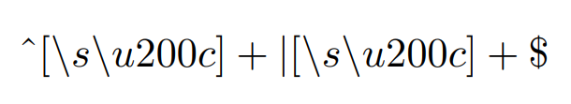
StackOverflow 2016 outage
34 minute downtime
Regular expression for long whitespace trimming
Fix was to change to a substring function
Match all spaces from the start of the string
or
Match all spaces until the end of the string

Slide 9


CVE-2022-3517
Used in npm
12.92M downloads (3.0.4)
7.5 CVSS
Versions <=3.0.4 were affected
assertValidPattern
MAX_PATTERN_LENGTH
{aaaaaaaaaaaaaaaaaaaaaaaaaaaaaaaaaaaaa...
would be catastrophic!

Slide 10
Legacy
Backwards compatibility
Performance changes
Somewhat unaware of ReDoS
if it works, it works..

Slide 11


Single and Sub-Matching
Single matching
Sub-matching

Slide 12

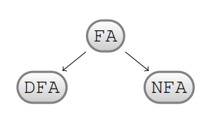
FAdo
Automata manipulation
Easy prototyping
Uses Lark for language parsing
CEmptySet
CEpsilon
CAtom
CDisj
Cconcat
CStar

Slide 13
POSIX Syntax
Used in grep, sed, and awk
Leftmost-longest match semantics
No backreferences, lookahead/lookbehind assertions, non-greedy quantifiers, and conditional expressions
POSIX
Syntax Variant | 3 a’s | One or more a’s | ‘b’ or ‘ab’
BRE | a\{3\} | a\+ | a\?b
ERE | a{3} | a+ | a?b
BRE
ERE
Notes:
What are backreferences, lookahead/lookbehind assertions, non-greedy quantifiers and conditional expressions?

Slide 14

PCRE Syntax
Used in Apache web servers, as well as in Perl, PHP, R, and JavaScript
Features go beyond POSIX and theoretical regular languages
One can match non-context-free languages, such as $a^{n}b^{n}c^{n}$
Notes:
What are backreferences, lookahead/lookbehind assertions, non-greedy quantifiers and conditional expressions?

Slide 15
State of the art
RE2
PCRE2
Hyperscan
Rust’s regex crate

Slide 16
Detecting ReDoS
Revealer
ReScue
ReDoSHunter

Slide 17
Counting
The ability for a language or an automaton to enforce numeric constraints over the number of symbols or patterns within strings
Doable, but complex, and mostly inefficient
The goal is to be efficient and secure

Slide 18

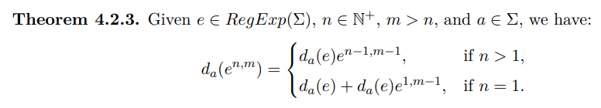
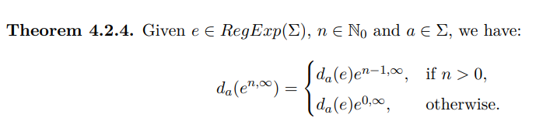
Counting
Fixed repetition
Bounded repetition

Slide 19
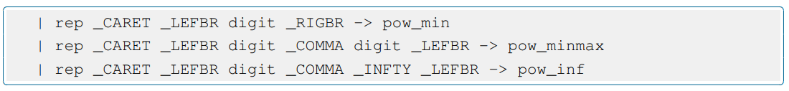
Counting
Derivatives, partial derivatives and linear form implemented for the following classes:
CPower
CCount

Slide 20

Multiple Matching

Slide 21

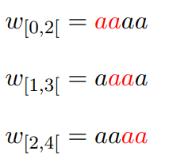
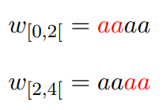
Overlapped versus Non-overlapped matching

Slide 22
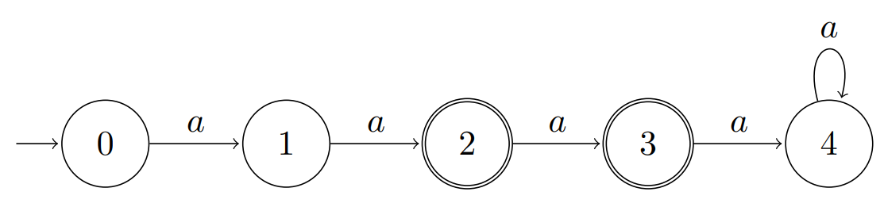

Modified Position Automaton
State ⬄ Indexed RE position
Given $r=a^{2,4},$
Brzozowki’s construction yields:

Slide 23
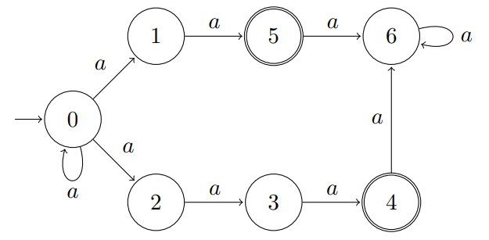
Modified Position Automaton

Slide 24
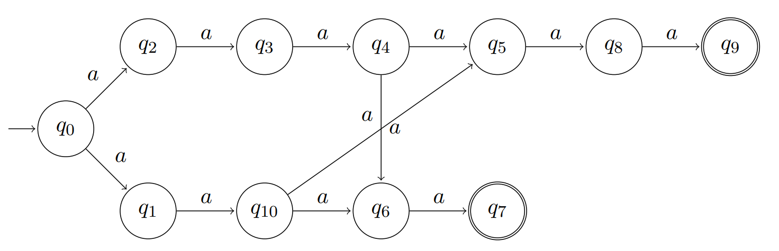
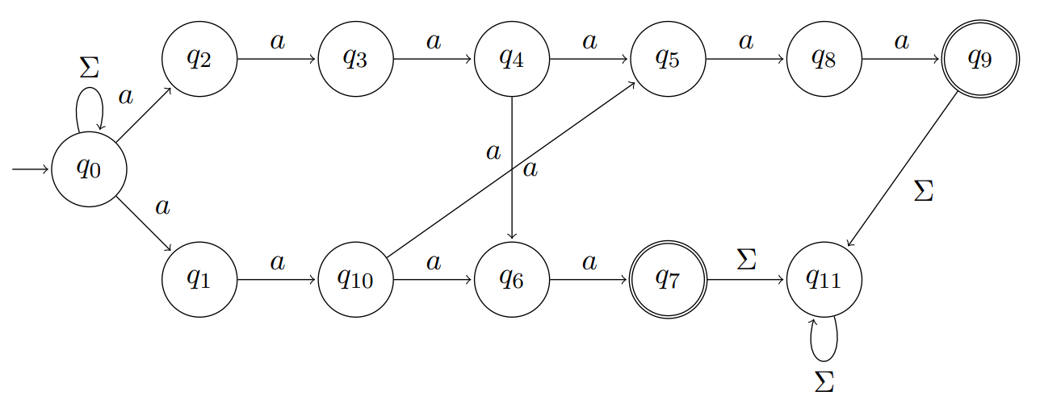
Modified Position Automaton
$$s=\left(aa+aaa\right)\left(aaa+aa\right)$$
$$w=aaaaabaaaaa$$

Slide 25
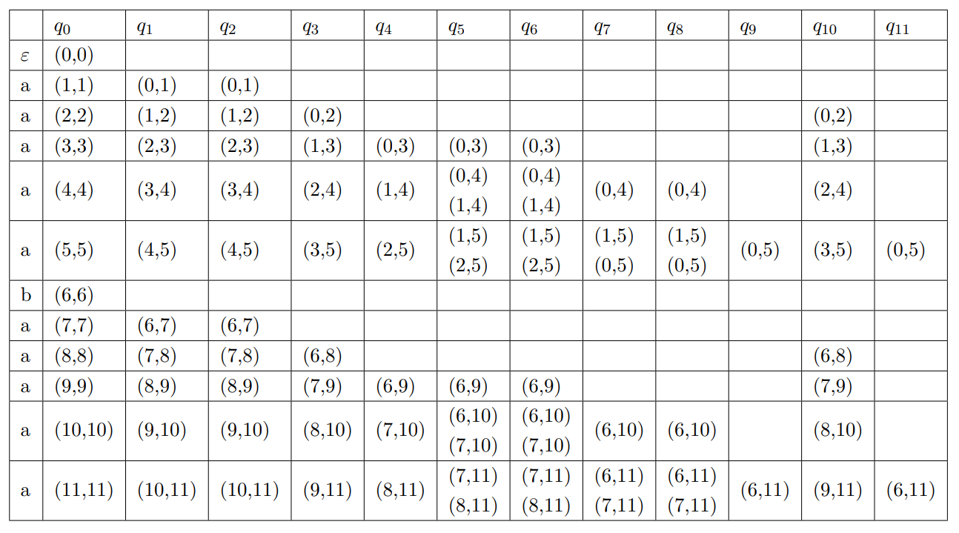
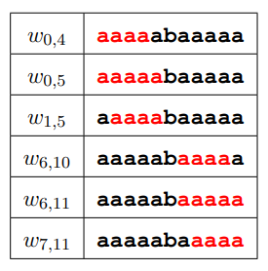
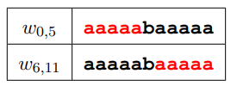

Modified Position Automaton
$$w=aaaaabaaaaa$$

Slide 26
Implementation
New class: matchNFA
table_matcher: Responsible for creating the matching table
enum_matches: Display the formatted matching table data
nfaPosCount: Modified Position Automaton builder

Slide 27
Demonstration

Slide 28
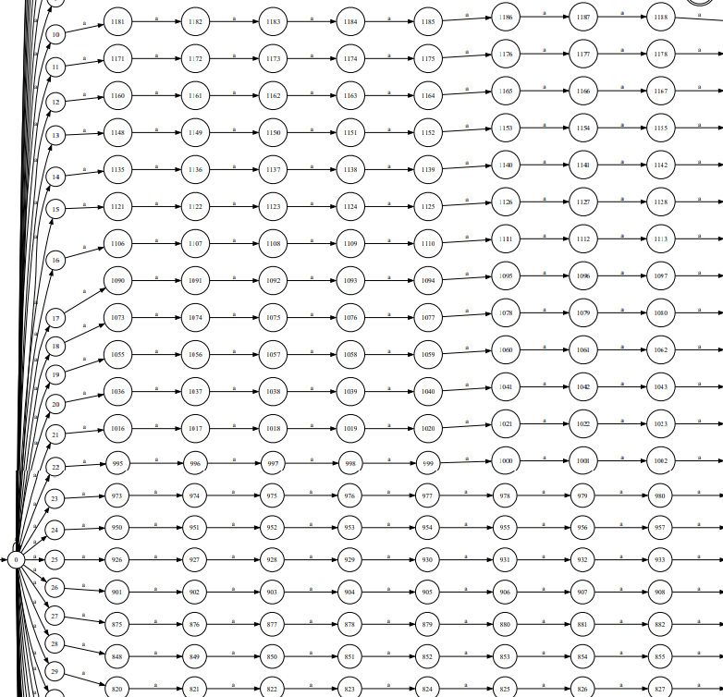
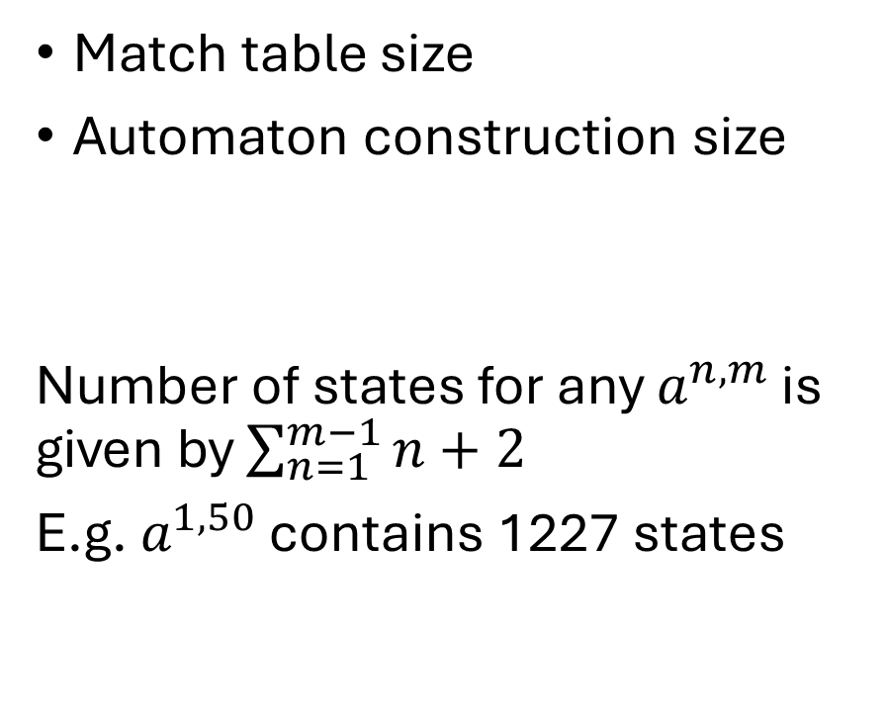
Limitations
Match table size
Automaton construction size
Number of states for any $a^{n,m}$ is given by $\sum_{n=1}^{m−1}{n+2}$
E.g. $a^{1,50}$ contains 1227 states

Slide 29
Conclusion
Datasets don’t usually include overlapping
Moving on from Python

Slide 30
Questions?

